Slide 1

New Generation IV Controllers for CCDs and CMOS Arrays
Bob Leach, Yaoting Yang, Scott Streit

Slide 2
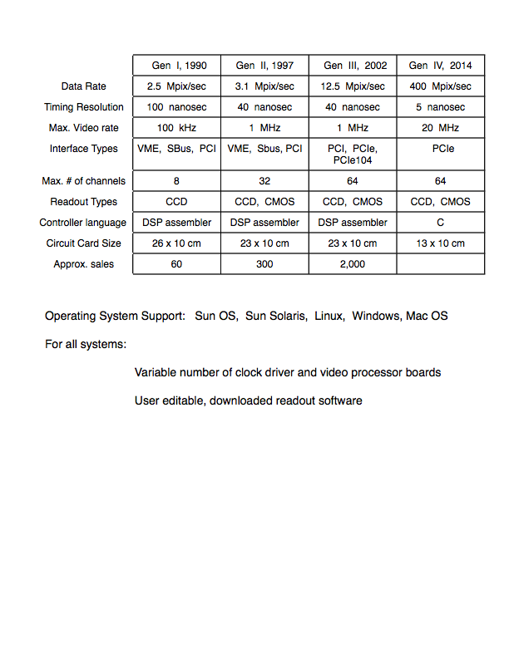

Slide 3
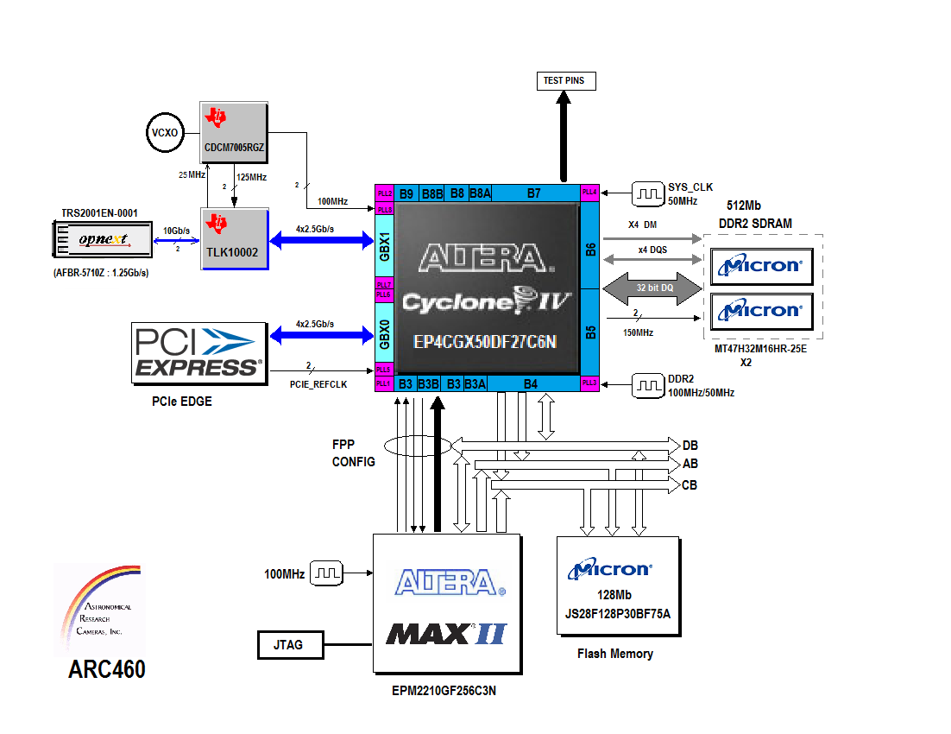
PCIe interface board block diagram

Slide 4
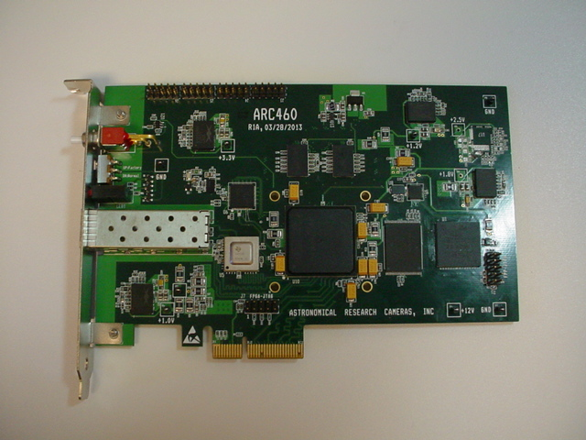

Slide 5
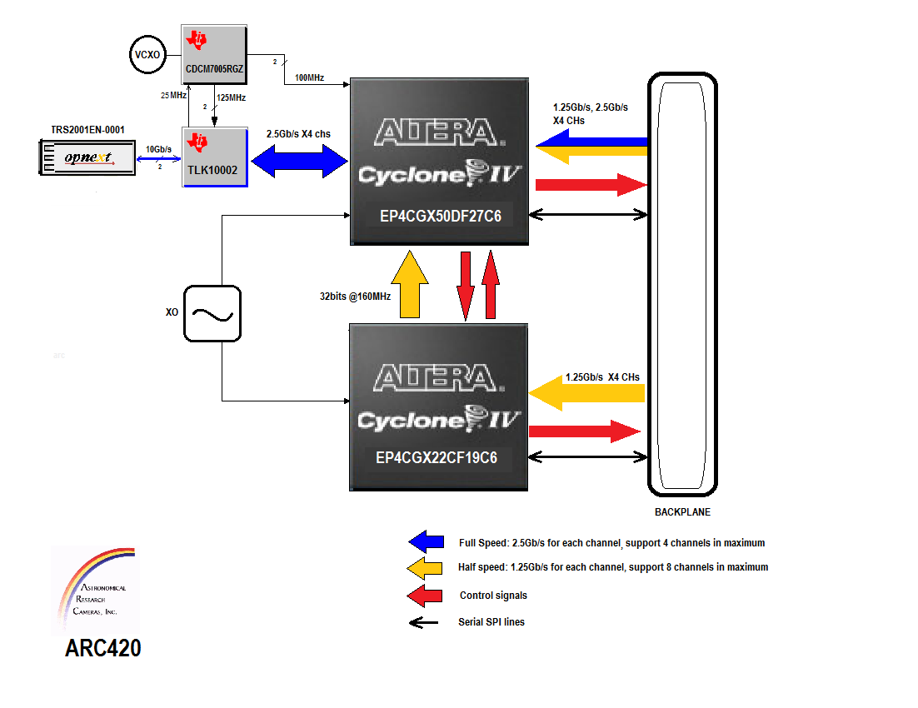
Timing board block diagram

Slide 6
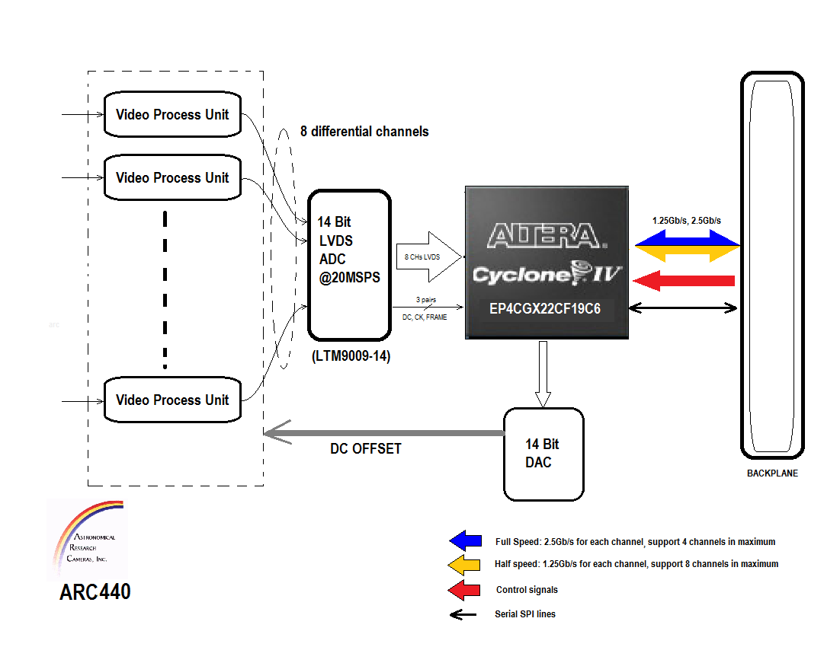
Fast CMOS video board block diagram

Slide 7
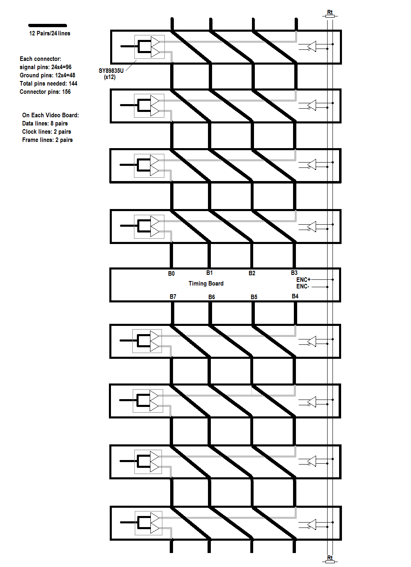
Serial bus for image data

Slide 8
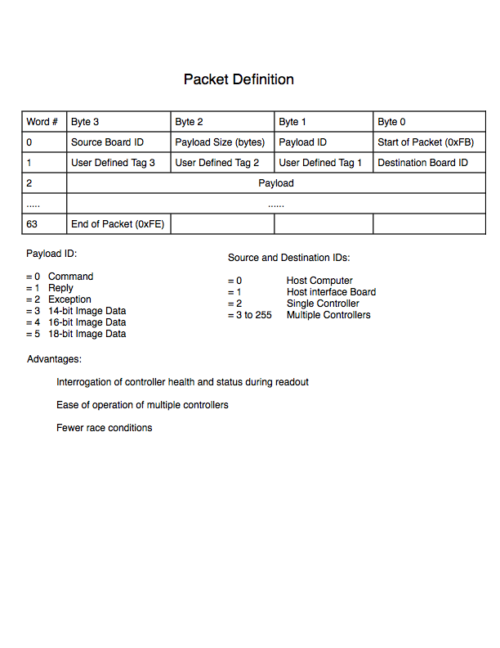

Slide 9
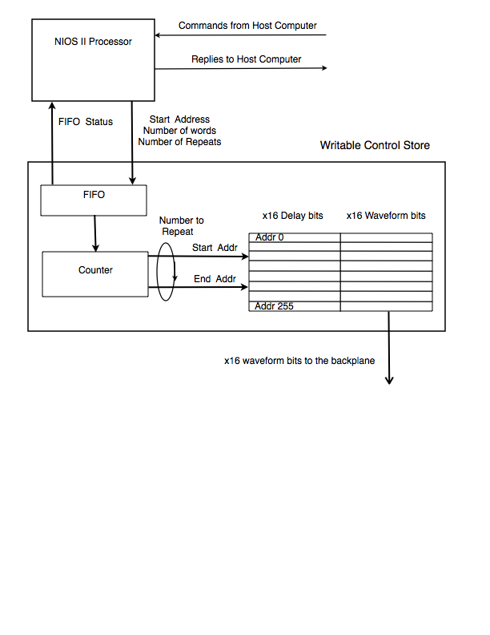
Timing board FPGA

Slide 10
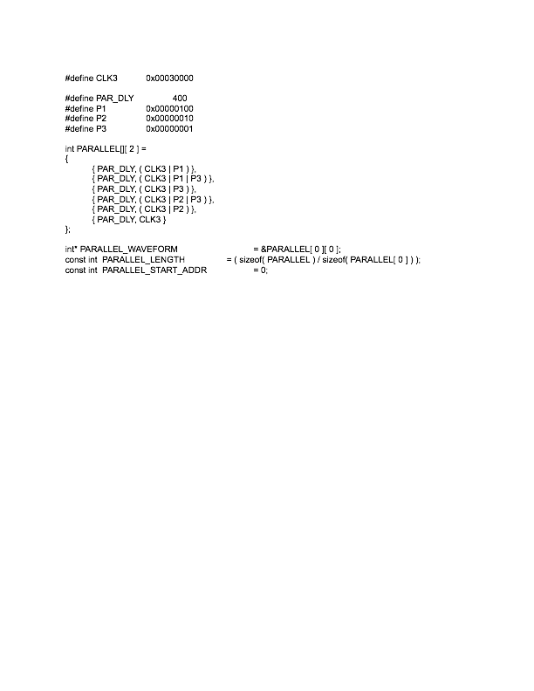
Example C code for generating WCS waveform table

Slide 11
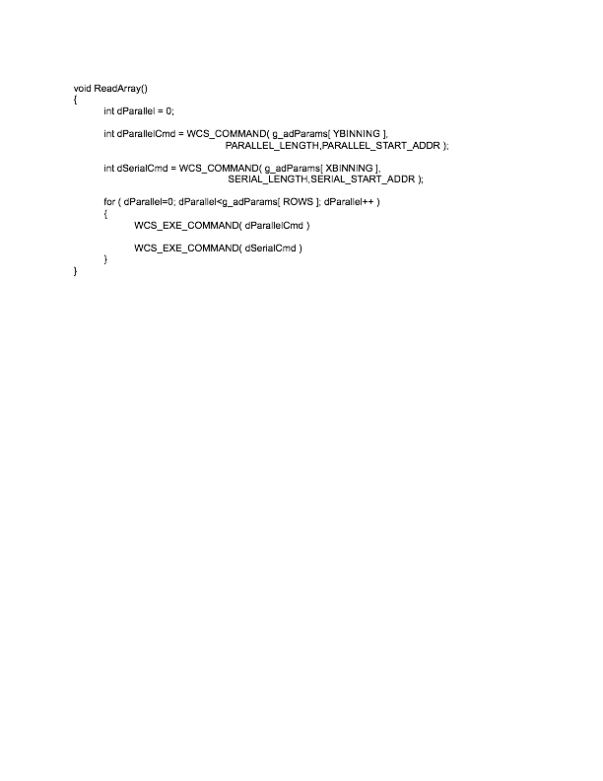
Example C code for CCD readout

Slide 12
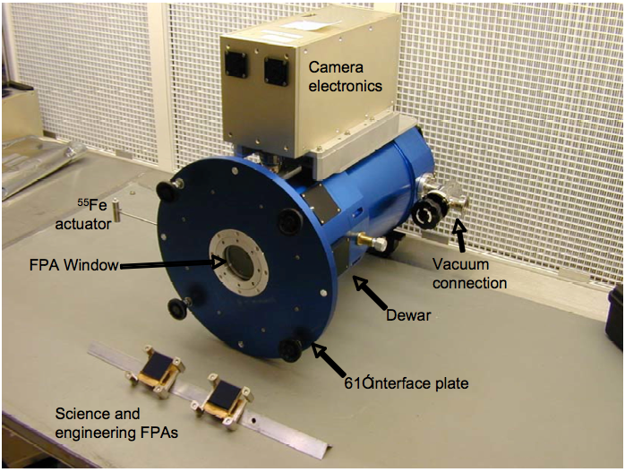

Slide 13
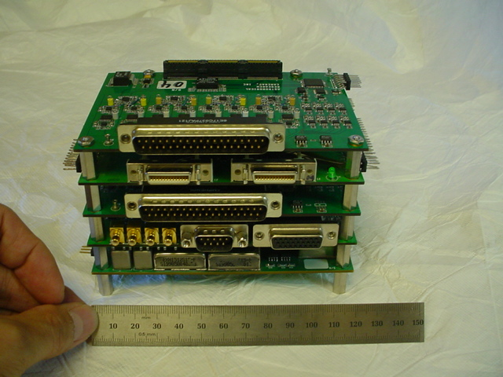

Slide 14
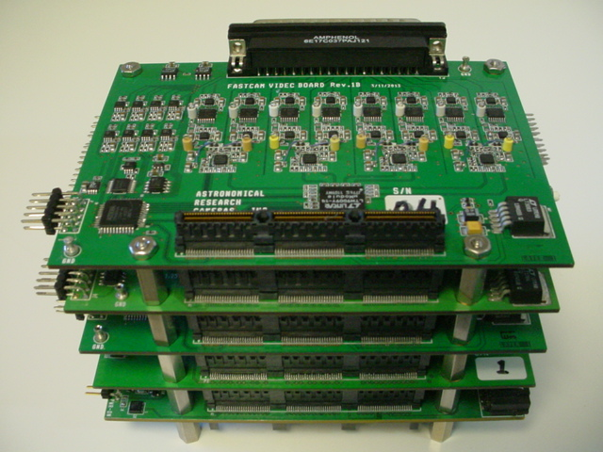

Slide 15
