Slide 1

Florence, SDW2013
FPGA designs in the NBI generation 3 CCD controller.
by
Preben Nørregaard
Niels Bohr Institute, Copenhagen
preben@nbi.ku.dk

Slide 2
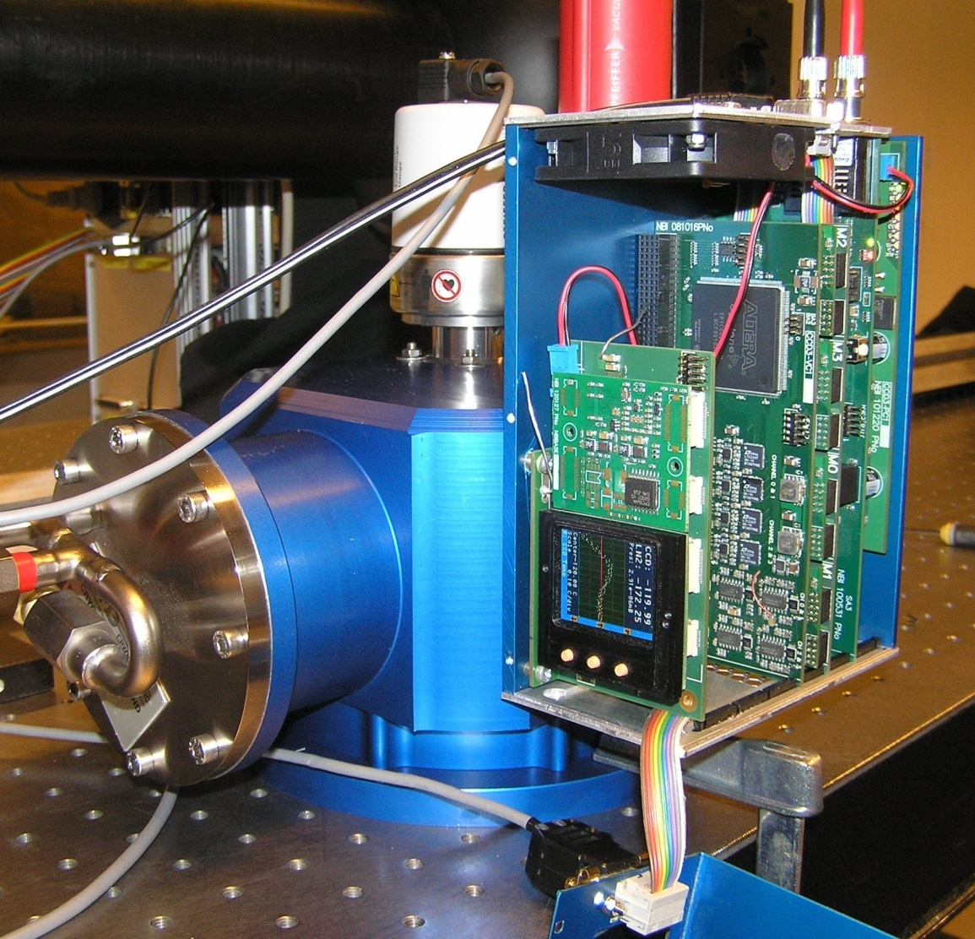
The Copenhagen gen. 3 array controller system design, is a result of the experience from building about 50 camera systems over a period of 20 years.
Controller size: 17.5 x 12.5 x 7 cm, ~1kg
24W total power consumption (<2Mpix/sec), 4 channels
Full digital synthesis of clocks, 12.5 ns resolution
80Msamples/sec oversampling digital CDS
Readout syncronized switch mode power supply
Up to 8 channels and 96 clocks / controller.
80Mbit optical link ( 2Mpix/s @ 32 bits ) to PCI, upgrading to 1.2Gbit link (30Mpix/s ) to PCIe 4Q2013
Integrated control/monitoring of temperature and pressure.

Slide 3
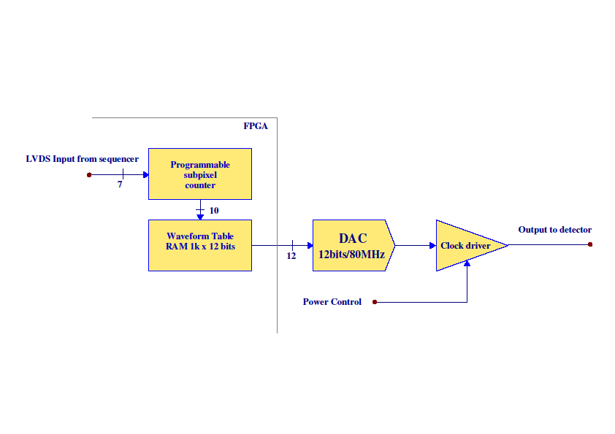
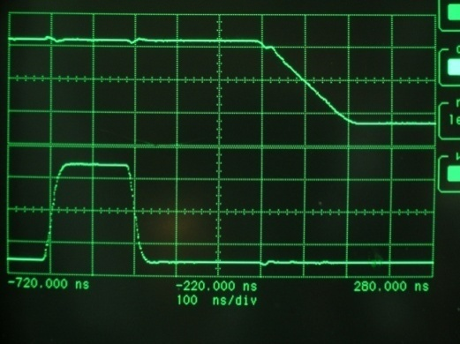
Digitally controlled clock driver

Slide 4
Digitally controlled CDS chain

Slide 5
Typical gain is 0.2 – 0.35 ADU/e-
Typical Fullwell is 800kADU
Digitally controlled CDS chain

Slide 6
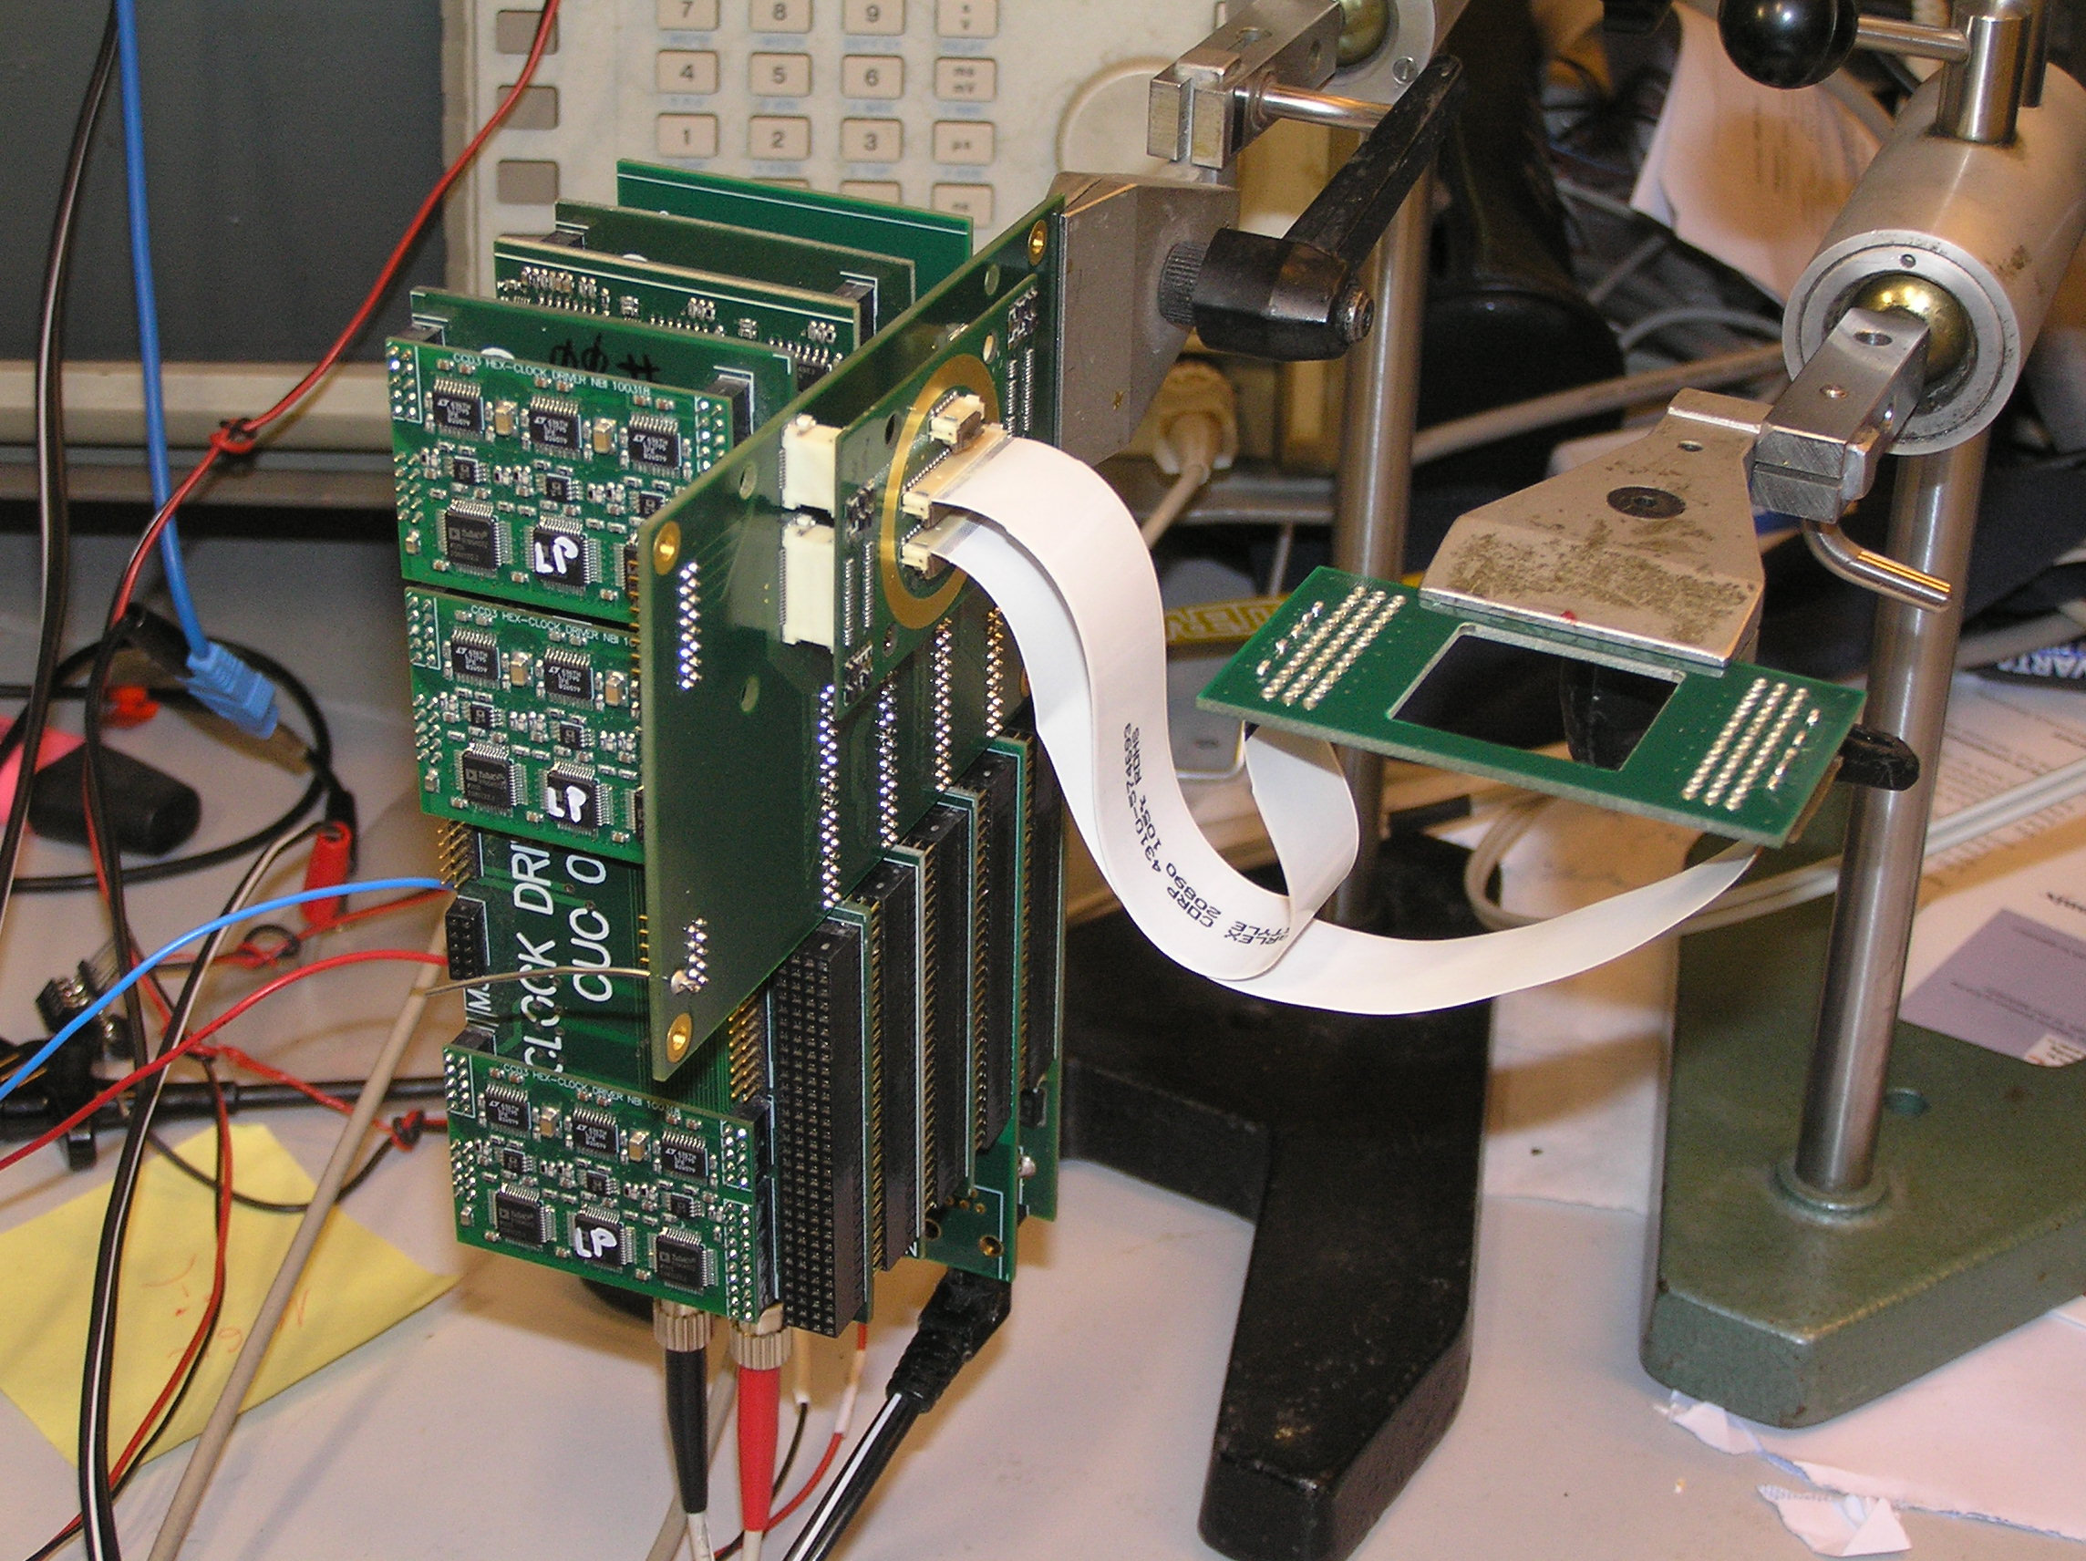
Thank you

