Slide 1

ESO AO Detector
Controller for the E-ELT
Javier Reyes, Mark Downing
European Southern Observatory, ESO (http://www.eso.org)
Jorge Romero
University of Málaga (http://www.uma.es)
Scientific Detector Workshop 2013. 7-11 October 2013. Florence, Italy

Slide 2
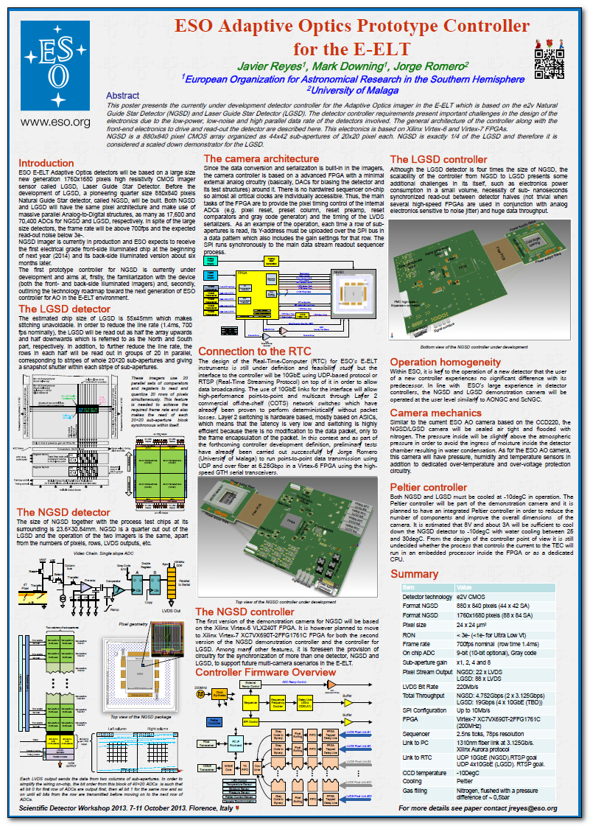
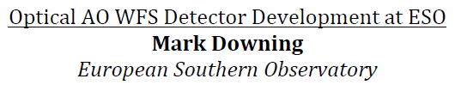
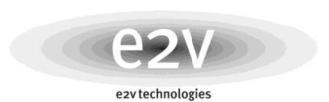
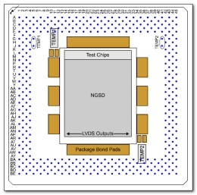
The LGSD detector
Large size detector: 55x45mm
1760 x 1680 pixels
88 x 84 SA
20×20 pixel sub-apertures
Massive parallel architecture
70,400 Analog-to-Digital structures
1.4ms, 700 fps nominally
The NGSD detector
NGSD is a quarter cut out of the LGSD
44 x42 SA
17600 ADCs
The operation of the two imagers is the same
Top view of the NGSD package
Scientific Detector Workshop 2013. 7-11 October 2013. Florence, Italy

Slide 3
NGSD Pixel Output Port
Data conversion and serialization is built-in in the imagers
22 high-speed LVDS output lines
Each LVDS output sends the data from two columns of sub-apertures
NGSD Controller Architecture
Advanced FPGA
Minimal analog circuitry around it, basically DACs for bias generation
10GbE fiber links
  Control PC
  Real-Time-Computer
Scientific Detector Workshop 2013. 7-11 October 2013. Florence, Italy

Slide 4
NGSD Prototype Controller
Xilinx Virtex-6 VLX240T FPGA
Xilinx Virtex-7 XC7VX690T
No sequencer on-chip so almost all critical clocks driven by the FPGA
Use of Gigabit Ethernet IP core
Some Other Features
Integrated Peltier controller
Temperature, Humidity and Pressure sensors
Over-voltage and Over-Temperature protection
Detector power-up sequencing
Synchronization to other cameras
Scientific Detector Workshop 2013. 7-11 October 2013. Florence, Italy

