Slide 1

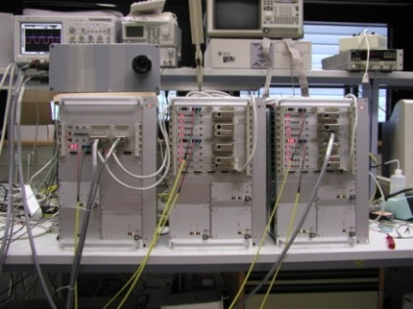
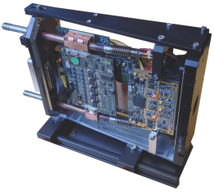
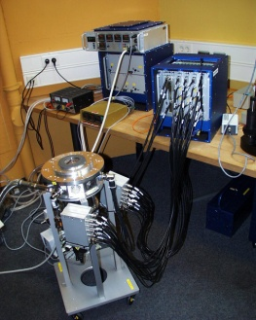
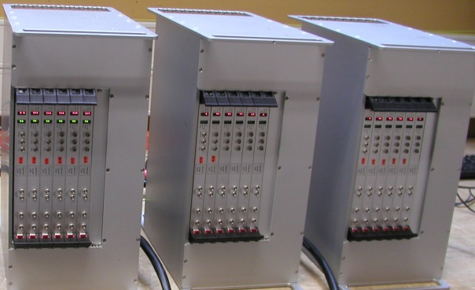
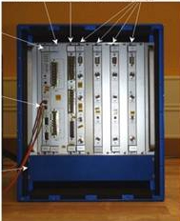
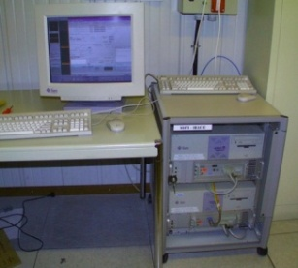
European Organization for Astronomical Research in the Southern Hemisphere
State-of-the-art detector controller for ESO instruments
The ESO NGC, New General common Controller
The controller has evolved over three decades from previous controller generations, namely the ESO IRACE and FIERA detector controllers.
IRACE
NGC
FIERA

Slide 2
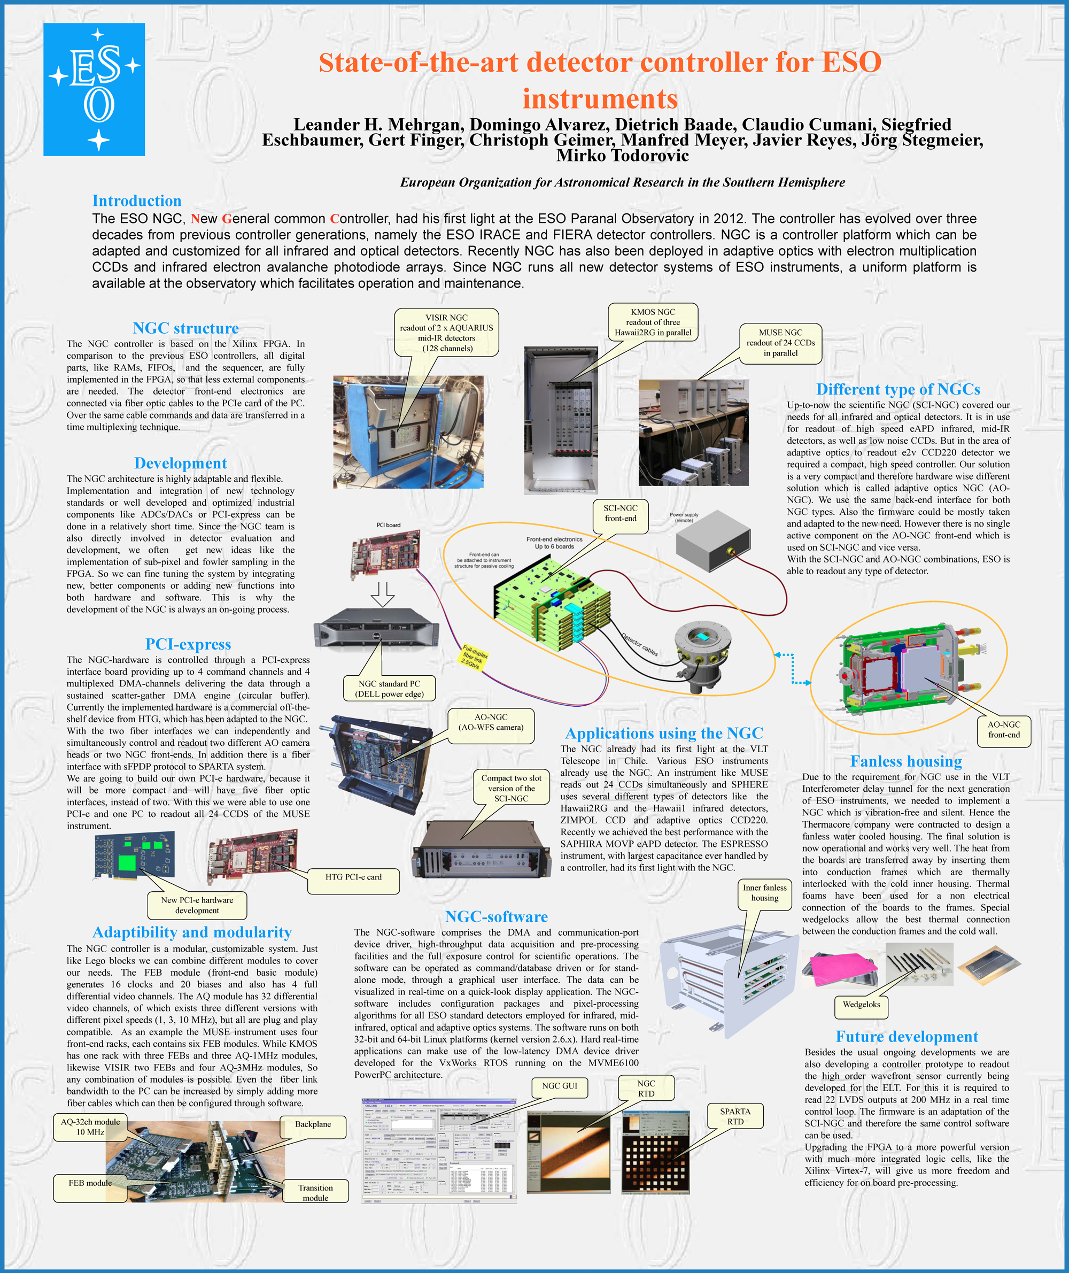

Slide 3

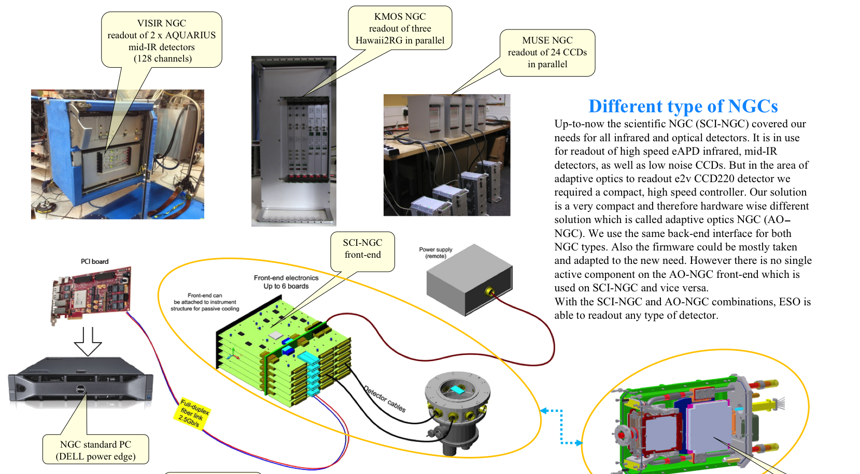
European Organization for Astronomical Research in the Southern Hemisphere

Slide 4
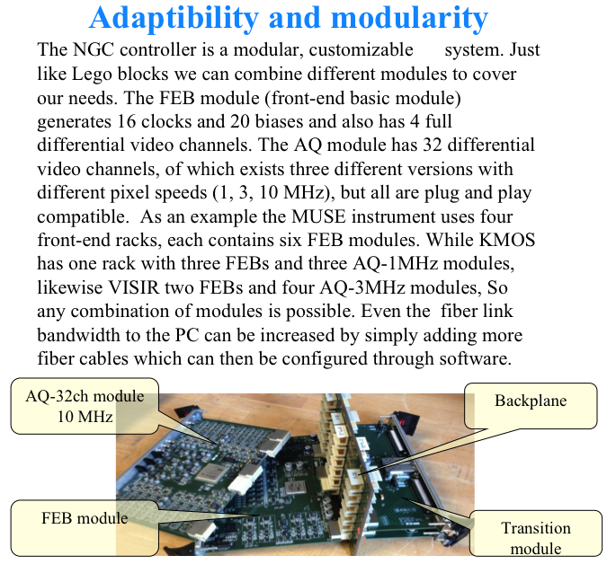
European Organization for Astronomical Research in the Southern Hemisphere

Slide 5
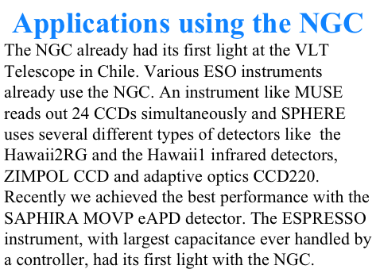
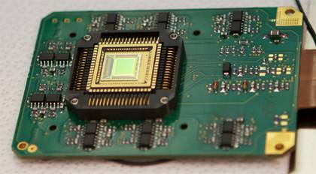
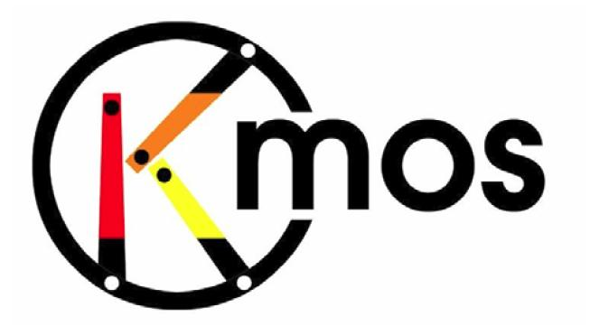
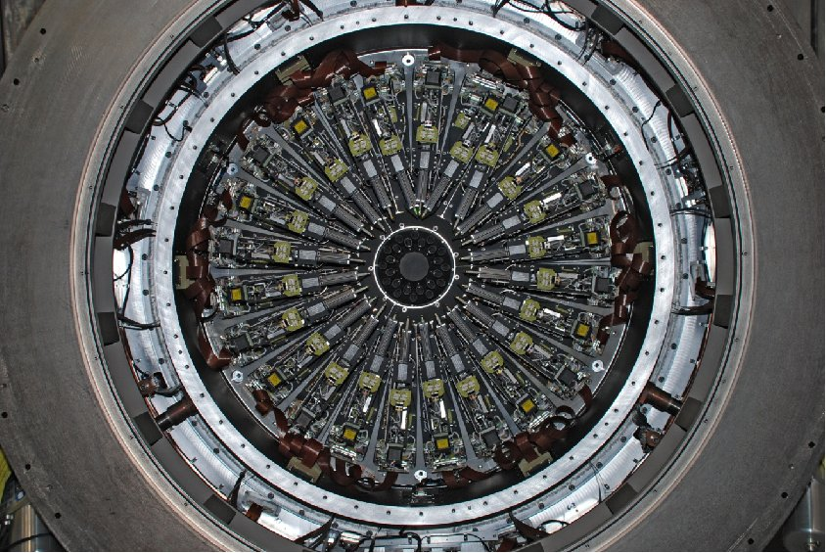

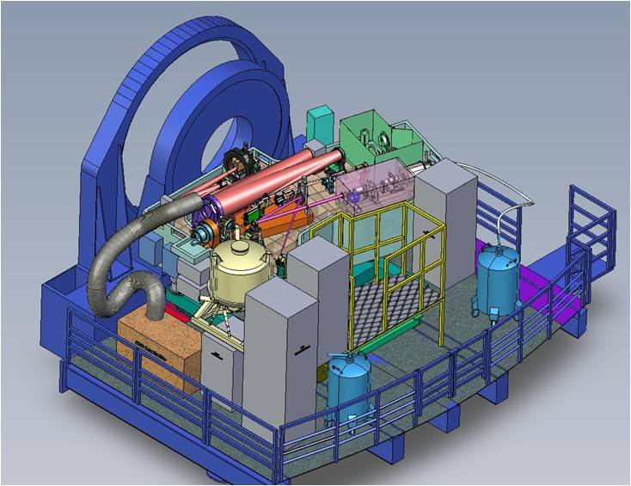
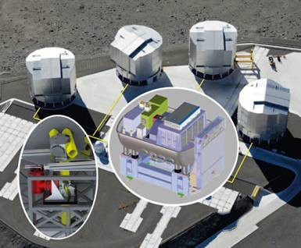
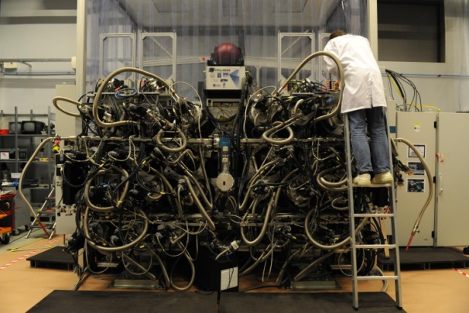
European Organization for Astronomical Research in the Southern Hemisphere
SELEX dev.
MUSE
SPHERE
GRAVITY

