Slide 1
Development of High Z Photon-Counting X-ray Detectors for Synchrotron Experiments Above 30 keV
M. Ruat, C. Ponchut
Scientific Detector Workshop, Firenze, October 10th 2013

Slide 2
Outline
Context
High Z detectors developments at ESRF
Bottleneck(s) and improvements
Beamline evaluations
Future plans

Slide 3
Outline
Context
High Z detectors developments at ESRF
Bottleneck(s) and improvements
Beamline evaluations
Future plans

Slide 4
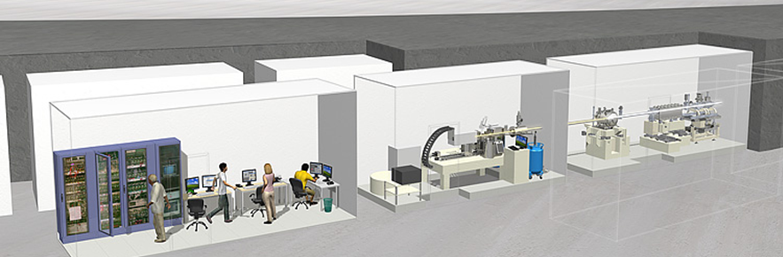
Detector developments for synchrotrons
Synchrotron == BRILLIANCE!
WIDE RANGE OF APPLICATIONS
Macromolecular crystallography (MX)
Single crystal diffraction (SCD)
Surface diffraction
Small- and wide-angle X-ray scattering (SAXS/WAXS)
Coherent X-ray imaging
Pre-clinical X-ray imaging
Time-resolved experiments
10²² B
Up to 10¹³ photons / mm2/s

Slide 5
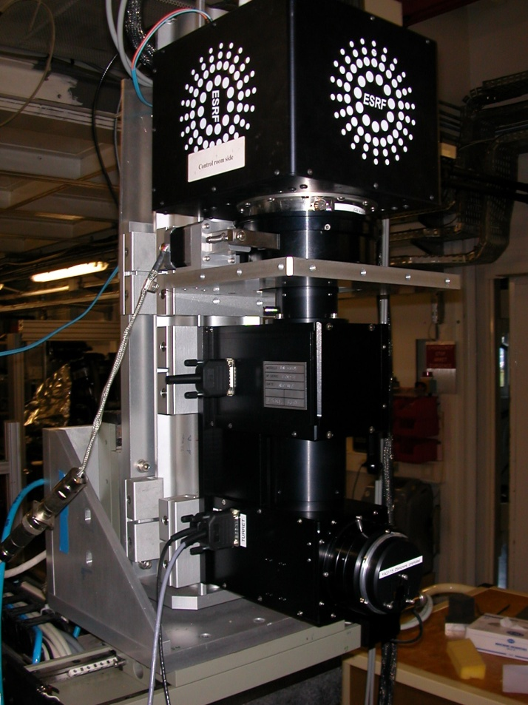
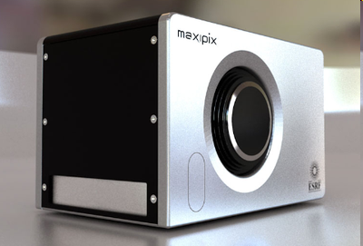

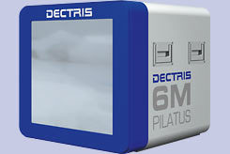
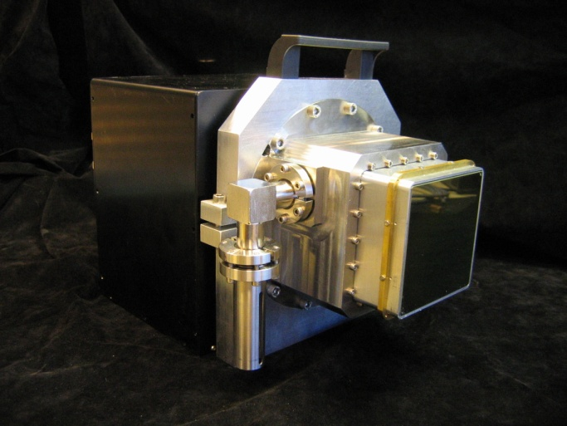
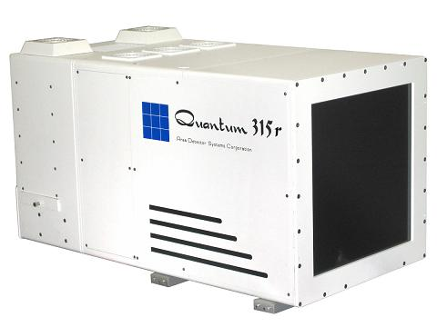
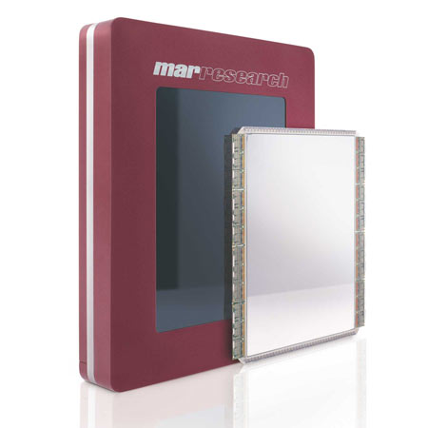
2D Detectors
In house
In house
Commercial
In house
Commercial
Commercial

Slide 6
Direct Detection Detectors
CCD/CMOS

Slide 7
Direct Detection Detectors
CCD/CMOS

Slide 8
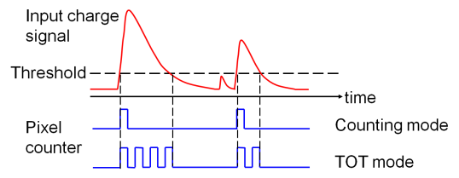
Direct Detection Detectors → Single Photon Counting
Single photon counting with threshold: noise-free detection
Today all direct detection & single photon counting detectors are equipped with Si sensors

Slide 9
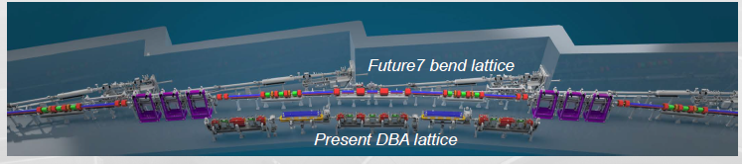
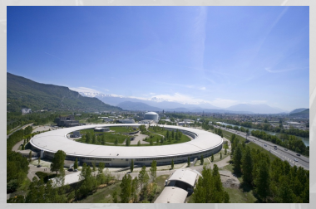
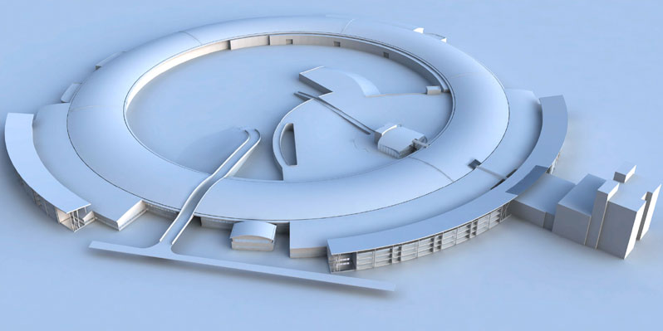
Towards High Z sensors
ESRF UPGRADE:
Increased brilliance & increased photon energies !!

Slide 10
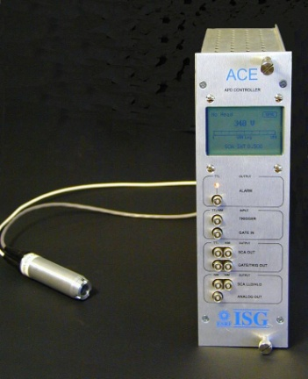


Towards High Z sensors
Direct detection: Filling gaps
1D detectors ← → 2D detectors
  Towards harder X-rays
  APD
  avalanche photodiodes
    Point or linear devices
    Sub-ns time resolution
  Photon counting
  pixel detectors
    Mpixel devices
    kHz frame rates
    ~100 ns time resolution
    2D APD array detector
    sub-ns time resolution
    MHz frame rates
    2D detector
    ~100 ns time resolution
    kHz frame rates
    High Z sensor layer
  ACE
  5 ns deadtime
  ~100 MHz count rate
  MAXIPIX
  1500 frames/sec
  Towards higher time resolution
Notes:
10

Slide 11
Outline
Context
High Z detectors developments at ESRF
Bottleneck(s) and improvements
Beamline evaluations
Future plans

Slide 12
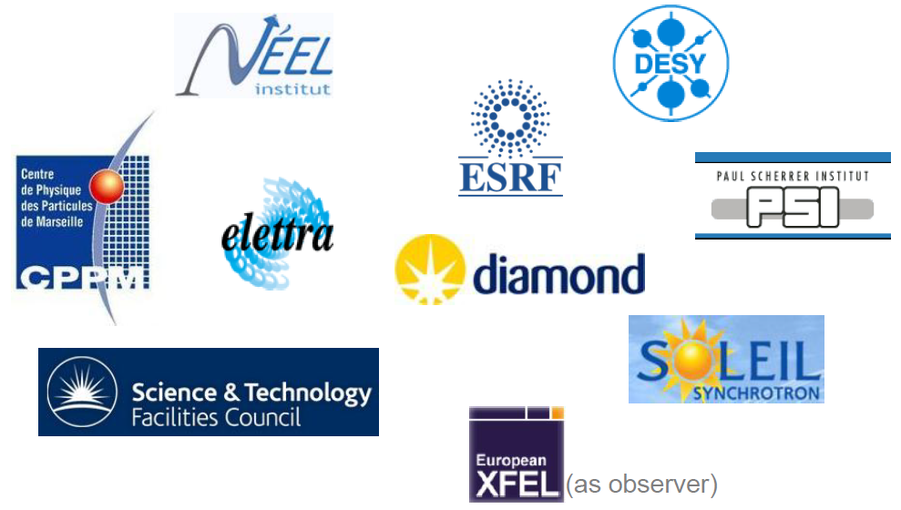
HIZPAD project
Development in the framework of HIZPAD European project (started in 2009)
Coordinated by ESRF

Slide 13
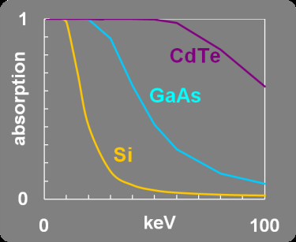
Why CdTe?
CdTe 1 mm
Si 500 µm
GaAs 300 µm
+ Wide, direct band-gap (1.44 eV)→ Room temperature operation
Notes:
13

Slide 14
Hybrid Pixel Detector
Sensor: CdTe 1 mm thick
Interconnects: Bump-bonding (In-Sn)
CMOS RO ASIC
ASIC: from MEDIPIX family (CERN) → 55 um pixel pitch

Slide 15
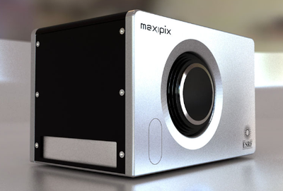
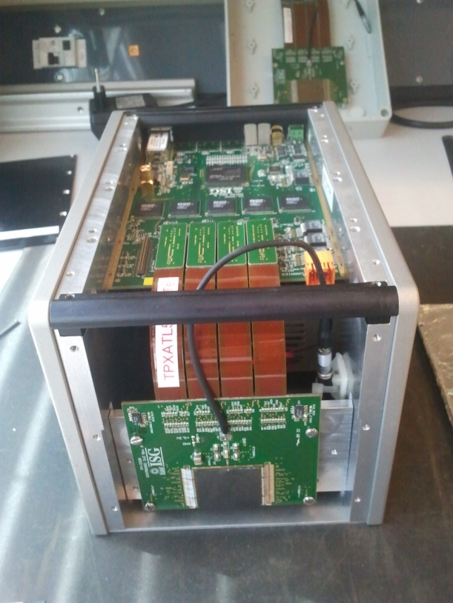
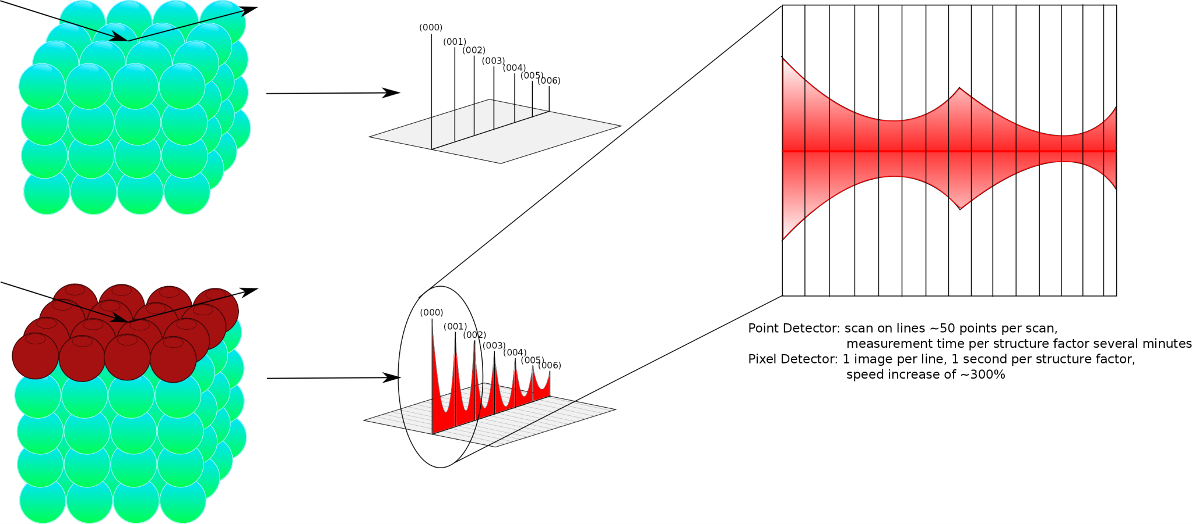
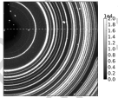
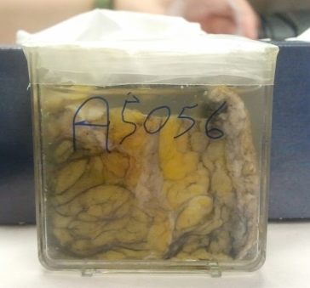
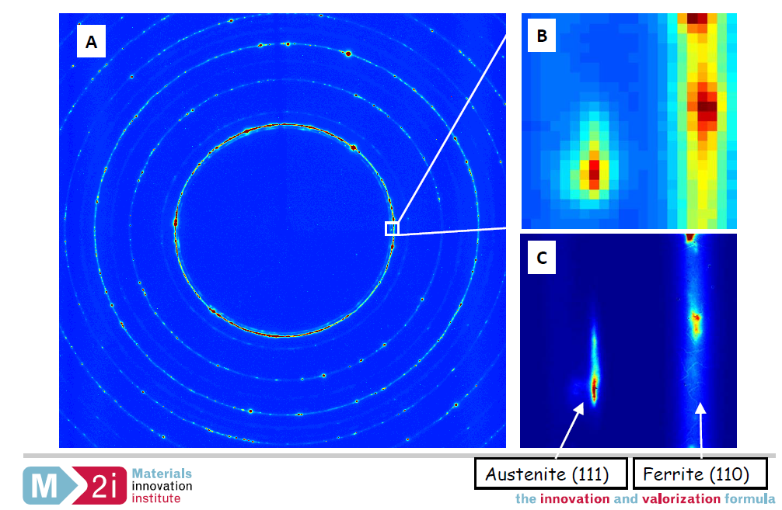
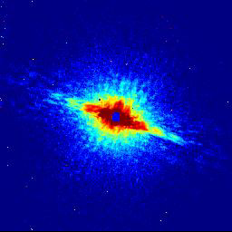

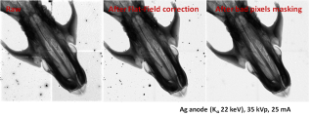
HIZPAD at ESRF → Maxipix-CdTe, a direct detection imaging system for synchrotron beamlines in the 5 to 150 keV energy range
Current detector system : Presentation
Sensor material | CdTe, single crystal (Acrorad)
Pixel pitch | 55 μm
Sensor size (pixels) | 512 x 512 (ohmic type)
Sensor size (mm) | 28 x 28 x 1
X-ray detection mode | Single photon counting
ASIC | TIMEPIX (CERN)
Readout | ESRF MAXIPIX, max speed 1.4 kHz
Flux (X/mm²/s) | Up to 3.10⁷ (Timepix limited)
Operation Temperature | Room Temperature
Absorption efficiency | 0.99 up to 70 keV
Applications:
Material science:
Surface diffraction, High-resolution diffraction, time-resolved diffraction, diffraction tomography, ptychography, …
X-ray Imaging

Slide 16
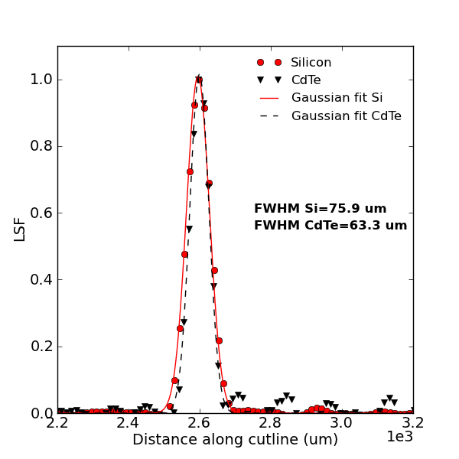
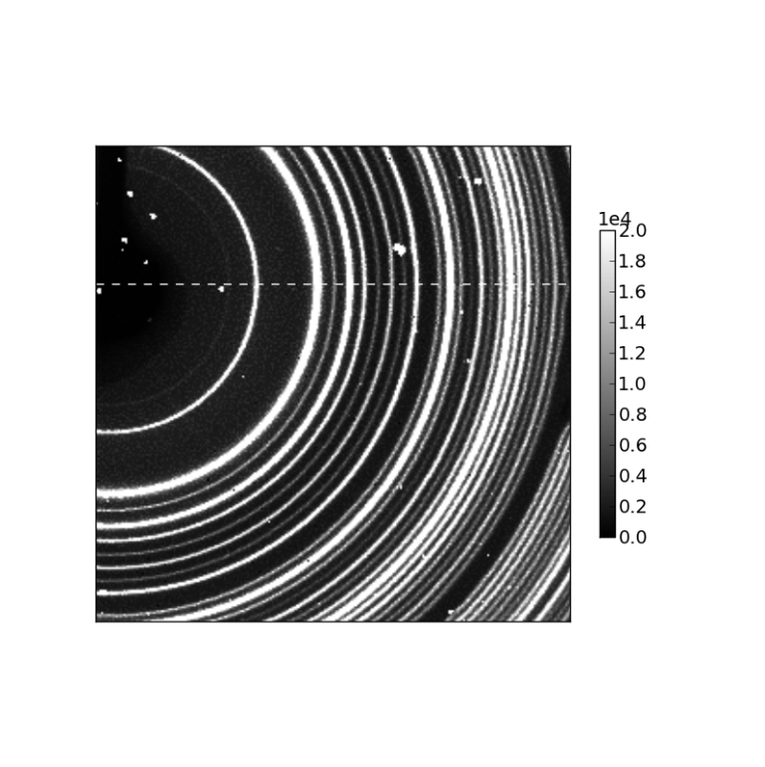
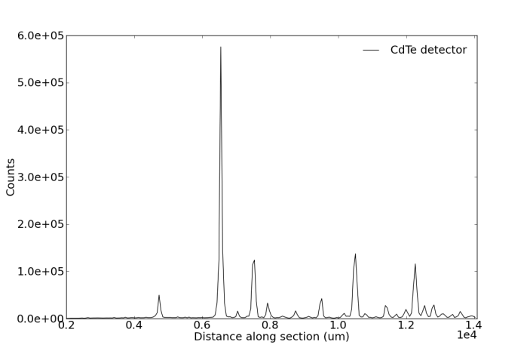
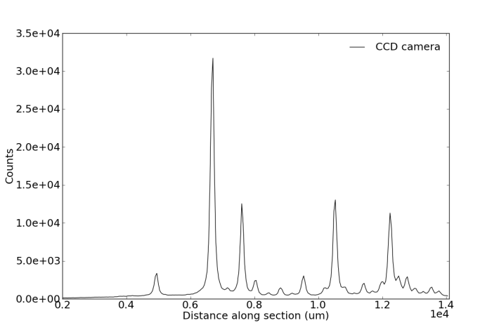
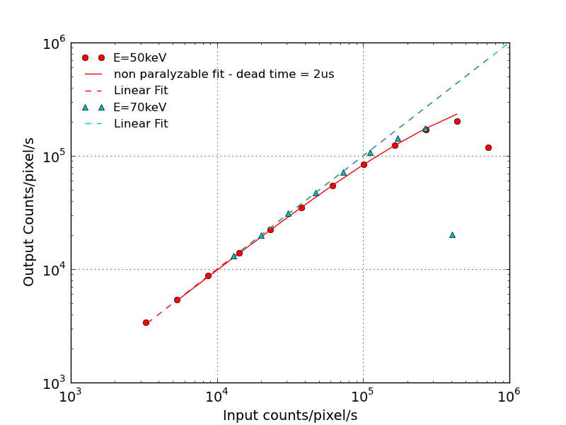
Current detector system : Performances
Spatial resolution 63 um
Yb₂O₃ nano-powder diffraction rings at 50 keV.
Comparison with FRELON (50 um pixel pitch) :No significant background, sharper peaks, more low intensity rings
Linear count rate up to 3.10⁷ photons/mm²/s
M. Ruat and C. Ponchut, IEEE Trans. Nucl. Sci., Vol. 59, n° 5, pp. 2392-2401, August 2012
C. Ponchut and M. Ruat, Proceedings of IWORID 2012
M. Ruat, E. Gros d’Aillon and C. Ponchut, proceedings of the 2012 IEEE NSS/MIC/RTSD conference

Slide 17
Outline
Context
High Z detectors developments
Bottleneck(s) and improvements
Beamline evaluations
Future plans

Slide 18
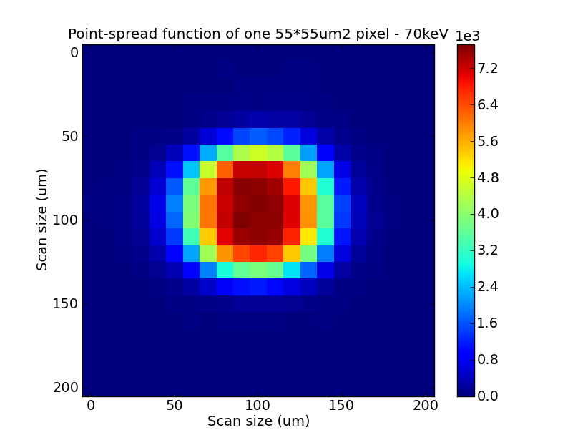
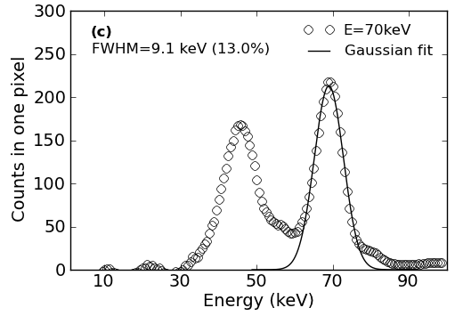
Charge sharing and fluorescence
Small pixels enables selection of fast electrons (single carrier sensing) but increase of charge sharing phenomenon
PSF
Only 50 % of the pixel area is not shared with neighbors → double counting
Fluorescence
Mean free path of fluorescence photons : 110 um
→ They escape from the illuminate pixel and contribute to charge sharing
Escape peak
→ Corrections at the ASIC level (Charge summing ASIC)

Slide 19
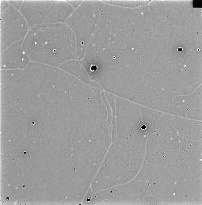
Flat-field image of a CdTe detector:
Observation of structural defects
1mm
1mm

Slide 20
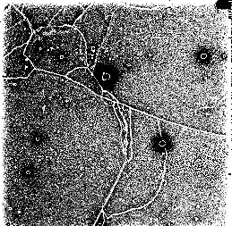
Flat-field image of a CdTe detector:
Observation of structural defects
Reduced color scale around median value
1mm

Slide 21
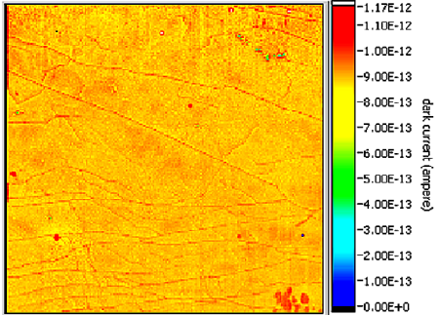
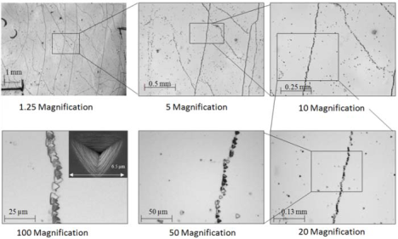
*
Flat-field image of a CdTe detector:
Observation of structural defects
*
*
1mm
* From C. Buis et al, Proceedings of the 2012 IEEE NSS/MIC/RTSD conference) 2011 IEEE, pp. 4804 - 4808
*
bump-bonding yield of 98 to 99%
1. Network of Lines (Native):
Increased counts by ~10% next to a line of reduced counts (drift of the charges to the neighbor pixels)
Dislocations walls / grain boundaries
Can be FF corrected
M. Ruat and C. Ponchut, IEEE Trans. Nucl. Sci., Vol. 59, n° 5, pp. 2392-2401, August 2012
C. Ponchut and M. Ruat, Proceedings of IWORID 2012
M. Ruat, E. Gros d’Aillon and C. Ponchut, Proceedings of the 2012 IEEE NSS/MIC/RTSD conference

Slide 22
Flat-field image of a CdTe detector:
Observation of structural defects
1mm
2. Extended clusters of saturated pixels (from bump-bonding process):
- current overflow of the analog input stage of the readout chip.
- Strain in the material (From E. Hamman et al, IEEE RTSD 2012)
Surrounded by large areas of reduced counts (gettering effect)
On-going development for improvement
M. Ruat and C. Ponchut, IEEE Trans. Nucl. Sci., Vol. 59, n° 5, pp. 2392-2401, August 2012
C. Ponchut and M. Ruat, Proceedings of IWORID 2012
M. Ruat, E. Gros d’Aillon and C. Ponchut, Proceedings of the 2012 IEEE NSS/MIC/RTSD conference

Slide 23
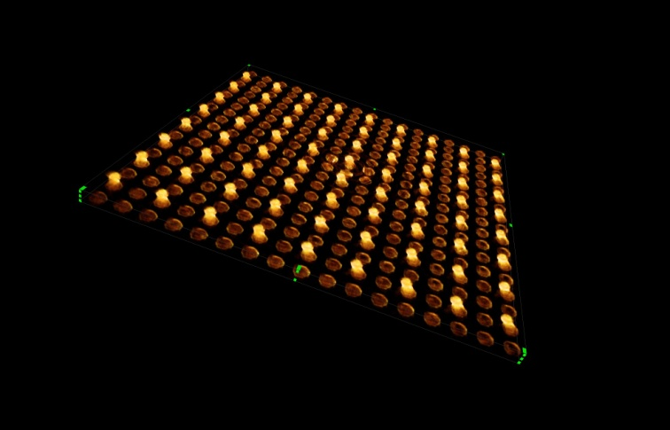
Some of the main milestones of the CdTe community:
Bump-bonding
- Quality of the material with respect to structural defects
- Contacting and bonding
3D rendering of CdTe on Timepix failed bump-bonding (pixel pitch 110 um)
From laminography experiment, ESRF - ID15, June 2012
Acknowledgments to A. Cecilia and E. Hamman from ANKA

Slide 24
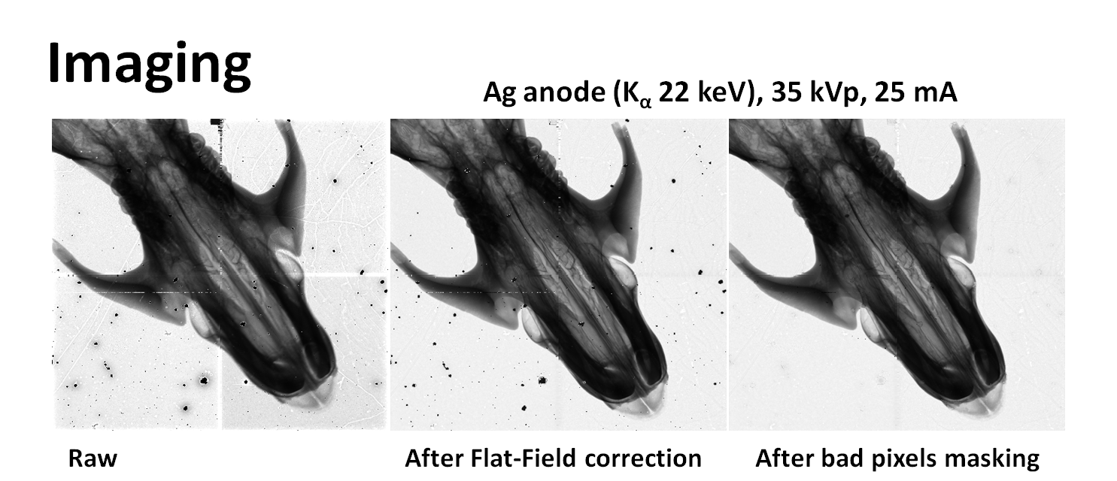
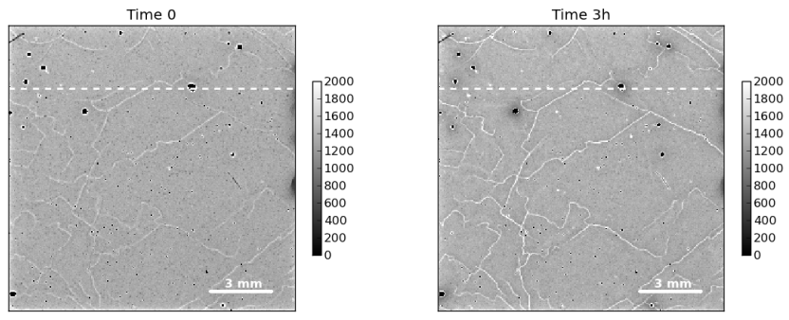
Correction for structural defects / bump-bonding faults
However….. These are active defects → Temporary correction!!

Slide 25
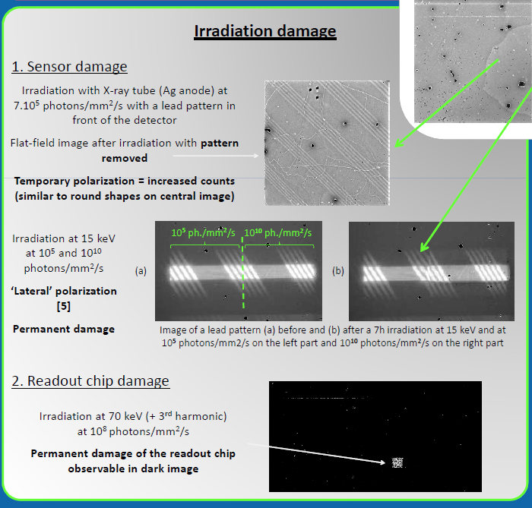
Instabilities : charging of the sensor
1. Irradiation with X-ray tube (Ag anode, Kα 22 keV)
7.10⁵ photons/mm²/s for 7 hours (1.8e10 ph./mm²)
With lead pattern in front of the detector
Last image taken with lead pattern removed
→ Phantom image of the lead pattern due to trapped charges
2. Irradiation at BM05, E = 15 keV
Left part of the irradiated zone: 10⁵ photons/mm²/s
Right part 10¹⁰ photons/mm²/s, for 10h (3.6e15 ph./mm²)
→ Lateral polarization == local electric field distortions due to differential irradiation
3 mm thick Lead plate
M. Ruat, proceedings of the IWORID 2013

Slide 26
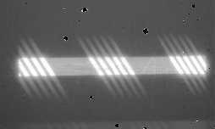
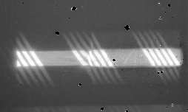
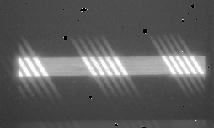
Irradiation with 30 keV X-rays @ 10¹⁰ photons/mm²/s for 12h
Instabilities : charging of the sensor
Before Irradiation
After 6h of continuous irradiation (right part)
After bias reset
Polarization / charging can be avoided (to a certain extent)!
→ Need to improve the design:
- Cooling or controlling the operation temperature and / or
- Reset the bias applied to the detector at regular interval times (known technique for CdTe detectors with Schottky diodes contacts)

Slide 27

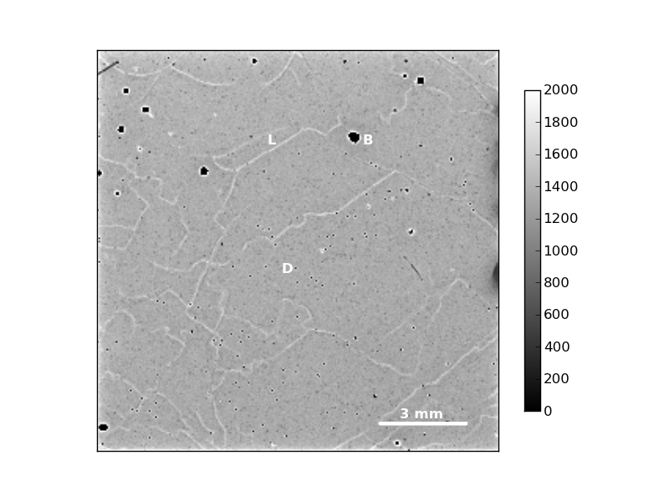
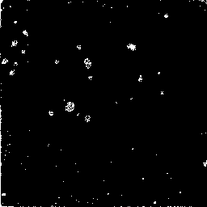
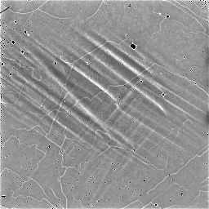
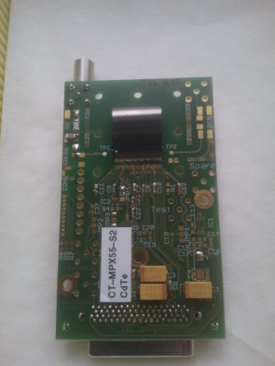
Dark and Flat-field images: as is when received
After 12h at 80°C (new noisy pixels on dark image existed before baking)

Slide 28
Outline
Context
High Z detectors developments
Bottleneck(s) and improvements
Beamline evaluations
Future plans

Slide 29
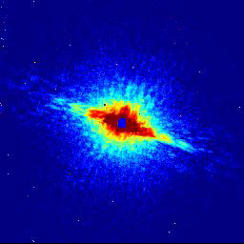
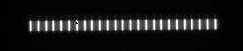
Beamline evaluations at ESRF
ID15 – Surface diffraction: Reflectivity liquid Ga on solid Sapphire at 70 keV (Oct. 2012)
ID15 – Surface diffraction: In-situ following of GaN growth at 70 keV (Oct. 2012)
ID11 – High resolution diffraction imaging at 80keV. Mechanical stability of retained austenite grains in TRIP steels studied by synchrotron X-ray diffraction during deformation (Nov. 2011)
ID17 - Edge-Illumination phase contrast imaging for mammography at 60 and 85 keV (Sept. 2012)
ID22 - Coherent SAXS or Ptychography experiment at 20 keV (Sept. 2012)
ID15 – Fast SAXS-WAXS experiment with Perkin Elmer detector for WAXS and Maxipix-CdTe as SAXS detector
ID17 – Detector evaluation for new tomography setup
for paleontology (June 2013)
ID17 – Dosimetry reconstruction for MRT (July 2013)

Slide 30
Outline
Context
High Z detectors developments
Bottleneck(s) and improvements
Beamline evaluations
Future plans

Slide 31
FUTURE PLANS
Detector design improvement to handle for CdTe material specific requirements
→ Reset bias routine, Controlled operation temperature, improve contacts and bonding (→HIZPAD²)
Charge sharing effect compensation
→ Medipix 3 ASIC
Faster counting and faster frame rate
→ Medipix 3, Eiger, Pilatus 3
Large area and/or modular architecture, requires edgeless sensor and 4-sides buttable ASIC
→ HIZPAD²
Alternative sensor materials e.g. GaAs

Slide 32

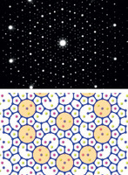
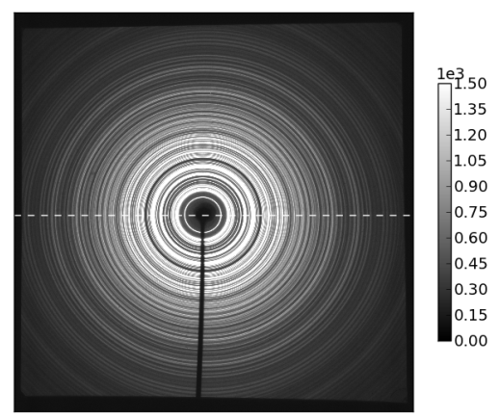
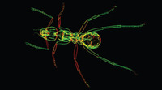
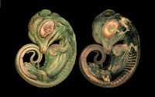
HIZPAD² is part of a JRA starting 2013 for 3 years
Budget: 1 Million euros
Partners: ELETTRA, CNRS/CPPM, CNRS/Néel, DESY, DLS, PSI, SOLEIL, STFC and EXFEL as observer.
Coordinated by ESRF
Dedicated to:
  Improved sensor quality and processes (specifically contacts & bump-bonding)
  Edgeless detectors and bigger pixel arrays
  Build enhanced demonstrators for beamline evaluations
  Theoretical approaches (modelling)
  Explore innovative X-ray sensor concepts, i.e. Quantum well materials

Slide 33
Many thanks to the following people who contributed to this presentation:
The ESRF Detector Unit
Collaborators of the ESRF Science Division
Our partners from European projects
Thank you for your attention!

Slide 34


ESRF Development "roadmap"
Context: Photon counting hybrid Pixel Detectors
nb. applications
SMARTPIX
>2000 fps, energy resolution, 1k x 1k
Large area
Pixel sensors improvements
active edge for larger areas
EIGER (collab. PSI)
>20 000 fps, large area
faster
MAXIPIX for UPBL
specific implementations
Energies> 30 keV
high-Z pixel sensors (HIZPAD, HIZPAD2)
high energy applications
14 units in operation at ESRF
MAXIPIX (Si sensor)
1280x256 pix./300 fps, 256x256 pix./1400 fps
Energies< 20-30 keV
2005
2010
2015

Slide 35


Irradiation with 30 keV X-rays @ 10¹⁰ photons/mm²/s for 12h
Before Irradiation
After 6h of continuous irradiation (right part)
Immediately after bias reset
Note: Left part of the illuminated zone was irradiated at flux within the linear counting range: no measurable charging effect
Bias reset + 10 min
Bias reset + 30 min

Slide 36

Beam viewer
Current developments: Hybrid Pixel Detectors
The MAXIPIX Detector and its evolution
TECHNOLOGY | CURRENT | FUTURE
SOFT X-RAYS LARGE FIELD OF VIEW NEEDED | Si sensors TIMEPIX chip | Edgeless Si sensors - Medipix 3 & SMARTPIX
HARD X-rays | CdTe sensor TIMEPIX chip | - HIZPAD² project: Slim-edge High-Z sensors, Improved processing - Medipix3 chip
M. Ruat - 3-WAY Meeting Aug. 2013 - APS

Slide 37
Context: ESRF Upgrade
Longer beamlines, increased photon energy, increased flux, new techniques → New detector solutions
Smaller objects → less signal → noise free detectors+ spatial resolution
Synchrotron is providing high spatial resolution → you want to have it on the detector as well (optics solution + direct detection solutions)

Slide 38


Instabilities : temporary radiation damage
Phantom images of previous irradiation field

Slide 39

Flat-Field when received (2012-02)
Soleil synchrotron 20 keV + air scatterer
Thld 5
12 x 60 s

Slide 40

As is, after 18 months of experiments…
Ag Tube 35kVp – 25 mA
+ 100 um Ag filter
Thld 11
100 x 1 s
Chips 00, 01, 11 exhibit more extended defects + history effect.
Chip 10 is noisy and some pixels look disconnected

Slide 41

After 2 hours at 50°C…
Ag Tube 35kVp – 25 mA
+ 100 um Ag filter
Thld 11
60 x 1 s
History effects have disappeared, as well as some defects on chips 00, 01, 11. Chip 10 idem → temporary :-(

Slide 42

Reset bias routine
Irradiation with or without bias reset every 10 minutes
Irradiation with X-ray tube (Ag anode, Kα 22 keV, 35 kVp, 50 mA)
~1.10⁷ photons/mm²/s for 7 hours on right part of the detector (7.2e10 ph./mm²)
Left part of the irradiated zone < 10³ photons/mm²/s
→ Imaging a lead pattern before and after irradiation
10³ ph./mm2/s
10⁷ ph./mm2/s
2 mm thick Lead plate

Slide 43
Reset bias routine
Irradiation with or without bias reset every 10 minutes
Irradiation with X-ray tube (Ag anode, Kα 22 keV, 35 kVp, 50 mA)
~1.10⁷ photons/mm²/s for 7 hours on right part of the detector (7.2e10 ph./mm²)
Left part of the irradiated zone < 10³ photons/mm²/s
→ Imaging a lead pattern before and after irradiation
Without bias reset

Slide 44

Reset bias routine
Irradiation with or without bias reset every 10 minutes
Irradiation with X-ray tube (Ag anode, Kα 22 keV, 35 kVp, 50 mA)
~1.10⁷ photons/mm²/s for 7 hours on right part of the detector (7.2e10 ph./mm²)
Left part of the irradiated zone < 10³ photons/mm²/s
→ Imaging a lead pattern before and after irradiation
Without bias reset
With bias reset

Slide 45
Detector instabilities: Overview
Polarization / charging
Extensive use → quicker polarization, enhanced radiation damage, extra noise
Low temperature baking (50°C) induces defects relaxation in CdTe
NEED TO CHARACTERIZE TEMPORARY vs PERMANENT or RECURRING EFFECTS
And the way to avoid or ‘anneal them’, if possible.
→ Need to improve the design:
- Cooling or controlling the operation temperature and / or
- Reset the bias applied to the detector at regular interval times (known technique for CdTe detectors with Schottky diodes contacts)

Slide 46
ID15 – Surface diffraction on liquid Ga(N) / solid Sapphire interface at 70 keV
Main outcomes from the use of 2D CdTe detector:
Faster and simplified sample and motors alignment procedure
High energy needed for buried interfaces studies
Measurement speed improvement:
Study fluctuations of intensity between Bragg peaks→ need for a sensitive detector with high dynamic range
72h of continuous irradiation without significant drift
In-house experiment with A. De Jong, J. Jasper and V. Honkimaki from ID15; Pr. E. Vlieg from Radboud University Nijmegen

Slide 47


ID17 – Edge-Illumination phase contrast imaging for mammography at 60 and 85 keV
Method
8m
slits
48h of continuous irradiation without significant drift
From P. Munro et al., AIP Conf. Proc. 1466, 118 (2012)
Illuminated zone 512 x 1 pixel
Results
Simplified alignment
Ability to work at high energies
Spatial resolution ok
Identification of small calcified zones due to tumor into human breast (60 keV)
2 bad lines due to defective pixels have been removed
In-house experiment with A. Olivo and P. Diemoz from University College London; P. Coan from Ludwig Maximilians University Munich; A. Bravin and T. Brochard from ID17

Slide 48


ID11 - Mechanical stability of retained austenite grains in TRIP steels studied during deformation
Method : High resolution X-ray diffraction
From R. Blondé et al., AIP Conf. Proc. 1466, 118 (2012)
TRIP → TRansformation Induced Plasticity effect.
Monitoring of individual grains in the bulk of the material to follow the formation of sub-grains prior to the transformation during deformation.
Conclusion: High-energy micro-beam XRD is a powerful tool to explore advanced multiphase steels
Users: Romain Blondé et al., Delft University of Technology, The Netherlands; in collaboration with J. Wright ID11

Slide 49



ID22 – Coherent SAXS or Ptychography experiment at 20 keV
First commissioned CdTe detector (single chip)
High number of photons in the center, CdTe needed to protect the readout chip
Low number of photons outside the center: photon-counting feature needed
Additional detector features needed: bad pixel masking and dead time correction to be accurately quantitative
First experiment with Maxipix-CdTe done in Sept. 2012 with P. Thibault, F. Pfeiffer et al. from Technische Universität München, Germany and P. Cloetens ID22:
Setup 1 (FRELON like):
1. Low flux scan
2. High flux scan
Setup 2 (50% gain in time):
Only one scan, attenuator in the center
1
Object: Siemens Star
Object: Nano-porous Au
2
2

Slide 50

ID22 – Coherent SAXS or Ptychography experiment at 20 keV
First commissioned CdTe detector (single chip)
→ Future developments: UPBL4
Future UPBL4 detector
Integrating:
'Infinite' count rate
Counting:
High sensitivity
CdTe Maxipix

Slide 51
Flat-fields:
A few additional disconnected pixels, not in the ‘damaged’ zone
Some blobs decreased in size (o), some increased in size (o)
Some blobs have some ‘rays’ linked to new structures (o)
Scratch or other undefined features linked to new structures? (--, o)

Slide 52

Lead pattern image: ‘Vamos a la playa’
Comes from the backside contact?
Comes from the CdTe bulk crystal?
Comes from the pixel contacts?

Slide 53
TOPOGRAPHY
Bragg geometry, grazing incidence, 20 keV monochromatic beam, 004 reflection
Stretched and Rotated image
Flat-Field
Can see blobs and dislocation lines. Faint lines looking like additional structures. Blobs aligned with these lines?
Large vertical structures visible with natural light on backside contact

Slide 54
BACKSIDE CONTACT SURFACE STATE
AFM
DIC microscopy
Conventional microscopy
EBM
EBM, 5 keV
EBM, 15 keV

