Slide 1
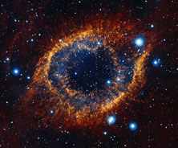
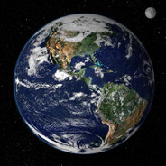
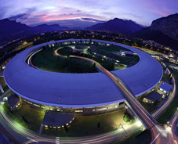

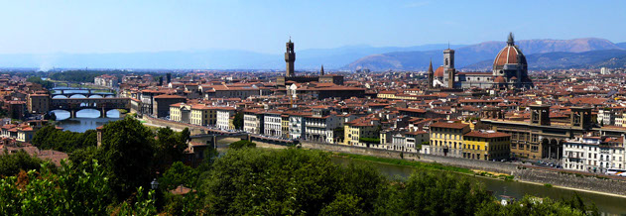
Welcome to the
Scientific Detector Workshop 2013
Special Evening Presentation
9 October 2013
Florence, Italy

Slide 2
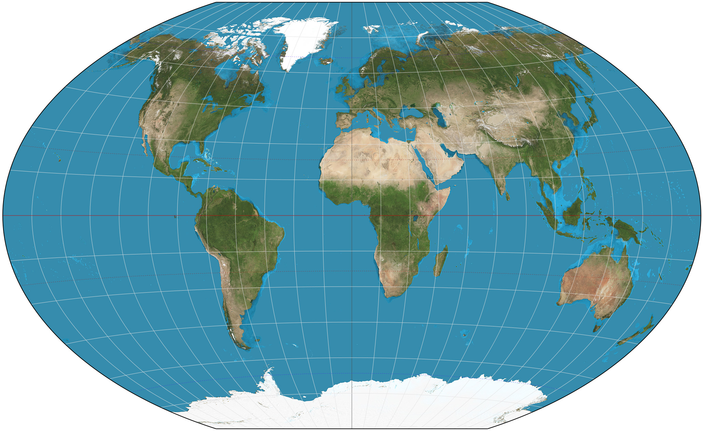
A gathering of the leaders in high performance detectors
for scientific applications from the x-ray to the infrared
162 attendees
90 organizations
18 countries
6 continents

Slide 3
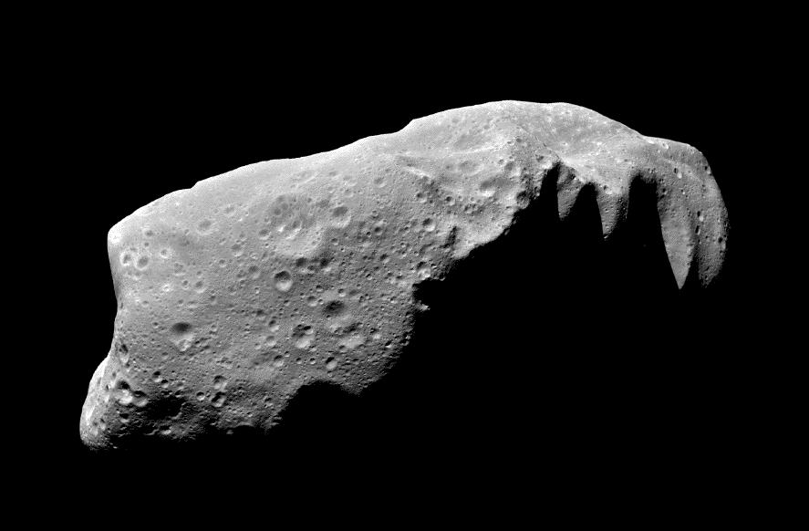
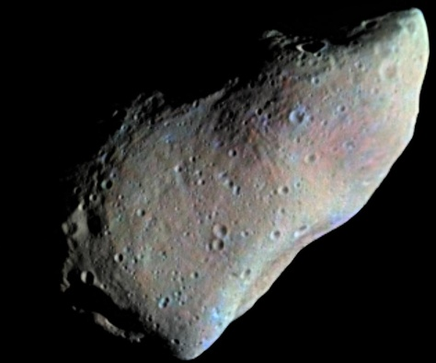
Lifetime Achievement Awards
These awards recognize leading members of the Scientific Detector Workshop community.
These individuals have made substantial and unique contributions over the course of their career.
The award is an asteroid, officially named by the International Astronomical Union (IAU).

Slide 4
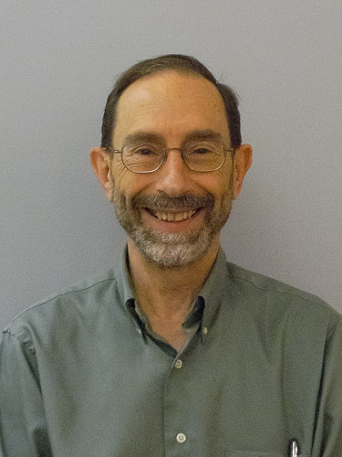
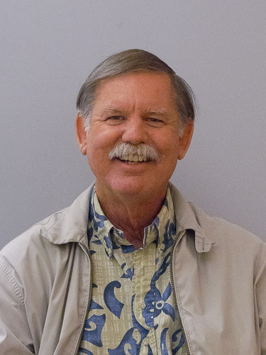
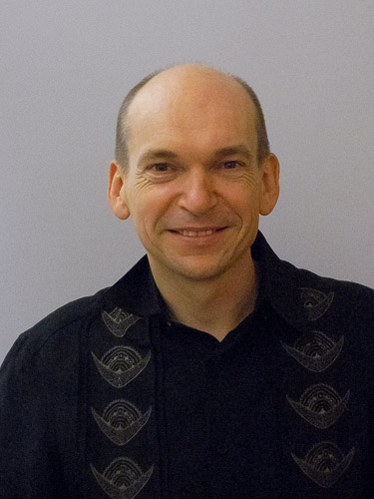
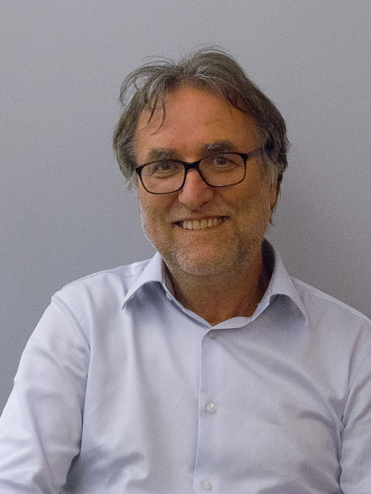
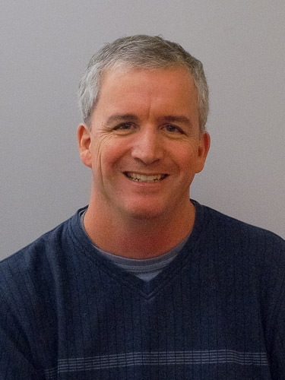
Lifetime Achievement Awards
Previous award winners (2002, 2005) in attendance this evening:
  Barry Burke
  Richard Bredthauer
  Jean-Charles
  Cuillandre
  Gert
  Finger
  Michael
  Lesser

Slide 5

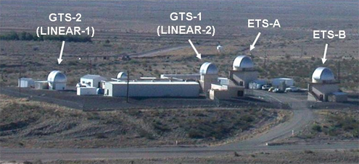
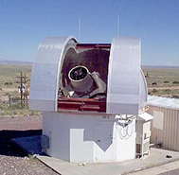


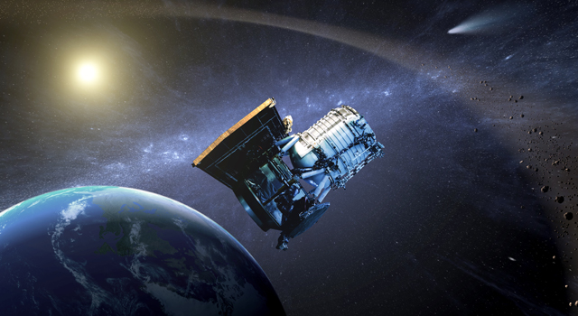

Many thanks to the two organizations that graciously donated asteroids to SDW2013
LINEAR
Lincoln Near Earth Asteroid Research

Slide 6
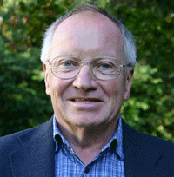
Asteroid #249556
(2010 KX29)
Presented to
Craig Mackay
Scientific Inventor
Craig Mackay (b. 1944) is Professor of Image Science at the Institute for Astronomy, Cambridge University. For more than 40 years, he has pushed the frontiers of digital imaging, developing new detector systems and instrumentation that overcome the limits of observing through the Earth’s atmosphere, including OH suppression spectrographs, adaptive optics, interferometry, aperture masking, and he invented the field of “lucky imaging”. He has worked on instrumentation for the Hubble Space Telescope and radio astronomy, and his patents include technologies used in human genome sequencing, and x-ray, neutron and transmission electron microscope imaging. His stellar teaching record is combined with ~200 publications, and he is renowned for his outstanding technical presentations, delivered with passion and clarity. The naming of this asteroid is on the occasion of the Scientific Detector Workshop 2013.
Asteroid 249556 discovered 18 May 2010 by WISE

Slide 7
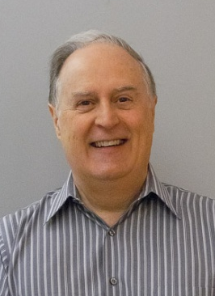
Asteroid #249544
(2010 HQ44)
Presented to
Ian McLean
Astronomy Instrumentalist Extraordinaire
Ian McLean (b. 1949) has been a leader in astronomical instrumentation for four decades, through his work at the Royal Observatory of Edinburgh (Scotland), the Joint Astronomy Centre (Hawai’i), and the University of California, Los Angeles (UCLA). He founded the UCLA infrared laboratory in 1989, a facility that has produced instrumentation for Lick Observatory, W.M. Keck Observatory, Gemini Observatory, and NASA’s Stratospheric Observatory for Infrared Astronomy. His leadership roles include chair of the Keck Science Steering Committee, Associate Director of UC Observatories, Vice Chair of UCLA Physics & Astronomy department, and chair of many international conferences. He has trained two generations of astronomers and instrumentalists through his university courses, seminars, articles, and books. He is a scholar, a gentleman, and a role model for scientists worldwide. The naming of this asteroid is on the occasion of the Scientific Detector Workshop 2013.
Asteroid 249544 discovered 23 April 2010 by WISE

Slide 8
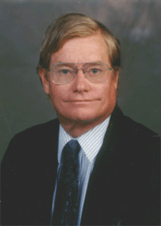
Asteroid #249547
(2010 HZ83)
Presented to
Bonner Denton
Analytical Chemistry Trailblazer
Bonner Denton (b. 1944), of the University of Arizona, blazed the trail for the use of digital imaging sensors in analytical chemistry. He is one of the world’s most prolific researchers and teachers, with more than 200 refereed publications, 15 patents, over 500 invited presentations, more than 60 graduate students, and several new courses that have been taught to thousands of students. A fellow of several professional societies, he is one of the most entertaining and passionate leaders of the scientific detector community, and fondly known for organizing detector conferences at scuba diving sites. The naming of this asteroid is on the occasion of the Scientific Detector Workshop 2013.
Asteroid 249547 discovered 28 April 2010 by WISE

Slide 9
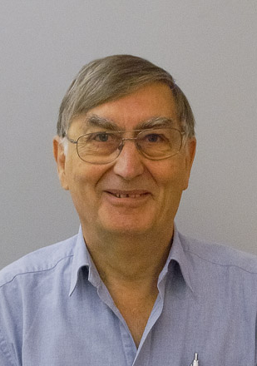
Asteroid #249546
(2010 HE47)
Presented to
Peter Pool
CCD Expert
Peter Pool (b. 1942) has been a crucial contributor to the development of high performance CCDs during his nearly five decade career that started at Marconi Research Laboratory in 1967. His work at Marconi, EEV and e2v has led to the development of new types of detectors and novel packaging approaches that have been universally adopted. His deep understanding of detector technology and user applications combined with his collaborative style has made him a valued partner in the most advanced instrumentation in astronomy, Earth science, and defence applications. The naming of this asteroid is on the occasion of the Scientific Detector Workshop 2013.
Asteroid 249546 discovered 23 April 2010 by WISE

Slide 10
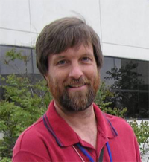
Asteroid #36213
(1999 TU158)
Presented to
Robert Green
Imaging Spectroscopist
Robert Green (b. 1960) has provided leadership and expertise in imaging spectroscopy for Earth and Planetary Science since joining the Jet Propulsion Laboratory in 1983. For thirty years he has been the Experiment Scientist for the “gold-standard” airborne AVIRIS sensor, and instruments he has collaborated on are orbiting the Earth, Moon, and Mars; next step is a space mission for atmospheric characterization of exoplanets. His knowledge of phenomenology and instrumentation is deep and broad, his science is first class, and his passion for discovery is infectious. The naming of this asteroid is on the occasion of the Scientific Detector Workshop 2013.
Asteroid 36213 discovered 9 October 1999 by LINEAR at Socorro

Slide 11
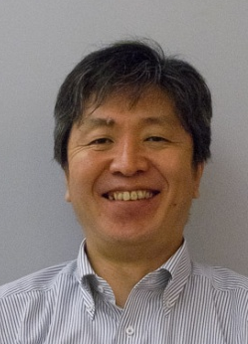
Asteroid #249553
(2010 JV136)
Presented to
Satoshi Miyazaki
CCD Pioneer
Satoshi Miyazaki (b. 1965), associate professor of astronomy at the National Astronomical Observatory of Japan, has pioneered the development and use of CCDs in the Japanese astronomical community. He motivated and guided the development of high performance, large format CCDs from Hamamatsu Photonics that are now used in some of the most advanced instrumentation in ground-based astronomy. He is Principal Investigator of the 870-megapixel Hyper Suprime-Cam project on the Subaru 8.2-meter telescope. The naming of this asteroid is on the occasion of the Scientific Detector Workshop 2013.
Asteroid 249553 discovered 14 May 2010 by WISE

Slide 12
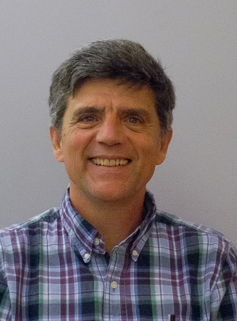
Asteroid #40919
(1999 TF162)
Presented to
John Tonry
Astronomy Trailblazer
John Tonry (b. 1953), of the University of Hawai’i, has defined the cutting edge of science and technology in many areas of astronomy. He developed the concept for the orthogonal transfer CCD that populates the world’s largest focal plane array, the 1.2 Gigapixel Pan-STARRS. Based on careful image processing techniques, he developed a new method for extragalactic distance determinations using surface brightness fluctuations to determine the distance scale of the universe. He was on the team that made Nobel Prize winning discovery of dark energy, and he is developing a system of telescopes to scan the entire sky twice per night to find the killer asteroid before it finds us. The naming of this asteroid is on the occasion of the Scientific Detector Workshop 2013.
Asteroid 40919 discovered 9 October 1999 by LINEAR at Socorro

Slide 13
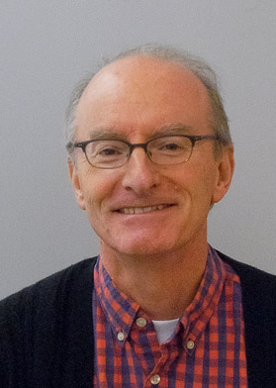
Asteroid #40981
(1999 TL284)
Presented to
Stephen Holland
CCD Developer Extraordinaire
Stephen Holland (b. 1956), of Lawrence Berkeley National Laboratory, is a pioneer in the development of high-performance silicon detectors for medical imaging, x-ray photon sciences, astronomy, and high-energy physics. He led the development of thick, high resistivity p-channel CCDs that provide very high quantum efficiency in the near-infrared. His CCDs are operating in several observatories, including the dark energy camera (DECam) in Cerro Tololo, the BOSS spectrographs at Apache Point, the low resolution spectrograph at the W.M. Keck Observatory, and exoplanet searches at Lick Observatory. The naming of this asteroid is on the occasion of the Scientific Detector Workshop 2013.
Asteroid 40981 discovered 9 October 1999 by LINEAR at Socorro

Slide 14
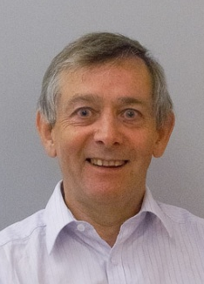
Asteroid #40917
(1999 TW156)
Presented to
Paul Jorden
CCD Mosaic Expert
Paul Jorden (b. 1951) has a unique career that has included leadership positions in the scientific community (Royal Greenwich Observatory) and industry (e2v technologies). His teams have developed state-of-the-art imaging sensors and applied them to ground-based and space astronomy over a period of more than three decades. He is distinguished in the astronomical community where he has been critical to the success of many of the most advanced facilities, including the CFHT Megacam, ESO VST, SAO Megacam, Kepler and Gaia, a mission which will measure more than a billion stars to map the Milky Way to unprecedented precision. The naming of this asteroid is on the occasion of the Scientific Detector Workshop 2013.
Asteroid 40917 discovered 9 October 1999 by LINEAR at Socorro

Slide 15
Congratulations to the SDW 2013
Lifetime Achievement Awardees !
  Ian
  McLean
  Bonner
  Denton
  Robert
  Green
  Paul
  Jorden
  Satoshi
  Miyazaki
  Peter
  Pool
  John
  Tonry
  Stephen
  Holland
  Craig
  Mackay

Slide 16
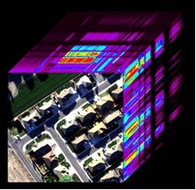
Understanding Worlds through 30 years of Infrared Imaging Spectroscopy
Robert O. Green, Ph.D.
Co-Lead, HyspIRI Mission Concept
Experiment Scientist, AVIRIS
Senior Research Scientist, Principal, Fellow
Jet Propulsion Laboratory
Pasadena, California

Slide 17
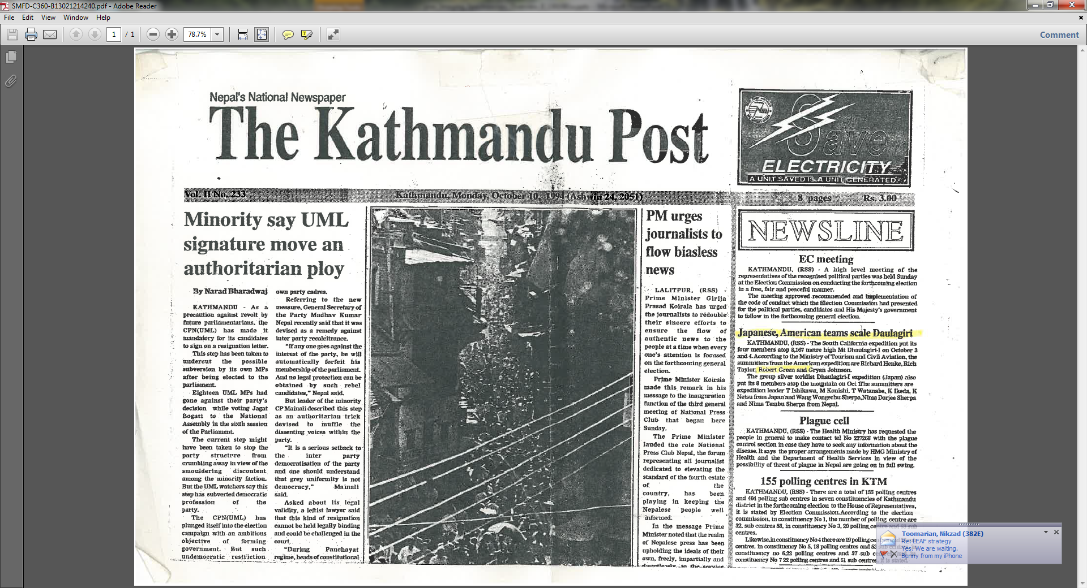
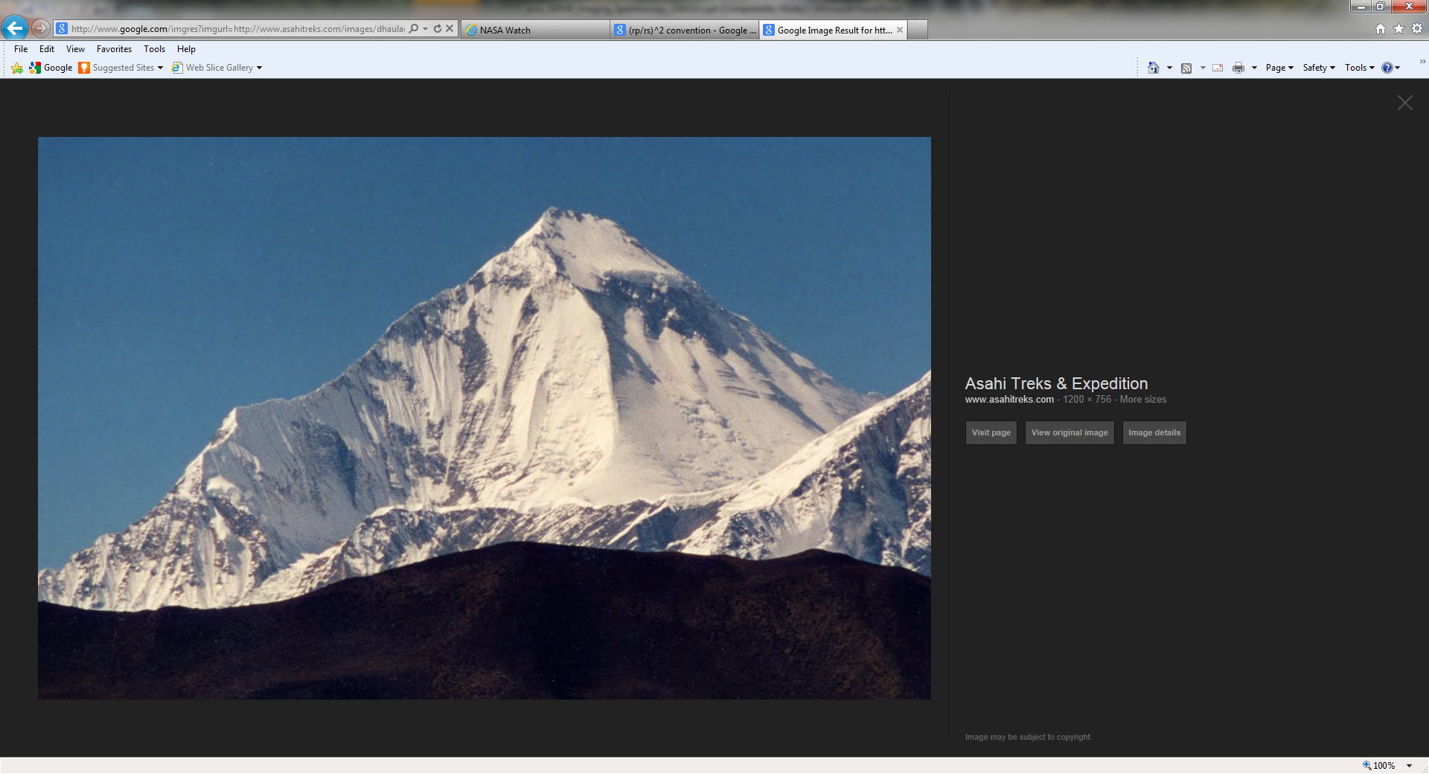
Dhaulagiri, Nepal: 8,167 m (26,795 ft ) - 7th tallest on Earth

