Slide 1
Maximizing Science from JWST Detectors
Michael Regan, Eddie Bergeron, Rachel Anderson, Doug Long (STScI)

Slide 2
Summary
Measuring and understanding
persistence
Correcting for temperature
variations

Slide 3
Measuring Persistence in HgCdTe in H2-RG detectors

Slide 4
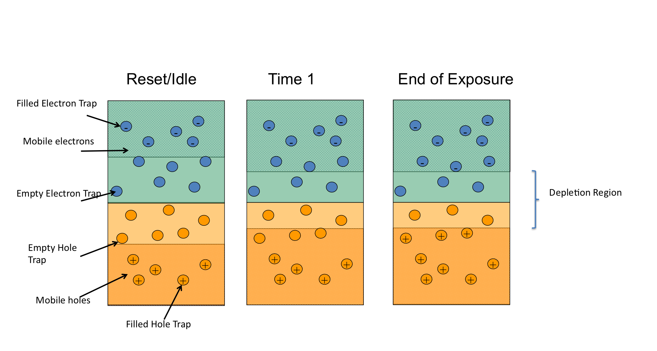
The Smith model (2008) of persistence does an excellent job of matching the observations.

Slide 5
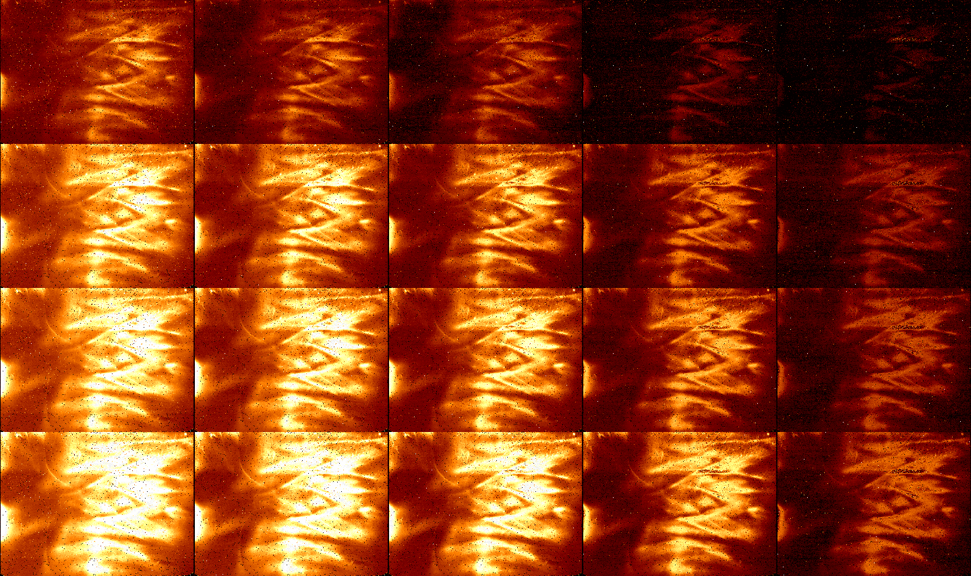
A persistence metric should specify how long to soak a saturation image and how long of an idle&reset before a dark is taken.
Exp
time
20 “
80 “
320 “
1200 “
0 “ idle
20 “ idle
80 “ idle
320 “ idle
1200 “ idle

Slide 6
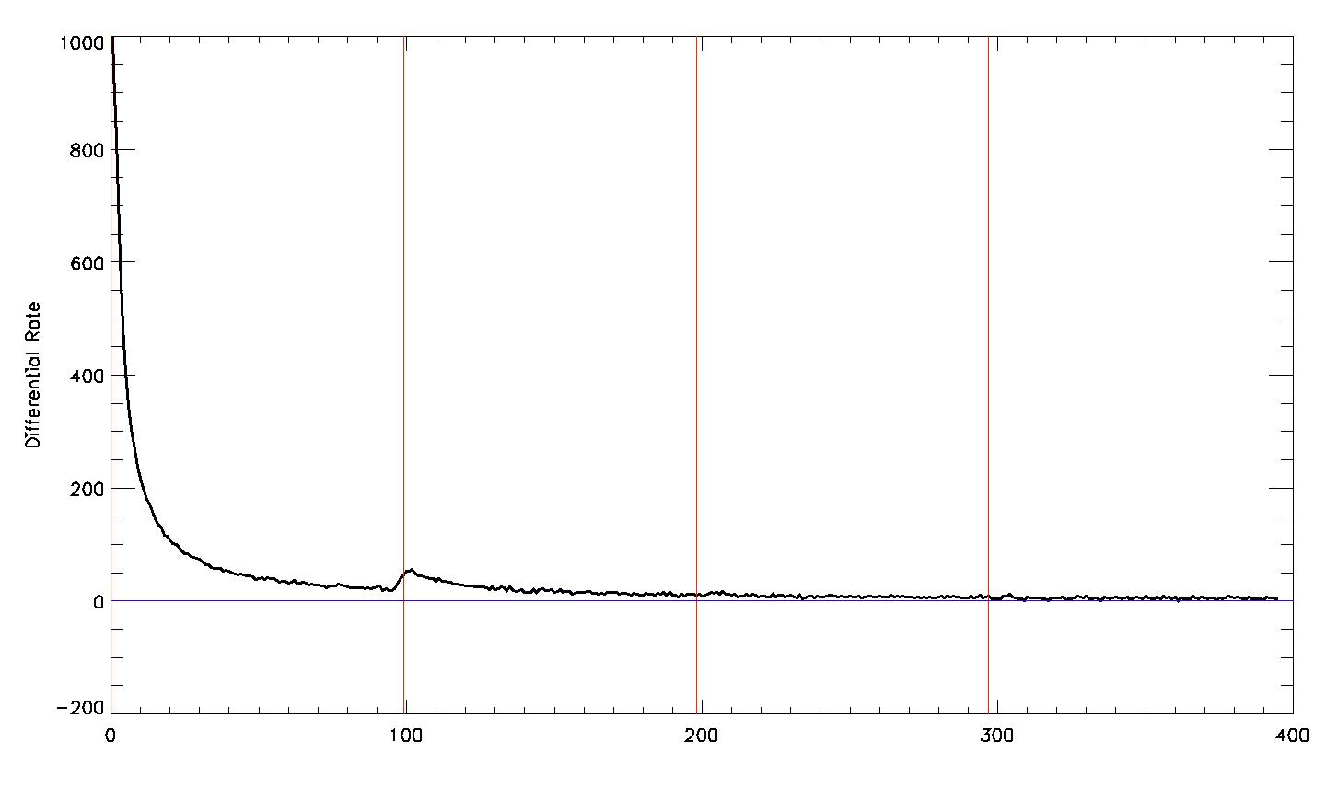
The differential rate falls off as an exponential
Read Number, 10 seconds/read

Slide 7
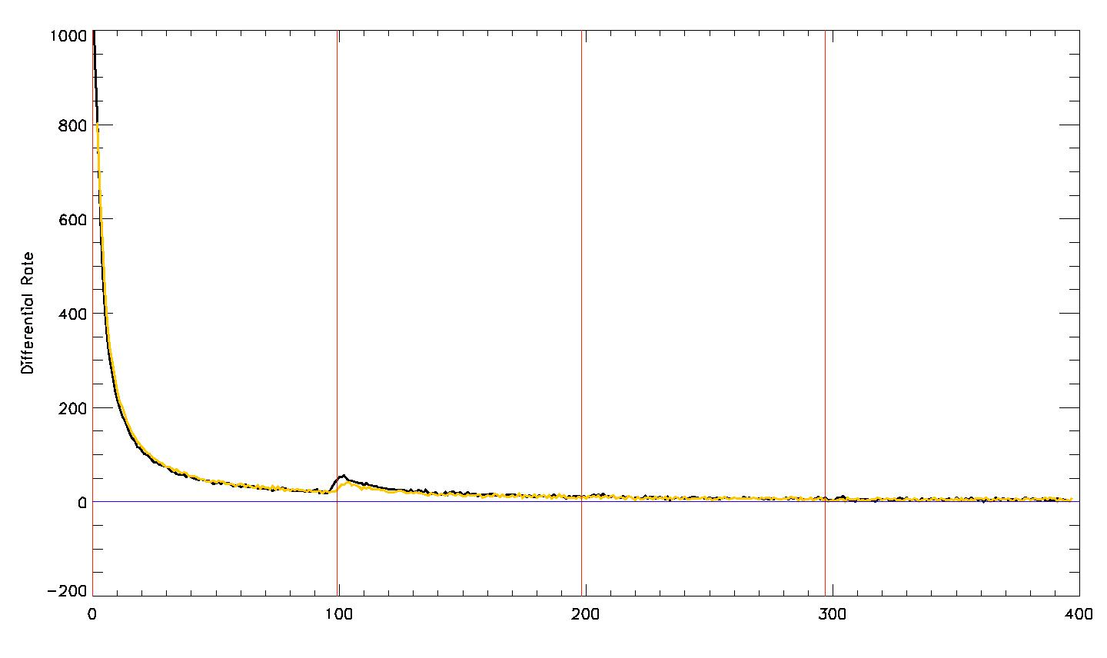
After 20 seconds of resetting.
Read Number, 10 seconds/read

Slide 8
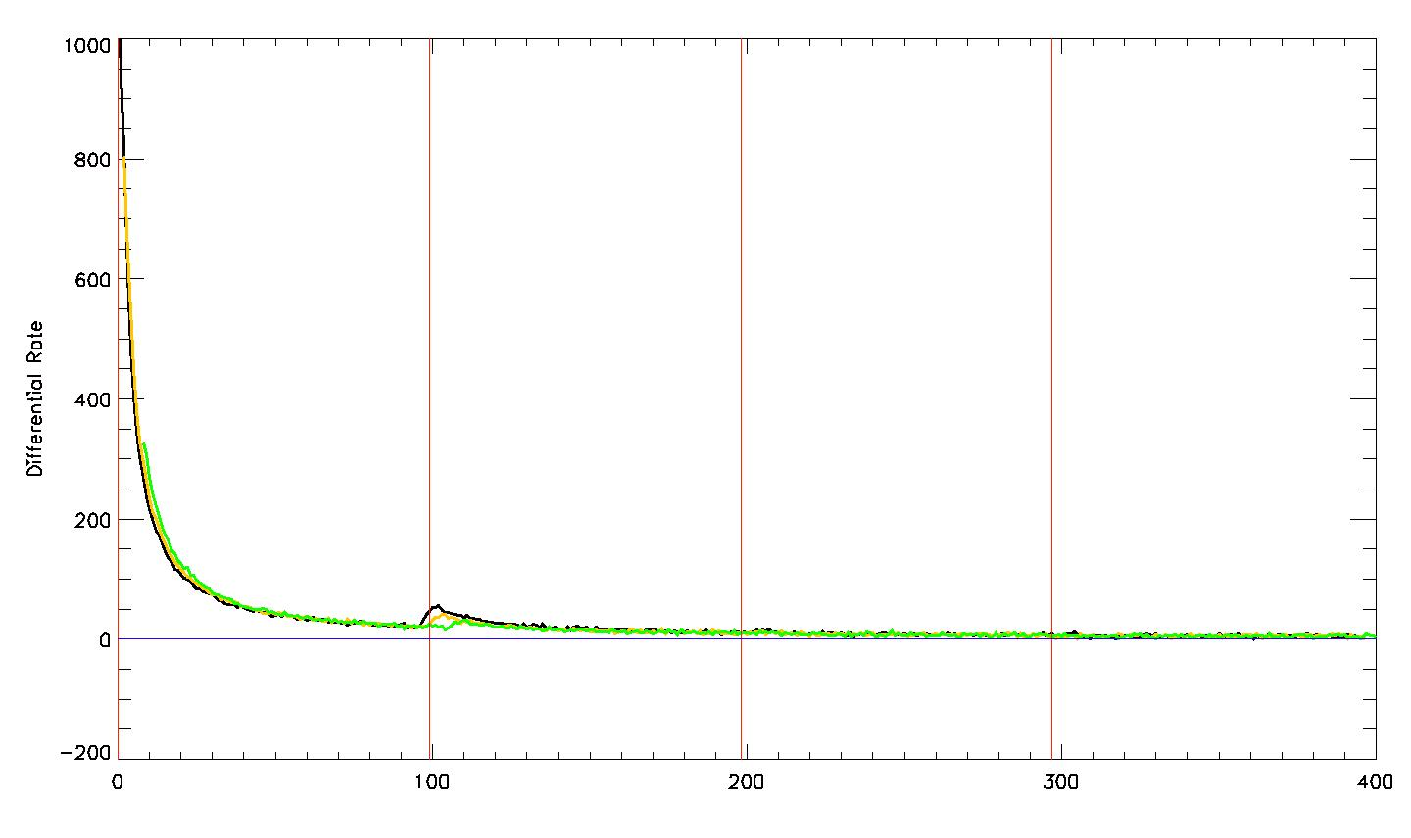
After 80 seconds of resetting
Read Number, 10 seconds/read

Slide 9
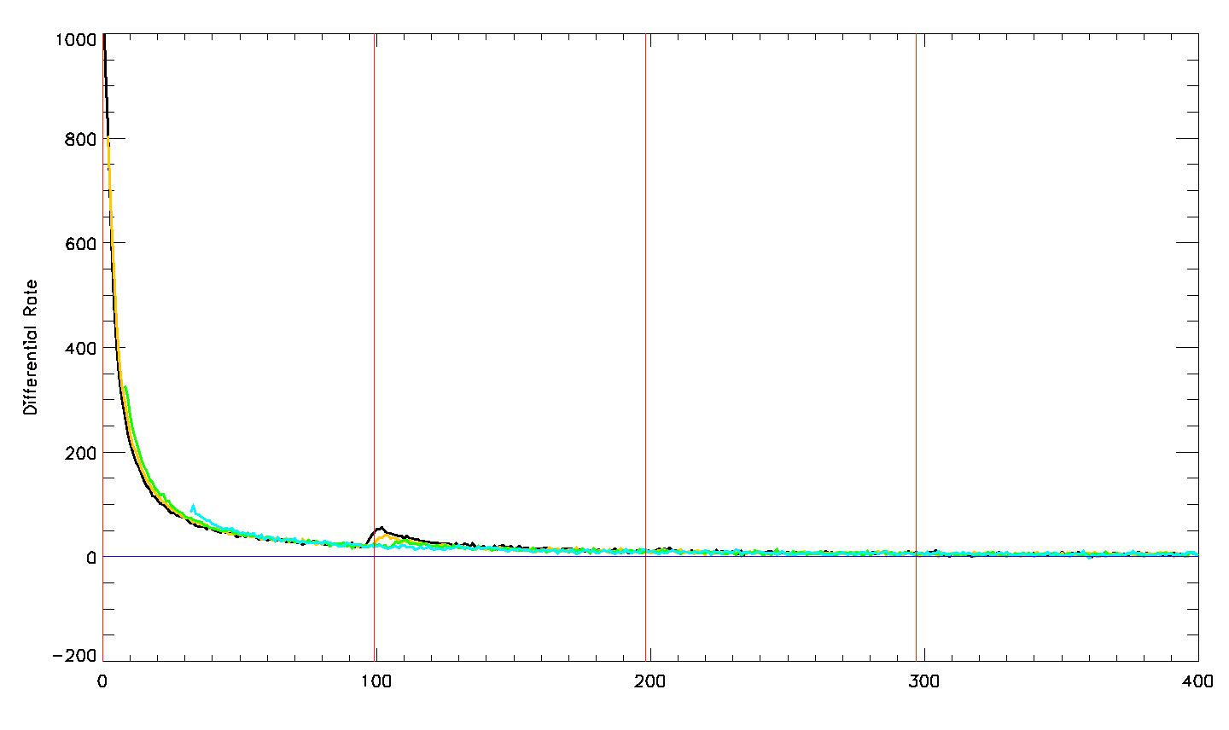
After 320 seconds of resetting.
Read Number, 10 seconds/read

Slide 10
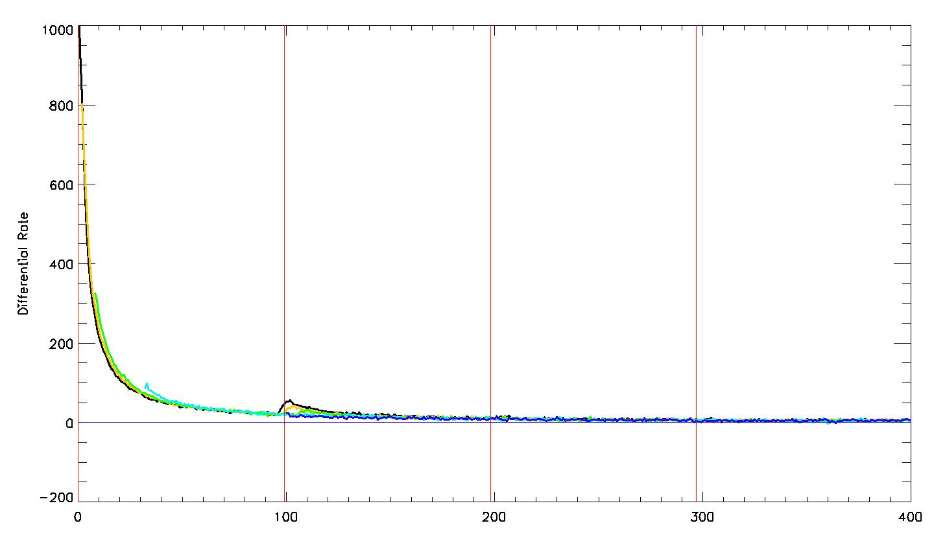
After 20 minutes of resetting.
Read Number, 10 seconds/read

Slide 11
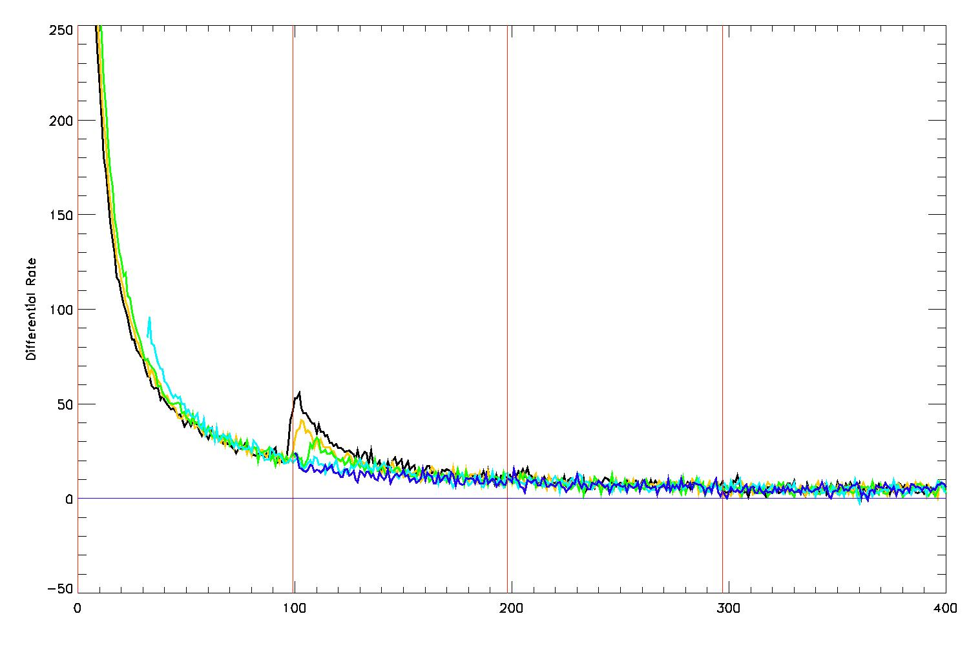
Overall, resetting doesn’t increase the decay of the persistence.
Read Number, 10 seconds/read

Slide 12
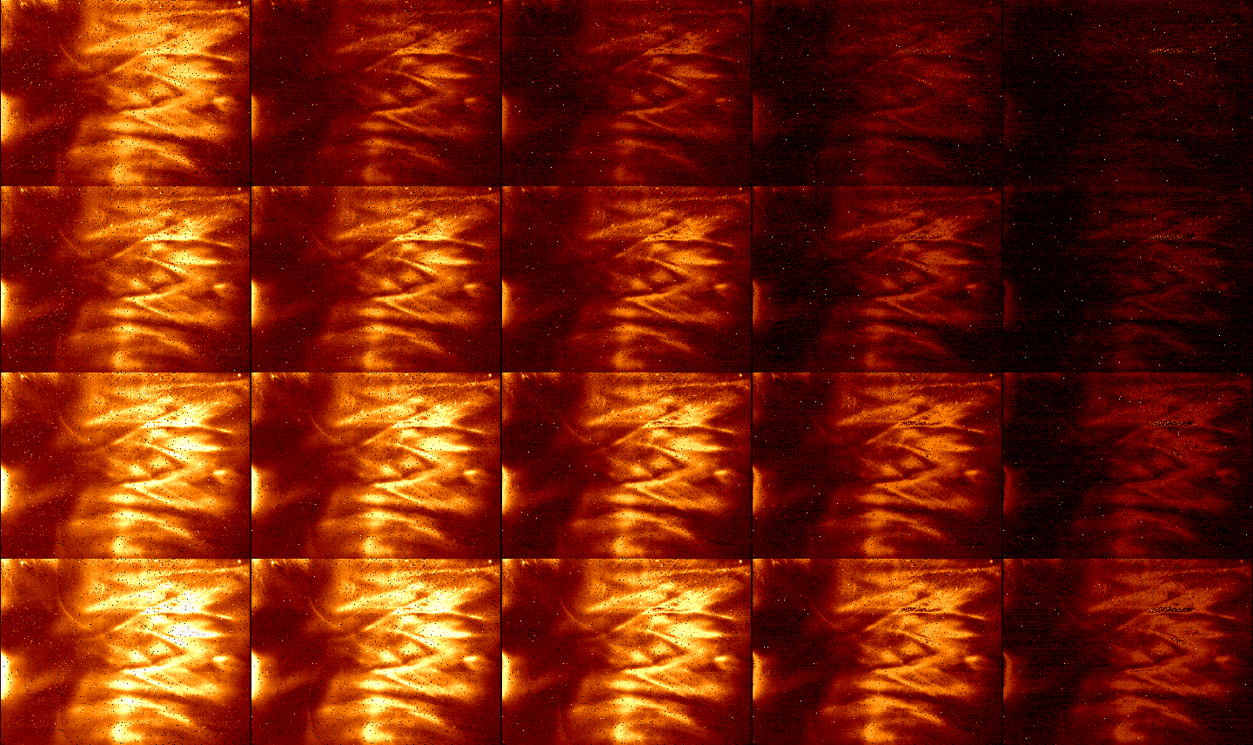
A simpler way to create the metric is just to set VRESET = DSUB and expose for the requested time.
Exp
time
20 “
80 “
320 “
1200 “
0 “ idle
20 “ idle
80 “ idle
320 “ idle
1200 “ idle

Slide 13
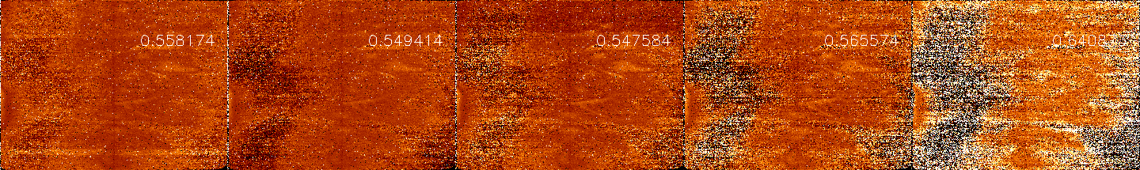
The bias change yields 55% of the persistence seen in the light saturated images. Which is consistent with the fraction of the full well used.
Saturation for 20 minutes
Changed bias for 20 minutes
Ratio

Slide 14
The maximum persistence is controlled by the number of empty traps in the depletion region.

Slide 15
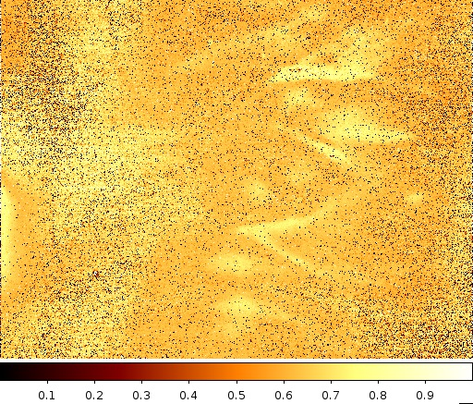
By lowering the detector bias, we can decrease the maximum persistence.
Ratio of total persistence
after lower net bias by
100 mV.

Slide 16
Correcting for Temperature Variations

Slide 17
The pixels are very good thermometers.
A 100 mK change in the middle
of an exposure.

Slide 18
The pixel response to temperature is not constant.

Slide 19
We can solve for the observed number of electrons using a general least square solution.
Light Sensitive Pixels
Reference Pixels
BUT, this requires inverting a 250 TB matrix!!

Slide 20
Using only a trial 100x100 subarray we are able to well approximate a temperature change.

Slide 21
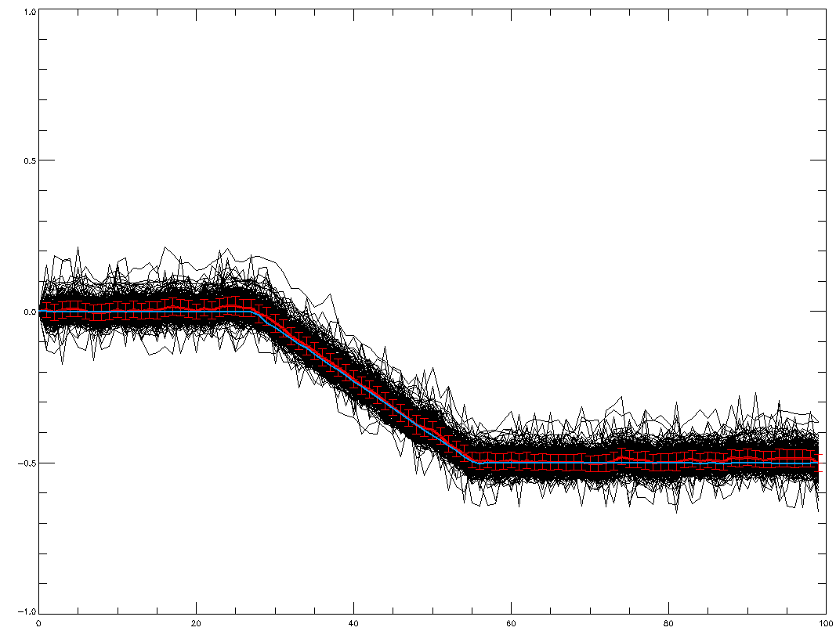
Alternatively, can use saturated hot pixels to directly determine the temperature (Rauscher method).

Slide 22
Conclusions
Persistence
Time of capture is related to time of decay but decay takes a lot longer
Only time can heal persistence.
Using bias changes is a better way to measure persistence.
Temperature
We can use the detector to measure it’s own temperature.

