Slide 1
Understanding Persistence:
A 3D Trap Map of an H2RG
Imaging Sensor
Rachel Anderson, Michael Regan, Eddie Bergeron
Space Telescope Science Institute

Slide 2
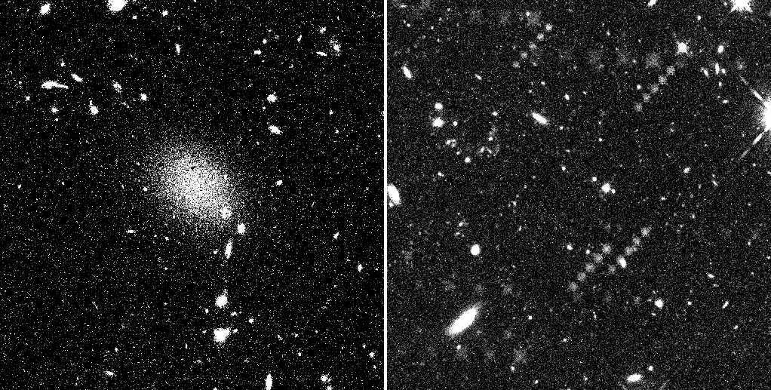
Persistence, the problem
Persistence occurs in IR detectors whenever a pixel is exposed to light.
Persistence can show up within the next exposure, or in an exposure hours later.
The level of persistence not only depends on the accumulated charge, but the amount of time the charge sat on the detector and time since last exposure.
Current best method to mitigate this effect is to simply wait for the persistence to decay.
Persistence affects scheduling, data reduction, and science. It is a significant problem for the HST and JWST missions.
Images courtesy of STScI/WFC3 Team
Notes:
It is not like we will have a multi-million dollar telescope flying above our heads doing nothing and making nobody happy, they will switch to another instrument during while waiting for persistence to decay, but it does complicates and limits scheduling options. You basically just wait for the problem to go away.

Slide 3
Persistence, the problem
Persistence occurs in IR detectors whenever a pixel is exposed to light.
Persistence can show up within the next exposure, or in an exposure hours later.
The level of persistence not only depends on the accumulated charge, but the amount of time the charge sat on the detector and time since last exposure.
Current best method to mitigate this effect is to simply wait for the persistence to decay.
Persistence affects scheduling, data reduction, and science. It is a significant problem for the HST and JWST missions.
Five back to back exposures
A single exposure of a bright galaxy two hours earlier
Images courtesy of STScI/WFC3 Team
Notes:
Top image: Image of gamma ray burst GRB090423, however you can see the dither pattern of a bright field that had been taken prior. That’s persistence.
Bottom image: Bright diffuse region is a persistence after-image. It is of the Sb galaxy NGC 2841 that had been observed 2 hours earlier.

Slide 4
A theory behind persistence, illumination
hours later, steady-state
start of exposure
flash of light
reset
-
-
-
-
-
-
-
-
-
-
-
-
-
-
-
-
-
-
-
-
-
-
-
-
-
-
Depletion Region
+
+
+
+
+
+
+
+
+
+
+
+
+
+
+
+
+
+
+
+
+
+
+
+
+
+
Empty hole trap
Empty electron trap
+
Filled hole trap
-
Filled electron trap
Figured modified from Smith et al. 2008
Notes:
Wait hours so all traps are empty or all are full
Different from Smith model because he doesn’t mention trap capture, otherwise it is the same.
Can create 1 to 2 by using a flash of illumination, then to 3 if you wait a long time not resetting, and then reset.

Slide 5
A theory behind persistence, Δ bias
steady-state starting point
hours later, steady-state
decrease net bias
increase net bias
-
-
-
-
-
-
-
-
-
-
-
-
-
-
-
-
-
-
-
-
-
-
-
-
-
-
Depletion Region
+
+
+
+
+
+
+
+
+
+
+
+
+
+
+
+
+
+
+
+
+
+
+
+
+
+
Empty hole trap
Empty electron trap
+
Filled hole trap
-
Filled electron trap
Figured modified from Smith et al. 2008
Notes:
The nice thing about this is that you can control precise step size, and where depletion region is.
We decrease DSUB and increase DSUB, to show both negative and positive persistence

Slide 6
Rational and objectives
Rational:
Why create persistence by changing the bias vs. using illumination:
  Can measure traps in a specific slice of depletion region.
  Can change net bias and let it sit at that level until we reach a steady-state (filling or emptying traps).
  Can make precise incremental changes in depletion region.
  Can create positive AND negative persistence (Regan et al. 2012).
Objectives:
Gather information to understand capture and release enough to model it.
Determine geometry of trap density (3D trap map)
  It is easy to assume uniform trap density, but the real geometry is not as simple as diagram (hemispheres, etc.)
  Might also be able to assume that all empty traps are sitting at the edges / surfaces.
Notes:
We have hemispheres, surfaces, changes in material, doping material, ..so can imagine changes in trap density, that it wouldn’t be constant.
An example of non-uniform trap density can be found in the Hubble Space Telescope’s Wide Field Camera 3 (WFC3) data, where below about half saturation (~40,000 e⁻ for WFC3) there is a very limited amount of persistence, but persistence grows rapidly above this point (Long et al. 2012)

Slide 7
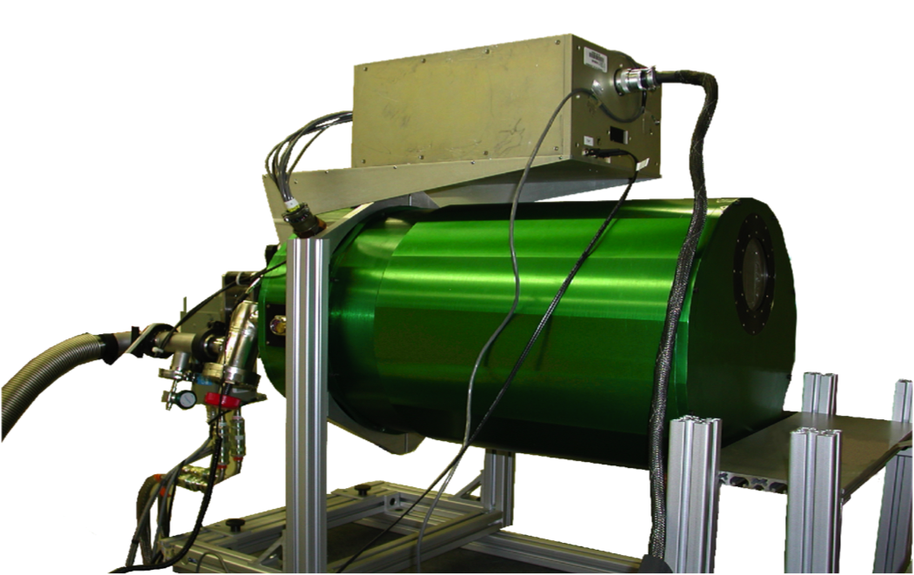
Experiment design
Data taken at the Operations Detector Laboratory at STScI with an engineering grade H2RG detector.
Vreset held constant at 85mV
Dsub stepped from 350mV to 0mV then back to 350mV in steps of 10mV.
Procedure at each step:
  Change Dsub
  Take six hours of darks to measure release / capture of traps
  Take final dark to measure darkcurrent and show that it is in a stable steady-state.
Notes:
DSUB is detector substrate voltage

Slide 8
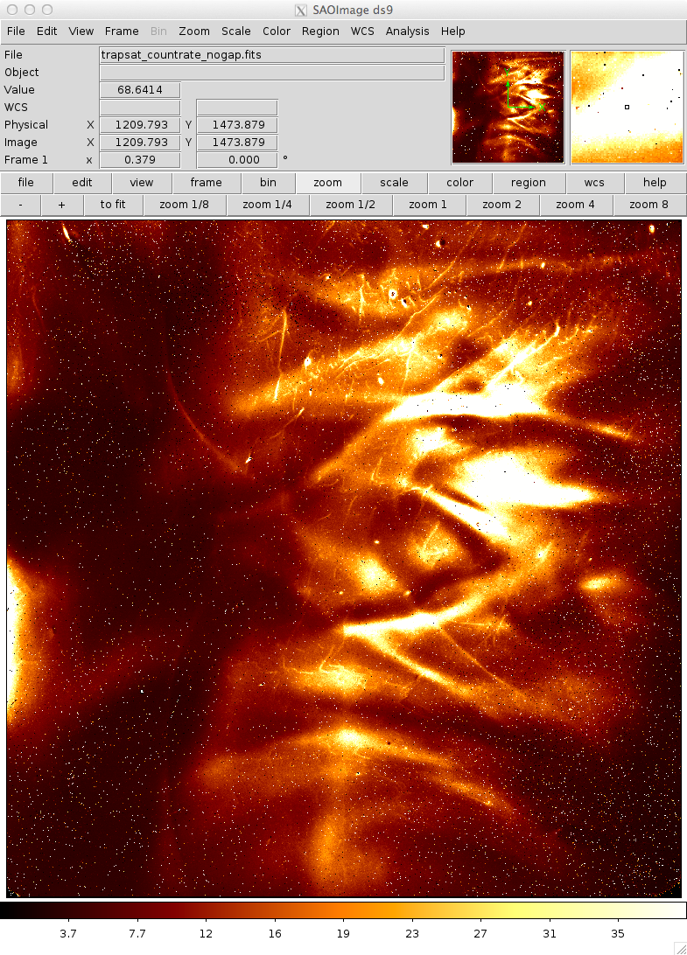
Data reduction
Applied reference pixel correction
Dark subtracted the first dark after changing the Dsub
  Shows change in traps per ±10mV change in bias level
Pixels were divided into 18 bins based on 2D trap density map of the detector (right)
2D trap density map of H2RG detector. Brighter regions have more traps. The trap density per pixel varies by more than a factor of 20 across the array.
Notes:
Engineering grade detector from 2005.
This is a high signal to noise dark that Eddie Bergeron took after saturating the detector. We use it as a 2D trap density map of our detector.
Low persistence regions (dark) are similar to JWST persistence levels. Science grade detectors don’t have these hightest persistence pixels, but it works for us because it enables us to explore a larger variance in trap density.

Slide 9
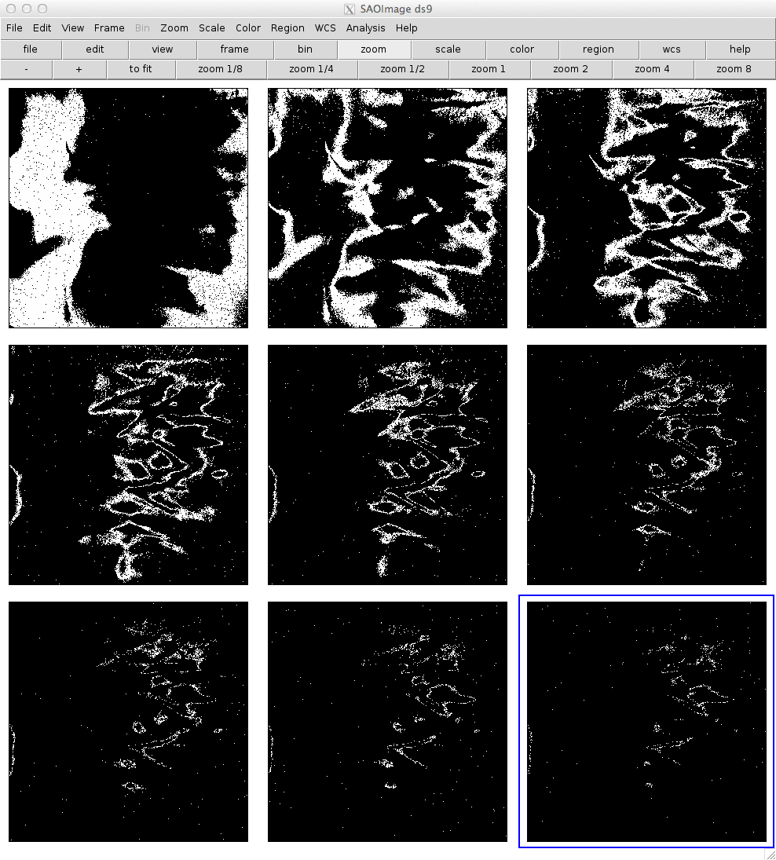
Bins
Bins 1 – 9 out of 18, bin 1 having the lowest density of traps
2D trap density map
Notes:
Location of pixels in bins 1-9...

Slide 10
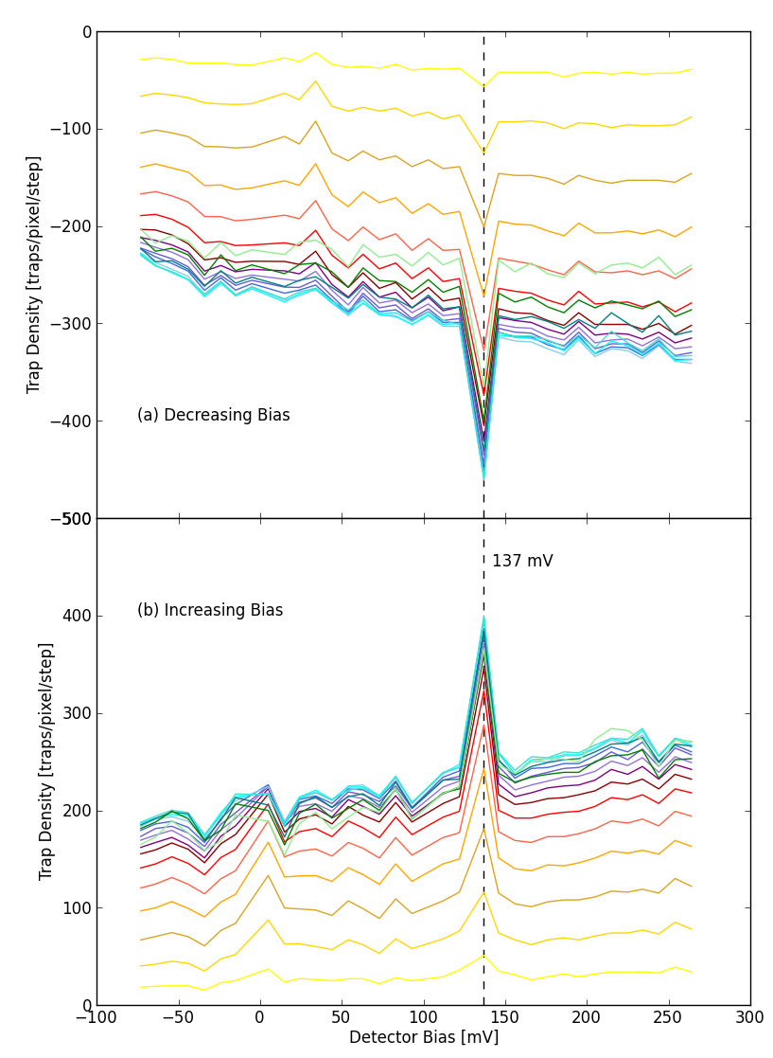
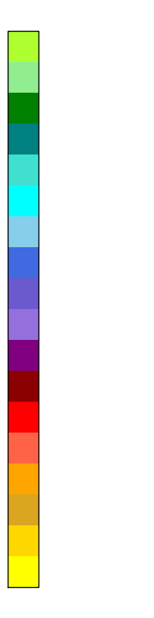
Results
high
There is positive and negative persistence.
We see small linear change in trap density as we step through full well.
There is little structure, except at 137 mV.
Trap density decreases as we approach saturation.
Each point is an average of at least 10,000 samples (more than 1,300,000 for low persistence regions), therefore we are seeing real structure in the trap density.
trap density bin
low
Notes:
Y-axis is the dark subtracted first dark after changing DSUB
Data is normalized by subtracting the lowest bin.

Slide 11
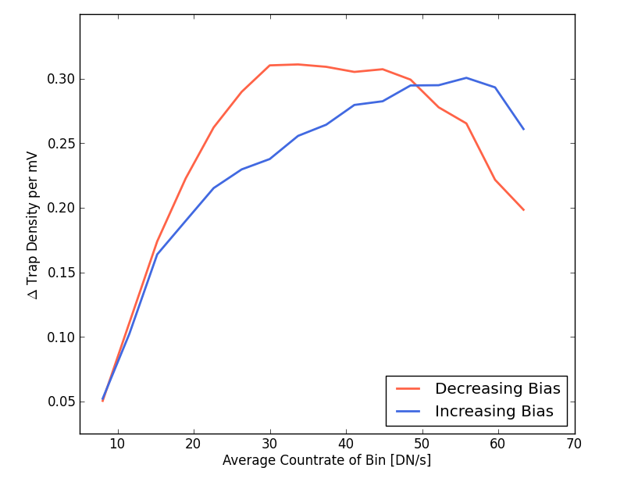
Results (cont.)
Increasing bias has shallower change in trap density per change in mV.
Higher bins are less understood (and are not seen in science grade detectors).
Notes:
Ignore highest bins: this trap density is unusual, flight detectors don’t have these, and you end up in the regime where you even have short time-scale traps.

Slide 12
Conclusions
Traps are seen throughout the depletion region, but decrease in density as we approach saturation.
Understanding of trap density should help us model persistence.
Results show linear (with some structure) relationship between persistence and the depletion region.
Increasing the bias increases the depletion region, increasing persistence. Therefore, there is a price to pay.
  This is being looked into for NIRSpec
Notes:
We do not have much structure, even on our ugly detector. Hopefully for most detectors we could assume constant density.
Can we model one detector, you’ve modeled them all? Will have to do a few more to show this, but short answer: No. Think of WFC3 persistence where below about half saturation (~40,000 e⁻ for WFC3) there is a very limited amount of persistence, but persistence grows rapidly above this point (long et al. 2012)

Slide 13
References
K. S. Long, S. M. Baggett, J. W. MacKenty, A. G.. Riess, “Characterizing Persistence in the IR detector within the Wide Field Camera 3 Instrument on Hubble Space Telescope”, Proceedings of the SPIE, Vol. 8442, 2012.
M. Regan, E. Bergeron, K. Lindsay, R. Anderson, “Count rate nonlinearity in near infrared detectors: inverse persistence”, Proceedings of the SPIE, Vol. 8442, 2012
R. M. Smith, M. Zavodny, G. Rahmer, M. Bonati, “A theory for image persistence in HgCdTe photodiodes”, Proceedings of the SPIE, Vol. 7021, 2008.

Slide 14
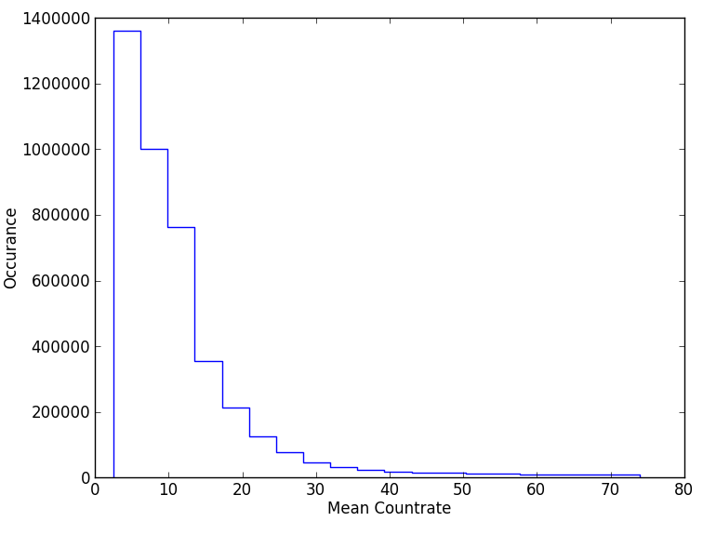
Bin Populations
Minimum population in one bin is 10,000 pixels.
Minimum bin width is
3.675 DN / s.

