Slide 1





Optical AO WFS Detector Developments at ESO
Mark Downing, Johann Kolb, Norbert Hubin, Javier Reyes, Manfred Meyer
European Southern Observatory ESO (http://www.eso.org)
Martin Fryer, Paul Jorden, Andrew Payne, Andrew Pike, Rob Simpson, Paul Jerram, Jerome Pratlong
e2v technologies ltd (http://www.e2v.com)
Bart Dierickx, Arnaud Defernez, Benoit Dupont
Caeleste, Antwerp, Belgium (http://www.caeleste.be)
Jorge Romero
University of Málaga (http://www.uma.es)
Philippe Feautrier, Eric Stadler
Institut de Planétologie et d’Astrophysique de Grenoble (http:// http://ipag.osug.fr/)
Jean-Luc Gach, Philippe Balard, Christian Guillaume
Laboratoire d'Astrophysique de Marseille LAM (http://www.lam.oamp.fr)

Slide 2
Outline
L3Vision CCD220 – developed by e2v on behalf of ESO/OPTICON
  Deployment of AONGC Cameras on VLT AO instruments
  Test Result Summary
    Trades made with Deep Depletion CCD220
    Improvements of the HV Clock Design
    SCTE
Next challenge → LGSD/NGSD
  Large CMOS Visible AO WFS Imager for the ELT to sample the spot elongation of Laser Guide Stars
  Specifications
  Wavefront Sensor Architecture and Design
  First results

Slide 3
e2v L3Vision CCD220
Metal Buttressed
2Φ 10 Mhz Clocks
for fast image to store transfer rates.
Store slanted
to allow room for multiple outputs.
8 L3Vision Gain Registers/Outputs
Each 15Mpix./s.
OP 4
Gain
Registers
Gain
Registers
OP 8
Image Area
240x120
24□µm
Image Area
240x120
24□µm
OP 3
Store
Area
Store
Area
OP 7
OP 2
Gain
Registers
Gain
Registers
OP 6
OP 1
OP 5
e2v CCD220:
    240x240 24 µm pixels
    Split frame transfer CCD
    8 L3Vision EMCCD outputs
    < 0.1 e- RoN at 1,500 fps
    Integral Peltier for cooling to -50ºC

Slide 4
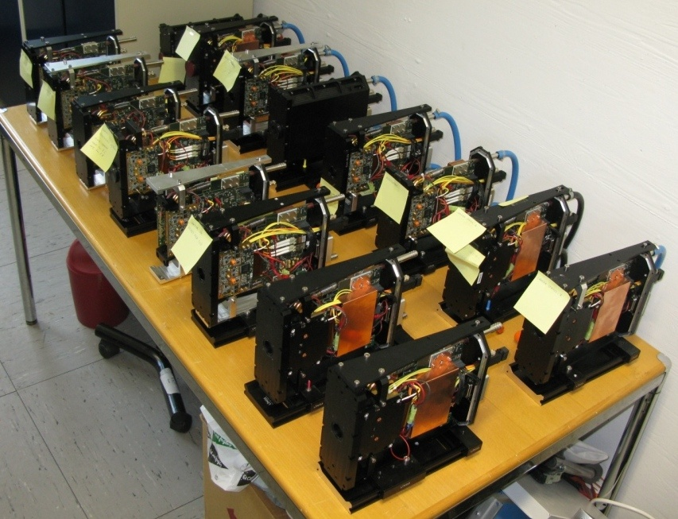
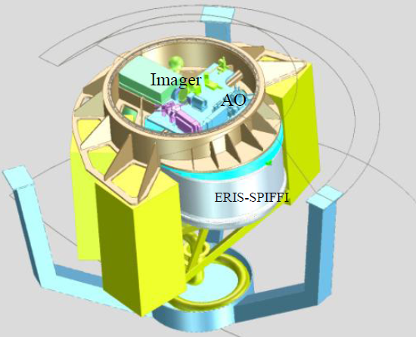
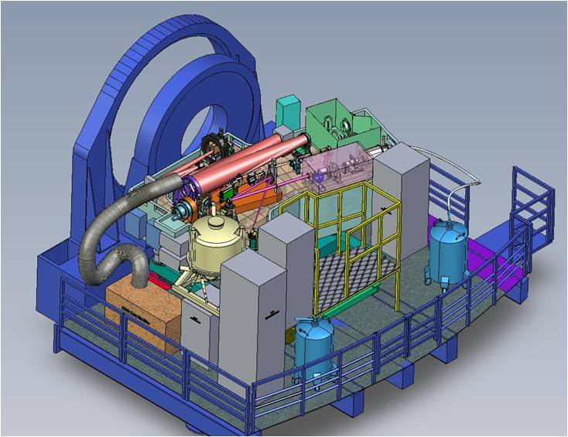
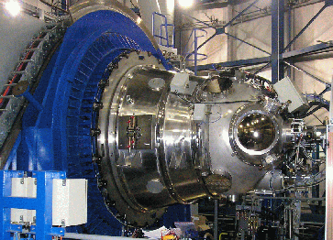
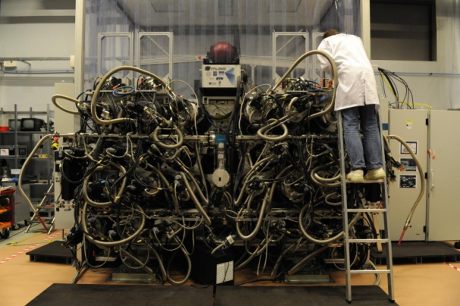
Deployment of AONGC WFS Cameras
ERIS
HAWKI
MUSE
SPHERE

Slide 5
CCD220 Impressive
(Measured) Test Results
Requirement | Measured | Specification
Frame Rate: | > 1,500 fps | >1,200 fps
Read noise at gain of 300 | < 0.2 e- | < 1.0 e-
Image Area Full Well: | > 160 ke- | > 5,000 e-
Cosmetics: # of traps, bright/dark defects | 0 | < 25
Dark Current: 1200fps & -40ºC 100fps & -50ºC | < 0.02 e-/pix/frame < 0.05 e-/pix/frame | < 0.04 e-/pix/frame
Key goal specs are met
Deep Depletion (highly sought after for better red response) is working as good as the standard silicon devices.
Next Steps:
Increase frame rate to 2,500 fps to extend use to E-ELT XAO (Extreme AO).
Test shuttered device CCD219 for pulsed laser guide star applications.

Slide 6
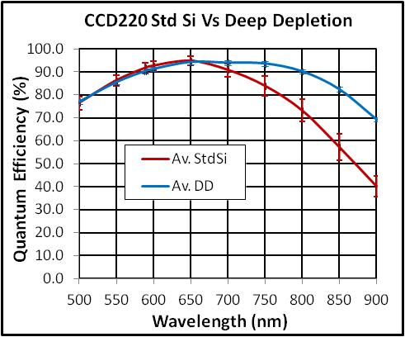
Trades made with Deep Depletion Device
Deep Depletion enabled devices to be built out of thicker silicon (40µm) for better red response;
  Highly sought after for applications using Natural Guide Stars.
  75% improvement

Slide 7
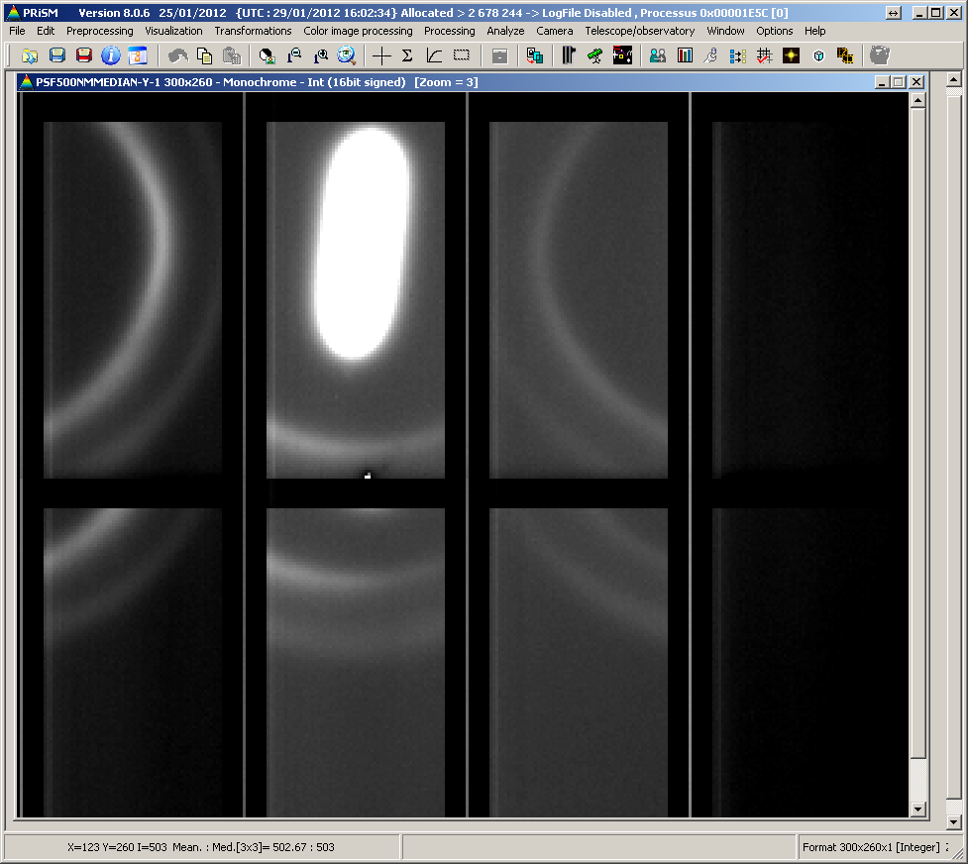
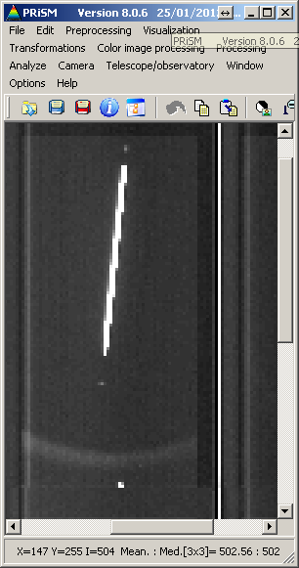
Trades made with Deep Depletion Device
Deep Depletion enabled devices to be built out of thicker silicon (40µm) for better red response;
  Highly sought after for applications using Natural Guide Stars.
During charge integration if the image area is simply run into inversion for lowest dark current like the Std Si device then obtain very poor PSF.
  Has an additional “p” well implant for EMCCD to work.
  A minimum bias is required to “punch-through” (depletion to extend beyond) this “p” well.
Deep Depletion
Std Si

Slide 8
Trades made with Deep Depletion Device
Deep Depletion enabled devices to be built out of thicker silicon (40µm) for better red response;
  Highly sought after for applications using Natural Guide Stars.
During charge integration if the image area is simply run into inversion for lowest dark current like the Std Si device then obtain very poor PSF.
Solution is to use Tri-Level clocking to obtain the best trade between PSF and Dark Current.
  Low Level that takes the device into inversion for low dark current.
  High Level just right for good frame transfer and low Clock Induced Charge.
  Very High Level for integrating charge to tune the PSF.
Integration
Frame Transfer
Image Area Clock
Very High Level
-0.5V
High Level
-8V
Low Level

Slide 9
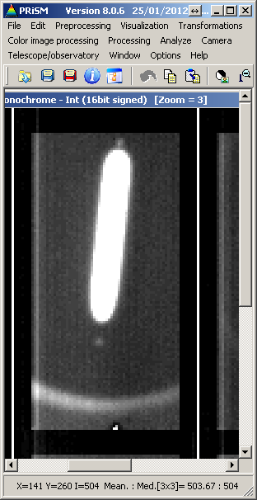
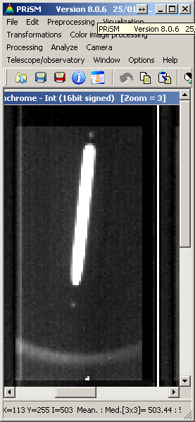
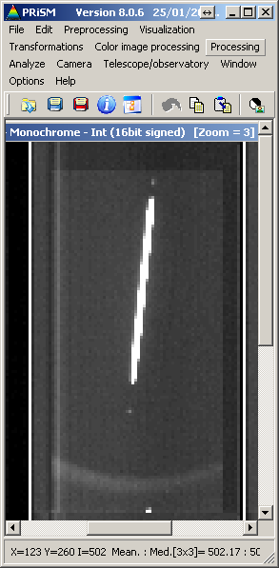
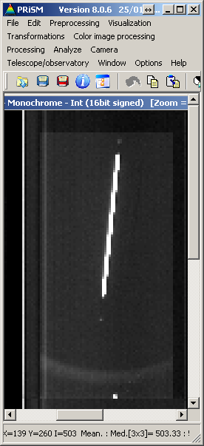

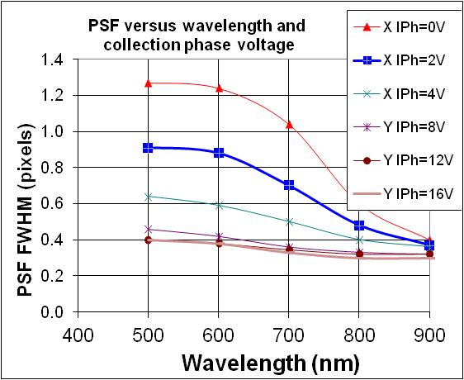
Adjust Very High Level to Tune PSF
VInteg=-8V
VInteg=-4V
VInteg=0V
VInteg=4V
VInteg=8V
VInteg=12V
Min met at > 2V.
Goal met at > 8V.
Min.
Goal
Min.
Goal

Slide 10
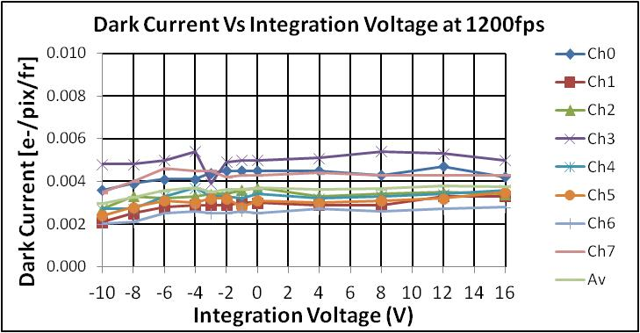
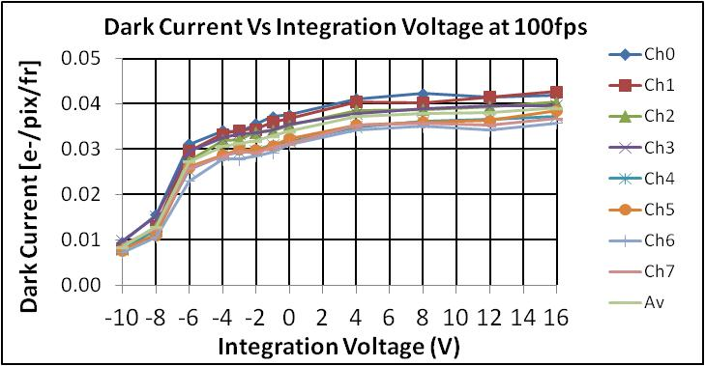

and trade with CIC and Dark Current
1200fps
100fps
As expected CIC does not increase with integration voltage.
Once out of inversion, dark current does not increase further with integration voltage.
  thanks to “Intrinsic dithering” – uses the fact that after inversion holes that have migrated into Si/SiO₂ I/F have long release time constant.
Goal Dark Current and PSF specs are met at 8V.

Slide 11
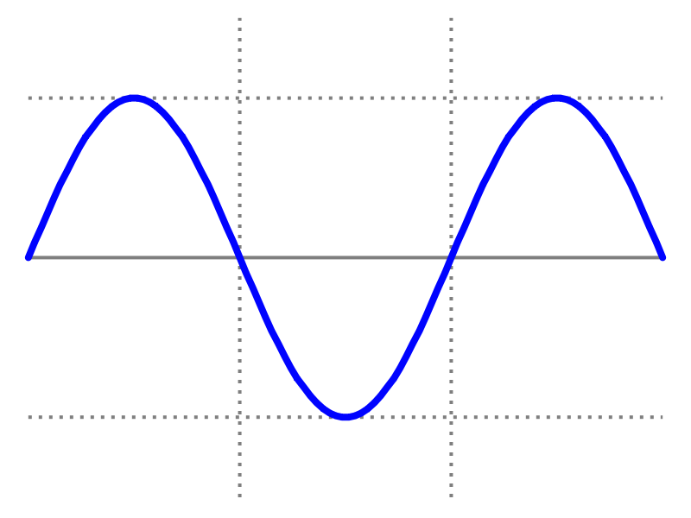
Improvement to Design of HV Clock
Peak Detector
20-50V
Peak Detector
~ 0V
ON
OFF
T_{pixel}
Design → LC resonant circuit
  switch, transformer, and capacitor (includes that of the CCD phases);
  tune to resonate at pixel (switch) frequency;
  simple, low power dissipation.
First implementation:
  levels stabilized by simply correction for the integrated difference between peak and reference level.
  Problem is that it does not respond quickly to transients/disturbances.
Both measurements and simulations prove that the resonance circuit is very sensitive to any changes in the load. The load (the CCD) changes during read out due to changes in clock (inter) capacitances.

Slide 12
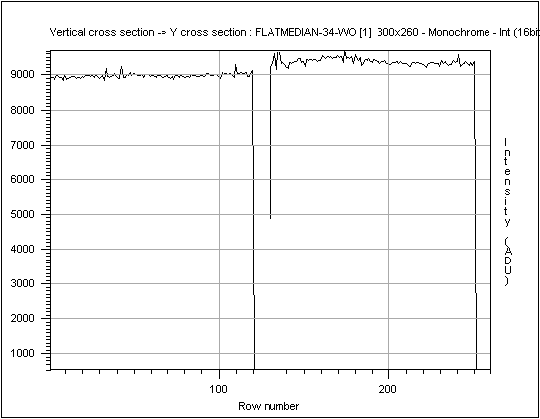
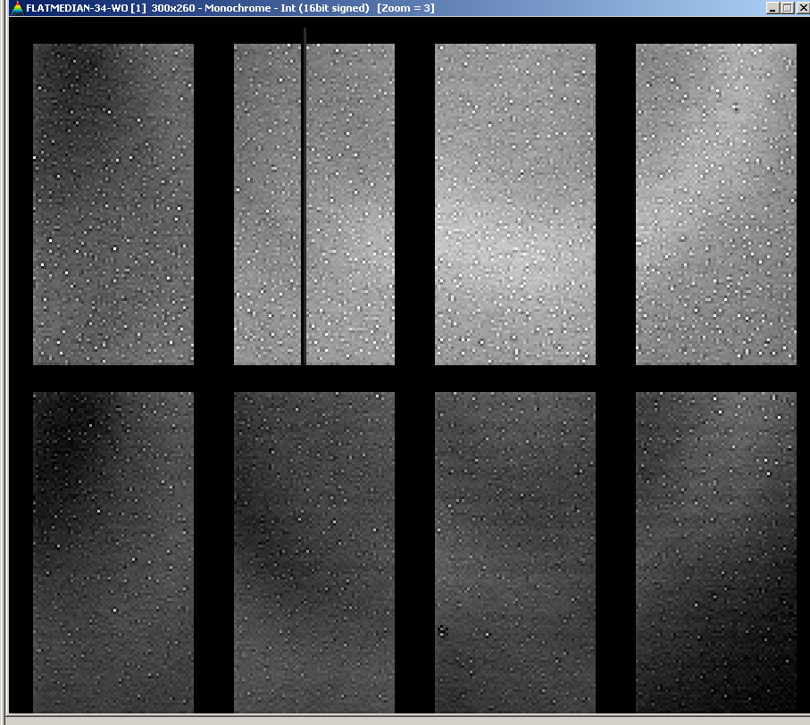
At Unity Gain: Flat field is very flat

Slide 13
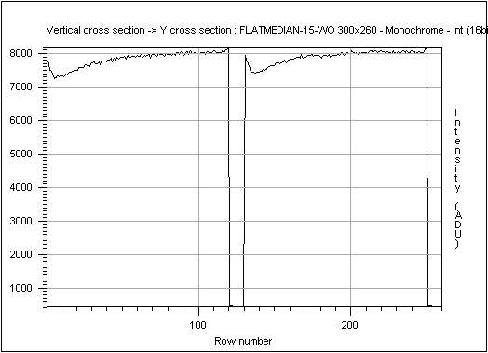
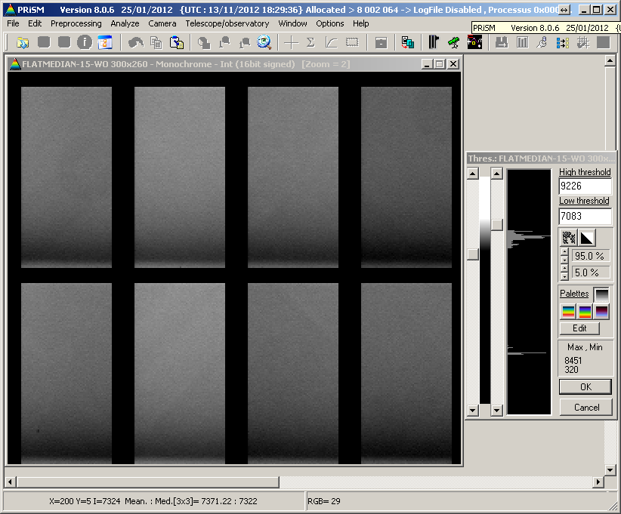
However at gain, flat field varies with readout
  Oscilloscope shows the amplitude of the HV Clock varies during a frame read out and variation is proportional to illumination level.

Slide 14
Solution is to use full PID controller in the feedback loop
Peak Detector
PID
Peak Detector
PID
A properly designed PID controller should respond quickest to disturbances.

Slide 15


Original design with step input

Slide 16
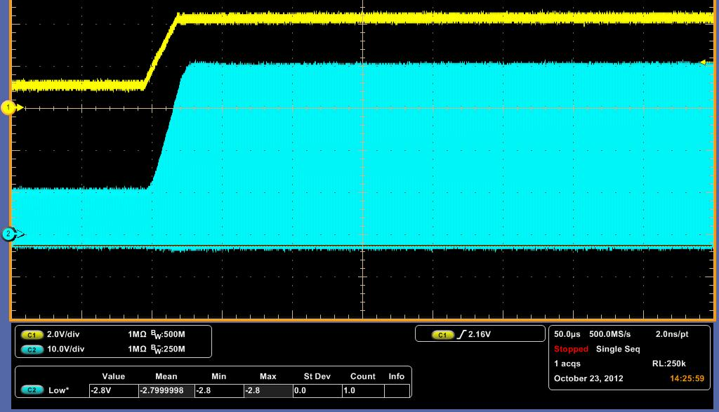
Optimised design with step input

Slide 17
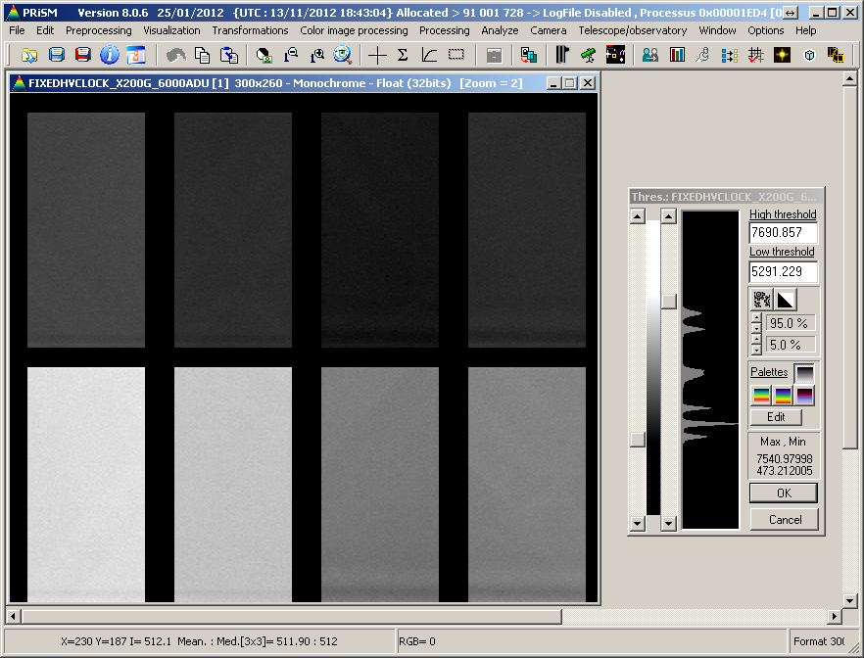
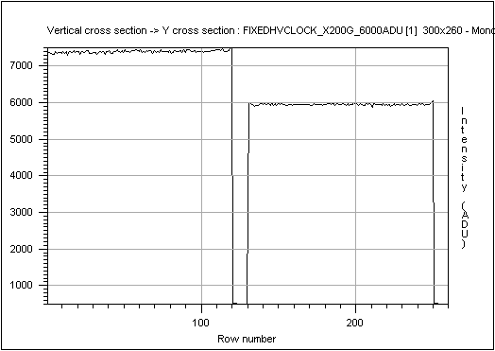
“Proof of the Pudding”
Before
Afterwards

Slide 18
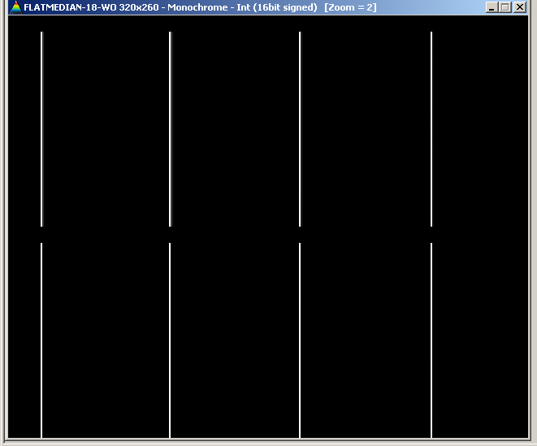
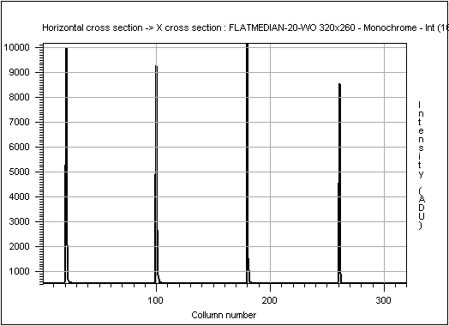
SCTE - Long Tail of Residual Charge
Store section
By reverse clocking the serial register able to get all charge in a single pixel
60 register elements
520 gain elements
Outputs

Slide 19
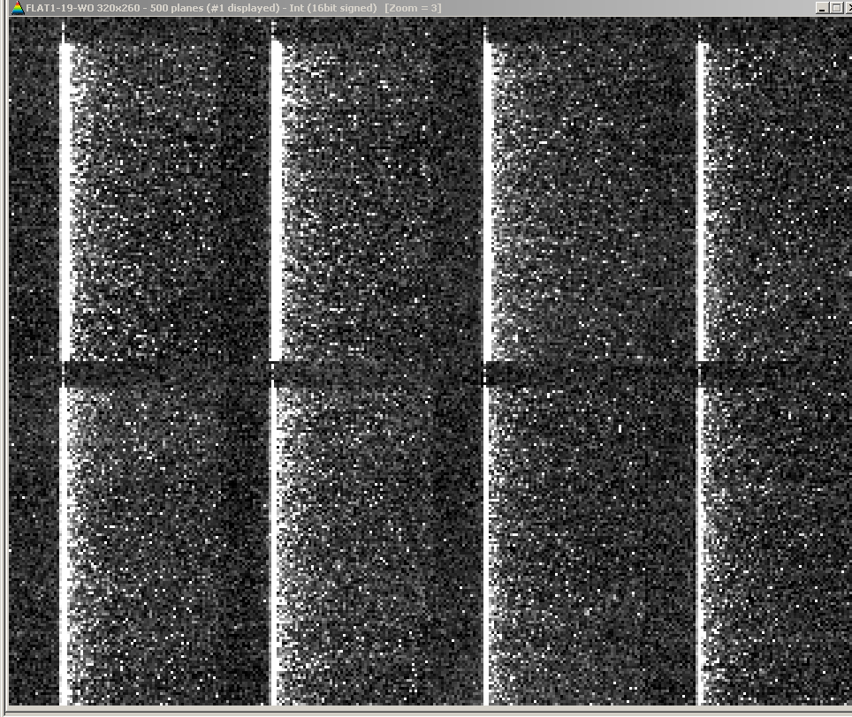
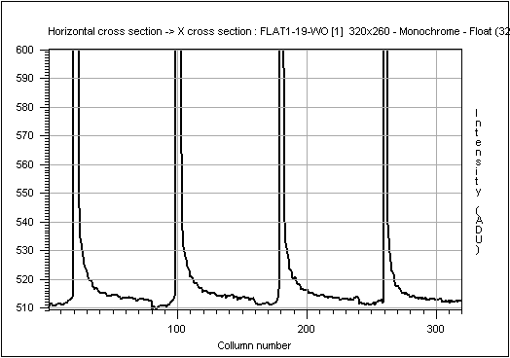
SCTE - Long Tail of Residual Charge
Lower range expanded
SCTE gets worse with higher gain and signal thus need to operate at lowest gain for the application.
To keep gain low, need to optimize for low read out noise at unity gain.
L3Vision has long tail of residual charge
Gain x 400
VROL=-5V

Slide 20
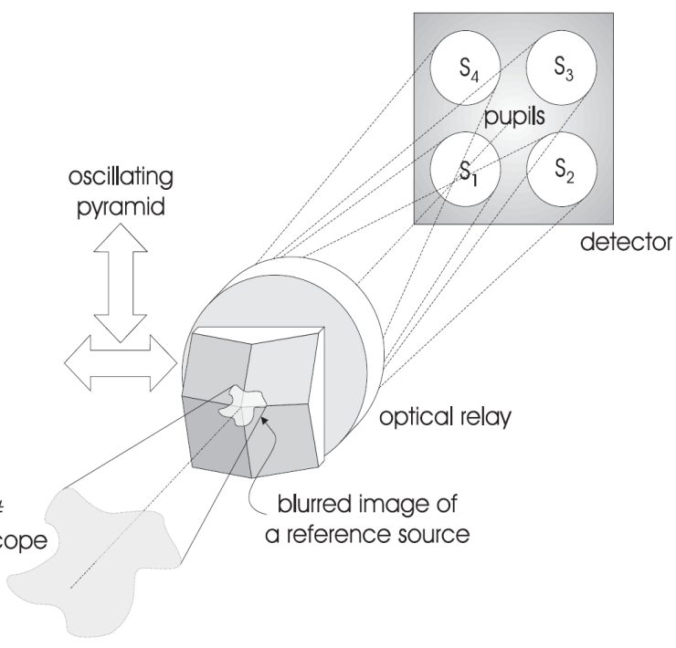
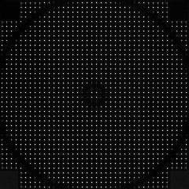
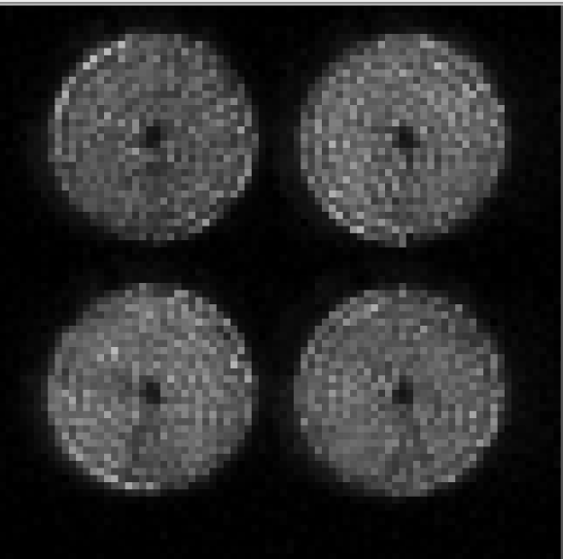
The need for good SCTE
With Shack Hartmann WFS, if SCTE does not vary much with signal then it is simply an offset in the centroid that can be subtracted.
However, with pyramid WFS, SCTE appears as cross-talk into neighboring sub-apertures → spec. is < 1%.
Sub-aperture

Slide 21
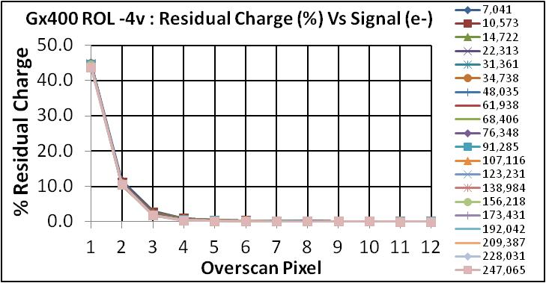
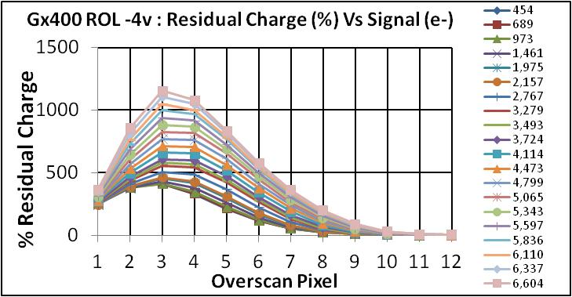
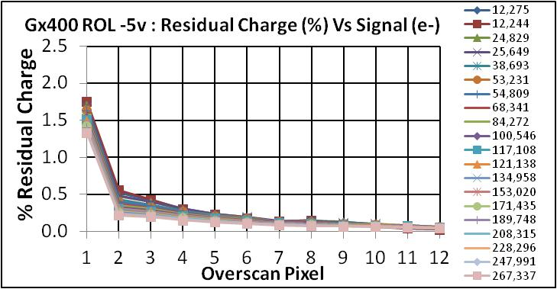
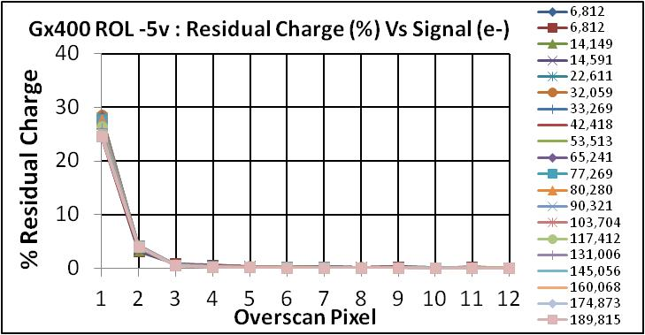
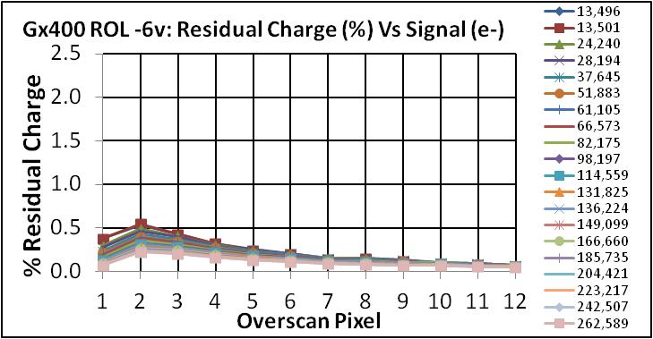
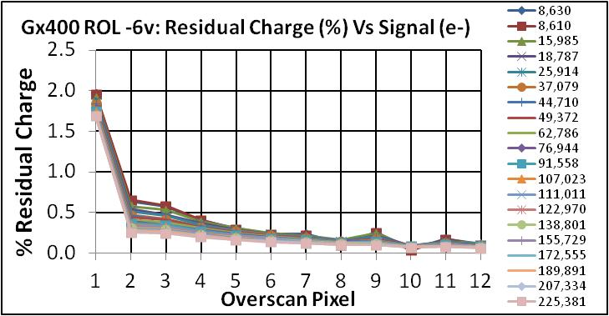
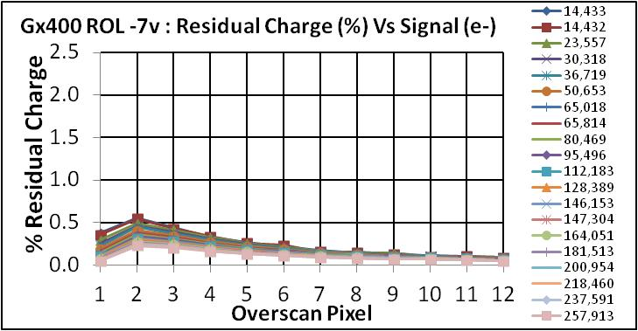
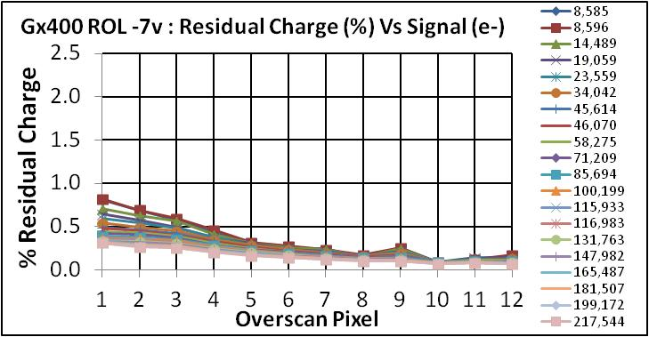
Gain 400; SCTE Vs Serial Clock Low Level
Best Amp
Amp 0
Least Best Amp
Amp 5
SCTE < 1% is only met when VROL = -7V; i.e. when serial register is clocked into inversion.
Fortunately, Clock Induced Charge does not increase significantly.
Tells us something about where the charge is being trapped – Si-SiO2 I/F
Strategy Followed:
Set up output amplifier biasing and serial register to maximize CIC and dark current as this guarantees that all charge is being detected.
VROL=-4V
VROL=-5V
VROL=-6V
VROL=-7V

Slide 22
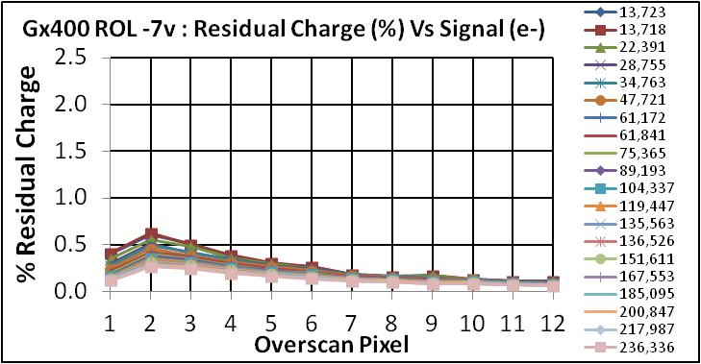
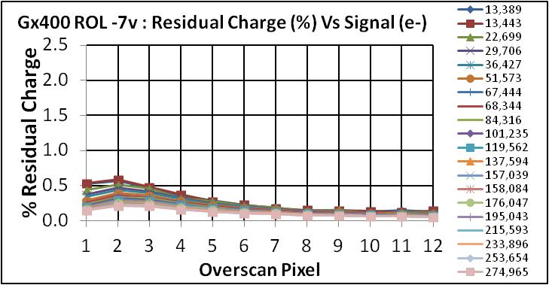
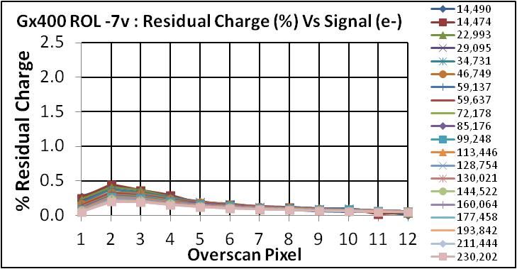
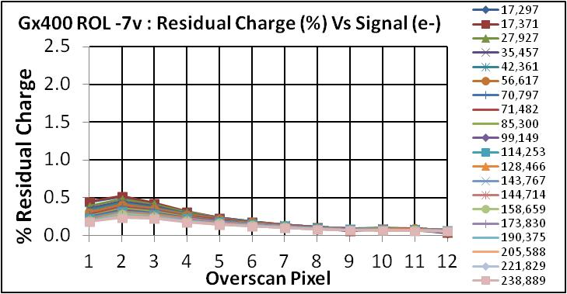
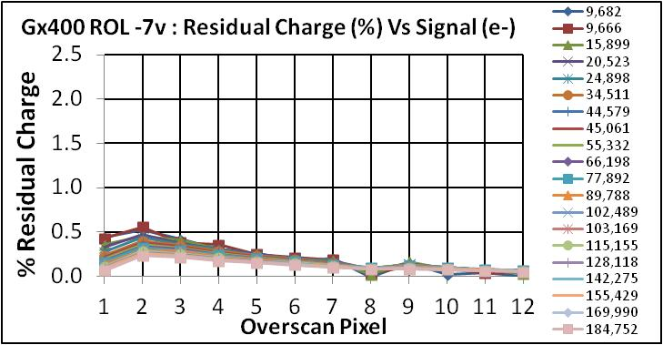
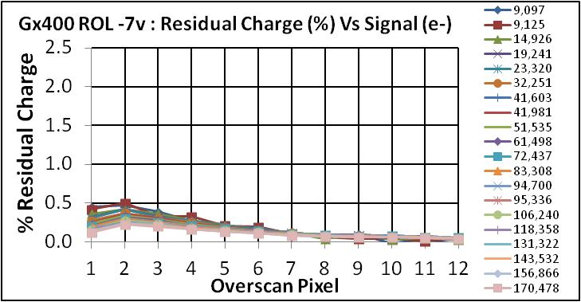
Gain 400: SCTE < 1% for all amplifiers with VROL=-7V
Amp 0
Amp 4
Amp 1
Amp 5
Amp 2
Amp 6
Amp 3
Amp 7

Slide 23
Outline
L3Vision CCD220 – developed by e2v on behalf of ESO/OPTICON
  Deployment of AONGC Cameras on VLT AO instruments
  Test Result Summary
    Trades made with Deep Depletion CCD220
    Improvements of the HV Clock Design
    SCTE
Next challenge → LGSD/NGSD
  Large CMOS Visible AO WFS for the ELT to sample the spot elongation of Laser Guide Stars
  Specifications
  Wavefront Sensor Architecture and Design
  First results

Slide 24

Block Diagram of Full Size Device; LGSD
44 LVDS Serial Links
Highly integrated
  All analog processing on-chip:
    correlated double sampling (CDS),
    programmable gain of x1/2/4/8 on the fly,
    9/10 bit single slope ADCs,
    total effective 12 bit data conversion
  20 top + 20 bottom rows processed in parallel to slow the read out per pixel (34µs) and beat down the noise.
  Fast LVDS serial interface to outside world
    simple digital interface;
    power consumption similar to high speed drivers to transport analog signals off-chip;
    better guarantee of achieving and maintaining low noise performance.
Multiplexer/serializer
Control
Logic
Control
Logic
20 x1760 single slope ADCs
Pre-amp & Gain of x1/2/4/8
1760x1680
pixels
Y-addressing
Y-addressing
84x84 Sub-apertures
each 20x20 pixels
Pre-Amp & Gain of x1/2/4/8
Control
Logic
Control
Logic
20x1760 single slope ADCs
Multiplexer/serializer
Natural Guide Star Detector (NGSD)
  pioneering scaled down demonstrator
  ~ ¼ of full size → non-stitched
44 LVDS Serial Links

Slide 25
Specifications of the LGSD (NGSD)
Physical characteristics
Pixel array (Refn pixels - 40 columns) | 1760x1680 (880x840 pixels in NGSD) - 5x6cm requiring stitched design (>> max. reticle 25.5x32.5mm)
Technology | Thinned backside illuminated CMOS 0.18µm – TowerJazz APD3; 6 metal layers
Silicon | High resistivity 1000 ohm-cm → targeting thickness of 12µm
Pixel pitch | 24µm
Pixel topology | 4T pinned photodiode pixel with low noise threshold transistors; slit wafer run more speculative ultra low threshold → 1e- goal
Array architecture | 84x84 time coherent “sub arrays” of 20x20 (8x8 NGSD) pixels - LGSD image area size of 4x4cm
Shutter | Rolling shutter in chunks of 20 rows → synchronous temporal detection within a sub-aperture.

Slide 26
Specifications of the LGSD (NGSD)
Read out
Number of rows read in parallel | 40 (20 in NGSD) rows in parallel
Number of ADC’s | 40x1760 (20x880 in NGSD) at 9/10 bits
Number of parallel LVDS channels | 88 (22 in NGSD)
Serial LVDS channel bit rate | 210 Mb/s baseline, up to 420 Mb/s (desired)
Frame rate | 700 fps up to 1000 fps with degraded performance 2 to 3 Gpixel/s = 20 to 30 Gb/s over 88 parallel LVDS channels
Power dissipation | < 5W , (NGSD 0.5W) including the 88 LVDS drivers
Actual LVDS driver dissipation per channel | 6.0mW at maximum data rate; 4.5 mW in sub-LVDS

Slide 27
Specifications of the LGSD/NGSD
Performance
Pixel full well Q_{FW} | > 4000 e-
Linearity to full well | < 5%
Read noise including ADC | < 3.0 e⁻_{RMS}
Image lag | < 2 %
Dark Current | < 0.5 e-/pixel/frame
QE | > 90% at 589nm; optimized for the red → BackSide Illumination (BSI)
Point Spread Function | < 0.8 pixel FWHM
Cosmetics | < 0.1% bad pixels
Already verified in Technology Demonstrator

Slide 28
Video Chain – single slope ADC
VRST
VSF
Double Register
110MHz DDR
Column
bus
Gray Code
9/10
Sync
reset
1
A
B
4T pixel
2
select
Pre-Amp
Parallel to Serial
3
Comparator
D
Q
D
Q
transfer
+
+
4
-
Clk
Clk
-
p⁺
n⁺
x1
x2
x4
x8
p-Si
Copy
Ramp
LVDS Out
PPD
SN
reset
transfer
signal
Single slope ADC chosen for robustness, excellent low noise and linearity (DNL).
Good compromise between speed, precision, power consumption, and area occupied
reset
video
ramp
Latch code
offset
comparator output
Gray code
0
512

Slide 29
LGSD Tentative Stitching Plan
10.56mm
10.56mm
10.56mm
10.56mm
5.28mm
10.56mm
Corner
11 LVDS
&
8800 column ADCs
11 LVDS &
8800 column ADCs
11 LVDS &
8800 column ADCs
11 LVDS &
8800 column ADCs
Corner
Yaddressing
Yaddressing
22x42
sub- apertures
20.16mm
Yaddressing
22x42
sub- apertures
22x42
sub- apertures
22x42
sub- apertures
22x42
sub- apertures
Yaddressing
20.16mm
Corner
Corner
11 LVDS
&
8800 column ADCs
Yaddressing
22x42
sub- apertures
22x42
sub- apertures
22x42
sub- apertures
22x42
sub- apertures
Yaddressing
10.08mm
20.16mm
Corner
Corner
8800 column ADCs
&
11 LVDS
Corner
8800 column ADCs
&
11 LVDS
8800 column ADCs
&
11 LVDS
8800 column ADCs
&
11 LVDS
8800 column ADCs
&
11 LVDS
Corner
Reticle View

Slide 30
NGSD anticipates scaling to LGSD
10.56mm
10.56mm
10.56mm
10.56mm
5.28mm
10.56mm
Corner
11 LVDS
&
8800 column ADCs
11 LVDS &
8800 column ADCs
11 LVDS &
8800 column ADCs
11 LVDS &
8800 column ADCs
Corner
Yaddressing
Yaddressing
22x42
sub-apertures
20.16mm
Yaddressing
22x42
sub-apertures
22x42
sub-apertures
22x42
sub-apertures
22x42
sub-apertures
Yaddressing
20.16mm
Corner
Corner
11 LVDS
&
8800 column ADCs
Yaddressing
22x42
sub-apertures
22x42
sub-apertures
22x42
sub-apertures
22x42
sub-apertures
Yaddressing
10.08mm
20.16mm
Corner
Corner
8800 column ADCs
&
11 LVDS
Corner
8800 column ADCs
&
11 LVDS
8800 column ADCs
&
11 LVDS
8800 column ADCs
&
11 LVDS
8800 column ADCs
&
11 LVDS
Corner
Reticle View

Slide 31
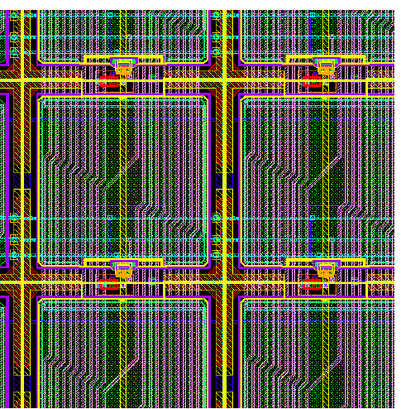
Read out
88x42 Sub-Apertures
North Half-Array
Center line
Random address Control
88x42 Sub-Apertures
South Half-Array
Random address Control
20x20 pixels per SA
4T 24um pixel
20 sets of row select lines per SA
Sub- aperture row addresses
(1 of 42)
Sub- aperture row addresses
(1 of 42)
reset, select & transfer
20 lines per column of pixel
Gain
20 rows of column bias & pre-amp with gain of x1/2/4/8 settable SA by SA
ADC Ramp
20 rows of comparators (35,200)
Timing, clocks and biases
ADC Gray Code BUS
20 rows of Registers A
D
Q
D
20 rows of Registers B
Copy
Q
LRC40 Checksum Calculator
110MHz Clock DDR
Parallel to serial
LVDS Outputs
Sync

Slide 32
Summary
CCD220:
Both Std Si and Deep Depletion variants of the CCD220 are working extremely well, production run of cameras is nearing completion, and our instrument project managers are now very happy.
LGSD/NGSD:
ESO has formed a good partnership with e2v and Caeleste.
The design of the NGSD is complete and in fabrication.
Extensive simulations have confirmed correct operation and performance.
Devices will be available in the coming months for testing

Slide 33
Thank You
This work has been "partially funded by the OPTICON-JRA2 project of the European Commission FP6 and FP7 program, under Grant Agreement number 226604"

Slide 34
TVP – optimises pixel deisgn
Optimize the pixel design to find best trade between image lag, linearity, gain, and noise (white and 1/f) by testing:
pixel variants with different transfer gate and transistor geometries;
different threshold voltages of the nmos transistors;
extra implants to improve image lag.
VRST
VSF
reset
1
select
2
3
transfer
4
Column
bus
p⁺
n⁺
p-Si
Pinned photodiode
p+ implant
p implant
transfer gate
reset
select

