Slide 1


Recent NanoPhotonic ⁽¹⁾ advances for Spectral domain optical coherence tomography (SD-OCT) as a potential
Non-destructive imaging technique for Gemstones, specifically Pearls. ⁽²⁾
Nick DelRe⁽²⁾ , Annette Widemann ⁽²⁾ , and Marina Epelboym ⁽²⁾ ⁽²⁾ EGL-USA, New York, ⁽²⁾ Gemology Headquarters International (GHi).
⁽¹⁾ A. Nitkowski, K. Preston, N. Sherwood-Droz, A. Berkeley, B. Behr, B. S. Schmidt, and A. Hajian, "Nanophotonic Spectrometer for Optical Coherence Tomography. /TornadoSpectralSystems
Acknowledgements: Photo’s & X-radiographs by EGL USA/GHI International
(photos by Fernando Paredes ). Nine (9)Slides courtesy of Tornado Spectral Systems
Scientific Detector Workshop 2013, 7-11 Oct. Florence, Italy

Slide 2
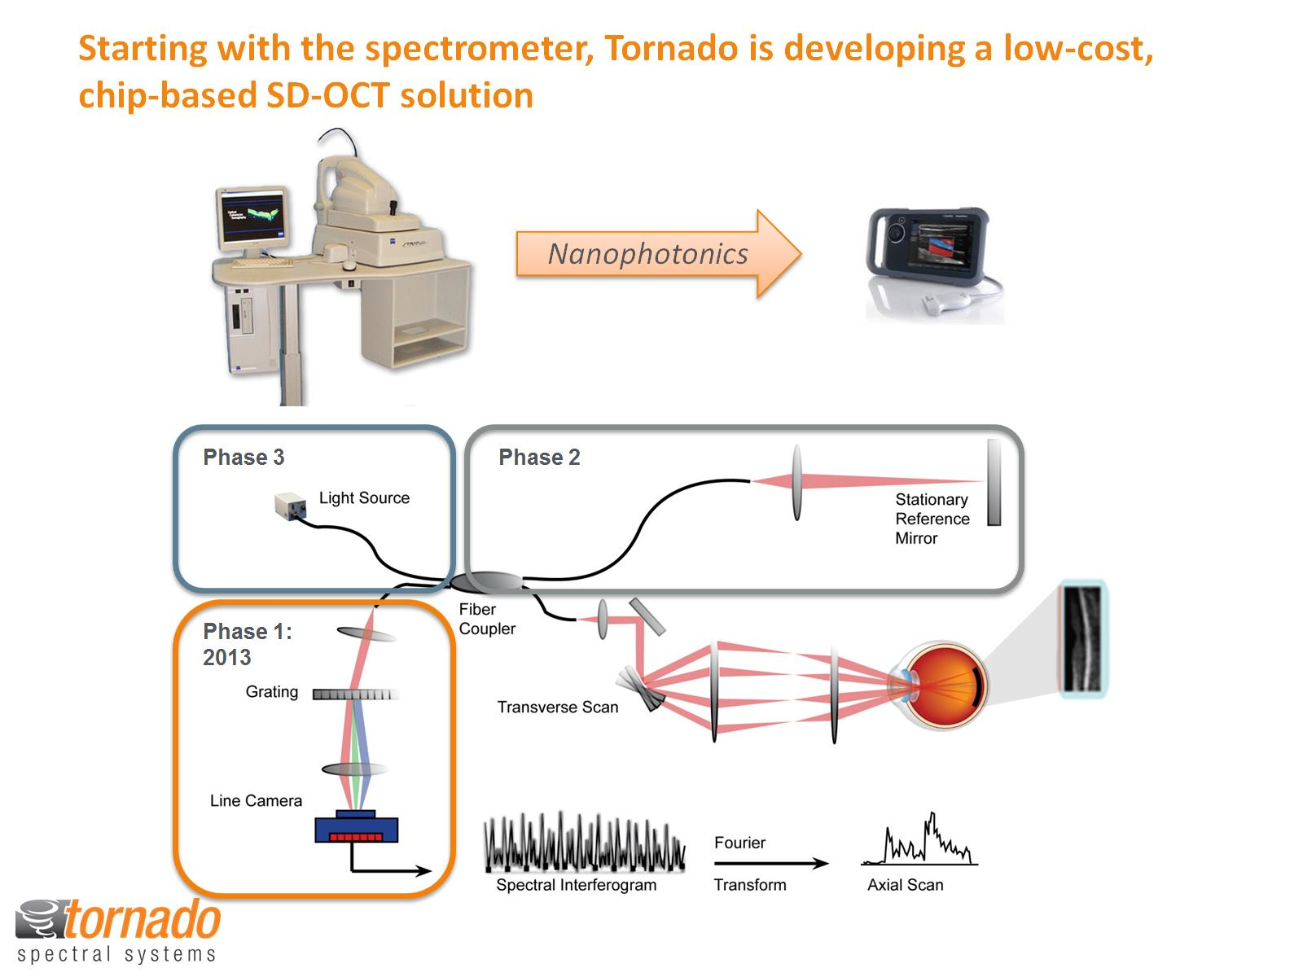
Starting with the spectrometer, Tornado is developing a low-cost, chip-based SD-OCT solution

Slide 3
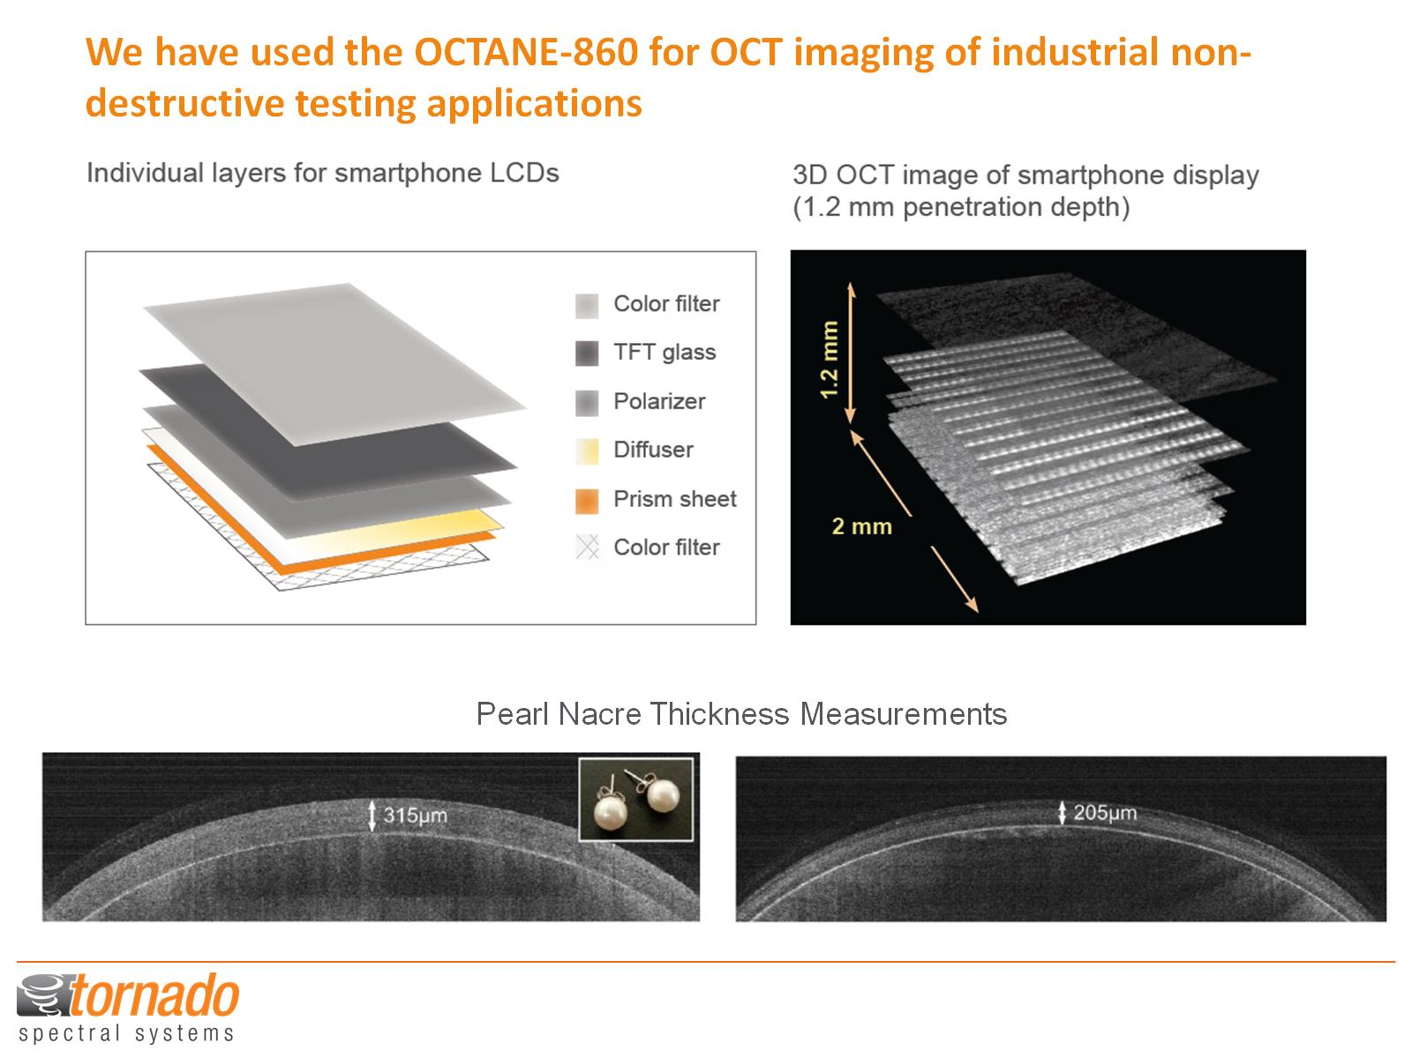
We have used the OCTANE-860 for OCT imaging of industrial non-destructive testing applications

