Slide 1
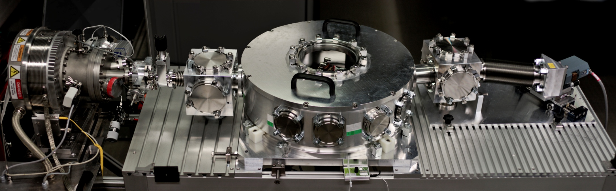
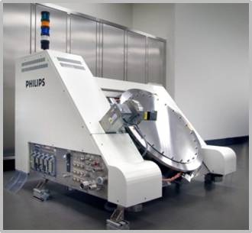
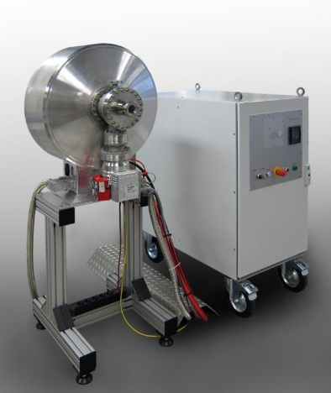
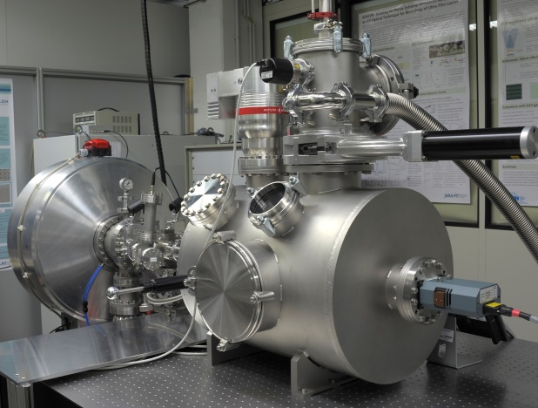
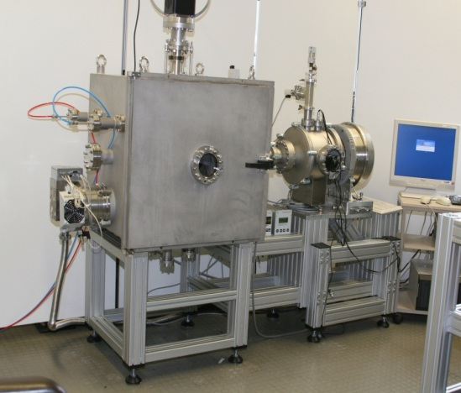
Terrestrial short wavelength metrology for solar science
Focus of research:
  EUV sources & metrology
  Industrially relevant EUV applications
    Reflectometry
    Nanostructuring
    Imaging
Reflectometer
High power EUVL source
High brightness
metrology source
Laboratory exposure tool
Defect inspection microscope
Stefan Herbert
Scientific Detector Workshop 2013
9th October 2013, Florence, Italy

Slide 2
Terrestrial short wavelength metrology for solar science
Motivation of attendance:
    Space science applications and EUV lithography/metrology share:
      Vacuum- and cleanlineness requirements - highest quality standards
      Challenges, connected with EUV-specific optical equipment and detectors
    Combine competences and experiences for mutual benefit
  Contribution for joint activities:
    Plasma source with quasi-solar
    emission spectrum
    Flexible metrology test bench
    for characterization of
    optics & detectors in the EUV
    Outgassing studies in vacuum
Stefan Herbert
Scientific Detector Workshop 2013
9th October 2013, Florence, Italy

