Slide 1
Test Results for an Array-Based GM-APD Detector Before and After Irradiation
Kimberly Kolb, Brandon Hanold, Joong Lee, Don Figer
SDW 2013 Conference
October 9, 2013
Notes:
The devices presented are hybridized silicon array-based Geiger-mode avalanche photodiodes. These photon-counting detectors are 256 x 256 pixels and represent some of first of their kind. We have irradiated them with 10x the equivalent of an 11 year mission at an L2 orbit. We dosed the arrays in geometric steps, taking data between doses, up to a total cumulative dose of 50 krad (Si).
New slide:
List of 1-2 word points
Prioritize
Make sentences
Zero read noise?
Moore Foundation / LL

Slide 2
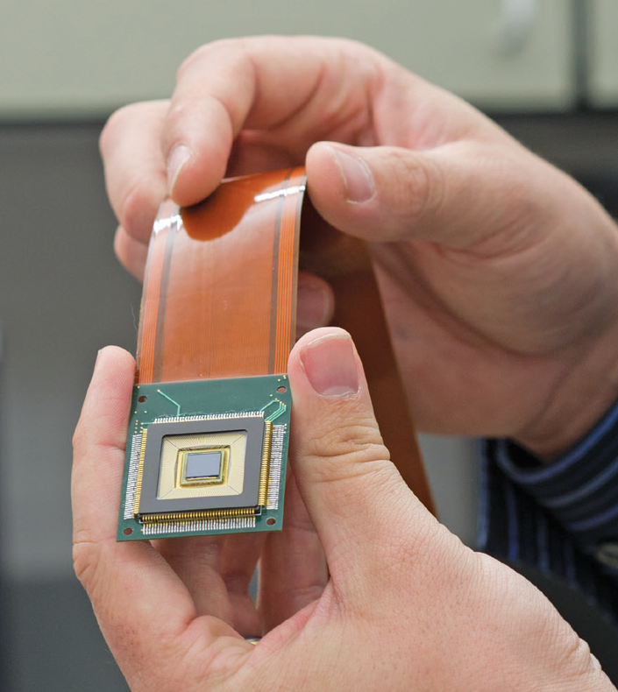
The Detector
Photon Counting
Zero Read Noise
Geiger-mode avalanche photodiodes
256 x 256 pixel array
Hybridized (silicon to silicon)
Developed with MIT Lincoln Laboratory with support from the Moore Foundation
RIT / A. Sue Weisler

Slide 3
Pre- and Post-Radiation Results
Median DCR vs time over incremental radiation doses
Median DCR vs temperature results pre- and post-radiation
Goal for DCR (170 K) | Pre-Radiation DCR (170 K) | Post-Radiation DCR (170 K) | Goal for DCR Increase at 5 krad (Si) (253 K) | Actual DCR Increase at 5 krad (Si) (223 K)
0.002 e⁻/pix/s | 9 e⁻/pix/s | 45 e⁻/pix/s | 0.5 e⁻/pix/s | 20 e⁻/pix/s*
* this is an un-settled DCR value taken from in-situ measurements
Notes:
The plot on the left shows median dark count rate as measured by 10,000 sample data sets over time. The vertical red lines coincide with the end of each intermediate radiation dose. The device was cold for these measurements. After the 11 year mission equivalent at 5 krad (Si), the dark count rate had increased by a factor of 1.3, and after the full dose of 50 krad (Si), the dark count rate had increased by a factor of 15.
The plot on the right shows median dark count rate as measured by 10,000 sample data sets over time. The device was warm for these measurements. The red line shows an exponential decay fit to the data, from which we calculated the 99% settling point of the DCR.
We experienced no catastrophic failures following the final dose and the device continued to operate rationally.
After the dark count rate reached a 99% settling point, the device was cooled and characterization of the post-radiation dark count rate and afterpulsing probability was completed for various operating temperatures.

