Slide 1
Near-infrared Imaging Spectrometer
for NEXTSat-1
Dae‐Hee Lee
Korea Astronomy and Space Science Institute

Slide 2
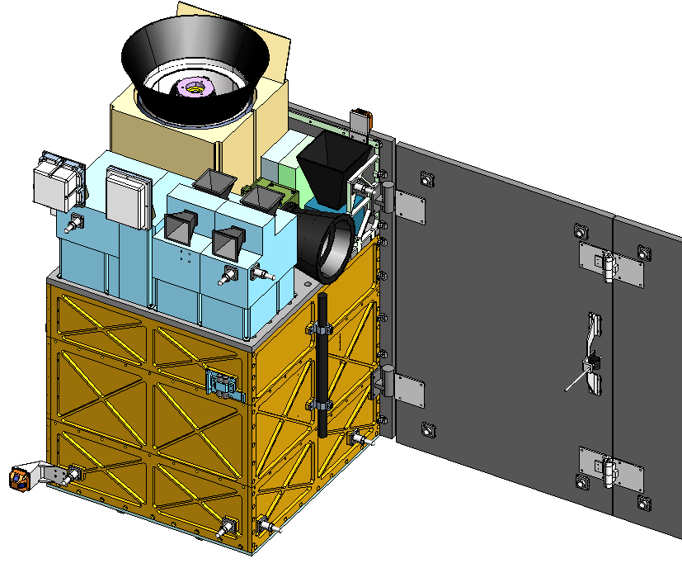
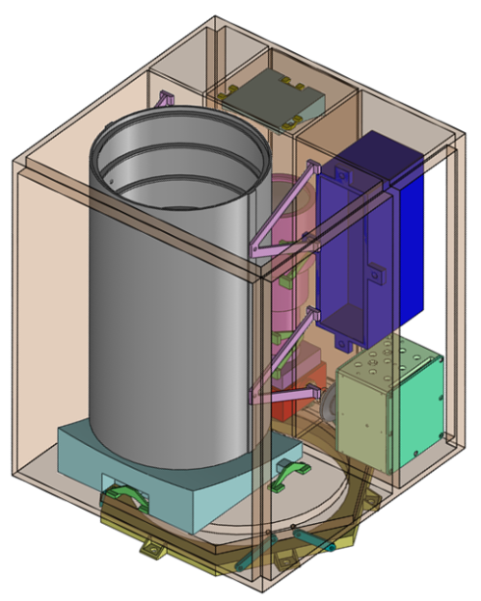
NISS on NEXTSat-1
  NEXTSat-1
    Korea’s 3rd Scientific Micro-satellite
    PI institute: SaTReC, KAIST
    Spacecraft mass ~ 136 kg
    Spacecraft size ~ 60x60x80 cm3
    Sun-sync orbit with 3 axis attitude control
    Scheduled launch in 2017
  NISS
    NIR Imaging Spectrometer for Star formation history
      Observing emission/absorption spectral lines
      Cosmic NIR background observation
    PI institute: KASI
    Mass ~ 18 kg, Size ~ 29x27x40 cm3
    Spectral coverage : 0.95 – 3.8 um
    Spectral resolution ~ 20 with LVF
    FoV: 2 x 2 degrees
    Survey area > 100 sq degree

Slide 3
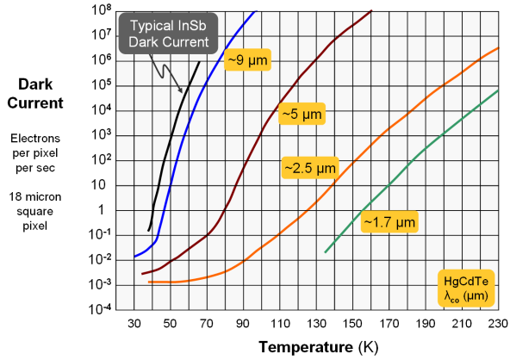
IR sensor & readout
Teledyne HgCdTe sensor
  1K x 1K array using technologies from H2RG (18μm cell pitch)
  (GBA H2RG FPA with reduced Active Pixels and PRICE!)
  Low noise (~10e⁻) & low heat dissipation (~ 1mW)
  Quantum efficiency : 75 ~ 85%
  Customized cut-off freq. : 3.8 μm
  Dark current at 80 K < 0.1e⁻/s @3.8 um
(Beletic et al. 2008, SPIE)
- Readout method: Window mode
- Reference pixel usage: CIBER2 heritage “Modified Guide Mode”

