Slide 1

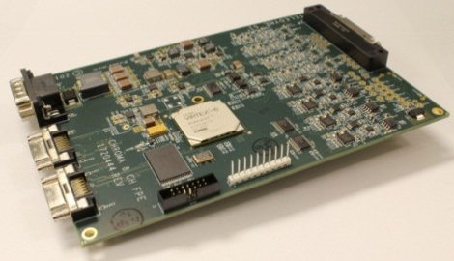
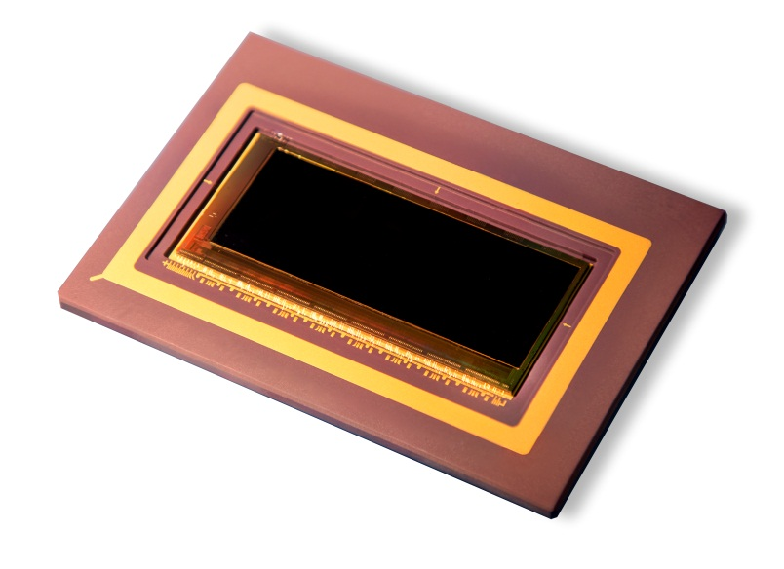

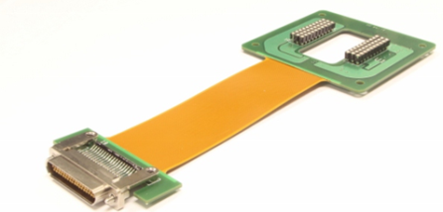
Performance of the CHROMA Focal Plane Array: A Variable-Format, Low-Noise Detector Designed for Imaging Spectroscopy
Richard T. Demers, Robert Bailey, James W. Beletic, Steve Bernd, Sidharth Bhargava, Donald Cooper, Jason Herring, Paul Kobrin, Donald Lee, Jianmei Pan, Anders Petersen, Eric Piquette, Brian Starr, Matthew Yamamoto, Majid Zandian
Image of Aral Sea over Central Asia taken by Landsat Data Continuity Mission (LDCM)

Slide 2
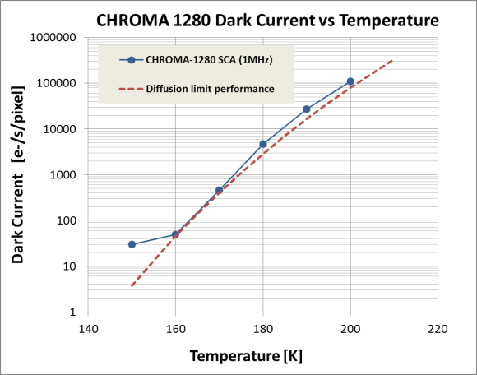
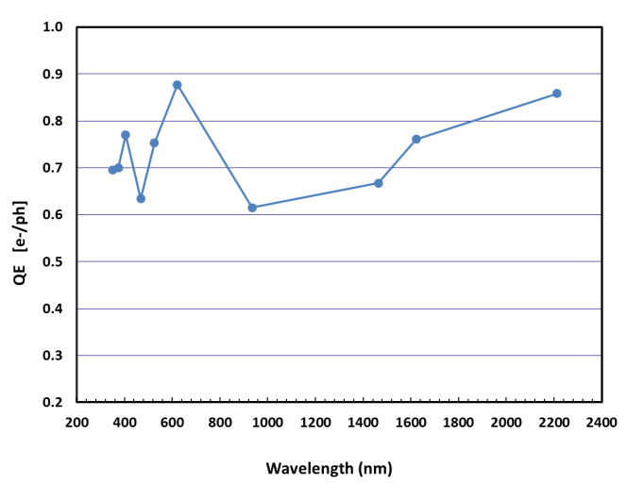
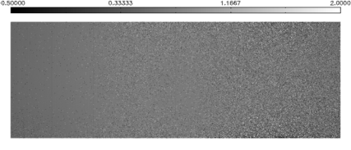
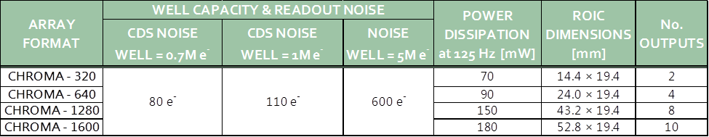
CONFIGURABLE HYPERSPECTRAL READOUT FOR MULTIPLE APPLICATIONS
Designed for ground-based, airborne and space-based VIS-SWIR imaging spectroscopy
Integrated in the HySICS instrument to be launched on a balloon in October 2013
Will be integrated into an airborne imaging spectrometer in 2014
DARK CURRENT
QUANTUM EFFICIENCY
Notes:
2

