Slide 1
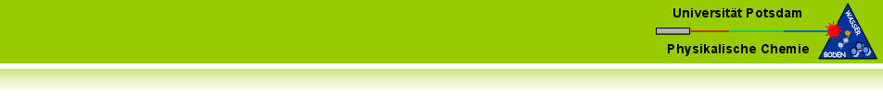

Fiber-based spectrally and spatially resolved light sensing in photobioreactors
Michael Sandmann, Marvin Münzberg, Julia Mießner, Roland Hass, Lena Bressel,
Oliver Reich
innoFSPEC, Institute of Chemistry, University of Potsdam,
Am Mühlenberg 3, D-14476 Potsdam/Golm, Germany.

Slide 2
Setup inside of the photobioreactor
SUN
reference fibers outside
nets
Modular mesh ultra-thin layer (MUTL) photobio-reactor (patent by IGV).
Fiber ends are used as light collecting device.
Up to 150 optical fiber ends are fixed at different positions inside the PBR.
Fibers are connected to a spectrometer via a fiber-optical switch.
compact
spectrometer
fiber-optical switch
2 m

