Slide 1
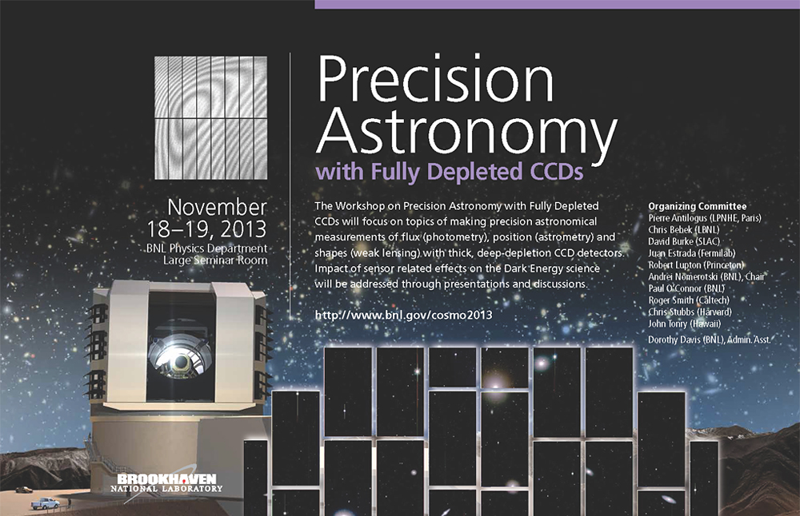
Brookhaven National Lab
Long Island, New York
http://www.bnl.gov/cosmo2013/
register by Oct. 18

Slide 2
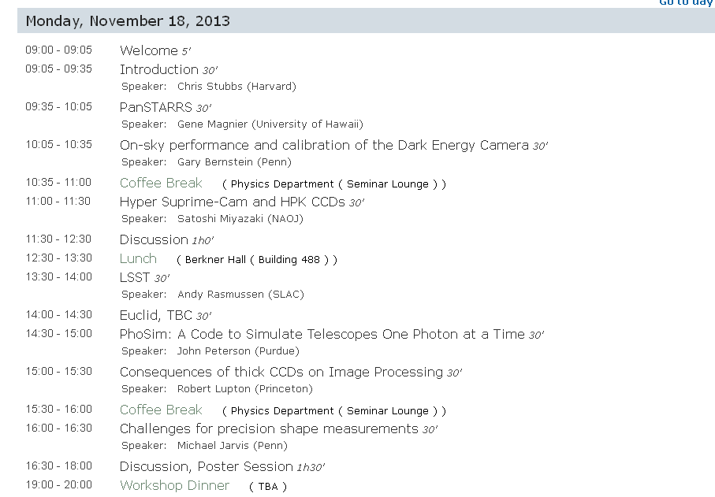

Slide 3
