Slide 1
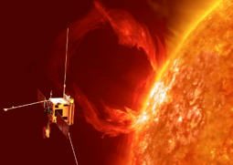
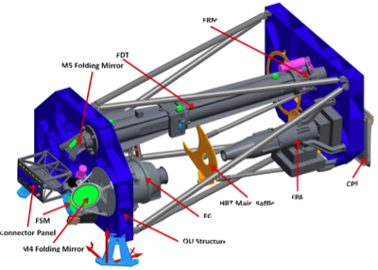
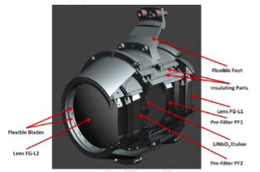
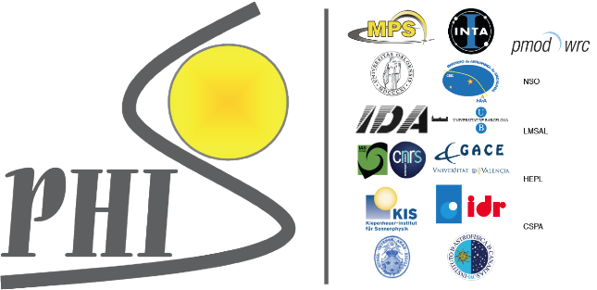

Poster L2
Filtergraph calibration for the
Polarimetric and Helioseismic Imager
Solar Orbiter
Carlos DOMINGUEZ-TAGLE, et al
Institut d’Astrophysique Spatiale, CNRS – Univ. Paris Sud
Solar Orbiter
PHI
Filtergraph
How the Sun creates and controls the heliosphere?
Doppler- and Zeeman-effects in the photospheric FeI 6173 Å absorption line
Fabry-Perot (LiNbO3) + NB filter

Slide 2
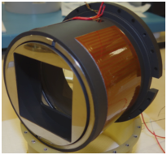
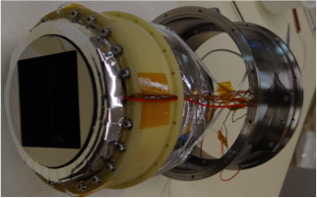
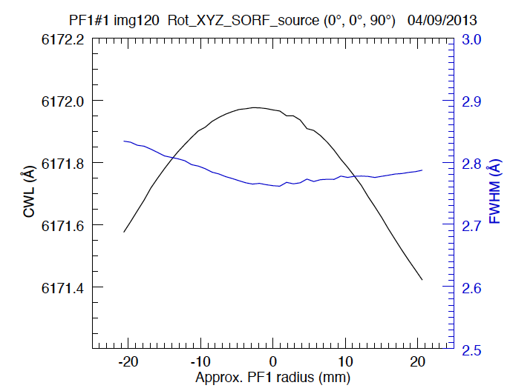
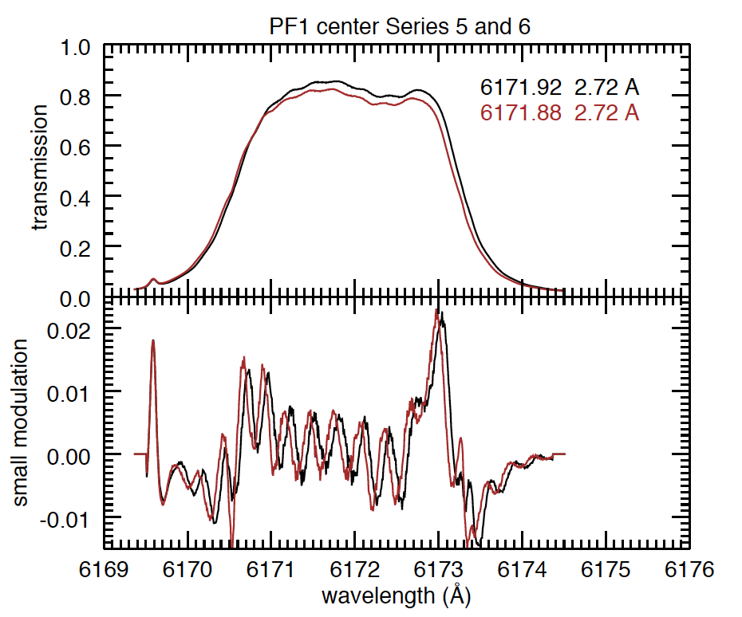
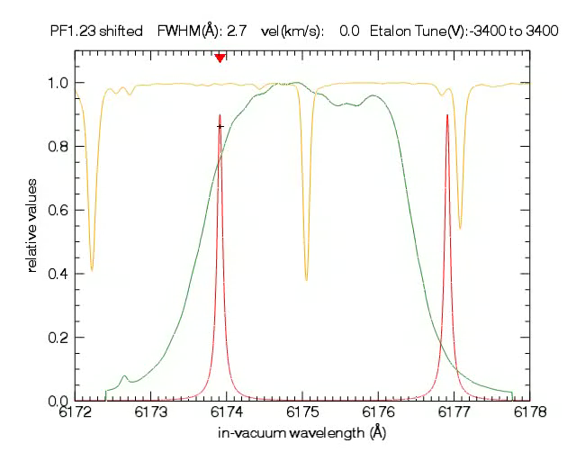
Poster L2
Filtergraph scan
Solar spectra: continuum with absorption lines. FeI 6173 Å (center)
Faby-Perot (LiNbO₃) passband: 0.1 Å
Measured NB filter FWHM= 2.7 Å

