Slide 1
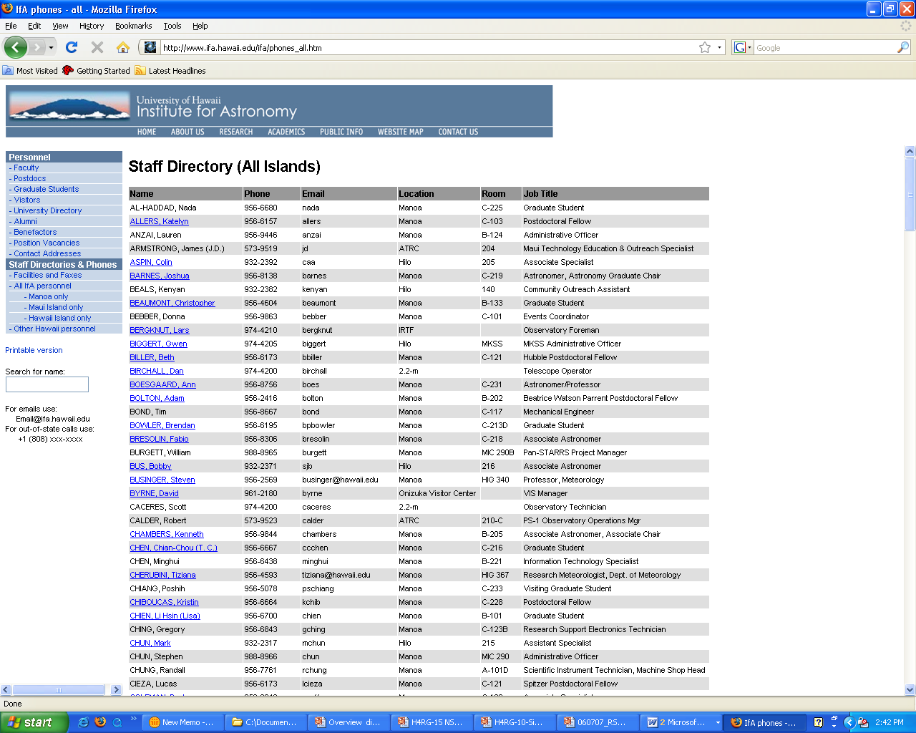
.
Investigation of
Linear-Mode, Photon Counting HgCdTe APDs
for Astronomical Observations
Science Detector Workshop 2013, Florence Italy
Donald N. B. Hall
University of Hawaii, Institute for Astronomy

Slide 2
Team
University of Hawaii –Institute for Astronomy:
  Dani Atkinson
  Marta Bryan
  Klaus Hodapp
  Shane Jacobson
Raytheon Vision Systems:
  Mike Jack
  Justin Wehner
  Eric Beuville
  Mark Murray
  Aaron Ramirez
  Trish Veeder

Slide 3
Overview
Status of University of Hawaii – Raytheon Vision Systems program to develop photon counting HgCdTe L-APD arrays
Noiseless linear-mode avalanche gain can be used either to amplify photo-charge relative to readout noise or, if high enough, to count individual photons
Why count photons when CDS noise is already below 1 rms e- ?
The major challenge is to push back the onset of tunneling current so as to achieve the required avalanche gain at low dark count rate.

Slide 4
Advantages of HgCdTe L-APD Approach
“Conventional” APDs exhibit excess noise that severely degrades photon counting in linear mode
  Both holes and electrons participate in the avalanche
  The avalanche is statistical with redistribution of carriers between ionizing events
  Photon counting driven to Geiger mode with its limitations
HgCdTe is unique among known semiconductors in that the linear avalanche process is “noise free”
  Only electrons participate in the avalanche process
  Holes are too “heavy” with low ionization cross section.
  There are no phonon interactions between ionizing collisions
  The avalanche is ballistic and so deterministic!
Noiseless avalanche gain can be used either to amplify photo-charge relative to readout noise or, if high enough, to count individual photons

Slide 5
HgCdTe L-APD Arrays for AO Wavefront Sensing & Fringe Tracking
Both UH IfA (with NSF ATI funding) and ESO (Gert Finger) have developed L-APD HgCdTe sensors, initially for AO Wavefront Sensing and Fringe Tracking (which are least demanding on dark current at < 100 counts/second):
  The UH IfA effort, now partnered with Raytheon Vision Systems, focuses on photon counting
  The ESO effort, partnered with Selex, has been directed to avalanche gained charge integration
These complimentary efforts build from Defense/Aerospace investment in LADAR and Range Gated Imaging technology:
  RVS 4x4 SB415B GHz bandwidth LADAR sensor
  Selex Swallow 320x256 LADAR sensor
The UH/RVS effort has demonstrated photon counting down into 10 kHz range.
The ESO/Selex effort has demonstrated photon noise limited imaging at <100 e-/sec gain normalized dark current – Gert’s talk.
Both efforts have now developed new readouts optimized for astronomy:
  UH-RVS 32X32 HILO from VIRGO
  ESO-Selex 320x256 SAPHIRA

Slide 6
Under the NSF program Raytheon improved dark current
Raytheon demonstrated noiseless photon counting at GHz bandwidth in 2007. NASA ROSES program reduced Dark Count X20 and Surface Current X100,000 in SB415.
2007 Photon Counting with Dark Count~500,000/sec; Isurf ~10⁻⁹A
2010 Photon Counting with Dark Count ~30,000/sec; Isurf ~10⁻¹⁴A
Slope ~ Isurf
Flat Slope Enables Tint to 10ms

Slide 7
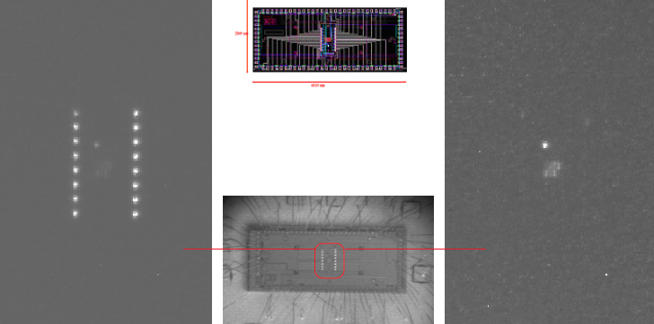
Si bandgap images reveal glow from readout amplifiers.
Bare readout imaged at Si bandgap wavelength
Full Power
Reduced Power
100 X exposure

Slide 8
L-APD HgCdTe Photon Counting at 10 KHz Frame Rate
Outputs #6 and #11 of SB415B - 90 μsec exposures after 10μsec reset with 4 μsec illumination by an IR LED. The vertical scale is 0.5 division per photon

Slide 9
UH/RVS photon counting L-APD ROIC approach
Base on a proven low background astronomy readout
  Raytheon VIRGO glow-suppressed architecture
  VIRGO 1k x 1k has demonstrated readout noise
  Readout noise scales with Fowler samples averaged
  0.5 μm CMOS process robust against avalanche bias voltages
  Paths to further voltage protection
64 output, 32x32 AO tip-tilt wavefront sensor
  64 outputs (32 top and 32 bottom) each reading up to 16 pixels in column
  62.5 KHz frame rate at 1 MHz pixel rate, 250 KHz - 4 MHz
  Higher frame rates for rectangular sub-arrays
Future: 64 output, 1k x 1k with four 16x16 guide windows
  Full frame rate is 60 HZ at 1 MHZ, 240 Hz at 4 MHz
  1k x 1k divided into four quadrants
  Each contains a 16x16 guide window

Slide 10
UH-RVS HILO development status
32x32@20 µm pitch SB485 ROIC produced and characterized:
  Three versions – basic Virgo unit cell plus two voltage hardened derivatives – HVN and HVP.
  All have 64 outputs with perimeter row and column of reference pixels.
  Characterized the basic and HVN versions - fully operable and met all requirements.
RVS achieved MBE layers with required micro-defect density.
The program developed both an initial 124 pin LCC test package and a custom package concept.
However detector fabrication resulted in arrays with unacceptably high dark current.
Program is on hold pending outcome of RVS investigation of root cause.
UH has developed laboratory and telescope test capability.

Slide 11
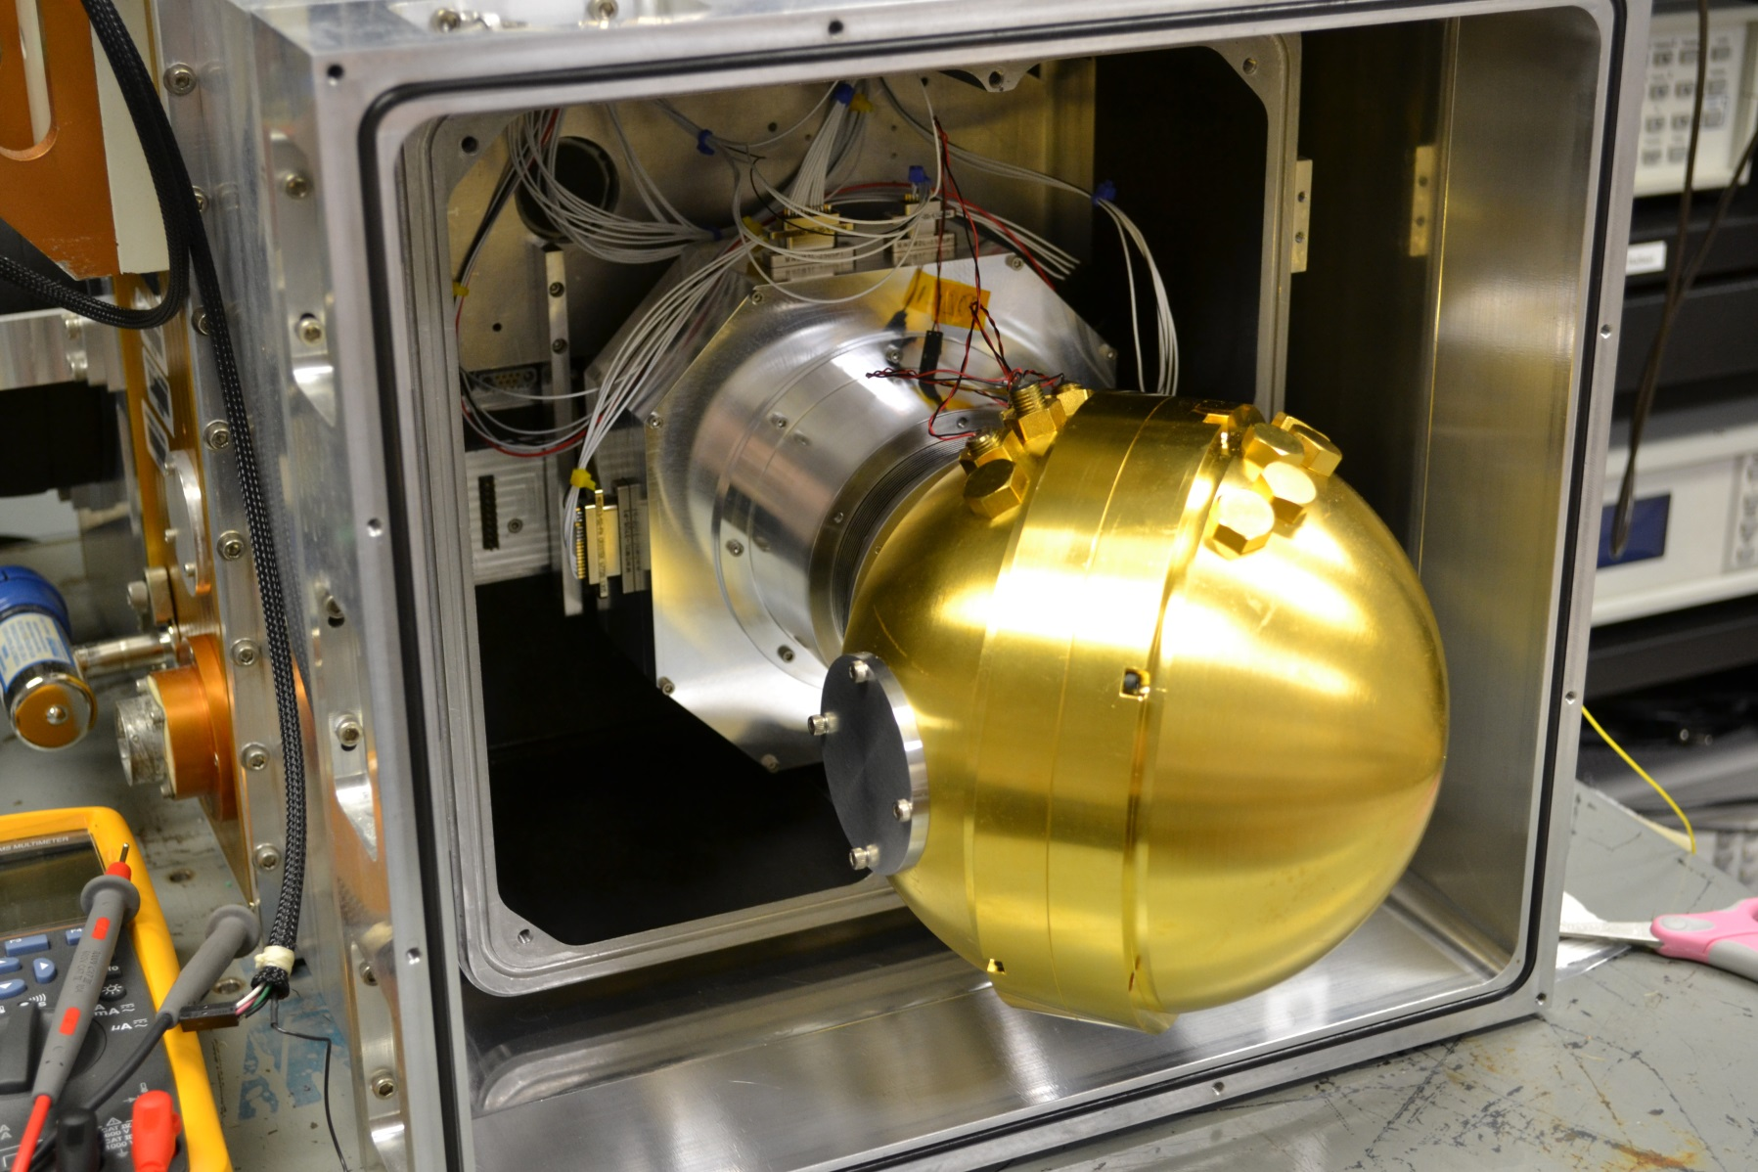
KSPEC with Cryogenic Integrating Sphere.
.

Slide 12
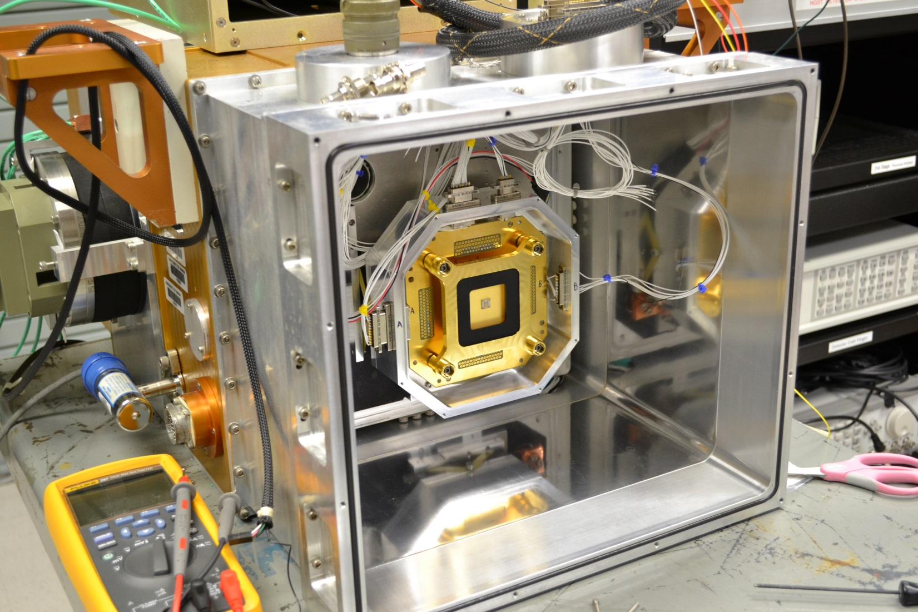
LCC Focal Plane.
.

Slide 13
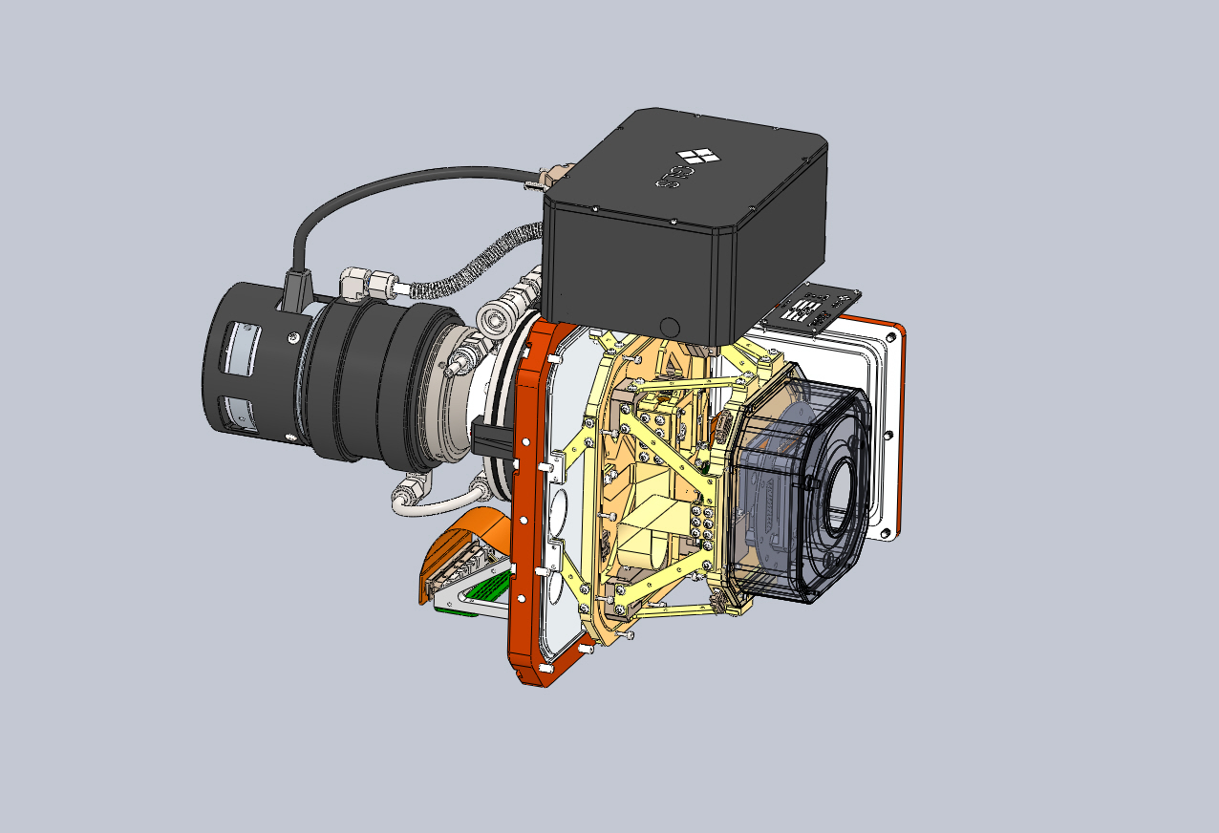
Telescope tests will utilize GL Scientific cryostat.
.

Slide 14
Why Photon Count when Read Noise < 1 rms e- ?
The assumption of uniform signal in each frame, inherent in traditional noise reduction through multiple CDS or SUTR, is not valid at the single photon level:
  The ramp is replaced by irregularly timed steps.
  Photon events in the first or last frame have zero weight while those half way up the ramp have weight 2.
  Solution is to take much longer ramps and to convolve with a template – simplest is a multiple CDS.
  Photon counting requires a SNR of ~ 3 or higher.

Slide 15
Some examples of photon starved observations
There are both ground based and space observations that require this level of performance:
  Ground based IFU spectrographs at the AO diffraction limit, particularly with FBG OH suppression.
  IR spectroscopy from Near-Earth/ Sun-Earth L2.
  Extra Zodiacal missions enabled by ion drive technology – Extra Zodiacal Explorer
  Time domain astronomy
Also allows noiseless binning of photons
  Nodding for background, particularly spectroscopic OH suppression.
  Sampling throughout a fast period orbit

Slide 16
Dark Current in HgCdTe L-APDs
Avalanching in HgCdTe requires n-on-p material to inject a photo-electron:
  LPE HgCdTe is n-on-p and has been used until now by Selex.
  Mature MBE is p-on-n but Raytheon has developed n-on-p for APDs.
  Selex is now growing n-on-p with MOVPE in 320x256 format.
At low bias voltages the RVS APDs have G-R limited dark current comparable to HAWAII arrays except for differences in maturity of n-on-p technology.
As voltage is increased to produce avalanching, there is a precipitous onset of tunneling current:
  Band to band tunneling is a fundamental limitation that can be ameliorated by band-gap engineering
  Trap assisted tunneling is usually the dominant current.
  It can be reduced with lower trap densities/bandgap engineering.
For low background, photon counting applications, the challenge is to achieve the required avalanche gain before the onset of tunneling current!

Slide 17
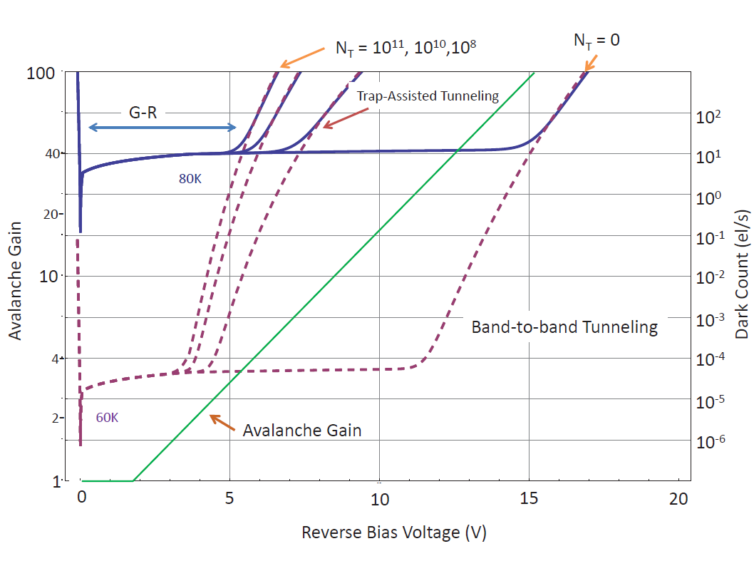
Avalanche Gain vs Tunneling Current for λc ~ 2.5 µm.
.

Slide 18
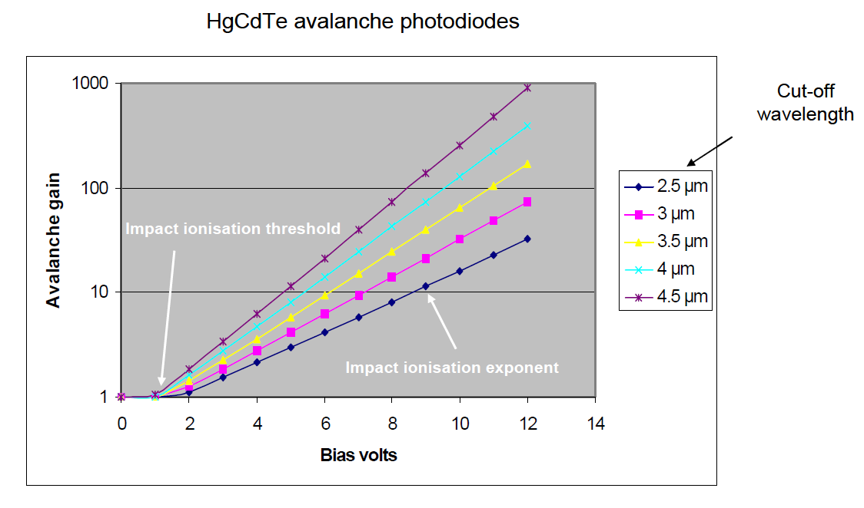
The avalanche gain of HgCdTe varies with bandgap.
.

Slide 19
Towards HgCdTe L-APDs for low background
MBE and MOVPE processes allow for bandgap engineering with:
  SEPARATE ABSORPTION AND MULTIPLICATION LAYER BANDGAPS
  WIDEST POSSIBLE ABSORPTION LAYER BANDGAP TO IMPROVE SUFACE PASSIVATION
  NARROWER MULTIPLICATION LAYER BANDGAP RAISES AVALANCHE GAIN (AT COST OF LOWER OPERATING TEMPERATURE)
  BUT INTERMEDIATE ENERGY PHOTONS PASS THROUGH THE ABSORPTION LAYER AND ARE ABSORBED IN MULTIPLICATION LAYER (THERMAL BACKGROUND)
For NASA,explore the optimization of these to achieve highest avalanche gain with low G-R current before the onset of tunneling current:
  MEASURE DARK COUNT RATE vs AVALANCHE BIAS VOLTAGE FOR REPRESENTATIVE CRYOGENIC OPERATING TEMPERATURES (35K TO 80K) FOR EXISITING ARRAYS
  FEED INTO MODELS AND ITERATE SAM ARCHITECTURE

Slide 20
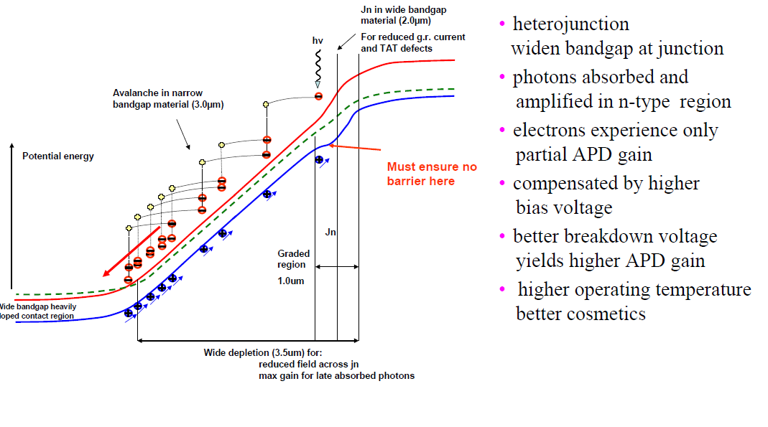
Selex MOVPE enables engineering of bandgap.
.

Slide 21
UH program
IN THE COMING YEAR UH WILL :
  CHARACTERIZE SEVERAL EXISTING SELEX SAPHIRA MOVPE ARRAYS (ALREADY ORDERED) FOR AO WAVEFRONT SENSING & LOW BACKGROUND APPLICATIONS
  FUND AN MOVPE GROWTH RUN OF APDs WITH IMPROVED ARCHITECTURE
  CHARACTERIZE THESE IN THE LAB AT LOW BACKGROUND
IN SUBSEQUENT YEARS UH MAY:
  FUND FURTHER IMPROVEMENT OF SELEX MOVPE APDs – POSSIBLY IN Selex’s LFNIR FORMAT – 1280X1024@15µM
  CHARACTERIZE THESE IN THE LAB AT LOW BACKGROUND AND AT THE UH88 TELESCOPE
  WORK WITH Selex TO MODEL PERFORMANCE
GOAL IS TO DEVELOP LARGE FORMAT PHOTON COUNTING ARRAYS AND DEMONSTRATE PERFORMANCE FOR NASA ASTROPHYSICS IR (AND VIS) MISSONS.

