Slide 1

Physics and applications of HgCdTe APDs
Ian Baker (SELEX) and Johan Rothman (CEA LETI)
09/10/2013

Slide 2
Outline
Amplified photodetection
HgCdTe APDs physics and limitations
HgCdTe APD
HgCdTe APD applications with arrays (imagery) and single pixel detectors
Summary/perspectives

Slide 3
Amplified photodetection

Slide 4
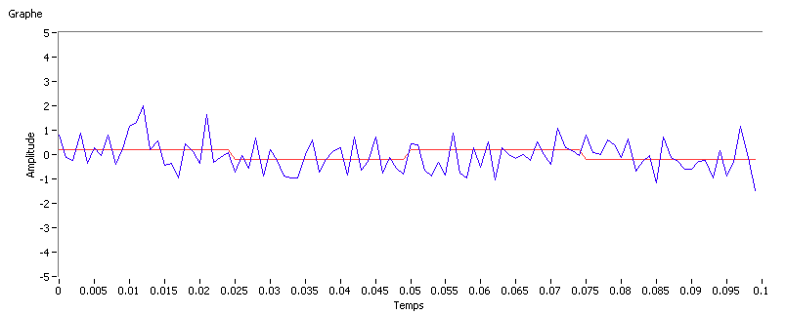
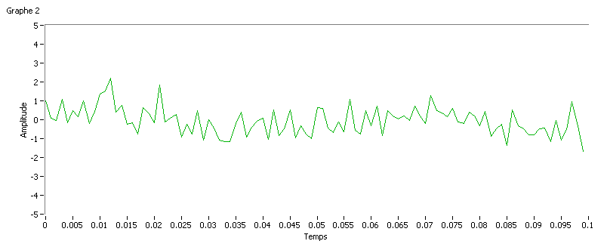
Photodetection without internal gain
Photon signal
Readout noise s_{RO}
Measured signal

Slide 5
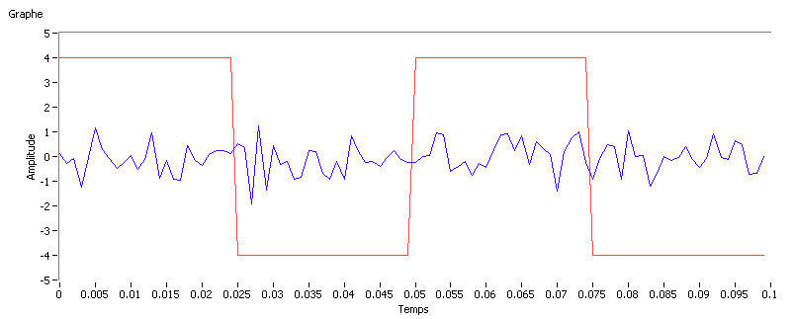
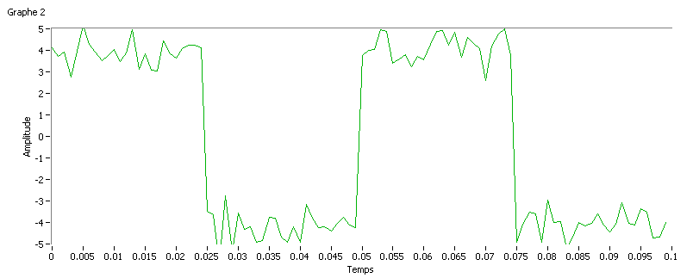
Photodetection with gain M
M x Photon signal
Internal photodetector gain M
RO noise
M
Measured signal
The gain extracts the signal from the read-out nosie:
Low signals and/or high read-out noise :
0.001- 10 000 photons per observation time

Slide 6
Photodetector gain
PD
gain
Amplifies the signal to avoid SNR degradation due to the noise in the read-out electronics
Avoid loosing information … at best:
P(M)
Excess noise
factor
σ_{M}
<M>
M
Information conservation FM

Slide 7
MxSignal+ Read out noise (Noise floor)
Avalanche gain with low excess noise
100mV
Signal x QE
Signal (100 photons)
10mV
Amplified SNR
High F
Low F
1mV
Variance in gain multiplies photon noise x√F
(F=APD excess Noise Factor)
Output voltage
~Photon
SNR
Photon noise (10 x√QE)
100µV
Electronic noise floor (FN)
10µV
Dark current noise
1µV
Increasing Gain
The object of avalanche gain is to increase the signal and photon noise above the fixed noise of the system
QEFR=QE/F should be maximal
Dark current noise should be minimal

Slide 8
HgCdTe avalanche photodiodes
Typical gain curve
Gain Probability Distribution Function (PDF) and excess noise factor
Gain physics (geometry, lc, temperature)
Dark current limitations
Response time measurements

Slide 9
HgCdTe Avalanche photodiodes (APDs)
Signature of multiplication without avalanche breakdown:
Single carrier multiplication: SCM !!!
Multiplication gain M
Reverse bias (V)
Avalanche gain M>1000 to detect light from uv to the IR cut-off wavelength
Low excess noise factor F=1.1-1.3 (DRS, Selex, BAE, Raytheon, CEA)
Information conservation record : QEFR ~60-90 %
  QEFR < 0.5 for all other amplified detectors (PM, Si/II-V APDs, EMCCD..) !
Potentially the best detector for low photon detection and photon counting ?

Slide 10
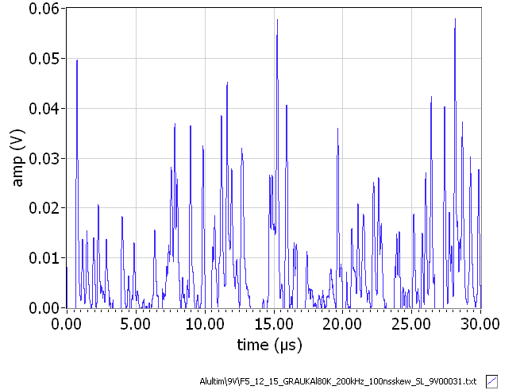
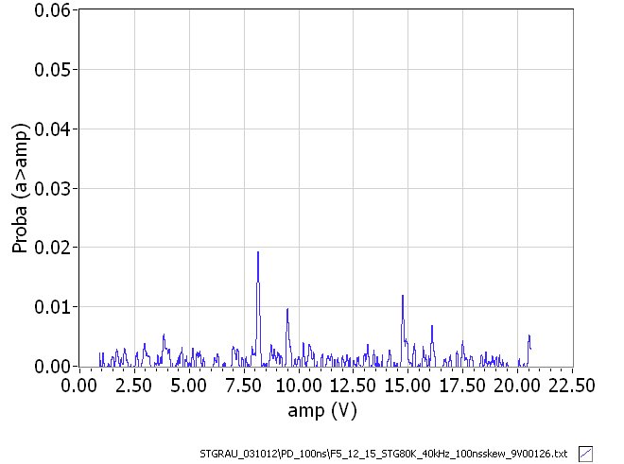
Multiplication gain distribution estimated from single photon detection (CEA-LETI)
APD hybridised on a
low noise ROIC
Noise/TC = 10-20 elect.
BW= 7 MHz
Cold filter
Residual thermal flux detected with MWIR APD 4.6 µm)
Single photon events 1.6MHz (I_{res}=230 fA)
ADV=0 (flux zéro)
Dark events
DCR=20-300 kHz
Seuil de <M> à 0.25 <M>
(DCR SWIR << 10 kHz)
amp (V)
time (µs)

Slide 11
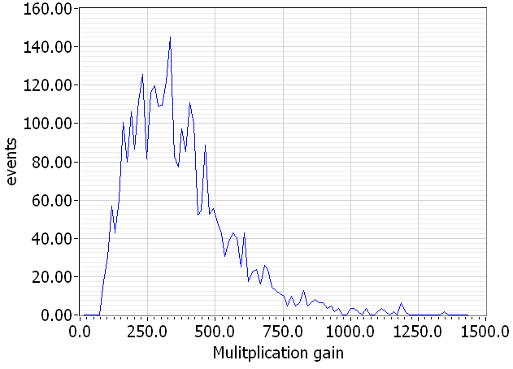
Gain probability density function (PDF) of MWIR CEA-LETI HgCdTe APD at 80 K
<M>=368
=1.25
Direct estimation of F= 1.25
The observed distribution enables high photon detection efficiency and the possibility to make photon number resolved (PNR) detection
  PDE=90 % at 0.5x<M>
  At the limit of PNR which is not possible with F>1.3 (F>=2 EMCCDs, SI/III-V APDs)

Slide 12
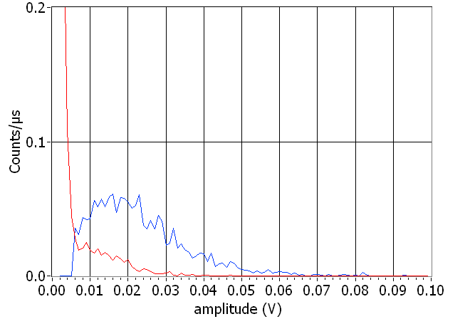
Linear mode photon counting with a CEA-LETI HgCdTe APD
Measured
Distributed dark-current generation
Measured 1 photon
APD gain PDF (+dark counts > 6 mV)
DCR=20-300 kHz
Seuil de <M> à 0.25 <M>
Distributed dark current generation
  Discrimination of non-amplified dark current events ➔ Lower DCR
  Low noise on the amplified dark current → Noise on the dark current is the limiting parameter

Slide 13
Avalanche gain in HgCdTe –
illustration of single carrier (electron) history dependent impact ionisation
Foundations for MCT APD technology
Absorption of photons must be on the P-side to generate electrons for full benefit of avalanche gain.
Above a depletion width of 2.5-3.0µm^{1,2} alloy and phonon scattering starts to impact ionisation threshold voltage.
Below approximately 1.0 to 1.5µm there is risk of gain saturation and tunnelling currents.
1.5-2.5µm is technologically convenient
hv
Electron and hole velocities limits the response time
Potential energy
Low F due to spatially ordered multiplication
Heavy hole mass – 0.55m₀ - low mobility
Holes must migrate to P-region to complete signal but otherwise do not take part in avalanche process hence low noise figure in HgCdTe
Recent literature
Johan Rothman, Laurent Mollard, Sylain Gout et al, “History-Dependent Impact Ionisation Theory Applied to HgCdTe e-APDs”, Jn of Elec Mat, Vol 40, No 8, 2011
Mike Kinch and Ian Baker, “HgCdTe Electron Avalanche Photodiodes”, Chapter 21, Mercury Cadmium Telluride - Growth, Properties and Applications, published by Wiley

Slide 14
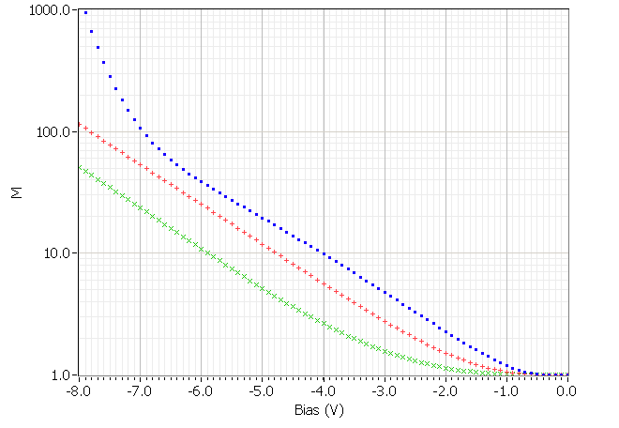
Influence of junction geometry on gain and noise
Front side illuminated APDs with λ_{c}=4.6 µm at T=80 K
Planar N+n-P diodes in
EPL and MBE grown epitaxies
Gain in CEA- APDs with different <w_{c}>
N+
Tunnel currents
<w_{C}>
n⁻~10¹⁴ cm⁻³
w_{c}=1.4 µm
w_{c}=0.8 µm
P~ 10¹⁶ cm⁻³
w_{c}=2.4 µm
The gain is correlated with the average junction extension
  Increased threshold voltage, ~ constant slope
  Gain variation have been modeled as a function of x_{Cd} and T*
The excess noise has been found increases with increasing junction width
  Junction geometry fluctuations and enhanced uncertainty on the gain ?
*Rothman et al, JEM 41, 2928 (2012)

Slide 15
Gain as a function of λ_{c} at T=80 K
CEA-Leti APDs
The gain decreases with decreasing λ_{c}
Exclusive electron multiplication with low F have been demonstrated down to λ_{c}= 2.2 µm (M=20 at 20 V)
  Limits the lowest possible dark current
The behavior of lower λ_{c} APDs is still not clear
  Onset of hole multiplication will strongly increase F and kill the particularity of HgCdTe APDs !

Slide 16
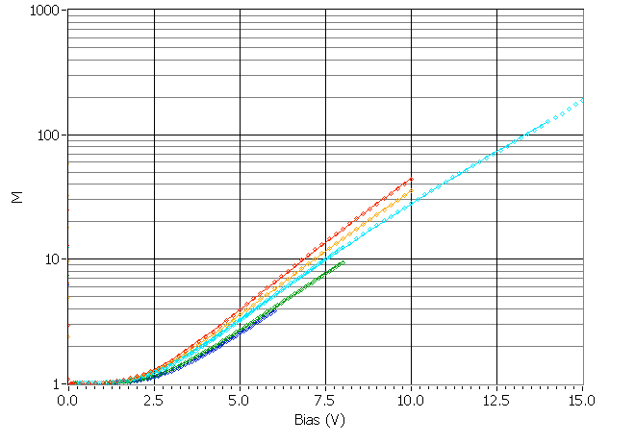
Variation of the gain as a function of temperature (λ_{c}=3.3 µm at T= 80K)
200K
220K
180K
273 K
293 K
The gain decreases as a function of temperature
Local gain model → variation of the band gap and increased (low) energy dispersion *
*Rothman et al, JEM 41, 2928 (2012)

Slide 17
Dark currents in HgCdTe APDs
I_{eq_in} @ 80 K
I_{eq_in} (M_{dark}< M)
DC generation
p
i
n
I_{eq_in} (pA)
I_{eq_in} decreases λ_{c} at constant gain and temperature
Dark current of 10 e/s have been observed for APDs with lc>3.0 µm → Low flux applications in astronomy
  Wavefront sensing, interferometry…
¹G. Perrais (Ph.D.S.), et al., J. electron. Mater., 36, 963 (2007)
²J. Rothman, et al., Proc. SPIE, 7834, 78340O 2010

Slide 18
3 µm cut off FPA : dark measurement CEA-LETI/SFD FPA (RAPID)
Under ~ 100 K, both currents reaches the same low level limited by the glow
At V_{APD} = -6,3 V, the GR dominates gain normalized current under 190 K
Would reach sub 5x10⁻¹⁵ A/cm² or 0.3 e-/s/pixel @ 80 K without glow
  At low bias, diffusion limited at temp. > 140 K
Notes:
Here is plotted the evolution of the median current density with temperature for the 64 top lines of the FPA witch are less affected by the glow. Even for these lines we are limited by the glow at a value of about 50 elec per sec.
Anyway we can observe interesting things. First at high bias voltage, ...
At low bias …

Slide 19
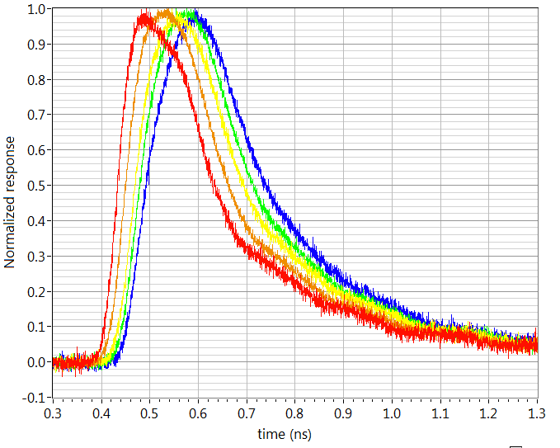
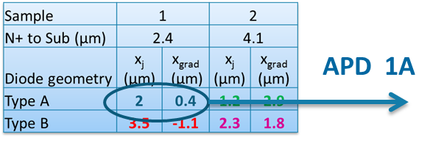
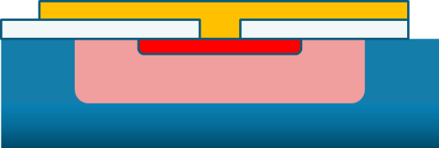
Response time variation as a function of bias and gain
Localized injection (APD center)
T= 80 K
-- M= 1.( (6 V), risetime 50 ps
-- M=5 (10 V)
-- M= 35 (14 V)
-- M= 70 (16 V)
-- M= 130 (18 V), risetime 100 ps
Delayed response at high gain with constant exponential decay with τ =270 ps
  Exponential decay due to impedance miss-matching
  Delayed response is due to a reduction of electron and holes velocities v_{e}=3.5x10⁶ cm/s, v_{h}=1.5x10⁶ cm/s
    BW → 10 GHz in narrow junctions (optimized resolution~20 ps)
    Close to Independent on temperature

Slide 20
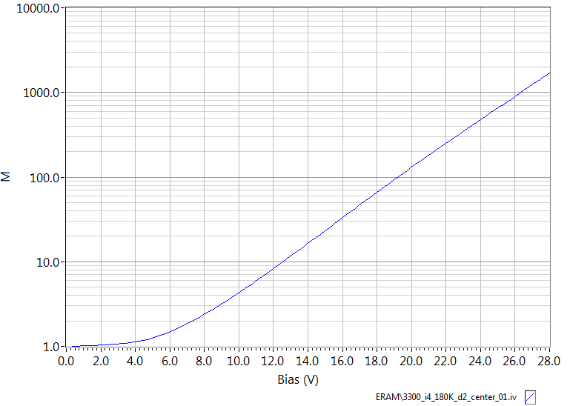
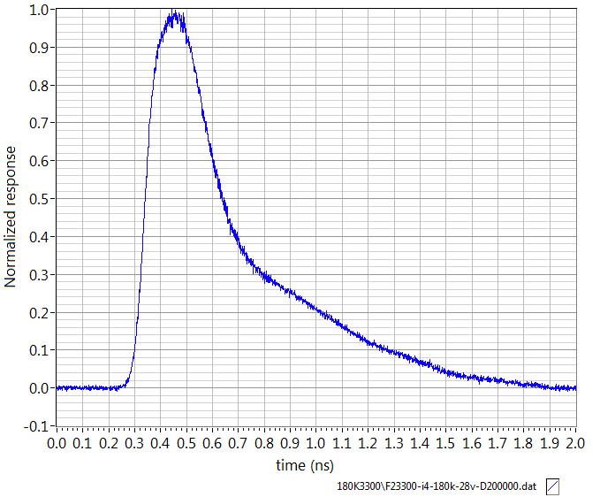
High gain perspectives
Impulse response with substrate
(edge and center response)
At 28 V and M= 1800 (180 K)
x_{j}=3.4 µm APD at T=180 K
Stable gain M=1800 at 28 V
Gain in excess of 1000 enables photon-counting with sub ns resolution using deported transimpedance amplifier (TIA)
  But at reduced BW is expected due to the large x_{j} ~ 2 GHz

Slide 21
Electronic engineers view of an avalanche photodiode in HgCdTe
The very impossible amplifier
Voltage controlled gain at the point of absorption
Little additional noise
Up to (10) GHz bandwidth
Requires no Si/Ge/III-V real estate
Negligible power consumption
Negligible non-uniformity
Shrinkable to the micron scale
Fundamentally highly stable
Ian Baker : Quite a useful component!

Slide 22
HgCdTe APD technologies
SELEX, DRS, Raytheon, BAE, LETI

Slide 23
Avalanche photodiode technologies:
Selex (UK) and DRS (US)
Selex (UK)
P absorber
hv
hv
Graded composition
P⁺ to p⁻
Avalanche region n⁻
N+
N+
Avalanche region n⁻
MOVPE/mesa technology
Higher operating temperature
High avalanche QE
Few pixel defects
Low excess noise F
Wafer scale processing
LPE/via-hole technology
Excellent breakdown quality
High avalanche gain
Panchromatic spectral response

Slide 24
Avalanche photodiode technologies :
CEA-Leti/Sofradir (Fr) and BAE (US)
Raytheon (US) ? (cf. Don Hall)
hv
hv
Absorbing layer
Avalanche region
Collection layer
Planar LPE technology
Excellent breakdown quality
High avalanche gain
Panchromatic spectral response
Fast response
Low gain dispersion
Low dark current
High operability
MBE/mesa technology
Higher operating temperature
High avalanche QE
Fast response
Low F

Slide 25
HgCdTe APD applications
MWIR HgCdTe APDs for imagery
SWIR HgCdTe APDs for imagery
Singel element applications

Slide 26
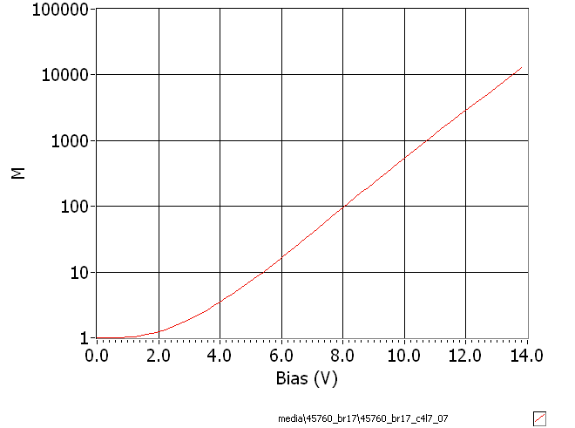
Typical performance of MWIR HgCdTe APDs at 80 K
Linear APD gain record
M=12 000 (SFD 2011)
12 000
Multifunctional thermal and/or active imaging
  Detection and identification
  Aerospatiale navigation
  Bio-medical research/cancer detection
FPAs for short integration times (30 ns – 1 µs) have been developed by Selex, DRS, CEA/SFD and Raytheon

Slide 27
SWIR HgCdTe APDs
80K performance
(< 0.05aA) ?
0.4-10 ns
Reduced gain at constant reverse bias
Reduced dark current at constant bias and temperature
Passive low flux fast frame rate imaging
  SELEX SAPHIRE→ Presentation by Gert Finger
  RAPID CAMERA (LETI/SFD/IPAG/ONERA/LAM), Presentation by Philippe Feautrier
High operating temperature (200-300 K) for high BW applications :
  active imaging (2D, 3D)
  single element detection …

Slide 28
Uniformity of avalanche gain in LPE/via hole technology at SELEX
Avalanche gain adds virtually nothing to non-uniformity
Depends only on voltage and alloy composition

Slide 29
Example of avalanche gain in astronomy using LPE/via hole technology
SELEX Saphira
APD sensor
Cutoff - 2.45 µm
Temperature - 40K
Int. time – 5.06ms
Bandwidth – 5MHz
APD gain – 33x
In photon starved applications can get two orders of magnitude improvement in sensitivity compared with conventional sensors
Courtesy: Gert Finger - ESO

Slide 30
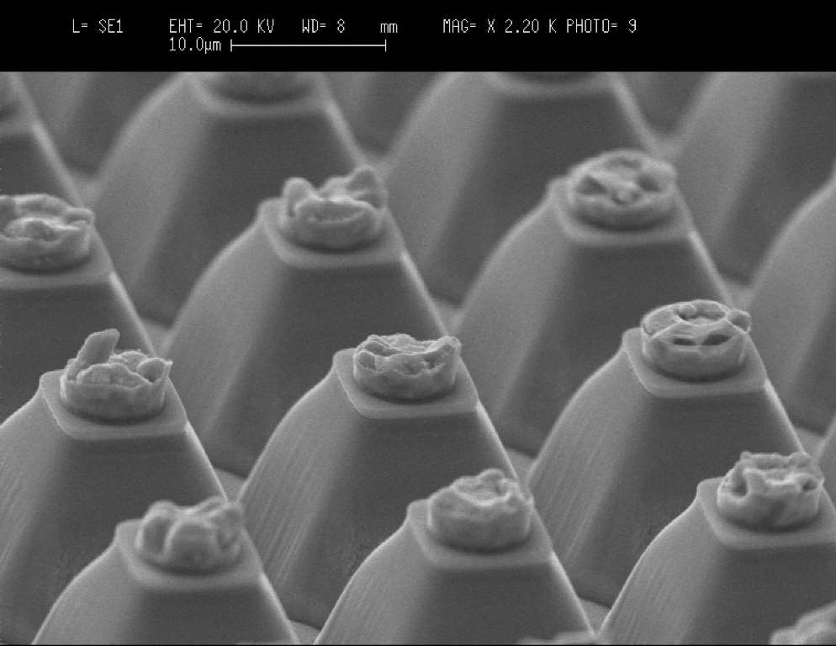
MOVPE technology for advanced eAPDs at SELEX
Mesa isolation provides photon confinement for high absorption efficiency and reduction of crosstalk and stray light export
Bandgap engineering to minimize breakdown, dark currents and response time
Narrow bandgap N-type for avalanching
All photo-electrons experience avalanche gain

Slide 31

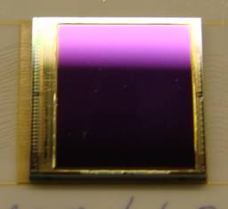
Ultra fast SWIR e-APD FPA and Camera
Minalogic (Rhone-Alpes/Isère) funded project :
  Partners:
    FPA developement : CEA-Leti, Sofradir
    Camera development and demonstration : IPAG, Onera, LAM…
Measured Detector performance
  320 x 240 pixels 30 µm pitch APD array : LETI on top
  8 outputs of 60 row @ 20 MHz : Sofradir bellow
  Wavelength: 0.2 – 3.2 µm
  M=10-30, QE/F~0.7
  Full frame readout: 1500 Hz (0.67 ms) min, up to 2 kHz, pixel frequency 20 MHz
  Windows: one rectangular window of any number of lines, each line read in 2.7 µs
    Maximum “fram rate” = 370 kHz
  System Noise: ~ 2-3 photons at 1500 Hz frame rate (with gain x15)
  Median Dark current : ~ 10 e/s/pixel
  Full well: 40 000 e (with gain x1) → low SNR images
  Gain and dark noise operability : >99.5% at low flux
31
26/09/2011
Ultra fast and sensitive

Slide 32

  3.3 µm λ_{c} RAPID FPA : V_{APD} = -8 V
FPA photonic measurement @ T_{FPA} = 80 K, V_{APD} = -8V
Gain
<M> = 31 ; Median = 30,8
99,8 % Operability (+/- 50%)
  Excess noise
  <F_{meas}> = 0,99
  Hyp. : quantum efficiency increase with bias η_{M}>η₁
    $$F_{meas}≞\frac{η_{1}}{η_{M}}F$$
Notes:
Now we will go on with the 3.3 µm cut off test results.
For a reverse bias voltage of 8 volts we get a gain of 31 with a very good operability.
We have also evaluated the excess noise factor. We get a mean value under 1 witch is not realistic. We think that it comes from an evolution of the effective quatum efficiency with the diode bias. In that case, the measure gives the true value of F multiply by the ratio between the low bias quantum efficiency to the high bias one.

Slide 33

3,3 µm λ_{c} RAPID FPA: QEFR
QEFR is the only measurable FOM$Q_{EFR}≝\frac{\text{h}\text{M}}{F}$
It can be estimated from measurable FOM
$Q_{EFR}≞\frac{\text{h}\text{1}}{{<F}_{meas}>}$
<QEFR> = 0,57 for at a gain 31 !
Notes:
So as we can’t access to the true value of F, the good figure of merit to quantify the information conservation is the quantum efficiency excess noise ratio. By definition this is the quantum efficiency at high bias voltage divide by the true value of F. As we have seen before this true F value is not accessible from direct measurement. Fortunately it can be measurable parameters, the unity gain quantum efficiency and the previously measured F factor. In our case we get a mean array value of 0.57.

Slide 34
3,3 µm λ_{c} RAPID FPA : dark noise
FPA input referred dark noise @ M=31 : end user FOM
  T_{FPA} = 82 K, V_{APD} = -8 V, Tint = 600 µs
  Pixel by pixel input referred dark noise evaluation
  Mean noise = 1,7 e- ; Median 1,5 e-
  99,54 % of pixels with noise < 10e-
Notes:
For this same FPA, the input referred noise in the dark at 600 µs integration time reaches a mean value of 1,7 electrons. Taking into account the previously calculated QEFR this gives a equivalent photon noise lower than 3 photons per pixel per frame.

Slide 35
Single element (mini-arrays )
System requirements and/or Optimisation is different than in FPA applications:
    BW/operating temperature/sensivity/active area…
Direct detection /Lidar/optical meas.
-Gaz analysis /TOF/
TC=50 ns- 10ps
Signal 0.001-100 photons/TC
Spectroscopy
-nanoscience/biochemistry
TC=1s-1ns
Signal=0.001-10000 photons
Telecom
TC=10 ns-10ps
Signal 1-1000 photons
Photon counting (number resolved)
-Quantum physics/
/high-energy phys./astrophys./biomed.
TC=1s-10ps

Slide 36
Detection system adapted to system requirements
Deported amplifier
High operating temperature
  BW 1Hz à 60 GHz
  Noise 300-1000 électrons/TC
  Compatible low T TEC <180 K
LIDAR, Télécom, Bio-médicale, science (magnéto-optique)
APD
Cold finger
(TEC cooled)
)
Hybridized amplifier
High sensitivity
  BW max ~ GHz
  noise 10-100 électrons/TC/pixel
    Low temperature
  Intelligent MUX
  Photon counting resolution
Optique quantique/ LIDAR/fluorescence moléculaire/spectroscopie…
APD
Cold finger

Slide 37
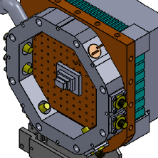
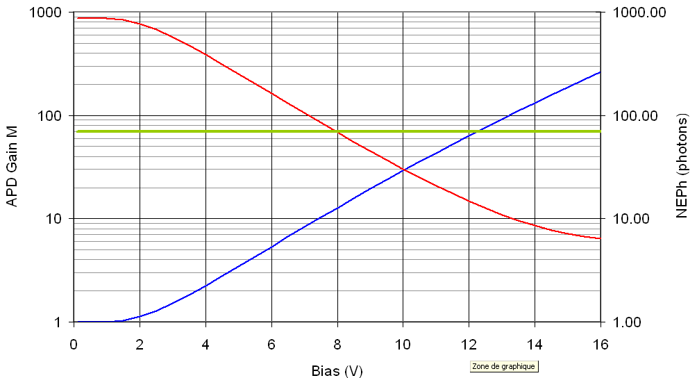
HgCdTE APD for LIDAR application with deported TIA
Expected performance, i_{TIA}= 1pA/Hz^{0.5} φ=120 µm ,λ_{c}=3.15 µm à 180 K
Limited by TIA noise (gain(T, xCd)
NEPh
Gain
Limited by dark current (T_{op}, f, xCd)
System optimization/ Operating temperature (high/low) :
Signal ↔BW ↔ TIA noise ↔ Surface ↔ gain ↔ λ_{c}(x_{Cd})
2 Demonstrators with deported TIA are currently being assembled at CEA
  BW_{TIA}=30 MHz, i_{TIA}<1 pA/Hz^{0.5} , T_{op}=160-200 K (TEC), φ>100 µm : CO₂, H₂0, CH₄ LIDAR
  BW_{TIA}=480 MHz, i_{TIA}=2.1 pA/Hz0.5 T_{op}=180-220 K (TEC): TOF, free space telecom

Slide 38
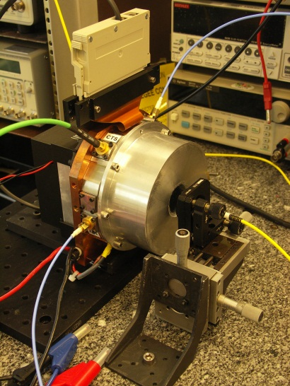
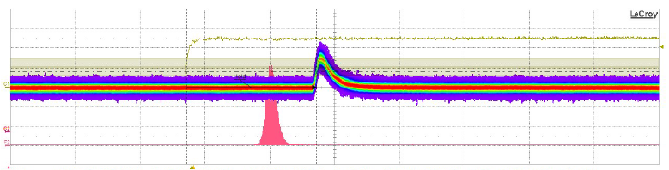
Performance MEATS-1 detector(CEA)
BW TIA=450 MHz
BW APD=50 MHz (diffusion limited)
NEP= 20 fW/Hz0.5
Active area 160 µm
T_{op}=192 K
Impluse response of 30 µm diode at 1 nW input power (APD gain=50)

Slide 39
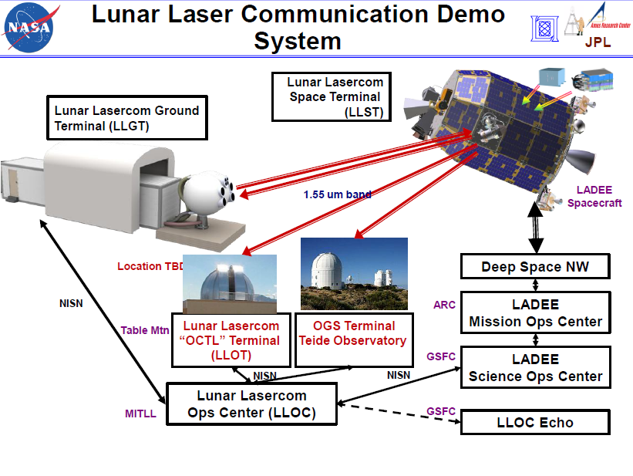
MEATS-1 for lunar laser communication with ESA and NASA
RF MEATS detector is waiting for photons from the moon on Tenerife

Slide 40
Photon counting detector perspectives
First CEA/Leti
photon counting
demonstration,
BW=7 MHz
APD- with low noise ROIC and/or fast amplifier
  Quantum physics and telecomunications, Lidar, spectroscopy, fluorescence life time, real-time physics
Optimal detector performances (applications)
  High PDE : ok > 90 %xQE
  Low DCR : ~ok (< 1 kHz in SWIR) at low temperature
  Photon number resolution : ok
  Temporal resolution 20 ps-10 ns
  Max repetition rate : 1- 10 GHz: possible, with external TIA and high gain > 300
  Spatial resolution -> photon counting imager : possible

Slide 41
Summary
HgCdTe APDs detects 0 to 1000 photons with minimal loss of information from uv to IR
  High gain M>1000
  Record high QEFR~60-80 %
  I_{dark} (I_{eq_in}) down to electrons/s
HgCdTe APD FPAs for active and passive imaging have been demonstrated with performances close to non-amplifed FPAs
  Low noise, high uniformity, high operability > 99.5 %
Single/multi element detectors
  Large horizon of applications
  2 demonstrators are under developments
    BW=30 et 500 MHz, NEPh< 10 photons (NEP< 10 fW/Hz0.5) à T_{op}~200K
  Demonstration of photon counting
Perspectives
  Cameras and detectors with optimized QE, F, I_{eq_in}, BW, operating temperature
  Photon counting arrays and detectors with photon number resolution
  Single photon detection with sub-20 ps resolution at record high PDE

Slide 42


Merci de votre attention

Slide 43
Avalanche gain in astronomy applications
Need a new figure of merit for APDs
as noise is now a combination of photon noise, gain noise and system noise
100mV
Signal (100 photo-electron)
10mV
1mV
Output voltage
Photon noise (10e rms)
100µV
Electronic noise floor (FN)
10µV
1µV
Increasing gain (bias voltage)
APD system sensitivity:
Noise Equivalent Photons
NEPh (SELEX def)
F – Noise Figure Q – Quantum efficiency FN – Fixed noise T – Transfer function M – Avalanche gain

Slide 44
Example of NEPh-Selex in a practical system
NEPh drops pro rata with avalanche gain until the photon noise becomes significant.
It then limits to some value dependent on the stray light and dark current.
The ultimate sensitivity is noise figure/QE (1/QEFR)
Cutoff – 4.4µm
Fno - 4.5
Quantum efficiency – 0.7
Temperature – 90K
Fixed noise - 50µV rms
Noise Figure – 1.3
x3
x6
x12
x25
x50
Actual NEPh effected by stray light and dark current
Ultimate NEPh is noise figure/QE=1/QEFR

Slide 45
Dark measurement on a RAPID retina with 3 µm cut off
Evaluate the dark current (low bias) and gain normalized dark current (high bias) evolution with FPA temperature
  At low temp. Long Tint is needed (up to 4s)
Example of short and long T_{int} images @ 80 K
V_{APD} = -0,2 V, Tint = 600 µs
V_{APD} = -0,2 V, Tint = 2 s
  ROIC glow is observed for long Tint, doesn't affect short integration time EO performances
Notes:
Now I will switch on measurement in dark conditions. The FPA was use to evaluate the dark and gain normalized dark current evolution with photodiodes temperature. To get a significant signal level we had to use long integration time. As an example, you can seen here the raw images that we get for 600 µs integration time and 2s. We have observed an excess of current coming from the bottom of the FPA. We know now that this due to ROIC glow.
As we will see later this glow doesn’t affect the FPA performance at the short integration times needed for astronomical applications.

Slide 46
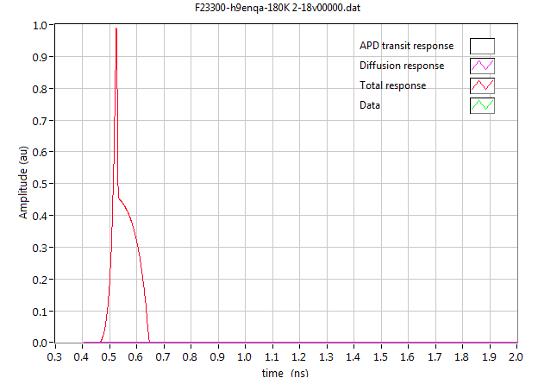
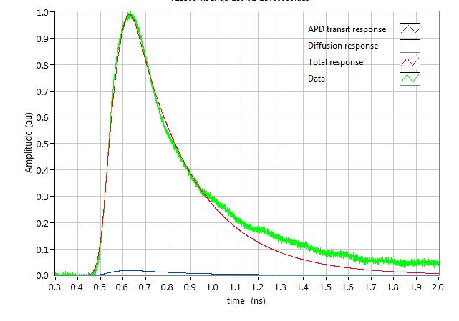
Response time modelling using the charge drift and multiplication model*
Short-circuit response
M=60, v_{e} =3.5x10⁶ cm/s, v_{h}=1.9x10⁶ cm/s
Sample 1A (x_{j}=2.2 µm)
18V bias, M=60
FWHM_{laser}=52 ps
RC=270 ps
Electron and hole velocity is estimated from the adjustment of the rise time (M given by gain measurements)
RC constant is close to constant for each sample
  RC_{1A}=270 ps → BW=600 MHz
  Probably due to parasitic impedance in the interconnection circuit
*Perrais et al, JEM 38, 1790 (2009)

Slide 47
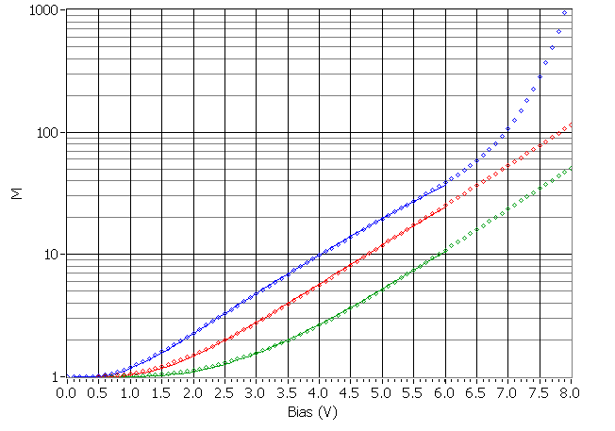
Physics of the gain
Local gain model
c=0.6
λ_{c}=4.6 µm (80 K)
wc | aEg/q | b
(µm) | (V/cm)^{1-c} | (V/cm)
0.77 | 22.2 | 3.24E+04
1.40 | 22.4 | 3.28E+04
2.40 | 22.6 | 3.25E+04
Excellent fit of gain on-set and gain saturation
  a and b independent of junction width w_{c}
a: saturating high field multiplication efficiency
b: critical field at which the electrons the electrons start to multiply

Slide 48
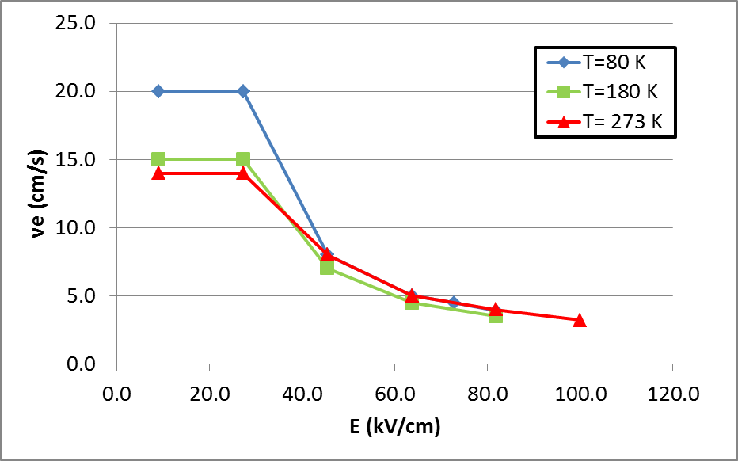
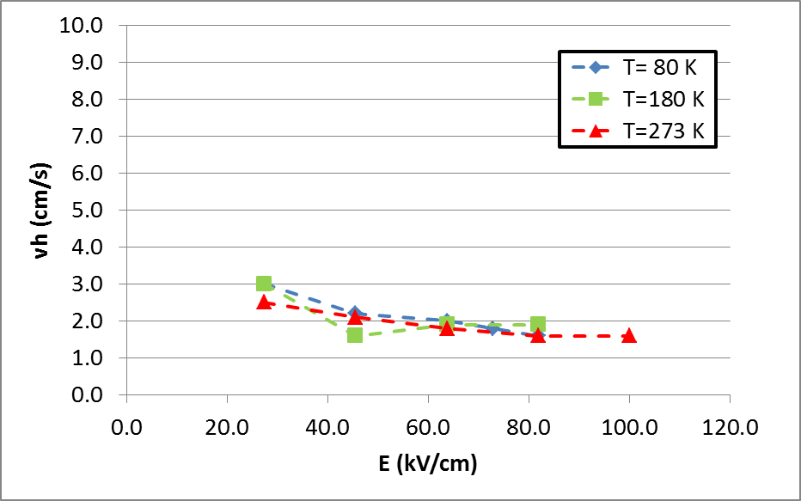
Electron and hole velocities in a x_{j}=2.2 µm APD
Electron junction drift velocity v_{e}
Hole junction drift velocity v_{h}
The low field low gain electron velocity decreases
The high field high gain electron and hole velocities are close to independent of the temperature
  v_{e}~3.5x10⁶ cm/s and v_{h}~1.5-2 x10⁶ cm/s at M~100
  But it reduces at high temperature at constant gain (as the same gain requires higher bias at higher temperature)

Slide 49
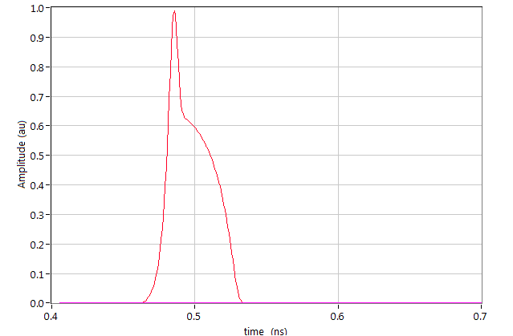
High BW perspectives at gains of 100 and
T= 200-300 K
x_{j}=0.8 µm, v_{e}=3.5x10⁶, v_{h}=1.9x10⁶ short-circuit limit →
FWHM< 50 ps, BW = 9 GHz !

