Slide 1

Highlights
Wednesday Oct. 8th, 2013

Slide 2
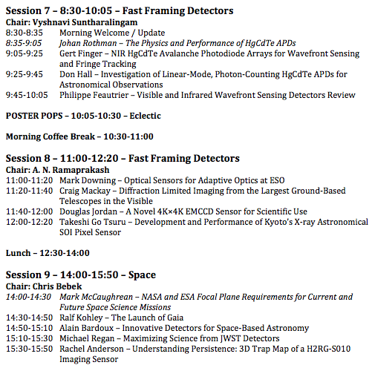

Slide 3
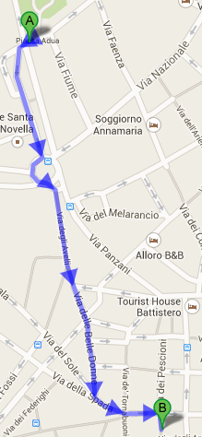

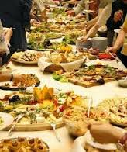
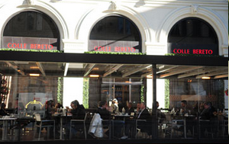
18:15 - 19:45
Piazza Strozzi, 5
BADGES!!!!

Slide 4
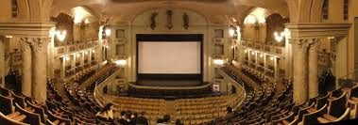
Robert Green’s special talk
Imaging Spectroscopy for Earth Science and Exoplanet Study
Teatro Odeon 20:00

Slide 5
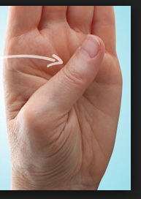
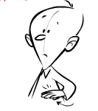
Speak Italian one gesture a day
Hand stretched, fingers closed, thumb tucked in, palm down
I am hungry
Let’s go eat

