Slide 1

National Aeronautics and Space Administration
Curved Focal Plane Array Technologies
Enabling
Compact, Wide Field of View Optical Systems
Shouleh Nikzad
Advanced UV/Vis/NIR Detector Arrays and Imaging Systems
NASA’s Jet Propulsion Laboratory, California Institute of Technology
Pasadena, California
Presentation
Scientific Detector Workshop 2013
Round Table Discussion on Curved Focal Plane Array
Florence, Italy
8 October 2013
© 2013 California Institute of Technology. Government sponsorship acknowledged.

Slide 2
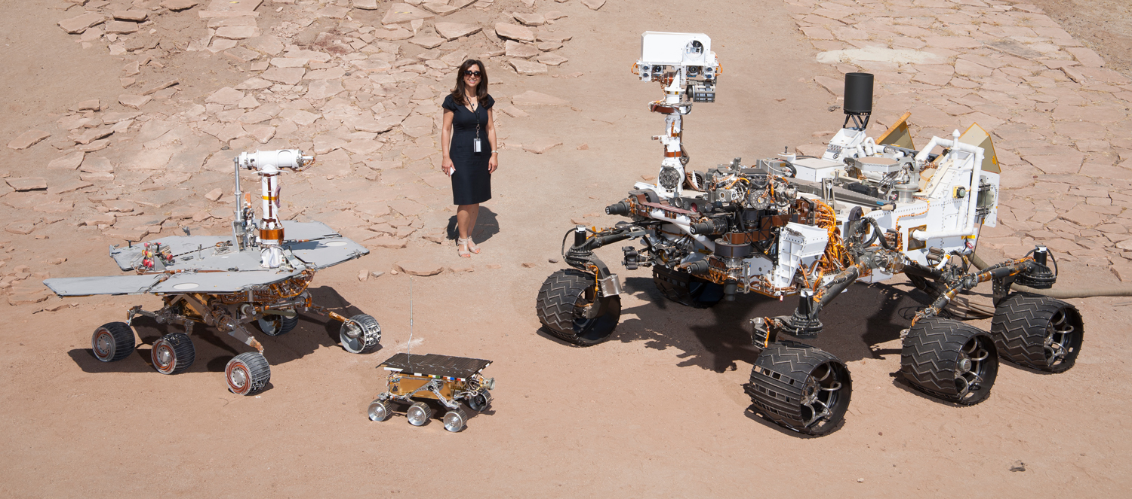
More on Motivation, Solid State CFPAs
Where were you vacationing last summer?
In a small Panoramic Camera, a CFPA can remove 3-4 elements which improves:
  Throughput (~order of magnitude)
  Efficiency
  Field of view (factor of 2)
  Image quality (aberration is introduced by each field flattener)
  Simplicity………

Slide 3
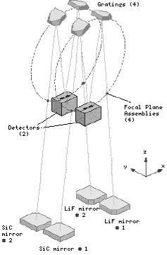
Curved Arrays have flown on multiple missions
Curved microchannel plates (MCPs) have been used to enable missions such as FUSE and Alice instrument in Rosetta, however, curved solid state detectors will have clear advantages
Also imaging spectrograph Alice has been used on Rosetta, on New Horizon, on LRO (LAMP), and as UVS on JUNO uses MCPs with 75 mm ROC. Called revolutionary because of capability and size.
Optical layout of FUSE instrument showing
curved MCPs on the Rowland circle

Slide 4
Challenges and Solutions
Challenges:
Microchannel plates require high voltage, are bulky, and have low
efficiency.
Lithography and direct write on curved substrates is expensive and
impractical.
Require a simple, low-cost method to manufacture CFPAs using
solid state detectors.
Solution:
  Decouple VLSI fabrication process from the required curvature
Imaging Array
Imaging Array

Slide 5
Curved High-purity Silicon Arrays
High-purity imagers with full
depletion can be back-illuminated
without thinning
Require a back electrode for depletion
Require a back surface treatment to
deplete all the way to the surface
Fully-depleted silicon
Imager
frontside
circuitry
Delta layer
(Thin electrode)
High-purity Si
photons
e-
Advantages:
Simple approach
Applicable to fully-processed devices
A wide range of shapes and curvatures can be obtained
Important factors:
Array thickness, array size
Silicon purity, depletion voltage, breakdown
Near IR variation as a function of thickness

Slide 6
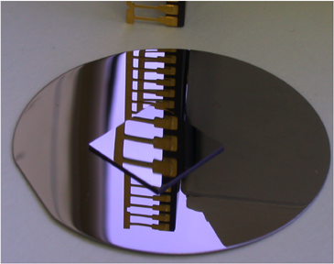
Curved High-purity Silicon Arrays
140
120
λ=500 nm, RT
100
-12
x10
80
60
40
0
20
40
60
80
100
120
140
Voltage (V)
Fabricated PIN diode arrays* to achieve ROC of 260 mm
  Devices were electrically functional and no punch through was observed. Over depletion is possible
  Devices responded to light
CCDs* with 100 mm ROC was also fabricated.
* All LBNL devices

Slide 7
Curved Silicon Membrane Arrays
Thinned membrane arrays conformed or attached to curved substrates
Detector Array
Curved Substrate
Advantages:
Simple Approach
Applicable to front or back illuminated devices
Applicable to a wide variety of silicon arrays
Compatible with delta doping for high and stable
efficiency
Challenges:
limits of silicon membrane deformation
Field effects
photons

Slide 8
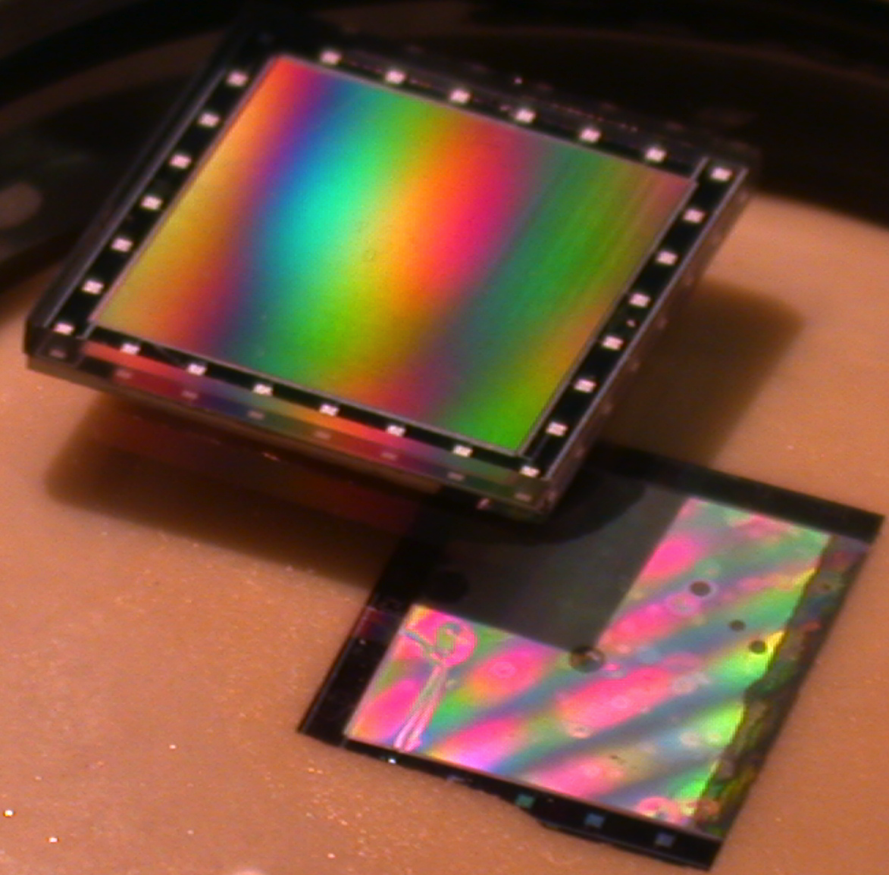
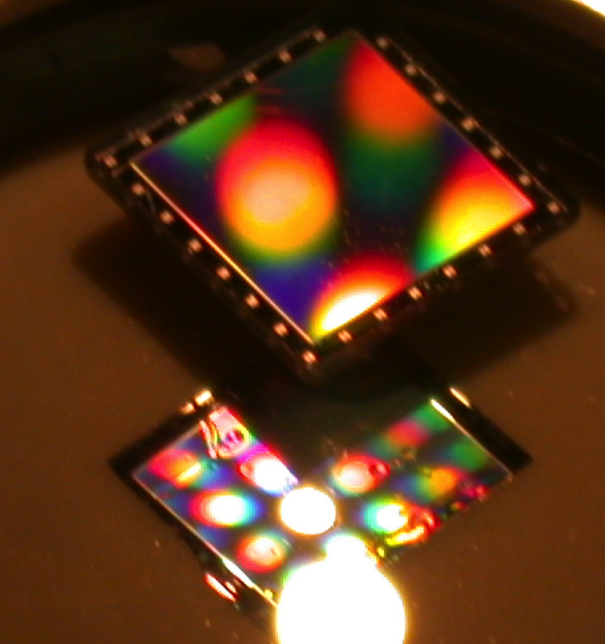
Thinned Curved CCD Arrays
Flat
Flat
Curved
Curved
1K x1K, 12 µm pixel CCDs were thinned and attached to curved substrates ROC=250 mm
For comparison, same CCD formats were thinned and attached to flat substrates

Slide 9
Results of Thinned CFPA, continued
10
10
9
8
8
7
Preamp Output (mV)
6
6
Air Off (flat)
Air Off
5
Air On
Preamp Output (mV)
4
4
Air On
3
2
Air pressure: 14 psi, ROC ~ 500 mm
2
1
Air pressure 18 psi, ROC~ 400
0
0
0
5
10
15
0
5
10
15
Light Intensity (arb units)
Light Intensity (arb units)
10
Freestanding thinned membrane CCDs were curved to different curvatures using air pressure
CCD was operated and output current was measured as a function light intensity for CFPAs with three different radius of curvature (ROC)
No change in the signal level or device behavior was observed as a function of curvature
8
6
Air Off (flat)
Preamp Output (mV)
4
Air On
2
Air pressure, 22 psi, ROC~250 mm
0
0
5
10
15
Light Intensity (arb units)

Slide 10
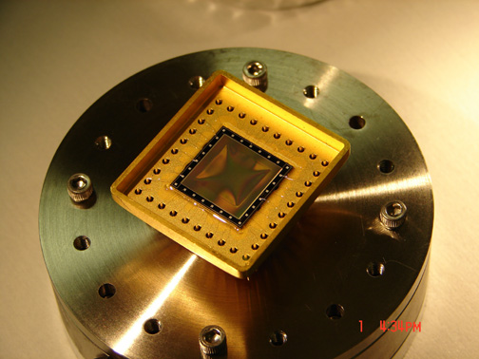
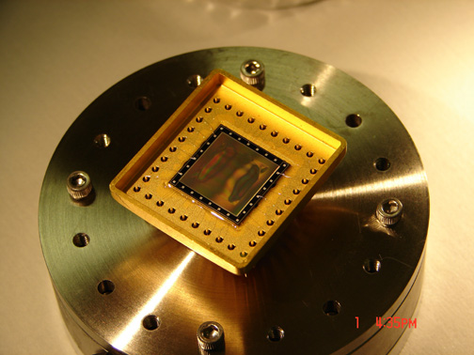
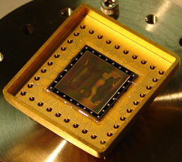




Experimental Results of Thinned CFPA
Freestanding thinned membrane 1k x1k pixel CCDs were curved to different curvatures using air pressure
CCD was taken from essentially flat configuration to ~250 mm radius of curvature (ROC) with no observed mechanical damage

Slide 11
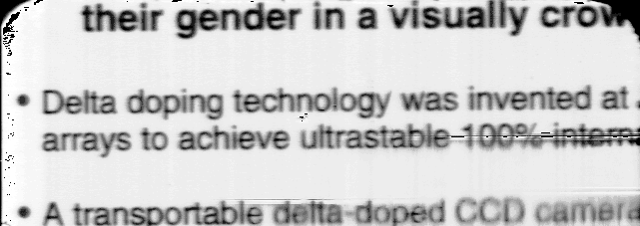
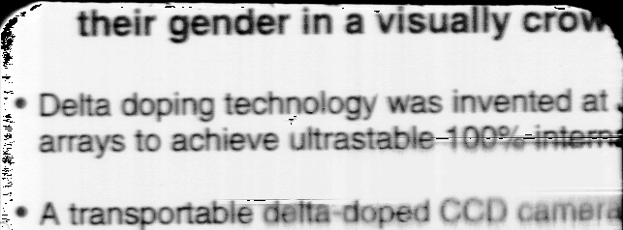
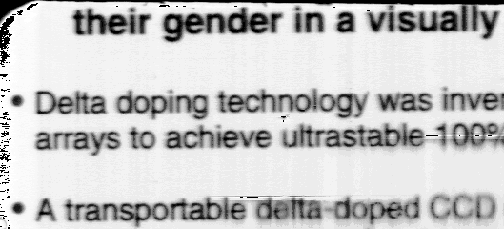
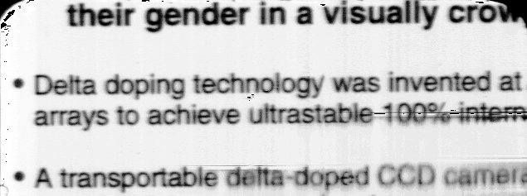
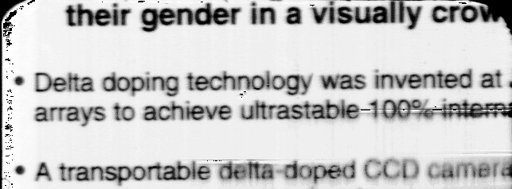
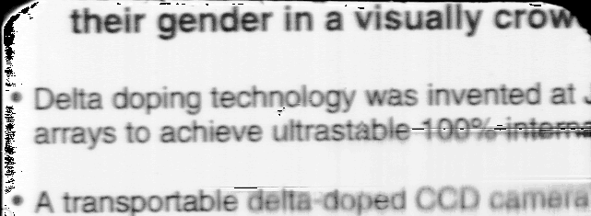
Imaging Results of Thinned CFPA
Freestanding (After Image)
Negative 0.2 psi
Freestanding (Before Image)
Negative 0.1 psi
Positive 0.2 psi
Positive 0.1 psi

Slide 12
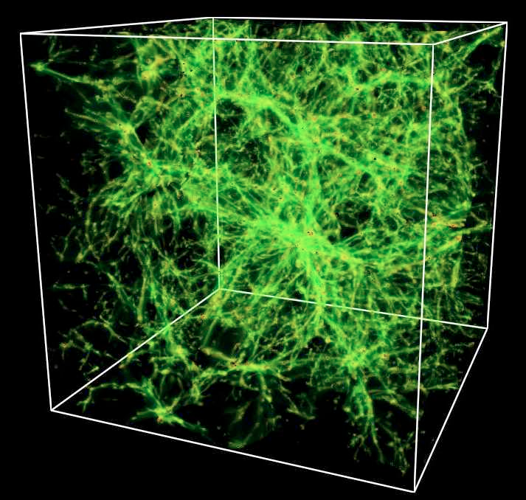
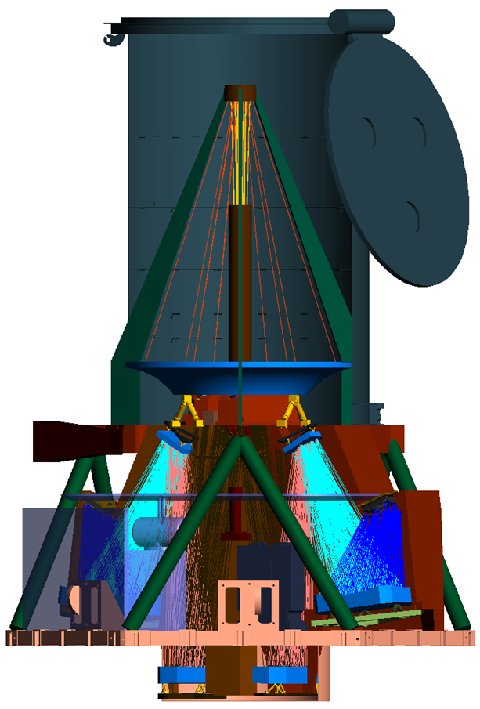
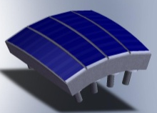
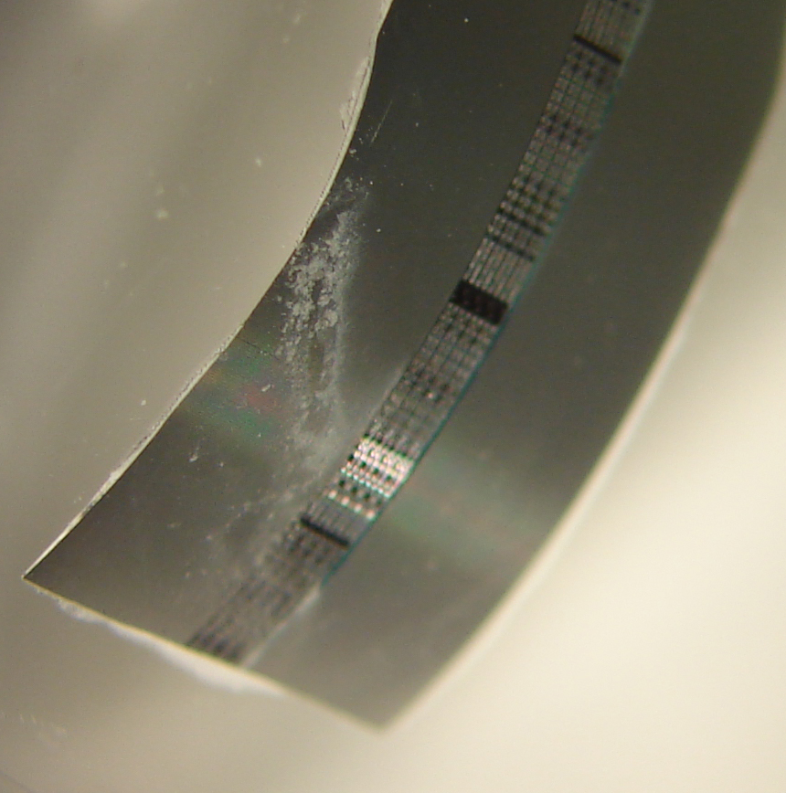
Example: Explorer-ISTOS Concept
A GALEX follow on mission, benefits from curved detector arrays
Preliminary work demonstrated a CCD array, thinned to 20 microns membrane and curved (supported) with ROC ~ 12 mm, far beyond ISTOS requirements. Strain for this severe curvature is 0.1% (limit of Si is 1%)

Slide 13
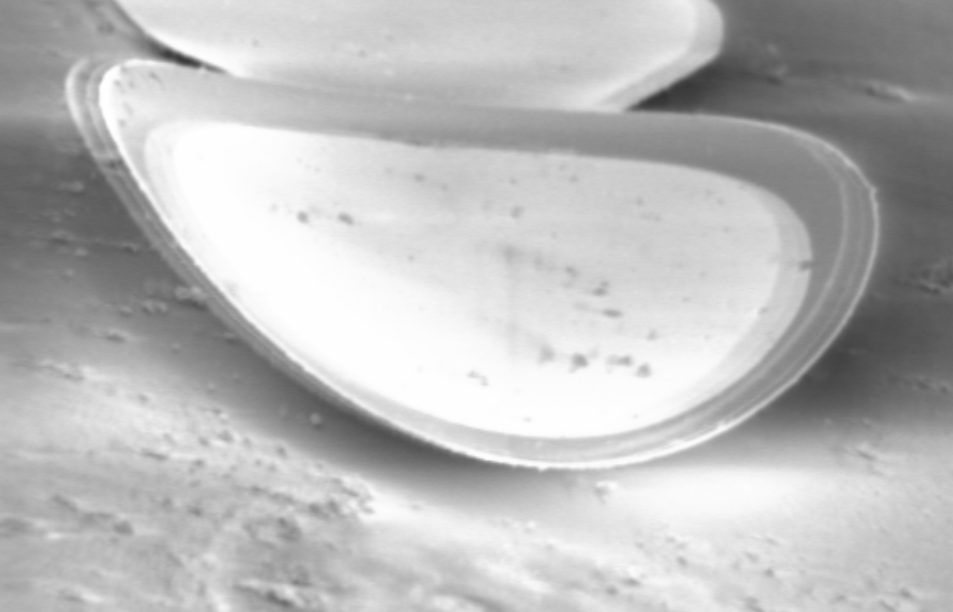
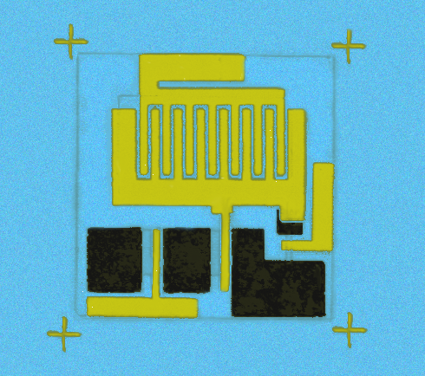
Curved Wide Bandgap Arrays
Photo-ElectroChemical Etching (PEC) of GaN
UV (Xenon Arc Lamp)
Opaque Mask
n-GaN
Holes created by UV light are swept
away from surface in p-type, towards
surface in n-type -> n-type etching
p-AlInGaN
ProtectedMUX
Pt Cathode
- Bandgap Selective
- Dopant Selective
Aqueous KOH (pH ~14)
GaN
Electrolyte
E_{C}
n-GaN
E_{F}
E_{V}
p-GaN

Slide 14
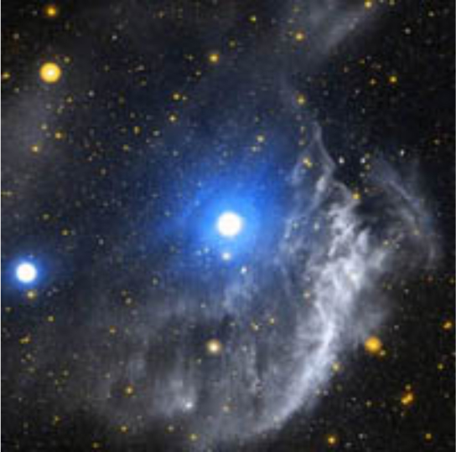
What does NASA space technology have to do with neuroscience, neurosurgery, or medicine?
NASA Requirements:
Great efforts and resources go into developing technologies and instruments to detect signatures from faint objects, characterize planetary atmospheres, detect remnants of dying stars, explore planetary bodies, look for signs of life…
These require high sensitivity, high accuracy, reliable, robust, compact, low power, low mass, non-invasive instruments that can work in harsh and unfriendly environments

Slide 15
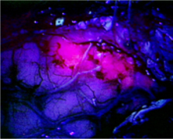
Should Sound familiar to Medical Doctors
Requirements in medicine
We as a people are/should be willing to spend great efforts and resources to help patients. We try to detect faint signals to delineate good cells from bad, get close to the area of interest without disturbing others , look for signs of life…
These conditions require high sensitivity, high accuracy, reliable, robust, compact, low power, low mass, non-invasive instruments that can work in unfriendly environments
There is great synergy and a great deal to leverage from. With relatively small investment great gains can be achieved!

Slide 16
Summary
Curved focal plane arrays enable large FOV, high throughput, low mass, and compact optical systems
The key to a practical (and low cost) fabrication approach for CFPAs is to decouple the VLSI fabrication from the required curvature
We have demonstrated multiple simple, practical approaches for fabrication of CFPAs
Simple modeling was performed to investigate deformation thinned membrane arrays
Some of the techniques were extended to GaN materials and devices

Slide 17
Backup Slides

Slide 18

Some Motivations for CFPAs
  Optical wave fronts are curved and don’t match the FPAs Field flatteners are used to match the FPA
  Allowing the FPA to be curved will:
      eliminate optical elements
      Reduce size and mass
      Reduce complexity
      Increase throughput and image quality
      Dramatically increase the field of view (FOV)
      Allow designer more parameters
Two-element simplification of design
(elimination of field flatteners)
Wide FOV, severely curved, needs only 2 optical elements
Wide FOV, essentially flat, needs 11 optical elements
Table qualitatively shows that optical systems with the same focal length (FL), field of view (FOV), allowing the FPA to be curved, reduces the number of optical elements
Notes:
Table shows result of a study for a number typical applications. It qualitatively shows that the allowing the image surface to be curved will dramatically reduces the number of optical elements and achieving large FOV. For example, the systems pointed by blue arrows have the same focal length, f number, and field of view. The first system allows severe curvature in the image surface while the second system’s image surface is basically flat. By allowing the curvature, the system goes from 11 to 2 optical elements.

Slide 19
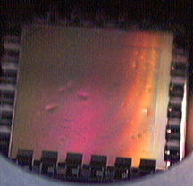
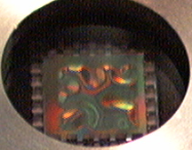
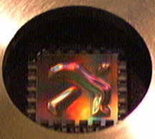
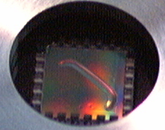
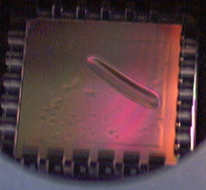
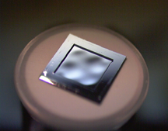
Experimental Methods for CFPAs using Thinned Membranes
Pressure conforming of Imager
Evolution of CCD flatness
Vacuum conforming of imagers (full contact)
Detector Array
Curved Substrate
Thinned membranes can be conformed to substrates for flat or curved
focal planes
Real time adjustment of curvature possible with no substrate attachment

Slide 20
Large Focal Plane Arrays
flat
Mosaics of curved detector arrays can form a large focal plane array that can be curved to the specifications of the system
Frontside circuitry
photons

Slide 21
Imaging Results of Thinned CFPA

Slide 22
Conforming Thinned Silicon
Sharpest Radius of Curvature for 0.01 Strain
350
300
250
200
Radius of Curvature (mm)
150
100
50
0
0
10
20
30
40
50
Square Array Side (mm)
Smaller arrays accommodate tighter ROCs, larger arrays require gentler ROCs,
Mosaiced arrays can accommodate a larger range of ROCs
Silicon has a mechanical deformation limit of 1.0 percent
Conforming a square array onto spherical substrate
Notes:
Geometrical calculations were used to map a square array to a spherical surface keeping in mind the silicon strain of 1%.

Slide 23
Finite Difference Analysis for Membrane Deformation
Elastic Deformation - Basic Equations
Displacement field:
Stress and strain fields:
Static equilibrium equation:

Slide 24
Finite Difference Analysis for Membrane Deformation
Si Membrane - Model
R
H
Cylindrical symmetry
0
Boundary conditions:
Pressure on element with norm n_{i}:
1) Contact with sphere:
on sphere
on free surface
“clamped edge”
2) Hydrostatic pressure:
on pressurized surface
on free surface
“clamped edge”

Slide 25
Finite Difference Analysis for Membrane Deformation
Numerical Implementation
Uniform Cartesian grid in (r,z) plane:
N_{r} points along the radius
N_{z} points along the thickness
z
r
Finite difference discretization:

Slide 26
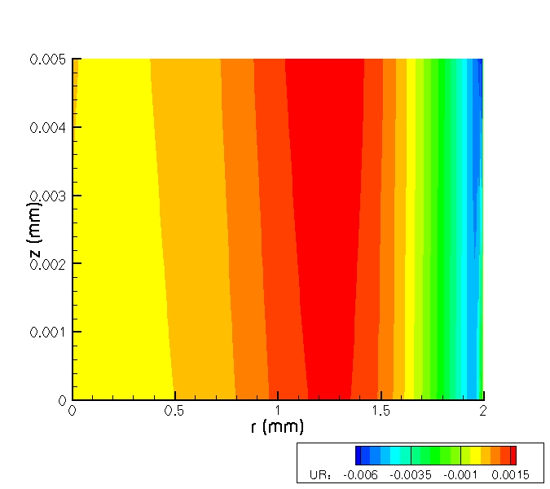
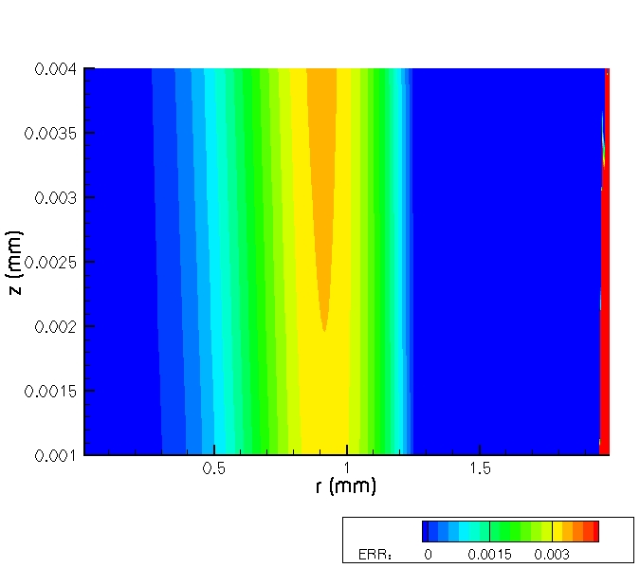
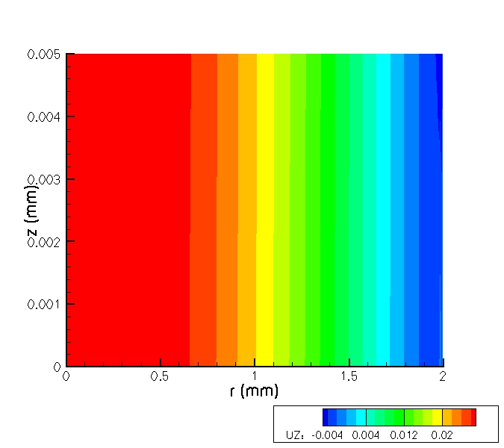
Results of Analysis for Hydrostatic Pressure
Radial strain
Radial displacement
Membrane radius = 2 mm
Membrane thickness H = 5 μm
Pressure = 5 * Young modulus
Vertical displacement
P

Slide 27
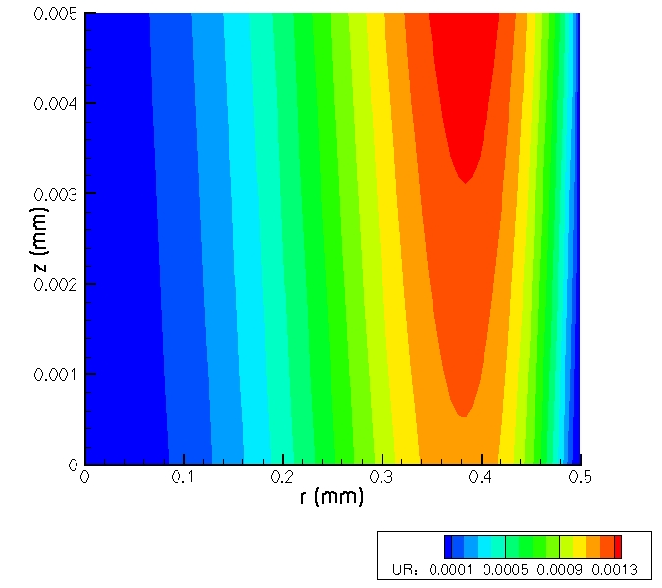
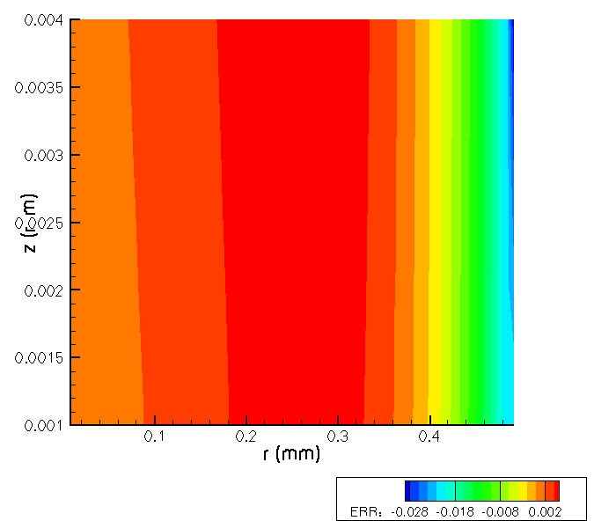
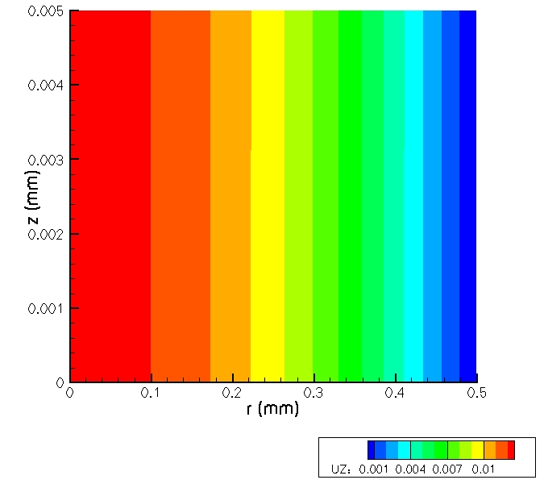
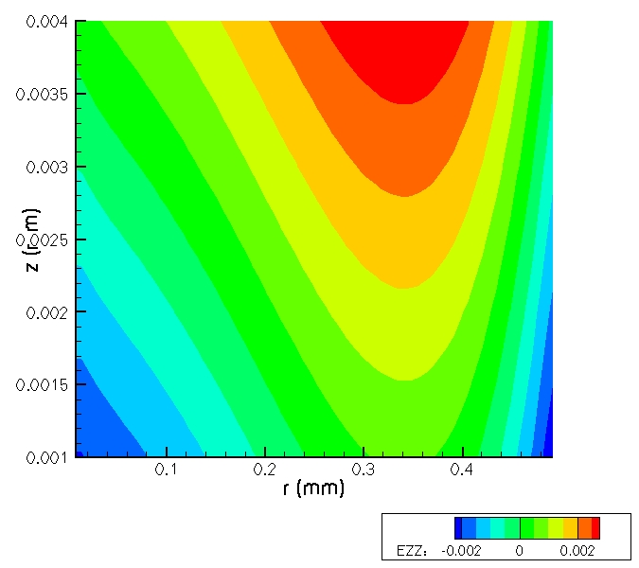
Analysis Results for Full Contact With Sphere
Membrane:
radius = 2 mm
thickness H = 5 μm
Sphere in full contact:
Displacement
Strain

