Slide 1
Spherically Curved CCD Imagers for Passive Sensors
J. A. Gregory, A. M. Smith, E. C. Pearce, R. L. Lambour,
R. Y. Shah, H. R. Clark, K. Warner, R. M. Osgood III, D. F. Woods, A. E. DeCew, S. E. Forman, L. Mendenhall, C. M. DeFranzo,
V. S. Dolat, and A. H. Loomis
*This work was sponsored the Defense Advanced Research Projects Agency (DARPA)/Tactical Technology Office (TTO) under Air Force contract number FA8721-05-C-0002. Opinions, interpretations, conclusions, and recommendations are those of the authors and are not necessarily endorsed by the United States Government.

Slide 2
Outline
Deforming Si and its effects on CCDs
Curved sensor examples
  Charge-coupled device (CCD) petal chip
  Space Surveillance Telescope
Notes:
Outline of talk and topics to be covered.

Slide 3
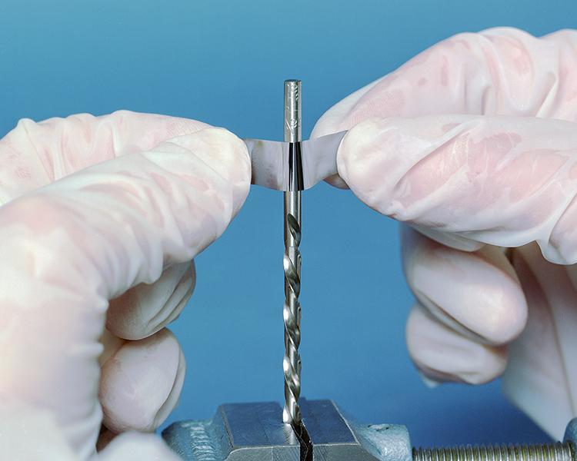
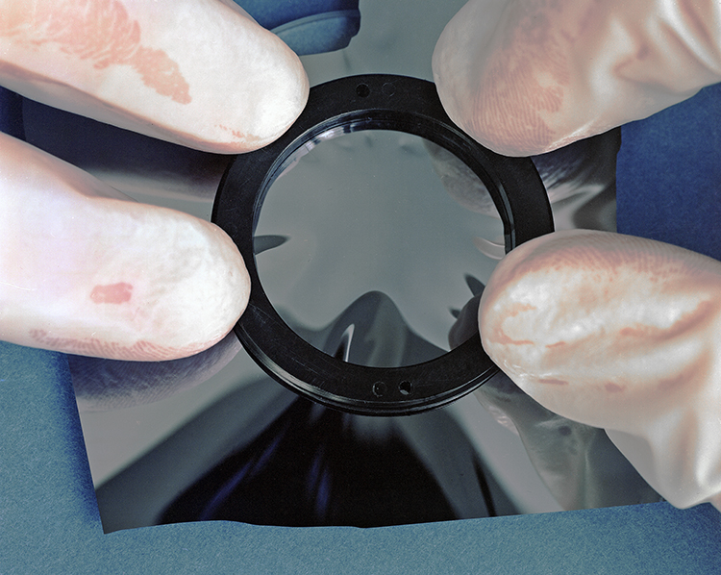
Deforming Thin Si Sheets
Si sheets of 50-µm thickness can withstand large deformation
  Single crystal material has failure strain, ε_{F}, ≈ 1.2% (σ_{F} ≈ 2 GPa)
    Corresponds to ≈0.2 steradian (sr) coverage of a convex or concave sphere
    Allows for ≈30° field of view, with only weak thickness dependence
Tensile load needed to avoid buckling while deforming spherically
  Buckling tendency increases with solid angle covered
Spherical Deformation with
Buckling Over a Glass Lens
Large-Strain (≈1%) Cylindrical Deformation
Notes:
Limits to deforming Si. Cylindrical deformation is much simpler to perform than spherical deformation. Tests done on very thin sections with thickness <50 µm and with few surface flaws due to chemical thinning process. Maximum strain is > 0 at “north pole” and approx 3/16*(radius of circular disk/radius of sphere)^2. For cylindrical deformation, |strain| = (0.5*membrane thickness/radius of cylinder).
Previously cleared for MSS Conference (MS-14362A).

Slide 4
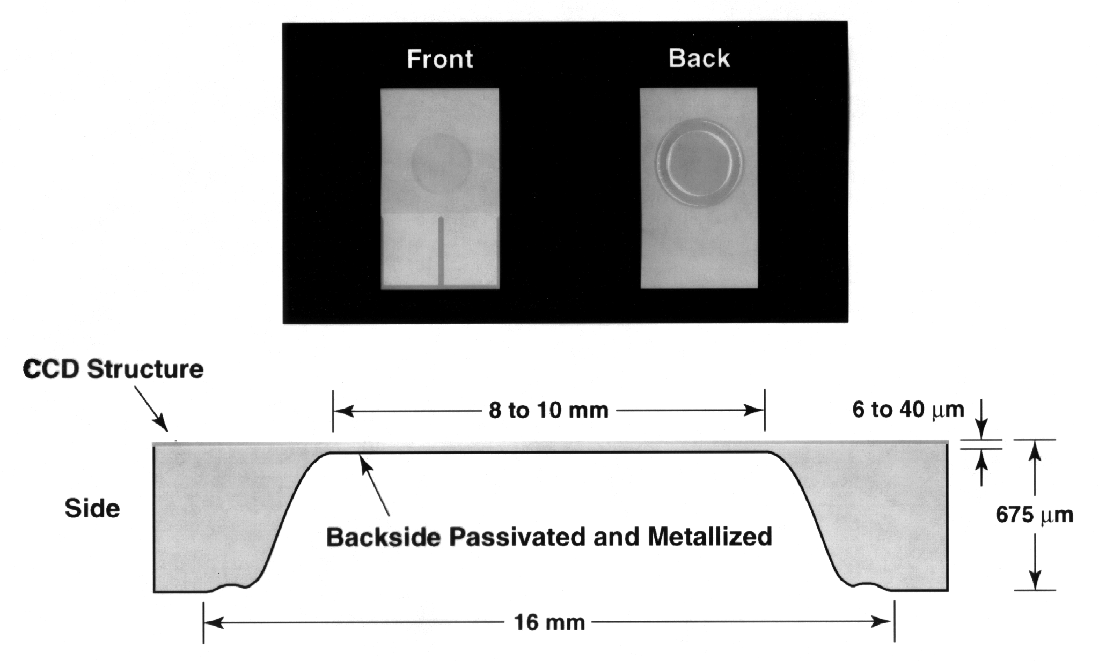
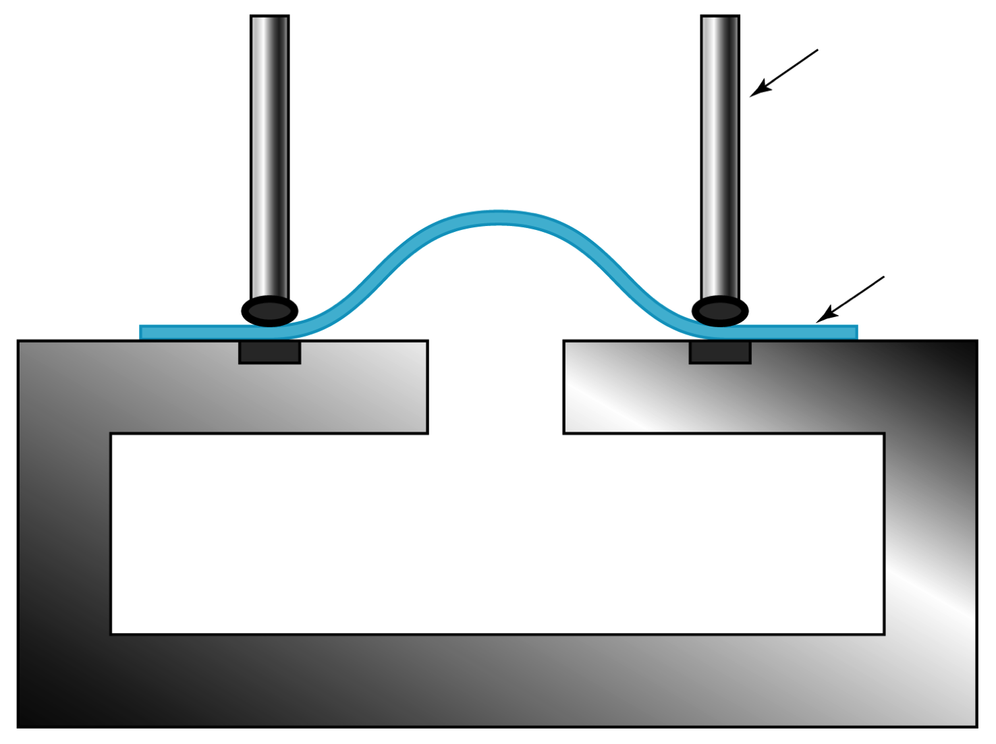
Spherically Deforming Thinned Devices
Clamp Ring
Top View
40 mm
Side View of
Thinned CCD
Pressure Chamber
View
Pressure chamber for
stressing CCD
CCD with Central Thinned Section
Out-of-plane displacement
  Good agreement for thickness and pressure dependence with analytical model
  Qualitative agreement for orientation dependence
  Induced tangential tensile stress eliminates buckling
Notes:
Photographs and cartoon cross section of CCD thinned in the center to allow pressurization and deformation of the Si.
Cartoon of jig used to pressurize the thinned CCD.
Fracture strain agrees well with literature for single-crystal Si
Previously cleared for MSS Conference (MS-14362A).

Slide 5
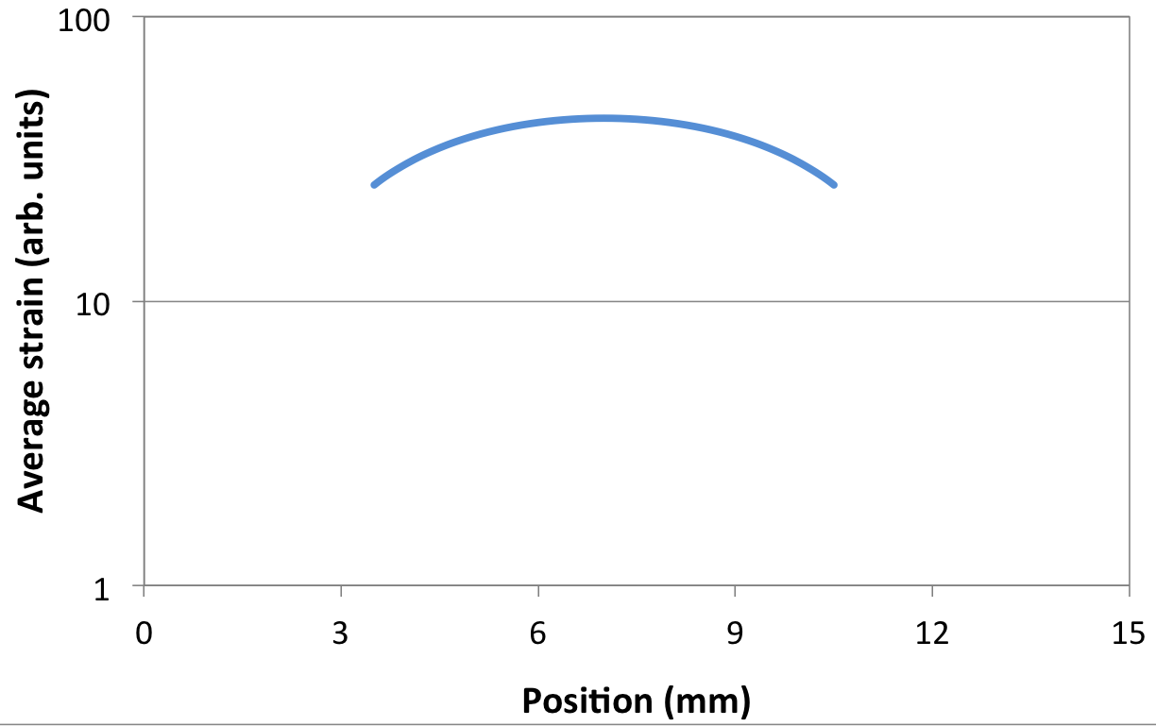
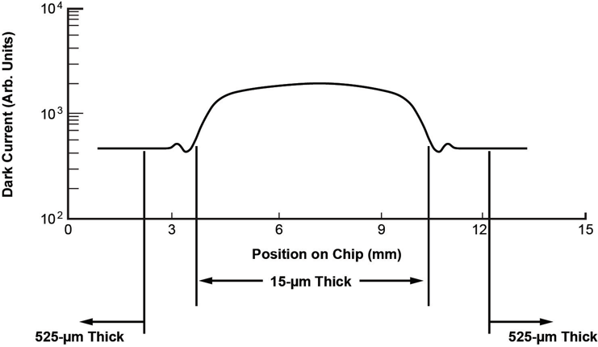
Effect of Strain on Dark Current
T = -50˚C
575 kPa
Calculated strain vs. position
Change of scaled I_{D} with
position across thinned section
Dark current reaches maximum at center of deformed CCD (maximum strain)
Notes:
Experimental results of deformation relating temperature and pressure to change in dark current, giving rise to a simple formula for Id.
Variation of dark current with position across the diameter of the thinned section of the CCD.
Deformation remains elastic, with changes in Id remaining reproducible for many pressure cycles.
Previously cleared for MSS Conference (MS-14362A).

Slide 6
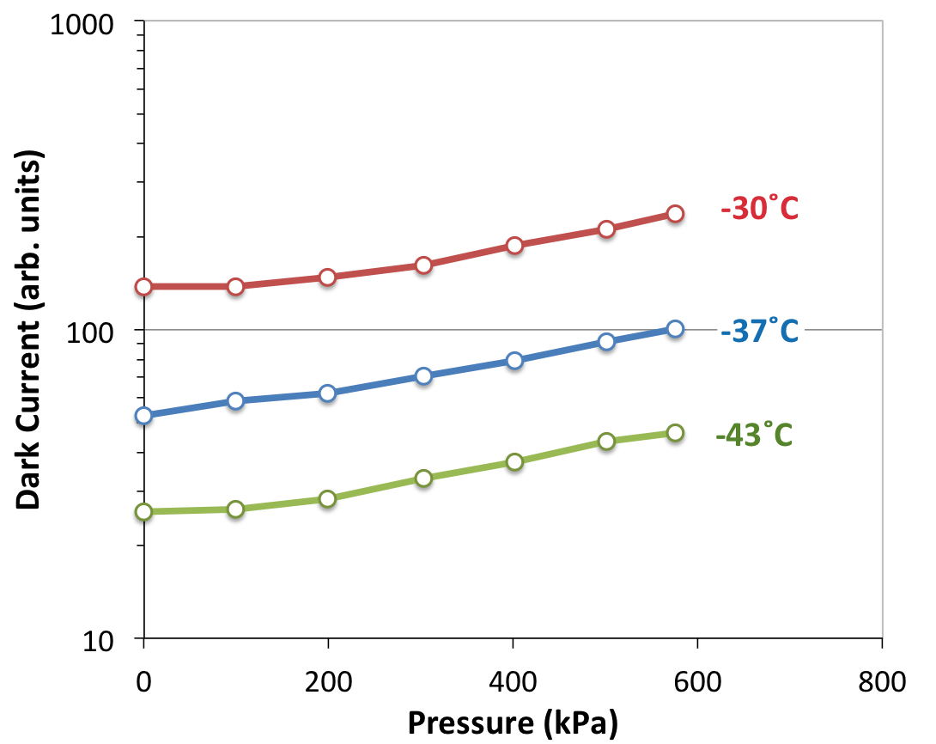
Scaled Dark Current (I_{D}) vs. Pressure
Effects can be modeled as strain-dependent reduction in bandgap
I_{D} = CT²exp[-(E_{g}⁰ + ∂E_{g}/∂ε•|Δε|)/2kT]
  ∂E_{g}/∂ε (-80 meV/%) agrees well with handbook values
No permanent degradation below ε_{F}
Notes:
Experimental results of deformation relating temperature and pressure to change in dark current, giving rise to a simple formula for Id.
Dark current increases with deformation, but a=can be compensated by modest cooling of < 5°C.
Deformation remains elastic, with changes in Id remaining reproducible for many pressure cycles.
Previously cleared for MSS Conference (MS-14362A).

Slide 7
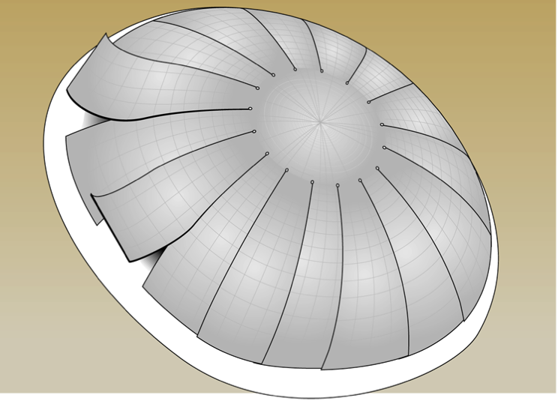
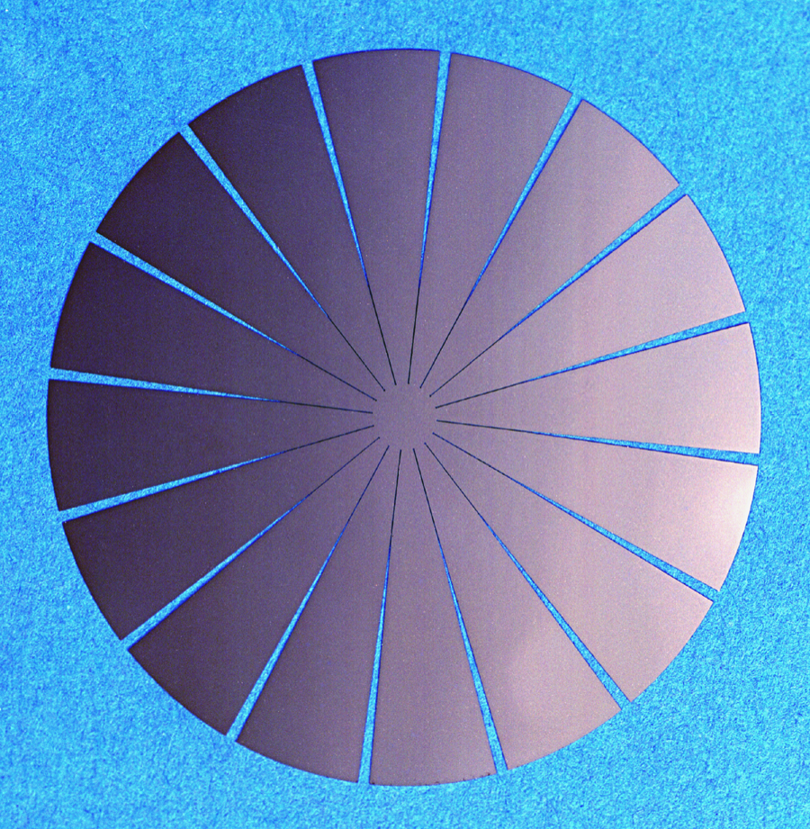
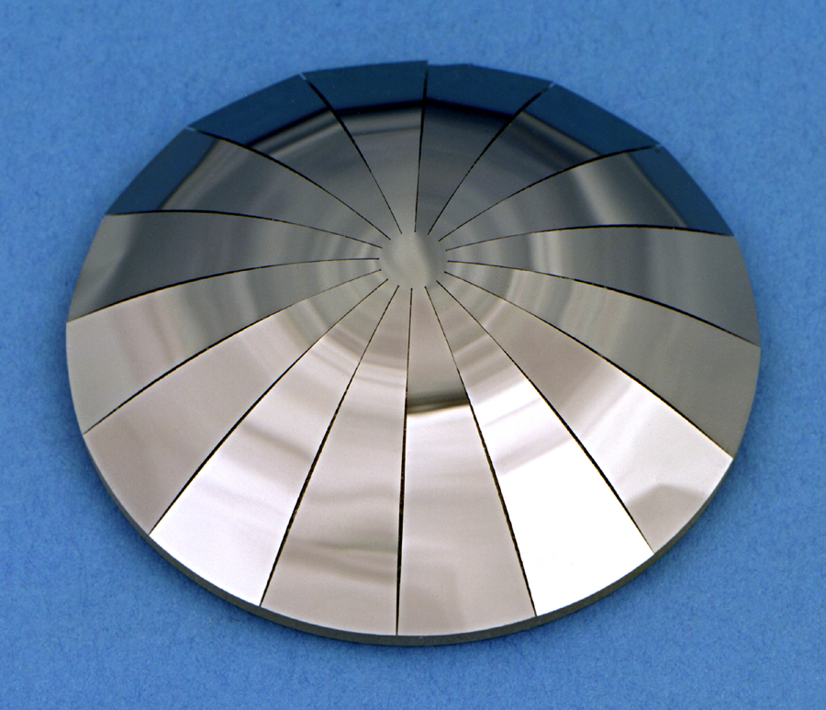
Petal-Chip CCDs for Wider FOV
Overlapping of petals during deformation allows for greater solid-angle coverage
Cover 1.14 sr
  70° object field-of-view
  Focal-sphere radius of 15 mm
  16 petals surround central disk
  Pixel dimensions ~ 24 μm, radially and tangentially
Image array only, no frame store
Polar array of pixels
  Rings and columns
    390,000 pixels
    360 rings out to serial register
    Successive rings contain increasing numbers of pixels
    Column length variable
  Serial register
    Along circumference of each petal
Examples of petal chips covering 1.4 sr
54-mm-diameter petal
membrane extracted
from thinned Si wafer
Petal membrane deformed about 38-mm-radius spherical mandrel
Notes:
A means of increasing the solid angle covered is to decrease the solid angle of a local region. Petal design is configured for gaps to disappear after curving to a given spherical radius. Note other curved surfaces could be accommodated. Membrane thickness ≈45 µm.
Design goals for optical performance of curved petal-chip CCD. The objective was to demonstrate a compact imager with a small radius of curvature. This is to be used on the f/2 optics train with a spherical focal surface.
Previously cleared for MSS Conference (MS-14362A).

Slide 8
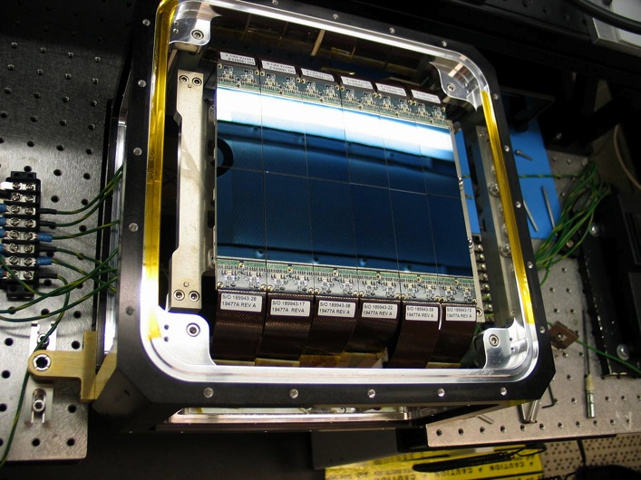
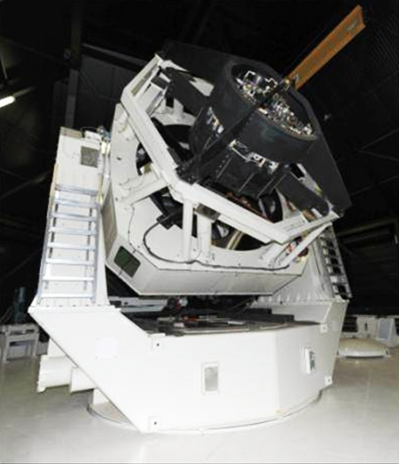
Fully Populated Space Surveillance Telescope Focal Surface
12 CCDs mounted to 5.44-m radius of curvature within 3 µm
CCD: 2 k × 4 k, 15-µm pixels
Space Surveillance Telescope,
3.5 m, f/1
Notes:
SST is operated to rapidly surveil the sky for dim satellite targets and to perform astrometry. Photo of completed focal-surface array in SST. Curvature of array appears to curve the reflection of the fluorescent bulb in the photo.
Photo of SST in place in NM.
Cleared for DARPA/TTO/SST website.

Slide 9
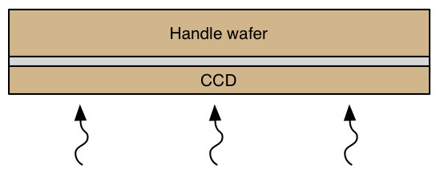
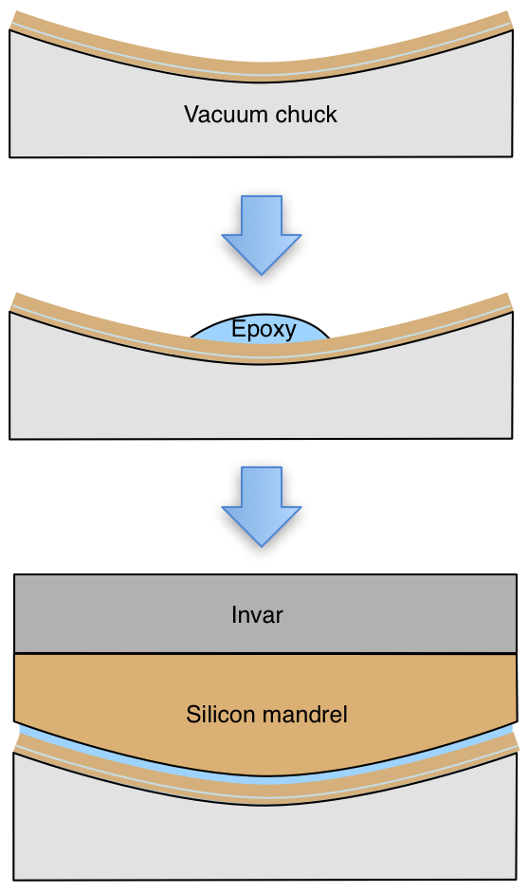
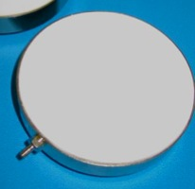
Vacuum-Assisted Bonding to Curved Mandrels
150
mm
Vacuum chuck
  Machined to desired curvature
  Eliminates buckling; places membrane in tension
Notes:
Method of mounting large format CCDs without buckling using a vacuum fixture. Thinned CCD is drawn down into curved vacuum chuck and mounted onto curved mandrel with epoxy. After the epoxy cures, the vacuum is released. This adds about 5% processing time and reduces yield by about 5%.
Contour map of mounted CCD shows excellent conformance, within 1.7 µm RMS of the 5.44-m target radius.
Cleared for AMOS Conf 2013, T. Blake (DARPA/TTO) et al.

Slide 10
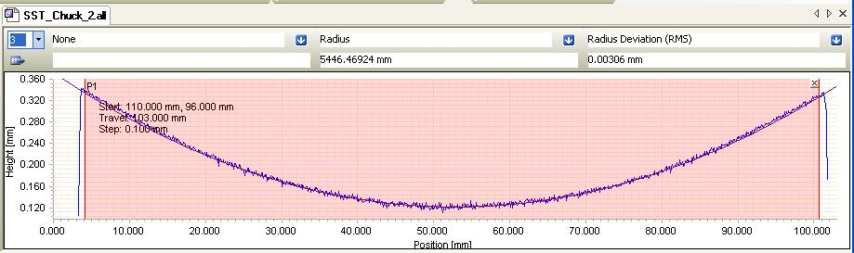
Profile Scan Results: CCD Held by Vacuum Chuck
Radius of curvature confirmed:5.446 m vs. 5.440-m target
3 µm RMS surface deviation
Notes:
Profile measurement of mounted CCD, within 3 µm for conformance to 5.440-m radius; best fit radius is 5.446 m.

Slide 11
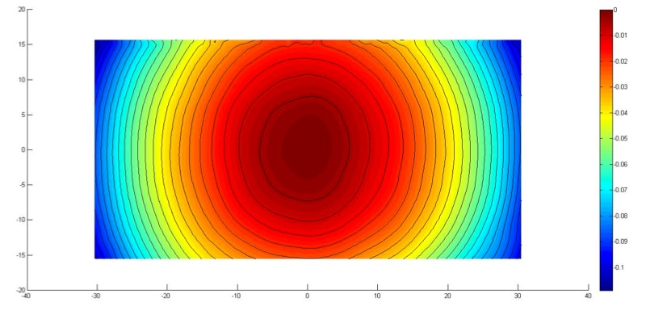
Post-Bonding Measurements
Surface scan data
Units = mm for all scales
Conformance to 5.44-m radius is < 1.7 µm rms for CCD
Within 3 µm for all CCDs in focal-plane array
Maximum strain < 3×10⁻⁵ (<< failure strain)
Dark current, CTE and cosmetics unchanged
Notes:
Contour map of mounted CCD shows excellent conformance, within 1.7 µm RMS of the 5.44-m target radius.
Cleared for AMOS Conf 2013, T. Blake (DARPA/TTO) et al.

Slide 12
Summary
Deforming Si and its effects on CCDs
  Principal effect is increased dark current
  No observed effect on CTE
Curved sensor examples
  Charge-coupled device (CCD) petal chip
    70˚ FOV
    Mechanical model demonstrated; CCD fabricated but not thinned
  Space Surveillance Telescope
    First use of curved CCDs in large focal-surface array
    Operational for ~1.5 years
Notes:
Summary of talk and topics covered.

