Slide 1


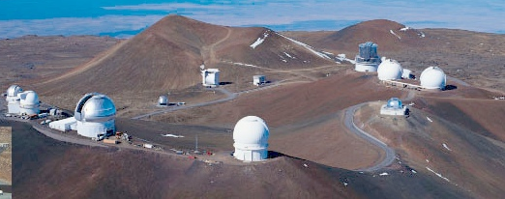
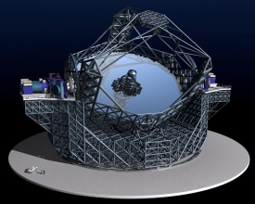
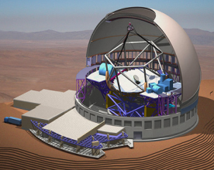
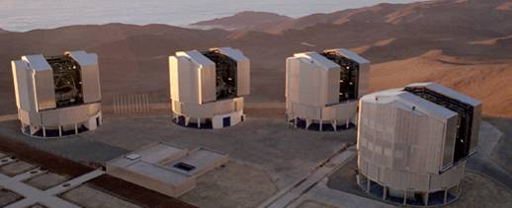

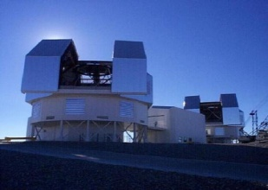
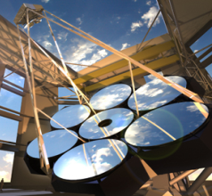
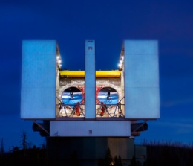
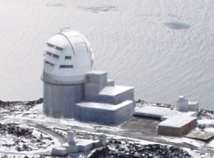
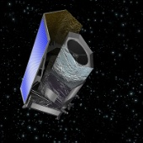
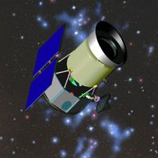
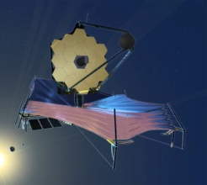
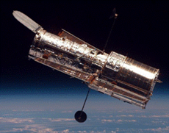
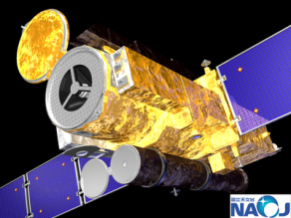
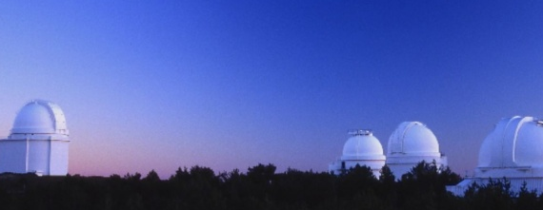
Scientific Detector Workshop 2013
7-11 October
Florence, Italy
Teledyne Detector Update
Presented by James W. Beletic
10. October 2013
Selmer Anglin¹, James Beletic¹, Richard Blank¹, Craig Cabelli¹, Scott Cabelli¹, Jing Chen¹, Richard Demers¹, Mark Farris¹, Don Lee¹, Gerard Luppino², Anders Petersen¹, Eric Piquette¹, Andre Wong¹, and Min Xu¹
¹ Teledyne Imaging Sensors, 5212 Verdugo Way, Camarillo, CA 93012, USA
² GL Scientific, 3367 Waialae Avenue, Honolulu, HI 96816, USA

Slide 2

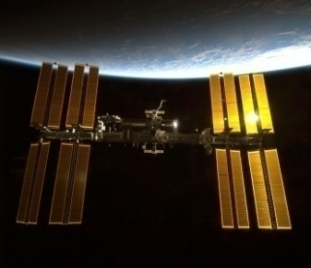
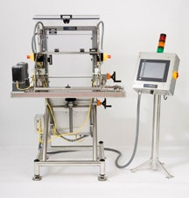
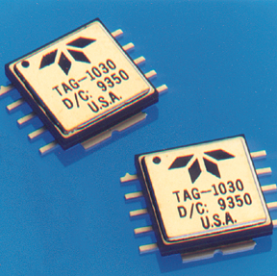
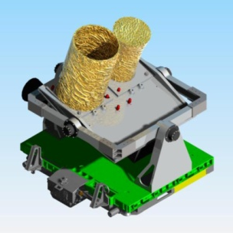
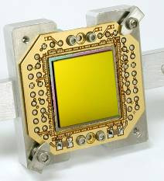
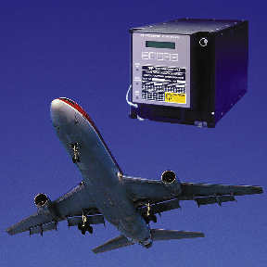
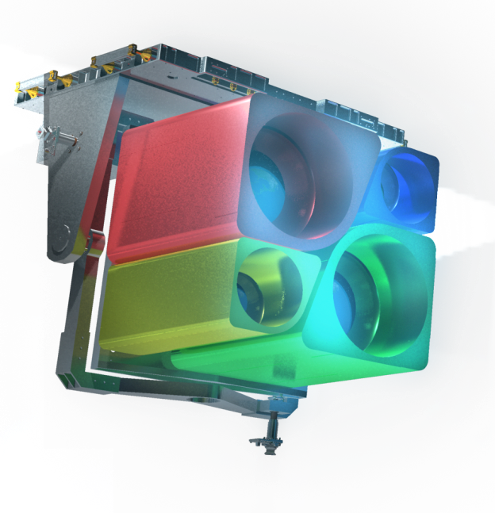
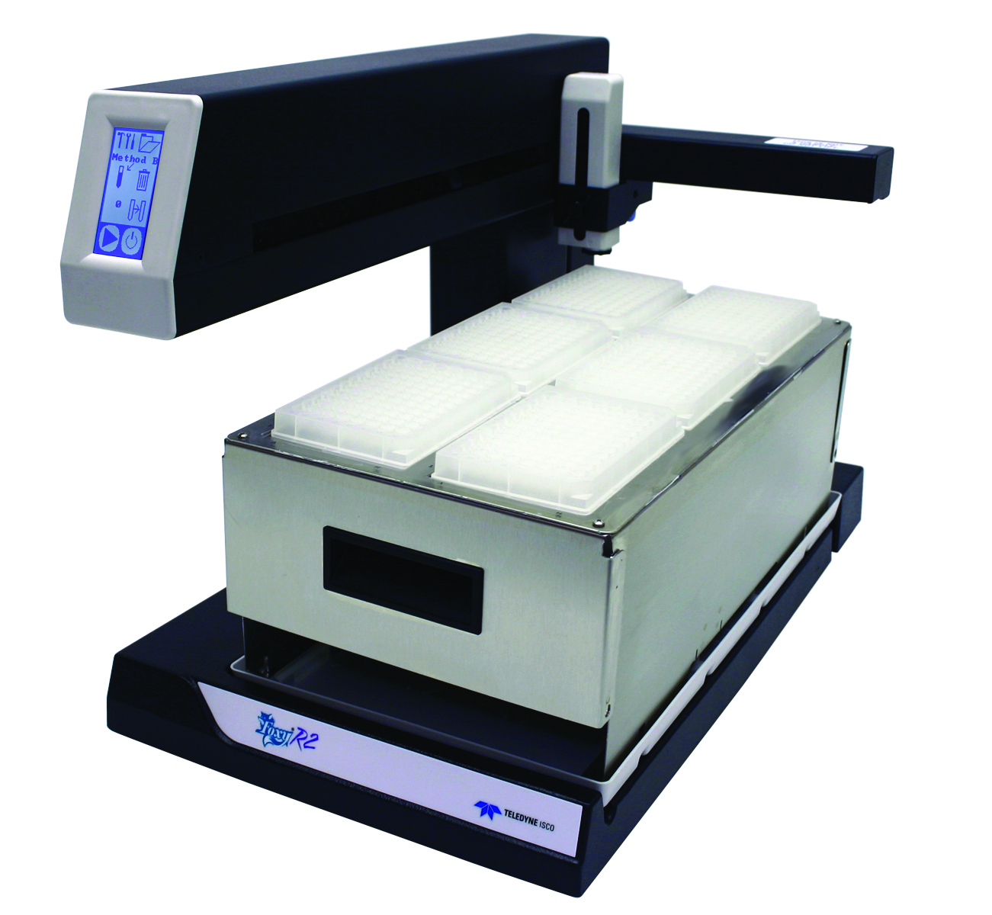





2
Engineered Systems
Digital Imaging
Instrumentation
Aerospace and
Defense Electronics
Dedicated to the Scientific Community
Space & Astronomy
Market Segment
2

Slide 3

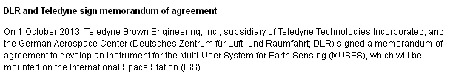

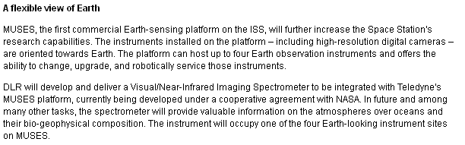
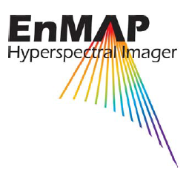
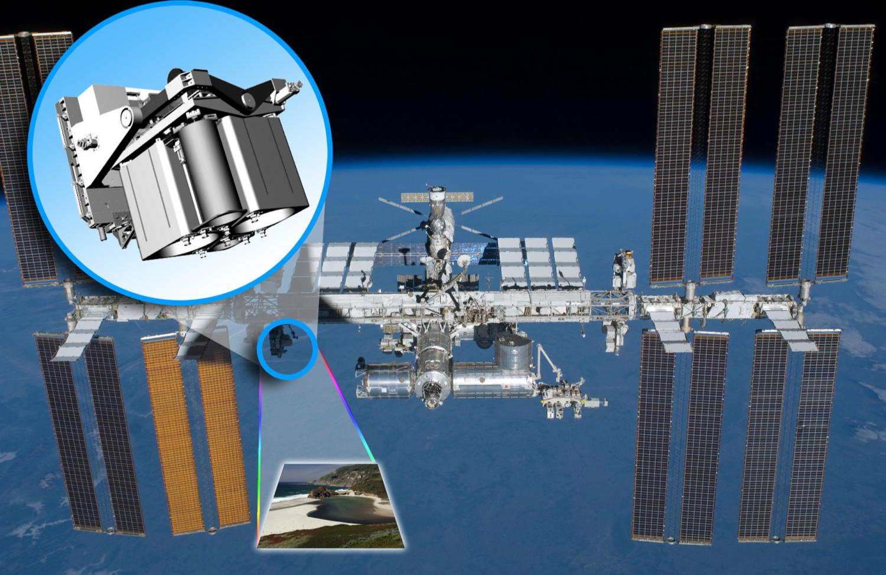
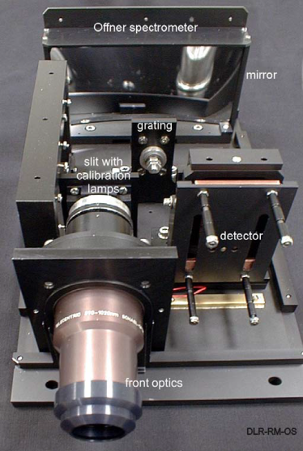
Copy of EnMAP VNIR spectrometer
420-1000 nm
5 nm spectral sampling
Image Sensor
BAE Fairchild
Backside illuminated CMOS
1024×128 pixels
24×24 µm pixel size
1 Me- full well
70 e- noise (high gain)
13 bit column parallel ADC
DLR Offner Spectrometer

Slide 4
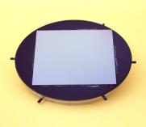
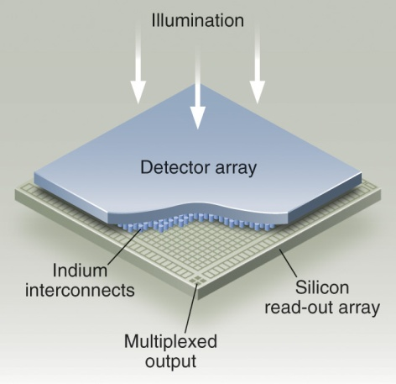
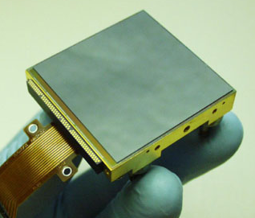
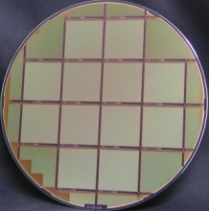
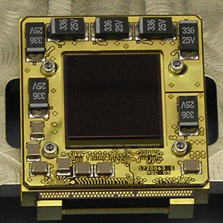
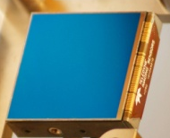
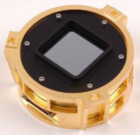
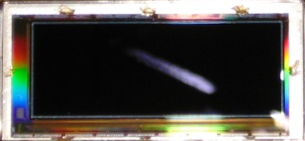
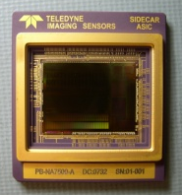
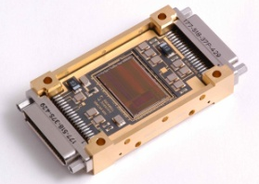
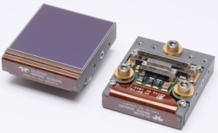
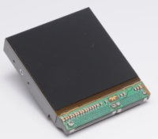
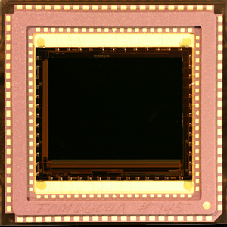
High-Performance Image Sensor Technologies
The highest performance
infrared sensors are
Hybrid CMOS image sensors.
Three Key Technologies
Growth and processing of HgCdTe detector
Design and fabrication of CMOS readout circuit
Hybridization of detector to CMOS readout
SIDECAR ASIC
Focal Plane Electronics
Imaging Spectroscopy Sensors
  Moon Mineralogy Mapper
  Mars Reconnaissance Orbiter (CRISM)
  Artemis
  AVIRIS
  PRISM
  HyspIRI
  Comet Hopper
HST ACS
LDCM TIRS
JWST
OSIRIS-REx
Euclid
WFIRST
Explorer Missions
H1R/H1RG
1024x1024 pixels
HST WFC3
WISE
OCO
Deep Impact/EPOXI
OSIRIS-REx
H2RG
2048x2048 pixels
JWST
Euclid
Ground-based astronomy
WFIRST
640x480 pixels
1280x480 pixels
1600x480 array in development
Developments for NASA Missions
Long-wave infrared sensors for
NEOCam asteroid survey mission
Sparse readout soft x-ray sensor
HyspIRI Visible-SWIR and HyspIRI Thermal IR (30-kHz frame rate)
H4RG-10 IR for WFIRST
FINESSE Exoplanet Prototype
H4RG-10
4096x4096 pixels
JMAPS
OPTIIX
HST SM5
WFIRST
H4RG-15
4096x4096 pixels
Ground-based astronomy
Future NASA missions
4

Slide 5
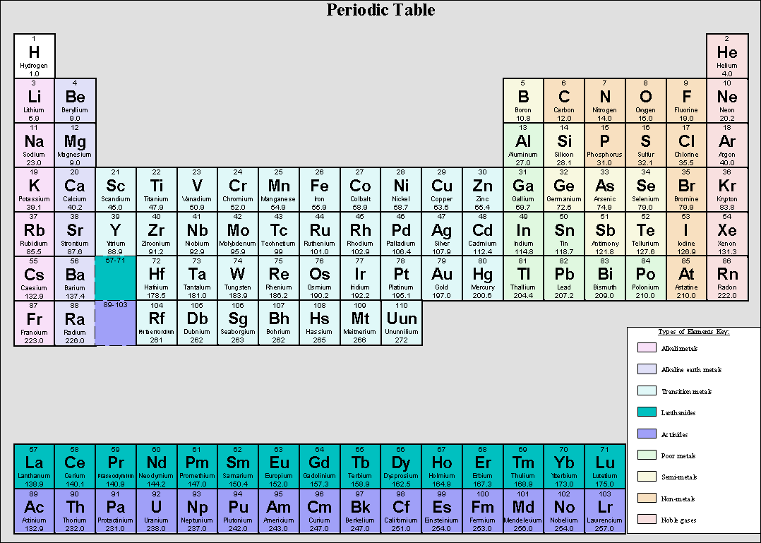
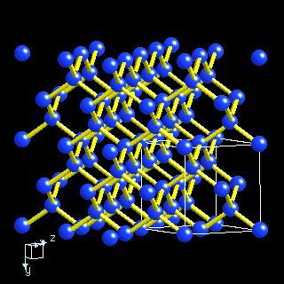
II
III
IV
V
VI
Detector Families
Si - IV semiconductor
HgCdTe - II-VI semiconductor
InGaAs & InSb - III-V semiconductors
InAs + GaSb - III-V Type 2
Strained Layer Superlattice (SLS)
5

Slide 6
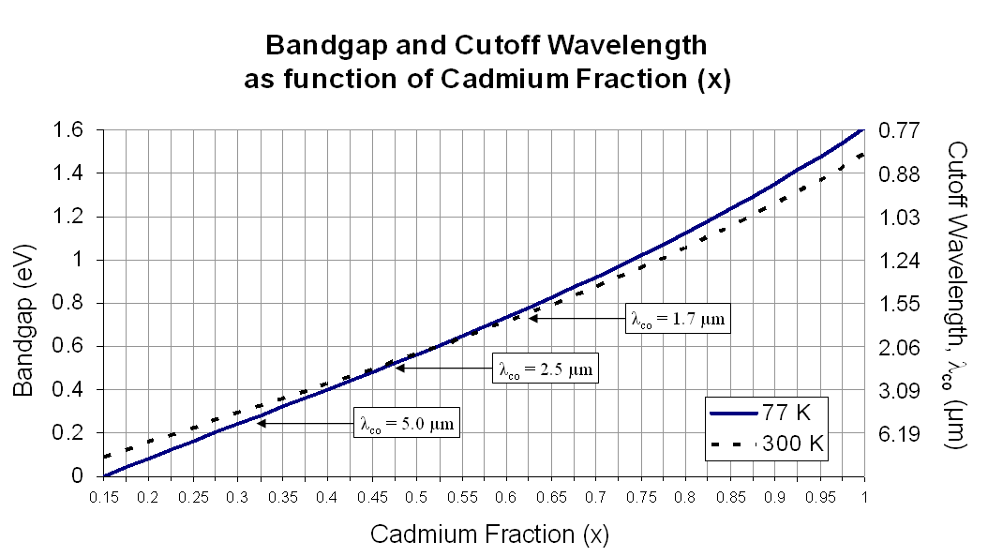
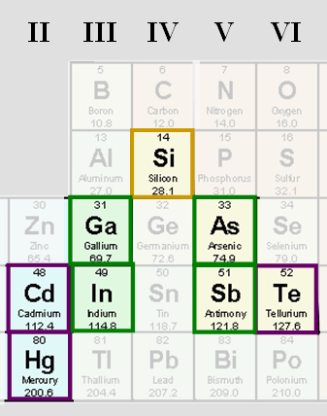

Tunable Wavelength: Unique property of HgCdTe
Hg_{1-x}Cd_{x}Te Modify ratio of Mercury and Cadmium to “tune” the bandgap energy
λ_{co} = 5.3 mm
HgCdTe crystal is grown by MBE on CdZnTe Substrates
G. L. Hansen, J. L. Schmidt, T. N. Casselman, J. Appl. Phys. 53(10), 1982, p. 7099
6

Slide 7
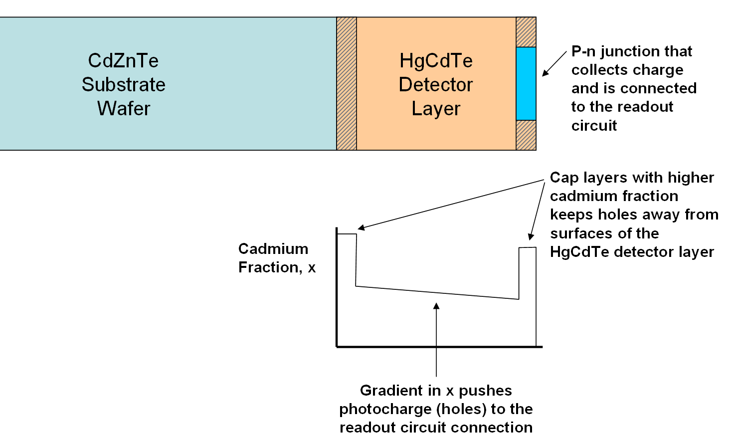
Growth Structure of p-on-n HgCdTe arrays
7

Slide 8
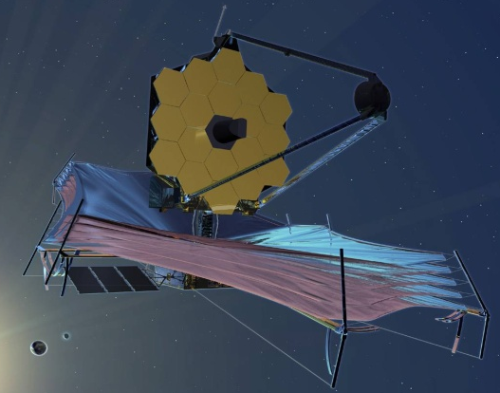
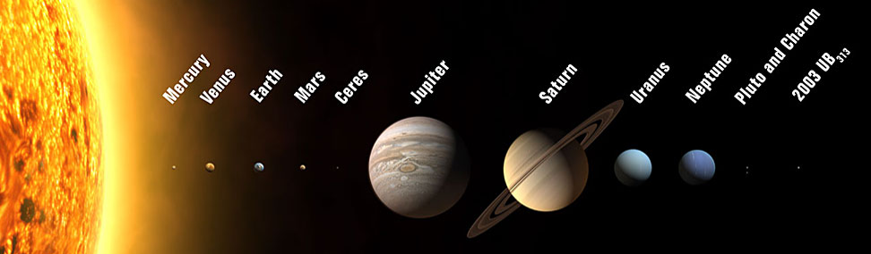
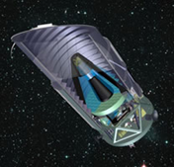
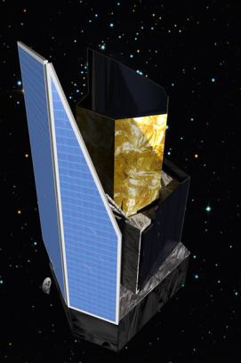
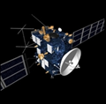




High-Performance Sensors Serving Space Astronomy
HST
WISE
JWST
JMAPS
NICMOS, WFC3, ACS Repair
Bands 1 & 2
NIRCam, NIRSpec, FGS
4Kx4K Arrays & Electronics
WFIRST
Euclid
Rosetta
OSIRIS-REx
Mars
Reconnaissance
Orbiter
Deep Impact
& EPOXI
New Horizons
Array sizes: 128x128 to 4096x4096 pixels
High-quantum efficiency (>80%)
Low readout noise (<6 electrons)
Focal plane electronics
Space flight packaging
Supporting NASA Explorer, New Frontiers, Discovery mission developments
Lander (çiva)
IR spectrograph
CRISM (Vis & IR)
IR spectrograph
IR spectrograph
8

Slide 9



H2RG Product Improvements: 2002 - 2013
Process Improvement
Reduced Persistence
Improved UV hard “blue” QE
Reliability Improvement
Bake stability & storability
Process Improvement
Lower readout noise
Process Improvement
Lower interpixel capacitance
Process Improvements
Lower dark current
Eliminate dark current tail
Higher operability
Higher yields
Process Improvement
Substrate Removal
Higher quantum efficiency in IR
Visible response (with high QE)
Less susceptible to cosmic rays
Eliminates fringing in the substrate
Reliability Improvement
Improved Balanced Composite
Structure (BCS)
H2RG Visible - IR Array Performance and Reliability
Dark Current
Lowered mean
Eliminated tail
2002 2003 2004 2005 2006 2007 2008 2009 2010 2011 2012
Initial Technology Development
Product Phase 1
Product Phase 2
9

Slide 10

Performance Confirmed by Users
1.2
2.5e5
Mean correlated double sampling (CDS) noise on 3 Science Grade and Engineering Grade KMOS FPAs below 10 electrons
1.0
2.0e5
0.8
1.5e5
Quantum Efficiency
Quantum efficiency (QE) greater than 80% from visible to IR (shown for 2.5 micron cutoff device)
Number of Pixel
0.6
1.0e5
0.4
0.2
0.5e5
0.0
0.0
1.0
1.5
2.0
2.5
0
10
20
30
40
Wavelength [micron]
Readout Noise [e-rms]
8
6
Record noise performance:
Fowler-32 noise < 2.5 electrons
Readout Noise [e-rms]
4
2
Data: Courtesy of ESO, KMOS project
0
0
10
100
1,000
10,000
Number of Fowler Pairs
10

Slide 11








HxRG Integration
Cryogenic SCA Package
Quasi kinematic mechanical mount
High flatness and parallelism
Comprehensive electrical interface
Mosaic Focal Plane Arrays
2x2 Mosaic modules
SIDECAR ASIC Focal Plane Electronics
Ultra-compact cryogenic focal plane electronics on a chip
Room-temperature interface electronics
Cable
SIDECAR ASIC Software & Integration Team
Software solutions
Dedicated customer interfaces
Camera Systems
Stirling Cooler Cryostat
Lab instrumentation
Scientific Instruments
Camera systems
Cryogenic foreoptics
Optics calibration modules
Vertical Integration
photons in
FITS files out
photons in
digital signal out
photons in
analog voltages out
Training, Integration & Installation
11
2002 2003 2004 2005 2006 2007 2008 2009 2010 2011 2012

Slide 12












H4RG-15 Focal Plane Development
4096×4096, 15 µm pixel pitch FPA
Significantly reduces price / pixel
Maintain established H2RG performance
Project funded by US National Science Foundation
Kicked off at Teledyne in December 2009
First prototype arrays have been fabricated and tested
On-sky evaluation in May - July 2012
Pilot production starting in March 2013
200 mm Silicon CMOS wafer with four
H4RG-15 ROIC die
H4RG-15 dummy hybrid array on SiC with SIDECAR ASIC in next-generation package
Whirlpool Galaxy, ULBCam, May 2012
12

Slide 13



Teledyne makes visible sensors also: H4RG-10 HyViSI
4096×4096 pixels
10 micron pixel pitch
Silicon Hybrid CMOS on SiC pkg
Challenges:
  Charge Diffusion Crosstalk
  Interpixel Coupling Crosstalk
  Readout noise
13

Slide 14





10 µm cutoff for NEOCam asteroid survey mission
Image Sensor Requirements
Wavelength (µm) | 6 – 10
Operating temperature range (K) | 35 – 40
Integration time (s) | 10
Dark current (e-/s/pixel) | <200
Read noise (correlated double sample; e-) | <30
Quantum efficiency (%) | >60
Well depth (e-) | >45,000
Pixel operability (%) (with all above properties) | >90
McMurtry et al., Optical Engineering 52, 091804 (2013)
McMurty et al
SDW2013 Presentation
Friday, 11 Oct .
14

Slide 15





SIDECAR ASIC – Focal Plane Electronics on a Chip
SIDECAR ASIC
36 analog input channels
36 16-bit ADCs: up to 500 kHz
36 12-bit ADCs: up to 10 MHz
20 output bias channels
32 digital I/O channels
Microcontroller (low power)
LVDS or CMOS interface
Low power:
<15 mW, 4 channels, 100 kHz, 16-bit ADC
<150 mW, 32 channels, 100 kHz, 16-bit ADC
Operating temperature: 30K to 300K
Interfaces directly to H1RG, H2RG, H4RG
Qualified to NASA TRL-9
  Vibration, radiation, thermal cycling
  Radiation hard to ~100 krad
SIDECAR ASIC
Ground-based package
Hubble Space Telescope
SIDECAR ASIC package
(Hermetically Sealed)
Cryogenic SIDECAR Package (Hermetically Sealed)
JWST SIDECAR ASIC package
SIDECAR ASIC cryogenic focal plane electronics with H2RG FPA
15

Slide 16

The new SIDECAR
Module
(SMd)
The SMd supports
  32 outputs (64 outputs in dual SMd configuration)
  Buffered and unbuffered operation of all Teledyne’s HxRG SCAs (x = 1, 2, and 4)
  Slow mode (up to 500 kpix/sec/port, 16 bit A/D)
  Fast mode (up to 5 Mpix/sec/port, 12 bit A/D); up to 10 Mpix/sec/port, 32 output dual SMd configurations)
Operating temperature: 77 K – 323 K
Mass: <100 g
16

Slide 17


SMd Configurations and Performance
SMd-s (“s” for space qualified)
Manufactured, screened, and qualified for direct use in space flight applications
Passive components screened to EEE-INST-002, level 1
SMd-e (“e” for engineering model)
Manufactured to the same print as the SMd-s
Passive components are only “space qualifiable”, i.e. they are the same components as in the SMd-s, but have not been screened to EEE-INST-002
SMd-g (“g” for ground-based)
Manufactured to the same print as the SMd-s
Passive components are commercial off the shelf (COTS) components, not appropriate for space flight
H2RG w/ SMd Readout Noise
  CDS 8.5 e-
  Fowler16 2.5 e-
  Fowler64 1.5 e-
Readout Noise (e-)
0 2 4 6 8 10
Scott Cabelli et al Poster Thu. 10. Oct.
1 2 4 8 16 32 64
Sample Size
Selmer Anglin et al SDW2013 Poster Friday, 11 Oct.
4×4 H2RG mosaic + 16 SMd
64 Megapixel IR
Focal Plane Array for Euclid
17

Slide 18



H2RG – SIDECAR ASIC Fast Mode Performance
Temperature | 250mV | 500mV | 1000mV
130K | 57 e- | 71 e- | 53 e-
150K | 70 e- | 68 e- | 50 e-
GBA H2RG SMd SAM
10 Mpix/sec/port
32 outputs
66 Hz full frame rate
Mark Farris et al SDW 2013 Poster Friday, 11 Oct.
18

Slide 19


Slide 20

Hybrid CMOS Imaging Sensors
Readout Circuit
Input signal
  Flux – object and background
Operating Mode
  Integration time
  Frame readout time
  Shutter (rolling, snapshot)
  Multiple storage cells per pixel
  Windows
  Reset (pixel, line, global)
  Event driven
Interface
  Input (analog, digital)
  Output (analog, digital)
  # of readout ports
Environment
  Temperature
  Radiation
Other Requirements
  Linearity
  Anti-blooming
Detector
Wavelength (λ)
Quantum Efficiency
Dark current & Noise
Radiation environment
Persistence
The functionality (“the brains”) of a CMOS-based sensor is provided by the readout circuit
20

Slide 21

Pixel Amplifier Options
21

Slide 22


CHROMA™ - Product for Hyperspectral Applications
30 µm pixel pitch, CTIA design
Snapshot, integrate-while-read (IWR) operation
Correlated Double Sampling (CDS) in pixel for noise reduction
Maximum full frame rate of 125 Hz
  Configurable window by rows for faster frame reads
  Frame rate is inversely proportional to number of rows read out
Dynamic range of 9000:1 (ratio of full well size to noise)
Stitched in format multiples of 160 columns by 480 rows
CHROMA 1280×480 pixel array
Rick Demers et al SDW 2013 Poster Wednesday, 9 Oct.
22

Slide 23

GeoSnap™ - 2K×2K Pixel CTIA Product
For Low to Moderate Flux Applications
The 2048×2048 pixel GeoSnap™ is a state-of-the-art CTIA readout integrated circuit (ROIC) for visible and infrared low to moderate flux scientific applications
Compatible with Teledyne’s HgCdTe infrared (IR) and silicon PIN HyViSI™ visible detectors
Digital input and digital output (ADCs on-chip)
23

Slide 24

THANK YOU FOR YOUR ATTENTION
Teledyne Imaging Sensors
Everywhereyoulook™

