Slide 1
Selex ES Detector Developments
Peter Knowles
SDW 2013

Slide 2
Established Array Capability
ACRT growth for photoconductors, visible to 20µm
LPE growth on CZT for homojunctions and APDs, visible to 10µm
MOVPE growth on 3” GaAs substrates for heterostructures, 2 to 14µm
Dual band arrays
Die and wafer scale processing of FPAs, up to 1080x1920
Pixel size down to 12µm

Slide 3
Multilayer MOVPE structure

Slide 4
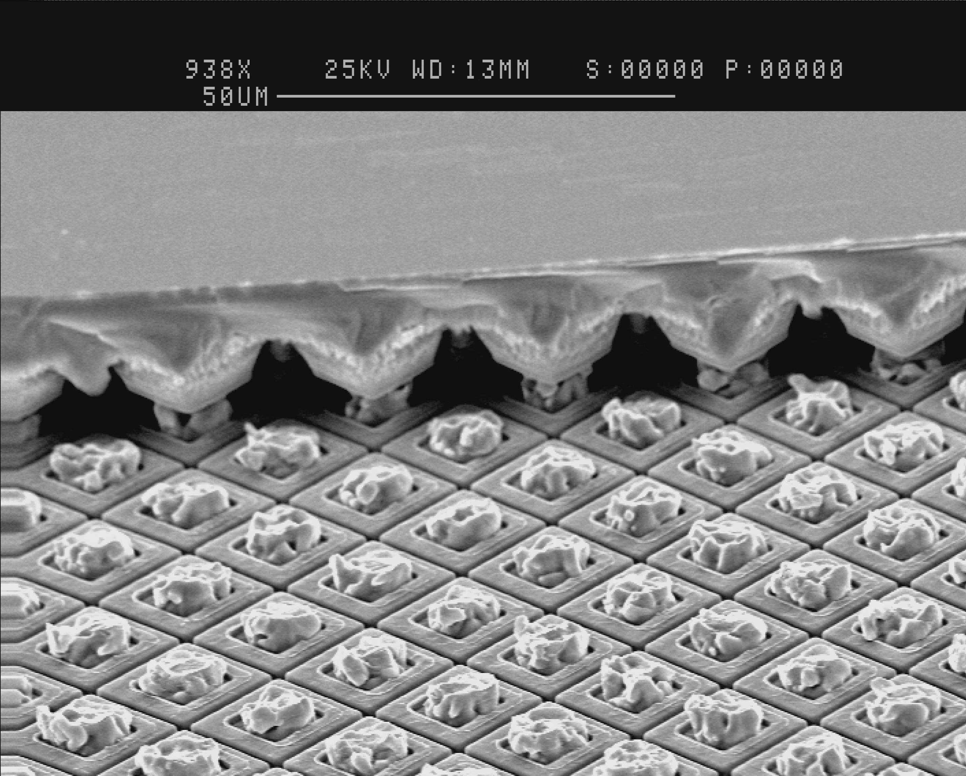
Design and technology – MOVPE MCT
Mesa etched diodes
  Excellent MTF due to physical isolation of absorber layer, eliminating electrical crosstalk
  Geometry gives optical concentrator and
  small p-n junction area relative to pitch
Hybridization
  MCT arrays hybridized using reliable indium bump technology
Notes:
Now I will talk about some of the technology, starting with the MCT photodiode technology.
We grow our MCT material on GaAs substrates. Using MOVPE. This provides a high volume production capability which can be used to grow a wide variety of structures of different bandgaps with grown-in P-N junctions.
It is possible to grow Long, Mid and Short wave MCT. This paper reports MW results.
After the material is grown mesas are etched giving individually isolated mesas with excellent MTF. The conical shape of the mesas

Slide 5
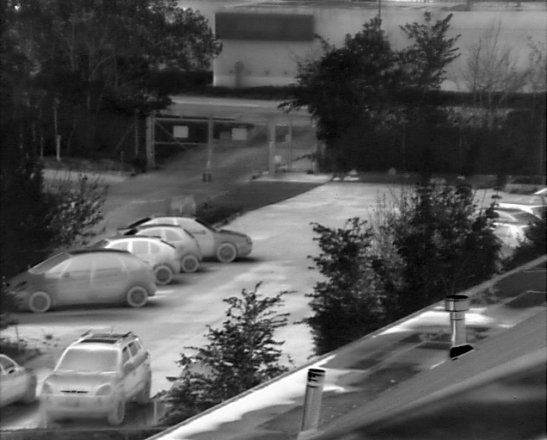
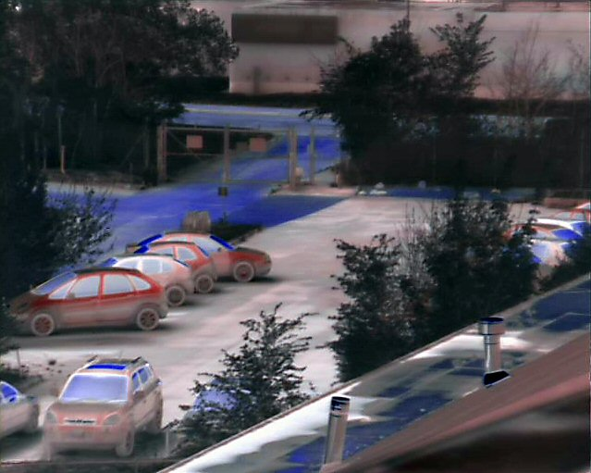
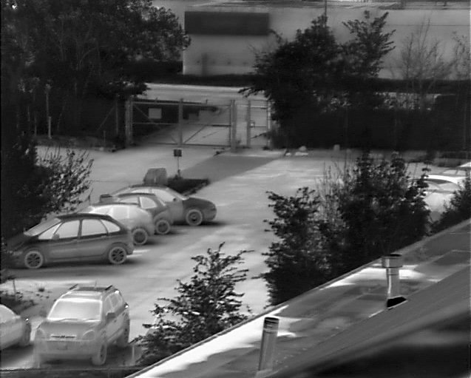
CONDOR II Dual Band Detector
640 x 512 / 24µm
DWIR
LWIR
8 – 9.4µm
MWIR
3.7 – 4.95µm

Slide 6
Complementary Capabilities
In-house ROIC design, 0.6µm and 0.35µm CMOS migrating to 0.18µm
Vacuum packaging and cryogenics
Warm electronics, module sets, and cameras
Tri Glycine Sulphate

Slide 7
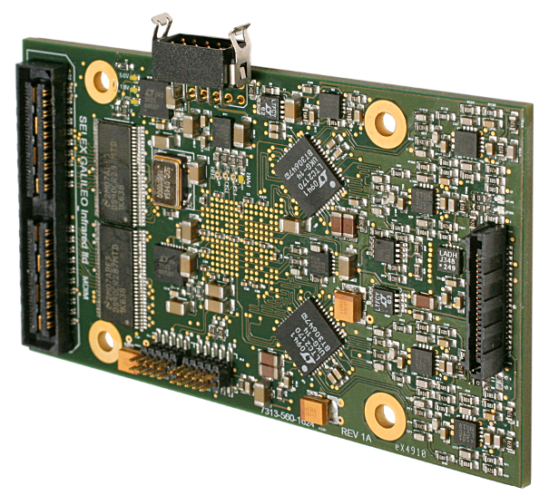
High Performance Electronics

Slide 8
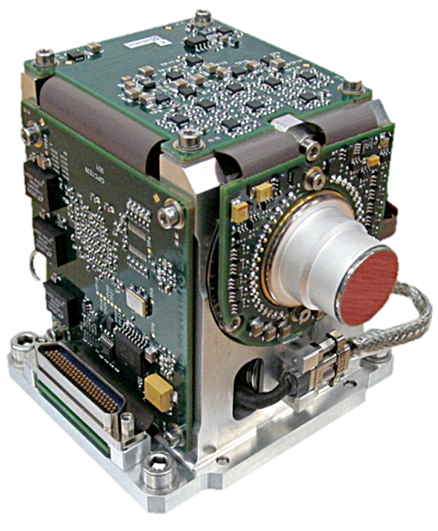

Fast Frame Camera Module
For all high speed imaging applications: Military, Scientific, Industrial
Size – 90 x 90 x 115mm
Weight – 940g
Power <11W @ 23ºC
Array - 384x384 MCT
Pixel - 20µm
Frame rate
1000fps @ 384x384
2000fps @ 256x256
4000 fps @ 192x192
6500 fps @ 144x141
CameraLink® video interface
Serial control interface
BIT
Windowing
Ruggedised

Slide 9
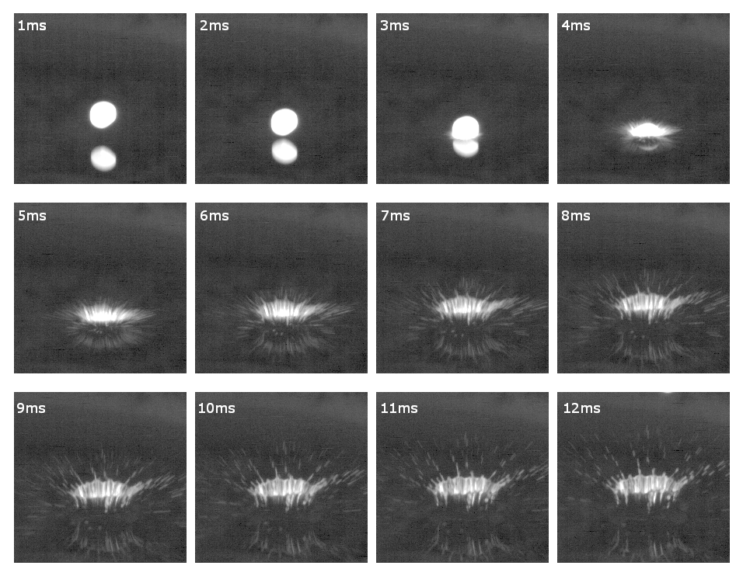
Water droplet at 1000fps

Slide 10
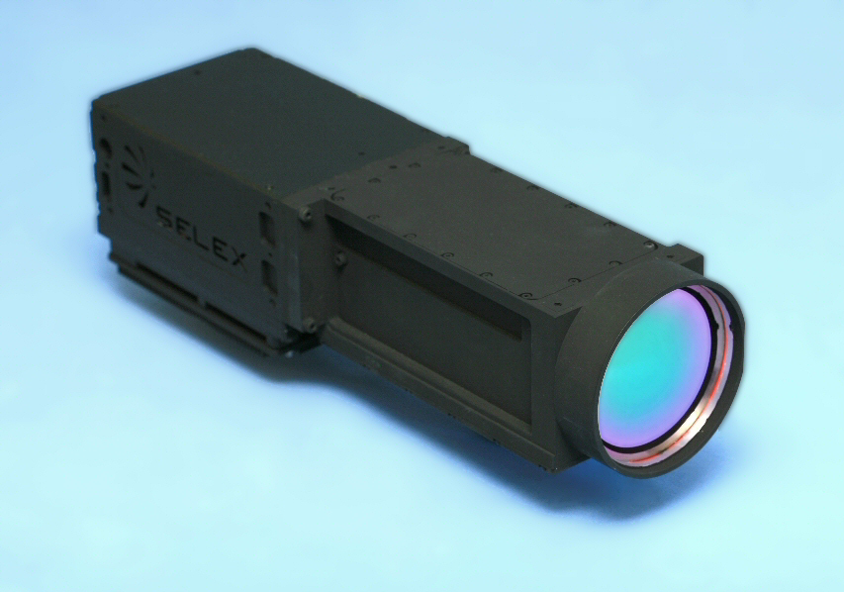
Thermal Imaging Cameras
  SLX camera series
    SLX-Osprey
    SLX-Hawk
    SLX-Merlin
    SLX-Harrier
    SLX-Condor
  New
    Horizon SD and HD

Slide 11
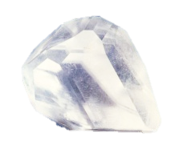
DLATGS Crystal
Room temperature operation
High detectivity
Wide response 0.2 to >100µm
High Curie temperature 60ºC
Alanine doping
Deuterated growth solution

Slide 12
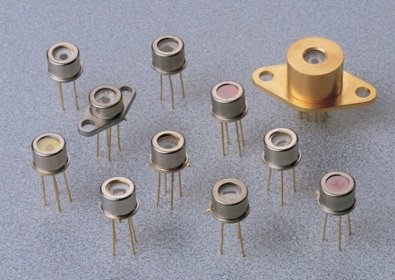
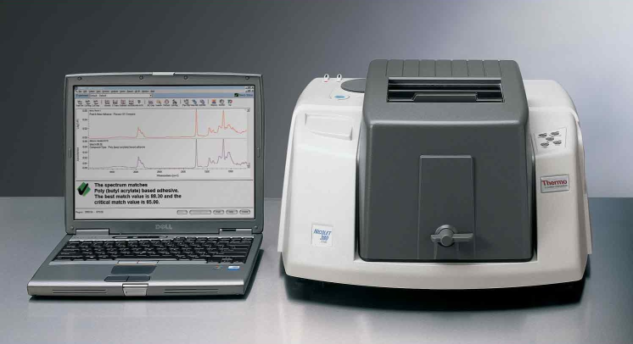
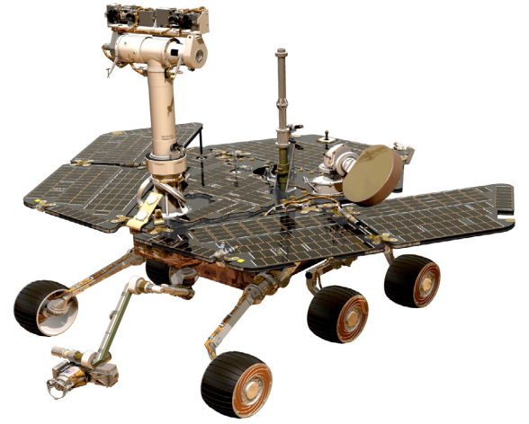
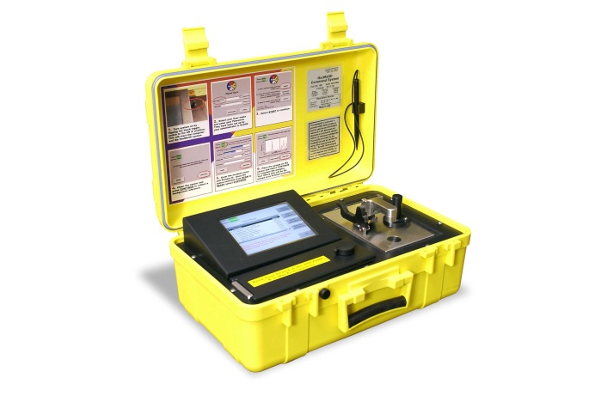
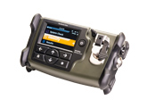
DLATGS Applications
Lab based
DLATGS Detectors
Space
Hand-held
Portable
Notes:
Developing Markets
Portable Instruments - reducing size and power consumption and improving product robustness
IR Microscopy - competing with single element LN2 cooled CMT detectors
Detectors for SpaceHigh power applications
New Markets
Long wavelength applications THz

Slide 13
HOT
Horizon SD and HD cameras
Large format ROICs, smaller pixels
Space Programmes
APDs – LPE and MOVPE
Ian Baker and Johann Rothman - Physics and Performance of HgCdTe APDs
Gert Finger – NIR HgCdTe Avalanche Photodiode Arrays for Wavefront Sensing and Fringe Tracking
Recent Developments

Slide 14
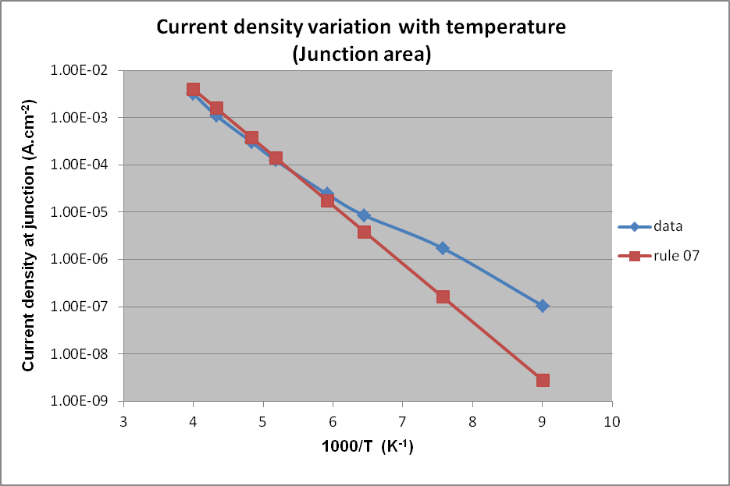
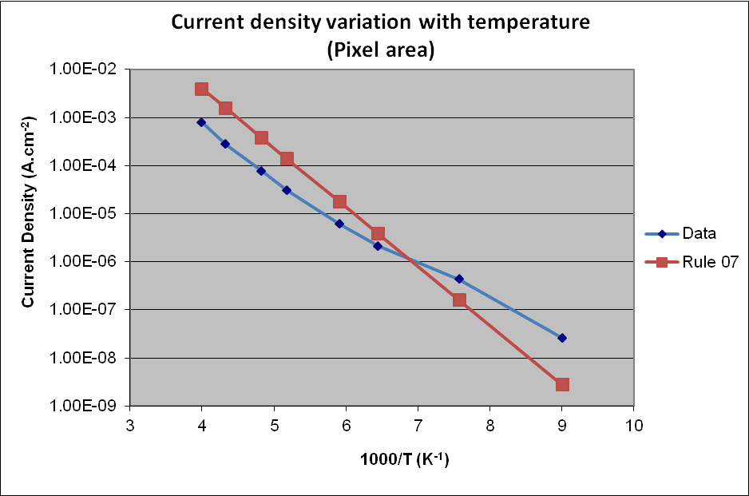
HOT MCT
NETD Histogram
HOT HAWK MWIR Array (155K)
Array 640 x 512
Pitch 16µm
MCT cut-off 5.1µm (@155K)
Median NETD 17.8mK
SD 2.9mK
Defects 217
Operability 99.93%
Dark current 8.5x10⁻⁶A.cm⁻²
Shows benefits of MCT grown by MOVPE and mesa diode design
Pixel Count
NETD (mK)

Slide 15
160K Image

Slide 16
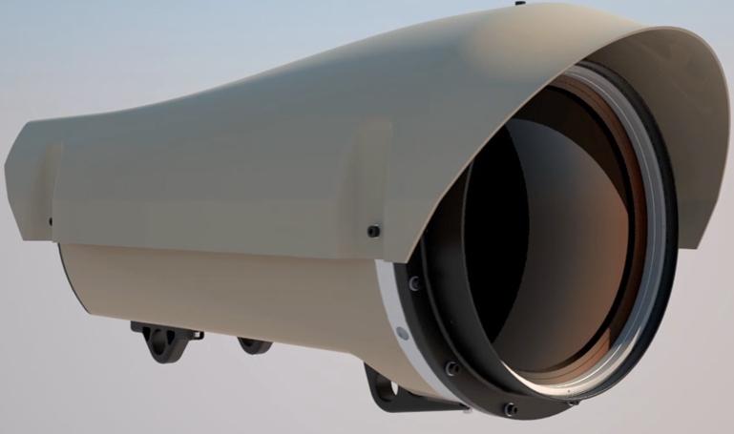
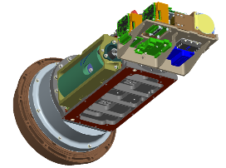
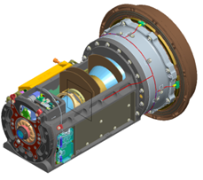
Horizon
ITAR free
Very long life linear cooling engine – 50,000 hour life
Common Electronics for SD and HD variants
Common F/4.0 zoom lens for SD and HD zoom ratio of 12:1
Narrow FoV IFoV
  SD = 16.7μRadians per pixel (640x512, 16µm)
  HD = 12.5μRadians per pixel (1280x720, 12µm)
Video and Control over Ethernet
Image processing features including but not limited to:
  Turbulence mitigation
  Electronic image stabilisation
Mass <22kg, size 305 x 305 x 625
Notes:
16

Slide 17
Large Format ROICs
1920x1080 All circuitry
FALCON – 3-side buttable megapixel array
for large area mosaics
Notes:
Timing automatic – Do NOT CLICK!

Slide 18
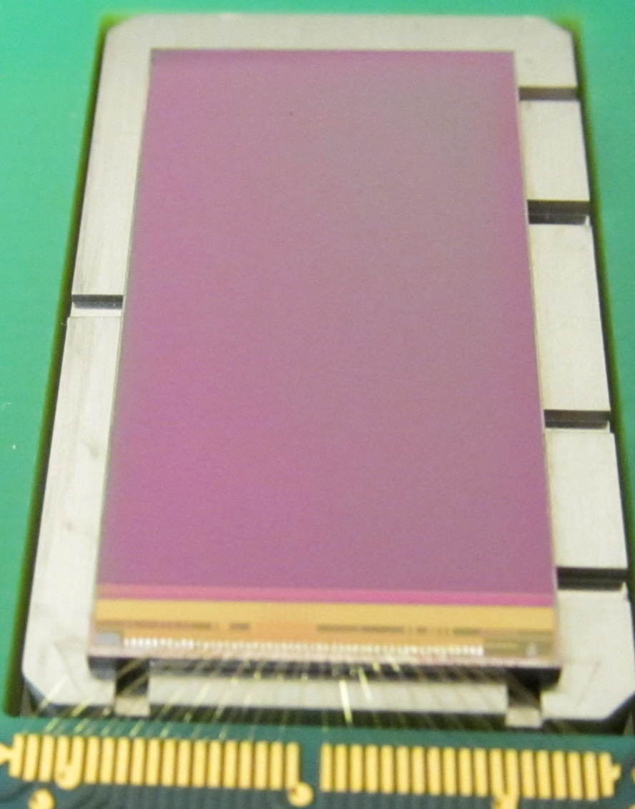
FALCON MCT Array
FALCON Array
Array 1920 x 1080, pixel 12µm
8x analogue outputs
Non uniformity <1% (max), 0.7% (typ)
Non linearity +/-0.5% (max)
CHC = 3.5Me- (ITR), 2.9Me- (IWR)
Power <15mW
Readout modes: ITR, IWR, Windowing
2 megapixel MCT array
Array buttable on 3-sides
Readout circuits
Bond pads

Slide 19
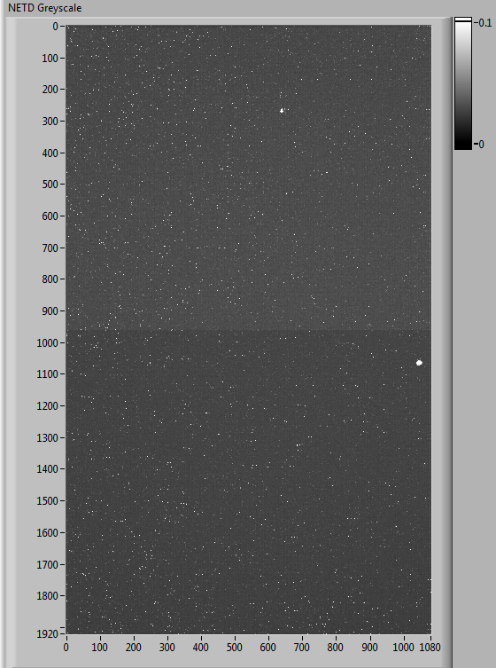
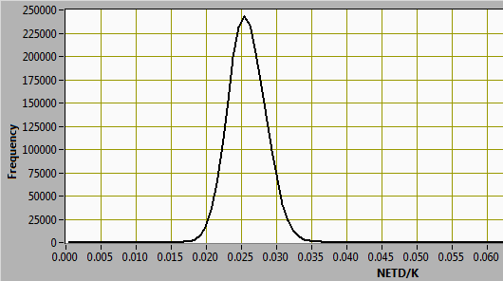
Array test results- NETD
FALCON array trials
High sensitivity, high uniformity, excellent operability
Parameter | Pixel array experiment
 | 1 | 2 | 3
Pedestal (mV) | 480 | 600 | 666
Pedestal Std Dev (mV) | 28 | 28 | 46
Mean signal (mV/K) | 18 | 22 | 21
Signal Std Dev (mK) | 0.6 | 0.6 | 1.1
Median NETD (mK) | 27 | 25 | 29
NETD Std Dev (mK) | 3.7 | 3.7 | 5.4
Operability (%) | 99.76 | 99.86 | 99.63
Row
NETD (K)
Column

Slide 20
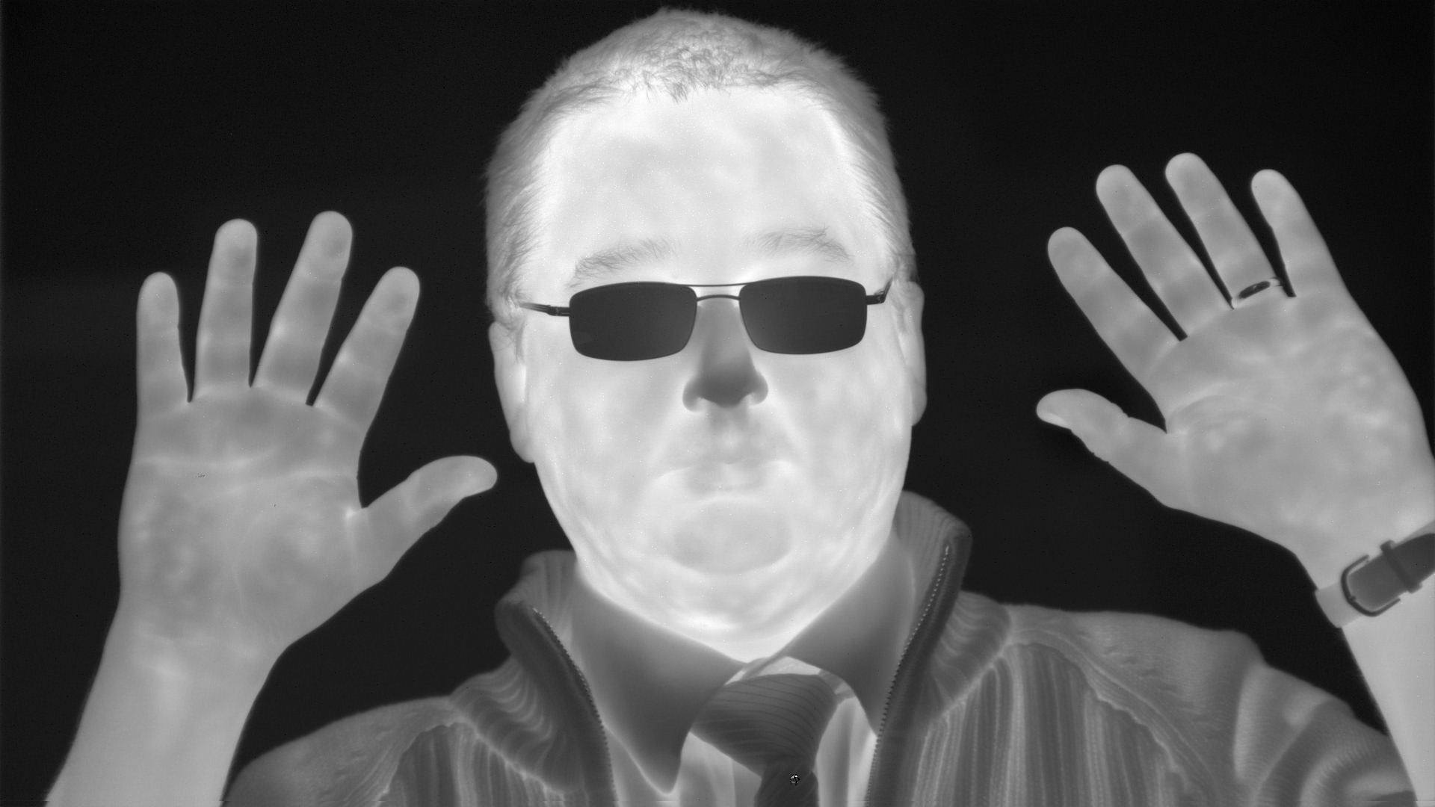
FALCON 1920x1080 / 12µm pitch Image

Slide 21
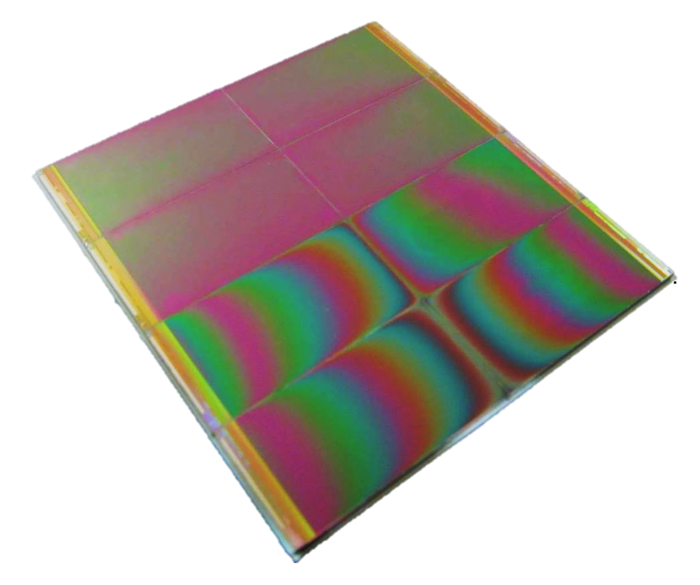
16 Megapixel MWIR mosaic array
Array tiles
FALCON HD1920x1080p / 12µm arrays
3-side buttable
MWIR
Mosaic Array
8x tiles
Power <100mW
High fill factor >99%
Scalable to
Other matrix sizes
Larger arrays (2kx2k, 4kx4k)
Smaller pixels (10µm, 8µm)

Slide 22
Space Programmes
Large format Near Infrared Array (ESA)
Currently in phase 2: deliverable is 1032 x 1280, 15μm pitch, 2.1µm cut-off, thinned MCT
Source follower architecture, enabled for APDs
Selex provide consultancy and test facility to Caeleste on parallel ASIC development
SWIR development (ESA)
2048 x 2048, 17μm pitch, 2.5μm cut-off, enabled for APDs, thinned MCT
VLWIR development (ESA)
Low dark current
Up to 14.5 μm cut-off wavelength
OSIRIS Rex Thermal Emission Spectrometer (Arizona State University)
NASA asteroid sample return mission
DLATGS uncooled pyroelectric detector
4 – 50μm spectral response

Slide 23
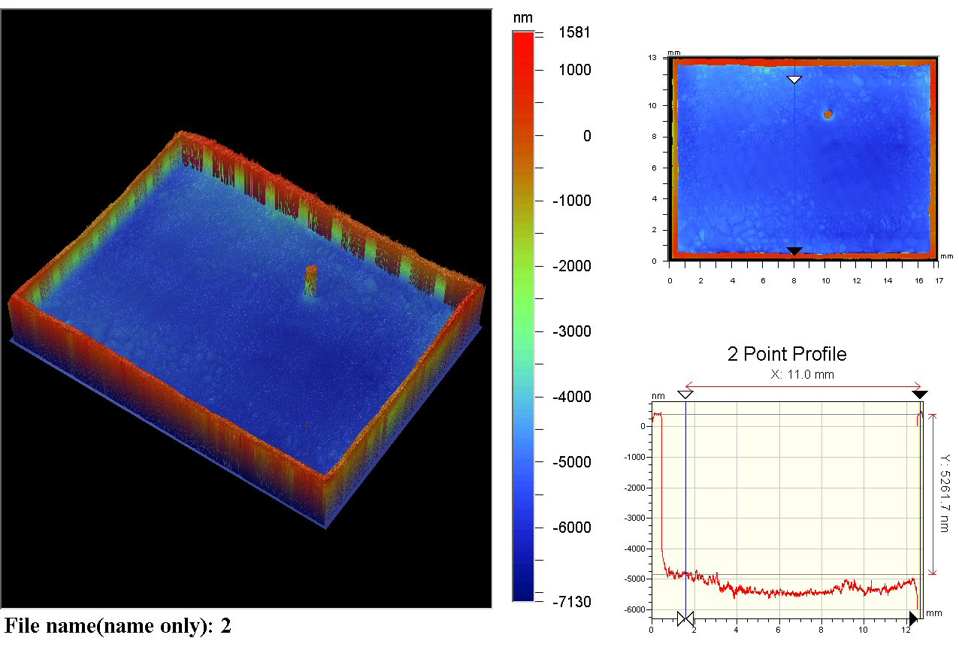
Large format thinning trials for extended VIS/NIR response

Slide 24
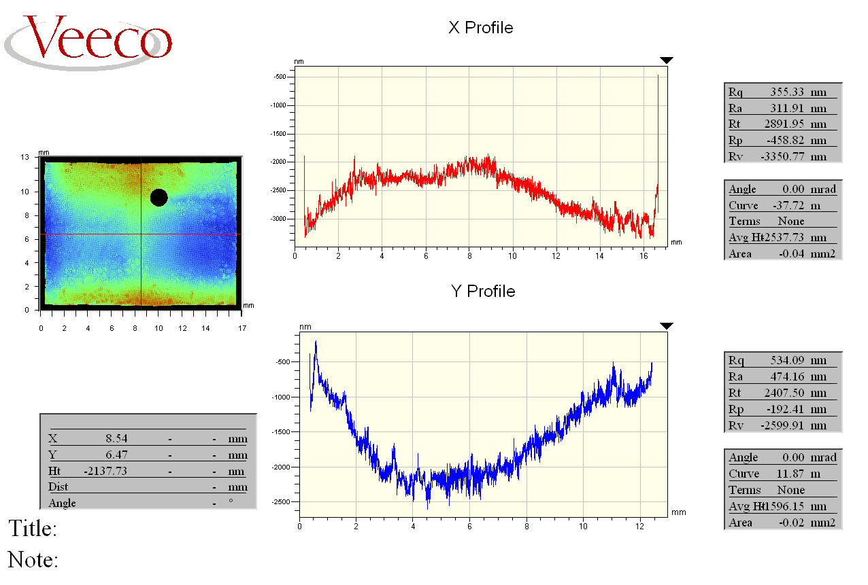
Large format thinning trials

Slide 25
Etch time effect on spectral response

Slide 26
Large format array packaging
Builds upon e2v experience of close buttable packages
Expansion matched header (molybdenum)
Wirebond to adjacent pcb with integral flexi
Both ROIC and pcb glued to header
Initial trials indicate that edge effects dominate and the expected stress is not size sensitive

Slide 27
APDs
Avalanche gain stability with respect to operating temperature
A 2.5μm (cut-off wavelength) HgCdTe eAPD array was tested at 80K and 90K operating temperature and the avalanche gain was measured as a function of applied diode bias
The graph shows excellent consistency between the two operating temperatures
  This indicates any system with reasonable control over the FPA temperature will have stable performance in low flux conditions where avalanche gain is required

Slide 28
APDs
Avalanche gain stability after high temperature baking
The HgCdTe APD array was subjected to two high temperature bakes and the performance was measured before and after
The results show that the avalanche gain process in the HgCdTe array is unaffected by the high temperature bakes, indicating that the APD array is robust
Avalanche Gain
Diode Bias (V) | Initial Measurement | After 72hr Bake at +70°C | After a further 24hr Bake at +70°C
4.6 | 2.7 | 2.7 | 2.7
5.1 | 3.2 | 3.1 | 3.1
5.6 | 3.7 | 3.7 | 3.7

Slide 29
APDs
Noise performance after high temperature baking
The dark current in eAPDs in HgCdTe is more sensitive to crystal imperfections than conventional detectors (due to the high bias voltage) and an extremely sensitive test of any degradation mechanism is the noise.
The graph below shows the measured noise of the array before and after a 3 day bake at high temperature showing no discernable increase. This shows that there are no significant deterioration mechanisms in HgCdTe eAPDs under normal use.

Slide 30
FALCON 1920x1080 / 12µm pitch Image

