Slide 1
MBE/Si HgCdTe Detectors as a Solution for High Performance, Lower Cost Focal Planes
L. Mears, J. Bangs, L. Corrales,
J. Getty, C. Keasler, M. Mitani
Raytheon Vision Systems
D. Figer, B Hanold,
Rochester Institute of Technology

Slide 2
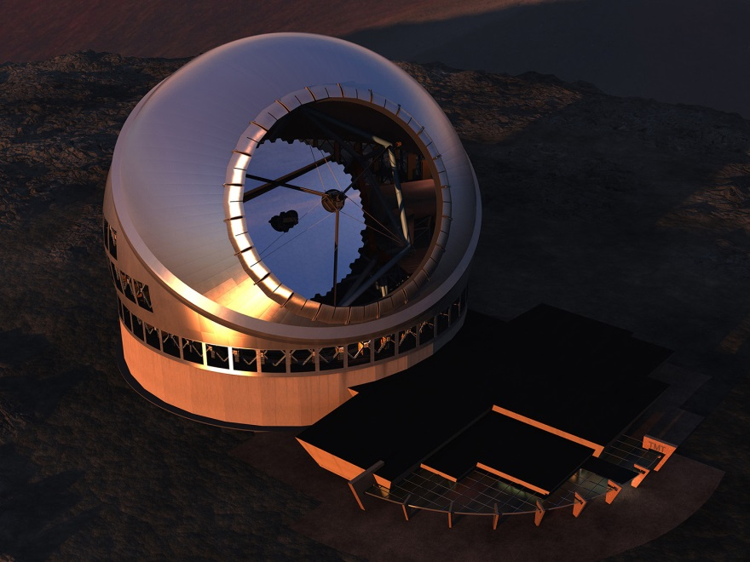
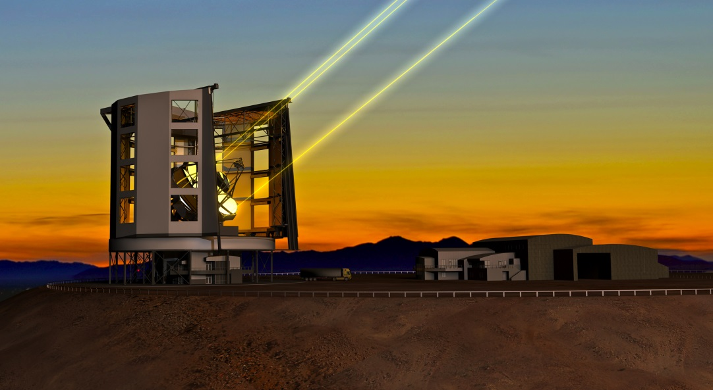
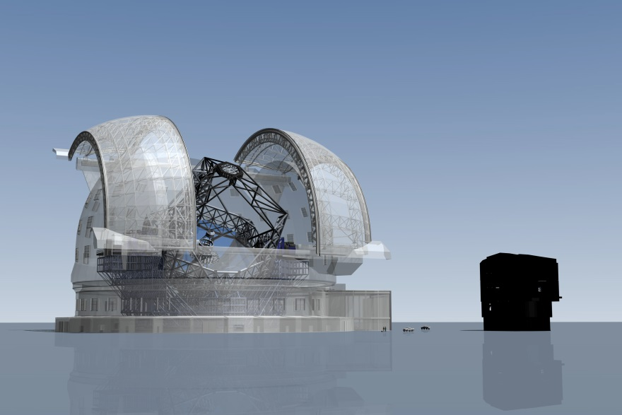
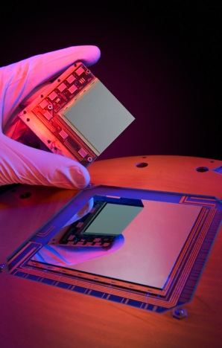
Demand for Astronomy grade devices will grow
… with the increasing
telescope sizes
increasing Megapixel cameras to Giga pixel ..
Cost matters!

Slide 3
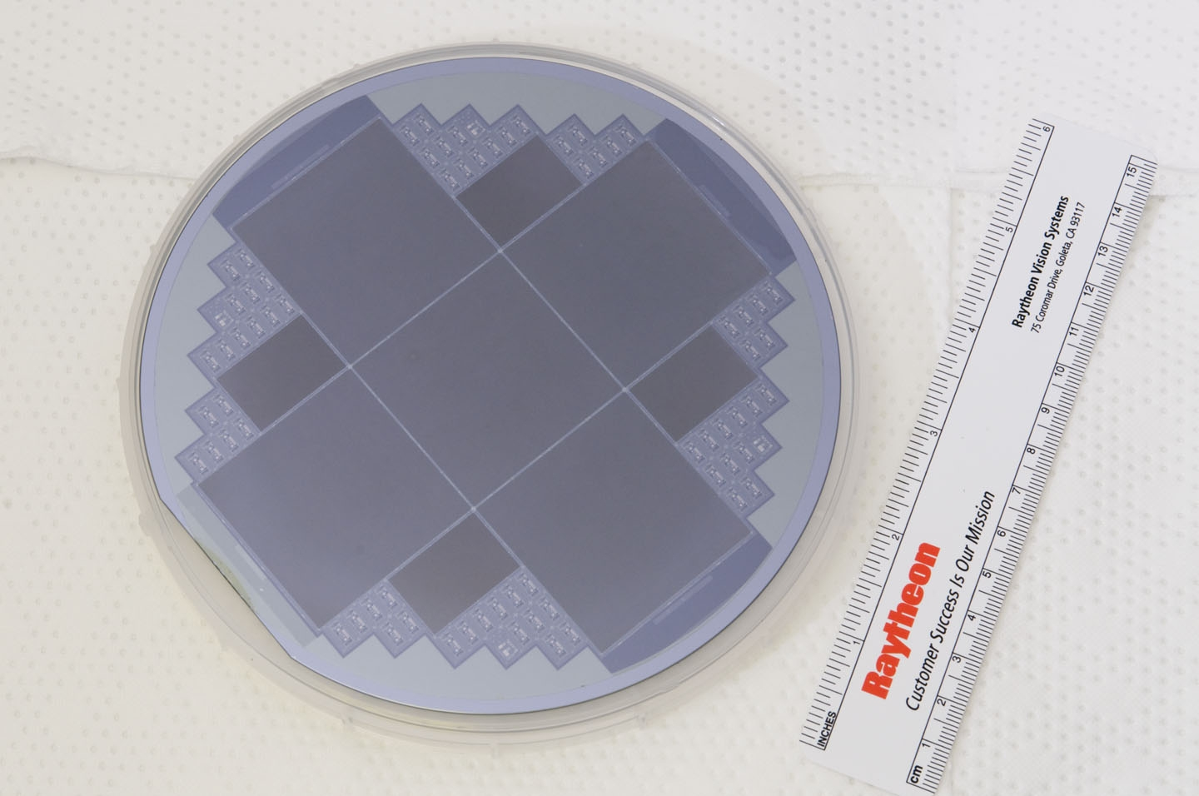
With 5x die per wafer, detector processing costs are greatly reduced! LPE/CZT is limited to 1 die per wafer.
HgCdTe MBE/Si enables major cost savings

Slide 4
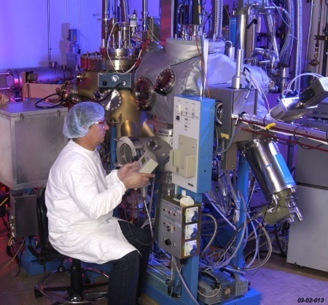
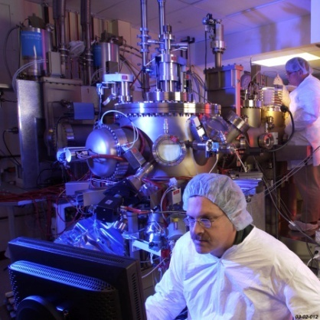
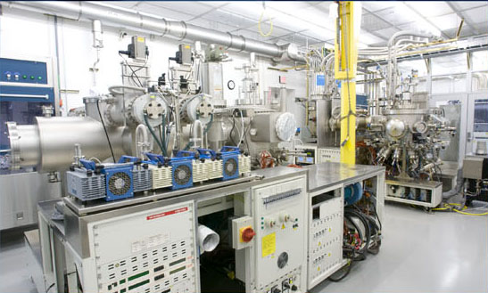
MBE HgCdTe Capabilities in place at RVS
4 MBE Systems in Goleta
1 Development
2 Production – on line
1 Additional production system this year
Wafer Sizes
Silicon – 100 &150 mm (will have 200 mm)
CdZnTe - 6×6 cm² to 8×8 cm²
Tunable Wavelength Ranges
SW/MW/LW HgCdTe/Si
MW/LW, LW/LW 2-color
In situ n- and p-type doping for advanced multilayer devices
HgCdZnTe quaternary materials for lattice- matched multilayer devices

Slide 5

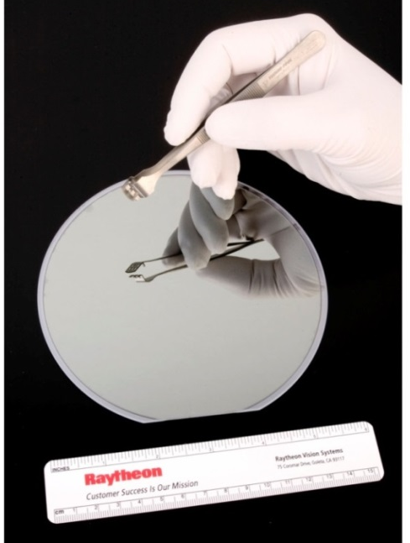
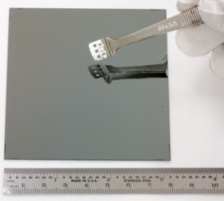
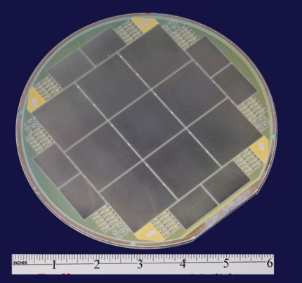
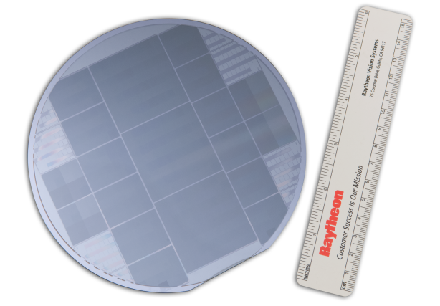
Large Area HgCdTe Materials
HgCdTe p-on-n DLHJ on 150 mm Si substrate
MBE on silicon enables ultra-large area IR FPAs
LPE/CZT
MBE/Si
Area
increased
2.7X
HgCdTe p-on-n DLHJ
on 8×8 cm CdZnTe
Starting material and fabrication equipment offer large flexibility in detector format and size within single wafers

Slide 6
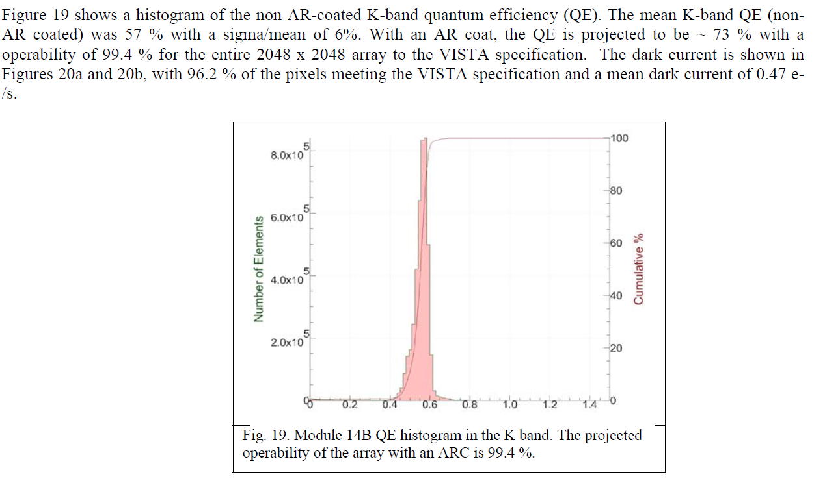
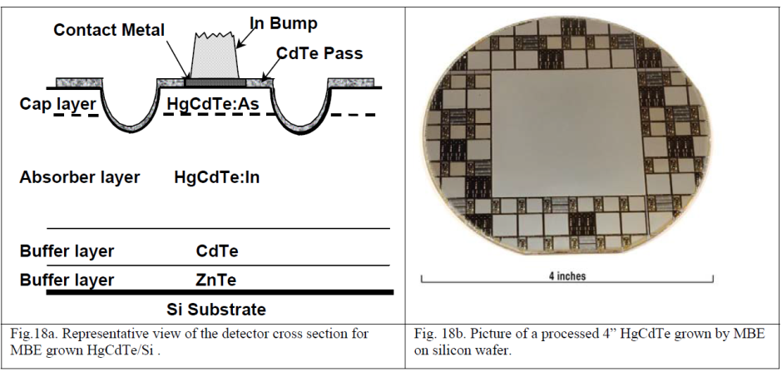
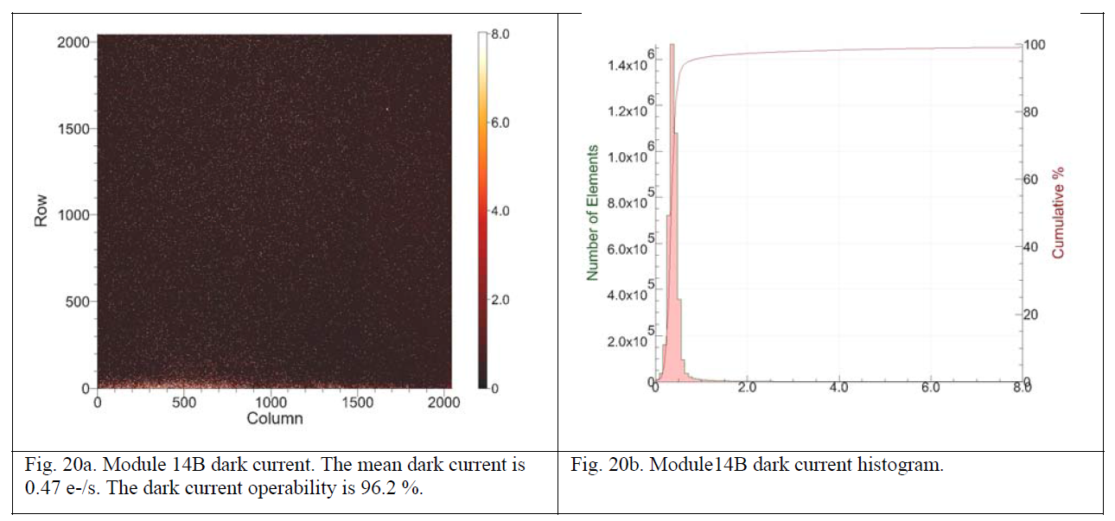
SWIR HgCdTe/Si performance Proven in 2005
2013 RVS capabilities
offer 6” wafers and
Improved processes
Increased wafer sizes
  More pixels/wafer
Lower defect densities
  Higher Operability >99%
Greater Uniformity
  <2% across the wafer
High reliability
  Improved hybrid process

Slide 7
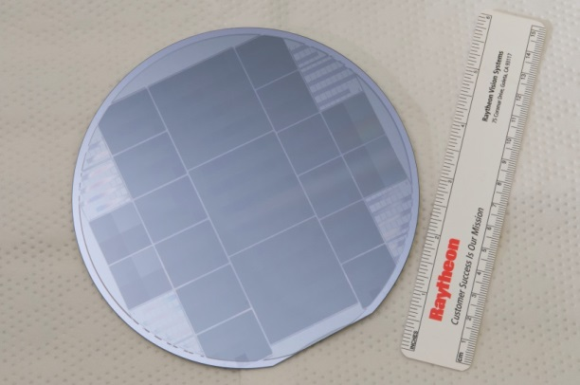
SWIR Advanced Technologies and Instrumentation for NSF & NASA (SATIN II) Project Status
Development project led by Rochester Institute of Technology (RIT), Funded by NSF & NASA
RVS is leveraging it's mature 6-inch HgCdTe/Si detector and focal plane capabilities to advance Astronomy FPA SoA
Design of Experiment (DOE) lots completed – Engineering Sensor Chip Assemblies (SCAs) at RIT for characterization (will be included in paper if available in time)
What’s next? Science Grade 2k x 2k SWIR focal planes demonstrating a > 40% cost reduction by April 2014.
Future – Lower Cost, High Performance 2k x 2k and 4k x 4k Focal Planes for Astronomers.
1st SATIN Layout with includes various detector die sizes includes three 2k x 2k and four 1k x 1k with variable unit cell designs

Slide 8
Design of Experiment (SATIN Wafers)
Diffusion length in SWIR MBE/Si expected to be short on the order of 2 µm – 4 µm.
Optimized two epitaxial designs, one to conserve QE and one to reduce Dark Current despite short diffusion length
Designed SATIN wafers based on QE & Dark current simulations shown

Slide 9
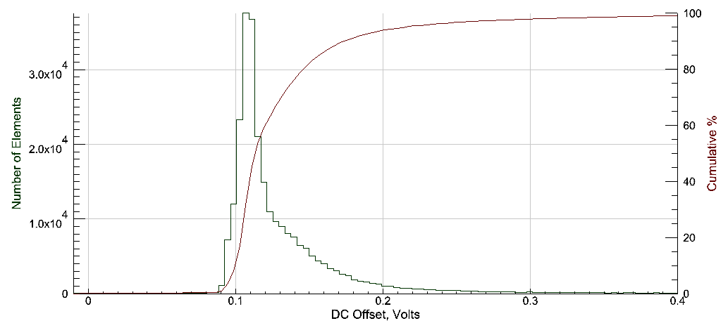
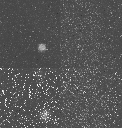
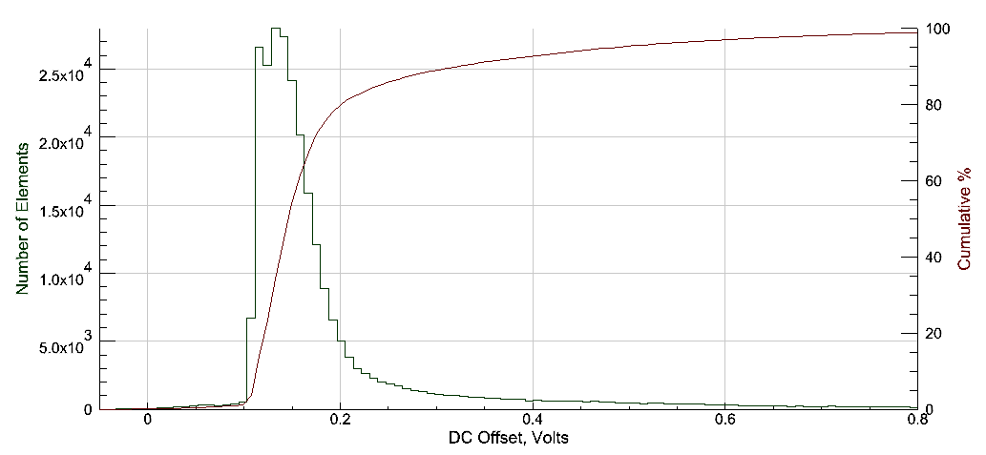
Results from SATIN experimental VUC Die
  At press time we have tested the variable unit cell (VUC) die from EPI 1 design only.
J-band is most sensitive
to diffusion length
UC1
UC2
UC1 – New design
Best distribution
UC3
UC4
Experimental VUC Die includes four unit cell designs/die, broken into quadrants
UC4 – Control, Std design
Good Distribution
J Band Signal @ 78 Kelvin

Slide 10
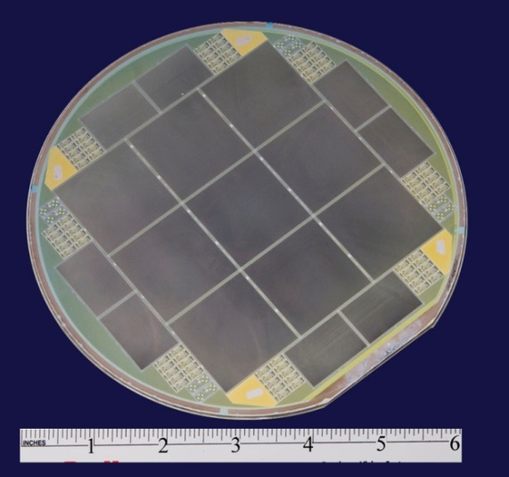
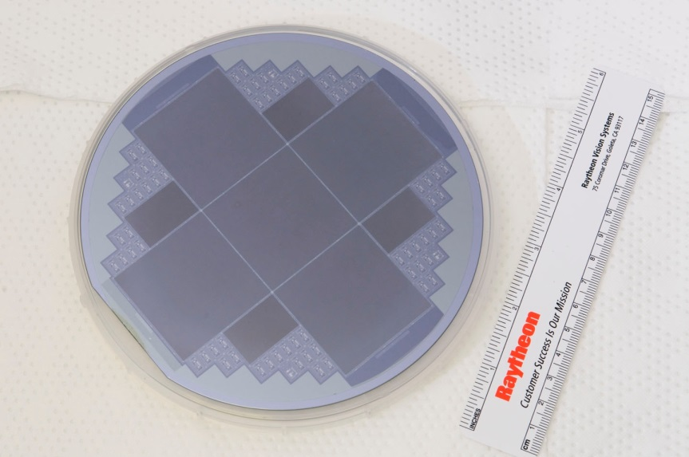
SWIR HgCdTe progress since VISTA
RVS is invested in large format processing:
Fully developed 150 mm HgCdTe processing line
Stepper & projection printing for fine pitch & alignment
Automated mesa etch, solvent cleaning, surface prep tools
150 mm Hg annealing tools
Learning cycles have resulted from other products
Product spec
Good repeatability obtained after process dial-in
Large format tools and processes are well qualified and continually improved resulting in increasing predictability to meet Astronomical Requirements!

Slide 11
Detector Materials Performance Comparison
Parameter | LPE/CZT | MBE/Si | Notes
Array Formats | 1024², 2048² | N * 512 X M * 512 | Can run multiple formats on the same wafer
QE QE Non-unifomity Dark Current Noise Operability | >75% <2% <. 05 e- @ 78 K <5 e- RMS w/Fowler 8 > 98% | >85% <2 % <.1 e- @ 78 K <5 e- RMS w/Fowler 8 > 99.5% | Dark current slightly higher on MBE/Si but it is offset by improved uniformity and lower cost
Wavelength | 0.9 um – 5.5 um 0.5 um – 5.5 um | 1.1 um – 5.5 um 0.5 um – 5.5 um | With substrate Substrate removed
Defect Densities | 1500/cm² | 150/cm² | 10x improvement
Substrate Size | 7 x 7 cm | 150 mm wafer
LPE has slightly better dark current but limited in size increasing cost.
MBE close in performance
MBE size, stitching and advanced processes → lower cost!

Slide 12
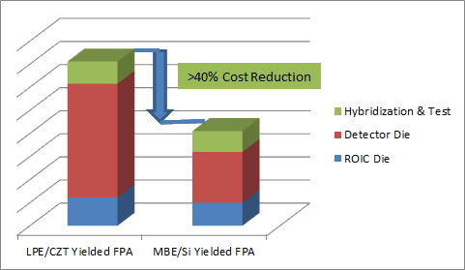
Anticipated Savings @ RVS
ROIC - No change
2K Detectors – 5 printed die/wafer vs. 1 printed die/wafer
Hybridization Savings – labor reduced by 4x
  Wafer Level AR Coat, matched CTE, Flatness
  Yield improvements with automation and less post process
  handling
> 40 % Cost reduction could
support 2 grad students for a whole year!
Expect cost savings of > 40%. Further savings possible with multiple orders or shared lot runs!

Slide 13
Future plans
RVS will offer Astronomy Grade SCAs at a reduced price
VIRGO ROIC and MBE/Si detectors easily scales to
4k x 4k (20 µm pixels)
Modest NRE costs will enable ROIC upgrades including reduced pixel size (15 µm or 10 µm), windowing and increased speed with additional outputs
RVS will continue to leverage ongoing SWIR MBE/Si efforts to minimize risk, costs and schedule

Slide 14
Relevant Papers
2k 15um pitch in “Large Format High Operability SWIR and MWIR Focal Plane Array Performance and Capabilities”, J Bangs et al, SPIE DSS 2011, Proc. SPIE 8012, Infrared Technology and Applications XXXVII, 801234 (May 20, 2011); doi:10.1117/12.887417
"Performance of MWIR and SWIR HgCdTe-based focal plane arrays at high operating temperatures ", Leon Melkonian, et al, 2009 Published in Proceedings Vol. 7660 Infrared Technology and Applications XXXVI, Bjørn F. Andresen; Gabor F. Fulop; Paul R. Norton, Editors, 76602W
"Status of HgCdTe/Si Technology for Large Format Infrared Focal Plane Arrays", Scott Johnson, 2004 (2005 Quantum Sensing and Nanophotonic Devices II, edited by Manijeh Razeghi, Gail J. Brown, Proceedings of SPIE Vol. 5732)
High-Quality Large-Area MBE HgCdTe/Si", J.M. Peterson, J.A. Franklin, M. Reddy, S.M. Johnson, E. Smith, W.A Radford, I. Kasai., Journal of Elect Mtrls, Vol 35, No. 6, 2006 pp 1283-1286
and many more

