Slide 1
An overview of Teledyne DALSA Professional Imaging CCD capabilities
Jan Bosiers
Teledyne DALSA Professional Imaging
High Tech Campus 27, 5656AE Eindhoven, The Netherlands jan.bosiers@teledynedalsa.com

Slide 2
Contents
Introduction to Teledyne DALSA Professional Imaging (TDPI)
TDPI CCD Technology
Building Blocks
Product Examples
Notes:
Technical Summary:
Please present most important technical highs and lows
Customer Update:
What is the status w.r.t. the customer regarding this project
Can be related to technical and/or schedule and/or resource and/or financials

Slide 3

Introduction to TDPI (1)
History
Origins in former Philips CCD group
Acquired by DALSA (Waterloo, ONT, Canada) in 2002
CCD Technology transferred from Philips FAB to DALSA FAB
Expansion of CMOS and camera/detector capabilities
DALSA was acquired by Teledyne (Thousand Oaks, CA, USA) in 2011
TDPI is located at High Tech Campus in Eindhoven, The Netherlands
Notes:
Technical Summary:
Please present most important technical highs and lows
Customer Update:
What is the status w.r.t. the customer regarding this project
Can be related to technical and/or schedule and/or resource and/or financials

Slide 4
Introduction to TDPI (2)
Product Focus
CCD Imagers
Professional applications
Originally focus on internal Philips needs: Broadcast, Medical
Current focus: Professional Photography, Photogrammetry/Aerial Photography, Medical & Scientific applications
X-ray detectors based on wafer-scale CMOS imagers
Medical applications
Integration of CMOS imagers with scintillator and camera HW & SW
Spin-off into non-destructive testing, crystallography, ...
Organisation
Business unit with dedicated M&S, R&D & Operations staff
In-house testing and assembly
ISO9001 and ISO13485 certified
Notes:
Technical Summary:
Please present most important technical highs and lows
Customer Update:
What is the status w.r.t. the customer regarding this project
Can be related to technical and/or schedule and/or resource and/or financials

Slide 5
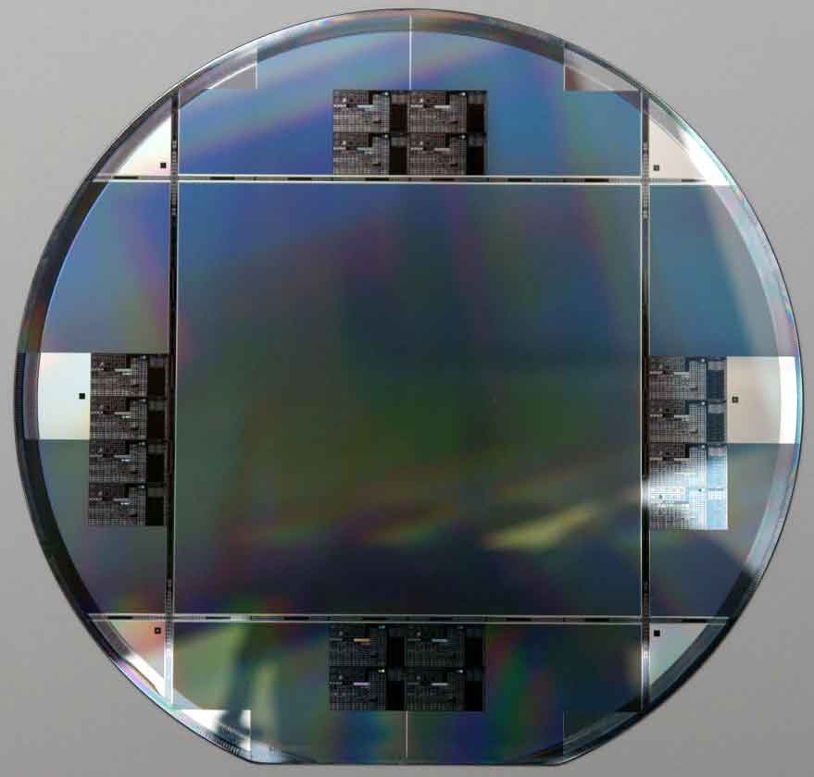
TDPI CCD Technology
Proprietary CCD technology
0.35μm litho capability, 6” wafers
Focus on professional applications
Frame-transfer and full-frame CCDs
Stitching expertise
Process is BST compatible
Notes:
Technical Summary:
Please present most important technical highs and lows
Customer Update:
What is the status w.r.t. the customer regarding this project
Can be related to technical and/or schedule and/or resource and/or financials

Slide 6
CCD Process
n-channel in p-well on n-substrate; p⁺ channel-stop
  Buried channel with high charge capacity
  Excellent transport efficiency (> 0.999 995)
  Vertical anti-blooming & fast electronic shuttering
Two layers of membrane transparent non-overlapping CCD gates
  Low capacitance
  High planarity
  High quantum efficiency
  Compatible with transport efficiency requirements
Metal-1 (Wm) strapping
  Low RC-times for fast transport
Metal-2 (Al) for Interconnect and Light Shield
Low optical stack
  Wide angular response
Optional back-end steps
  Metal-3 for Interconnect and/or Light Shield
  Color filters and/or Micro-lenses
Notes:
Technical Summary:
Please present most important technical highs and lows
Customer Update:
What is the status w.r.t. the customer regarding this project
Can be related to technical and/or schedule and/or resource and/or financials

Slide 7
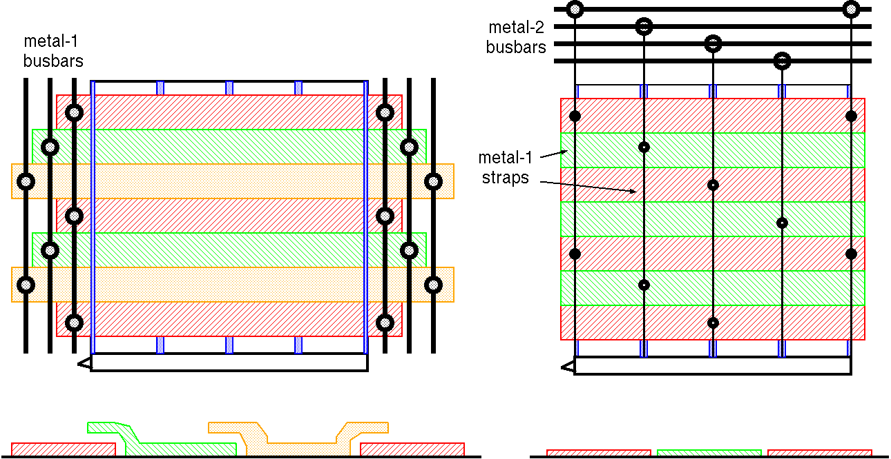
CCD Concept
Conventional CCD
Overlapping thick poly-silicon gates
High RC values
TDPI Generation-2 CCD
Non-overlapping ‘membrane’ gates
Metal-1 straps, Low RC values
Notes:
Technical Summary:
Please present most important technical highs and lows
Customer Update:
What is the status w.r.t. the customer regarding this project
Can be related to technical and/or schedule and/or resource and/or financials

Slide 8
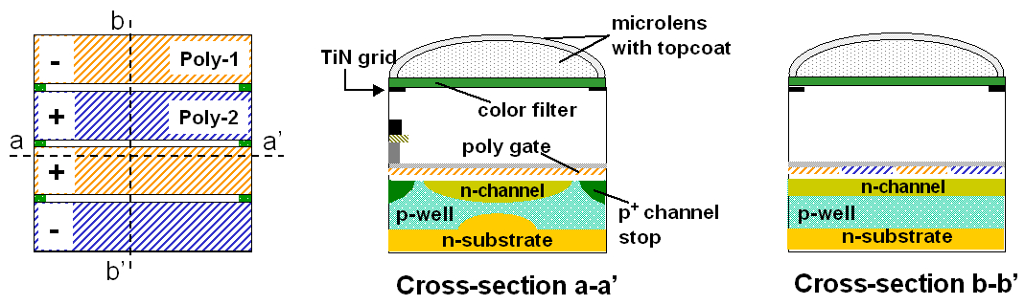
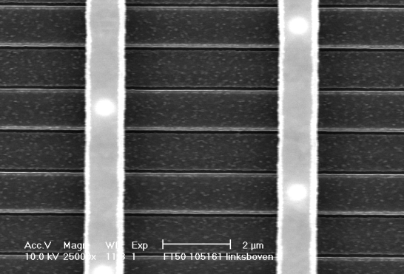
CCD Pixel
Notes:
Technical Summary:
Please present most important technical highs and lows
Customer Update:
What is the status w.r.t. the customer regarding this project
Can be related to technical and/or schedule and/or resource and/or financials

Slide 9
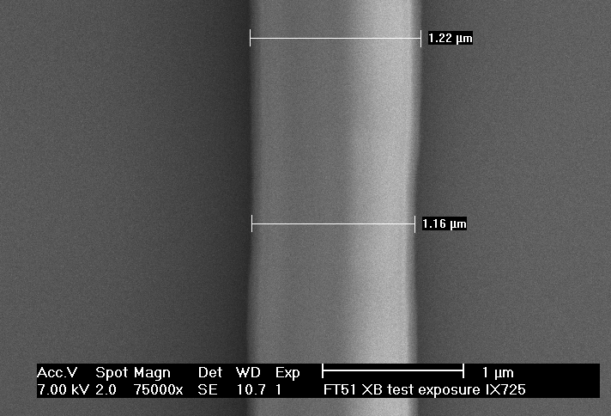
Stitching Capabilities
First stitched CCD imager, 1987
  HDTV imager
  Stitching at image-storage transition
Current products
  90% of CCDs is stitched
  No yield loss (functionality, performance)
  Stitched image sizes from 24mm x 36mm to 108mm x 96mm
Example
  Stitched poly line
  1.2μm width
Stitch location
Notes:
Technical Summary:
Please present most important technical highs and lows
Customer Update:
What is the status w.r.t. the customer regarding this project
Can be related to technical and/or schedule and/or resource and/or financials

Slide 10
Contents
Introduction to TDPI
TDPI CCD Technology
Building Blocks
Product Examples
Notes:
Technical Summary:
Please present most important technical highs and lows
Customer Update:
What is the status w.r.t. the customer regarding this project
Can be related to technical and/or schedule and/or resource and/or financials

Slide 11
Building Blocks
Pixels
Readout Structures
Amplifiers
Notes:
Technical Summary:
Please present most important technical highs and lows
Customer Update:
What is the status w.r.t. the customer regarding this project
Can be related to technical and/or schedule and/or resource and/or financials

Slide 12
Standard Pixels
Four-phase pixels
Vertical anti-blooming and electronic shutter
Monochrome and color versions
Bi-directional transport
TDI-mode compatible
Pixel | (μm) | 12 | 12 | 9 | 7.2 | 6 | 5.2
Techn. Generation | (#) | 1 | 2 | 1 | 2 | 2 | 2
Idark @ 60ºC | (pA/cm²) | 300 | 120 | 300 | 100 | 100 | 100
QE_max, Gr, monochrome | (%) | 27 | 50 | 23 | 43 | 37 | 37
Qmax | (kel) | 450 | 290 | 170 | 50 | 50 | 55
ML |  | no | no | no | no | yes | yes
Notes:
Technical Summary:
Please present most important technical highs and lows
Customer Update:
What is the status w.r.t. the customer regarding this project
Can be related to technical and/or schedule and/or resource and/or financials

Slide 13
Pixels for ultra-low dark current
Four-phase pixels with additional implant
Combining multi-pinned phase (MPP) with vertical anti-blooming and electronic shutter
Bi-directional transport
Pixel |  | 12μm, low Idark mode | 6μm, low Idark mode | 6μm, standard mode
Qmax | (kel) | 55 | 30 | 45
Idark | (pA/cm², 60ºC) | 1.5 | 2 | 100
Idark | (pA/cm², 20ºC) | 0.1 | 0.1 | 3
Notes:
Technical Summary:
Please present most important technical highs and lows
Customer Update:
What is the status w.r.t. the customer regarding this project
Can be related to technical and/or schedule and/or resource and/or financials

Slide 14
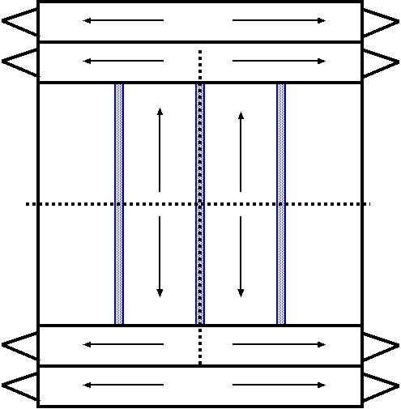
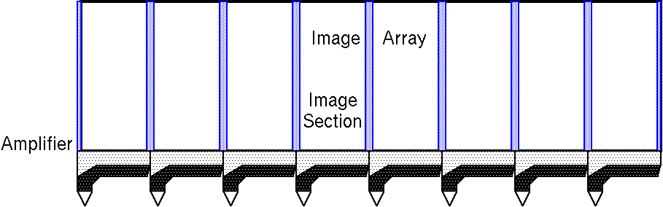
Readout Structures
At each corner
Option of dual register
Output taps
Notes:
Technical Summary:
Please present most important technical highs and lows
Customer Update:
What is the status w.r.t. the customer regarding this project
Can be related to technical and/or schedule and/or resource and/or financials

Slide 15
Amplifiers
Broadcast
  Three-stage source follower
  Optimised for 37.125MHz pixel rate
  Conversion gain 20μV/el
  8.5 electrons noise in HDTV bandwidth (0.4-30MHz)
Photography and Photogrammetry Applications
  Three-stage source follower
  Optimised for 25MHz pixel rate and
  Conversion gain 40μV/el
  10 electrons noise after CDS at 25MHz
Notes:
Technical Summary:
Please present most important technical highs and lows
Customer Update:
What is the status w.r.t. the customer regarding this project
Can be related to technical and/or schedule and/or resource and/or financials

Slide 16
Contents
Introduction to TDPI
TDPI CCD Technology
Building Blocks
Product Examples
Notes:
Technical Summary:
Please present most important technical highs and lows
Customer Update:
What is the status w.r.t. the customer regarding this project
Can be related to technical and/or schedule and/or resource and/or financials

Slide 17
Product Examples
Imager for HDTV
Imagers for Professional Photography
Imagers for Photogrammetry
Imagers for Scientific Applications
Notes:
Technical Summary:
Please present most important technical highs and lows
Customer Update:
What is the status w.r.t. the customer regarding this project
Can be related to technical and/or schedule and/or resource and/or financials

Slide 18
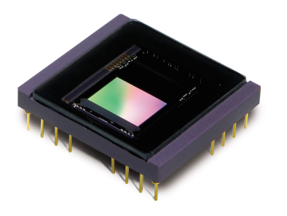

Imager for HDTV
2/3” imager
  5.0μm pixel size, monochrome, FT-CCD
  9.6 x 5.4 mm² image area
  2 outputs at 37MHz for 74MHz pixel rate
12-phase image section for switchable resolution and aspect ratio
  3 x 4-phase pixel (1080 HDTV)
  2 x 6-phase pixel (720 HDTV)
  4 x 3-phase pixel (cinema mode, widescreen)
  Cylindrical micro-lenses
Triple-speed capability
  2 outputs at 111MHz for 222MHz pixel rate
Notes:
Technical Summary:
Please present most important technical highs and lows
Customer Update:
What is the status w.r.t. the customer regarding this project
Can be related to technical and/or schedule and/or resource and/or financials

Slide 19
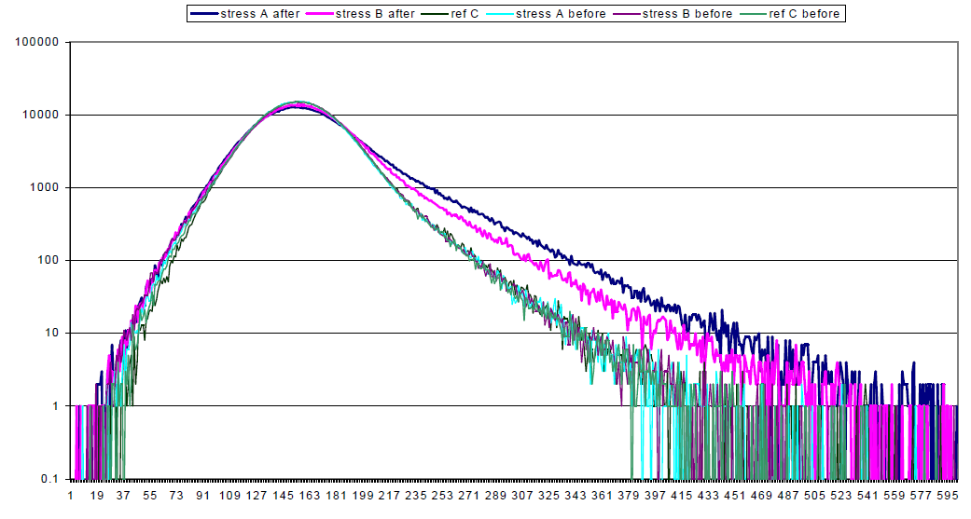
Imager for HDTV (2)
Radiation hardness tests by NASA
Radiation stress conditions:
  Stress A: 55 MeV, 3 rad(si) in 27.7 seconds, 2.0E7 protons/cm²
  Stress B: 200 MeV, 1 rad(si) in 8.5 seconds, 1.775E7 protons/cm²
Results:
  “Moderate increase in FPN and the amount of leaking pixels”
  “No other performance parameters were influenced by the radiation, the devices remain fully functional”
Histogram of dark images, before and after irradiation
Notes:
Technical Summary:
Please present most important technical highs and lows
Customer Update:
What is the status w.r.t. the customer regarding this project
Can be related to technical and/or schedule and/or resource and/or financials

Slide 20
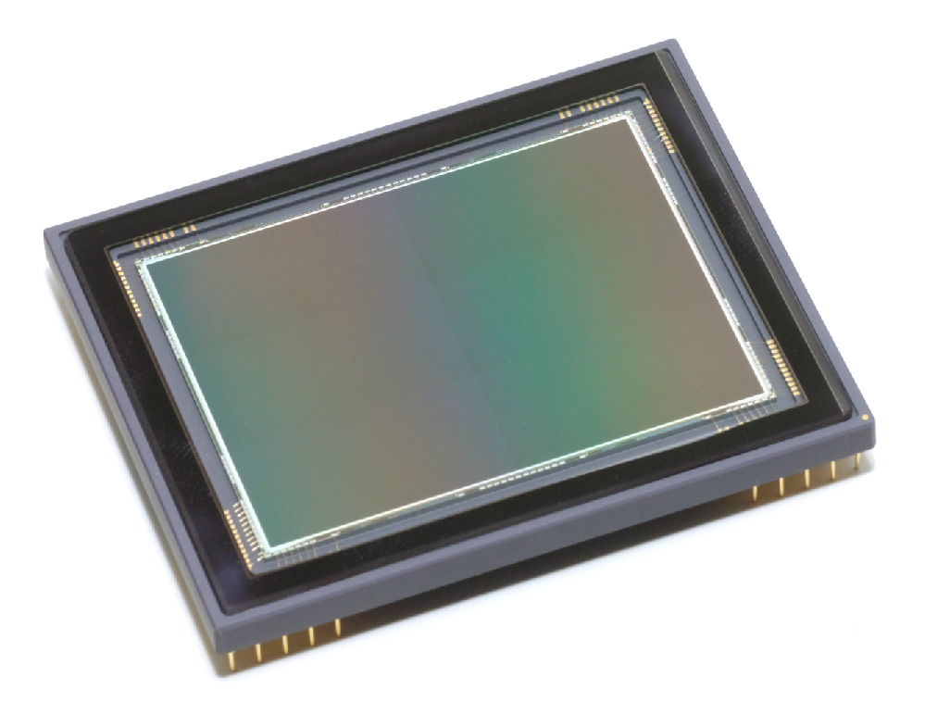
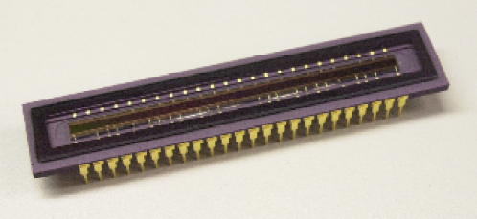
Imagers for Professional Photography
80M-pixel imager
  5.2μm pixel size, RGB Bayer color
  53 x 40 mm² image area
  4 outputs at 25MHz
60M-pixel imager
  6.0μm pixel size, RGB Bayer color
  53 x 40 mm² image area
  4 outputs at 25MHz
  Dual mode: ultra-low dark current or high dynamic range
TDI imager for 360º panoramic photography
  8.0μm pixel size, RGB stripe filters
  60 x 1.6 mm² image area
  8 outputs at 25MHz
Notes:
Technical Summary:
Please present most important technical highs and lows
Customer Update:
What is the status w.r.t. the customer regarding this project
Can be related to technical and/or schedule and/or resource and/or financials

Slide 21
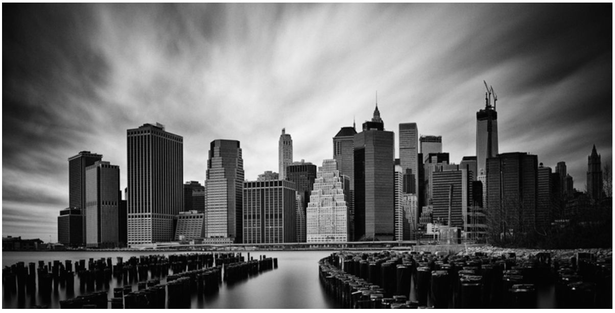
Image from 60M-pixel imager
PhaseOne IQ260 medium format digital back
TDPI 60M-pixel 53 x 40 mm² CCD imager, ultra-low dark current mode
1 hr exposure, ISO 140, un-cooled
Notes:
Technical Summary:
Please present most important technical highs and lows
Customer Update:
What is the status w.r.t. the customer regarding this project
Can be related to technical and/or schedule and/or resource and/or financials

Slide 22
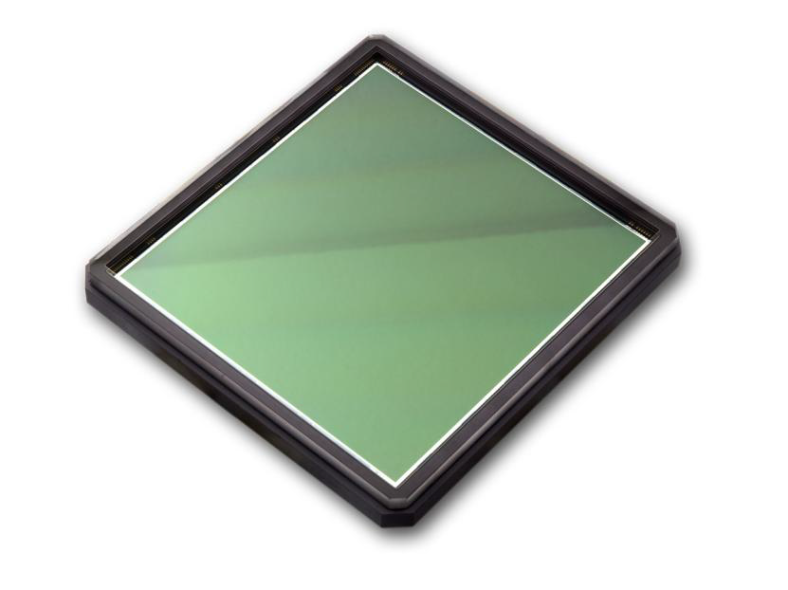
Imagers for Photogrammetry
140M-pixel imager
  7.2μm pixel size
  88 x 82 mm² image area
  TDI functionality for FMC (Forward Motion Compensation)
  4 outputs at 15MHz
252M-pixel imager
  5.6μm pixel size
  96 x 82 mm² image area
  TDI functionality for FMC
  16 outputs at 30MHz
Notes:
Technical Summary:
Please present most important technical highs and lows
Customer Update:
What is the status w.r.t. the customer regarding this project
Can be related to technical and/or schedule and/or resource and/or financials

Slide 23
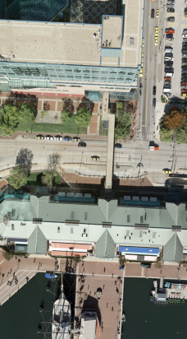
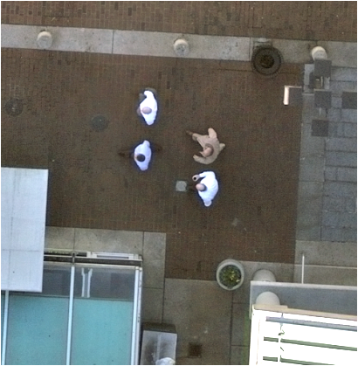
Image from 250M-pixel imager
Notes:
Technical Summary:
Please present most important technical highs and lows
Customer Update:
What is the status w.r.t. the customer regarding this project
Can be related to technical and/or schedule and/or resource and/or financials

Slide 24
Imagers for Scientific Applications
Imager for SPECT application
  Single-Photon Emission Computed Tomography
  FT-CCD
  1k x 1k 12μm pixels
  Ultra-low dark current
  EM-CCD register using single-poly concept operating at 25MHz
Imager for FLIM application
  Fluorescence Lifetime Imaging
  FT-CCD
  512 x 512 24μm super-pixels
  Demodulation of incoming light up to 80MHz
Very-high speed ISIS imagers
  In Situ Image Storage for 120-image burst at 10 million frames per second
  Concepts and imager designs by Prof. Etoh (Kinki Univ., Ritshumeikan Univ.)
  Each pixel directly connected to CCD storage section
  Newest generation: high fill factor achieved with back-side illumination
Notes:
Technical Summary:
Please present most important technical highs and lows
Customer Update:
What is the status w.r.t. the customer regarding this project
Can be related to technical and/or schedule and/or resource and/or financials

Slide 25
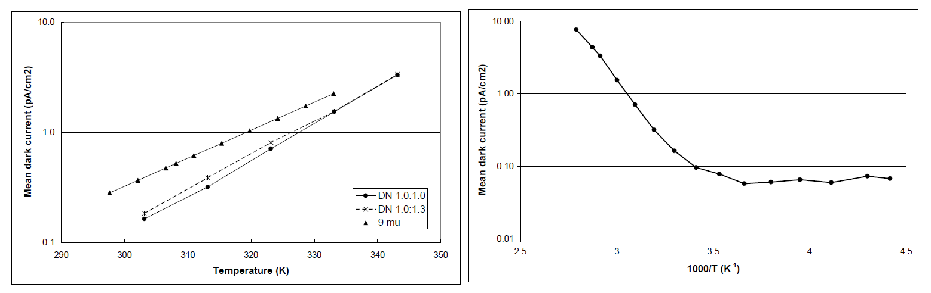
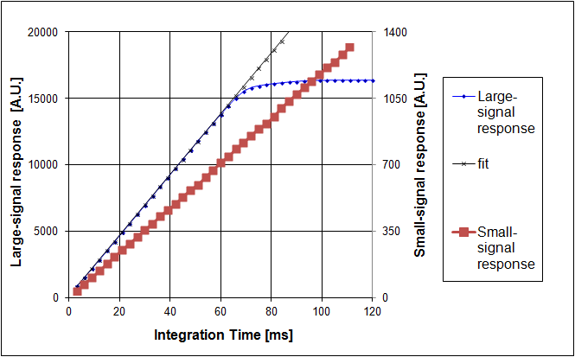
Imagers for Scientific Applications
SPECT imager electron multiplication and dark current performance
Linearity of EM multiplication, small and large signals,
25MHz EM transport frequency, 25ºC
Dark Current vs. Reciprocal Temperature
Notes:
Technical Summary:
Please present most important technical highs and lows
Customer Update:
What is the status w.r.t. the customer regarding this project
Can be related to technical and/or schedule and/or resource and/or financials

Slide 26
Contents
Introduction to TDPI
TDPI CCD Technology
Building Blocks
Product Examples
CMOS and Assembly Capabilities
Notes:
Technical Summary:
Please present most important technical highs and lows
Customer Update:
What is the status w.r.t. the customer regarding this project
Can be related to technical and/or schedule and/or resource and/or financials

Slide 27
CMOS capabilities for X-ray detectors
8” wafer-scale CMOS imagers (up to 13 x 13 cm² or 12 x 15 cm²)
3-side buttable design
CsI scintillator for X-ray conversion
Radiation-hard design and technology
Switchable pixel sensitivity (i.e. selectable full well corresponding to X-ray saturation dose) for multi-modality medical applications
3T pixels with Pinned Photo-Diode with high QE (60%)
Non-destructive readout enabling real external CDS
Low-power 14 bit column-parallel ADC (280μW/column)
Available pixel sizes from 20 to 200 μm
Detectors up to 30 x 30 cm² available
Concept suitable for very-large size scientific imagers
Notes:
Technical Summary:
Please present most important technical highs and lows
Customer Update:
What is the status w.r.t. the customer regarding this project
Can be related to technical and/or schedule and/or resource and/or financials

Slide 28
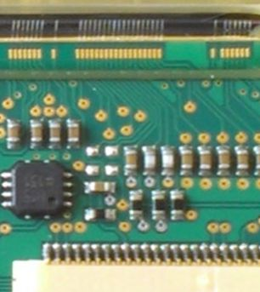
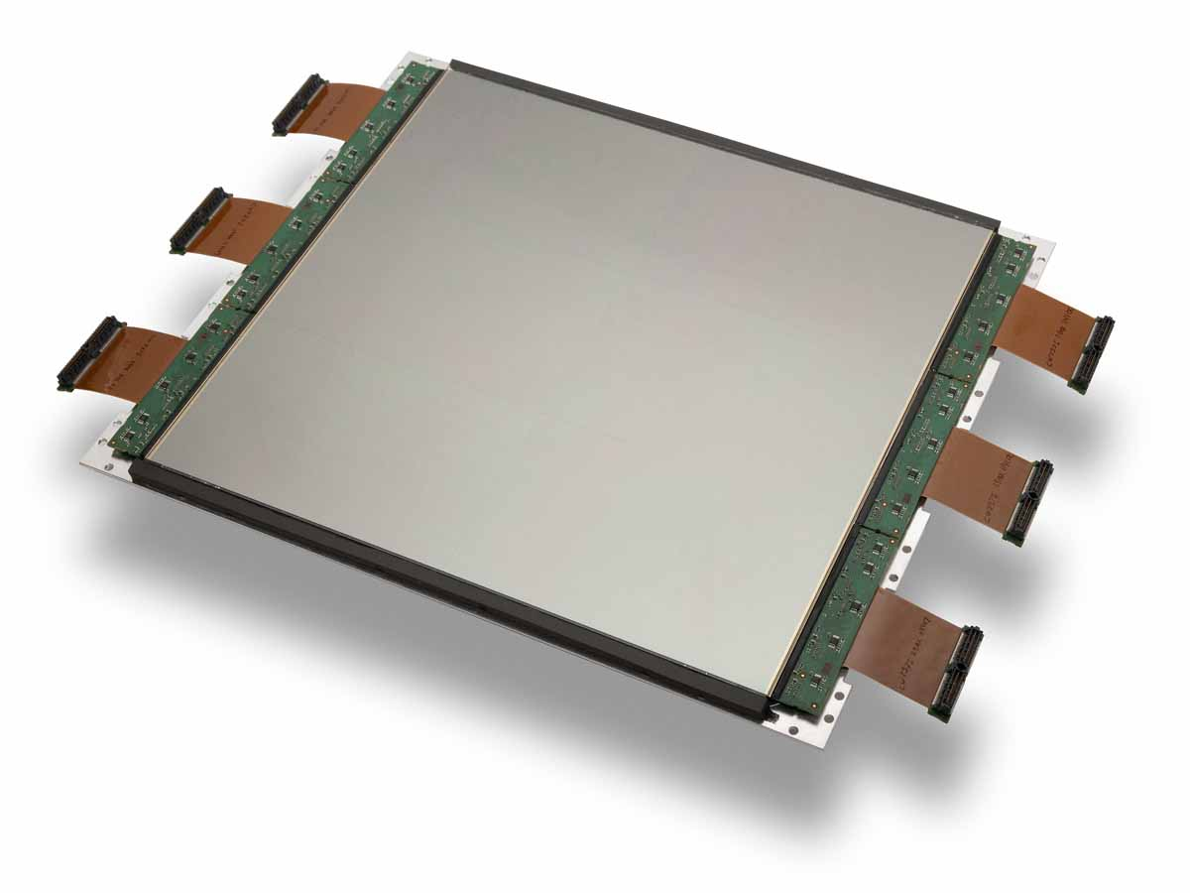
Detector Assembly Capabilities
Production line for 8” CMOS-imager based multi-tile X-ray detectors
2 x n arrays of 3-side buttable CMOS imagers
Precision dicing, long-range wirebonding, attachment of fiber-optic and scintillator
Low-temperature processing (glob top, adhesives, ...)
< 15μm butting accuracy (alignment + process)
Semi-automated process
Detail of dicing performance and placement accuracy for four
8” wafer-scale CMOS imagers
Bonding from CMOS to PCB and glob top protection
Assembled 30 x 30 cm²
X-ray detector with six
8” wafer-scale imagers
Notes:
Technical Summary:
Please present most important technical highs and lows
Customer Update:
What is the status w.r.t. the customer regarding this project
Can be related to technical and/or schedule and/or resource and/or financials

Slide 29
Summary and Conclusions
Teledyne DALSA Professional Imaging (TDPI)
  Has in-house state-of-the-art CCD technology for professional applications
  Is supplying CCD imagers to the leaders in these markets
  Designs CMOS imagers and integrated X-ray detectors
  Has proprietary detector assembly processes
  Is supplying Medical X-ray detectors to leading medical OEM’s
  Has in-house assembly lines for CCD & CMOS components and for X-ray detectors
Notes:
Technical Summary:
Please present most important technical highs and lows
Customer Update:
What is the status w.r.t. the customer regarding this project
Can be related to technical and/or schedule and/or resource and/or financials

Slide 30
Acknowledgement
Many thanks to:
CCD experts at TDPI Eindhoven
  Herman Peek, Wilco Klaassens, Walter de Laat, Holger Stoldt, Harry van Kuijk, Erik-Jan Manoury, Alexander Zyazin, René Leenen, Mesut Koyuncu; and many others
CCD experts in Bromont waferfab
  Raymond Frost, Robert Groulx, François Dion; and many others
CMOS and Detector experts at TDPI in Eindhoven
  Laurens Korthout, Peter Hartog; and many others
Notes:
Technical Summary:
Please present most important technical highs and lows
Customer Update:
What is the status w.r.t. the customer regarding this project
Can be related to technical and/or schedule and/or resource and/or financials

