Slide 1
Results of Acceptance Tests of Hyper Suprime-Cam CCDs
Yukiko Kamata, Hidehiko Nakaya, Satoshi Miyazaki
National Astronomical
Observatory of Japan
Notes:
Good morning
I’m delighted to be here today.
My name is Yukiko Kamata of National Astronomical Observatory of Japan.
Today,
I will talk about “Results of acceptance tests of Hyper Suprime-Cam CCDs”.

Slide 2
Hamamatsu Fully Depleted CCD
CCD Evaluation Setup
CCD Acceptance Tests Results
CCD Safe Handling
Notes:
First I will talk about the Hamamatsu Fully depleted CCD.
Then, I’ll introduce our CCD Evaluation Setup.
After that, I will show you the results of acceptance tests for the CCD.
Finally, I am going to talk about the safe handling of many CCDs.
If you have any questions, I’d be happy to answer them at the end.

Slide 3
Hamamatsu Fully Depleted CCD
Notes:
I’ll start with Hamamatsu fully depleted CCD.
As you may know, Hyper Suprime-Cam has started the observation at Subaru Telescope in Hawaii.
It has a 1.5 degree field of view.
That field of view has been paved with 116 fully depleted CCDs which are fabricated by Hamamatsu Photonics K.K.

Slide 4
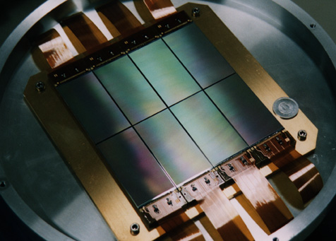
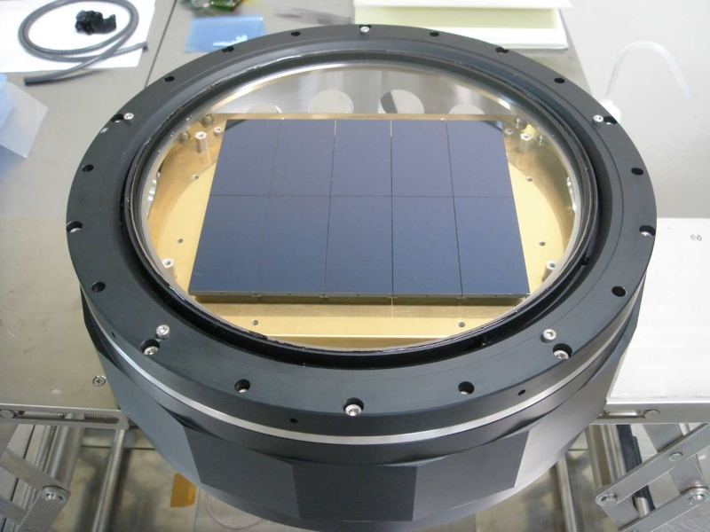
NAOJ-HPK Collaboration
1994 - 1996 Back Illuminated small CCD
1996 - 1998 2k4k Front illuminated CCD
1999 - 2008 BI 2k4k Fully Depleted CCD
1998
2008

Slide 5
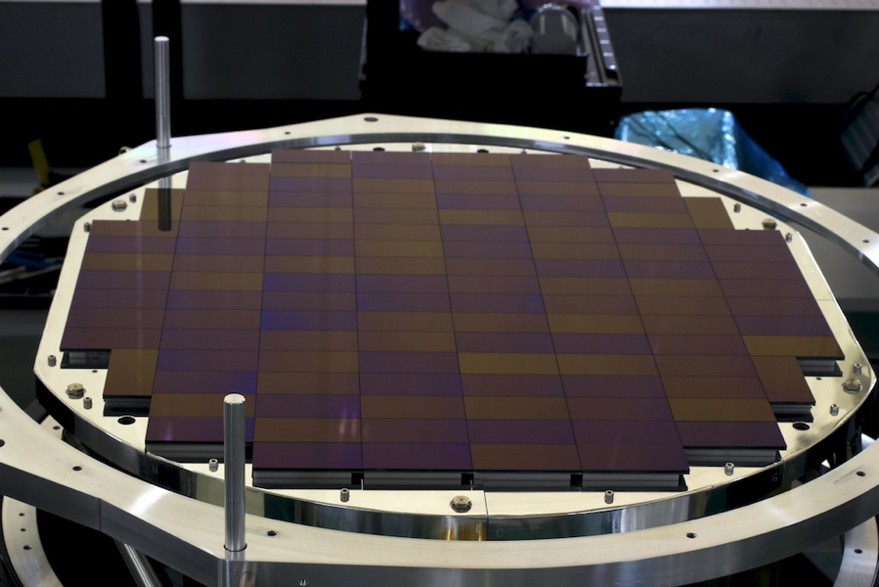
HSC Focal Plane
116 HPK FD CCDs
1998

Slide 6
Fully depleted back-illuminated CCD
Parameter | Specification
Number of active pixels | 2048(H) x 4096(V)
Pixel size | 15 μm x 15 μm □
Silicon thickness | 200 μm
Number of Output | 4
Package type | 4-side buttable
Made by HAMAMATSU Photonics
Notes:
This picture is Fully depleted back illuminated CCD.
The package is 4-side buttable.
Number of active pixels is 2K x 4K and the pixel size is 15 um by 15 um square.
It is made of N-type silicon wafer with high resistivity.
The silicon wafer is 200 um thick.
And this CCD has 4 amplifiers.

Slide 7
Package Structure
Pt sensor
Pin grid array
CCD
CCD base
PIN base
MOS-FET
Alignment pin
Load resistance
Notes:
These pictures show the package structure.
The left shows side-way view and right shows backside of the CCD.
The package of CCD consists of two parts, CCD base and PIN base.
The CCD base has interconnections between the bonding pads and the pin grid array.
The PIN base has three alignment pins which secure the CCD on the cold plate.
Both are made of Aluminum Nitride.
Through the PIN base and CCD base, CCD is cooled.
And There are 4 MOS-FETs, 4 load resistances for readout and platinum temperature sensor on backside.

Slide 8
CCD Evaluation
Notes:
Next, let’s move onto the CCD evaluation.
As mentioned previously, Hyper Suprime-Cam has a 1.5 degree field of view, and we have paved it with 116 CCDs.
In order to select the best 116 CCDs, finally we have measured nearly 200 CCDs.
I’m going to talk about the results of 116 CCDs which were installed in the HSC dewar.

Slide 9
Acceptance Test Items
Items | Tested by
Quantum Efficiency | Visible light Image
Linearity
Full well Capacity
Amplifier Responsivity | Fe55(X ray radiation source) Image
Charge Transfer Efficiency
Readout noise | Over scan region of Image
Dark current | Dark current Image
Column Defect | Dark current image of 60 minutes exposure Light image with half of full-well
Notes:
Now I’ll start with acceptance test items.
8 acceptance test items are shown in this table.
We have tested 7 items except quantum efficiency for all CCDs.
And only in testing, quantum efficiency we measured 21 CCDs which are randomly selected.

Slide 10
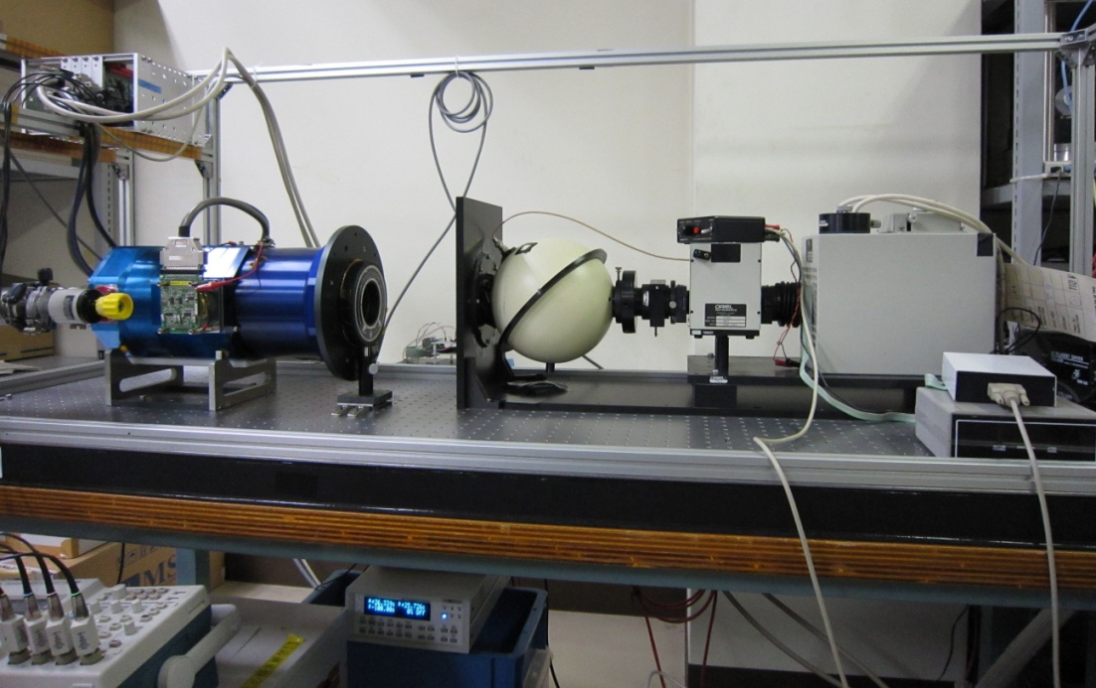
Measurement Setup
Light Source
Readout Electronics
X-ray Source
Fe 55
Messia 5
(Digital Circuit)
Mfront 2
(Analog Circuit)
CCD
(In dewar)
Xe Lamp +
Monochromator
(300 – 1100 nm)
PC
Cooling System
Temperature Controller
Lakeshore (@ -100 ºC)
Cryo Tiger
Notes:
Next I’ll explain the measurement setup.
This figure shows a block diagram of measurement setup.
It consists of 4 parts, light source, CCD, readout electronics and cooling system.
Depending on the test items, we use X-ray source and monochrometer
We use the readout electronics which is called Mfront2 for the analog circuit and Messia5 for the digital circuit.
These were specially developed for the fully depleted CCD in use for Suprime-Cam of Subaru Telescope.
The CCD is in the dewar and cooled to -100 C by cooling system.

Slide 11
Acceptance Tests Results
Notes:
And now I’ll talk about the acceptance tests results.

Slide 12
Performance of the 116 CCDs
(@ -100 ºC)
Item |  | Requirement | Results
QE | 400 nm 550 nm 650 nm 770 nm 920 nm 1000 nm | > 45 % > 85 % > 90 % > 85 % > 80 % > 40 % | 52.1 ± 1.9 % 94.6 ± 1.0 % 93.1 ± 1.6 % 87.3 ± 1.7 % 73.8 ± 0.7 % 37.4 ± 0.7 %
CTE Parallel direction Serial direction |  | > 0.999995 > 0.999995 | 0.9999973 ± 0.0000017 0.9999987 ± 0.0000051
Dark current |  | A few e-/pixel/hour | 0.42±0.18 e-/pixel/hour
Full well (1 % departure) |  | 150,000 e- | 160,000 ~ 180,000 e-
Amplifier responsivity |  | > 4 μV/e- | 4.39 ± 0.28 μV/e-
Readout noise (150kHz readout) |  | < 5 e- | 4.38 ± 0.31 e-
Column defect |  | < 20 | 0 ~10 / CCD
Packaging (Global height variation) |  | < 35 µm Peak to valley | 113/116 : < 35 μm 3/116 : 37 ~ 45 µm(in the worst case)
Notes:
This table shows the performance of the 116 CCDs.
Starting from the left, Items, Requirements and Results are shown.
As you can see, the results satisfy almost all the requirement.
Form next slide on, I’ll explain the detail of the quantum efficiency, linearity, amplifier responsivity column defect and height variation.
----- 会議メモ (13/10/06 20:44) -----

Slide 13
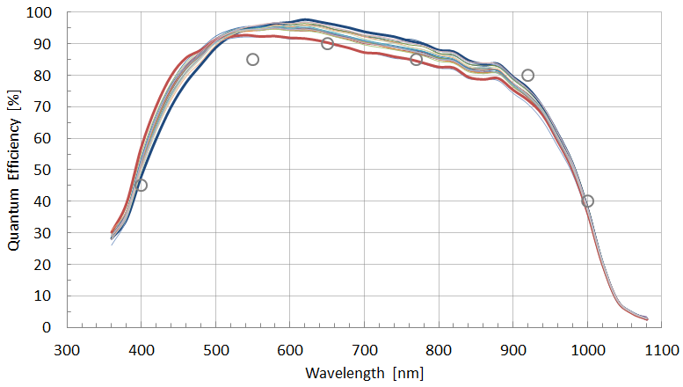
Quantum Efficiency Raw Data of 21 CCDs
-100 ºC
Thin AR-Coating
Thick AR-Coating
○ : Specification
-- average of 21 CCDs
Each CCD has different thickness of AR-Coating.
Thickness of AR-Coating differ from CCD to CCD．
Notes:
First I’ll talk about the quantum efficiency.
This graph shows the raw data of the quantum efficiency for 21 CCDs.
On the horizontal axis shows wavelength in nm.
On the vertical axis shows quantum efficiency in %.
The specifications of quantum efficiency is shown as gray circles.
The measurement results show that the CCDs almost satisfy the specification from 360 nm to 1060 nm, except 920 nm.
And the variation of QE is large from 400 nm to 900 nm.
Recently, we confirmed this large variation depends on the thickness of anti-reflective coating (on each CCDs).

Slide 14
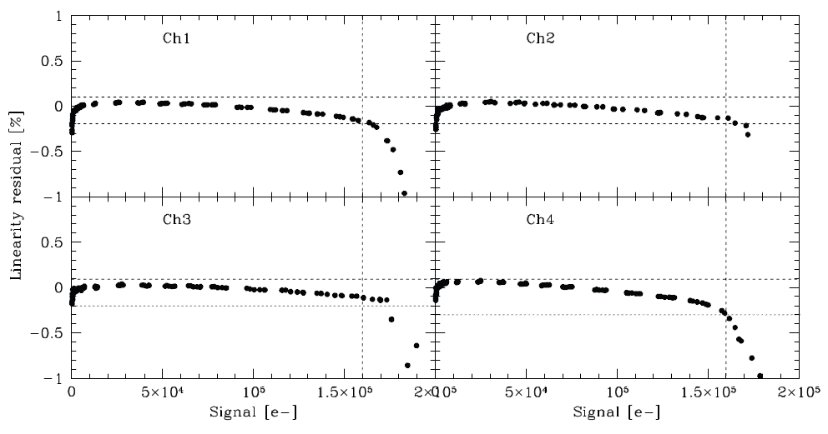
Linearity
457 channels have better than +/- 0.25 % linearity
7 channels have +/- 0.5 % linearity with 160,000 e-.
Notes:
Then I’ll go on with linearity.
This graph shows an example of CCD linearity.
On the horizontal axis shows charge in e-.
On the vertical axis shows linearity residual in %.
In the case of this CCD,
The linearity of 4 channels have within +/- 0.2% from 0 to 160,000e-.
Finally, we measured the linearity for 464 channels of 116 CCDs.
457 channels have better than +/- 0.25 % linearity
Only 7 channels have +/- 0.5 % linearity with 160,000 e-.

Slide 15
Amplifier Responsivity
Amplifier Responsivity
Quality depends on each lot.
Notes:
Next We’ll show you the distribution of amplifier responsivity of all channels.
This graph shows the amplifier responsivity of 4 lots.
On the horizontal axis shows amplifier responsivity in uV/e- and
On the vertical axis shows the number of CCD channels.
As you can see in this graph, the amplifier responsivity depends on Lot number.
Only the Lot B was about 15 % lower than the other Lots.
In spite of low amplifier responsivity, the readout noise was satisfied with under 5 e- for all channels.
So we accepted these CCDs.
In addition, the standard deviation of each lots are small.
We confirmed the quality of amplifier responsivity consist in each lot.

Slide 16
Column Defects
No defect
One block of blight columns
82 / 116 CCDs are perfect. No Column Defect.
Notes:
Right, I’ll keep going with Column defect.
I counted the number of column defect using the light-illuminated image and the dark current image.
82 of 116 CCDs have no column defect like in the left image.
The rest of CCDs have several column defects less than 10,
However, a few bright columns tend to be clustered and looks like as a single column defect like in the right image.

Slide 17
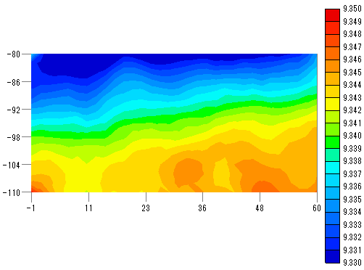
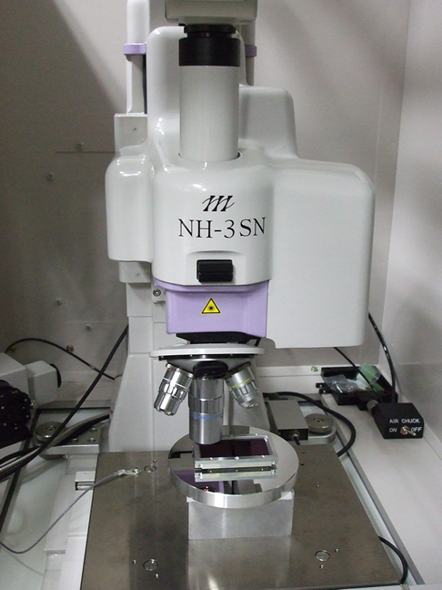
Measurement of Flatness
P-V : 20 μm
Reference plate
Flatness : 2 um
Ch4
|
|
|
|
|
Ch1
Sample : 2mm pitch
32 x 16 points
y
▲
Measurement origin
(x, y)=(4, 0.3) mm
The corner of active area
Laser Probe 3D Measuring Instrument
NH-3SP from Mitaka-Koki
x
Notes:
Now that we’ve looked at electrical performances.
Let’s move onto the flatness of CCDs.
We measured the flatness of each CCD at room temperature.
The left picture shows the laser probe 3D measuring system made by Mitaka-koki.
We have mounted a CCD on the aluminum reference plate with 2.0 um flatness.
In this figure the measurement origin was set to be the corner of active area.
We measured 32x16 points with 2 mm pitch.
The measurement result of flatness was as shown the top-right image,
In the case of this CCD, the flatness was 20 um in Peak to valley.

Slide 18
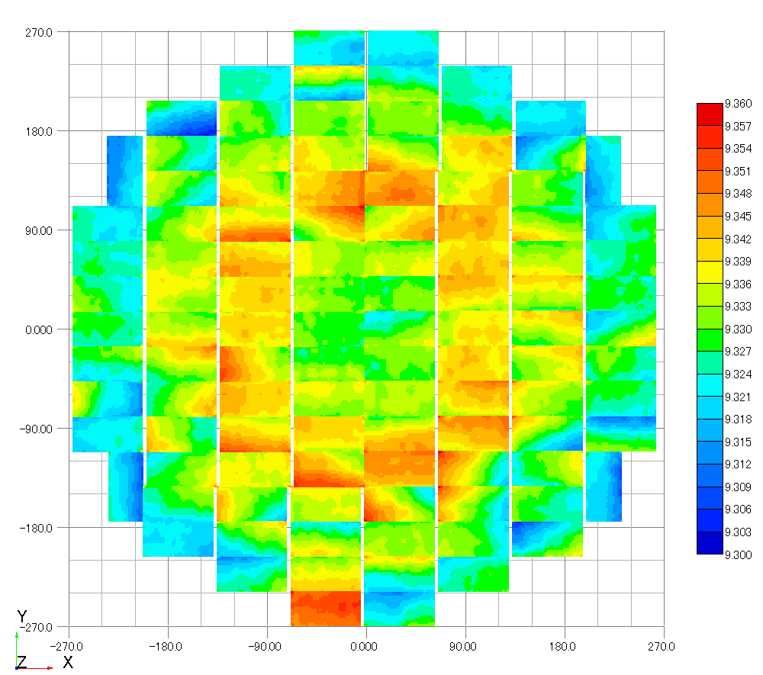
Focal Plane Flatness
At room temperature
[mm]
[mm]
Notes:
This map shows relative height of surfaces of the 116 CCDs in the field of view.

Slide 19
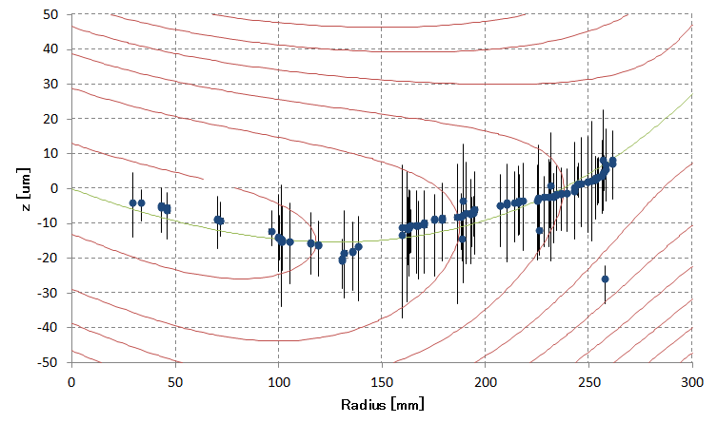
Focal Plane Flatness Peak to Value
At room temperature
'+' away from M1
2.8
2.7
2.6
2.5
Z [um] +σ
Notes:
This graph shows the sectional view of the focal plane of Hyper Suprime-Cam.
On the horizontal axis shows radius in mm of the focal plane.
On the vertical axis shows the distance of primary mirror.
The red contour shows the expected image size which is the convolution of the optics aberration with the 0.4 arcsec seeing.
The green line indicates the best image height for each radius.
The blue dot shows the average of each CCD height.
We have located the CCDs at the best position on the Field of view.
As a result the average of the hight and best image position may become smallest.
The overall flatness except auto focus CCD was within 45 um.

Slide 20
Focal Plane Flatness Standard deviation
'+' away from M1
At room temperature
2.8
2.7
2.6
2.5
Statistically is not too bad.
Notes:
Statistically is not too bad.

Slide 21
CCD Safe Handling
Notes:
Finally, I’ll introduce our CCD Handling environment.
As you know, CCD is very sensitive to static electricity and fragile.
So working environment and jig are an important.

Slide 22
Handling Environment
Border of protective area
Wrist band
Ionizer
Conductive gloves and finger covers
Notes:
This picture shows a handling environment when we have installed CCDs in the dewar.
The blue line in the picture is the border line of protective area.
In this area, only authorized person can be enter.
All the equipments; conductive sheet conductive table and ionizers are connected to the electrical ground.
Every time before working, we used a static field meter to check the electrostatic discharge.

Slide 23
Flexible Cables
Without Potting
With Potting
Short plug
Airborn Connector
Silicon adhesive potting protects CCDs from ESD
Notes:
And we prepared a special flexible cables.
The left picture shows flexible cable before potting and the right picture shows after potting.
As shown the left picture, pins of the connector are exposed and prone to receive discharges.
On the other hand, as shown right picture,
After covering the pins with silicon,
The pins are protected in order not to be touched directly.
And I made a short plug which short-circuited all the pins to connect the electronics side.
In this way, we protected the CCDs from electric discharge.

Slide 24
Special Jig
Slide the frame
Lift up the CCD
CCDのCarry用アルミ枠を取るためのジグ
主な目的は，CCDを物理的に壊さないため！
Surface2
Surface1
Physical damages are minimized.
Notes:
Finally, I’ll introduce the jig.
As shown in this picture,
We prepared a special jig to safely remove the aluminum frames from a CCD.
The structure is simple.
The jig supports bottom of the PIN base on surface1, and supports aluminum frame with surface2.
By sliding the aluminum frame to this direction, aluminum frame can be safely removed.
In this way, We can safely pick up the CCD from this direction.

Slide 25
Conclusion
We tested 116 CCDs and installed them in HSC.
All of the CCD provided superb performance.
We built the special environment for CCD safe handling.
Notes:
Thank you for your attention

Slide 27
Appendix

Slide 28
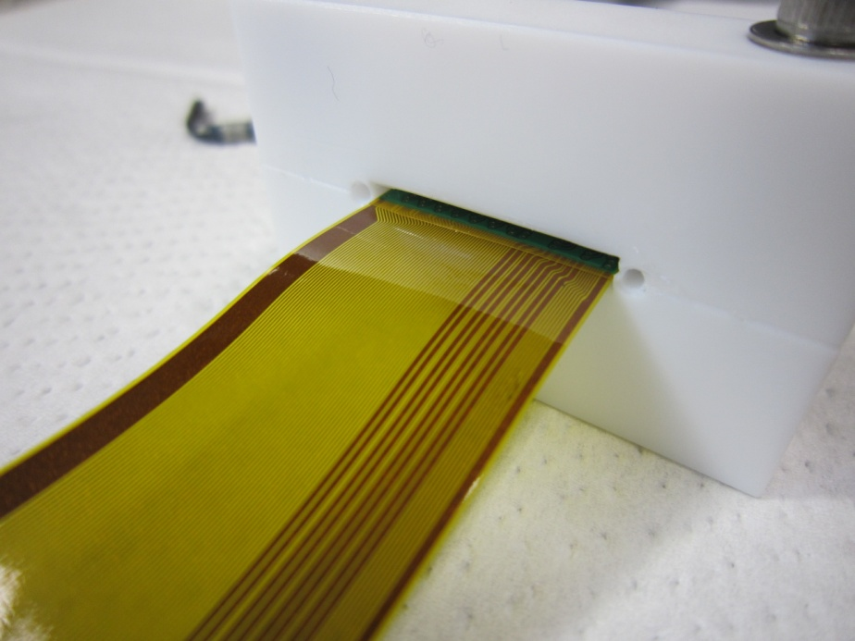
Potting on the Connector
Potting Silicon on the pin
Sandwiching the connector by Teflon covers
Silicon Adhesive ： X35-181 and C-181H (Shin-Etsu Chemical)
2 liquid mixed type
Cures in 4 hours at 80 ºC
Notes:
How to make the potting connector.
These pictures show making a potting a connector.
The silicon adhesive is 2 liquid mixed type, made by Shin-Etsu chemical.
And it cures in 4 hours at 80 C.
The key point at here is covering the pins with silicon adhesive.
So that the CCD protect from ESD damage.

