Slide 1
Performance Improvements for Fully Depleted Charge-Coupled Devices
S.E. Holland, C.J. Bebek, J.H. Emes, D.E. Groom, S. Haque, A. Karcher,
W.F. Kolbe, J.S. Lee, N.P. Palaio, C.H. Tran, and G. Wang
Lawrence Berkeley National Laboratory
F. Dion, R. Frost, and R. Groulx
Teledyne DALSA Semiconductor

Slide 2
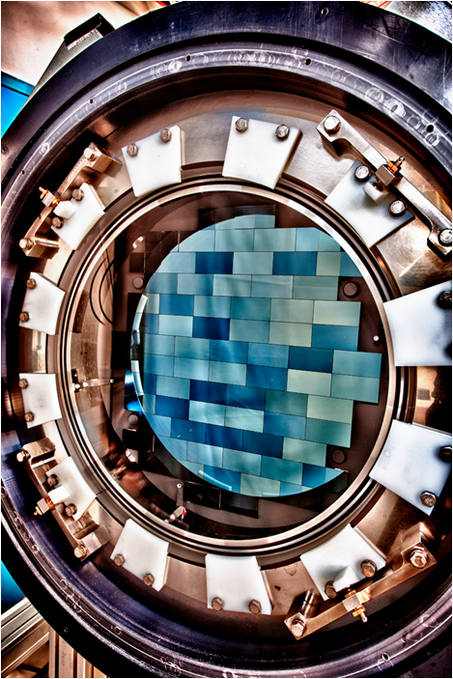
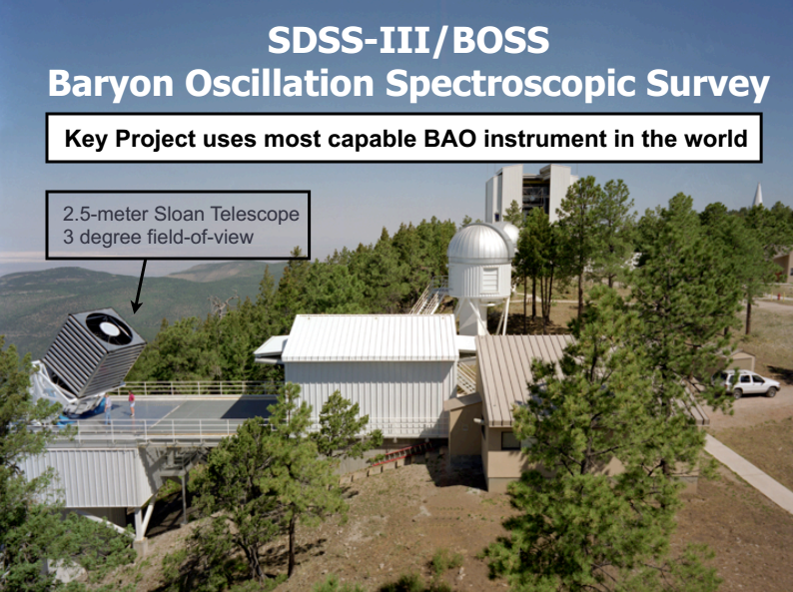
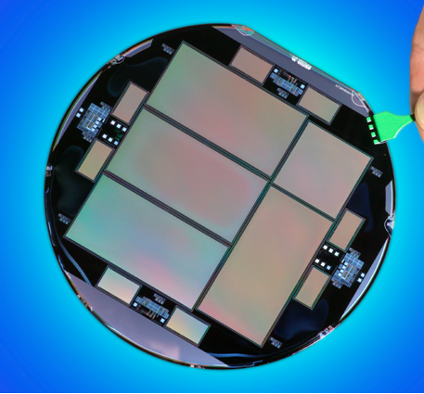
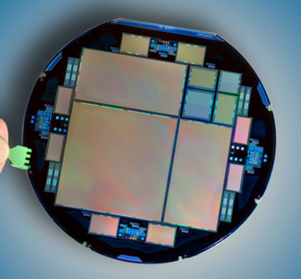
Introduction
Major results since 2009 SDW
CCDs for the Dark Energy Survey Camera and BOSS
DECam – 62 2k x 4k’s and 12 2k x 2k’s (15µm pixels)
1st light September 2012
BOSS – 2 4k x 4k’s (15 µm pixels)
In operation since 2009 with > 2 million spectra taken
250 µm thick CCDs

Slide 3
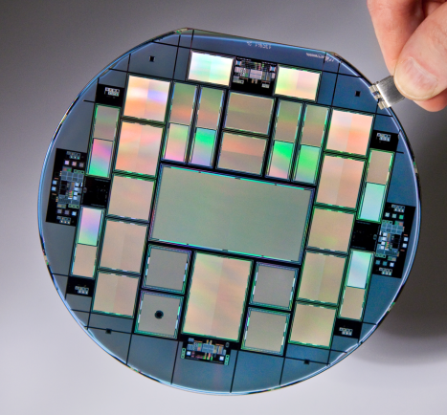
Introduction
Major results since 2009 SDW (cont’)
R&D efforts to improve noise, readout speed and QE
Internal LBNL R&D funding
Wafer delivery Fall 2010
6 and 12 channel CCDs (10.5 µm pixels)
Low noise amplifiers (buried contacts)
Skipper CCD (sub-electron noise)
Fast CCDs for direct x-ray detection
196 amplifiers
Department of Energy NNSA grant
Wafer delivery late 2012
16 channel CCDs (10.5 µm pixels)
4k x 4k and 4k x 2k
Low noise amplifiers (buried contacts)
Not successful this run

Slide 4
Introduction
Major results since 2009 SDW (cont’)
R&D efforts to improve noise, readout speed and QE
?
Internal LBNL R&D funding (FY 2013)
Wafer delivery October 2013
4k x 4k (15 µm) with buried contacts
2nd generation low noise amplifiers
1 x 1 µm² buried contact size
Large format Skipper (4126 x 886)
Internal LBNL R&D funding (FY 2014)

Slide 5
Outline
Major R&D areas
Read Noise
Readout Speed
Quantum Efficiency

Slide 6
Noise improvements
Development at Teledyne DALSA of buried-contact technology to reduce the floating-diffusion capacitance
4th poly layer doped p type for p-channel CCD
47 µm / 6 µm transistor
4.3 µV/e-
3.2 e- rms at 70 kpixels/sec (-140C)
Floating diffusion
20 µm / 6 µm transistor
9.3 µV/e-
1.70 e- rms
2 x 2 µm² buried contact
S. Haque et al, Proc. SPIE, 8298, 2012

Slide 7
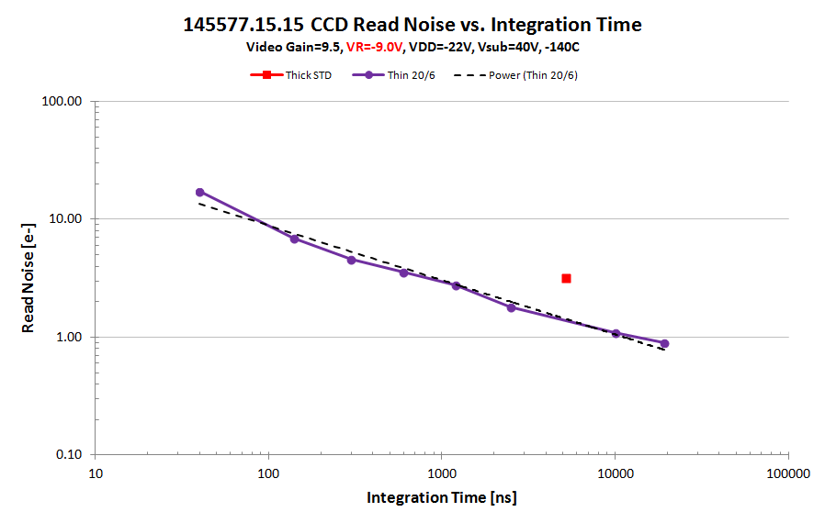
Noise improvements (cont’)
Buried contact noise results for 2 x 2 µm² buried contact
Unpublished results

Slide 8
Noise improvements (cont’)
In progress – buried contact amplifiers on 16 channel CCDs (10.5µm) and 1 x 1 µm² contact (mix and match lithography)

Slide 9
Outline
Major R&D areas
Read Noise
Readout Speed
Increase # amplifiers/CCD
1st prototypes 6 and 12 channels at 512 column pitch
Latest versions 16 channels at 512 column pitch
4k x 4k and 4k x 2k (10.5um) CCDs

Slide 10
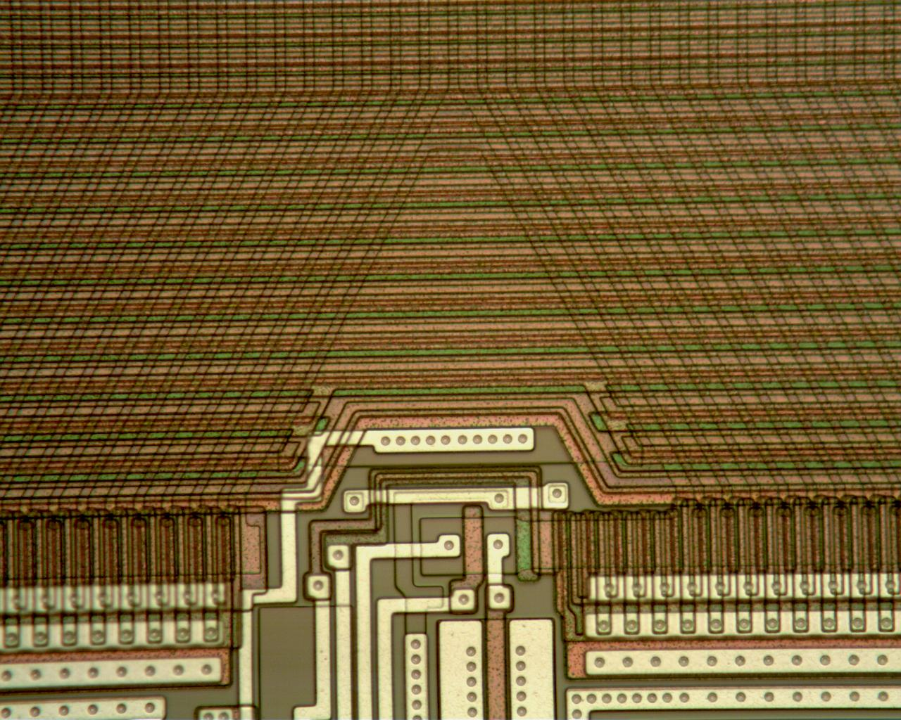
Readout speed improvements
Scalable CCD with amplifiers every 512 columns
11 row taper in vertical register (10.5µm pixels)
Vertical
Serial
10.2 µm pitch
C.J. Bebek et al, Proc. SPIE, 8453, 845305-1, 2012

Slide 11
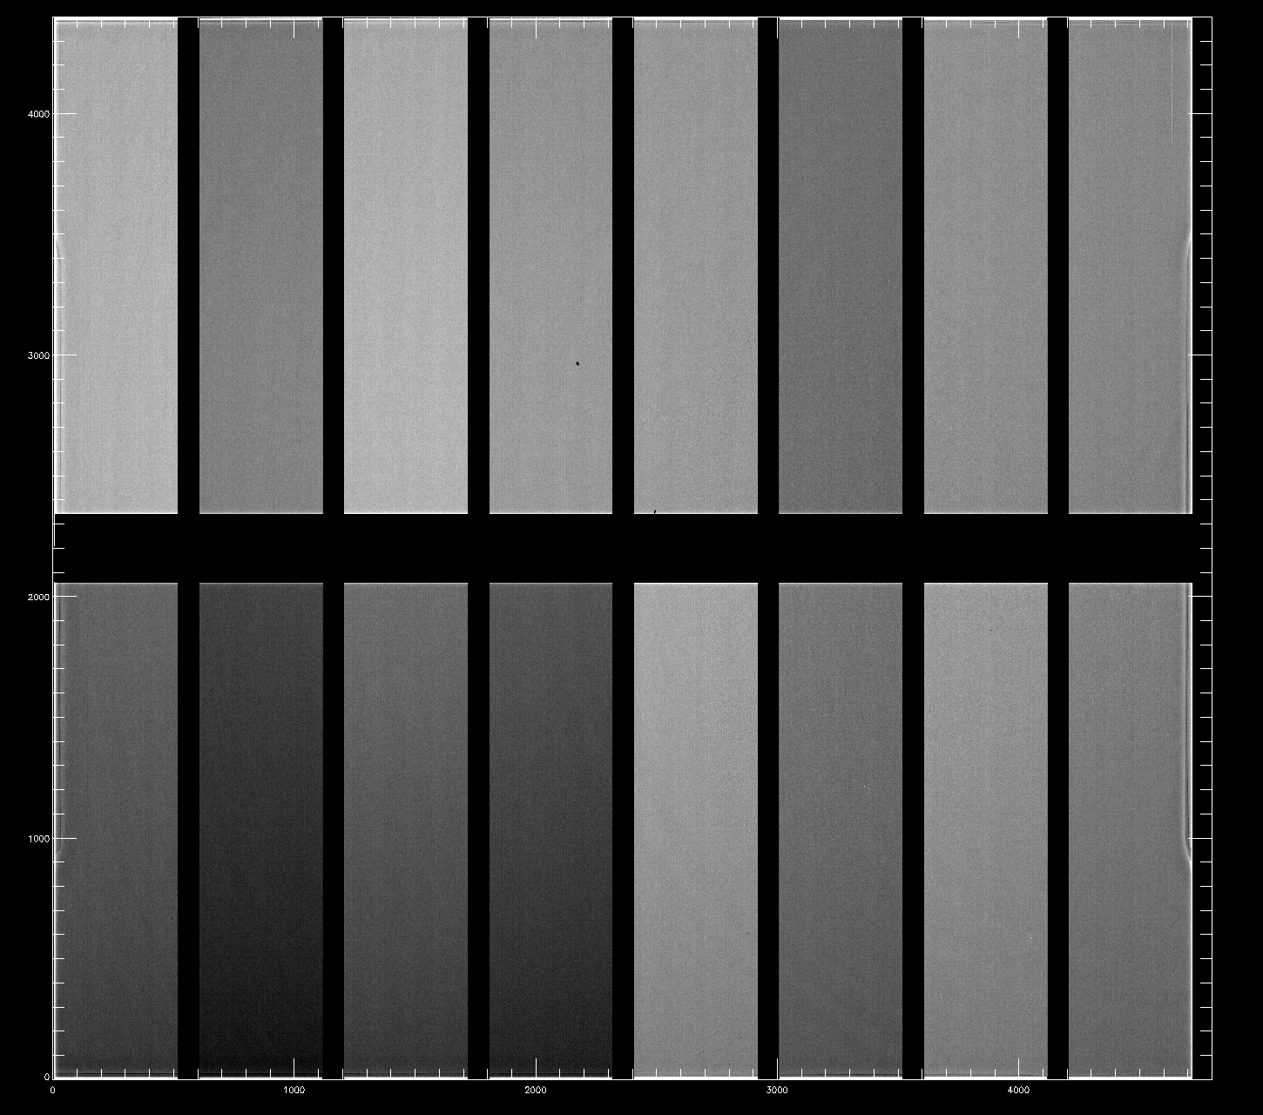
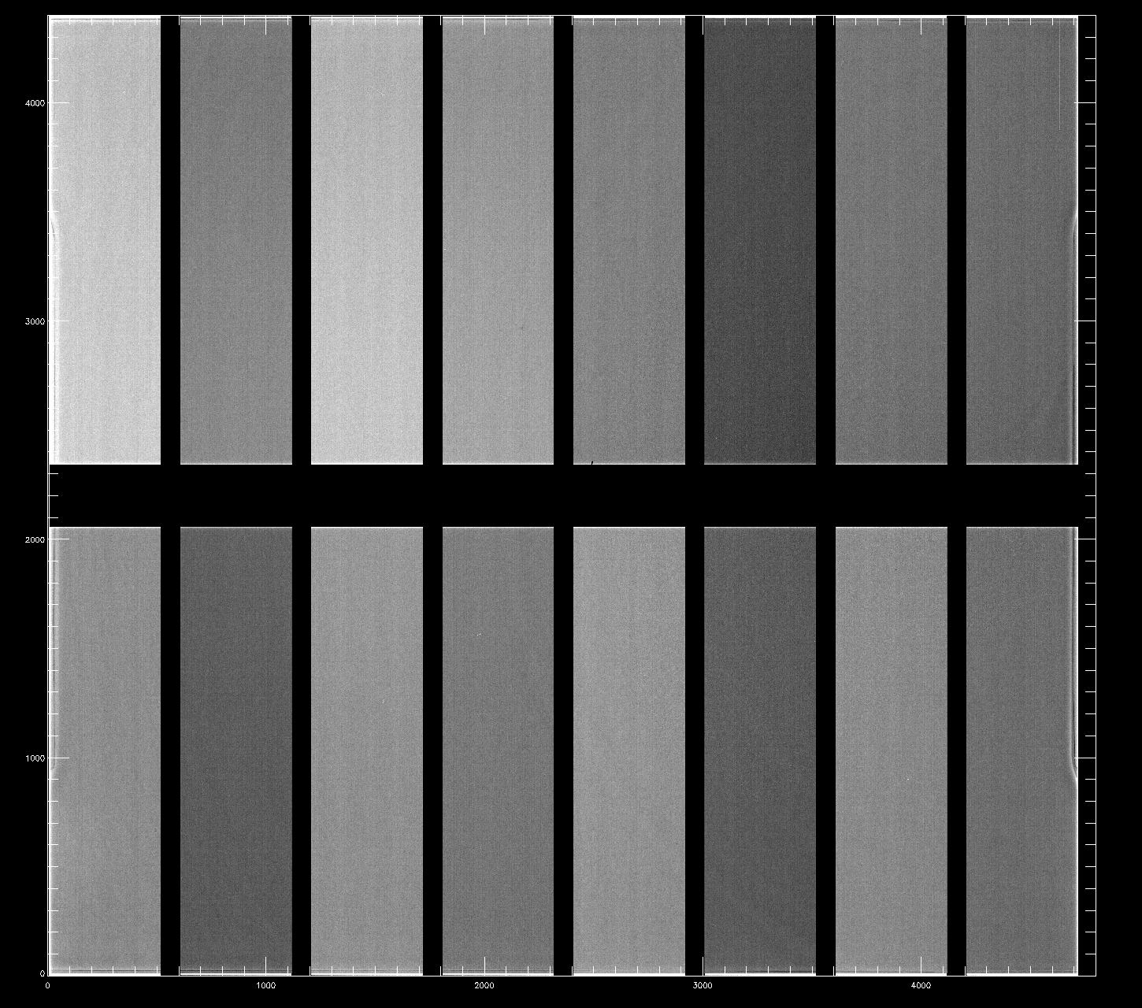
16 channel CCD images – 4k x 4k (10.5µm)
200 µm thick CCD
U band filter 500 nm narrowband filter
Images taken 4 channels at a time

Slide 12
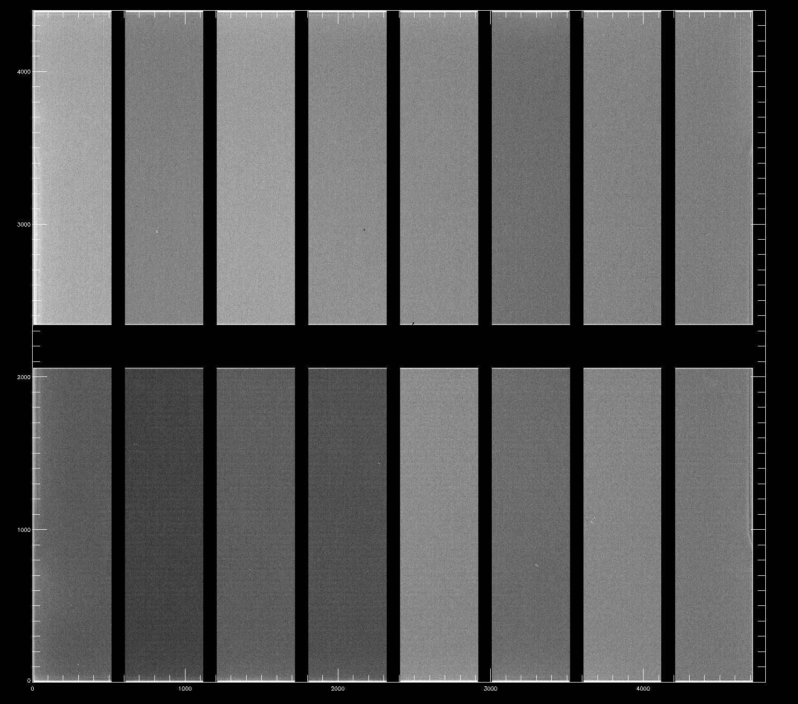
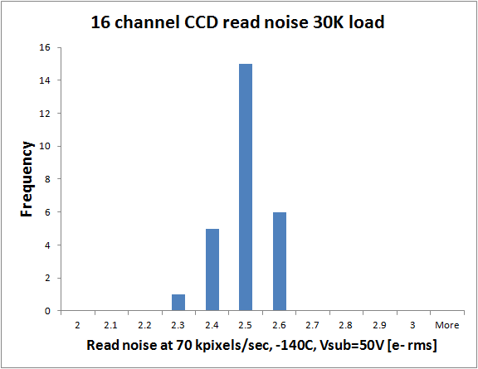
16 channel CCD images – 4k x 4k (10.5µm)
200 µm thick CCD
1 µm narrowband filter
Read noise (27 channels from 4 different CCDs)

Slide 13
Outline
Major R&D areas
Read Noise
Readout Speed
Quantum Efficiency
Efforts to reduce backside n⁺ layer thickness
Improved anti-reflection coating materials

Slide 14
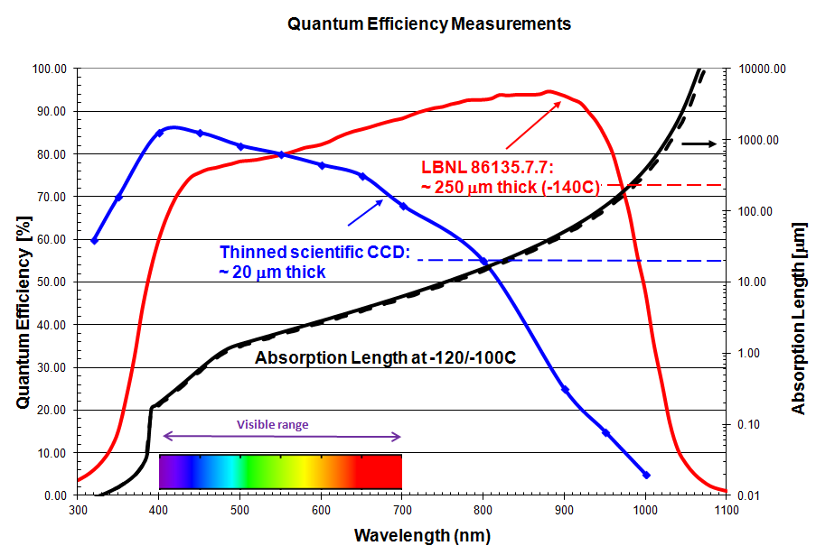
Improving blue quantum efficiency
Good blue response requires very thin dead layers on the back surface of the CCD and appropriate anti-reflection coatings

Slide 15
Improving blue quantum efficiency
Back side n⁺ contact technology is in-situ doped polysilicon (ISDP)
Terminates the electric field in the fully depleted substrate
As thin as possible for blue response
Standard for DECam was 25 nm, exploring thinner layers (15, 10, 5 nm)
Electric Field
y
CCD cross section
Not to scale
Depleted
Depletion edge

Slide 16
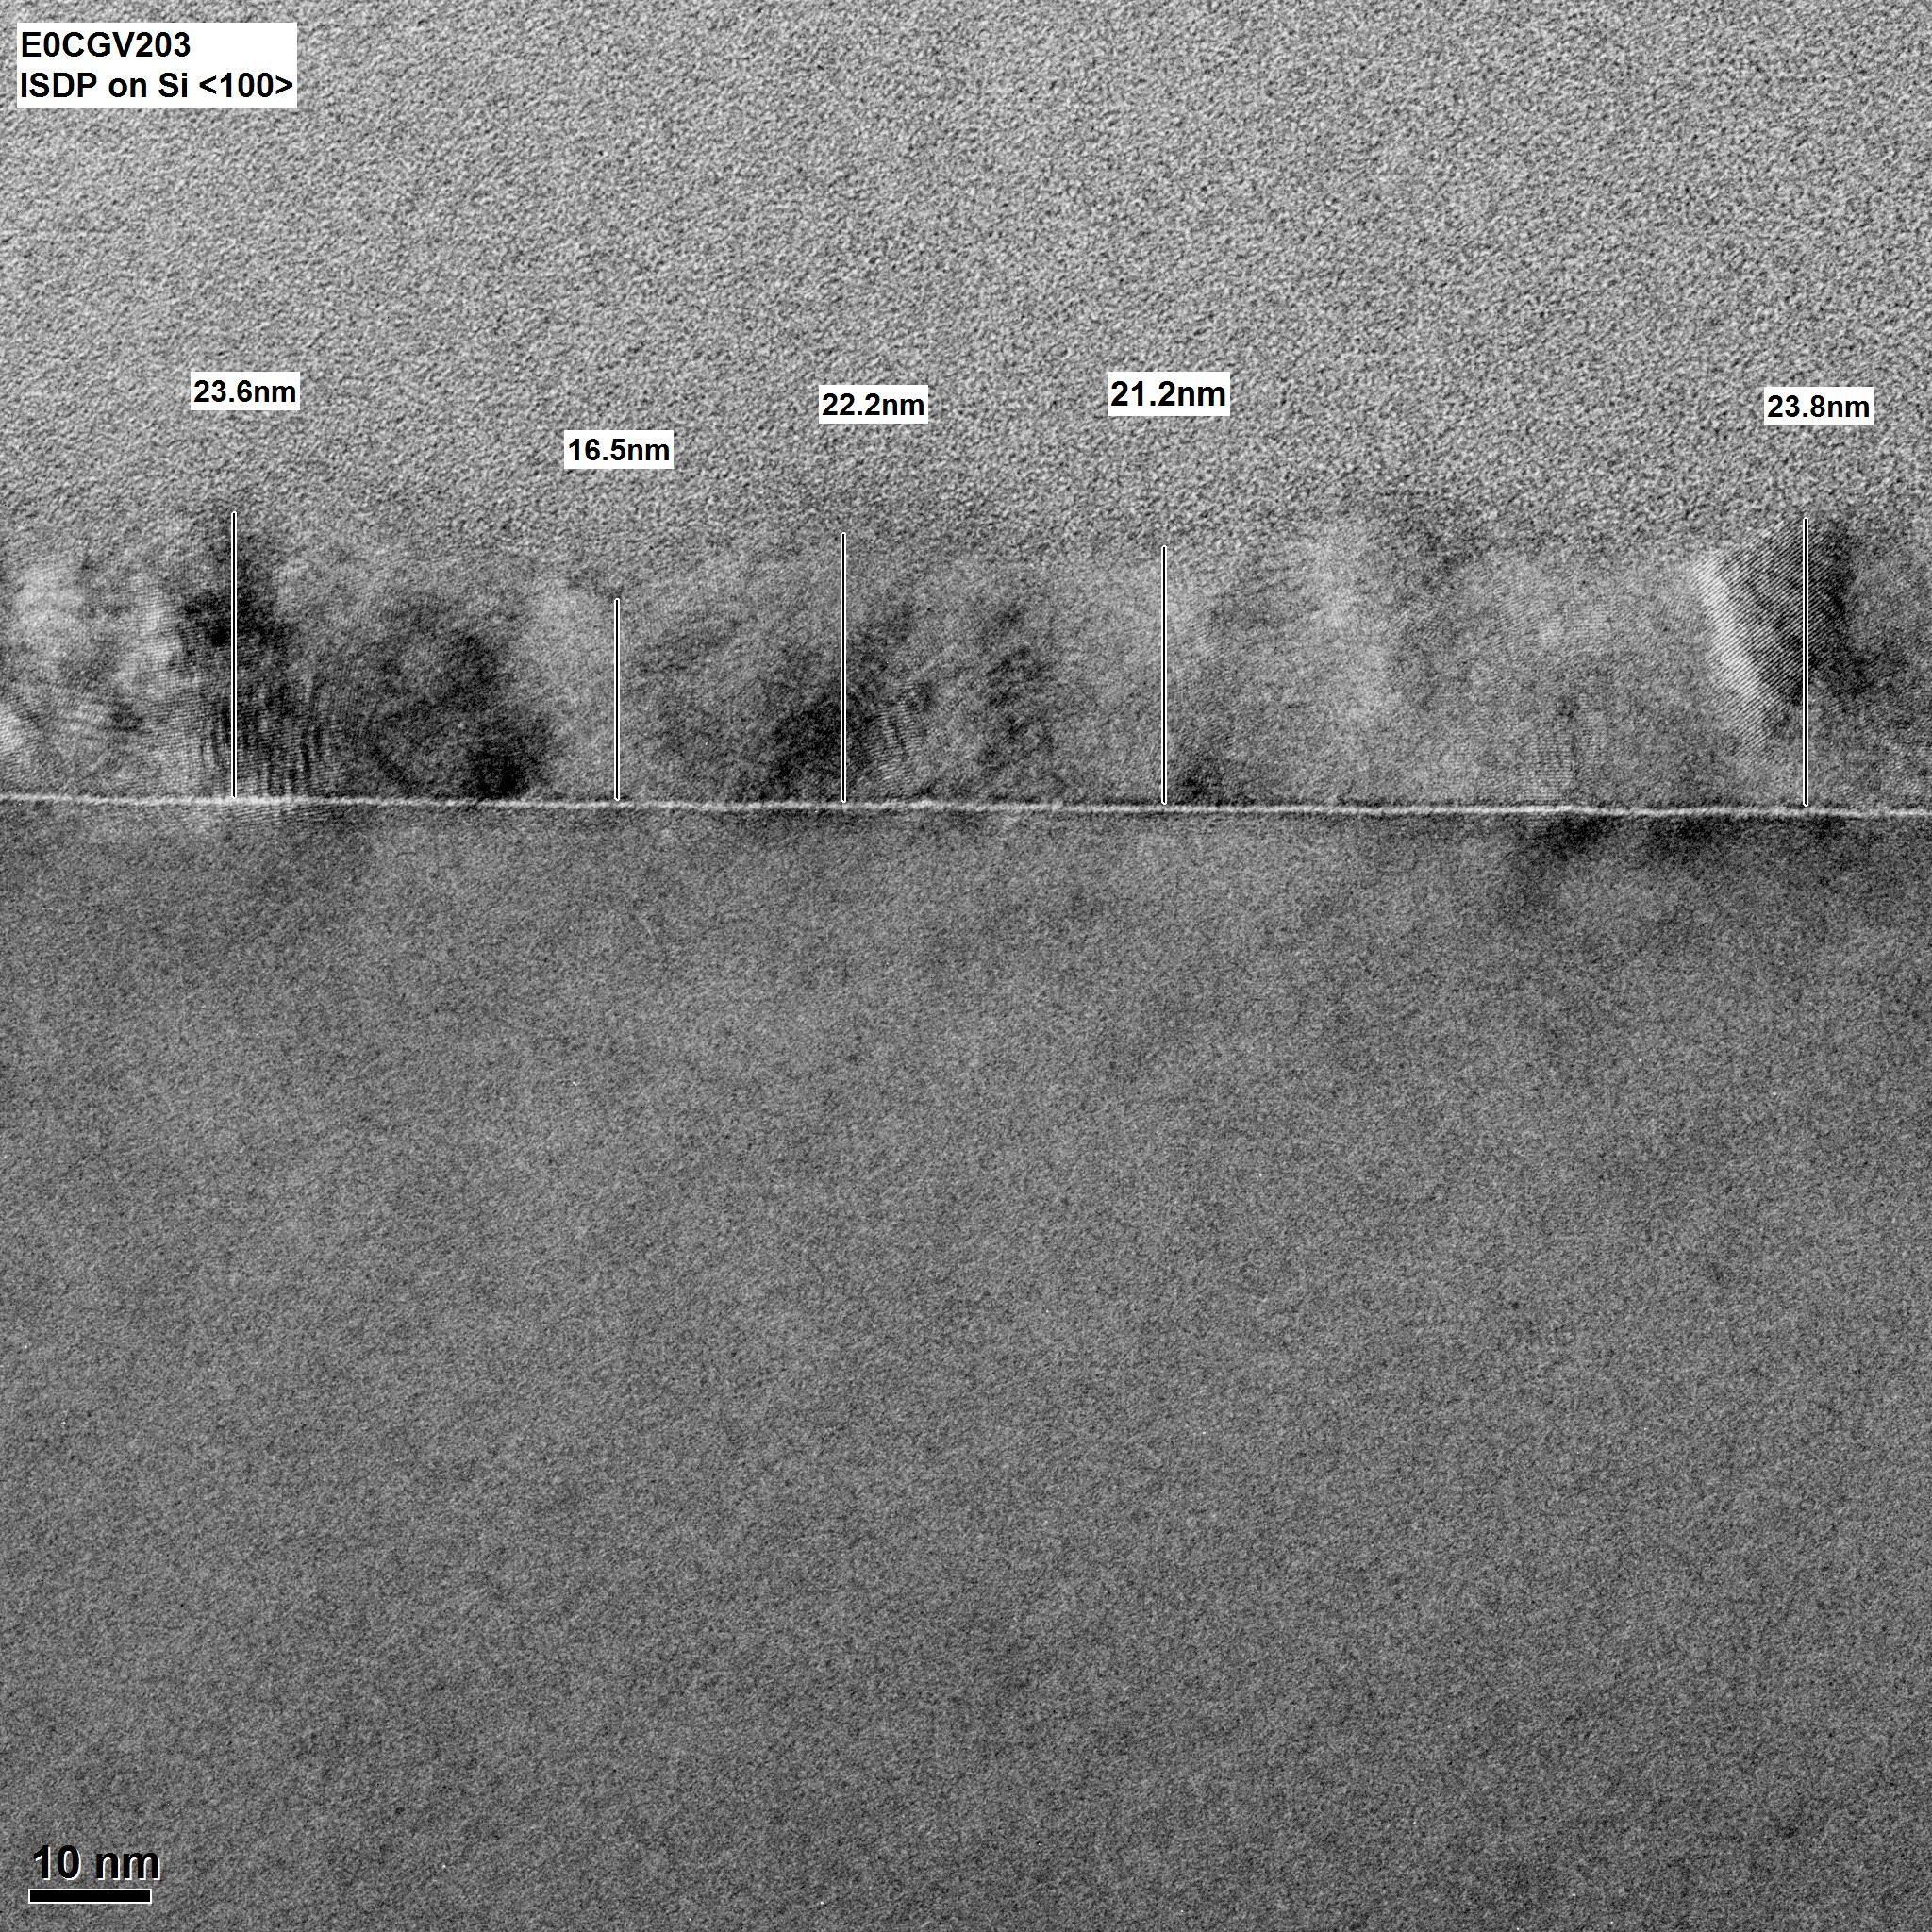
TEM image – 25 nm ISDP
PECVD SiO₂
ISDP
Low-pressure chemical vapor deposition of PH₃/SiH₄ at 650C
TEM image – nominal 25 nm ISDP film on silicon
(Evans Analytical Group)
Silicon substrate

Slide 17
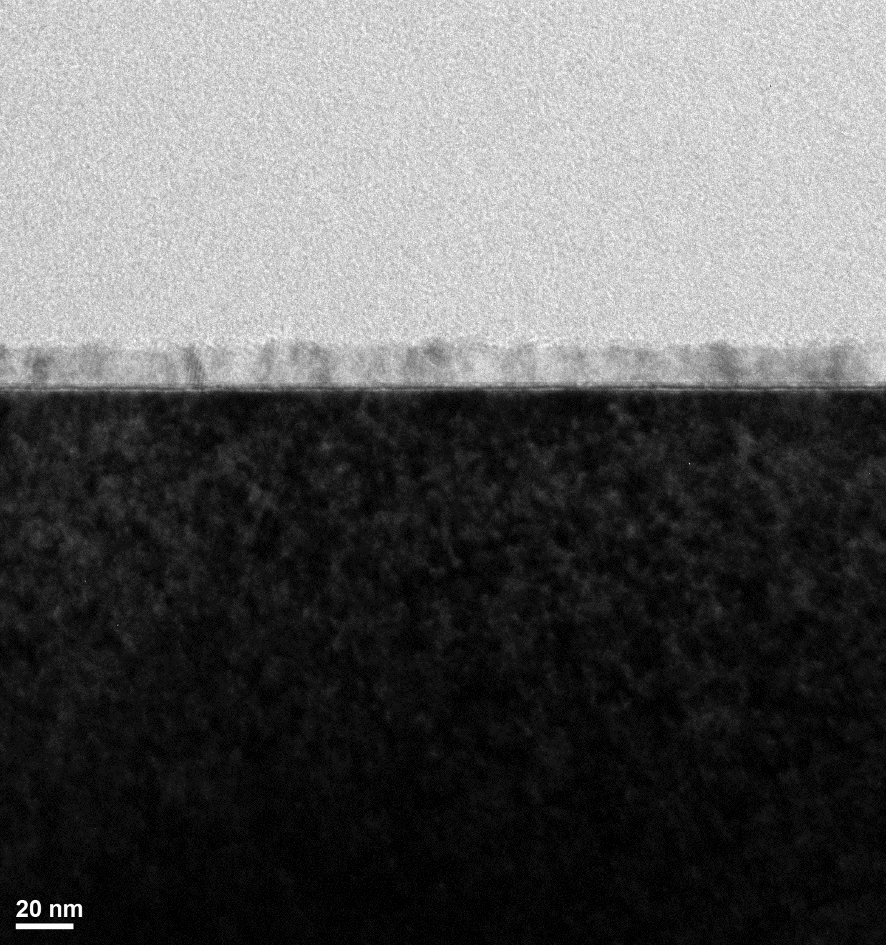
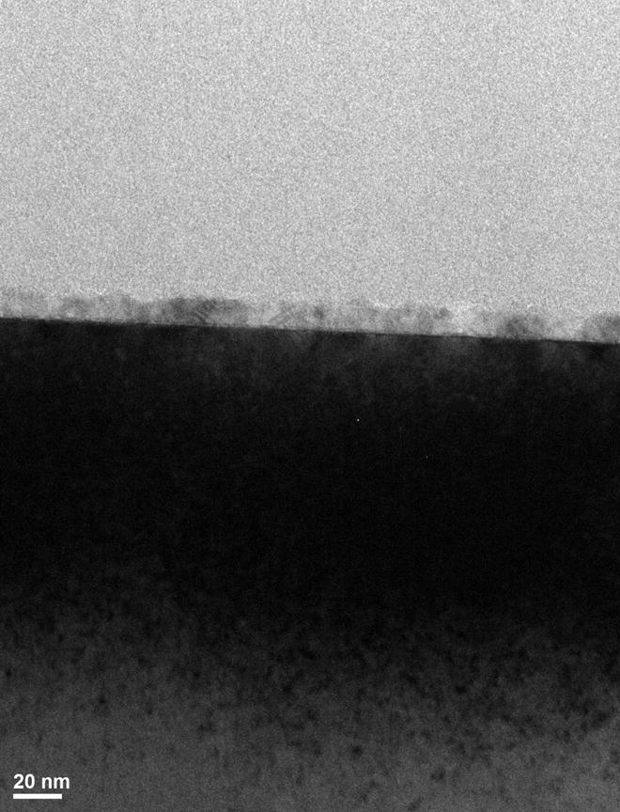
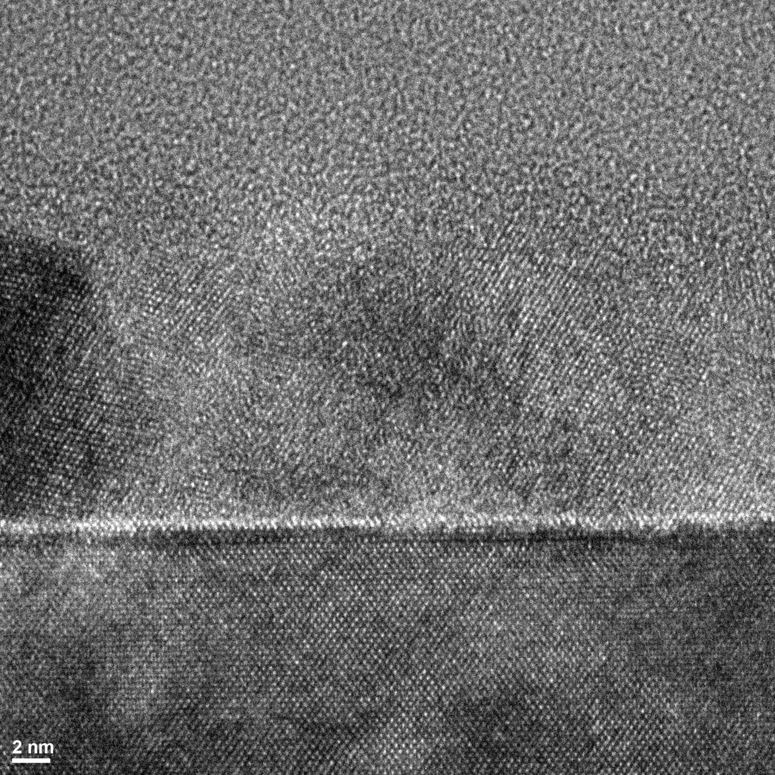
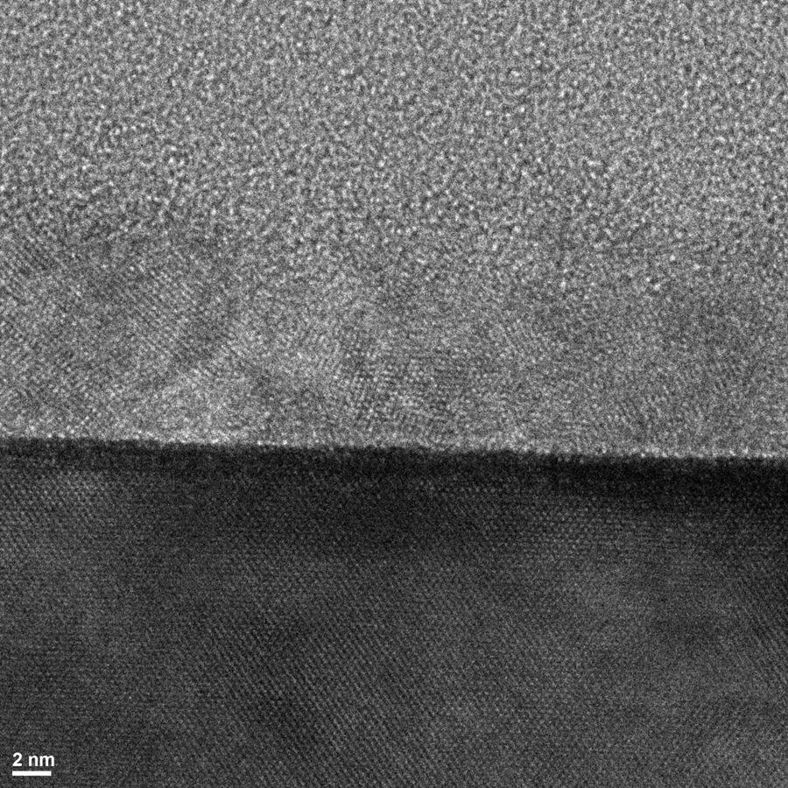
TEM images – 15 and 10 nm ISDP
CCDs with good performance have been fabricated with 15 and 10 nm thick ISDP layers
~ 15 nm
~ 10 nm

Slide 18
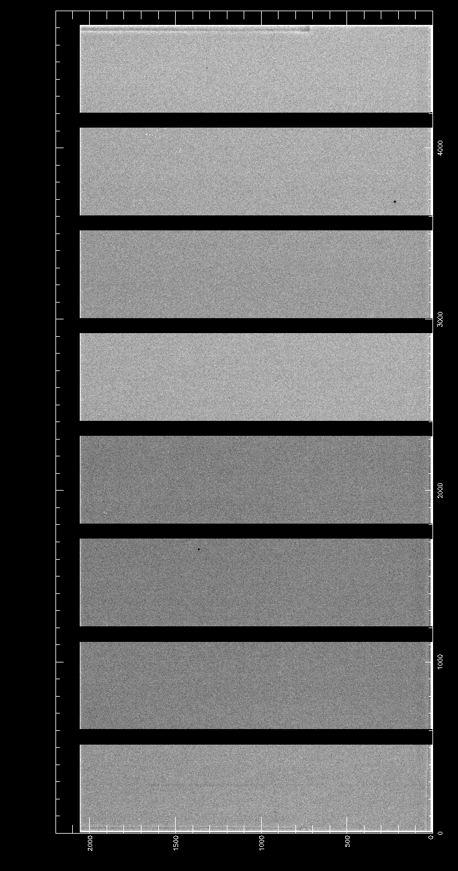
10 nm ISDP results
9.3 ± 0.25
350nm flat field
(QE measurement)
10nm ISDP
55nm ITO
80nm SiO₂
½ 4k x 4k (10.5µm)
11.1 ± 0.44
10.5 ± 0.27
11.0 ± 0.35
12.5 ± 0.40
Average thickness measurements in nm
5 process runs (150 mm wafers)
10.9 ± 1.1 nm

Slide 19
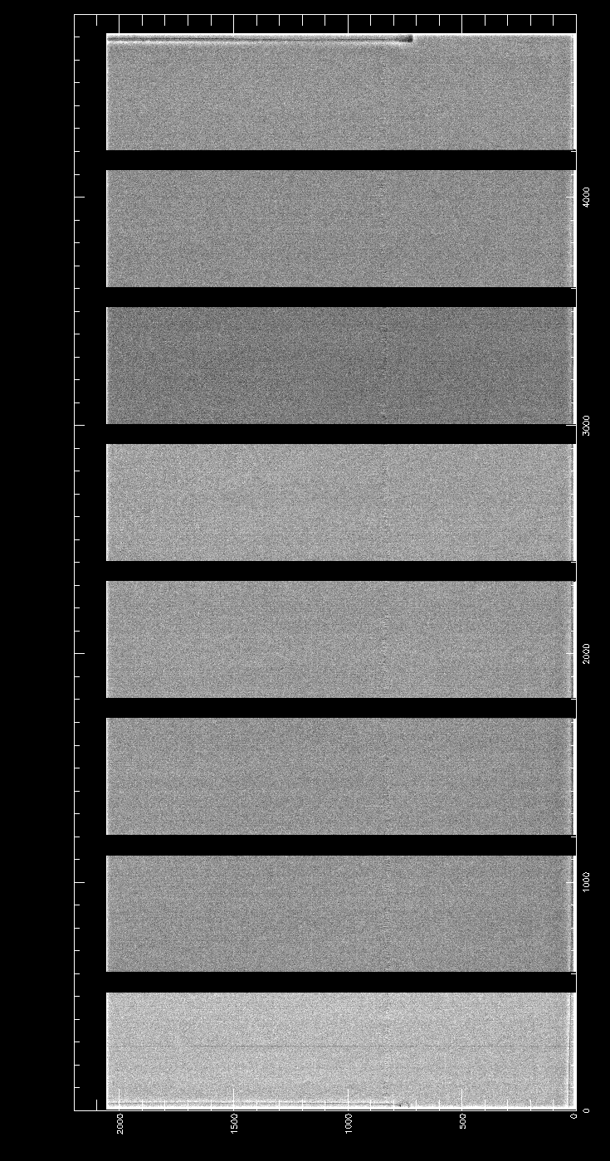
10 nm ISDP results
9.3 ± 0.25
500nm flat field
(QE measurement)
10nm ISDP
55nm ITO
80nm SiO₂
½ 4k x 4k (10.5µm)
11.1 ± 0.44
10.5 ± 0.27
11.0 ± 0.35
12.5 ± 0.40
Average thickness measurements in nm
5 process runs (150 mm wafers)
10.9 ± 1.1 nm

Slide 20
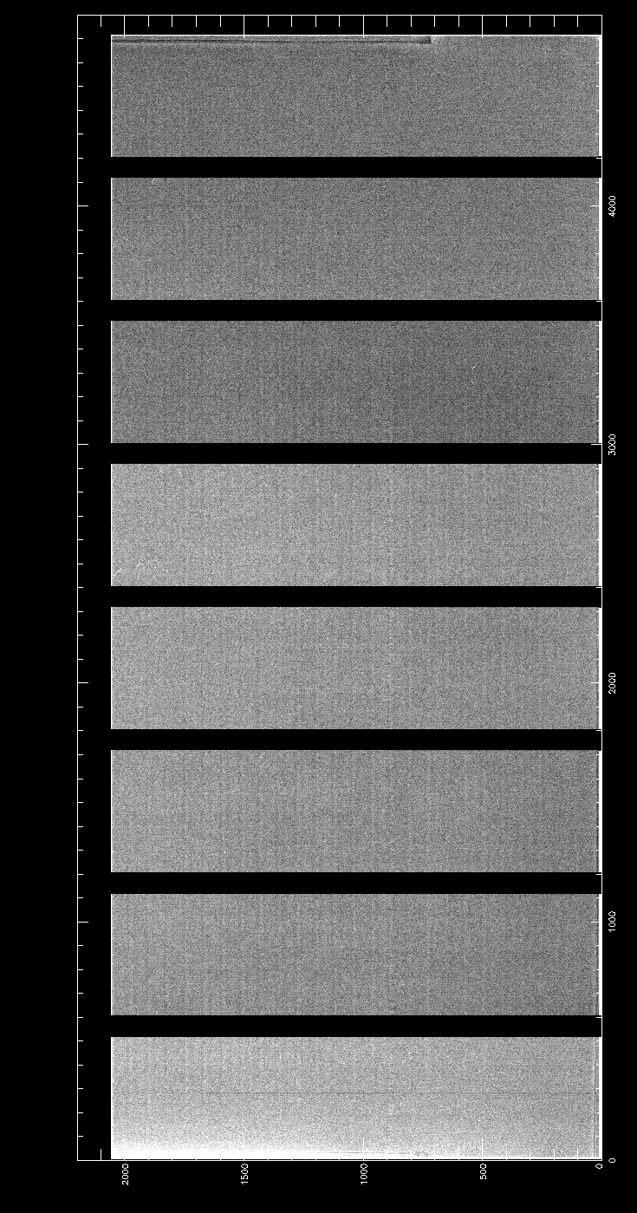
10 nm ISDP results
9.3 ± 0.25
1000nm flat field
(QE measurement)
10nm ISDP
55nm ITO
80nm SiO₂
½ 4k x 4k (10.5µm)
11.1 ± 0.44
10.5 ± 0.27
11.0 ± 0.35
12.5 ± 0.40
Average thickness measurements in nm
5 process runs (150 mm wafers)
10.9 ± 1.1 nm

Slide 21
Outline
Major R&D areas
Read Noise
Readout Speed
Quantum Efficiency
Efforts to reduce backside n⁺ layer thickness
Improved anti-reflection coating materials

Slide 22
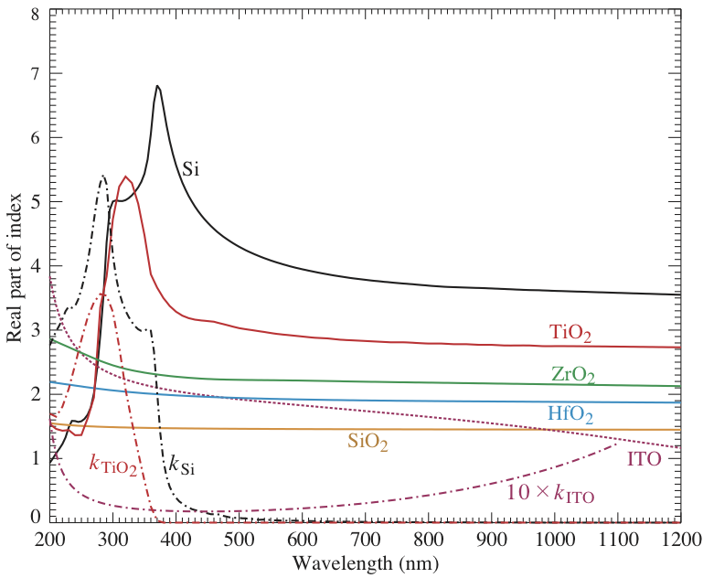
Quantum efficiency – antireflection coatings
LBNL standard: 55/80 nm ITO/SiO₂
QE improvements / AR coatings
ITO index drops in the red and ITO absorbs in the blue and red
Desire high index material with little or no absorption (rules out TiO₂)
Investigate ZrO₂
Initial work done with J. Slack (LBNL energy efficient windows group)

Slide 23
Preliminary QE – ITO/ZrO₂/SiO₂
Experimental data (symbols)
1-Reflectivity
Calibration check
Theoretical model
D.E. Groom et al, “Quantum efficiency of a back-illuminated CCD imager – an optical approach,” Proc. SPIE, 3649, 80-90, 1999.
Treats silicon substrate as a thin film with QE = Absorption in silicon substrate
Models absorption in the ISDP layer (dominant loss in blue) using the SOPRA Sipoly10 n,k values (10% amorphous silicon)

Slide 24
Preliminary QE – 10 nm ISDP with ZrO₂/SiO₂
UV enhanced AR coating v2
30 nm ZrO₂
25 nm SiO₂
10 nm ISDP

Slide 25
Quantum efficiency – standard ISDP/AR
Standard AR coating
55 nm ITO
80 nm SiO₂
25 nm ISDP
200 µm thick, Vsub = 50V
Δ(1-R, QE) at long wavelengths due to absorption in the ITO

Slide 26
Quantum efficiency – UV vs standard
UV versus standard coating
Standard coating (25 nm ISDP)
55 nm ITO
80 nm SiO₂
UV coating (10 nm ISDP)
30 nm ZrO2
25 nm SiO₂
200 µm thick, Vsub = 50V

Slide 27
Future efforts – broadband coatings
Calculated broadband coating QE compared to standard coating with 25 nm ISDP
Broadband AR coating
53 nm ZrO₂
87 nm SiO₂
10 nm ISDP assumed for broadband coating
Higher red response expected due to larger index at red wavelengths (ZrO₂ vs ITO)

Slide 28
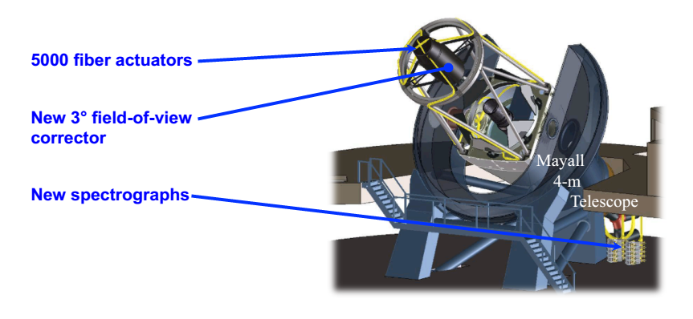
Summary – Future projects
DESI – Dark Energy Spectroscopic Instrument
30 spectrographs (4k x 4k, 15µm pixel)
CCD area comparable to DECam
To be installed on Mayall Telescope (Tucson, Az) NOAO)

Slide 29
Thank you for your attention

