Slide 1

Highlights
Tuesday October 8th, 2013

Slide 2
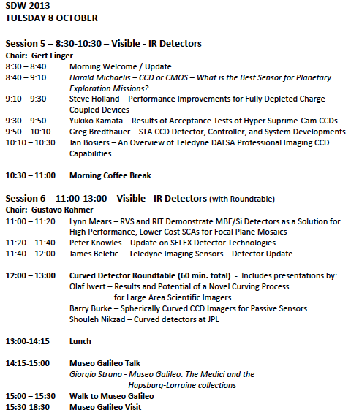

Slide 3
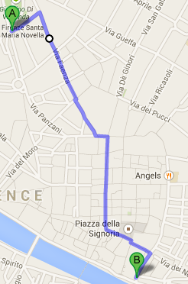
Museo Galileo 15:30-18:30
Galileo’s New World
Astronomy and Time
The Representation of the World
Vincenzo Coronelli’s Globes
The Science of Navigation
The Science of Warfare
Teaching and Popularizing Science: Mechanics, Optics, Pneumatics, Electromagnetism
The Precision Instrument Industry
Measuring Natural Phenomena: Atmosphere and Light, : Electricity and Electromagnetism

Slide 4
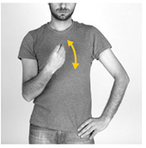
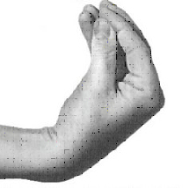
Speak Italian one gesture a day
Single: What are you saying?
Double: What in God’s name are you saying?

