Slide 1



DETECTORS AND ADVANCED COATINGS FOR EFFICIENT UV/OPTICAL/NIR SYSTEMS
National Aeronautics and Space Administration
Shouleh Nikzad
M. E. Hoenk, A. Carver, T.J. Jones, J. Hennessy, A. Jewell, E. Hamden, &T. Goodsall
Jet Propulsion Laboratory, California Institute of Technology
Scientific Detector Workshop
Florence, Italy
7 October 2013
© 2013 California Institute of Technology. Government sponsorship acknowledged.
Notes:
1

Slide 2
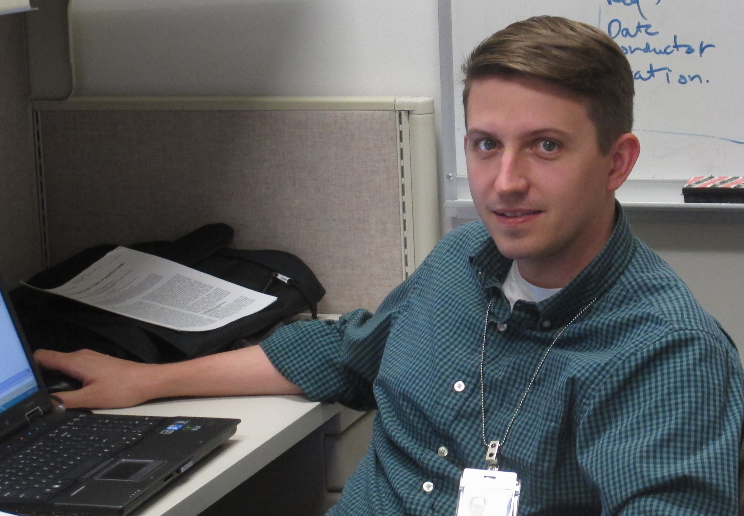
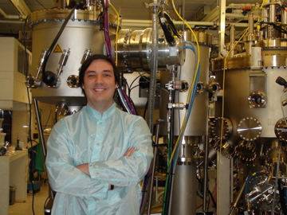
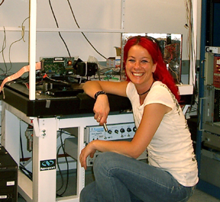
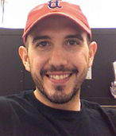
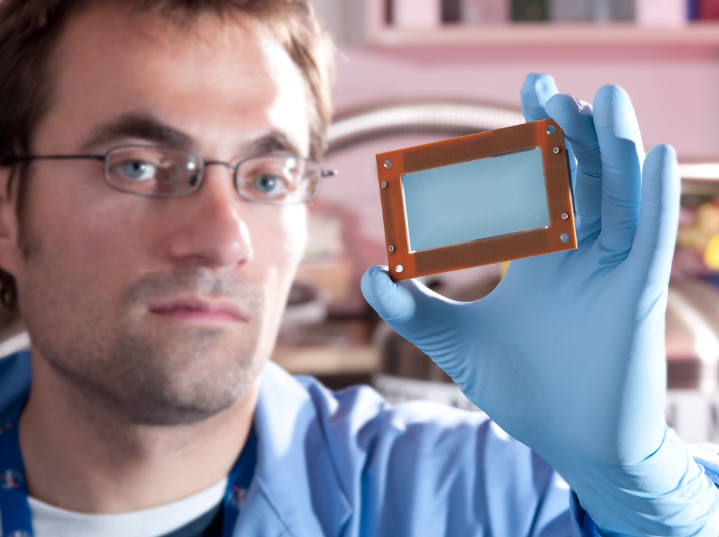
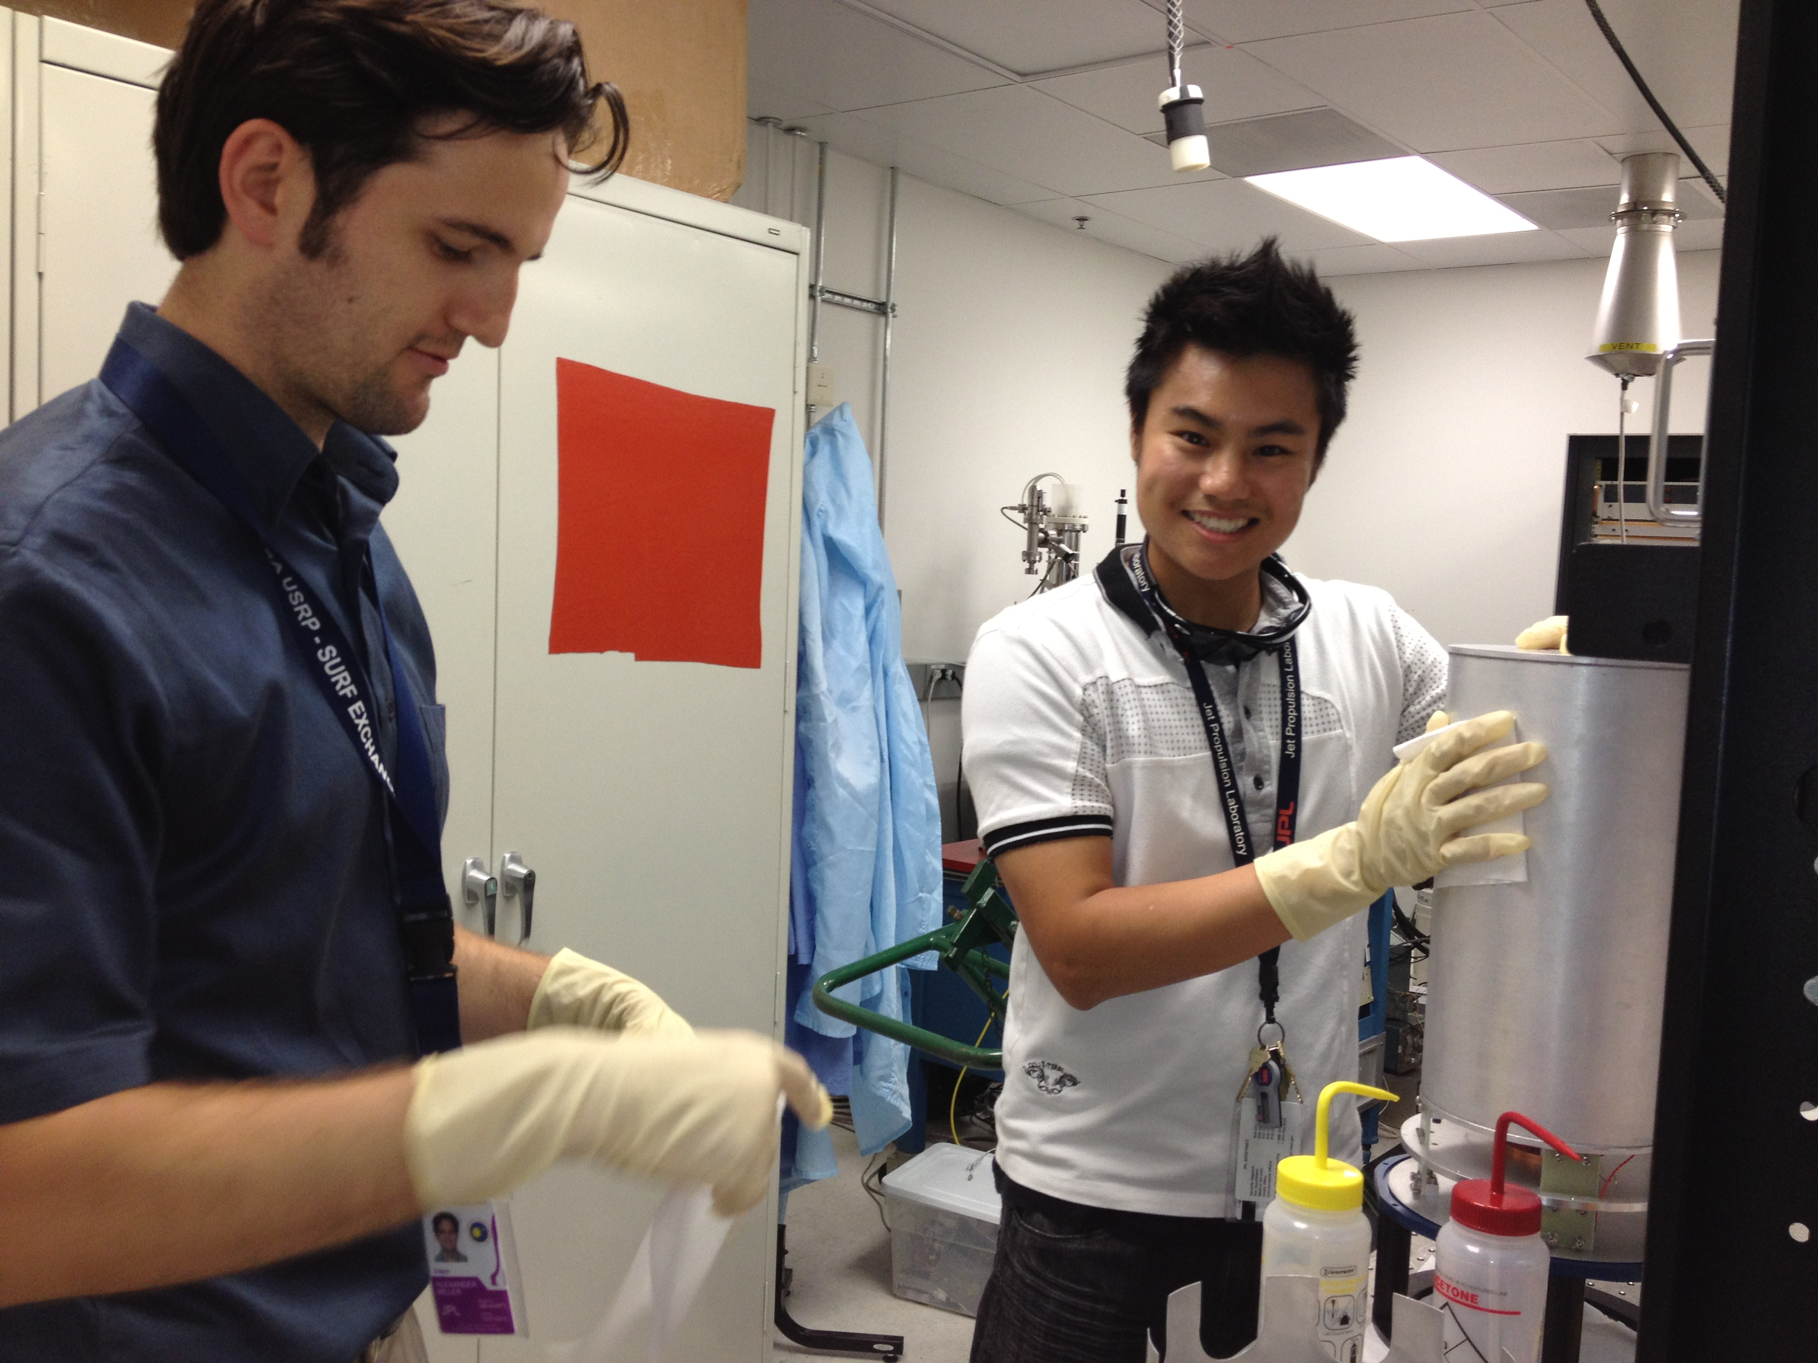
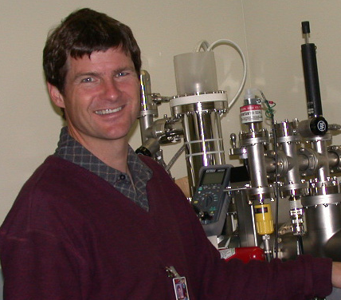

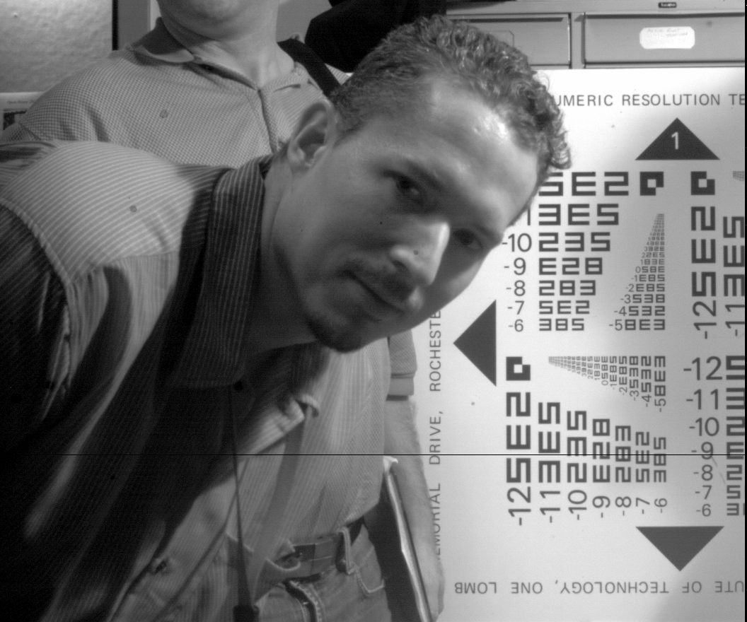
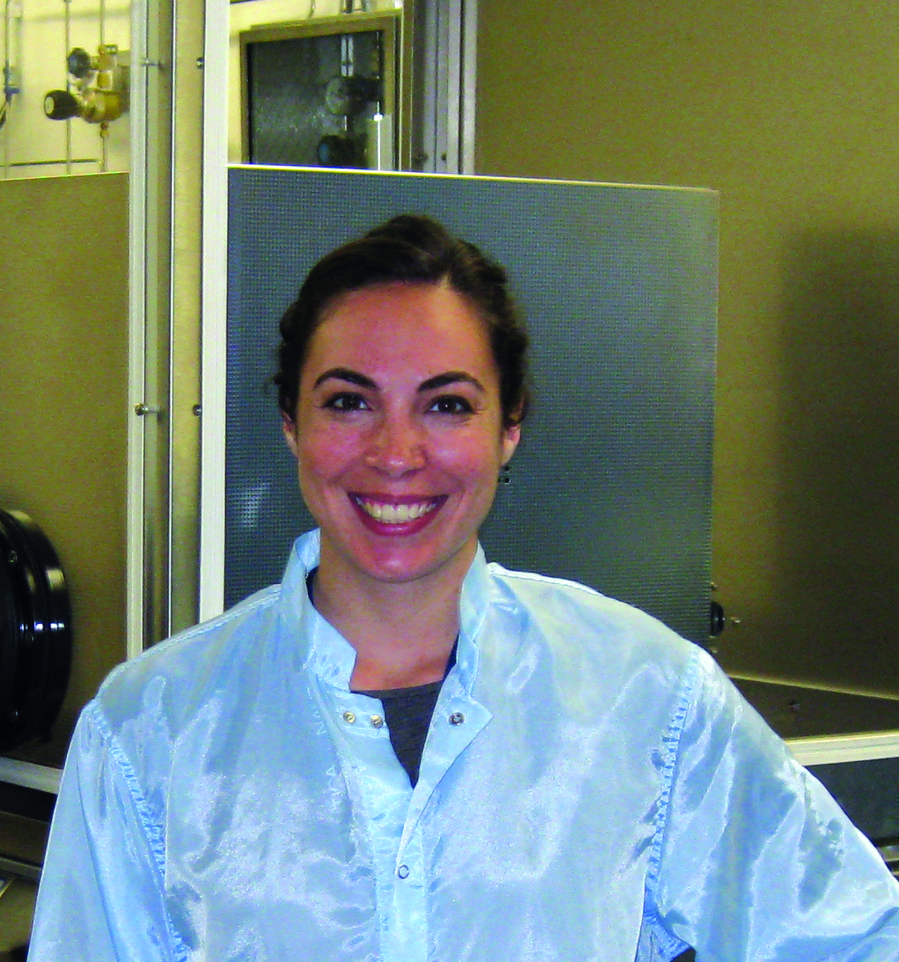


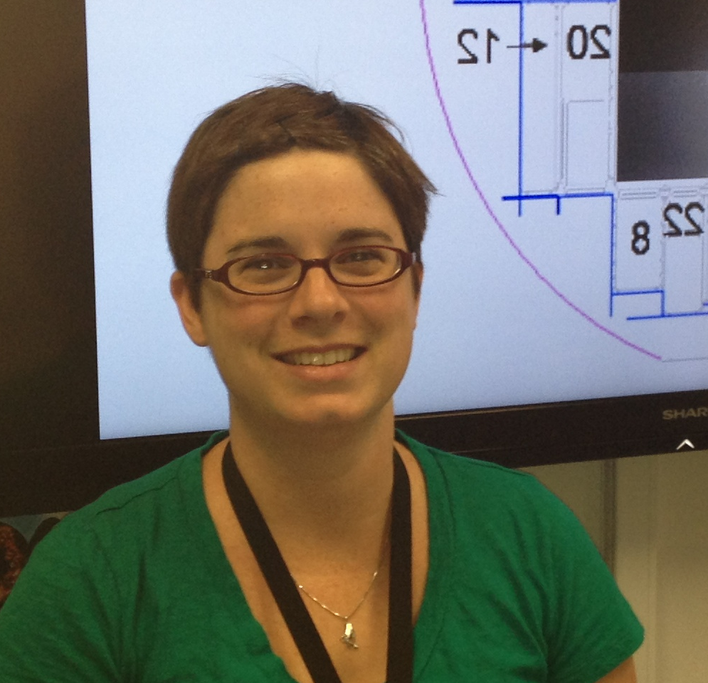
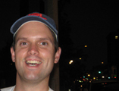
Nicole Lingner, Grad Caltech
John Hennessy
Caltech Postdoc
scholar
Alex Carver, ECH
Doug Bell
Todd Veach
Sam Cheng, Grad, USC
Bob Beach
Todd Veach, PhD
Grad, ASU
Tim Goodsall, ECH
Alex Miller, Grad
ASU
Matt Dickie
Todd Jones
Erika Hamden
NESSF, Columbia
Paul Maker
Michael Hoenk
April Jewell, NPP fellow
Frank Greer
Doug Bell

Slide 3
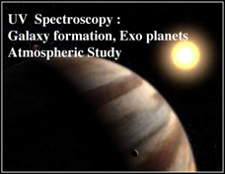

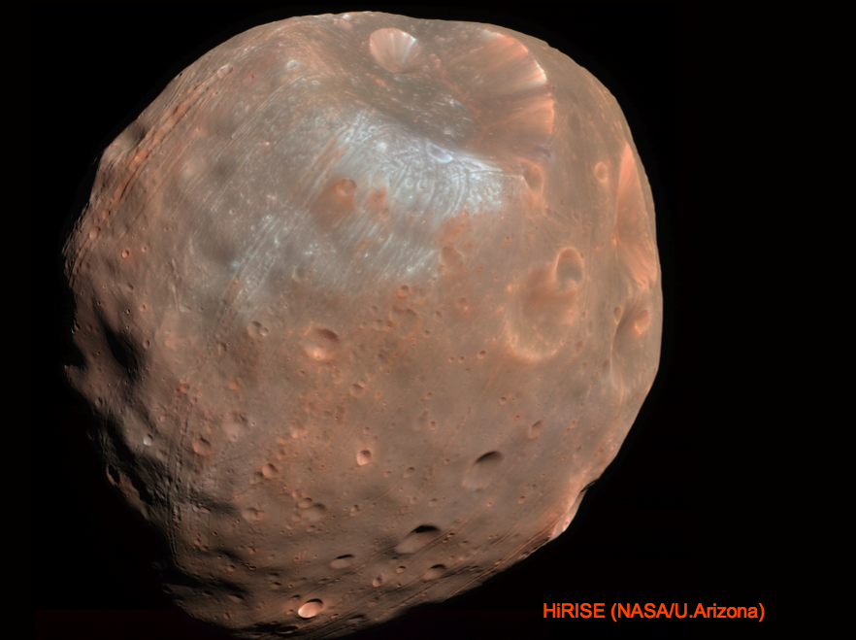

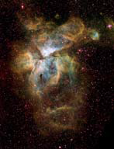

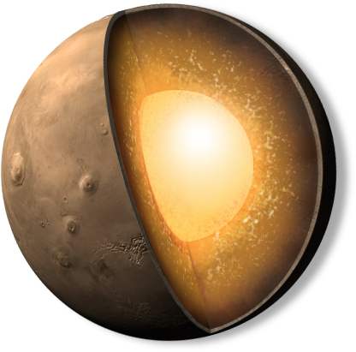

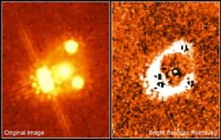
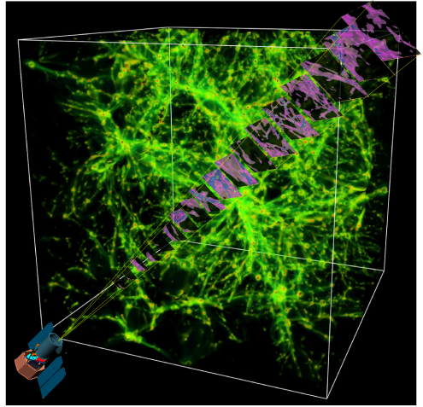

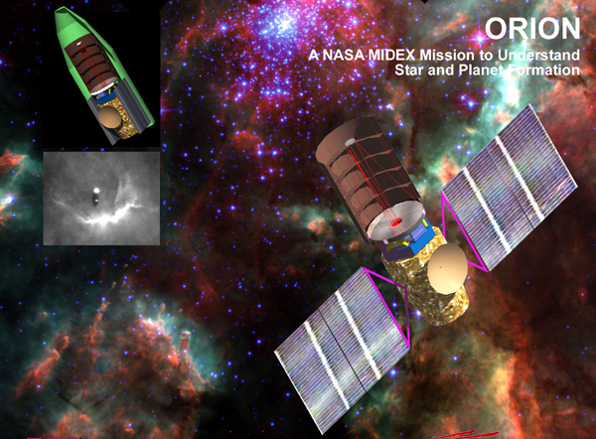
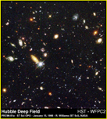
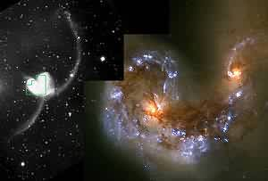
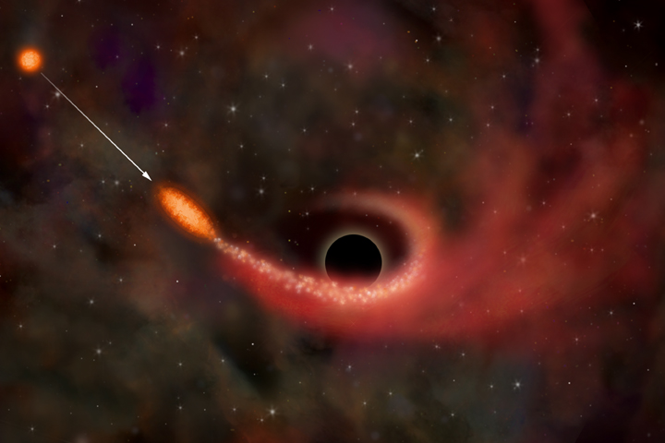
Future UV/Optical/NIR Missions
Dark Matter
Protoplanetary disks to exoplanets
JDEM/SNAP
Contrast Imaging: Dark matter/Dark Energy
Star Formation
Mapping IGM

Slide 4
Outline
High Performance UV/Vis/NIR Si Detectors with Atomic-scale surface/interface engineering
  Delta doping plus ALD AR coatings
  Enables high efficiency, stable response, and reliable performance
Large-Scale Processing for High Throughput & High Yield
  Wafer level processing (up to 8-inch wafers), batch processing
  Wafer scale devices (taking up the entire 8-inch wafer area)
Examples of Science Motivations and Device Solutions/Deliveries
FUV EMCCD (FIREBall)
  UV P-channel CCDs (CHESS)
  Broadband (WaSP)
Brief Note on work on Reflective Optical Coatings
See Poster by Hoenk et al, Superlattice-doped detectors

Slide 5
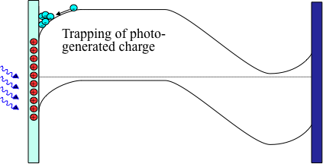
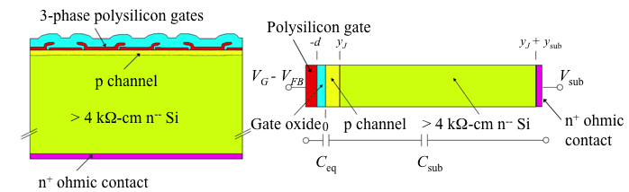
High Performance Silicon Imaging through Back-illumination
Key detector performance parameters depend on back illumination for all silicon imaging devices.
These key parameters include wide spectral range, efficiency, resolution, stability of response, dark current, and high fill factor

Slide 6
Delta doping for surface
bandstructure engineering
and passivation
-
-
-
-
-
-
-
-
-
-
-
-
-
-
-
-
+
-
+
-
+
-
+
-
+
-
+
+
-
+
-
+
-
+
+

Slide 7
100% Internal QE with Delta doping through Atomically Precise Interface Engineering
100% internal quantum efficiency, uniform, and stable (QY has been removed so maximum QE is 100%).
Extreme UV measurements were made at SSRL
Compatible with AR and filter coating: response can be tailored for different regions of the spectrum

Slide 8
High External QE with Atomic Layer Deposition through Atomically Precise Interface Engineering
What is ALD?
Surface reaction mediated deposition
ALD cycles are repeated until desired film thickness is achieved
Metals, Nitrides, and Oxides are achieved through choice of precursor and reactant species
Can achieve thin film deposition or surface modifications at near room temperature
Results in smooth, stoichiometric, thin layers.
Abrupt interfaces and precision control makes ALD perfectly suitable for multilayer coatings
OH
OH
wafer
Initial Surface
CH₃
CH₃
CH₃
CH₃
Plasma
Al
Al
Thickness
CH₃
CH₃
C
CH₄
O
O
O
O
Number of Cycles
CH₄
CH₃
CH₃
CH₃
CH₃
CH₃
CH₃
CH₃
CH₃
OH
O
OH
OH
O
OH
Al
Al
Al
Al
Al
Al
Al
Al
O
O
O
O
O
O
O
O
Silicon wafer
Silicon wafer
Silicon wafer
Silicon wafer
Precursor Dose
Precursor Purge
Plasma/Reactant Dose
Reactant Purge
Cycle Repeats to Grow Additional Monolayers

Slide 9
High Precision AR Coatings
Incorporating diffusion barriers into the design, when appropriate, allows us to deposit films with behavior predicted by our model.
Multilayers are feasible with these device integrated coatings. Opens the door for other types of coatings (e.g. visible blind coating, interference filters, etc.) deposited by ALD.
Reproducibility and accuracy of the ALD technique enables rational design and fabrication of AR coatings at the nanometer scale.
Model – SiO₂/HfO₂/Al₂O₃/Si
Actual – SiO₂/HfO₂/Al₂O₃/Si
Si Baseline Reflectance
Reflectance (%)
Wavelength (nm)
Wavelength dependence of coating performance correctly predicted by AR coating models based on precision UV ellipsometry measurements

Slide 10
MBE Delta doping and ALD-AR coatings resulting in
High Performance Silicon Imagers
Molecular Beam Epitaxy (MBE) and Atomic Layer Deposition (ALD) uniquely enable atomic-level engineering of surfaces/interfaces to achieve high efficiency, stable response, and low dark current in back-illuminated silicon arrays.
This is true for UV/Visible/NIR and especially true in UV where absorption happens within nanometers of the surface
Versatile techniques applicable to essentially all silicon detectors and imagers

Slide 11
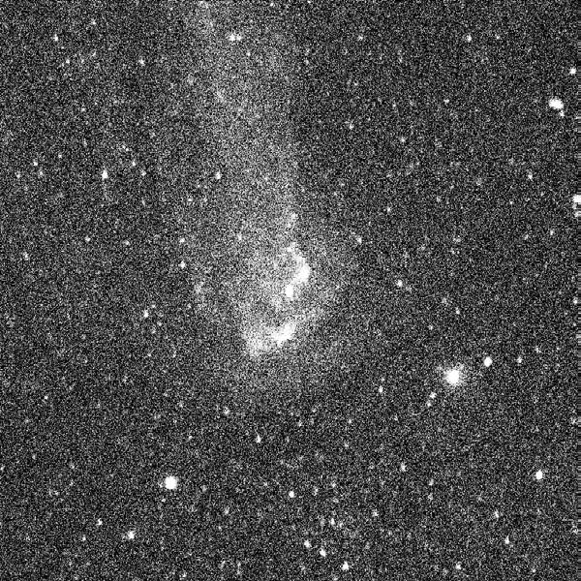
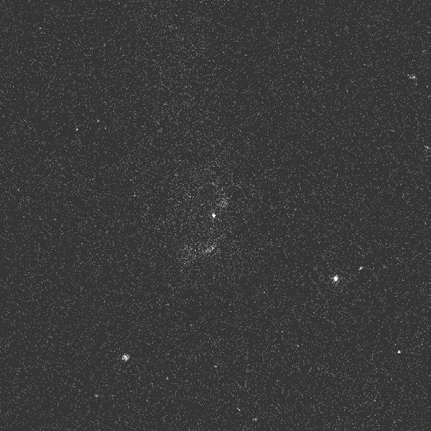
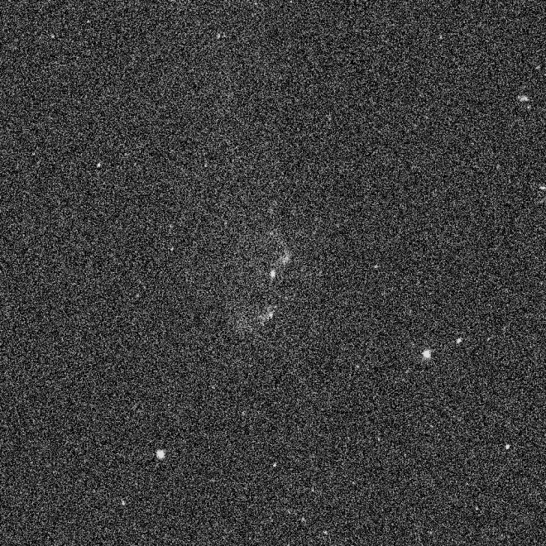
Higher QE CCD with gain
MCP Data (GALEX)
Delta doped EMCCD
Higher QE, lower noise
up to 10x S/N
Normal CCD
EMCCD Simulation has 4x S/N of GALEX
P. Morrissey, KISS Workshop on Next Gen UV Instrument Technologies, August 2011

Slide 12
Electron Multiplied CCD (EMCCD)
Iφ1
EMCCD (Electron Multiplied CCD) operates by adding avalanche gain in the final register (gain or multiplication register). Combined with low noise readout this can translate into single photon counting.
Iφ2
Iφ3
Charge Transfer
Regular CCD
Charge multiplication
register
Charge transfer
P. Pool e2v

Slide 13
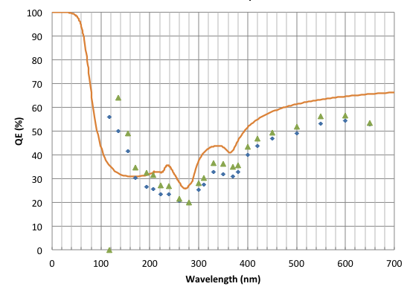
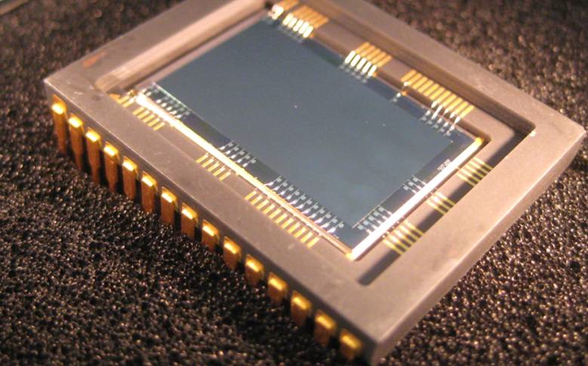
Delta doped EMCCD
0.5
Quantum Efficiency of Delta doped EMCCD
0.5Kx1k, 13 µm EMCCD
Delta doped Electron Multiplied CCD (EMCCD) for solid state photon counting spectroscopy

Slide 14
> 50% Quantum Efficiency Achieved in UV
Achieved by Atomic Control
at the surfaces and interfaces with
Delta-doping and ALD Antireflection Coating
Delta doping & Atomic Layer Deposition o f standard CCDs & EMCCDs
Nikzad, et al. Applied Optics, 2012

Slide 15
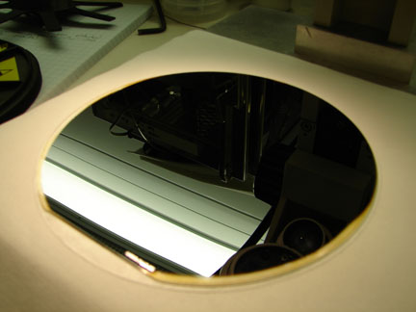
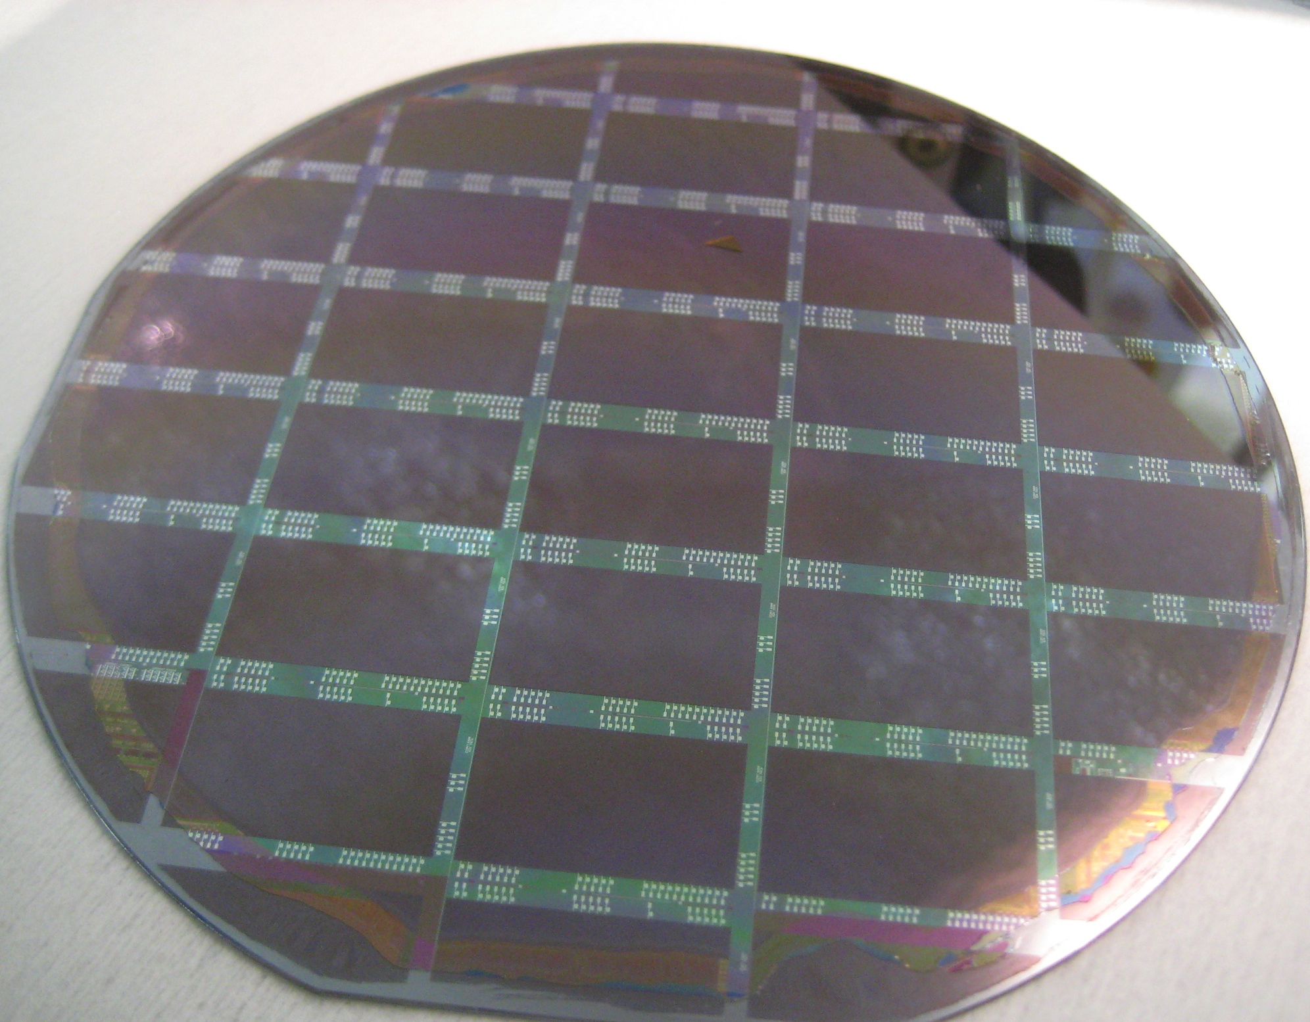
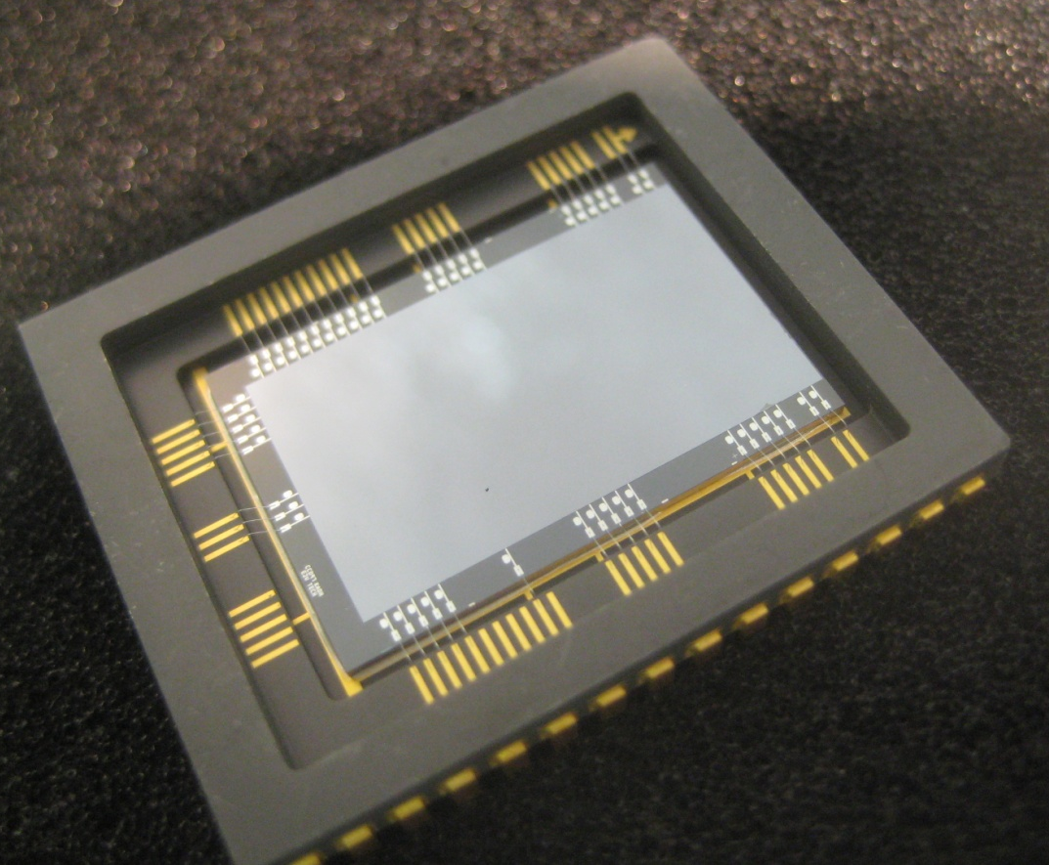
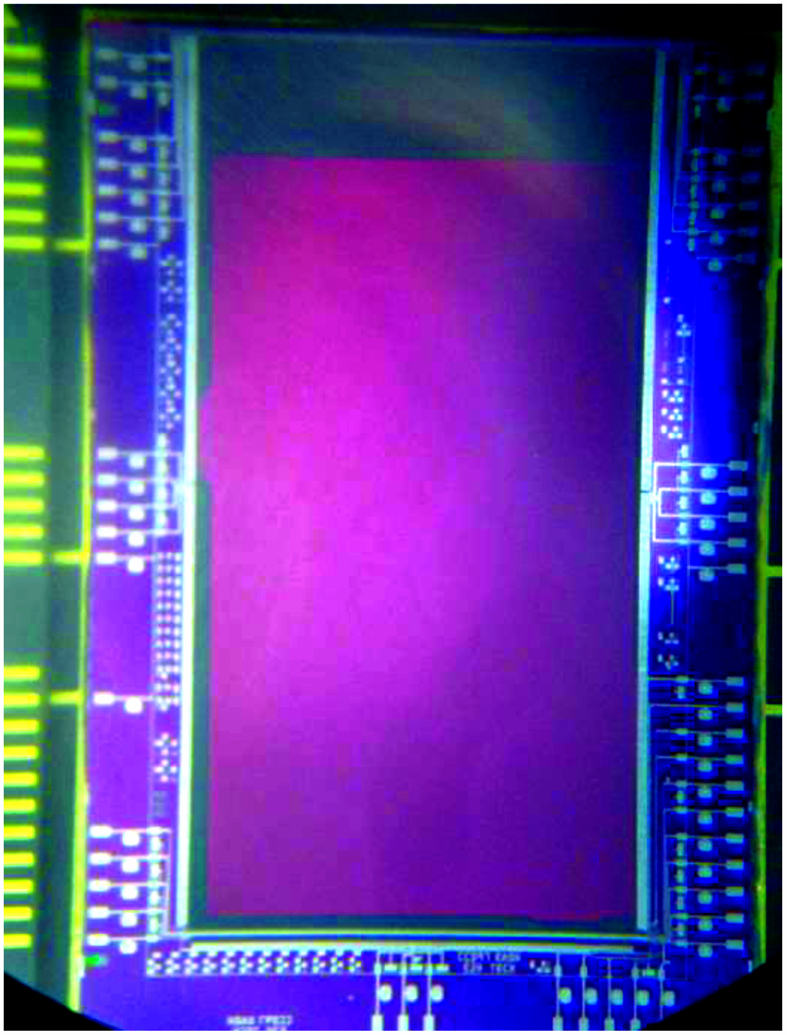
Wafer-Scale Processes

Slide 16
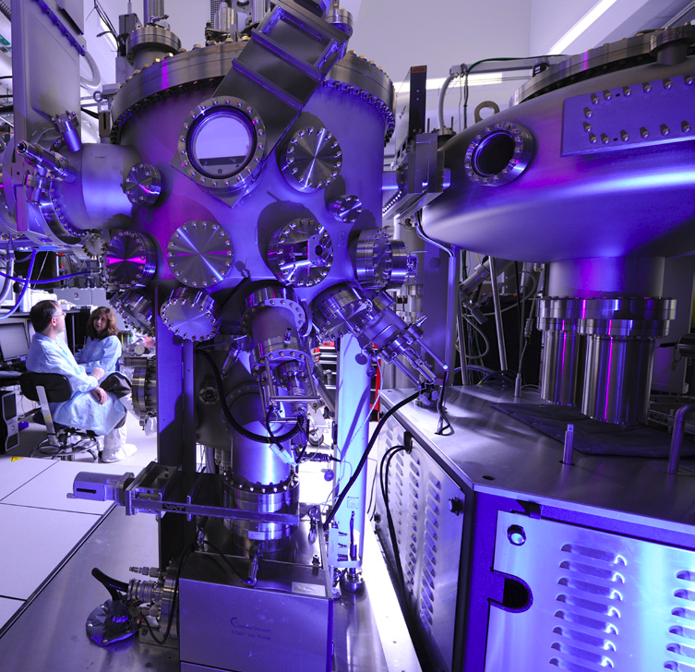
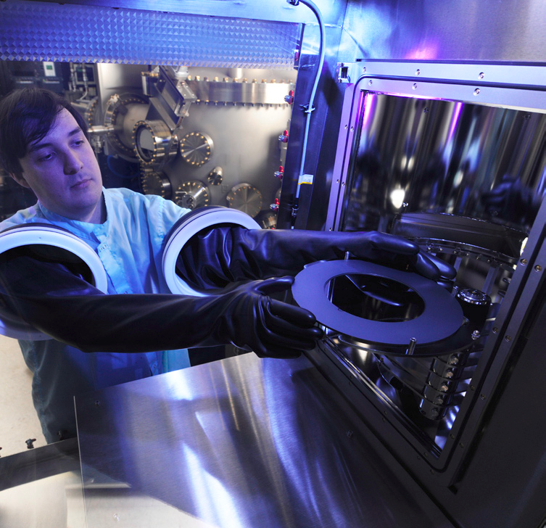
8-inch Wafer Silicon Molecular Beam Epitaxy (MBE)
High throughput, high yield processing of high performance detectors
Delta doping up to 8-inch diameter wafers
Batch processing multiple wafers
First results

Slide 17
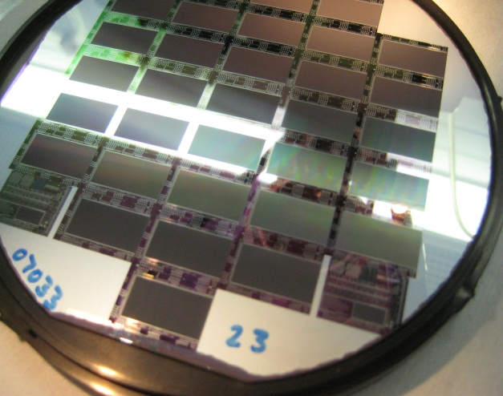
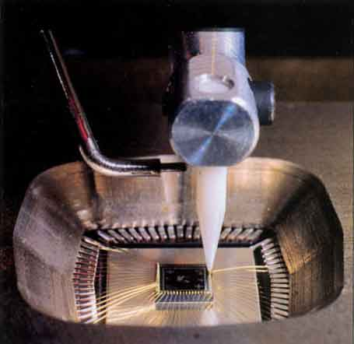
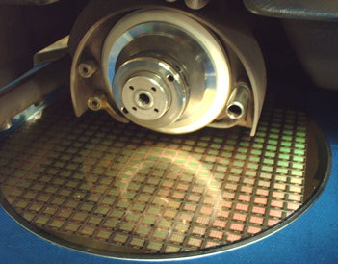
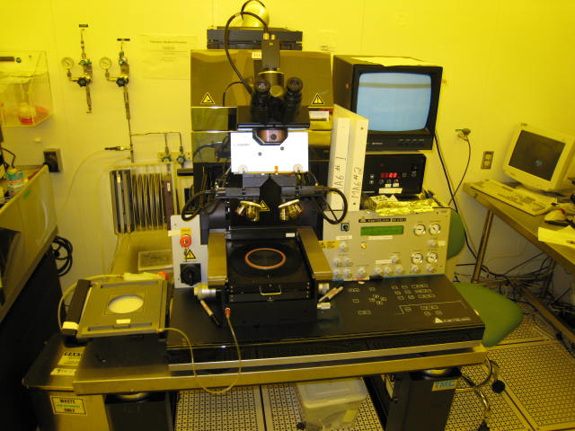
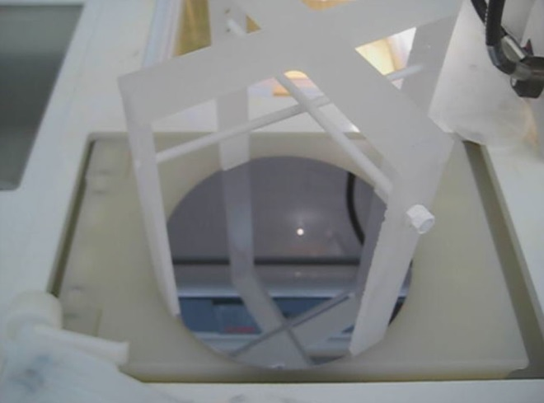
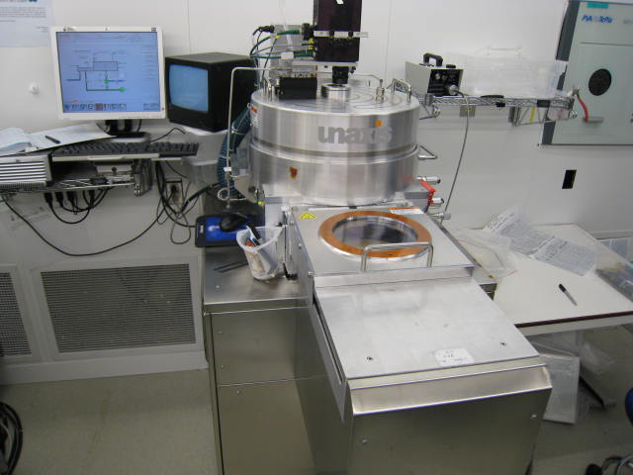
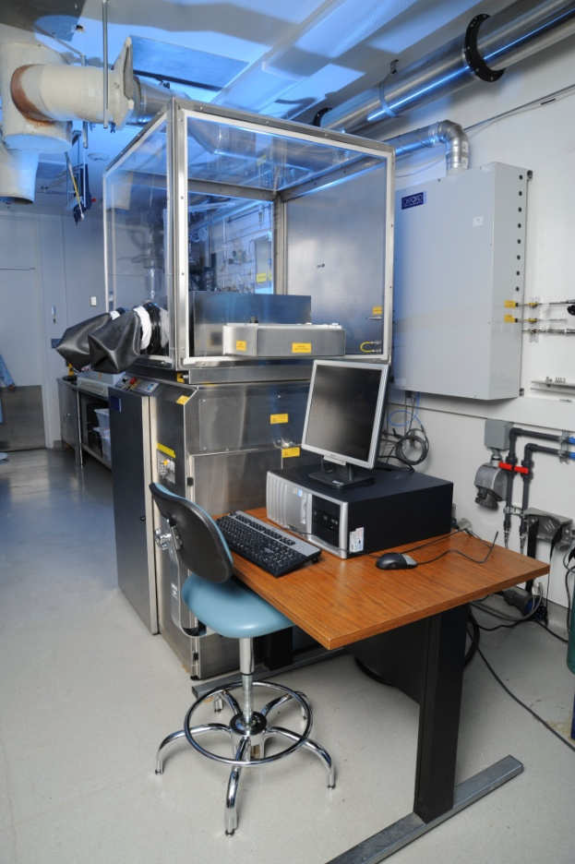
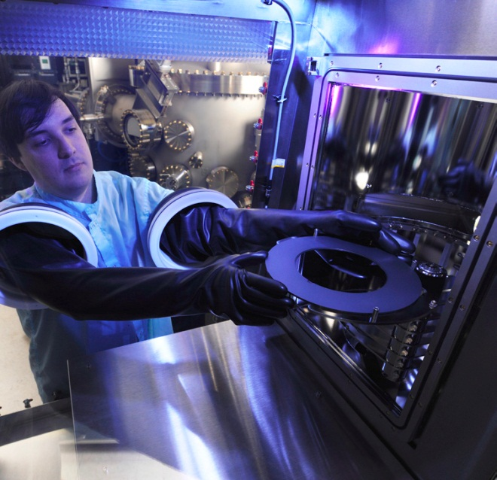
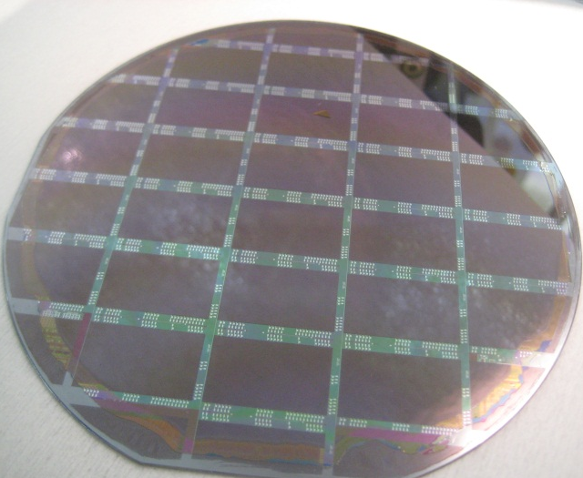
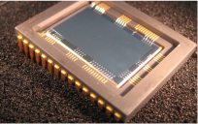
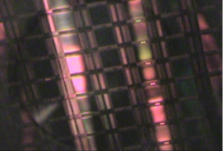
Wafer-scale process flow
e2v CCD97 wafer
Process steps…
Wafer-wafer bonding
Thinning
MBE growth
ALD coating
Patterning
Etching
Dicing
Packaging
Superlattice-doped
Electron Multiplying CCD
Wafer with CMOS imaging arrays in 8-inch MBE
Veeco 8-inch Silicon MBE at JPL’s Microdevices Lab
ALD oxide
EMCCD silicon (~10 µm)
MBE-doped Si
EMCCD electronics
Handle wafer (~800 µm)
E2v CCD97 wafer: after bond pad exposure

Slide 18
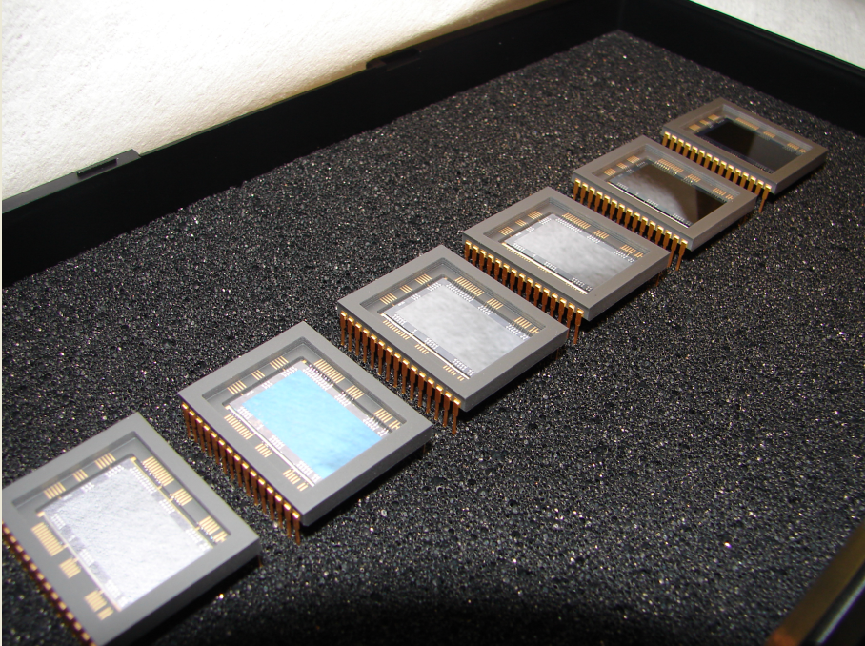
Six R-grade e2v CCD97’s from the bonded, thinned, delta-doped wafer 18 have been packaged, wire-bonded and are being tested. One is AR coated with the FIREBALL multilayer design

Slide 19
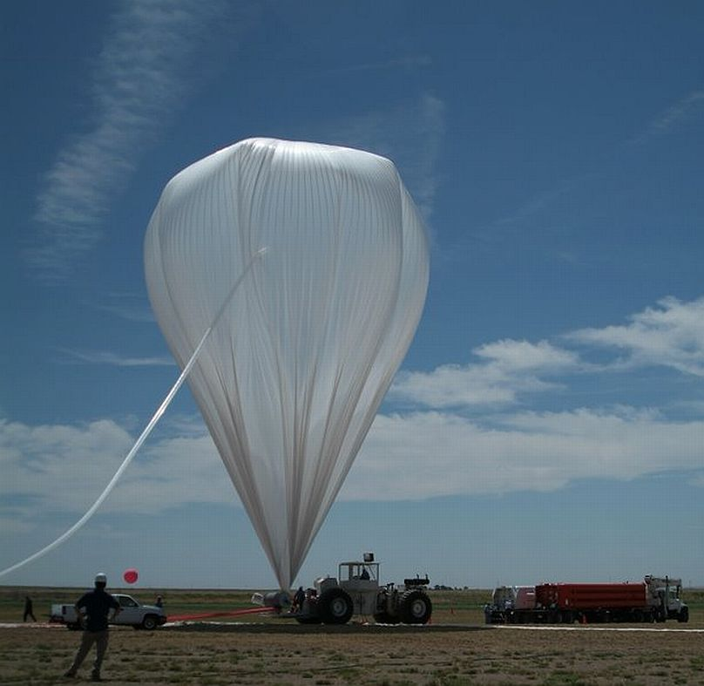
FIREBall-2
Funded balloon under ROSES-APRA
PI: Chris Martin
Detector range: 195-205 nm, 200 nm center require QE > 50%
FIREBall-1 flew a GALEX spare detector which was an MCP.
Collaboration also with David Schiminovich, Erika Hamden, Columbia U
Alice Reinheimer, Peter Pool, P. Fochi, et al e2v
An EMCCD wafer (p-type substrate) was cored down to 4 inches, bonded, thinned, and sections of it were diced into die that were delta doped. Above are the photograph of the device and the preliminary measurements showing high QE in the UV indicating successful delta doping.

Slide 20
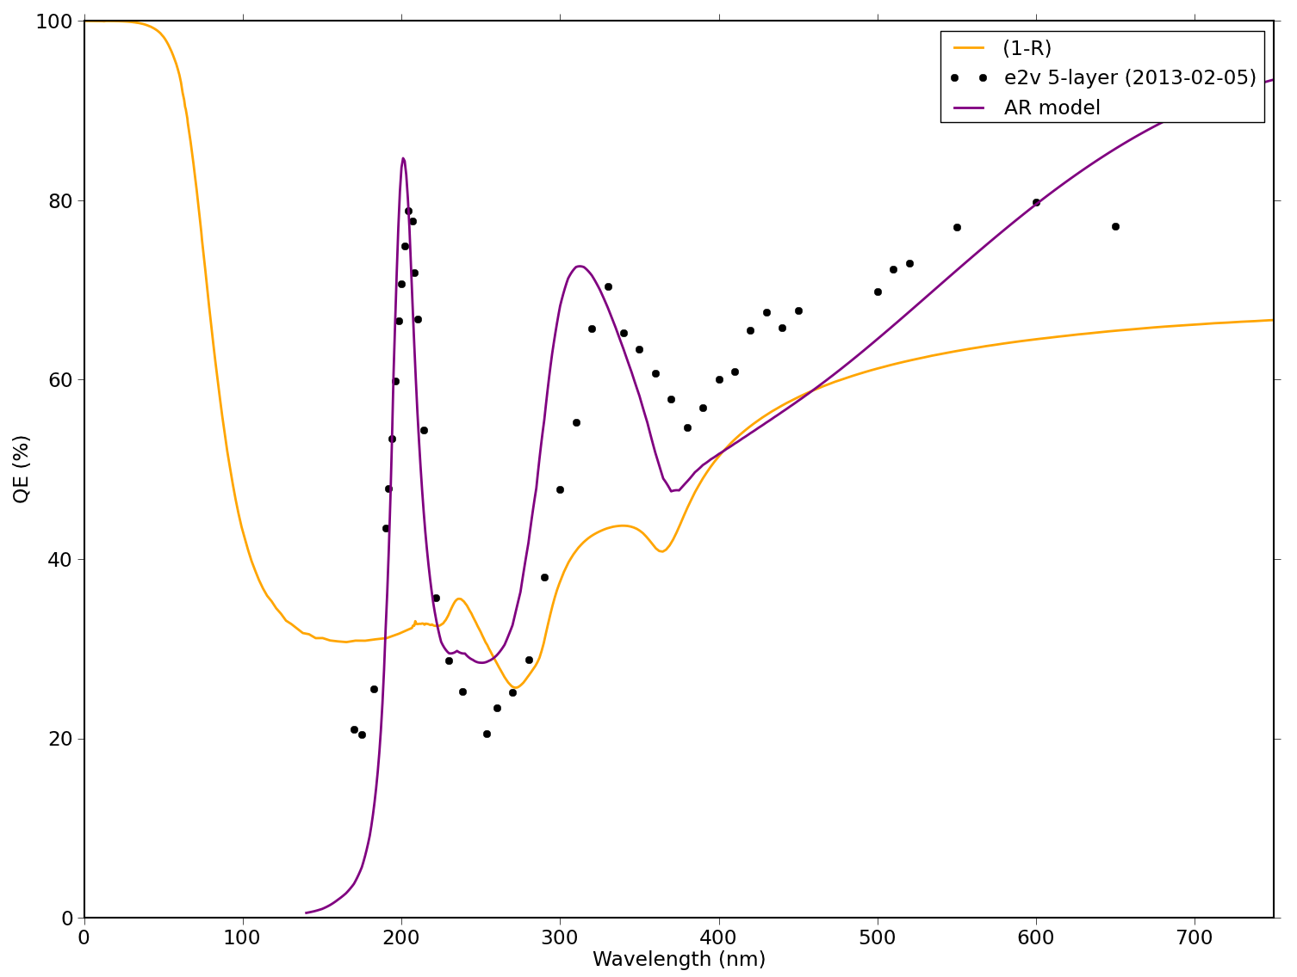
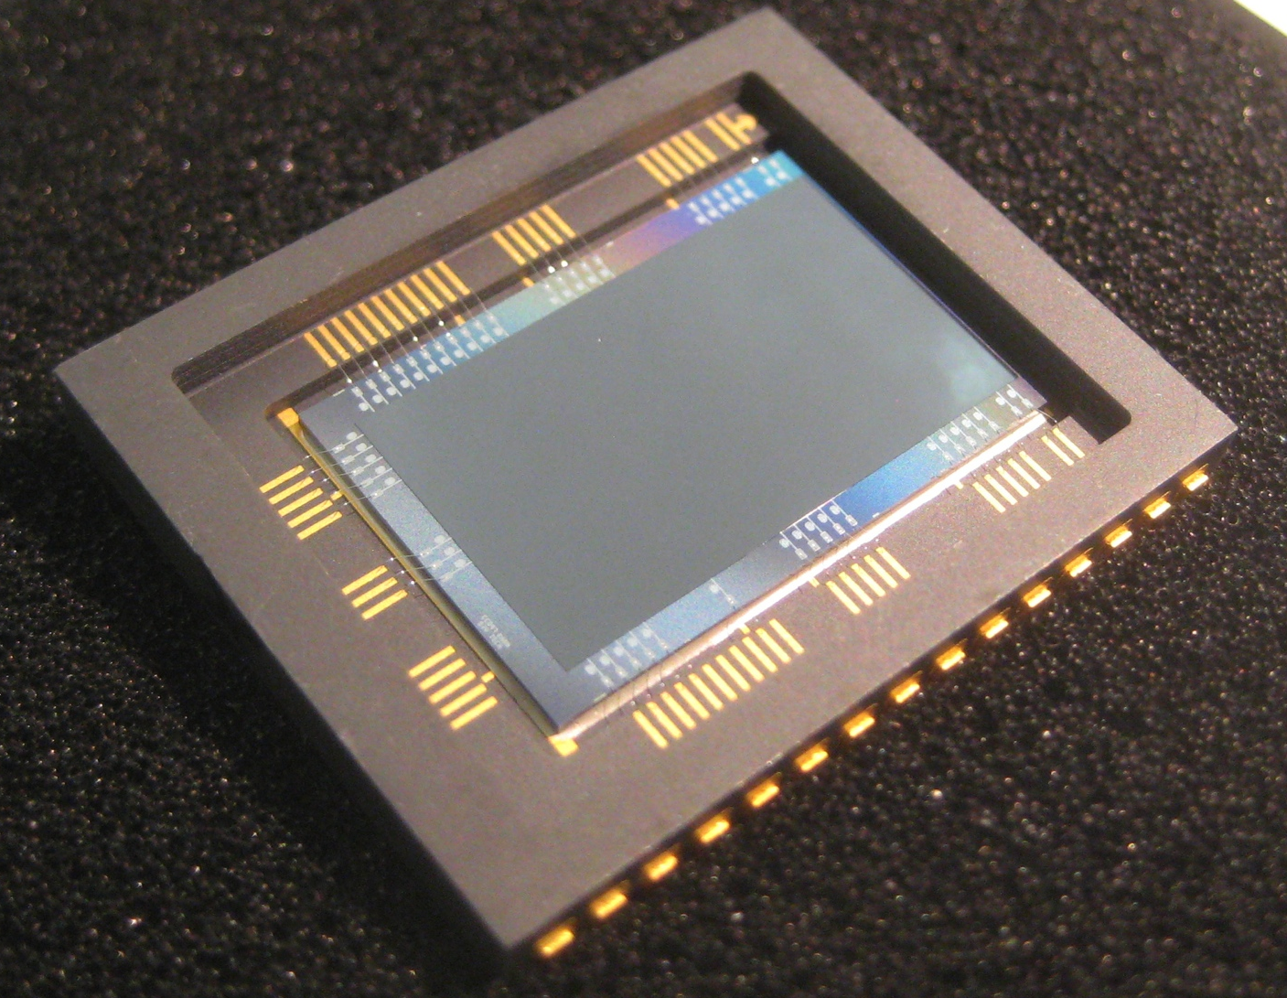
Preliminary QE Results on AR Coated (5-Layer),
Delta Doped EMCCD (0.5 Megapixel, CCD97)
More measurements required to obtain absolute QE
5-layer, delta doped CCD97
Location of the peak matches the model!

Slide 21
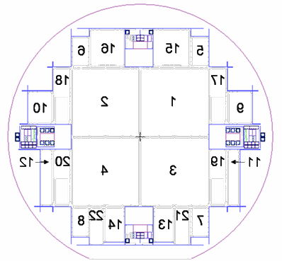




Delta (& super-lattice) doping 12 Megapixel LBNL Fully Deplted CCDs
Wafer Probe at -65°C
Four 12-Megapixel, 10.5 µm pixel, p-channel CCD
Processed by N-type delta doping
63% Yield for Science grade CCD measured by LBNL
Collaborations with Chris Bebek and Steve Holland, et al. at LBNL
See S. Holland talk

Slide 22
25 C
-140 C

Slide 23



Characterization in FUV, UV, and Visible

Slide 24

Far UV Rocket
CHESS (sounding rocket, PI:Kevin France CU)
Collaboration with Paul Scowen, Todd Veach*, Alex Miller, ASU
FUV, 3.5kx3.5k (100 – 160 nm) bare, delta doped delivered to CHESS

Slide 25
Far UV Rocket
CHESS (sounding rocket, PI:Kevin France CU)
Collaboration with Paul Scowen, Todd Veach*, Alex Miller, ASU
FUV, 3.5kx3.5k (100 – 160 nm) bare, delta doped delivered to CHESS
3-4x QE gain over MCP

Slide 26






Delta doping Large Area Array at Wafer Level
STA 2kx2k CCDs (n-channel, p-type delta doping)

Slide 27




Delta-doped, AR coated fully depleted 2kx2k STA devices for WaSP guide and focus CCDs
(320 – 1000 nm)
WaSP for Palomar
WaSP
Photographs of an STA 3600 imager diced from a delta doped 200 micron wafer. It has been flattened against AlN and mounted in a AlN frame prior to wire bonding to flex.
New packagaing to accommodate WaSP requirements are under development

Slide 29

ALD Coatings for Broadband Response

Slide 30


Breakthrough Results in Deep UV with Alacron/Fastvision
PI: Michael Hoenk. “Superlattice-doped”, new design, Hoenk (US patent)
3 Mpxl CMOS, low noise, 150 frames/ second, 8” wafers.
Demonstrated unprecedented stability. 500x saturation exposure to Excimer laser (100 million high energy pulses of the laser hitting the device!!).
Called a breakthrough by industry!!
See Michael Hoenk’s poster

Slide 31



Reflective Coatings for Astrophysics & Planetary Applications
Far Ultraviolet Spectroscopic Explorer (FUSE)
Collaboration with: Kevin France
CU - CASA
Reflective coatings determine the mission architecture for any UV mission (FUSE, HST/COS, etc.)
FUV has a significant number of spectral lines that are of great interest to astronomers
PI: W. Moos
Johns Hopkins
Purple: neutral gas (trace species)
Blue: neutral gas (dominant ion)
Green: warm, (intermediate ionization) plasma
Red: highly ionized plasma
Credit: T.A. Rector and B.A. Wolpa, NOAO, AURA, and NSF.
Notes:
This is a false-color image of the star AE Aurigae (bright source of light slightly off center of image) embedded in a region of space containing smoke-like filaments of carbon-rich dust grains, a common phenomenon. Such dust might be hiding deuterium, an isotope of hydrogen, and stymieing astronomers' efforts to study star and galaxy formation. The FUSE satellite has surveyed the local deuterium concentration in the galaxy and found far more than expected. Because deuterium is a tracer of star and galaxy evolution, this discovery could radically alter theories about how stars and galaxy form.

Slide 32

Benefits of Improved Mirror Coatings
Aluminum mirrors require protective coatings (i.e. LiF or thick MgF₂) to prevent oxidation which would otherwise destroy reflectivity in the FUV
Coatings also important in optical wavelengths as they affect polarization
By using very thin, but high quality, MgF₂, both issues can be addressed simultaneously.
  Very thin coatings minimize impact on polarization of incident light
  Thin films of MgF₂ (1-2 nm) enable higher reflectivity (due to lower absorption losses) than LiF or thick MgF₂
Reflectivity (%)
MgF₂ (1 nm)
MgF₂ (2 nm)
MgF₂ (HST)
LiF/Al (FUSE)
Wavelength (Å)
 | Size
FUSE | ~6 m
FUSE w/ improved coatings | ~3 m
Collaboration with K. France, M. Beasley* (CU) F. Greer* ( JPL)
Modeled using TFCalc Software

Slide 33


ALD Chemistry for MgF₂
Published Process*
5Mg(tmhd)₂(g) + 2TaF₅ (g) ---> 5MgF₂(s) + 2Ta(tmhd)₅(g)
Challenging Chemistry
Mg precursor has very low vapor pressure. Ta precursor will react with any oxygen in the system leading to Ta₂O₅ rather than MgF₂.
JPL Developed Process♩
Mg(EtCp)₂(g) + 2HF (g) ---> MgF₂(s) + 2H(EtCp)(g)
Robust and Facile Chemistry
This reaction occurs readily. The Mg precursor has a high vapor pressure, is easy to work with, and can be used for other reactions (i.e., MgO).
*Pilvi, T.; et al., Chem. Mater., 20 (2008) 5023.
♩Greer, F.; et al., in preparation
Notes:
Bis(2,2,6,6-tetramethyl-3,5-heptanedionato) magnesium
Bis(ethylcyclopentadienyl) magnesium

Slide 34






Characterization
ALD Aluminum
ALD MgF₂ on Aluminum
Bare substrate
ALD Al-coated substrate
E-Beam Evaporated Aluminum

Slide 35

Opportunity to fly on SLICE*
Mirror from SLICE will become available for coating soon. Future flights with ALD coatings
*U of Colorado rocket: Sub-orbital Local Interstellar Cloud Experiment (SLICE)
PI: Kevin France

Slide 36
Summary
  Atomic scale surface engineering through MBE and ALD enable high efficiency, stable response in detectors
  Wafer scale and batch detector processing enable high throughput, high yield compatible with mission delivery time scale and cost
Delivery to FIREBall, CHESS, WaSP Progress
  Optical coatings also using ALD allows high efficiency reflective coatings for more efficient systems.

Slide 37
Thank you for
Your Attention!

Slide 38

CCD201, bonded and thinned

Slide 39


ALD AR coatings, using CCD97
Shadow mask
CCD97, bonded, thinned, delta doped

Slide 40

AR coatings, using CCD97

Slide 41





Human-Eye-inspired curved arrays
Enabling the very compact & the very large cameras
flat
Flat
Curved

Slide 42


Camera for Laboratory Characterization
and
for on-sky observation
And

Slide 43

Why does the peak shift?

Slide 44
Delta doping technology
Delta-doped layer
(boron in single atomic layer)
0.004 µm
Bandstructure engineering for optimum device performance with atomic layer control over silicon surface
original Si
~ 15 µm
CCD
frontside
circuitry
Native oxide
0.002 µm
Thinned CCD
Low temperature process, compatible with VLSI, fully -fabricated devices (CCDs, CMOS, PIN arrays)
Hoenk et al., Applied Physics Letters, 61: 1084 (1992)

Slide 45
-
-
-
-
-
-
-
-
-
-
-
-
-
-
-
-
+
-
+
-
+
-
+
-
+
-
+
+
-
+
-
+
-
+
+

Slide 46
QE > 80% with ALD Multilayer Coatings
Response (from reflectivity and absorption) measured on blank silicon and fused silica wafers and on conventional CCDs looks good but the position of the peak is shifted
1 Megapixel prototype with Cassini CCD
Hamden et al., SPIE, Astronomical Instrument and Telescopes, Amsterdam, July 2012
Ref: Erika T. Hamden, et al, Paper 8453-8 of Conference 8453

Slide 47

Performance of ALD Protected Mirror
Measured reflectance of 20 nm of ALD MgF₂ protected aluminum is as good as COTS mirror (perhaps better)
  Approaches theoretical performance of protected aluminum
Need to extend these measurements to the FUV and to thinner ALD MgF₂ films
Reflectivity (%)
Compared to Bare Al Reference Mirror
Bare E-beam Al
E-beam Al with MgF₂ coating
Bare E-beam Al (w/XeF₂ treatment)
E-beam Al (XeF₂ treatment)
with MgF₂ coating
Wavelength (nm)
Greer, F.; et al., in preparation

Slide 48

XPS Characterization of ALD MgF₂
Evaporated MgF₂
ALD MgF₂
Binding Energy (eV)
Binding Energy (eV)
ALD MgF₂ [Mg(EtCp)₂ + HF] yields similar film stoichiometry to a thermally evaporated film, but with higher resistance to oxidation after air exposure.
Greer, F.; et al., in preparation
Greer, F.; et al., in preparation

Slide 49

ALD MgF₂ - Performance
Took simplified approach to mirror coating problem initially to look at just the performance of ALD MgF₂ itself
  No complications of ALD Al nucleation and cross-contamination of the films in same chamber
  Used glass substrate with e-beam evaporated aluminum
ALD MgF₂ is amorphous as deposited at 250ºC.
  Surprising, but extremely good result for application as protective layer
TEM Prep Layers
TEM Prep Layers
ALD MgF₂
ALD MgF₂
Evaporated Aluminum
Evaporated Aluminum
Greer, F.; et al., in preparation

Slide 50
-
-
-
-
-
-
Trapping of photo-generated charge
+
+
+
+
+
+
+
+
+
+
+

Slide 51
-
-
-
-
-
-
-
-
-
-
-
-
-
-
-
-
-
-
-
-
-
-
Trapping of photo-generated charge
-
+
-
+
-
+
-
+
+
-
+
-
+
-
+
+
-
+
+

Slide 52
-
-
-
-
-
-
-
-
-
-
-
-
-
-
-
-
+
-
+
-
+
-
+
-
+
-
+
+
-
+
-
+
-
+
+

