Slide 1

Backside illuminated CMOS active pixel sensor with global shutter and 84 dB dynamic range
G. Meynants, G. Beeckman, W. Ogiers, K. Van Wichelen, J. Bogaerts
CMOSIS NV, Antwerp, Belgium
Scientific Detector Workshop – Firenze – 8 October 2013

Slide 2
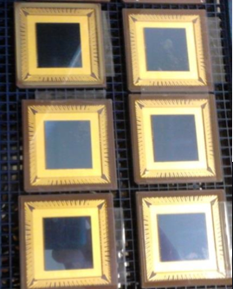
The problem(s)
(where we started with)
Backside Illuminated Thinned Focal Plane Array “BITFPA”
Characteristic:
Large dynamic range: 84 dB
FWC > 400,000 e- & Noise < 25 e- RMS
Global shutter
Backside illuminated
QE: 50% 270-400 nm
75% QE 400-800 nm
1k x 1k pixels, 16 Hz
10-20 µm pixel size

Slide 3
Outline
Pixel architecture
  Dynamic range
  BSI compatible global shutter
Architecture
Backside thinning
  Process flow
  Hot pixel cluster issues
Work in progress

Slide 4
Dual gain channel global shutter pixel
Pixel schematic

Slide 5
Dual gain channel global shutter pixel
Pixel schematic
Photodiode &
charge sense amplifier
Sample reset & signal
high gain
Sample reset & signal
low gain

Slide 6
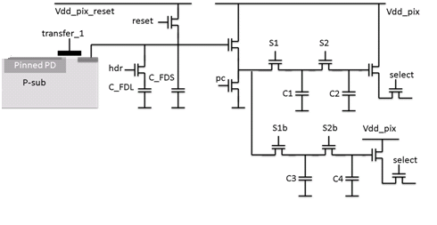
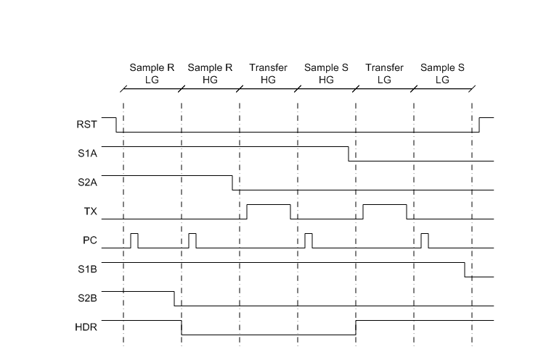
Dual gain channel global shutter pixel
Pixel timing
Timing at end of exposure
Synchronous in all pixels
high gain signal
high gain reset
low gain signal
low gain reset

Slide 7
Timing – 1. End of exposure, after FD reset

Slide 8
Timing – 2. First charge transfer

Slide 9
Timing – 3. Sampling of high gain signal

Slide 10
Timing – 4. activate HDR switch

Slide 11
Timing – 5. 2nd charge transfer

Slide 12
Timing – 6. sample low gain signal

Slide 13
Pixel implementation and measured FSI characteristics
Pixel pitch | 20 x 20 µm²
In-pixel capacitors | 2x MiM 150 fF 2x MOS 150 fF
Process | 0.18 µm 4LM CIS
Channel | High gain | Low gain
Conv. gain | 13 µV/e- | 1.5 µV/e-
FWC 2.8 V 3.3 V | 45 000 e- 58 000 e- | 450 000 e- 510 000 e-
Dark current @ RT, FSI | 6000 e-/s | 6000 e-/s
Noise | 20 e- RMS | 150 e- RMS
FSI characterisation on testchip and FSI prototypes

Slide 14
Image sensor architecture

Slide 15
Readout chain & noise budget
 |  |  | LOW-GAIN | HIGH-GAIN
Pixel
 | Conversion Gain @ pixel output | [V/e-] | 1.50E-06 | 13.00E-06
 | Swing at pixel output | [V] | 0.77 | 0.75
 | FWC | [e-] | 513.33E+03 | 57.69E+03
 | Noise @ pixel output | [Vrms] | 268.00E-06 | 268.00E-06
 | input referred noise | [e-rms] | 178.7 | 20.6
Column Gain Stage + S/H
 | Max. input swing (column) | [V] | 1.80 | 1.80
 | Column swing | [V] | 0.77 | 0.75
 | capacitor ratio CFF/CFB |  | 2.40 | 2.40
 | amplifier Acl |  | 2.38E+0 | 2.38E+0
 | Noise Generated | [Vrms] | 302.85E-06 | 302.85E-06
 | Max. output swing | [V] | 1.90 | 1.90
Signal Properties On S/H Caps
 | Sampled Signal Noise | [Vrms] | 706.04E-06 | 706.04E-06
Column Multiplexer
 | Noise Generated | [Vrms] | 304.06E-06 | 304.06E-06
Signal Properties On CDS Input
 | Signal Noise | [Vrms] | 763.62E-06 | 763.62E-06
 | Input Referred Noise | [e-rms] | 215.6 | 24.9
Output Stage (incl. CDS)
 | simulated noise | [Vrms] | 313.00E-06 | 313.00E-06
Signal Properties After output stage
 | Signal Noise | [Vrms] | 825.28E-06 | 825.28E-06
 | Input Referred Noise | [e-rms] | 233.0 | 26.9
 | Signal Swing | [V] | 1.82 | 1.77
 | Input Referred Swing | [e-] | 513.33E+03 | 57.69E+03
 | Conversion Gain | [V/e-] | 3.54E-06 | 30.69E-06
Dynamic Range
 | channel | [dB] | 66.86 | 66.63
 | overall | [dB] | 85.62
Noise (output) low gain: 233 e- RMS
high gain : 27 e- RMS

Slide 16
Noise and SNR – dual gain

Slide 17
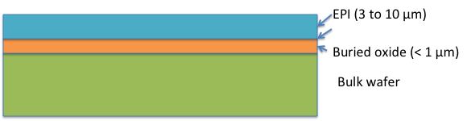
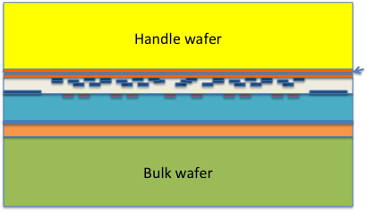
SOI based thinning flow
1. SOI Start material – 3 to 10 µm
2. Standard CMOS processing (on SOI substrate)
3. Bonding of handling wafer after CMOS processing
Notes:
----- Notulen (10/06/13 22:56) -----
tekening updaten, verwijder backside passivation

Slide 18
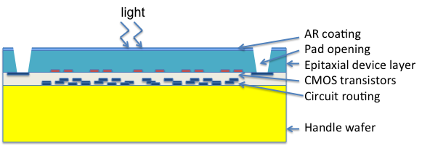
BSI thinning flow (2)
4. Remove substrate under BOX – accurate thinning
5. Remove BOX
6. BSI passivation + AR coating, pad opening

Slide 19
Quantum efficiency: separate process optimization for UV/VIS
270-400 nm > 50%
400-800 nm > 75%
Optimized thickness
  3 µm epi-layer on SOI
Optimized ARC
  Al2O3 layer – thinner layer
Backside passivation through Al2O3 layer: fixed negative charge in the Al2O3
Optimized thickness:
  10 µm epi-layer on SOI
Optimized ARC
  Al2O3 layer – tuned thickness
Backside passivation through Al2O3 layer

Slide 20
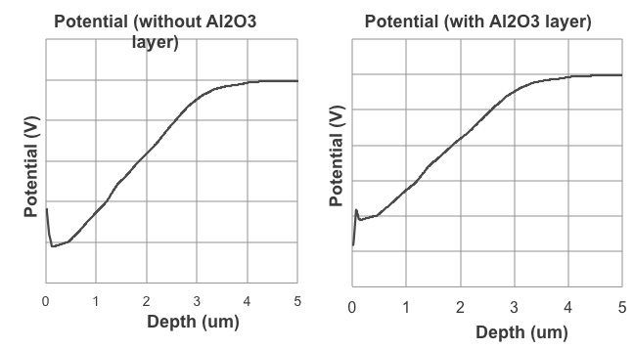
Sapphire (Al₂O₃) deposition
Fixed negative charge (9.6e-12/cm2 reported in solar cell research)
This can compensate for the valley in the the electric field caused by the outdiffusion of backside boron implantation.

Slide 21


First images on first SOI prototypes: large hot clusters
More and larger clusters with higher supply voltage and thicker epi layer
and strong increase of I(array) on SOI vs. bulk
BSI (other product)
10 µm pixel, gray image
3 µm epitaxial layer
FSI on SOI, BITFPA
20 µm global shutter pixel, dark
10 µm epitaxial layer

Slide 22

10 µm BSI EUV dual-gain-per-pixel imager
Low gain channel
High gain channel

Slide 23
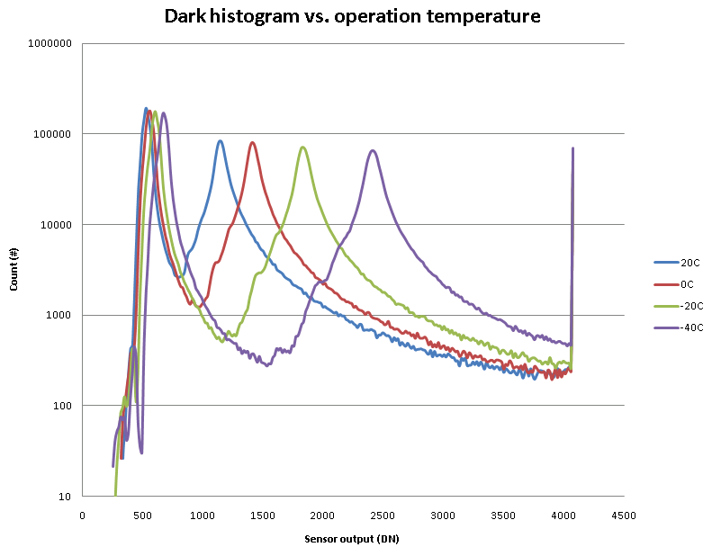
10 µm BSI dual gain pixel temperature dependency
Stronger at lower temperature
Low gain channel
High gain channel

Slide 24
EMMI – NIR channel
BITFPA FSI imager processed on SOI – 20 µm pixel
NIR light emission in hot clusters
Electroluminescence
➔ Hot cluster = self-absorption of
emitted photons
More clusters and more emission at higher pixel supply levels

Slide 25
Pixel detail – SF drain emission center
Pixel with a metal top plate (BSI design, 20 µm global shutter)
SF
drain
EMMI microscope
Layout

Slide 26
Pixel detail – RST drain emission center
RST
drain

Slide 27
Vertical gettering in bulk CMOS wafers
Notes:
the gettering layer is an impurity trapping site
the layer is created by precipitation of supersaturated oxigen
this creates stress, leading to stacking faults and dislocation loops
this forms a trapping site for the impurity
When the impurity is located in the gettering layer, it has no influence
any more on the device at the top of the wafer (photodiodes or mosfets)
This is known as intrinsic gettering.
Alternative gettering techniques exist (extrinsic gettering)

Slide 28
Lack of vertical gettering in SOI wafer

Slide 29
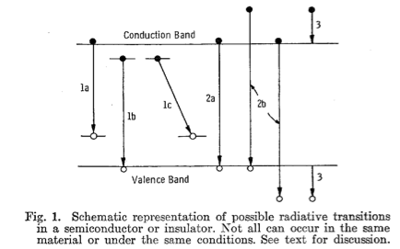
Electroluminescence in Si?
H. Ivey, Electroluminescence and Semiconductor Lasers
IEEE J. Quantum electronics, Vol. QE-2, No.11, Nov 1966
Transitions involving impurities
Interband transitions
  Intrinsic emission
  Higher energy emission involving “hot” carriers
  (“avalanche emission”)
Interband transitions involving hot carriers
(“deceleration emission”)
In Si very low band-to-band radiative recombination rate (indirect bandgap material) – phonon-assisted transition needed
Impurity or crystal defect can replace the role of the phonon
  Sub-bandgap energy emission.
  Not what we see here, energy of detected luminescent photons > band gap
Hot carriers in strong electric fields
But where do these hot carriers come from? And why are there so many?

Slide 30
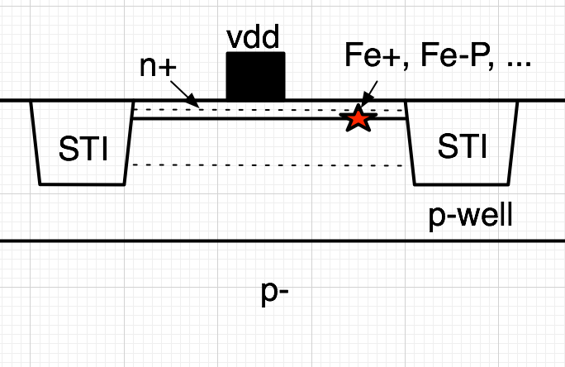
And why emission at the HV n+ areas?
Gettering of defects in
n+ area:
  Some impurities may bind
  to the Phosphor at the
  n+ area
  For example Fe may form
  Fe-P pair in n+, inside or
  outside the space charge region
  Fe-B may also be formed (in the p-well for example)
The defect decreases avalanche breakdown voltage of the junction.
Strong E-field over reverse biased
p-well/n+ junction at N+ supply diffusions causing avalanche breakdown -> hot carriers -> photoemission

Slide 31
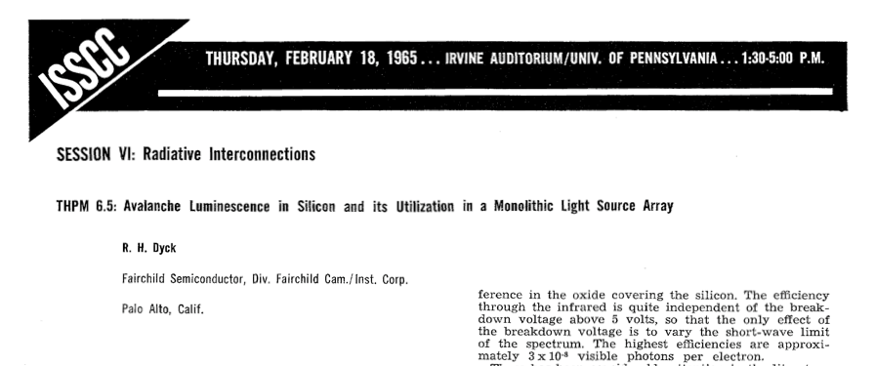
We could make light emitting pixels for a monolithic display…
This was already proposed on 1965 ISSCC by R.H. Dyck of Fairchild Semiconductor

Slide 32
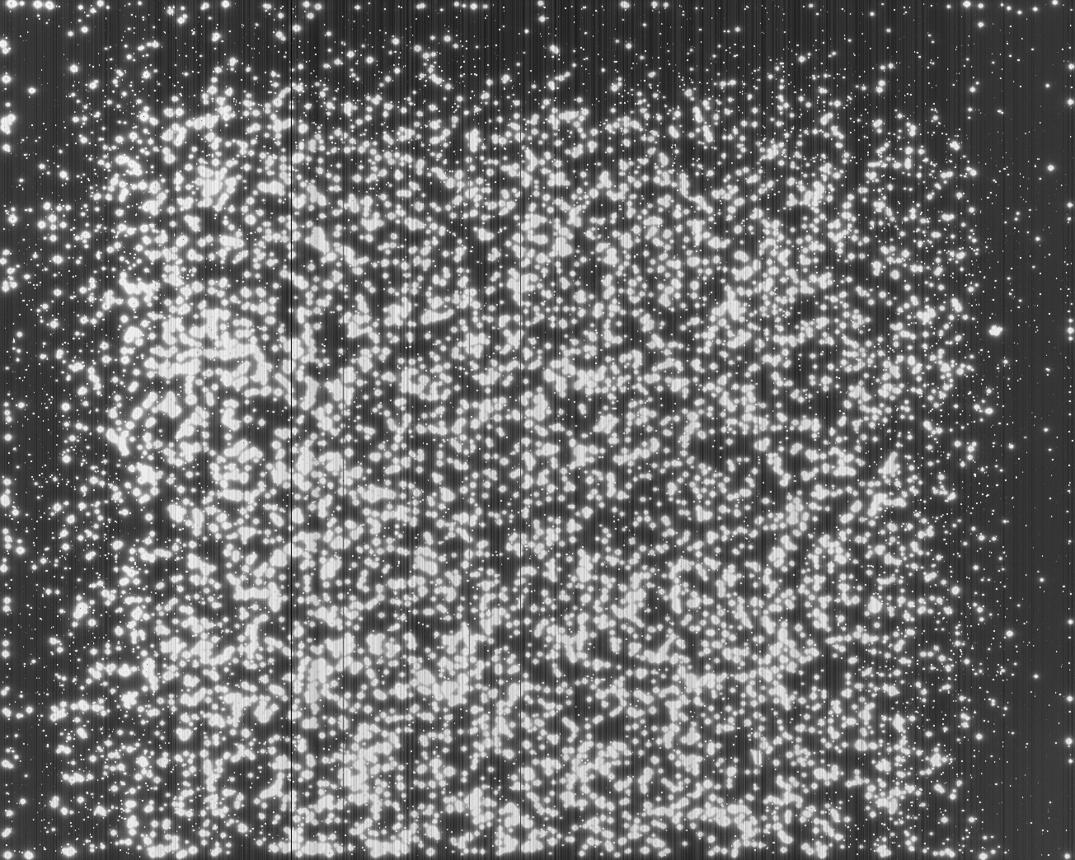

Fix
Dark image 50ºC, 500 ms
Before
After
Demonstrated on 10 µm SOI FSI device

Slide 33
Conclusion
Image sensor in development with 84 dB and a dual-gain global shutter pixel architecture
  High gain channel with low noise
  Low gain channel to cover the entire dynamic range
  Both channels each cover 66 dB. Combined 84 dB capture in a single exposure.
Backside thinning flow had some issues:
  Imagers processed on SOI substrate showed a lot of hot cluster defects.
  Photoemission has been observed on these clusters
  Caused by impurities in the silicon that can not be gettered vertically because BOX is barrier
  Instead these impurities diffuse and are collected at n+ areas.
  If these n+ areas are at high potential, radiative recombination is observed, probably due to avalanche breakdown
  Issue is now fixed, fix demonstrated on an image sensor with 10 µm pixels and a new SOI processing run has just started on the BITFPA imager

Slide 34
Acknowledgements
Ingrid De Wolf of IMEC for assistance with EMMI measurements
ESA for the support of this detector development in the frame of the ESA contract 4000100375/10/NL/RA “Back-illuminated Thinned CMOS Imager Focal Plane”

Slide 35
Thank you
Guy Meynants
Founder & CTO
CMOSIS nv
Coveliersstraat 15
B-2600 Antwerp, Belgium
+32 3 260 17 32
guy@cmosis.com

