Slide 1
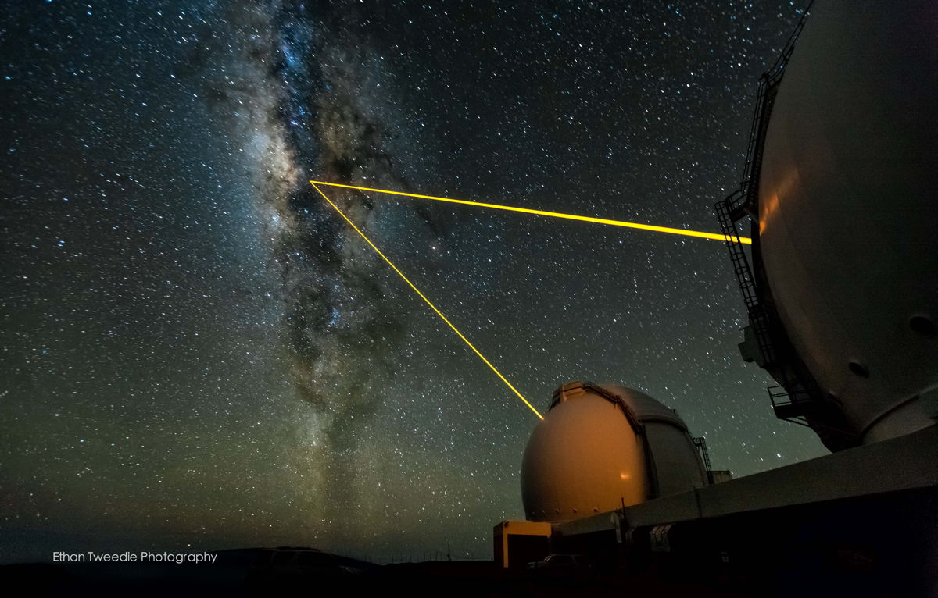
W.M. Keck
Observatory Update
Randy Campbell
Notes:
SA, specializing in AO science operations
Past , Present, and Future

Slide 2
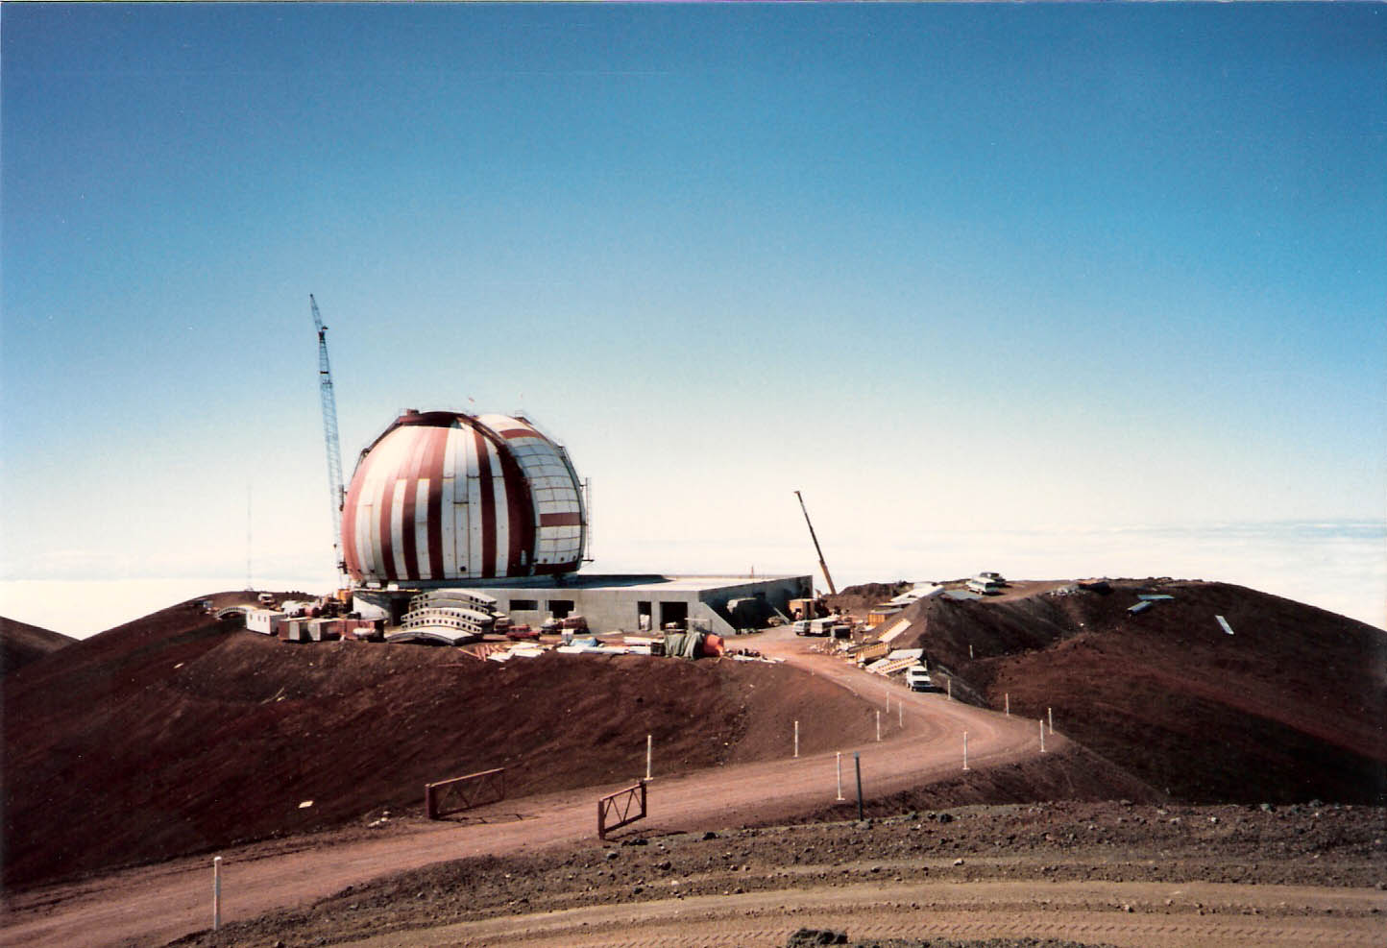
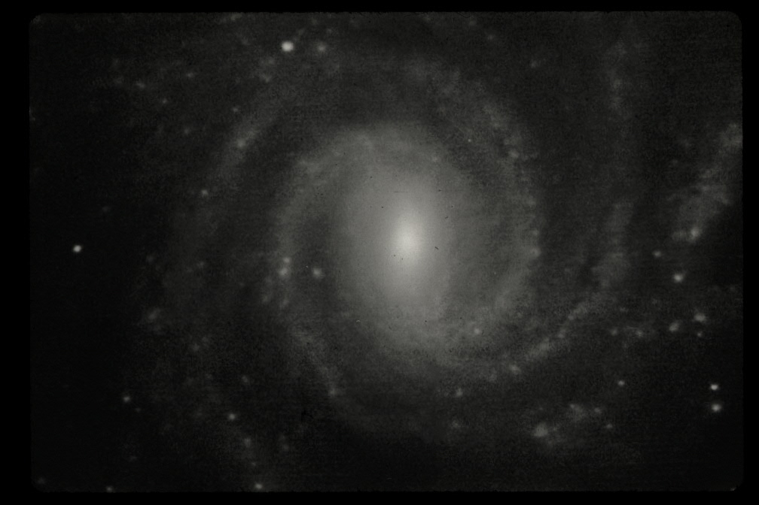
2013: 20th Anniversary of Science Operations
Keck 1, 1988
First Light Nov 1990
Engineering Camera
with 9 segments
Photo Courtesy of Gerry Smith, Keck Project Manager
Notes:
First light image with an engineering camera
Successful demonstration led to approval and funding (W.M. Keck foundation) for Keck II

Slide 3
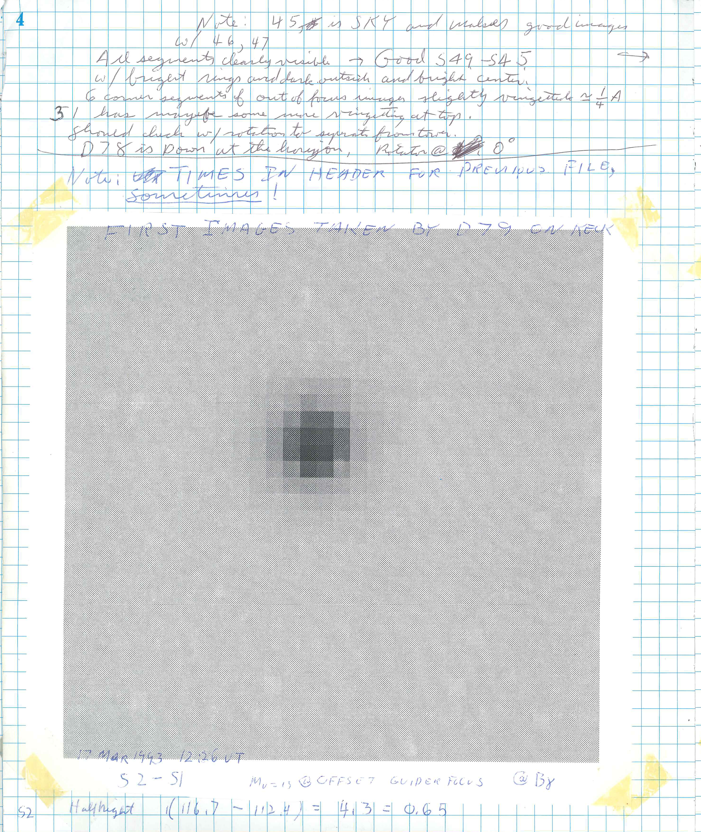
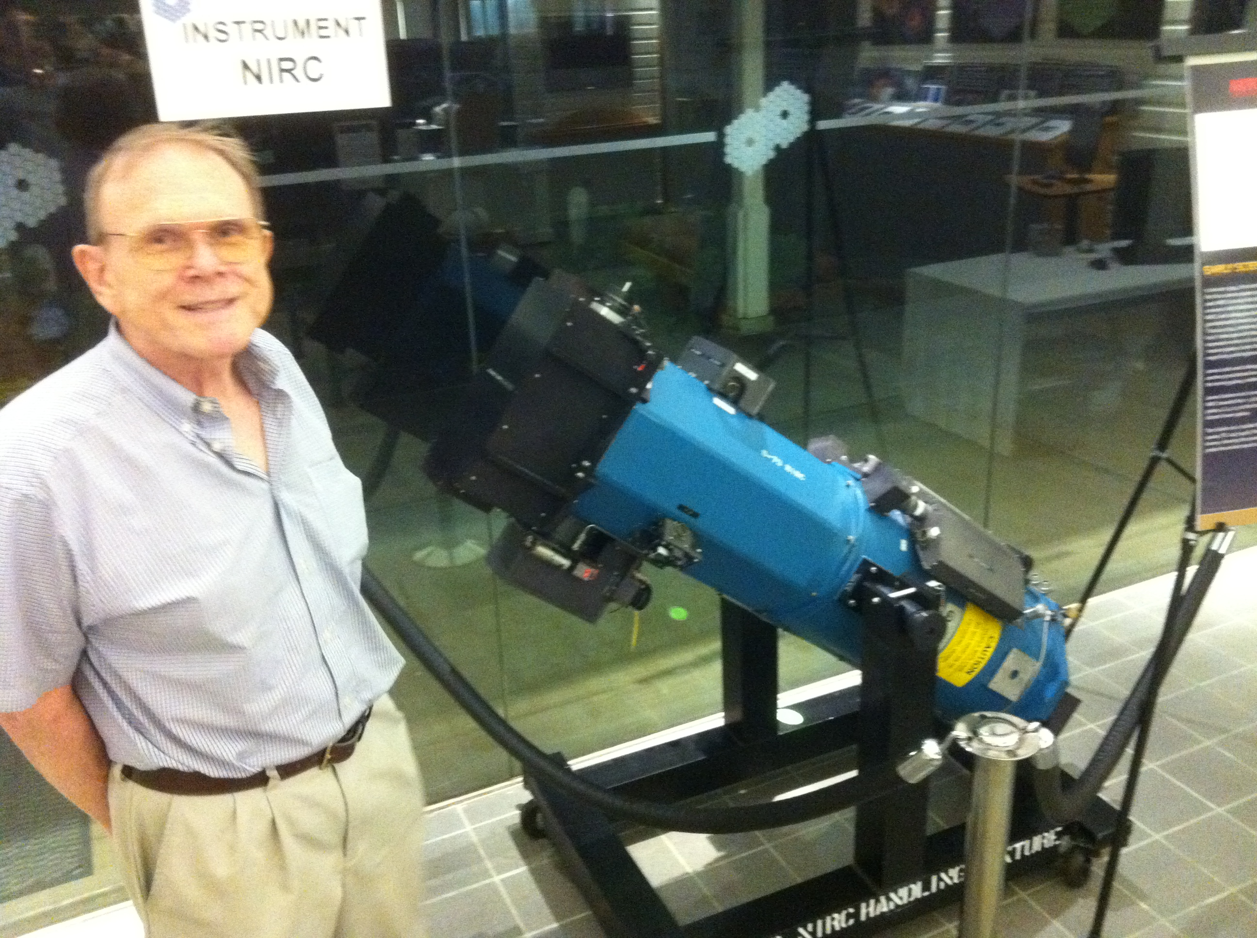
First Science instrument image 17 Mar 1993
First Instrument, NIRC
All 36 segments
D79 (Dewar#79) Log Book
Detector:
  256² InSb SBRC
Sensitivity, Ks = 23.83
  (SNR = 5, T_{int}=3600, Aperture = 0.5”)
  (MOSFIRE Sensitivity, Ks = 23.89)
  Keith Matthews awarded the American Astronomical Society’s (AAS) Joseph Weber Award for Astronomical Instrumentation for 2013.

Slide 4

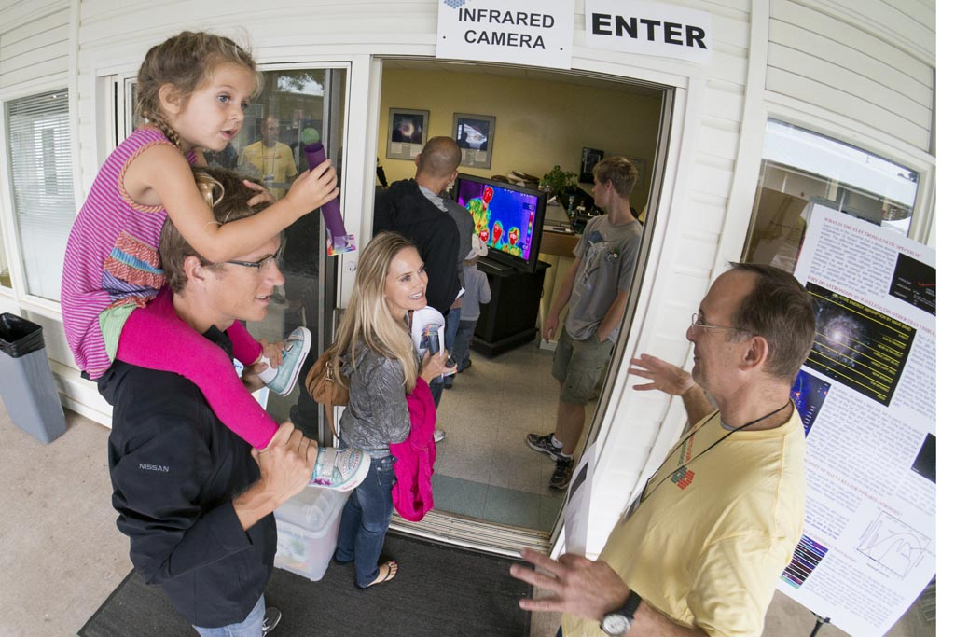
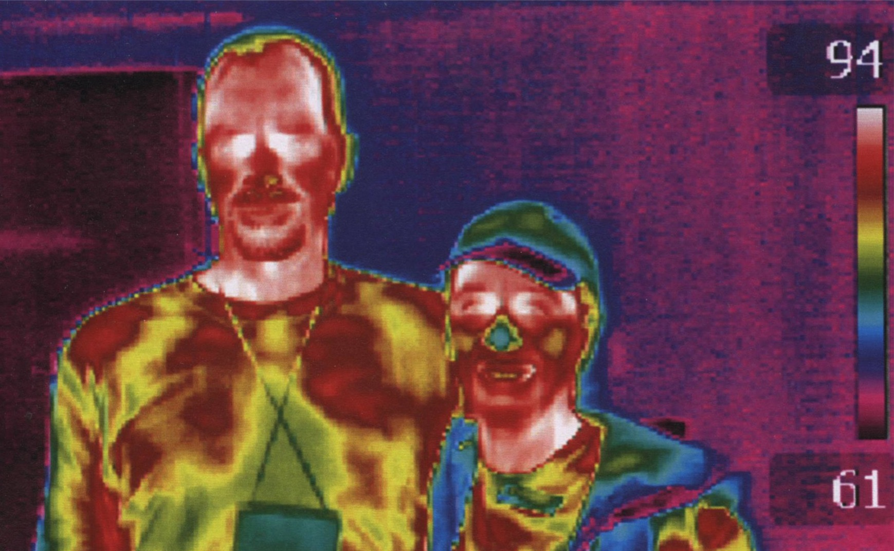
20th Anniversary
  HQ Open House
    ~2500 participants
    60 exhibits
  Science Meeting
  VIP Gala
Notes:
I manned the IR Camera station where we took thermal images of visitors,
Using a fluke device with a microbolometer array, operates at room tempeture, cost less than $10k

Slide 5
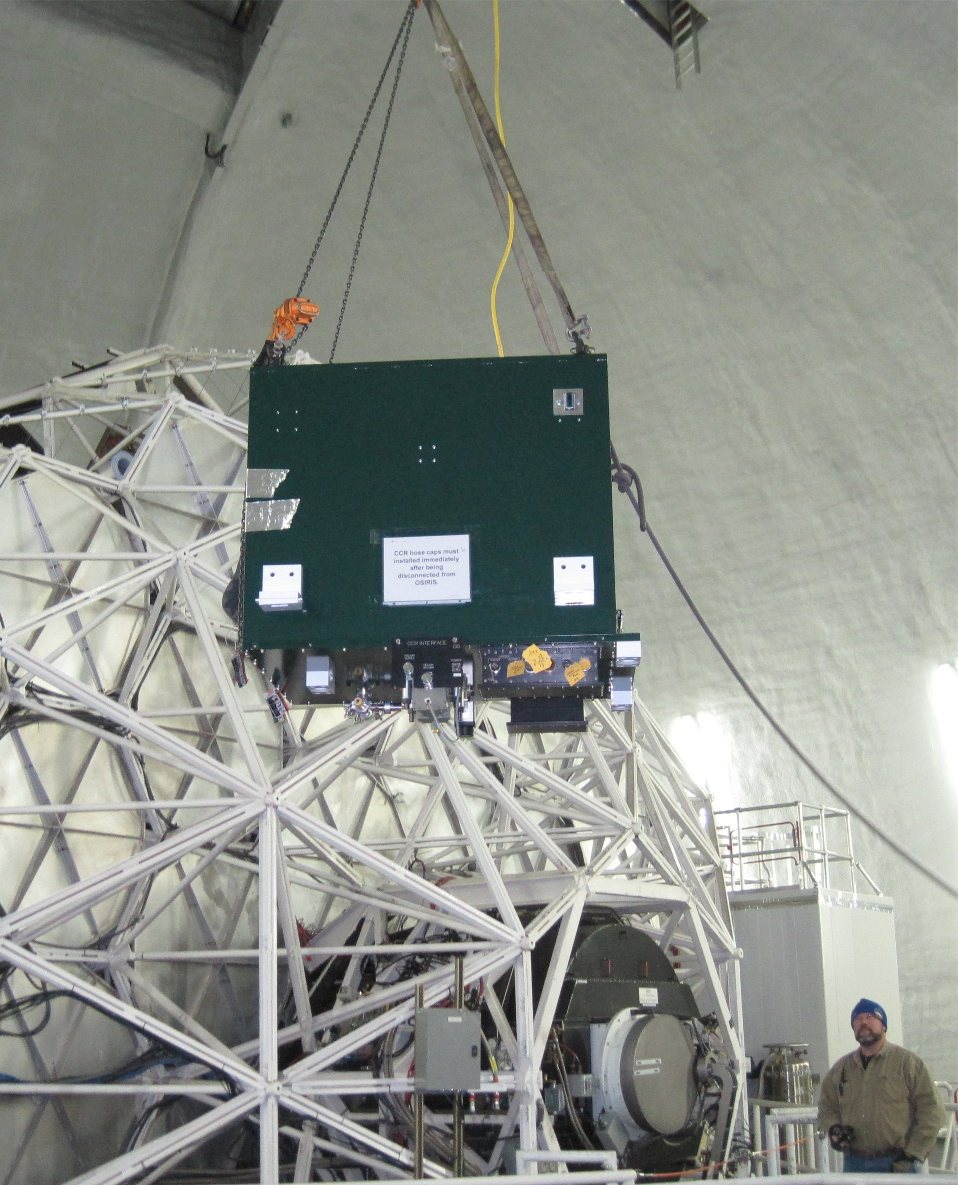
Current Instruments
Keck I
  LRIS, multi-object spectrometer, imager
    PI’s Judy Cohen, Bev Oke CalTech
    Blue: 2x2Kx4K E2V, Red: 2x2Kx4K LBL
  HIRES, High Resolution Echelle Spectrometer
    PI Steve Vogt, UCSC
    CCD: MIT-LL 2Kx4K
  OSIRIS, AO fed, IR integral field spectrometer
    PI James Larkin UCLA
    Spectrograph: Hawaii 2, Imager, Hawaii 1
  MOSFIRE, IR multi-object spectrometer, imager
    PI’s Ian McLean UCLA, Chuck Steidel CalTech
    Hawaii2RG
  NIRC, decommissioned 2010
    PI Keith Matthews CalTech
OSIRIS moving to Keck 1, 2012
Notes:
K1 LGS in into its second semester of Science Operations with OSIRIS, moved over from Keck II

Slide 6
Current Instruments
Keck II
  DEIMOS, multi-object spectrometer, imager
    PI Sandra Faber UCSC
    8x2Kx4K E2V
  ESI, high resolution Echelle spectrometer
    PI Joe Miller UCSC
    2Kx4K E2V
  NIRC2 (D82), AO fed, IR imagers/spectrometer
    PI Keith Matthews CalTech
    Aladdin III InSb 1Kx1K
  NIRSPEC , IR high resolution Echelle spectrometer
    PI Ian McLean UCLA
    Aladdin III InSb 1Kx1K
    NIRSPAO when used with Adaptvie Opitics
Keck-Keck Interferometer, decommissioned 2012

Slide 7
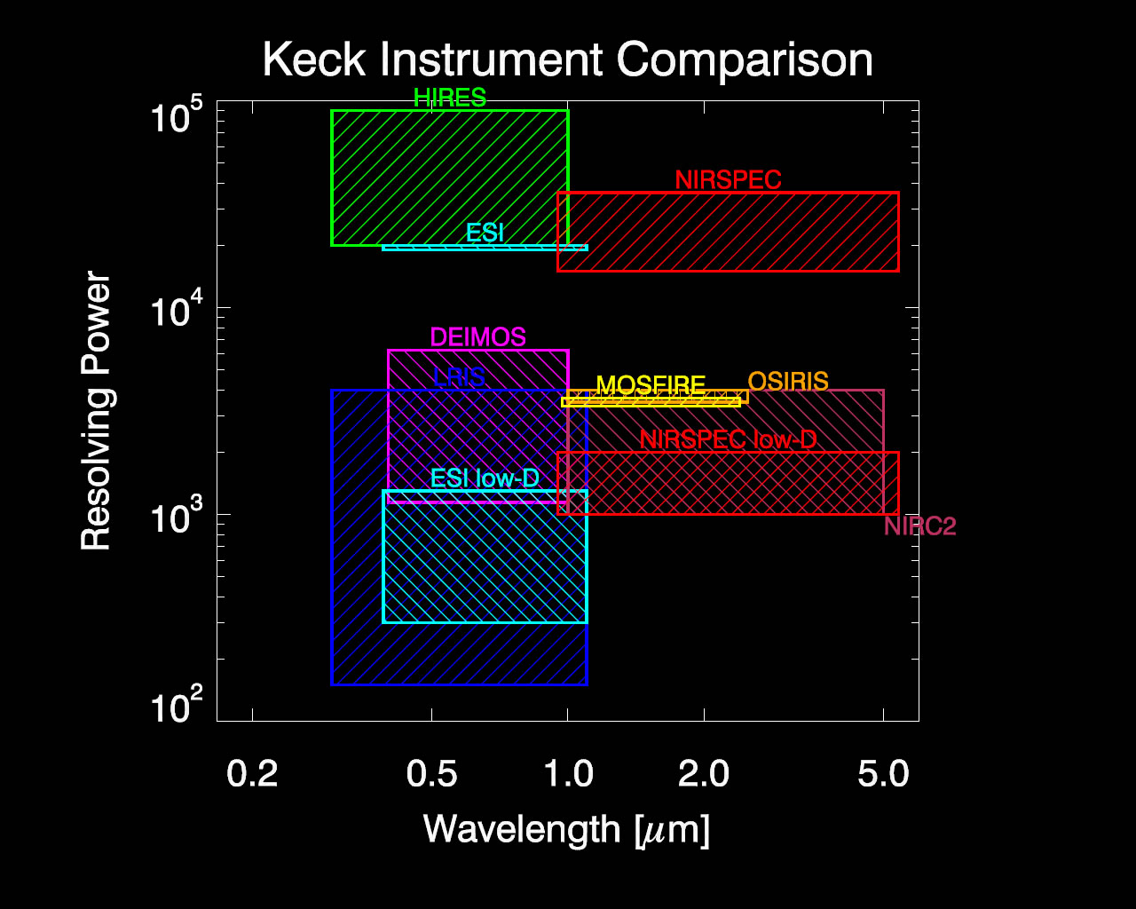

Slide 8
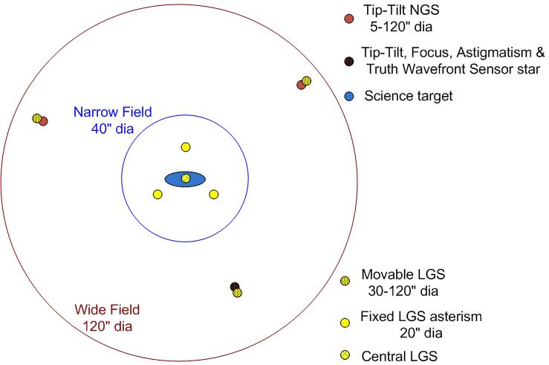
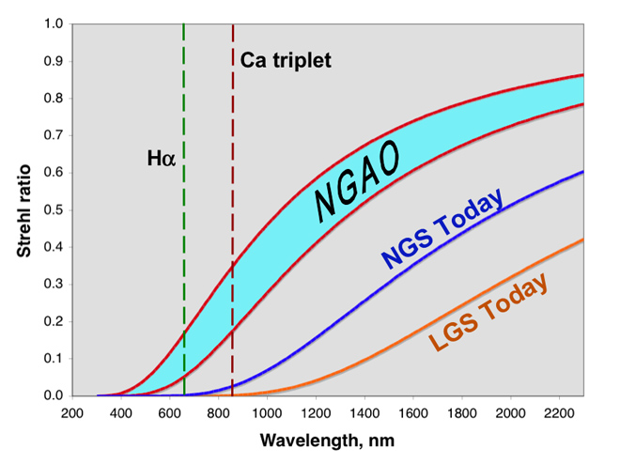
NGAO
Next Generation AO
7 LGS Asterism
Major Goals
Improved near-IR performance
  Strehls ≥ 80% at K)
  Improved PSF stability & knowledge
AO correction at red wavelengths
  Strehl of 15 - 25% at 750 nm
Increased sky coverage
Notes:
Take advantage of developments in
tomographic wavefront reconstruction
MEMS and other deformable mirrors
Sodium lasers
Computing power
Photometry to 5%
100 micro” astrometry
But this is not yet fully funded but Pieces of it are in development

Slide 9
AO Development
Center launch telescope for Keck II
TOPTICA / MPB / ESO Fiber Laser
(D. Bonaccini Calia, 2010)
Laser table on
elevation ring
Laser Head
Notes:
The Dye laser will be replaced in 2014 with a 20W continuous-wave Raman fiber-amplifier laser being fabricated by a consortium of TOPTICA Photonics AG and MPB Communications Inc
The infrastructure and launch system is capable of operating 3 lasers to create a 7 laser spot asterism

Slide 10
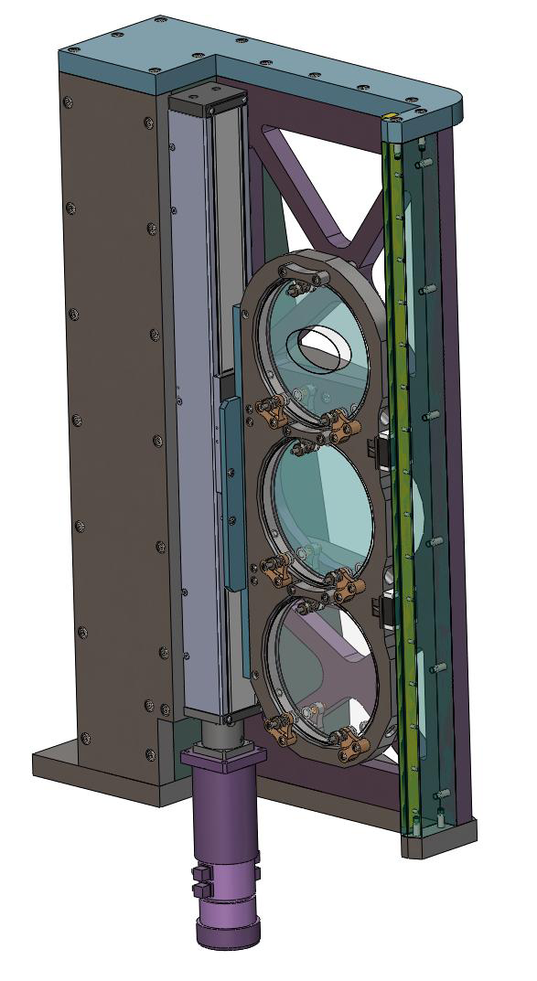
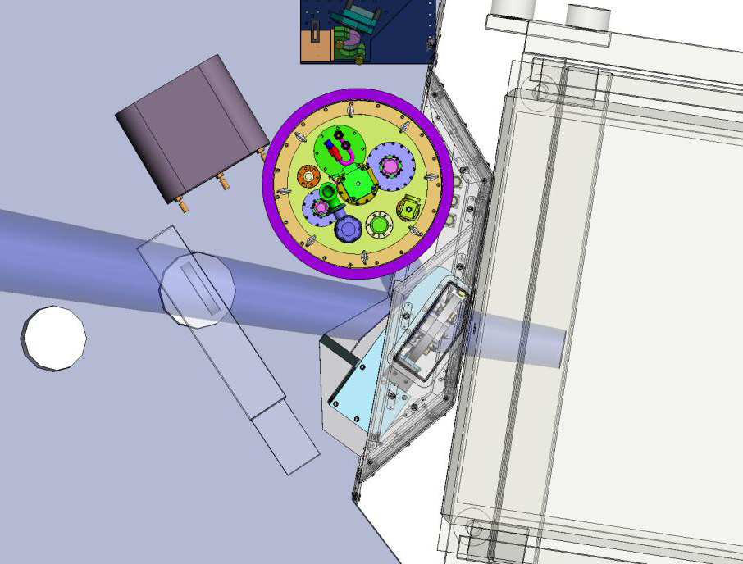
Near IR Tip/Tilt Sensor
H2RG
  ARC electronics
Differential Multi-Accumulate Readout
  (Smith and Hale, 2012)
ROIs
Top View
Camera Dewar
OSIRIS
Dichroic Pickoff Stage
10
Notes:
LGSAO performance is sometimes limited by TT
Keck / CalTech project, CIT providing the camera, see Roger’s talk?
AO correction on IR tt star boosts performance
Eng grade H2RG
A technology stepping stone to NGAO
Differential Multi-Accumulate Readout, Roger Smith and David Hale

Slide 11
PSF Reconstruction
2 projects with overlapping goals:
Field Dependent PSF,
  A. Ghez, UCLA
On-Axis PSF, Keck,
  P. Wizinowich, WMKO
Notes:
Not understanding the PSF is one of the biggest limitations of AO science.
It takes away from the precision of photometry, astrometry, and the morphology of resolved objects

Slide 12
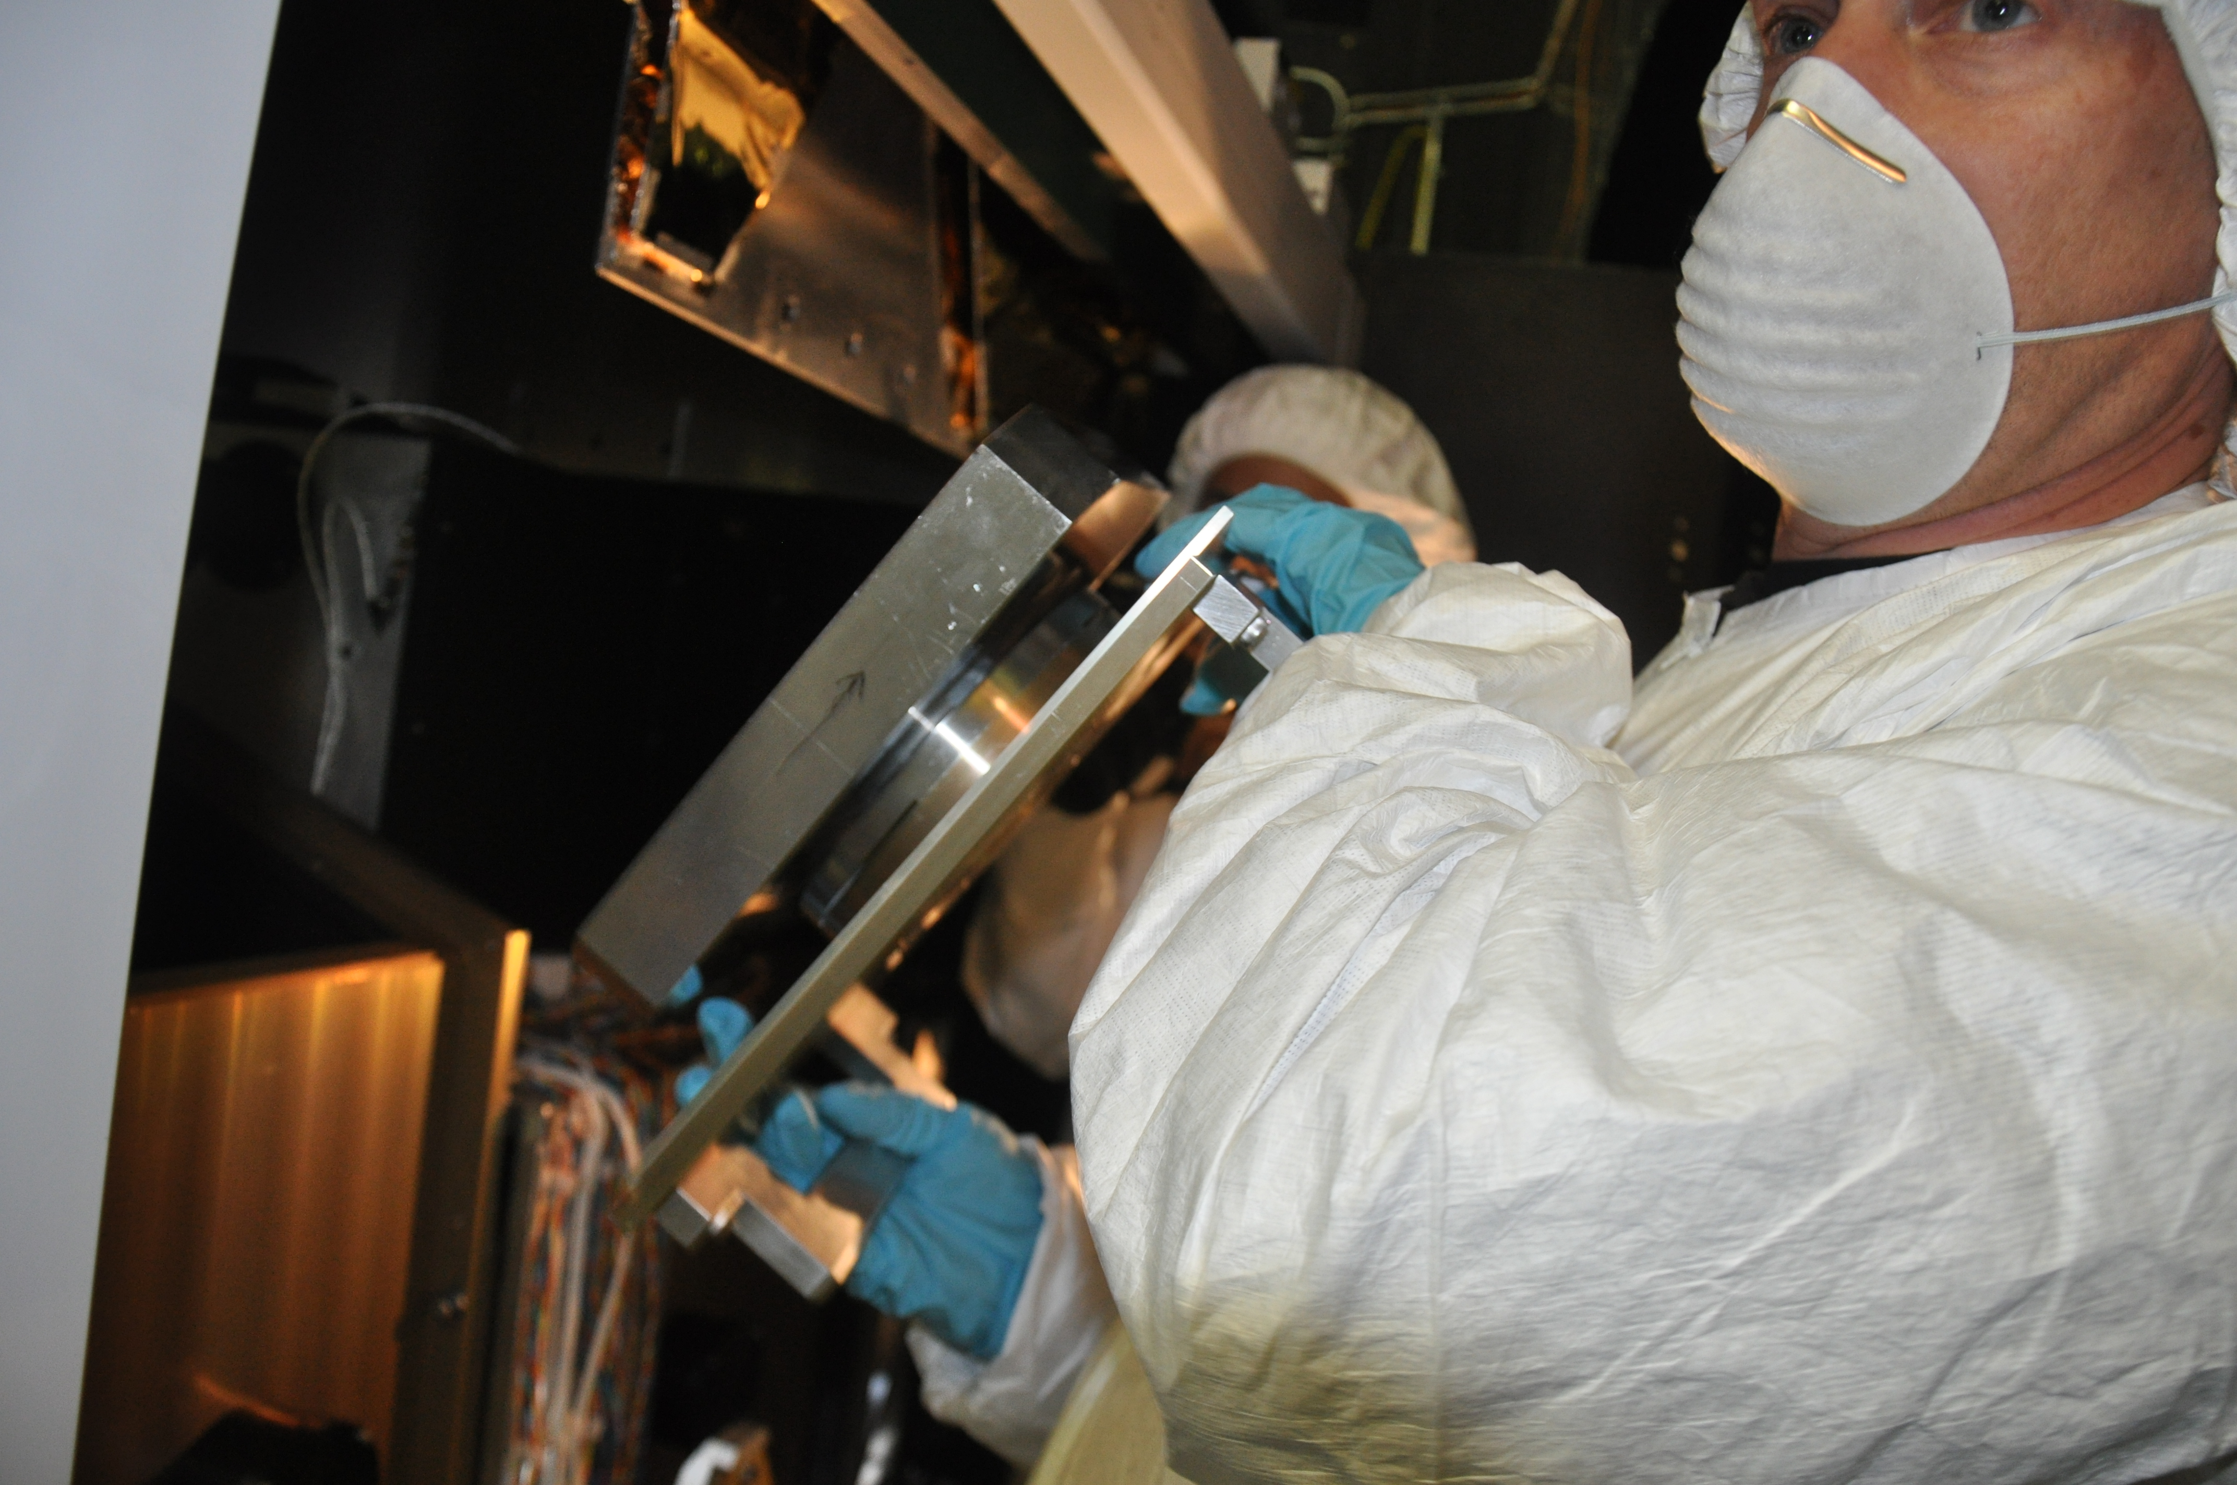
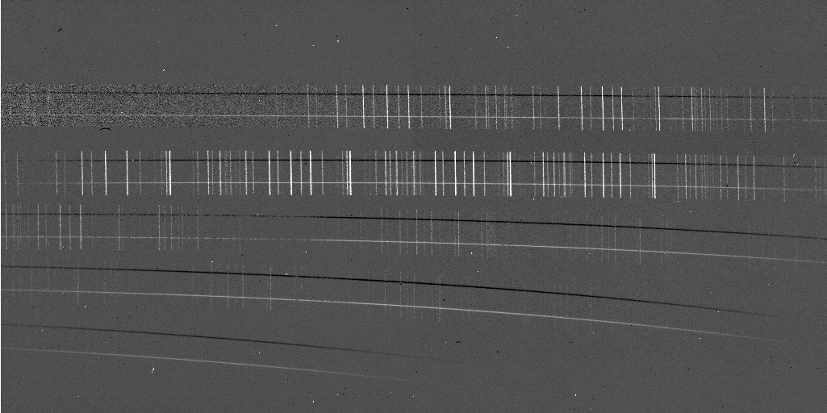
OSIRIS upgrades
  Grating replacement
  Throughput improved
  x 1.5 in J,H
  x 2.5 in K
  H2RG with sidecar
    2014
New for 2014
NIRES (D85)
  PI: K. Mathews
  Single setting
  1.0 - 2.5 μm spectral coverage
  H2RG
  ARC electronics
Notes:
NIRES , pi Matthews, D85

Slide 13
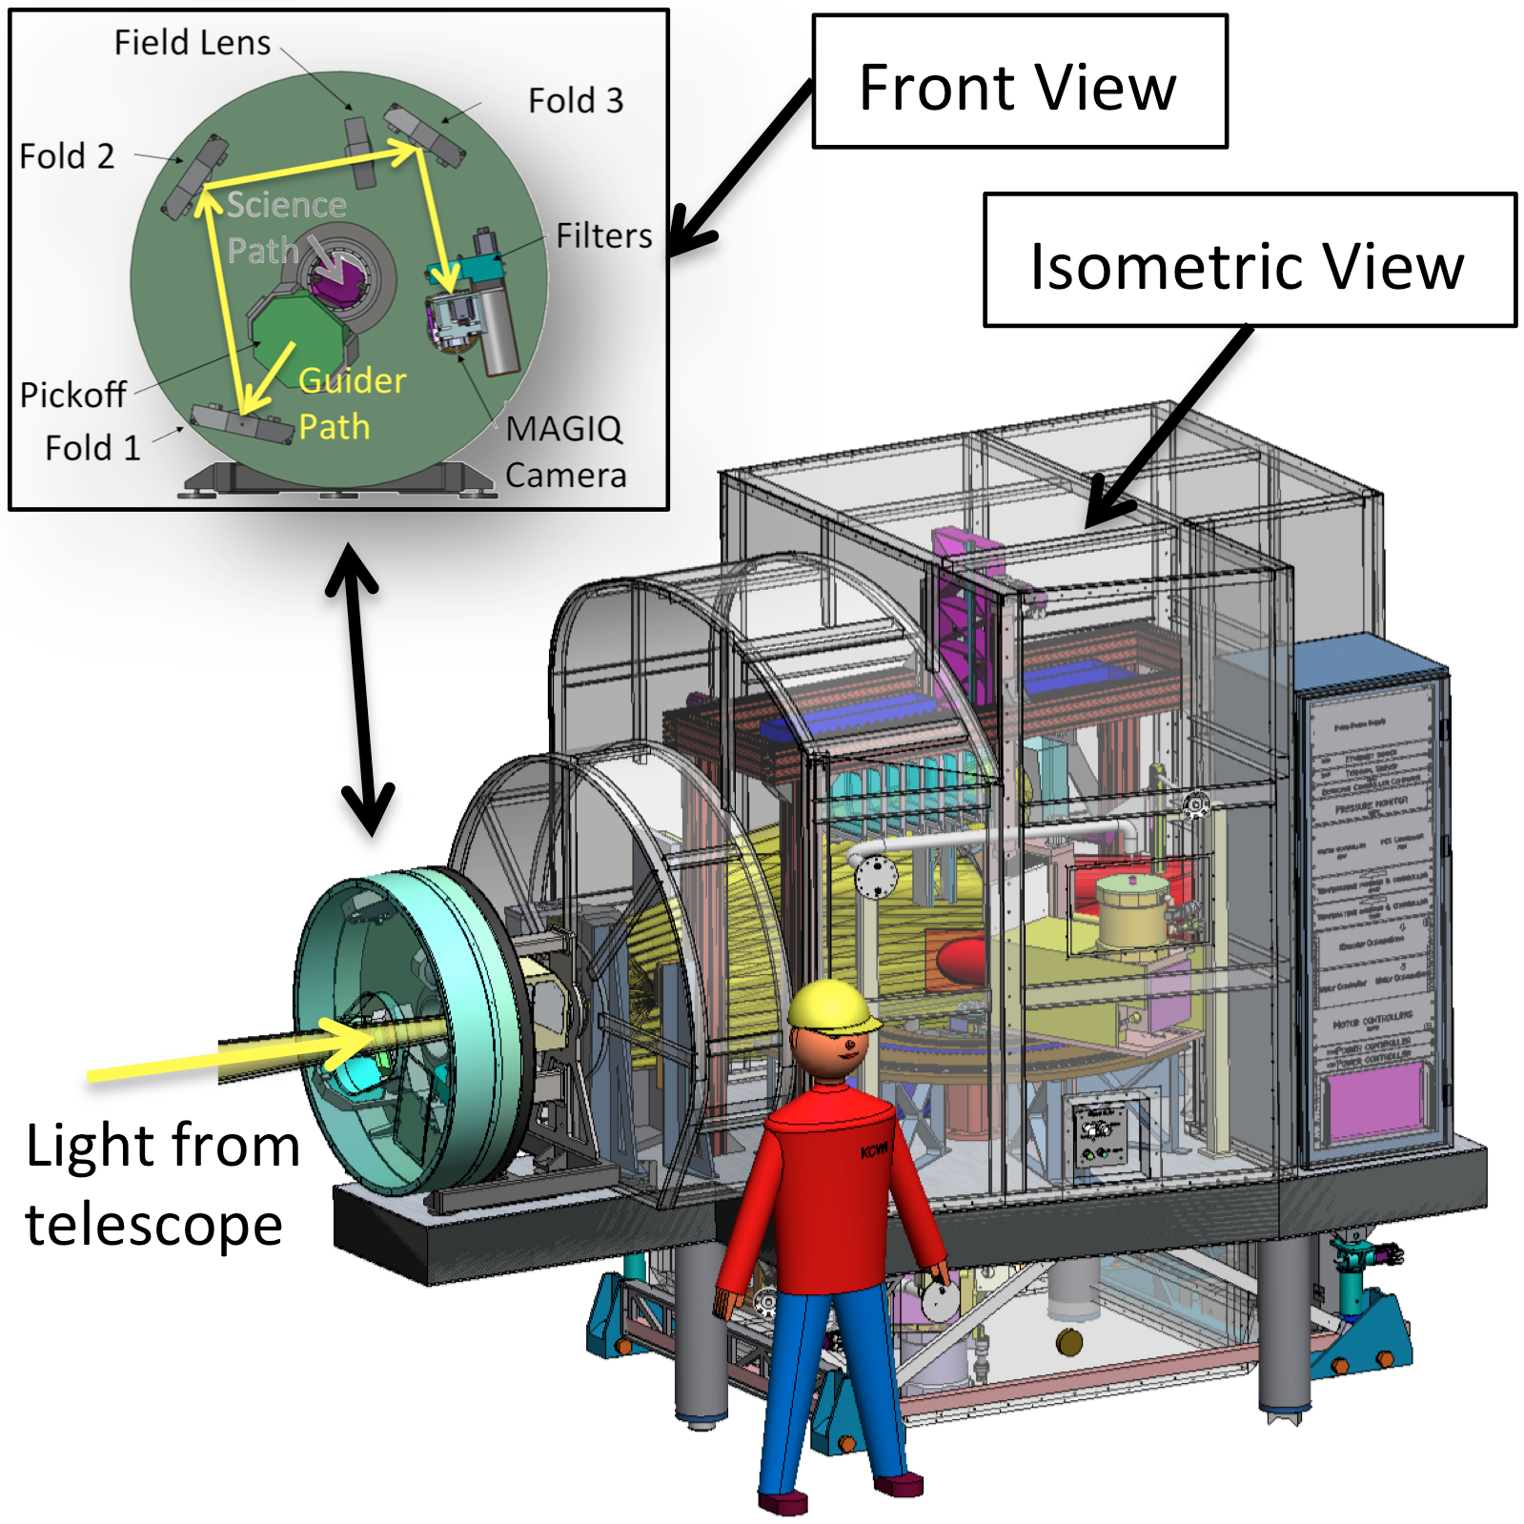
Keck Cosmic Web Imager,KCWI
PI: Chris Martin, CalTech
k
CCD: e2v 4Kx4K
Nod and Shuffle
Notes:
Integral field spectrometer based on an image slicer design
Red and blue channel, Blue channel is being developed first
E2v CCD, ARC electronics

Slide 14
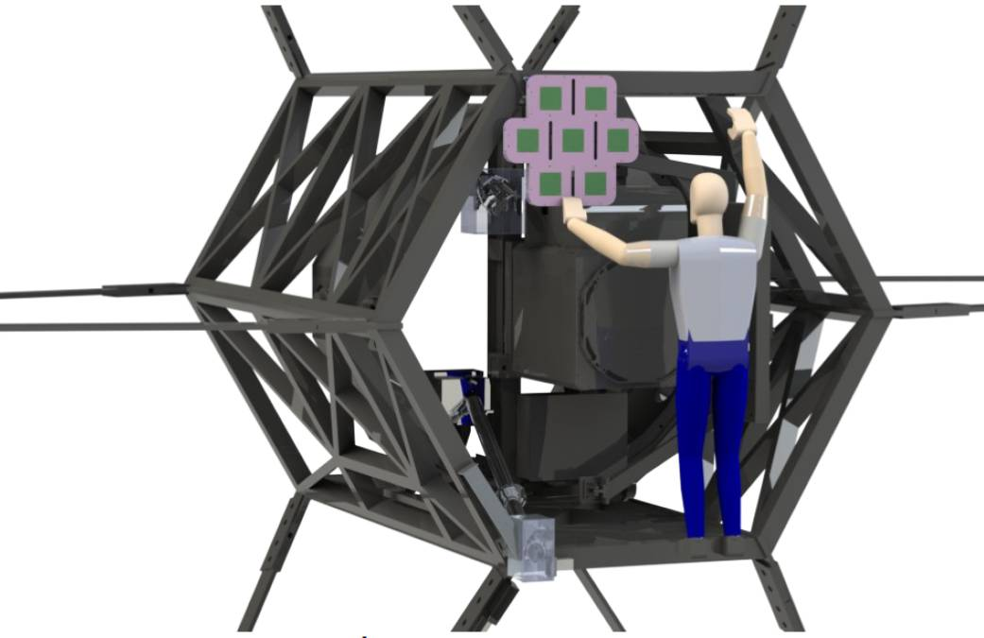
LGS Safety
Transponder Based
Aircraft Detection,
TBAD
Coles and Murphy, UCSD
PASP 2012
TBAD bore sighted on the
Keck II secondary
Shutter laser when the ratio
Narrow Beam Signal
Wide Beam Signal
> threshold
Notes:
The first automated laser safety system approved by the FAA
1090 +/- 3 MHz with a pulse coded response
Operate without spotters on Keck II starting Friday

Slide 15
Thanks

