Slide 1

I’m Fearful !
Big Bang Creationism – What If!
A Creative Engineer Is Not an Oxymoron
Peter Moore & Marco Bonati – Cerro Tololo International Observatory

Slide 2
The engineering role
“An engineer is a professional practitioner of engineering, concerned with applying scientific knowledge, mathematics, and ingenuity to develop solutions for technical problems” – Wikipedia.
i.e. Engineers apply knowledge and use ingenuity to create something useful (technology).

Slide 3
The engineers game plan
Scientific Discovery
Knowledge
Knowledge and Ingenuity
Engineer
Something Useful
Scientist
My ‘Fear’ is that engineers are beginning to loose their ability to apply Ingenuity to their professional activities.
So what is ingenuity and where does come from ?

Slide 4
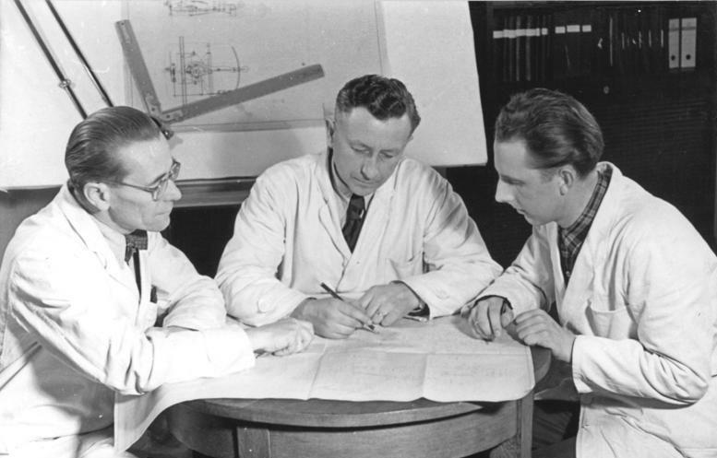
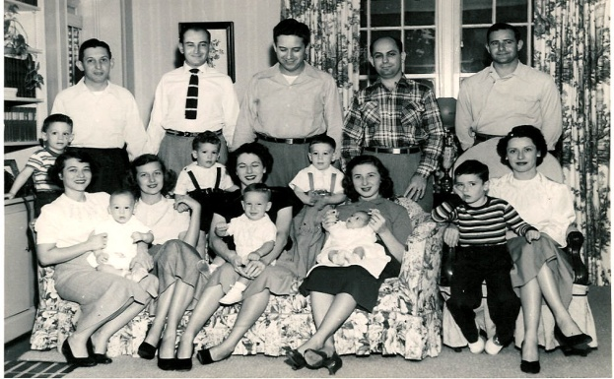
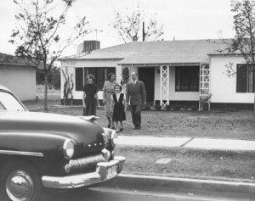


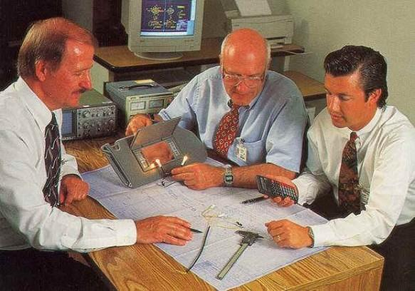



The Engineer at Work
The Engineer at Play
The Engineer at Home
1950
1980
2010

Slide 5

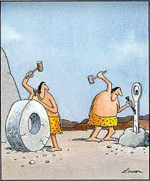
What is Ingenuity ?
“The quality of being cleverly inventive or resourceful; inventiveness” – Dictionary.com
“The power of creative imagination” – Freedictionary.com
Big Bang Creationism
‘Big Bang’ ingenuity model
‘Creationist’ ingenuity model

Slide 6


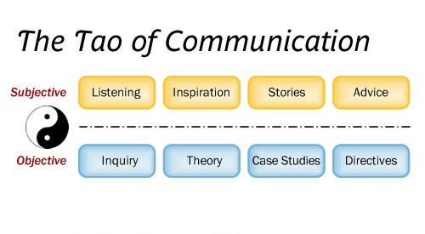
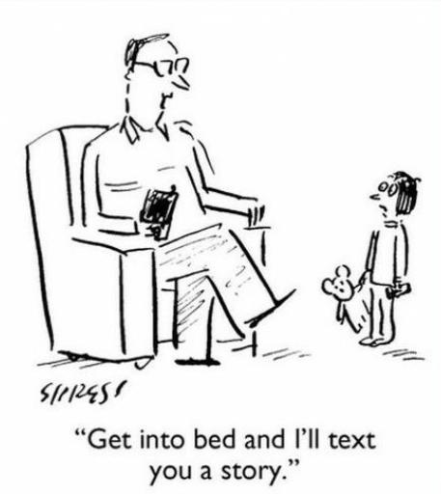
So where does ingenuity come from ?
Communication

Slide 7
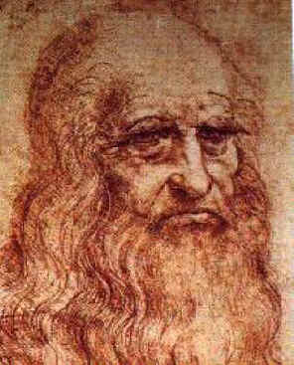

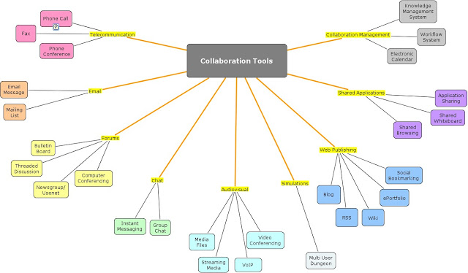


So where does ingenuity come from ?
Collaboration
Clear Focus
Time for Ponderance
Supportive Environment
and Pizza !

Slide 8
Big Bang Creationism
Scientific Discovery
Knowledge and Ingenuity
Engineer
Something Useful
Scientist
Ingenuity cannot be taught – It ‘happens’
How it happens is irrelevant but:
It will not ‘happen’ unless it is fostered
When it does ‘happen’ the result is innovation
i.e. new technology

Slide 9
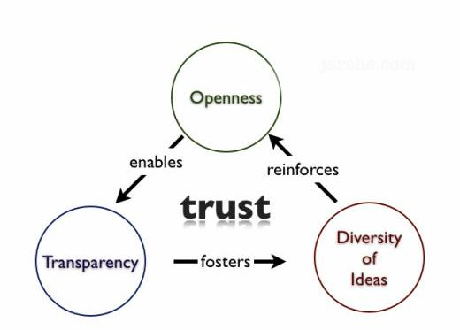
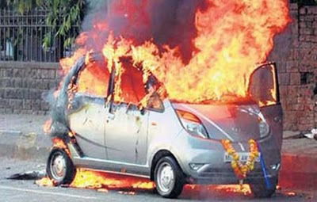
Factors affecting Ingenuity:
Motivate Ingenuity
Demotivate Ingenuity
Interest in problem
Multi-tasking
Knowledge questing
Tight deadlines
Interaction with others
Vertical hierarchies
Time to ponder
Stagnation
Variety in skill set
Insufficient pizza
Trust
Fear of failure
etc.
etc.

Slide 10
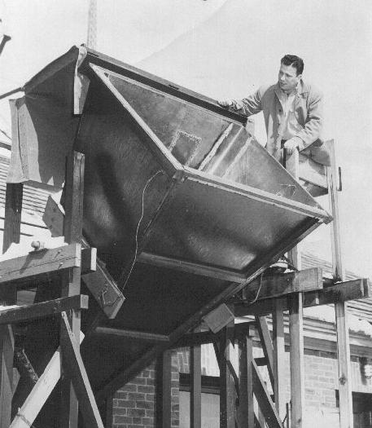
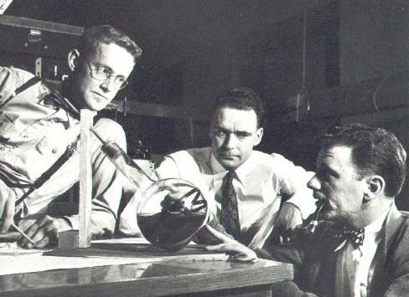
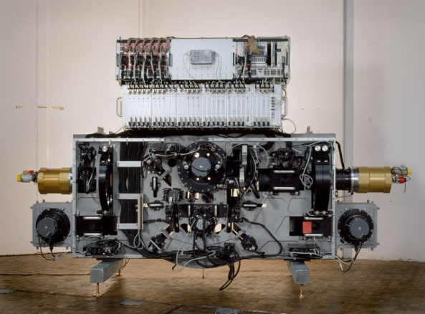
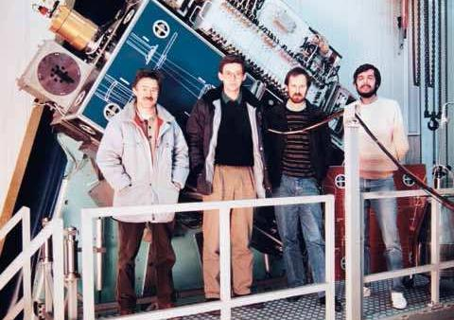
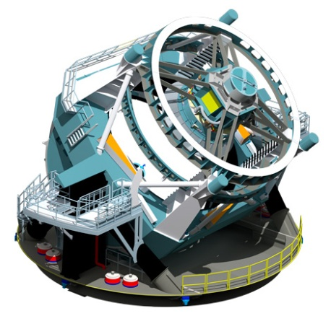
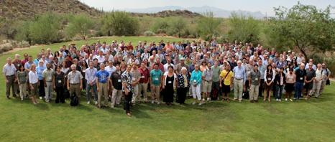
Back to the ‘Fear’:
The Engineer at Work
The Engineering Project
The Engineering Team
1950
1980
2010

Slide 11
Conditions confronting the Engineer of today
Partitioning of responsibility (‘stove piped development’) implying a loss in quality of communication and collaboration – Reducing the opportunity for innovation.
Inability to properly estimate project resources and funding limitations make ‘low risk’ technology the only option at the cost of potentially more appropriate technology – Fear of failure.
Project management requires vertical hierarchies with high administrative overhead and inflexible deadlines – You cannot schedule creativity.
Anonymity – Loss of ‘ownership’ leading to lower personal interest and reducing trust.

Slide 12
Big Bang Creationism – What If!
We ‘nudge’ the engineering paradigm by:
Increase the use of existing communication schemes and create new ways to promote collaboration (Telephone, ccd-world, ‘outside’ visits) – To reduce isolationism.
Allow the opportunity to participate in the early project stages to innovate and assess novel techniques to address the technical challenges - Reduce the risk of failure and create an environment of trust early.
Build in scheduled time for innovation and exploration of novel ideas into the project schedule – And a budget for pizza.
Interest all people involved in what you are doing and look for opportunities to accept novel ideas and commentary as feedback – Allow ownership in the project and allow trust to flourish.

Slide 13

Big Bang Creationism – What If!
Questions ?
Image Credits:
ESO
NRA
LSST Corporation
Mario Vellandi
Leonardo da Vinci
We thank you for your interest! - Peter & Marco

Slide 14
