Slide 1
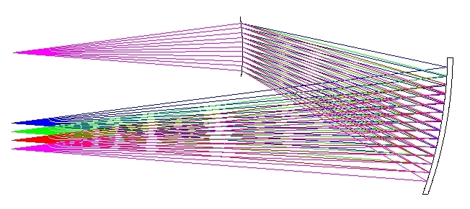
Darragh O’Donoghue
Southern African Large Telescope Foundation (SALT)
&
Chris Clemens
Univ. of North Carolina
The talk will be restricted to optical / NIR
spectroscopy and cover:
  The history of ‘‘spectroscopes’’
  Modern spectrograph technologies
  Spherical optics: Offner spectrometers
  Spherical gratings and spectrometers
  Exemplary instruments
  Costs & future development
The real story is how a grating and a spherical mirror can be used as a spectrometer:
grating
mirror

Slide 2
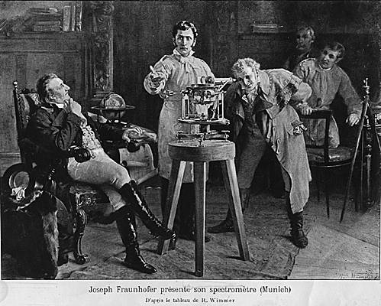
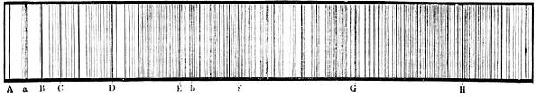
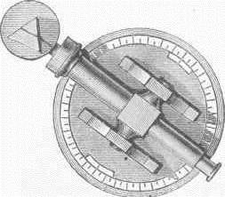
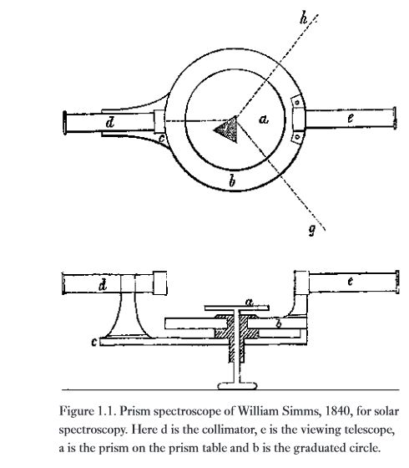
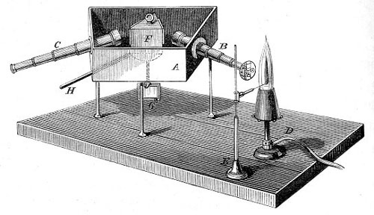
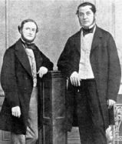
19th Century Spectroscopes
Prism
Joseph von Fraunhofer’s drew the “lines” of the solar spectrum using the spectroscope he invented in 1820
JvF demonstrating his spectroscope
Telescope
  Kirchoff and Bunsen used the spectroscope to gain the first understanding of the physical nature of spectral lines, discovering many elements
  Babinet and Simms introduced the collimator in France (1839) and England (1840) respectively.

Slide 3

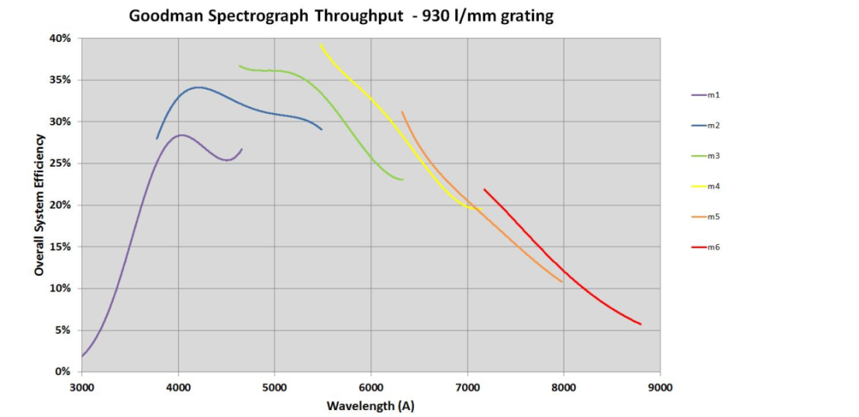
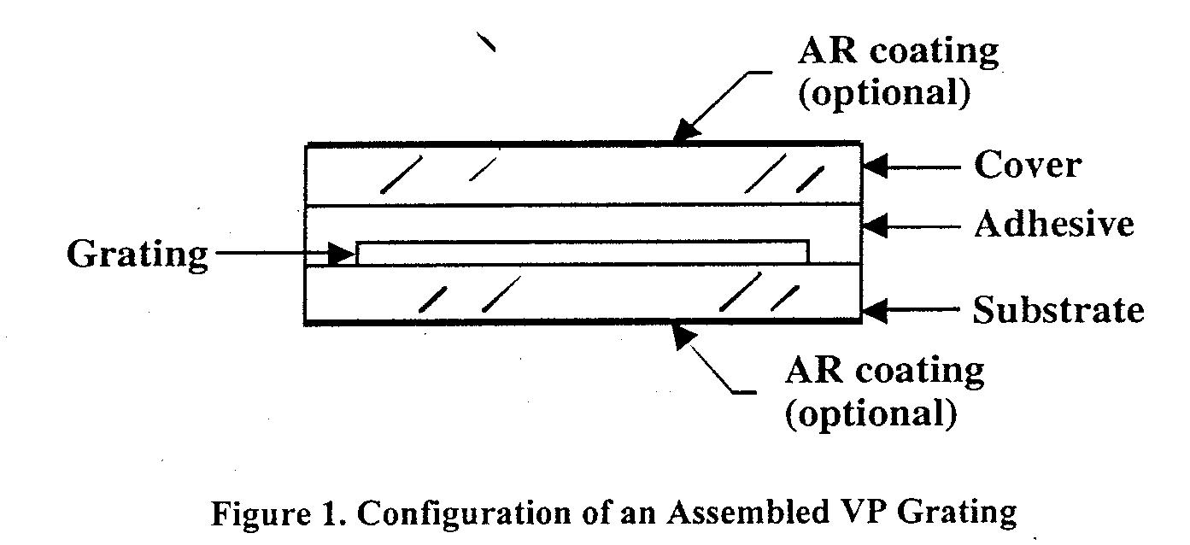
Diffraction Gratings Replace Prisms
  The first (not very useful) diffraction gratings were made by David Rittenhouse in Philadelphia in 1785 and von Fraunhofer in the 1821: they strung hairs/wires between two finely-threaded screws.
  In the late 1800s, Rowland made very accurate engines for ruling gratings on speculum which became the dispersers almost exclusively used for several decades all over the world.
  Holographic gratings were invented in the late 1960s, and are made by etching photoresist with a powerful laser interference pattern; but their efficiency is modest because they are surface relief gratings without a blaze.
  High efficiency Volume Phase Holographic (VPH) gratings, which have refractive index variations “written” by an interferogram, came into astronomy in the 1990s, and have since become the dispersing element of choice.
Overall telescope + instrument efficiency vs wavelength
0 10 20 30 40
(%)
Dichromated
gelatin
300 400 500 600 700 800 (nm)

Slide 4
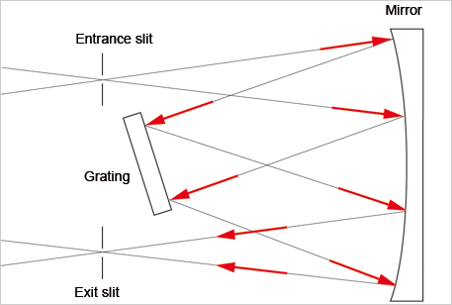
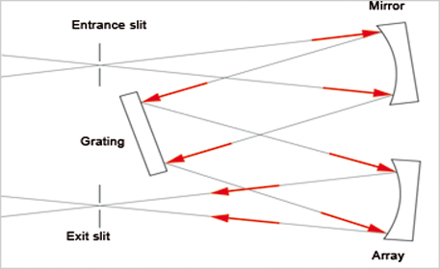
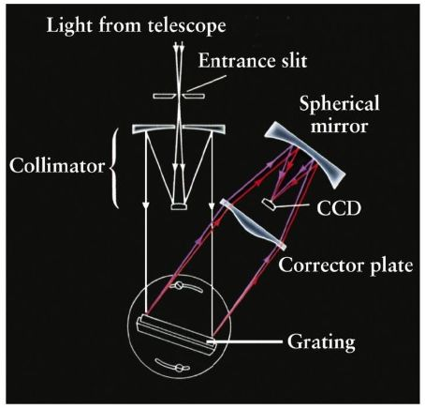
Mirrors in spectrographs
  Until the end of the 19th century, collimators and cameras of spectroscopes were exclusively comprised of lenses.
  Mirrors were introduced by Ebert (1889) & Fastie (1952), and Czerny & Turner (1930): but suffered from poor image quality and field of view.
  With the invention of corrector plates by Schmidt (1931) and Maksutov (1944), astronomical spectrographs adopted catadioptric designs from ~1950.
Catadioptric spectro-graphs from 1950 - ~1980s
Ebert (1889)-Fastie (1952)
Czerny-Turner (1930)
Almost all commercial instruments are of the Czerny-Turner design (but with correction)

Slide 5
Modern Optical / NIR Spectrographs
Modern astronomical spectrographs require high multiplexing, and high efficiency to target very faint objects. Technology has been pushed to the limits:
Mirrors have gone out of favour owing to obscuration in the beam by
the detector; lenses have made a comeback. But there has been a price:
Many lens elements are required (10-20) which are often large & heavy:
up to 600 mm in diameter: costly and optomechanically challenging.
Almost all designs include one or more CaF2 / FK51 elements:
    CaF2 has wonderful dispersion properties but it is expensive, and
    mechanically and thermally fragile
To meet alignment tolerances of ~25 micron, optomechanics are hard.
Expensive anti-reflection coatings are required.
As telescope size increases, so does the spectrograph: a 10 m
telescope may typically have a low/med res spectrograph of ~2 metre
in linear dimension. ELTs are facing a x3 further increase.

Slide 6
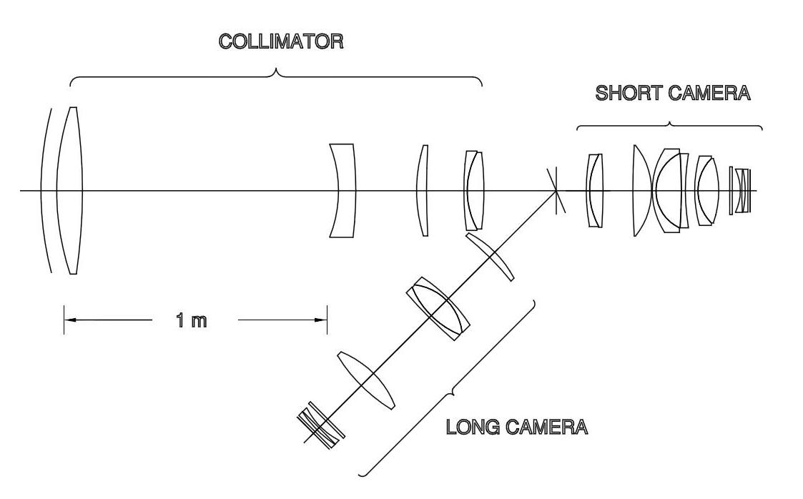
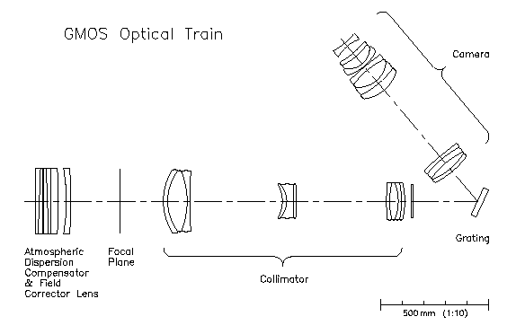
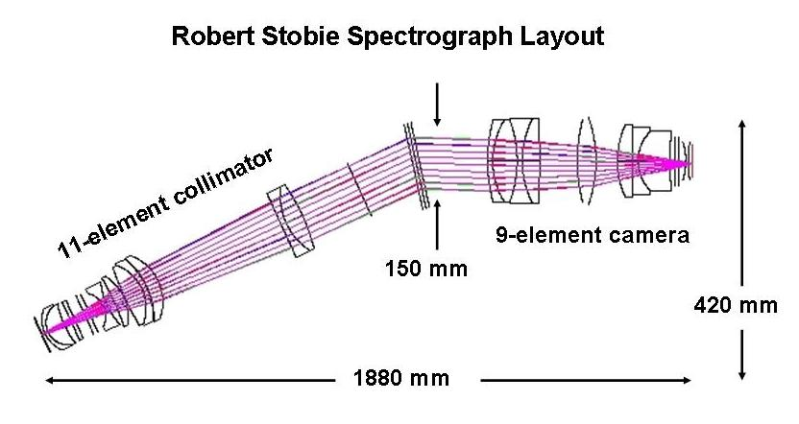
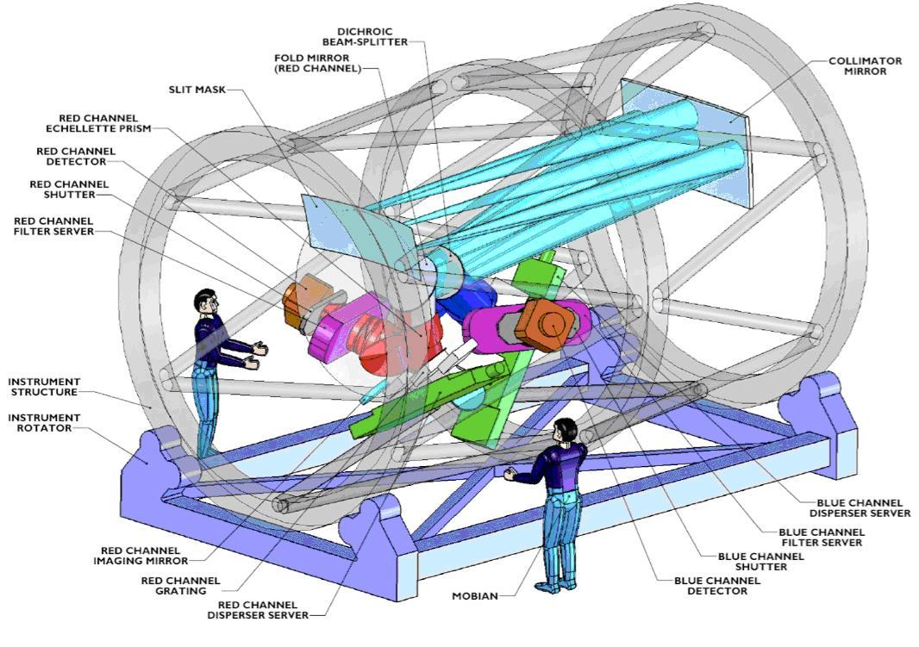
IMACS on Magellan
GMOS on Gemini
600 mm
1 m
1 m
MOBIE on TMT
RSS on SALT
1.8 m
½ the lenses are CaF2

Slide 7
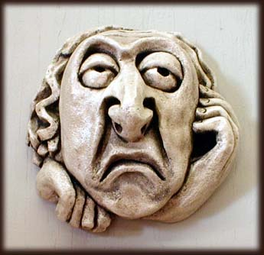
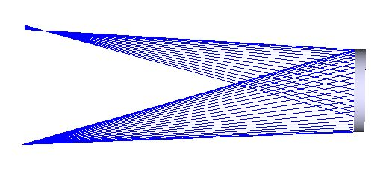
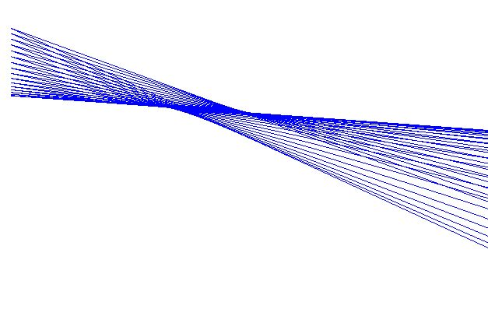
Is There An Easier Way?
Revisiting mirrors:
  A major problem is self-obscuration – the detector
  sitting in the beam
    Solution: use mirrors off-axis
  Mirrors have 4 x the focusing power of lenses, so usually only 1 needed
    Focal length (mirror) = R / 2; focal length (plano-convex lens) ~ 2 R
  Mirror optical designs are usually very compact (they are folded)
Off-axis mirror usage - what is the problem? Answer – huge astigmatism
Image
1 mm
(not 2 CCD pix
= 30 microns)
Point source
30 mm off axis
50 mm, F/4
spherical mirror

Slide 8
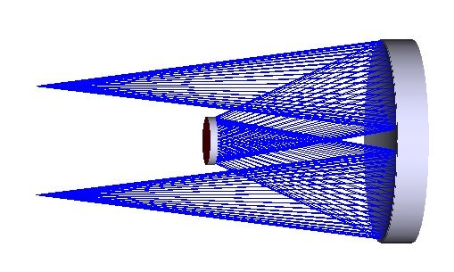
Enter The Dyson and Offner 1-to-1 Relays
Offner relay
Identical spherical 3rd mirror,
radius R
Image
Invented in 1973
by A. Offner for lithography
Convex 2nd
mirror, radius R/2
Concave spherical
1st mirror
radius R
Object
EXCELLENT image quality: corrected for all 5 primary optical aberrations:
The astigmatism from the first reflection is balanced by equal and opposite astigmatism from the third as well as …
… field curvature balanced. True only if Petzval sum is 0:
∑ 1 / R_{i} = 0 , R_{i} is the radius of the i-th mirror
Offner: (1 / R) - (2 / R) + (1 / R) = 0
1st mirror 2nd mirror 3rd mirror

Slide 9
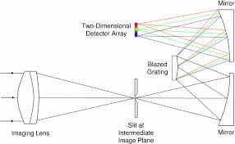
Offner Spectrometers:
Replacing the convex secondary in an Offner relay by a convex grating was suggested by Thevenon, as reported by Mertz (1977), thereby producing an imaging spectrometer using a curved disperser.
The light impacting the grating is not collimated, spherical mirrors provide the focusing power in an excellent imaging design, and their off-axis deployment means no obscuration.
Spectrum on detector
Tertiary mirror
Convex
grating
Primary mirror
Telescope
EntranceSlit

Slide 10
Collimated and Spherical Wavefronts
Imagers and Spectrometers
  Since Fraunhofer, Babinet, Simms, Kirchoff and Bunsen, spectrometers have used flat dispersers (prisms and gratings), requiring collimators and cameras to turn spherical wavefronts from point sources (or slits) into flat wavefronts and back again.
  Offner optics based solely on spherical wavefronts. They are simple, compact (no collimator needed; folded), and have excellent image quality.
  Offner spectrometers have almost exclusively been used on space platforms:
    Earth observation satellites (from JPL): Mouroulis and collaborators
    Solar system missions (e.g. Cassini)
    Astronomy satellites (e.g. Gaia)
  The ‘fly in the ointment’ is: spherical dispersers are required.
  Convex gratings are hard to make and expensive
  (Rowland produced concave mirror gratings, not used in astronomy
  because of the limited field of view and efficiency)

Slide 11
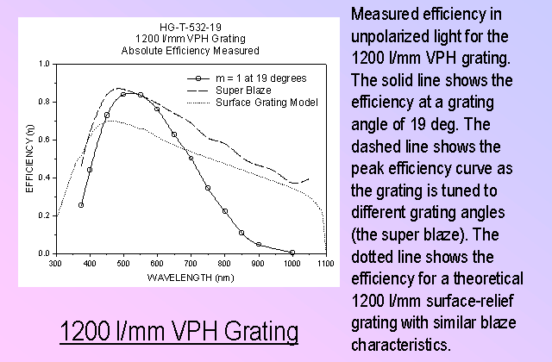
Needed:
An inexpensive, efficient convex grating
As mentioned, VPH gratings are the dispersers of choice for optical/NIR instruments because
of their remarkable efficiency
(w.r.t. surface relief gratings).
My co-author, Chris Clemens, is one of only ~3 commercial suppliers of astronomical VPH gratings in the world.
In 2012 February, Chris succeeded in making a prototype spherical VPH grating for use in a spectro-
meter I designed, and which we call the Half Offner.
Super blaze curve
Traditional
surface relief

Slide 12
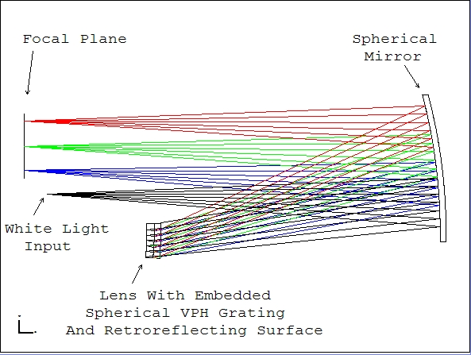
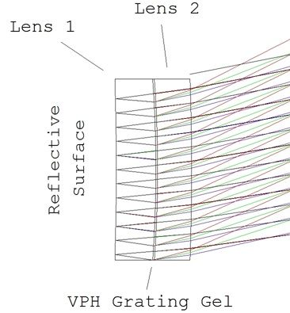
The first “Half Offner”-type spectrograph
design using VPH gratings
The grating is used in double pass: on the first pass, the light is undiffr-acted (i.e. in zero order)
After reflection off the rear surface, it is diffracted efficiently in first order
Lens 2
Lens 1
Reflective rear surface
VPH grating: dichromated gelatin

Slide 13
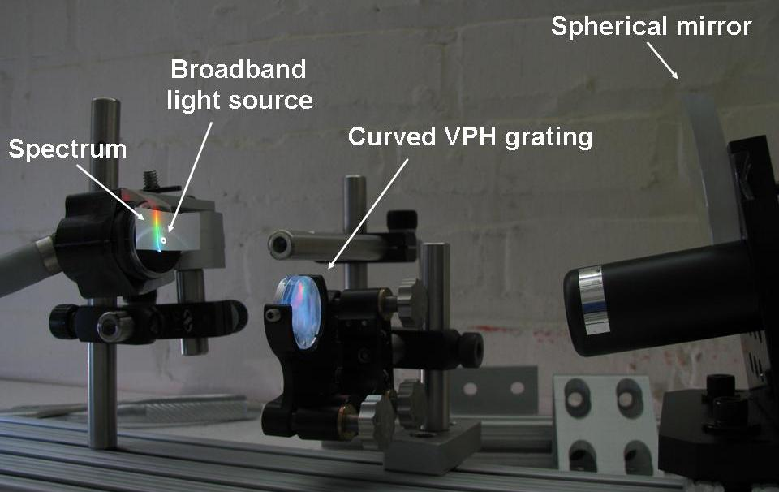
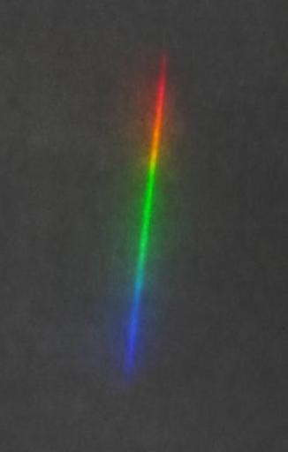
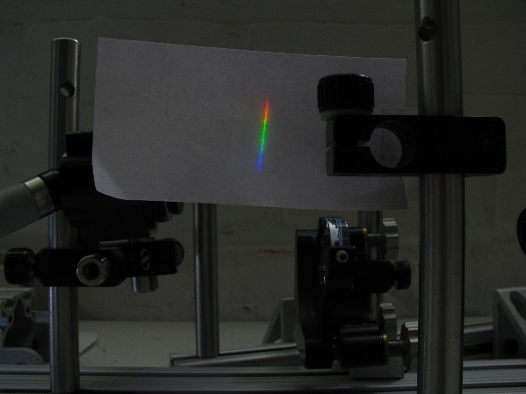
Proof Of Concept Prototype: 2012 May-June
Design, procurement, commission and testing in 6 wks
1 x off-the-shelf spherical mirror, 50 mm in diameter, from Optosigma
2 x off-the-shelf meniscus lenses from JML Optical …
… turned into a curved VPH grating in Chris’ lab
Some optical bench fixturing
We only got eyeball estimates of performance (due to time limits): looked
good..BUT measurements still needed
20
mm
Layout of the mini prototype
Resulting spectrum

Slide 14
A new vista in spectrometer design has opened
    Design space is largely unexplored. Here are the spherical grating
    spectrometers of which I am aware:
      Offner spectrometers
      Dyson spectrometers
      Headwall spectrometer. Unknown to us at the time we designed
      and built the “toy” Half Offner, Headwall Photonics have a patent
      on a design very similar to the Half Offner, but with a surface
      relief convex grating (only information is in the patent)
    An entirely new and even simpler design arises from the
    realization that the astigmatism of a spherical mirror, used off-axis,
    is perfectly balanced by the astigmatism of a spherical grating. The:
    Spherical Transmission Grating Spectrometer

Slide 15
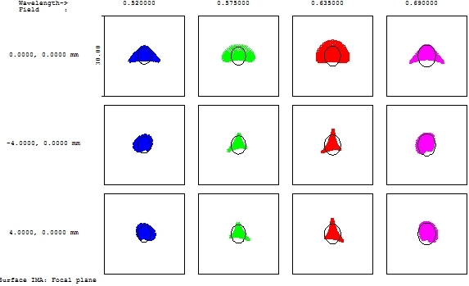
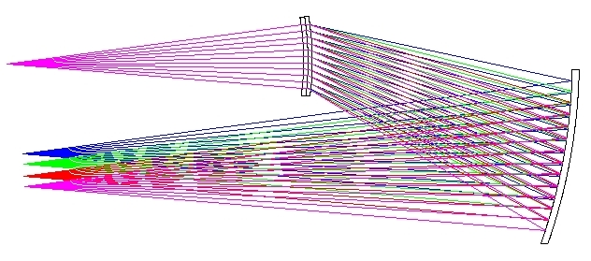
STGS-type spectrometers
‘Ideal’ spherical transmission grating
Entrance
slit
Diffraction-limited
image quality: almost
all light inside Airy disc
Focal
plane
5200-6900 A
R ~ 1000
A real system: a spherical
VPH transmission grating:
Spherical
mirror
30 micron boxes: 2 CCD pixels
A replacement for the
Czerny-Turner design?
Teaching instruments?
500 mm

Slide 16
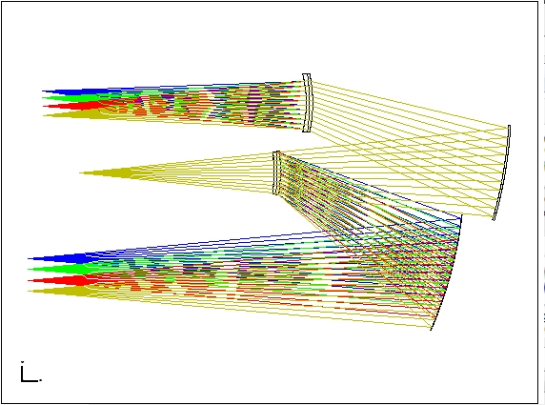
STGS-type double beam spectrometer
Undiffracted in first order by passage through G1
Red arm: 6350-8400 A
G2
“Reverse” STGS
Entrance
slit
G1
M2
“Forward” STGS
Diffracted in
first order by G1
Blue arm: 5200-6900 A
M1
Light not diffracted in first order by G1 (via M1) passes to G2 (via M2)
No dichroic break, maximum efficiency at overlapping wavelengths

Slide 17
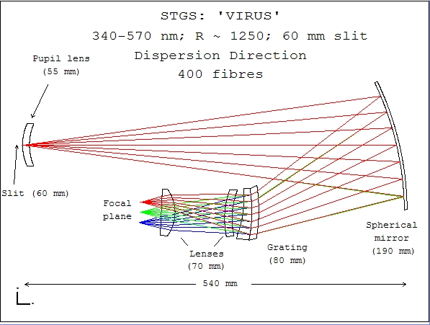
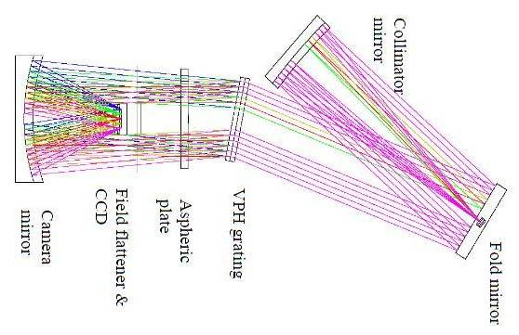
Real instruments 1: STGS spectrometer: VIRUS-like
Spherical
camera
mirror
Aspheric
corrector
Spherical
collimator
mirror
Field-
flattening
lens and CCD
(in beam)
VPH
grating
Slit
Fold
mirror
& field
lens
STGS
** Unobscured **
Smaller optics
1 spherical mirror
3 small spherical lenses
40 micron spatial resolution
both have:
3400 – 5700 Ang
Resolution 700 - 1200
60 mm slit
HET Virus
** Obscured (detector in beam) **
3 mirrors (spherical or flat)
1 large and 1 small aspheric lenses
1 small spherical lens
80 micron spatial resolution
1 on McD 107-in, ~150 soon on HET

Slide 18
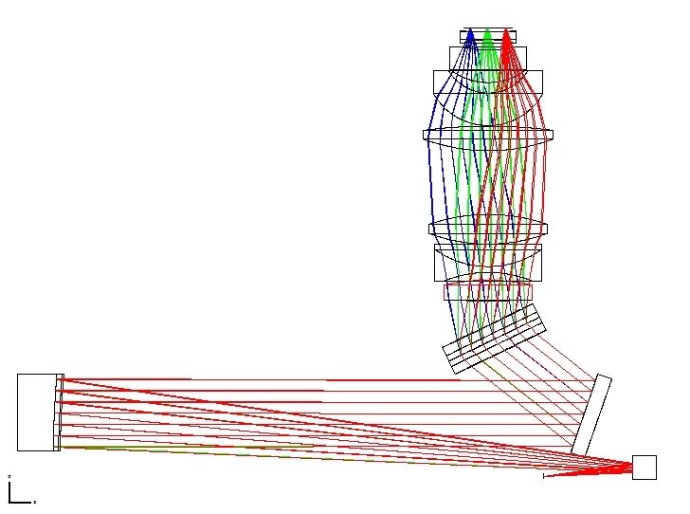
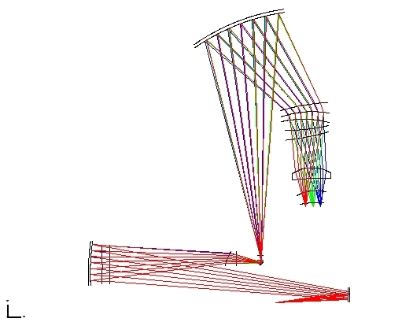
Real instruments 2: As a X-disperser and camera in an echelle spectrometer
Spherical
mirror
(200 mm)
9-element refractive camera with 3 x CaF2 lenses
(150-200
mm)
90 mm
VPH
grating
SALT
HRS
STGS-
type
3-element refractive camera
(80 mm
lenses)
Pupil
re-imaging mirror
170 mm
VPH
grating
Slit re-imaging
Fold
mirror
From echelle
Dichroic
From echelle
Dichroic
STGS X-disperser & camera
Unobscured
Smaller and robust optics:
all fused silica or BK7
80 x 120 mm VPH grating
1 spherical mirror (200x280 mm)
4 spherical lenses (80 mm)
SALT HRS Blue
9-element refractive camera
3 large CaF2 lenses, 150-
200 mm in diameter
170 mm VPH grating
Both systems are fed by the same fibres and echelle grating. Resolution is 64000.

Slide 19
Cost Of Low Resolution VIRUS-like STGS Hardware
Optics:
  180 mm spherical mirror $ 4000
  70 mm curved VPH grating (recurring cost) $ 7000
  3 x 80 mm BK7 or fused Si field lenses $ 9000
  Optics coatings $ 3000
  Integral field unit $ 8000
Mechanics: $ 2000
Electronics & software: $ 5000
Detector & software:
  1 x 25 mm EMCCD: $ 37000
$ 75000
This is the cost for a 1-off – should be much cheaper for many.

Slide 20
Future Developments:
50 mm grating manufacture and lab testing to verify expected efficiency and image quality
Coupling to IFU into a prototype instrument for SALT :
  R ~ 1000 spectrograph
  380 – 760 nm
  Point sources: transients; SNe follow-up
4.5” on sky on SALT
F/~4 pseudo-slit:
19 x 100 micron fibers
(+ 40 mu
cladding)
= 2.7 mm
19 hexagonal lenslets
with pitch of 200 mu
coupled to 19 x 100
micron optical fibres
re-arranged to

Slide 21
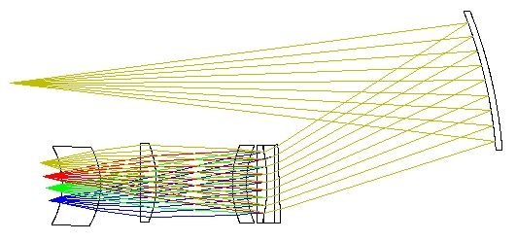
Prototype Instrument:
R ~ 1000
IFU coupled
380 – 760 nm
Point source spectroscopy
314 mm
Entrance slit: 10 mm long IFU fed at F/4
90 mm
Dispersed focal plane
at F/2
Grating
All lenses are BK7
Almost all optics are COTS from CVI Melles-Griot or Edmunds Optics.
50 mm

Slide 22
Summary and Conclusions
Spherical grating spectrographs are a compelling alternative to those using planar wavefronts and dispersers. They are:
  Very simple
  Compact, *very compact* if IFU-fed (eases optomechanics)
  Very inexpensive ( 1 x 19-fibre IFU instrument ~ $100k )
  Mirrors provide most of the power but they are not obscured
  Minimal number of optical components … so … efficient
  Can be fed by traditional longslit (more compact with an IFU)
  Apart from the optical astronomy, potential usage in:
    The infrared (put the whole thing in the fridge)
    The far UV (only 1 reflection) (but not a VPH grating, of course)
    Hyperspectral imagers for Earth resources or astronomy (very compact) (from satellites or planes)
    Laboratory spectrometers (simple and compact )
Plans are advanced for a proof-of-concept R ~ 1000 instrument with 1 IFU to be tried initially on the SAAO 74” telescope and then on SALT.

