Slide 1


Multi-Object Spectroscopy with deployable IFUs
− a new era in Astronomy enabled by detector technologies
Martin M. Roth ¹⁾
Sebastian Kamann ¹⁾, Lutz Wisotzki ¹⁾
Sebastian Sanchez & CALIFA collaboration
¹⁾Leibniz-Institut für Astrophysik Potsdam (AIP)
Universität Potsdam
1

Slide 2
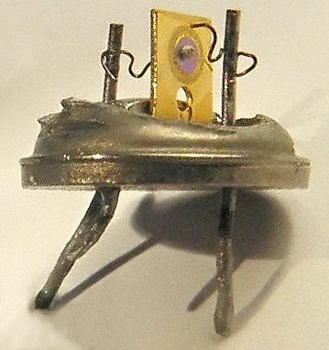
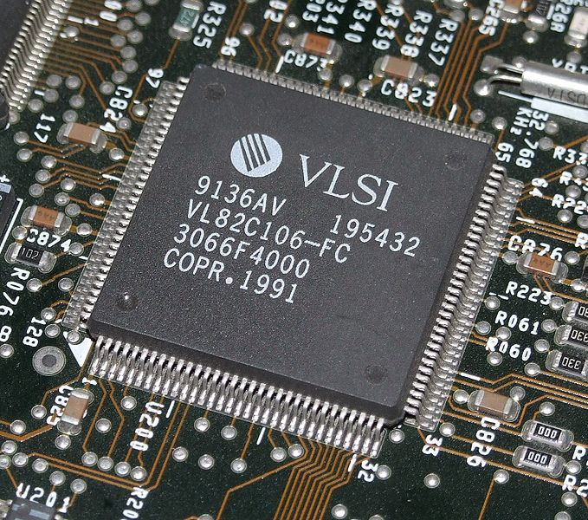
Prologue…
anonymous 1960s
VLSI 2009
Notes:
Integration density [in no. of transistors, or logic gates] VLSI: 10.000 – 100.000 transistors // ULSI: 100.000 -1 million transistors // GLSI: > 100 million

Slide 3
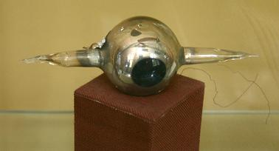
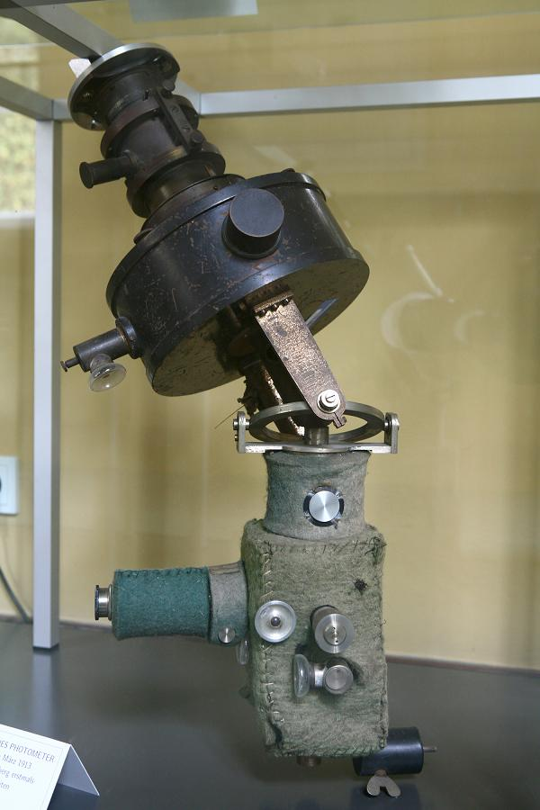
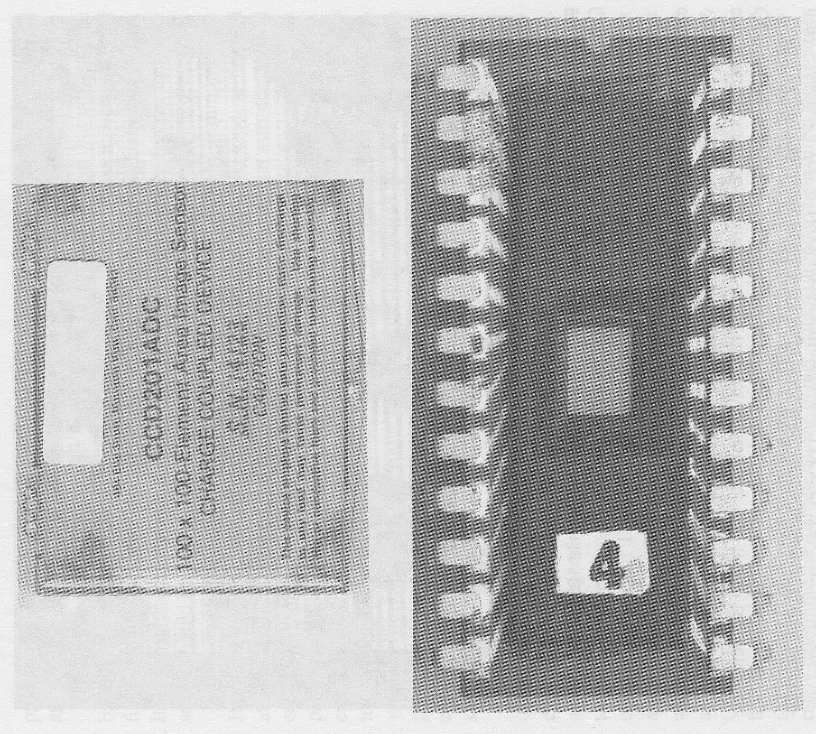
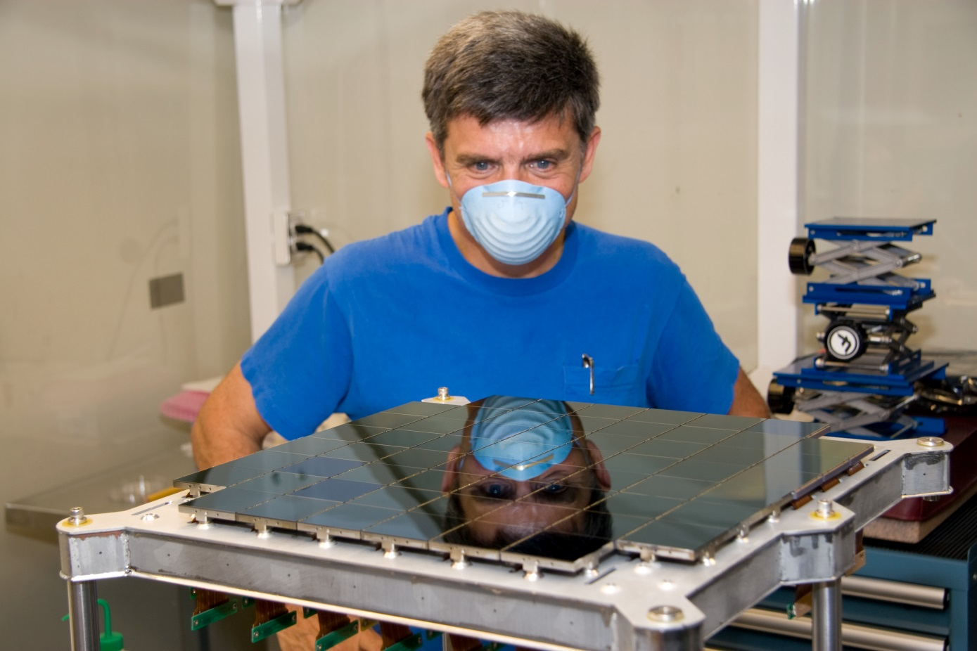
Potsdam 1913
Pan-STARRS
2007
JPL 1974
Notes:
1 pixel photo-electric detector from 1913, from Babelsberg Observatory in Potsdam
multiplex factor of 10.000: 100x100 pixel 1st generation CCD from Fairchild
with another multiplex factor of 14 million: PanSTARRS orthogonal transfer CCD mosaic, 1.4 Gpixel

Slide 4
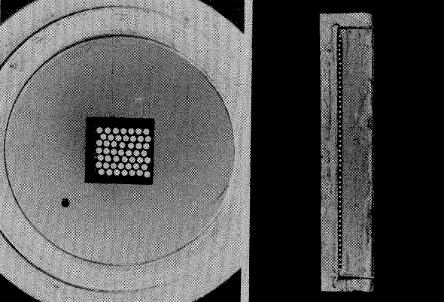
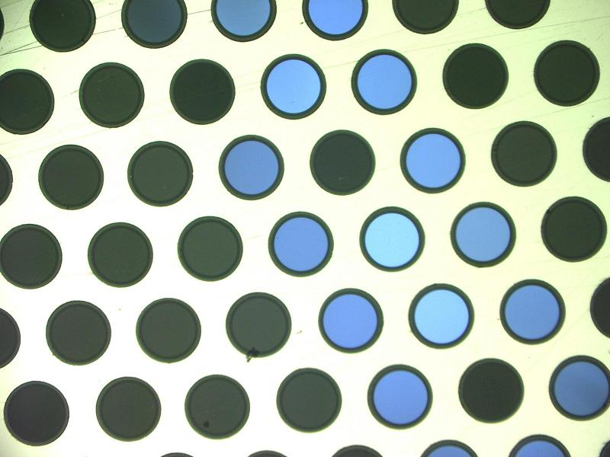
DensePak 1988
VIRUS 2012
Notes:
DENSEPak: 49 fibers // VIRUS: 246 fibers, up to 140 spectrographs → 34.000 fibers in total

Slide 5
Overview:
Multiplex Advantage
Multi-Object Photometry
Multi-Object Spectroscopy
Fusion: Multi-Object Photometry + Spectroscopy
Integral Field Spectroscopy
Multi-Object Integral Field Spectroscopy
Outlook

Slide 6
1. Multiplex Advantage

Slide 7
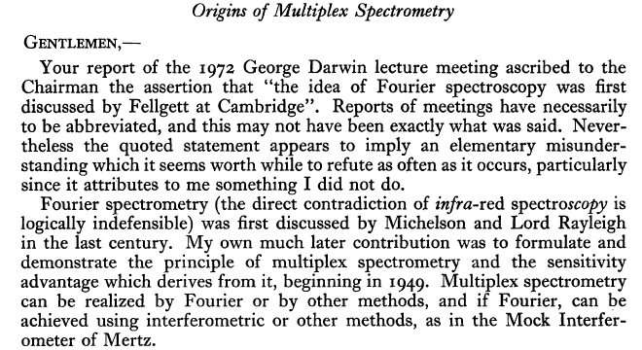
Peter Fellgett, 11.4.1922 − 15.11.2008
SN_{mux} = N^{1/2} x SN_{scan}
The Observatory, Vol. 93, p. 210-211 (1973)

Slide 8
2. Multi-Object Photometry

Slide 9
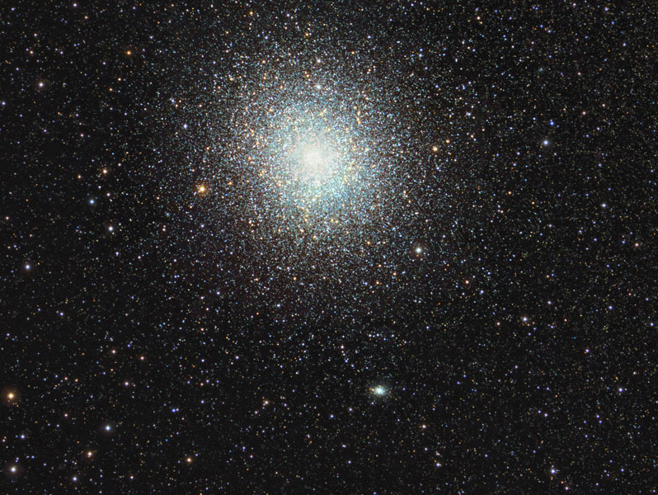

Slide 10
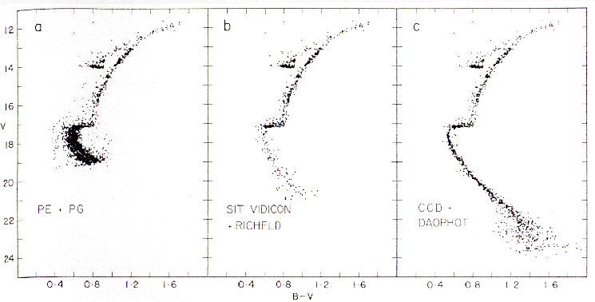
1977
1987
Hesser et al. 1987

Slide 11
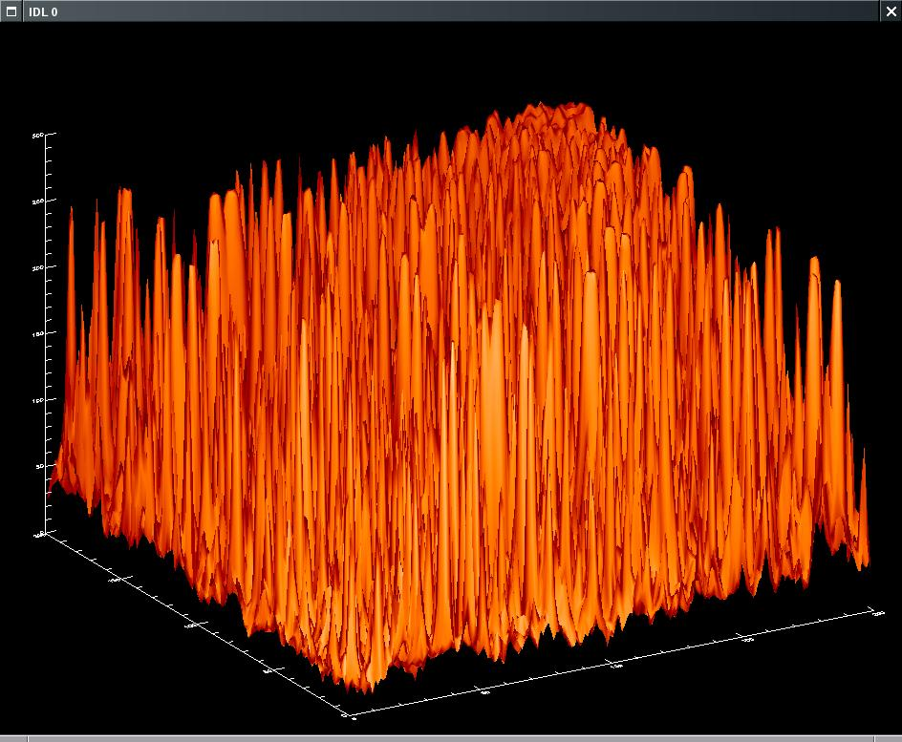
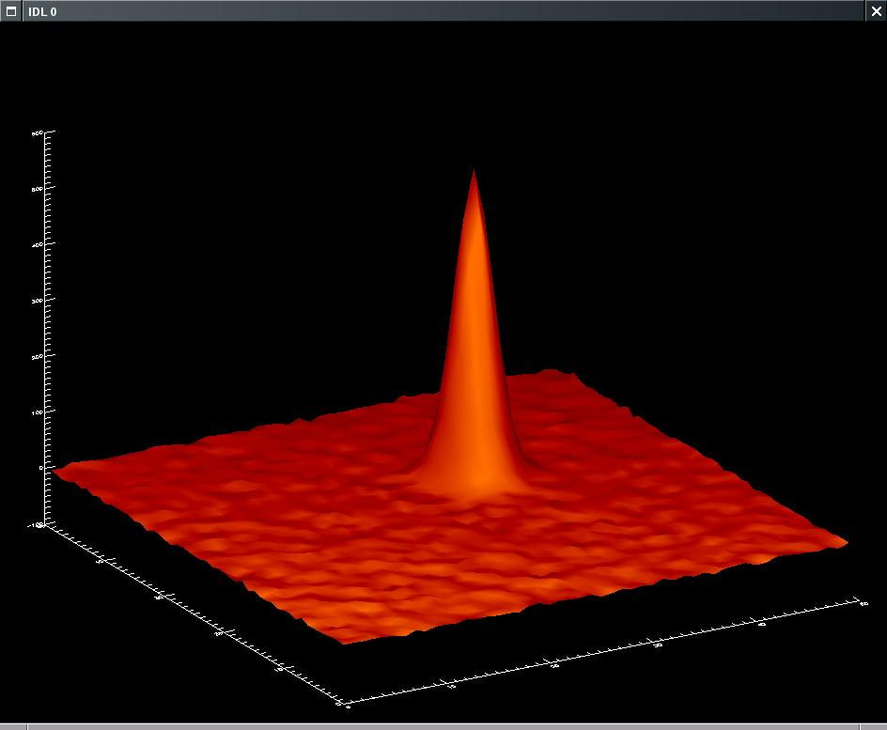

Slide 12
3468 citations (ADS as of Oct 5, 2013)

Slide 13
3. Multi-Object Spectroscopy

Slide 14
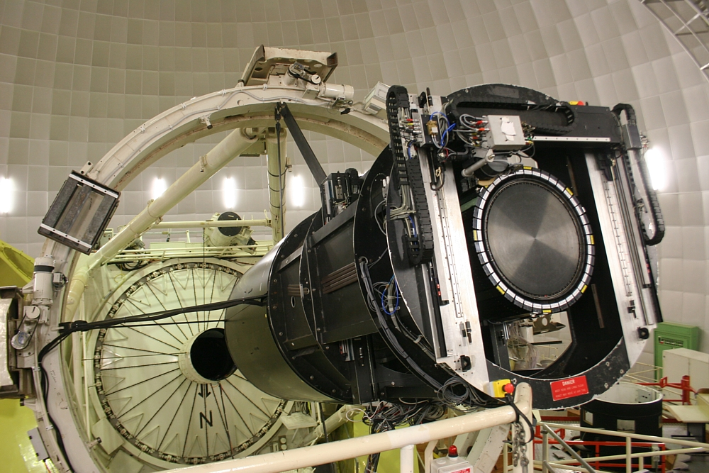
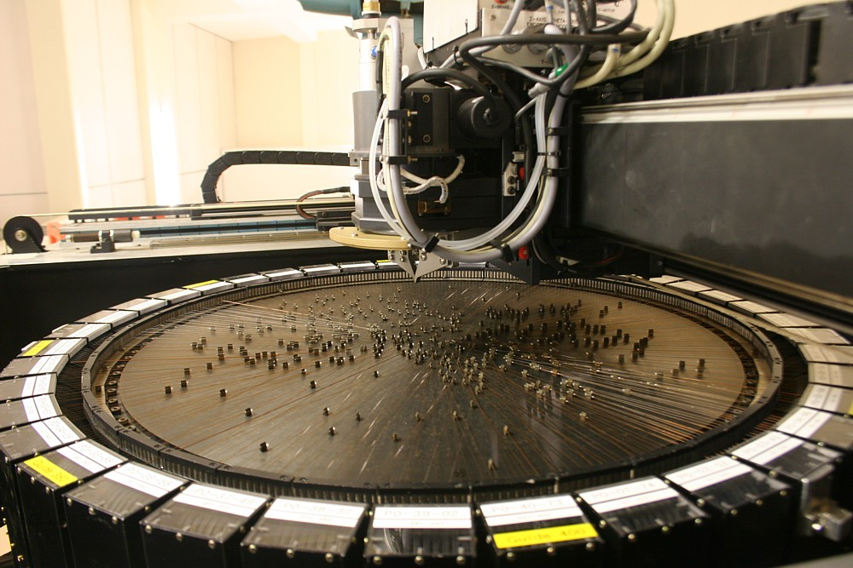

Slide 15
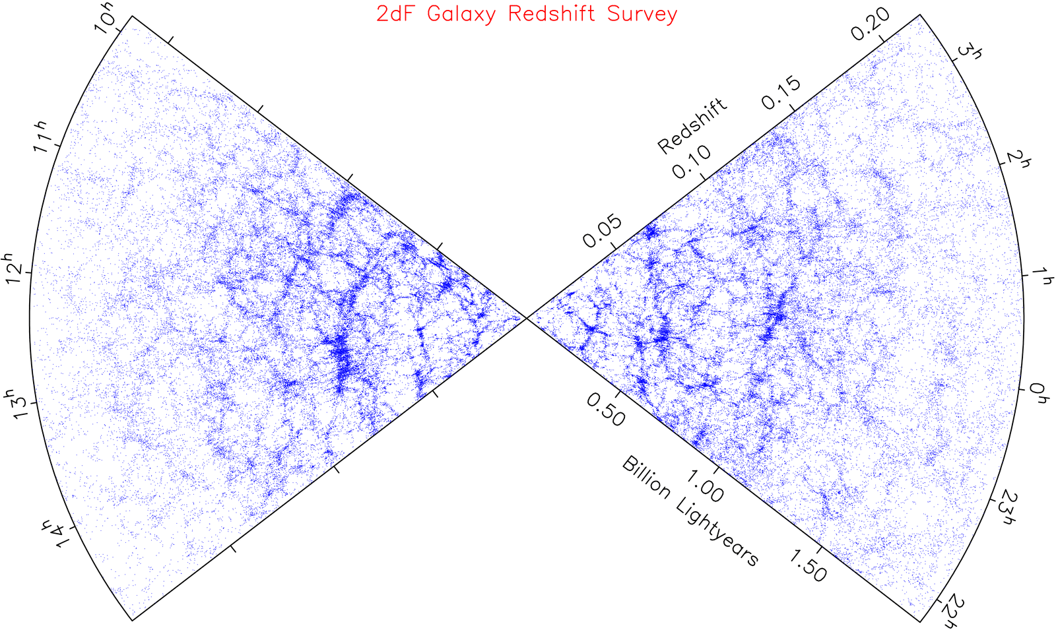

Slide 16
4. Fusion:
Multi-Object Photometry + Spectroscopy

Slide 17
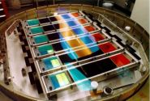
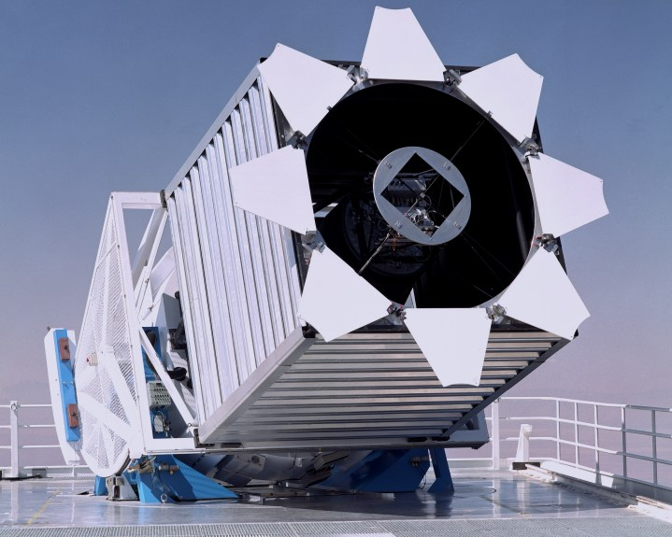
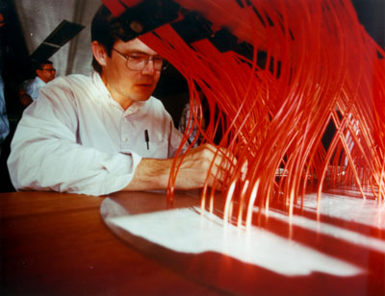
SLOAN Digital Sky Survey
2.5m SDSS Telescope
Apache Point Observatory

Slide 18
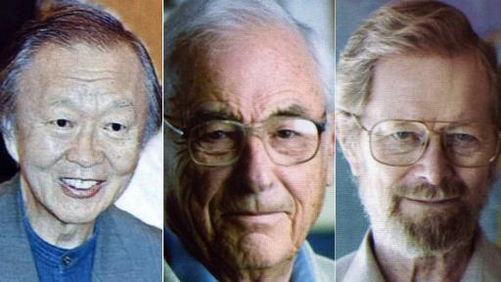
Physics Nobel Price 2009:
→ Fibre Optics
→ CCD Detector
Charls Kao Willard S. Boyle George Smith

Slide 19
SLOAN Digital Sky Survey
Combined imaging and spectroscopic survey:
SDSS-I: 2000-2005
SDSS-II: 2005-2008 → DR7
SDSS-III: 2008-2014 → DR8, DR9, DR10
Deep images in 5 filter bands: → DR8: largest optical survey dataset
u′, g′, r′, i′, z′ • images for >500 million stars and galaxies
359/481/623/764/906 nm ²⁾ • spectra for ~2 million objects
• 8000 square degrees survey area
Telescope and instrumentation (York et al. 2000):
2.5m telescope, f/5, 3^{O} FoV, 0.5m auxiliar telescope (photometric calibration)
120 MPixel CCD camera, FoV 1.5 deg²
2 fiber-coupled spectrographs > 600 spectra per exposure
Public acces to SDSS data:
http://skyserver.sdss3.org/dr8/en/tools/chart/navi.asp

Slide 20
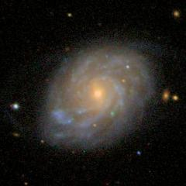
NGC2253
SDSS fiber
Notes:
NGC2253, d=56 Mpc

Slide 21
5. Integral Field Spectroscopy,
„3D“ Spectroscopy

Slide 22
Integral Field Spectroscopy −
two (complementary) benefits:
    high spatial resolution
    large FoV

Slide 23
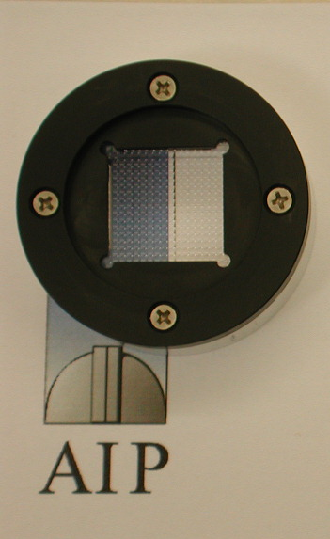
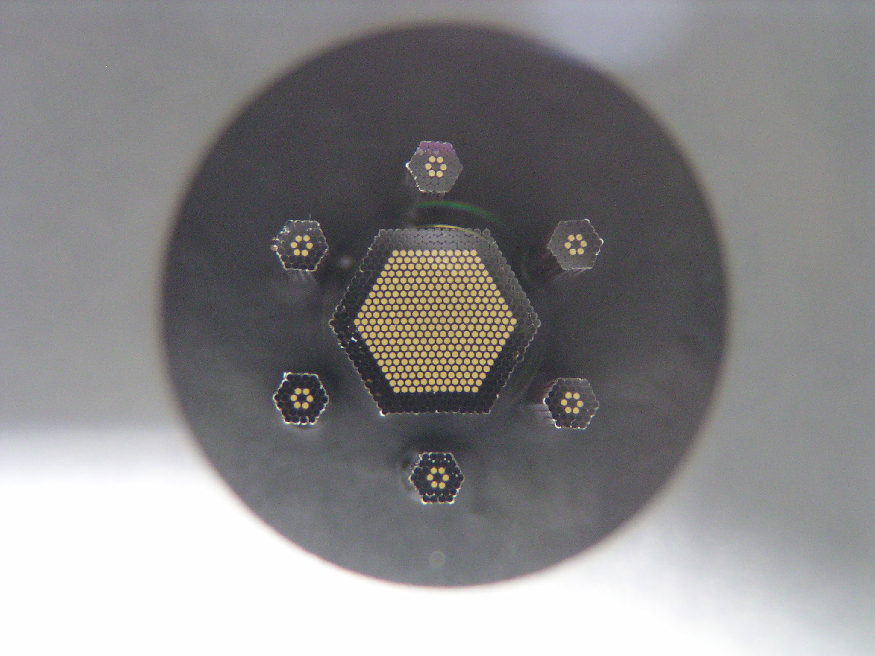
PMAS at Calar Alto 3.5m
LARR IFU
PPak IFU
8 arcsec
74 arcsec

Slide 24
Example 1:
    high spatial resolution:
    crowded-field 3D spectroscopy

Slide 25
PMAS at the Calar Alto 3.5m Telescope
M3
Sebastian Kamann
AIP thesis (2013)

Slide 26
PMAS at the Calar Alto 3.5m Telescope
M3
Sebastian Kamann
AIP thesis (2013)
Notes:
14 stars deblended near center of M3

Slide 27
50 vrad + 161
from literature
17 excl.
77 vrad + 308,
23 excl.
80 vrad + 256
from literature
40 excl.
First results from PMAS observations,
thesis Sebastian Kamann (2013)

Slide 28
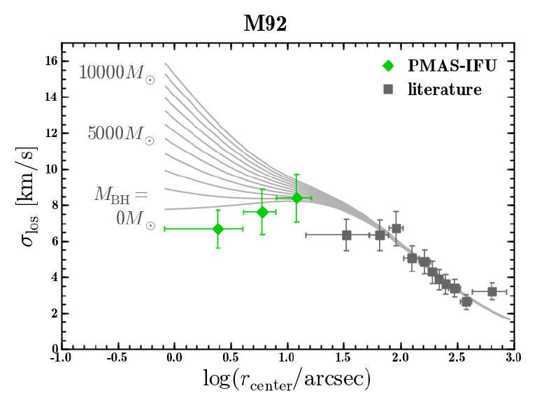
Kamann (2013)

Slide 29
50 vrad + 161
from literature
17 excl.
77 vrad + 308,
23 excl.
MUSE
FoV
80 vrad + 256
from literature
40 excl.

Slide 30
Example 2:
    large FoV

Slide 31
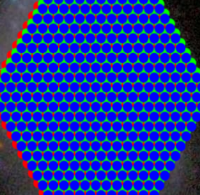
SDSS
IFU
Sanchez et al. 2012
PPak

Slide 32
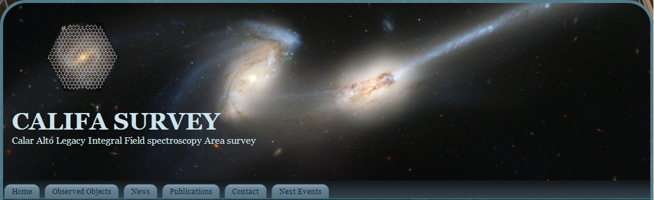
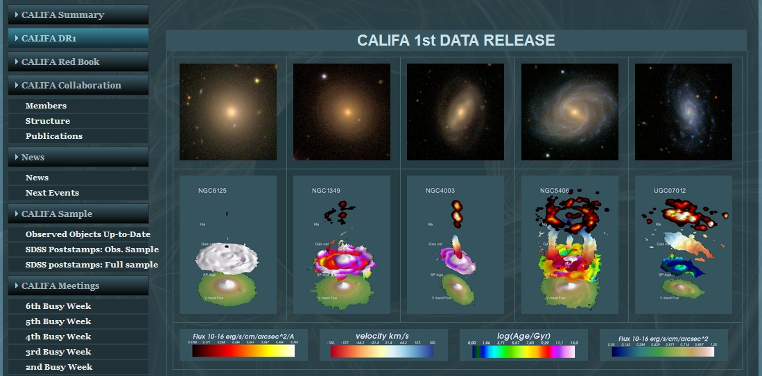
Data Release DR1:
Husemann et al. 2013
public access:
www.caha.es/CALIFA

Slide 33
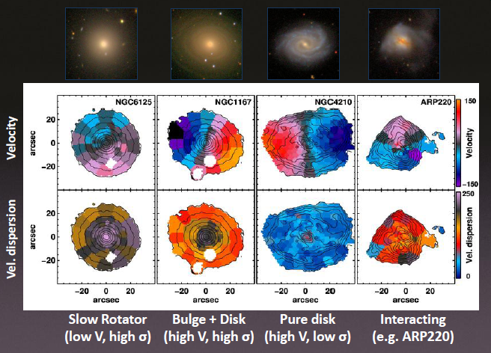
Kinematic Classification
E
Sa
Sd
Merger

Slide 34
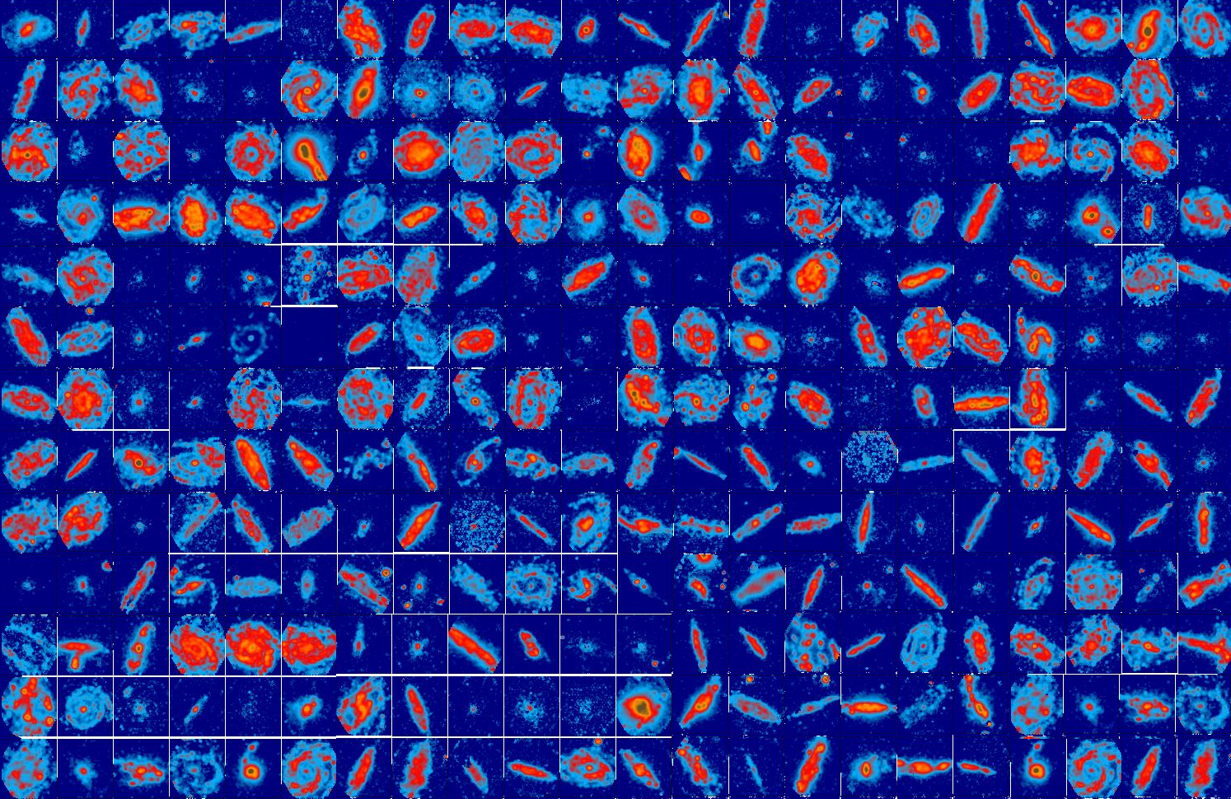
Ionized gas in the CALIFA sample

Slide 35
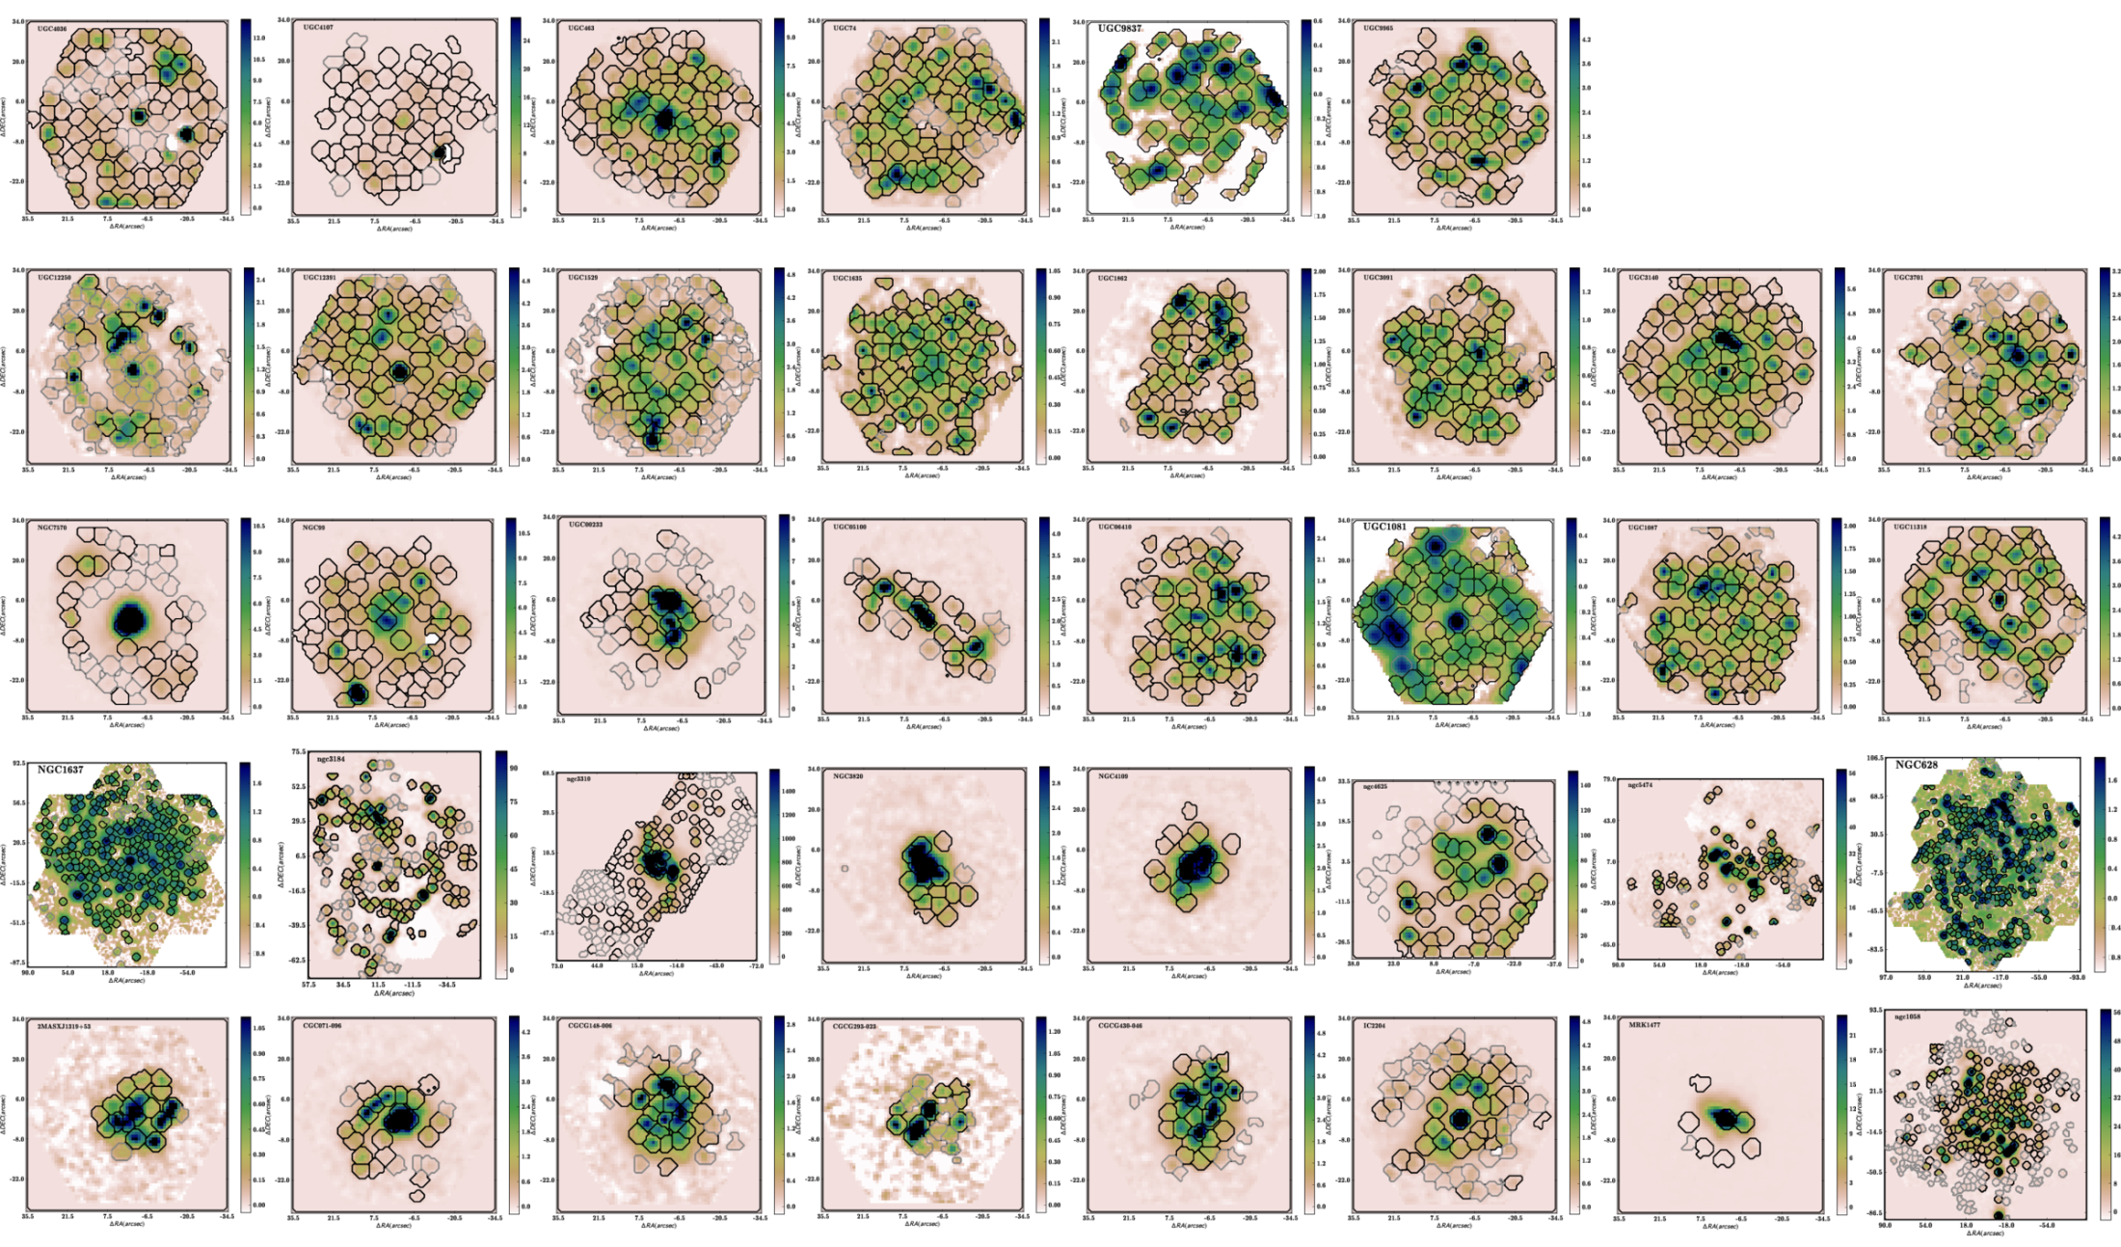
H II regions in CALIFA galaxies

Slide 36
6. Multi-Object
Integral Field Spectroscopy

Slide 37
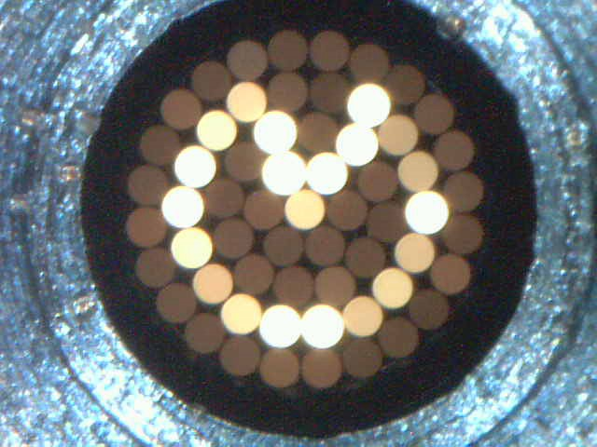
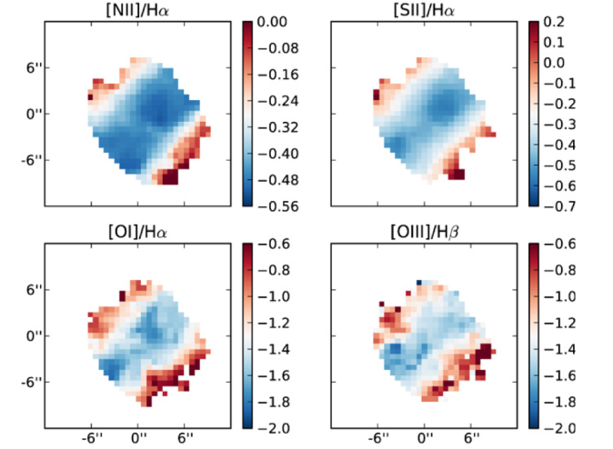
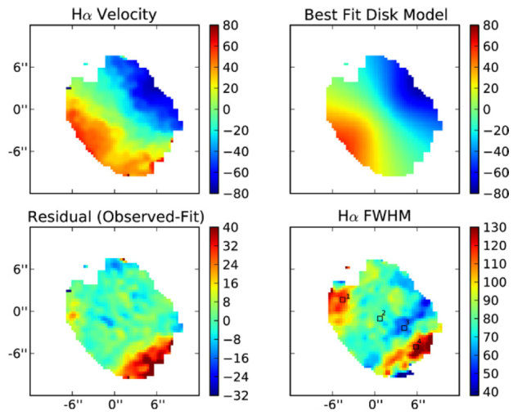
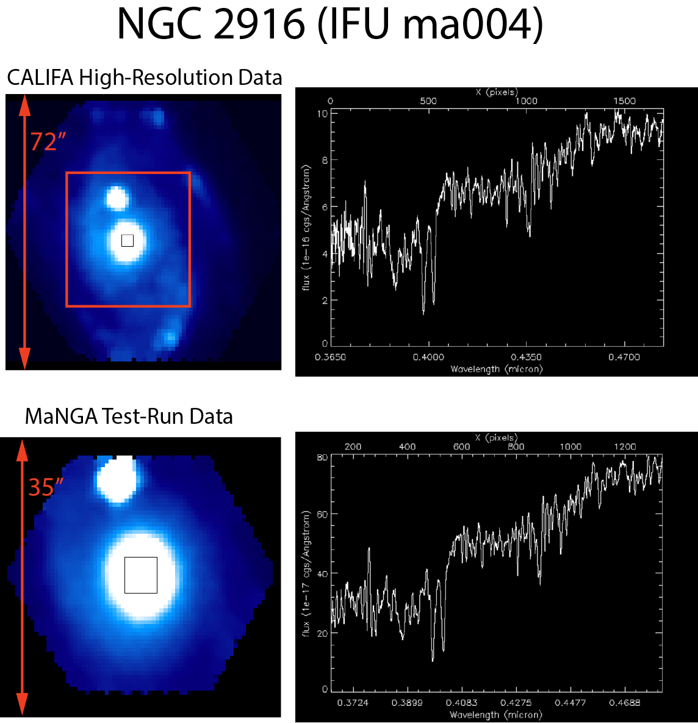
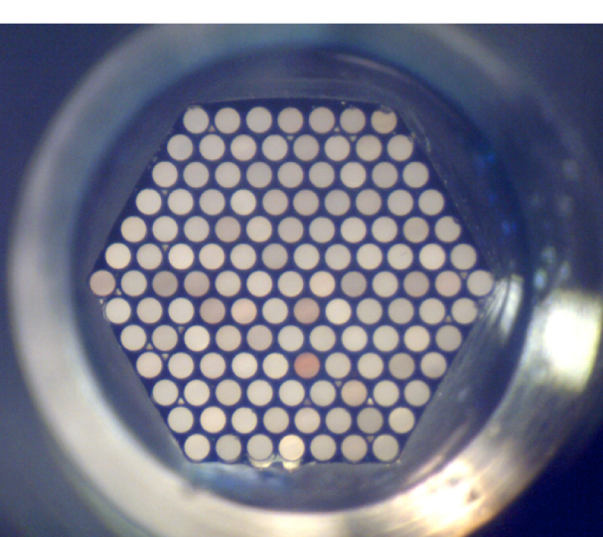
IFU-MOS surveys (~5.000 galaxies)
SAMI (AAO)
Fogarty et al. 2012
MaNGA (AS3)
NGC 2916
(data from
recent test run)
37

Slide 38
FIREBALL
FIREBALL Baseline Parameters
 FLAMES OzPoz patrol field with 26’ diameter FoV
 90 hexabundle IFUs, each with ~5” diameter FoV
 Hexabundles: 61 fibres, 0.6” projected fibre core
diameter
 6 spectrographs, adapted for fibre-feed, R~1200-2100
 free spectral range: 430-850nm (goal: blue extension)
 total throughput goal: 30%
 sensitivity: R ~19.8 survey limit, resulting in 100-
160 galaxies per FLAMES field at median z ~ 0.2;
typical half-light sizes for disk galaxies 2”-6” diameter
 detector head, NGC CCD controller, vacuum/cooling
system adapted from MUSE
 individual spectrograph shutters
 no moving parts other than shutters + fibre positioner
 retain full existing facility and utilise as much FLAMES
infrastructure as practical
Notes:
38
FIREBALL ESO Proposal in 2011 with 8 European Institutions (PI: InnoFSPEC-VKS)
Status current on hold
Astrophotonics Technologies (Hexabundles)
Unrivalled facility for extragalactic and stellar astronomy
6 fold increase in multiplex
5 fold increase in d-IFUs area
5 fold increase in throughput
AIP-Hosted a thinkkshop on FIREBALL like science 10-13 September 2012. “Galaxy Surveys using Integral Field Spectroscopy”

Slide 39
7. Outlook

Slide 40
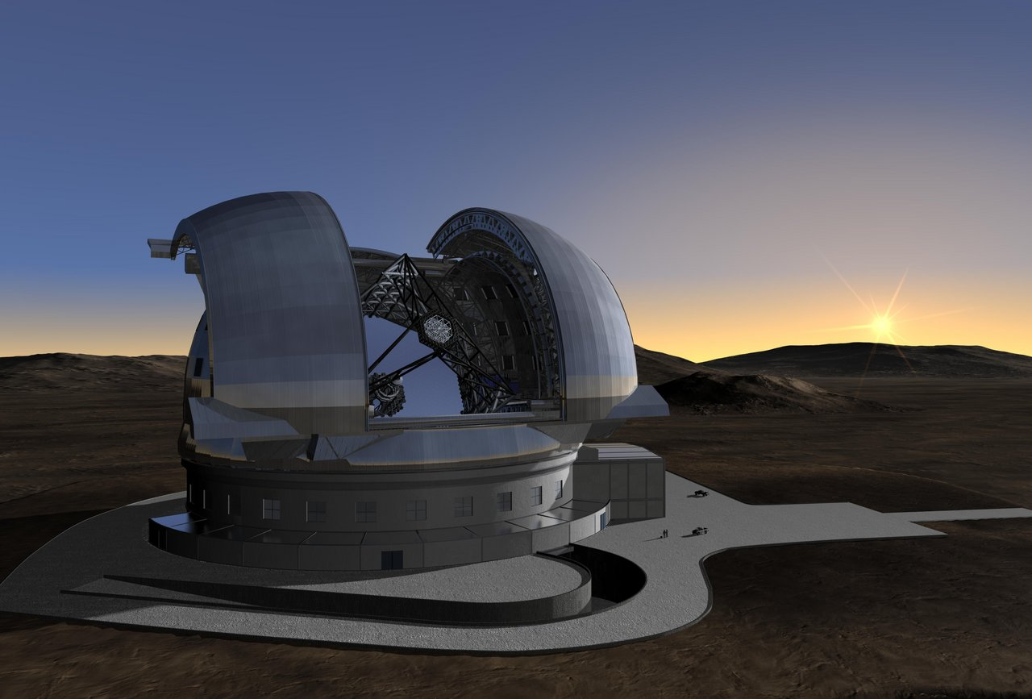
E-ELT

Slide 41
The End.

Slide 42
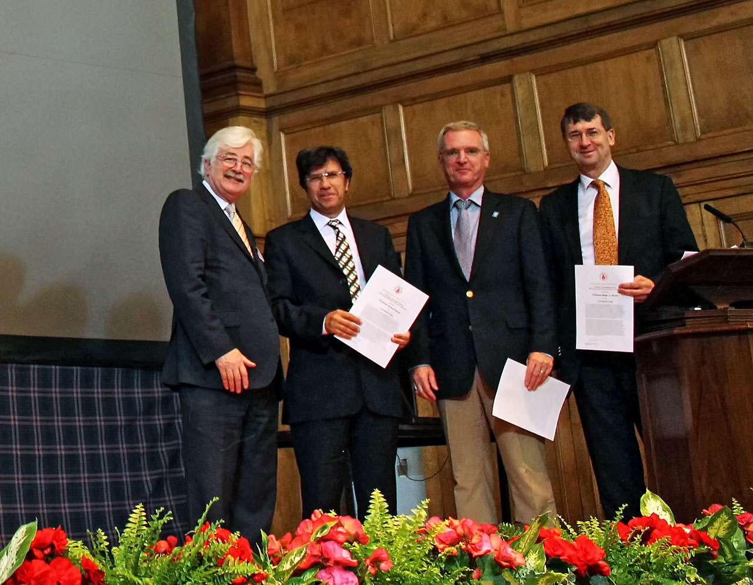
SAURON Receives 2013 Group Achievement Award of the Royal Astronomical Society
ESO PR 04 Jul 2013

Slide 43
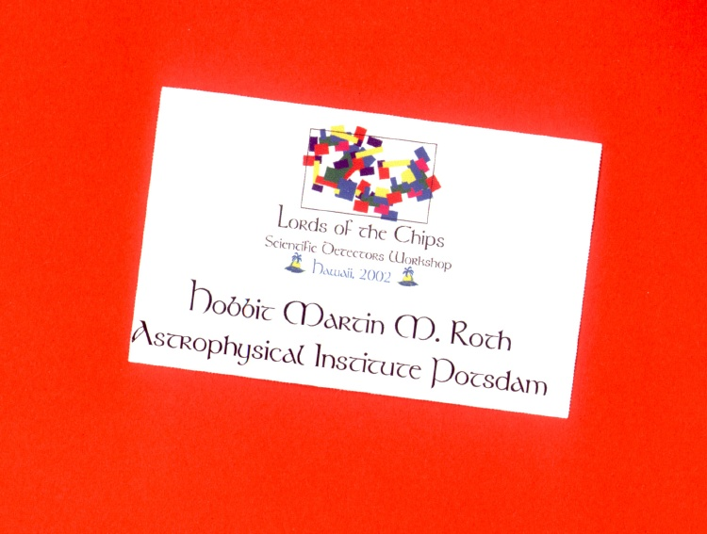

Slide 44
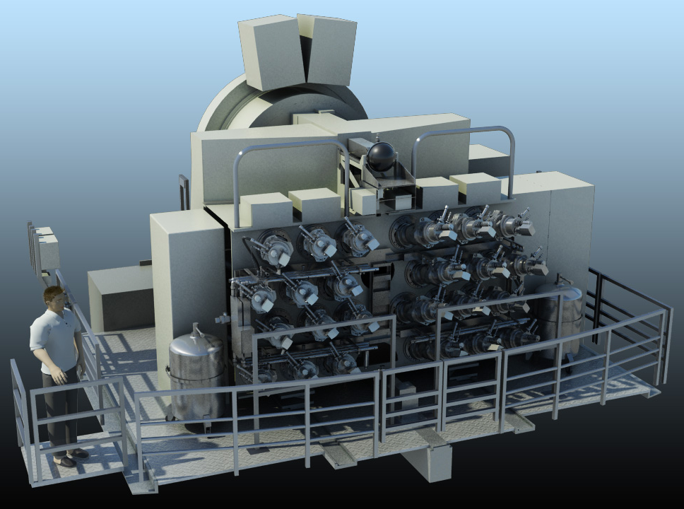
2-dimensional ortsaufgelöste Raman-Spektroskopie
MUSE,
2nd Generation VLT Instrument

Slide 45
SDW2013

Slide 46
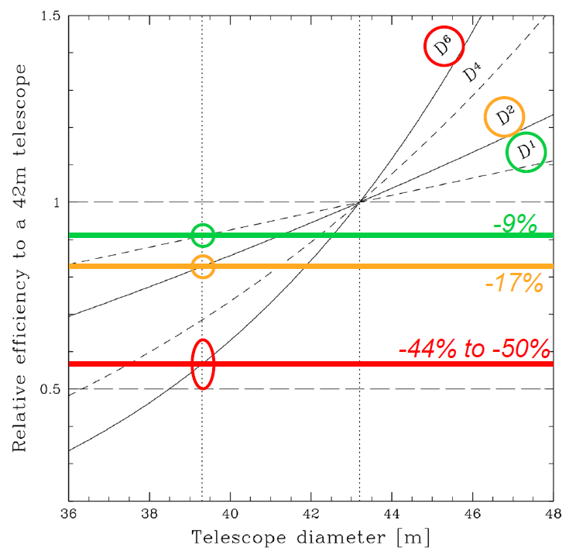
E-ELT
Delta-Phase-B Trade-Off
~ D⁶: direct imaging of explanets
~ D⁴: AO-limited observation,
e.g. stellar spectroscopy in
Virgo Cluster galaxies
~ D²: photon-limited observations,
e.g. cosmic expansion
→ CODEX
~ D¹: resolution limited obs., e.g.
resolved stellar populations
~ D⁰: RV research of exoplanets
Notes:
Na Schicht (Mesosphäre) 90km, 589nm
588,9950 nm (D2), 589,5924 nm (D1)
Deformable VLT M2: diameter 1120mm, 1170 actuators,
Max. fitting error 62nm wavefront (Zernicke)

Slide 47
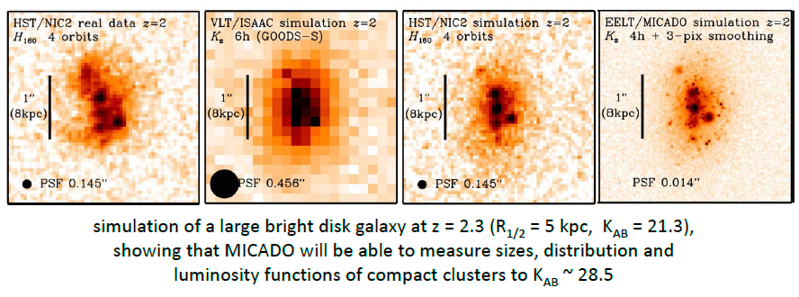
Expected E-ELT Performance (Davies 2013)

Slide 48
E-ELT Instrumentation Plan:
MICADO
HARMONI
ELT-MOS

Slide 49
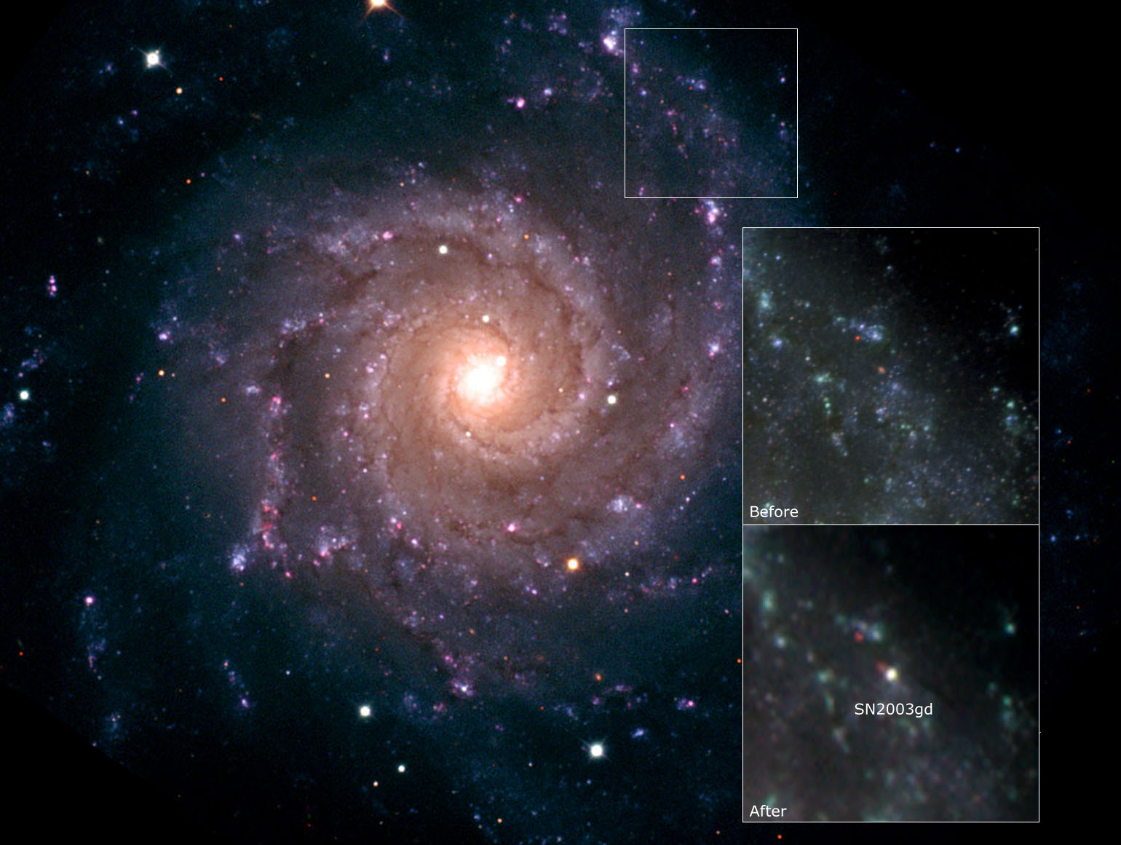
Smartt et al. 2004
Science 303, 499
NGC 628 (M74)
10 Mpc
10.5‘ x 9.5‘
Notes:
INT image, inserts: top and „Before“: GEMINI, bottom „After): INT
Copyright Isaac Newton Group of Telescopes, La Palma

Slide 50
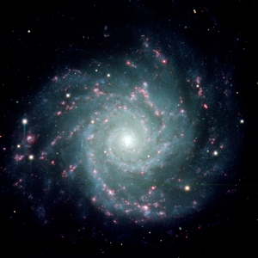
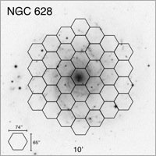
Sánchez, S. F., Rosales-Ortega, F. F., Kennicutt, R.C.,
Johnson, B. D., Diaz, A. I., Pasquali, A., Hao, C. N. (2011),
„PPAK Wide-field Integral Field Spectroscopy of NGC628 –
I. The largest spectroscopic mosaic on a single galaxy“, MNRAS 410, 313

Slide 51
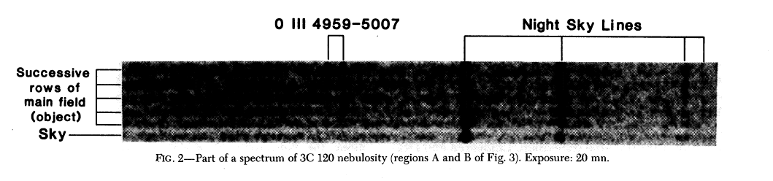
Prototype Fiber Bundle IFU: UH 2.2m
1980
Mauna Kea 2.2m Telescope
hexagonal fiber bundle, 169 fibers
36 sky fibers (in 4 blocks)
fill-factor ~ 75 %
total of 205 fibers, 100 μm core diameter
fiber diameter = 0.42“ on the sky
photographic image-tube spectrograph (ill-adapted)
Vanderriest, C. (1980),
“ Fiber-Optics Dissector for Spectroscopy of Nebulosities around Quasars and similar Objects”
PASP 92, 858

Slide 52
PMAS Lensarray: Calar Alto 3.5m
2011
z = 0.212
Husemann et al. 2011, A&A 535, 72

Slide 53
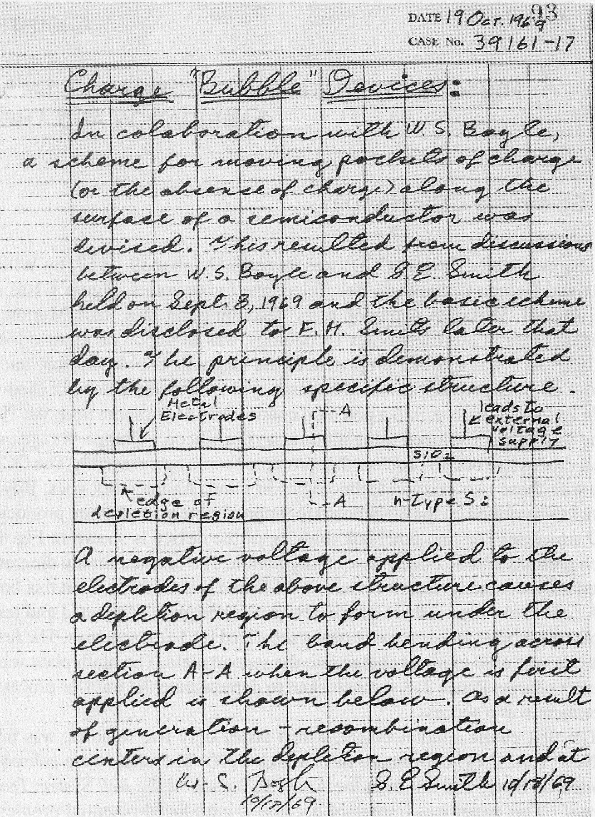
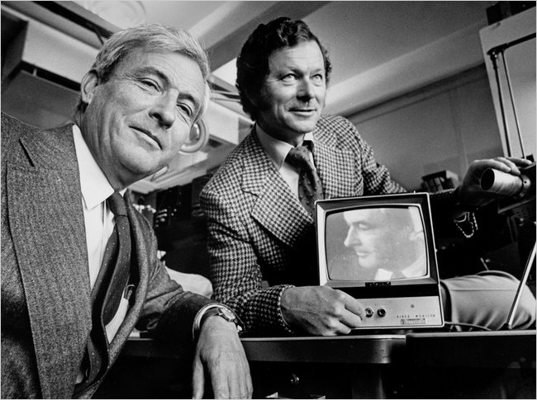
Invention of the CCD
Williard S. Boyle  und
George E. Smith, Bell
Telephone Laboratories
Sep. 8, 1969: first idea
Lab Notebook entry on
Oct.19, 1969
IEEE Convention N.Y.C. March 1970
Boyle & Smith (1970) , Bell System
Tech. Journal, Vol. 49, p. 593
Tompsett, Amelio, Smith (1970),
Appl. Phys. Ltrs. Vol.17, No.3, p.111
 died 7. Mai 2011

Slide 54
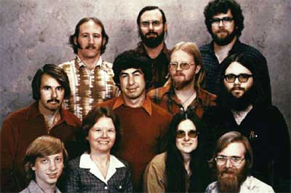
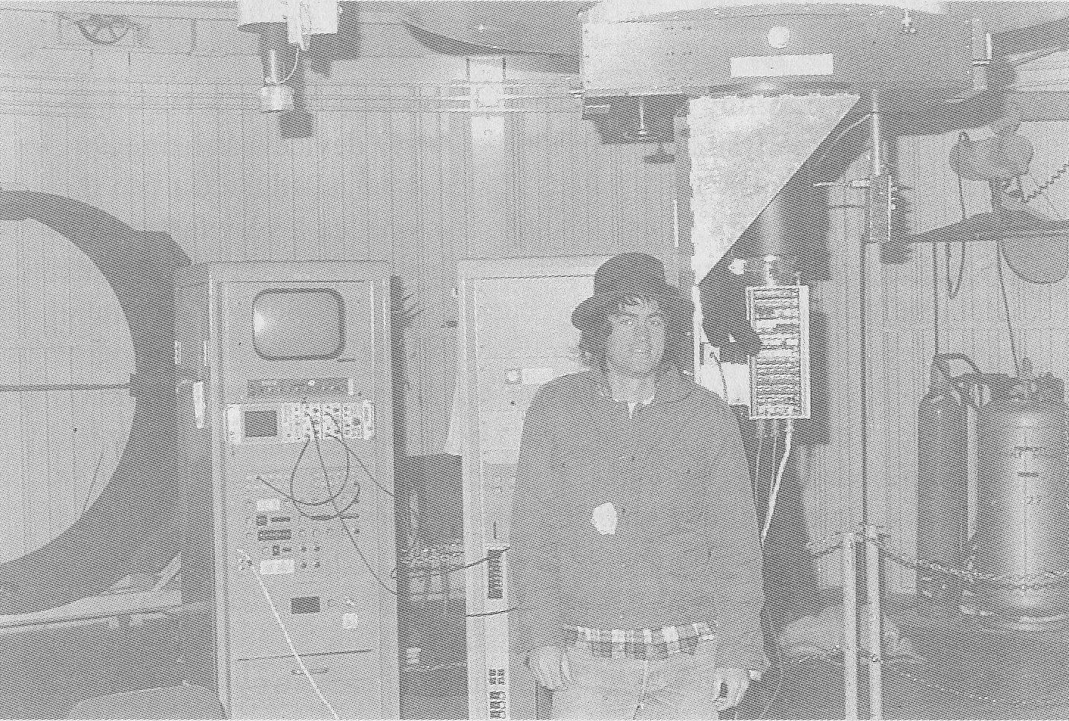
TI 0.4Kx0.4K CCD at Mt. Lemmon 154cm Telescope (1976)
Microsoft 1978

