Slide 1
Imaging Spectroscopy with MUSE at the ESO-VLT: Science Drivers
Lutz Wisotzki, AIP for the MUSE consortium
SDW2013 – 07 Oct 2013

Slide 2







MUSE in a nutshell
2nd generation instrument for ESO VLT
Integral Field Spectroscopy in optical domain:
  1' × 1' field of view (in Wide Field Mode)
  0.2" × 0.2" spatial pixels
  → 90,000 spectra on 24 spectrographs
  Adaptive Optics supported
built by consortium of 6 institutes + ESO
PI: Roland Bacon (Lyon)
commissioning scheduled for Feb 2014
See also Poster by Kelz et al.:
Serial Acceptance Testing of 24 Detectors for MUSE

Slide 3
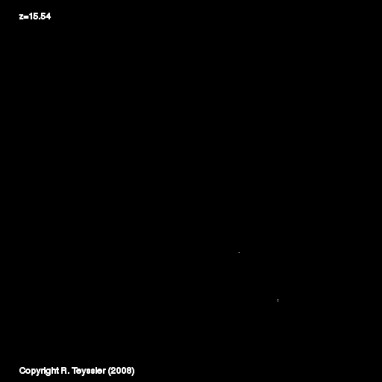
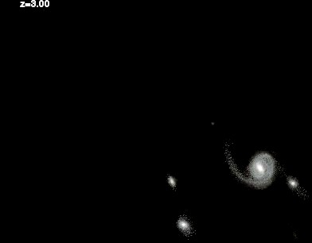
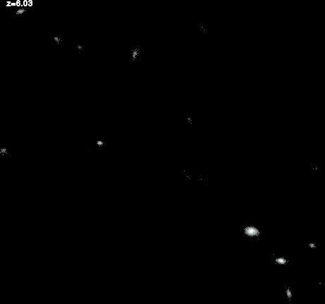
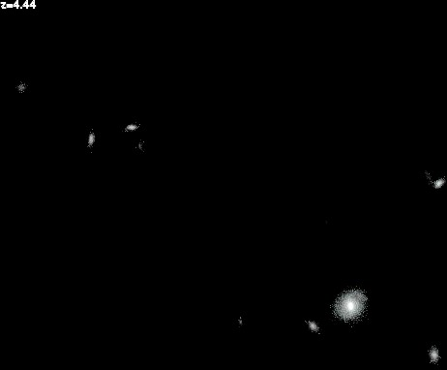
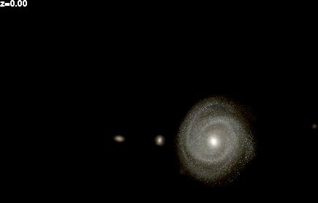
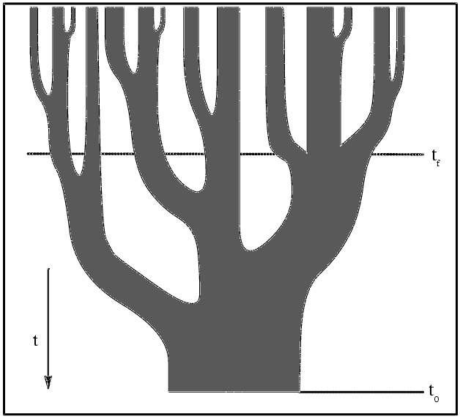
The formation of galaxies
Galaxies grow by
hierarchical merging
smooth accretion of matter
converting gas into stars
feedback into ISM and IGM
Formation of a Milky Way-like galaxy in a cosmological context (numerical simulation)

Slide 4
Cosmic lookback time and galaxy redshifts
“epoch of galaxy formation”

Slide 5
Finding high-redshift galaxies
General spectroscopic galaxy surveys:
  very low fraction of high-z objects!
VLT/VIMOS Deep Survey
9141 galaxies, I_{AB} < 24
Le Fevre et al. 2005

Slide 6
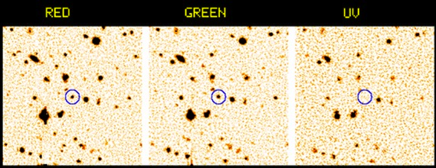
Finding high-redshift galaxies
“Lyman Break” technique:
  Characteristic colours: Pre-selection from broad band imaging
  + follow-up spectroscopy of selected candidates
(Figure from Pettini 2004)
(Figure by C. Steidel)

Slide 7
Finding high-redshift galaxies
Lyman α line emitters (LAEs):
  For z > 1.8: Ly α detectable from the ground
  standard method: Narrow-band imaging + follow-up spectroscopy
Ouchi et al 2008

Slide 8
What are the progenitors of Milky Way-type galaxies?
Growth history of `simulated MW´
Simulations suggest that
MW progenitors were
bright in the Ly-α line,
but most are too faint
for existing narrow-band surveys!
below current
sensitivity in Ly α
Simulation by Yajima et al 2012; cf. also Dayal & Libeskind 2012

Slide 9
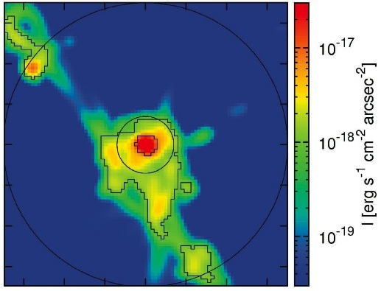
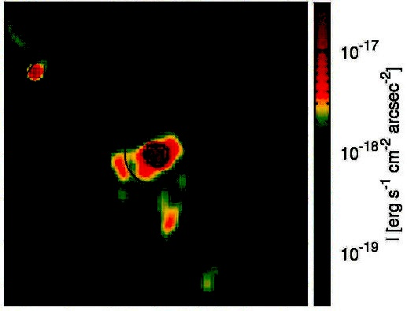
How do galaxies get their baryons?
Simulations: High-z galaxies grow predominantly by smooth accretion of gas
through filamentary streams
Best chance for detection: Ly-α emission from densest filaments near galaxies
but predicted surface brightnesses are extremely low (and uncertain!)
SB limit: 10⁻¹⁸ erg s⁻¹ cm⁻² arcsec⁻²
Current limit
for NB imaging
Simulation: Goerdt et al 2010
Simulation: Dekel et al 2009

Slide 10
Top-Level Science Goal for MUSE:
Push detection of Ly-α emission to faintest possible flux levels!
We want to
detect genuine low-mass galaxies at high z,
  because these are the building blocks of ``normal´´ galaxies.
constrain feedback and chemical enrichment of the IGM,
  because outflows from low-mass galaxies may dominate this process.
understand how galaxies get their baryons,
  in particular: Test the predicted scenario of ``smooth accretion´´

Slide 11
Global performance goals for MUSE
Reach significantly fainter than NB imaging!
  Dispersive system (to beat down sky background, especially in the red)
  High spatial resolution (again to reduce background)
  Capability for very long integrations – highest possible stability!
Cover the broadest possible redshift range!
  Cover much of optical λλ simultaneously!
Provide high-resolution spectral and spatial information!
  Obtain spectra of all observed objects
  Minimise degradation by atmospheric seeing
Efficient usage of telescope time!
  Achieve high multiplexing factor
➡ Build an Integral Field Spectrograph optimized for `Deep Fields´!

Slide 12
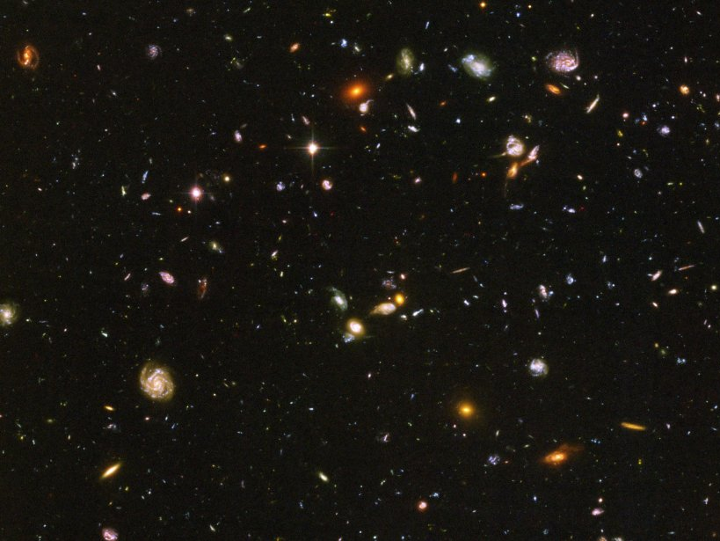

Slide 13
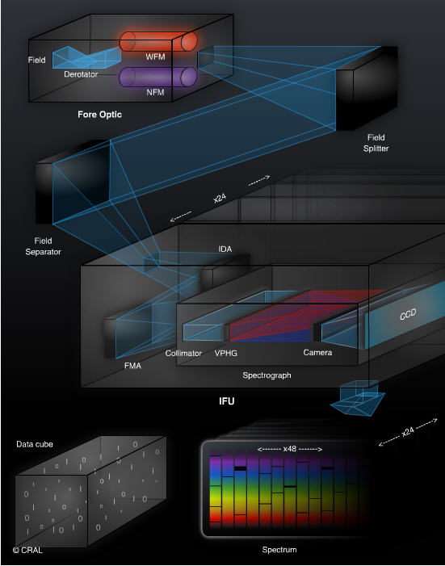
Telescope,
Fore Optics
Splitting & Relay Optics
Image Slicers, 24 Gratings
24 Detectors
Data Cube:
300 x 300 x 3600

Slide 14

VIRUS: Visible Integral-field Replicable Unit Spectrograph for the 10m Hobby-Eberly Telescope
75 fiber bundles
150 spectrographs
33600 fibers
Goal: Blind Survey over >500 deg² for ~10⁶ bright LAEs as probes for the geometry of the universe at z=2–3

Slide 15
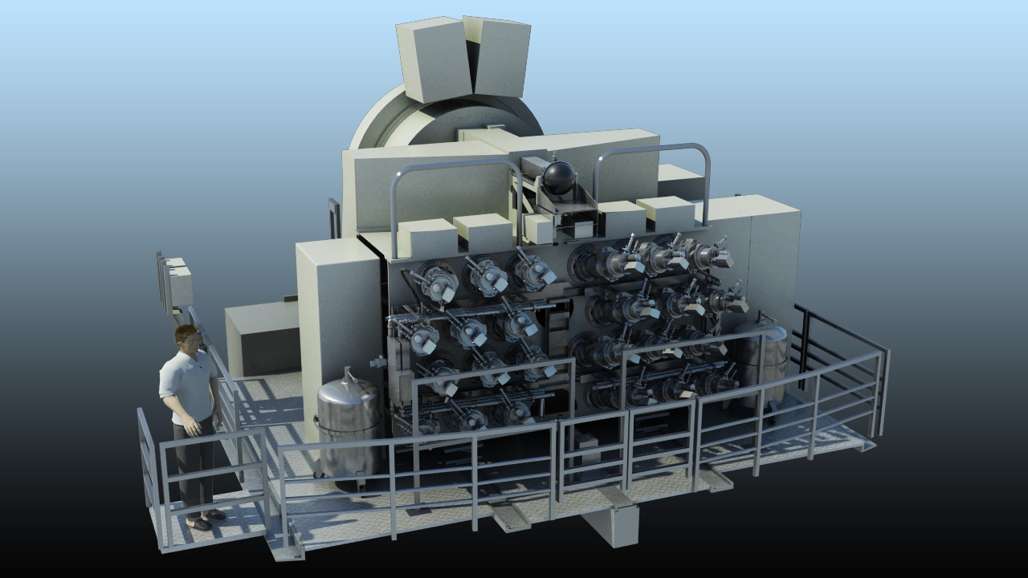
Rear view

Slide 16
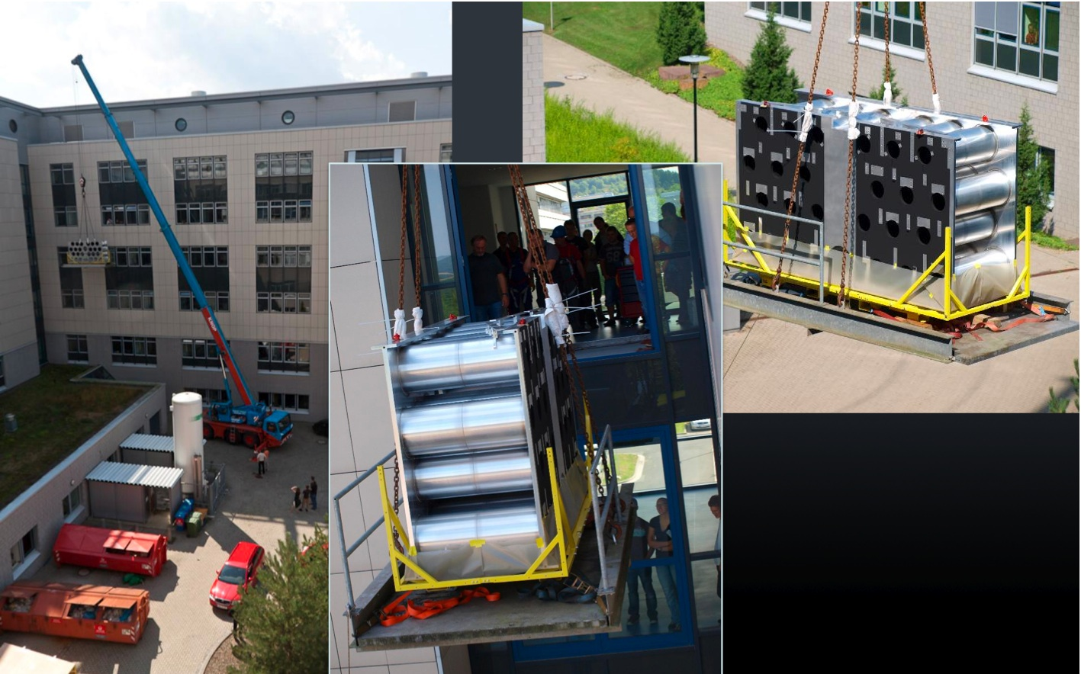
Instrument main structure

Slide 17
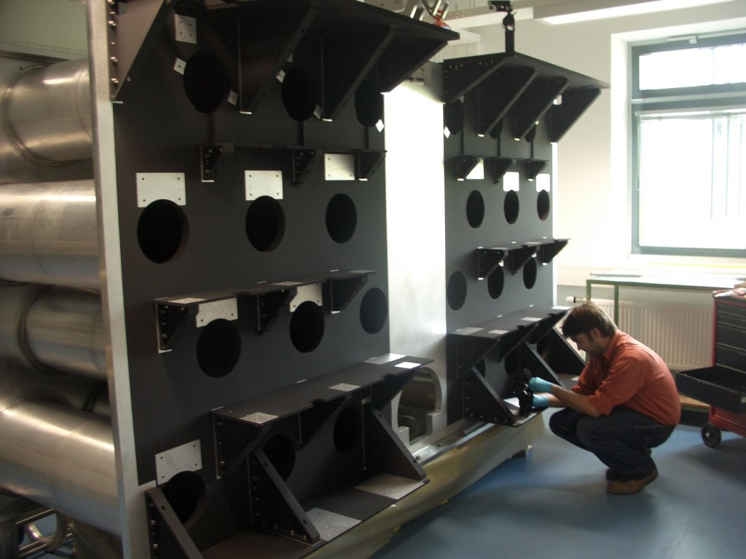
Instrument main structure

Slide 18
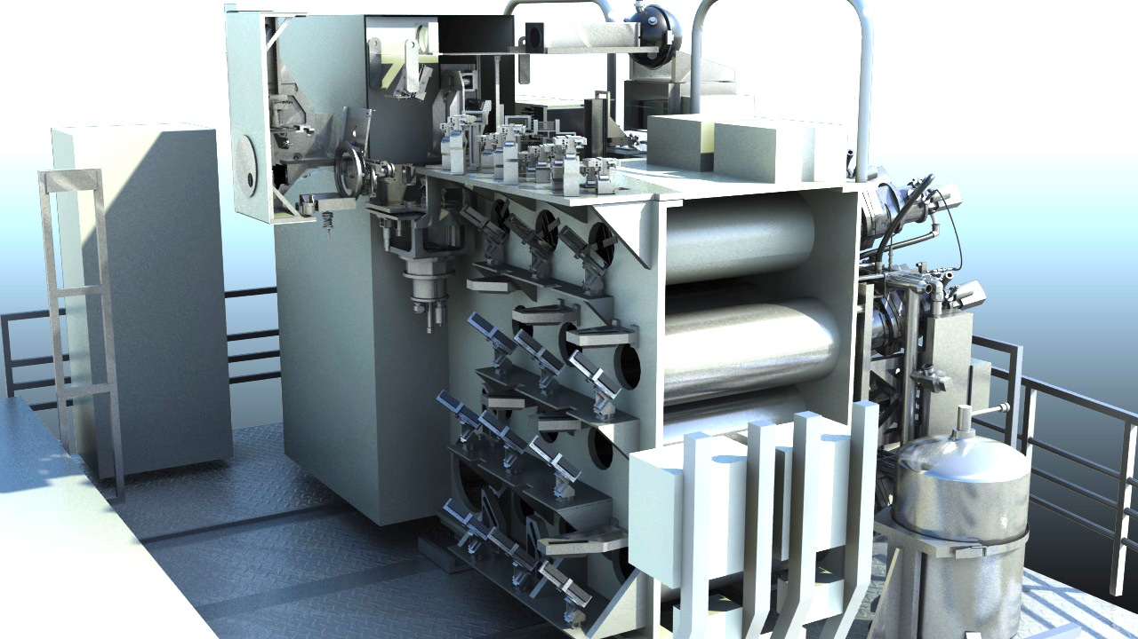
Front view

Slide 19
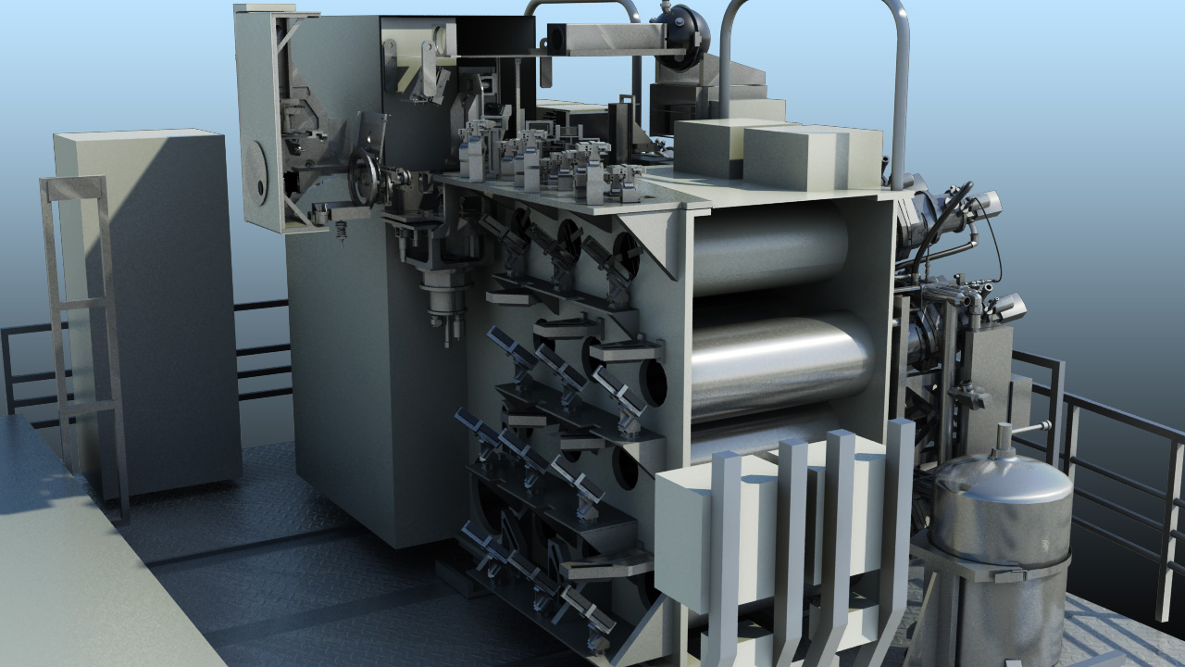
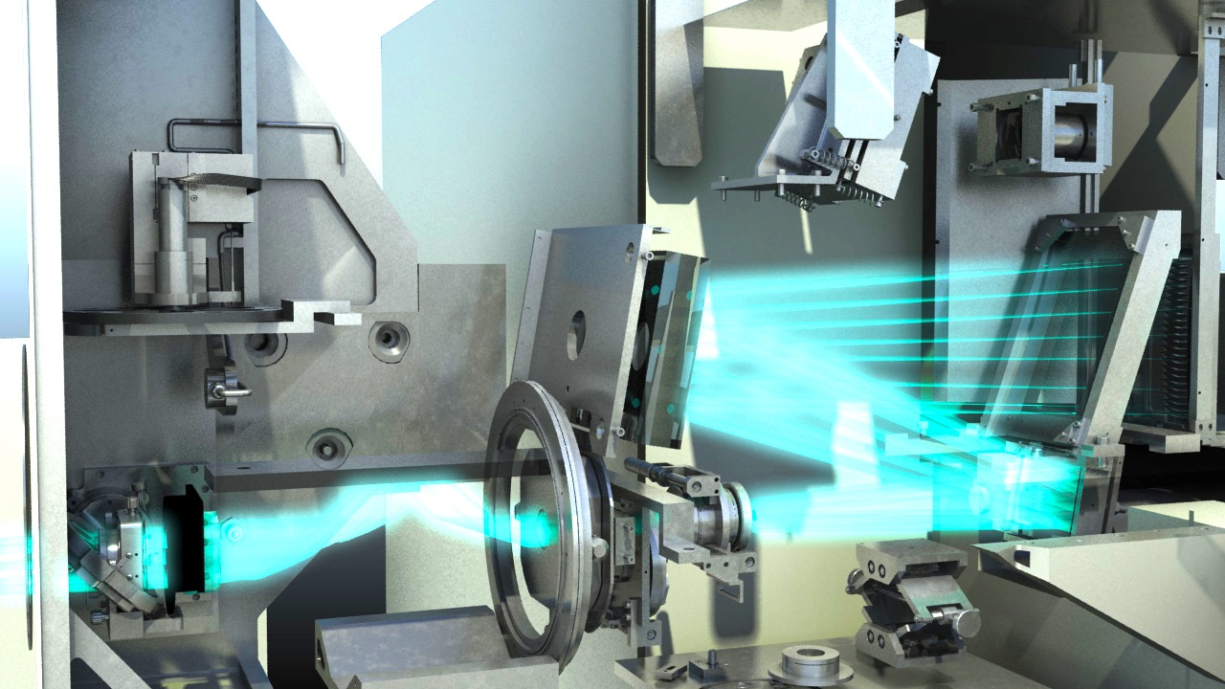
Fore-optics (w/ field derotator)

Slide 20
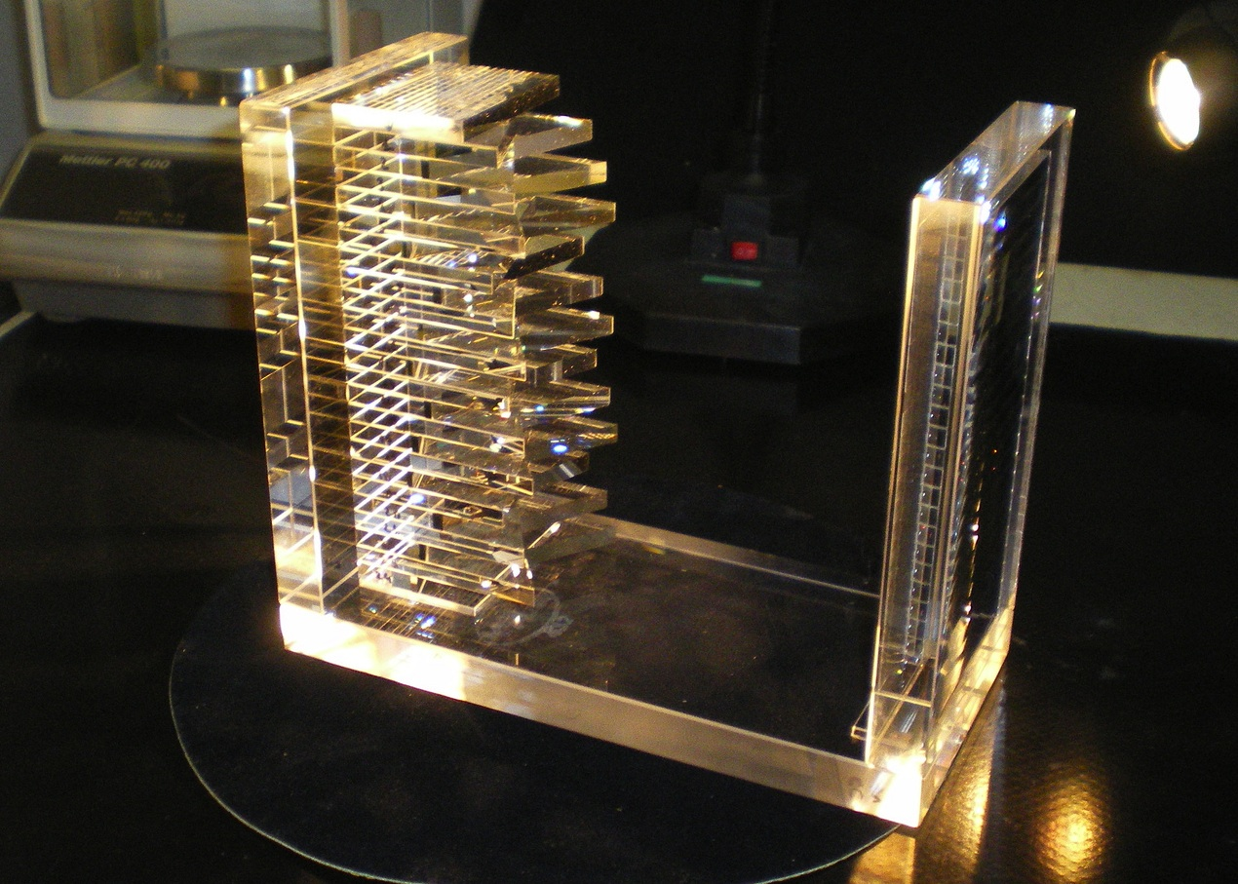
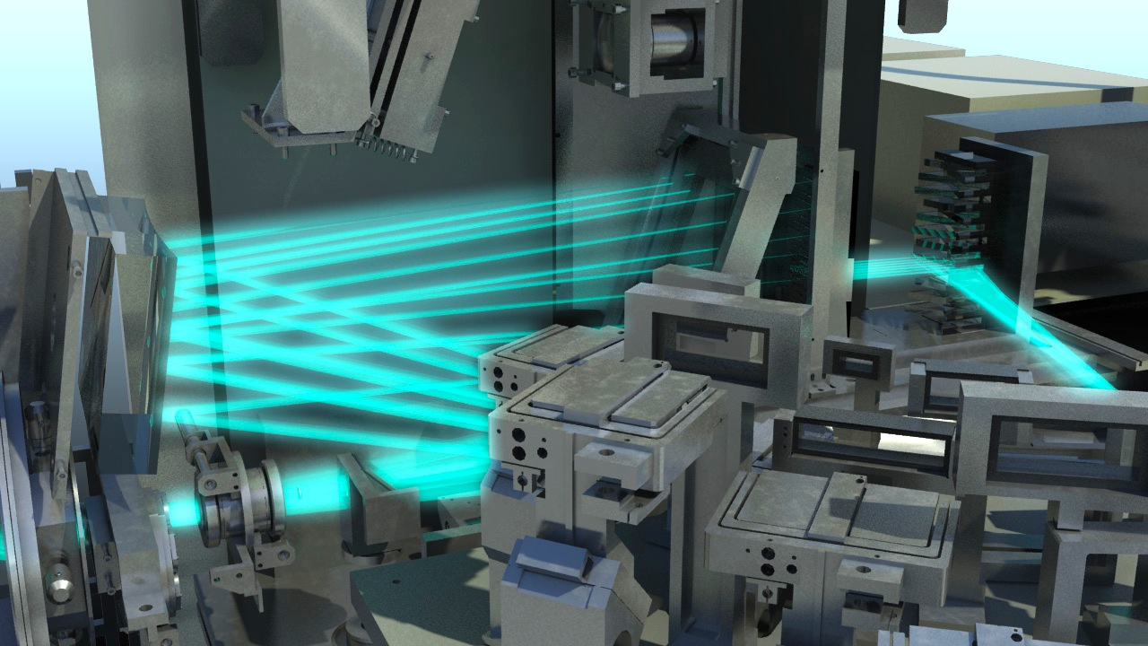
Field splitting & relay optics

Slide 21
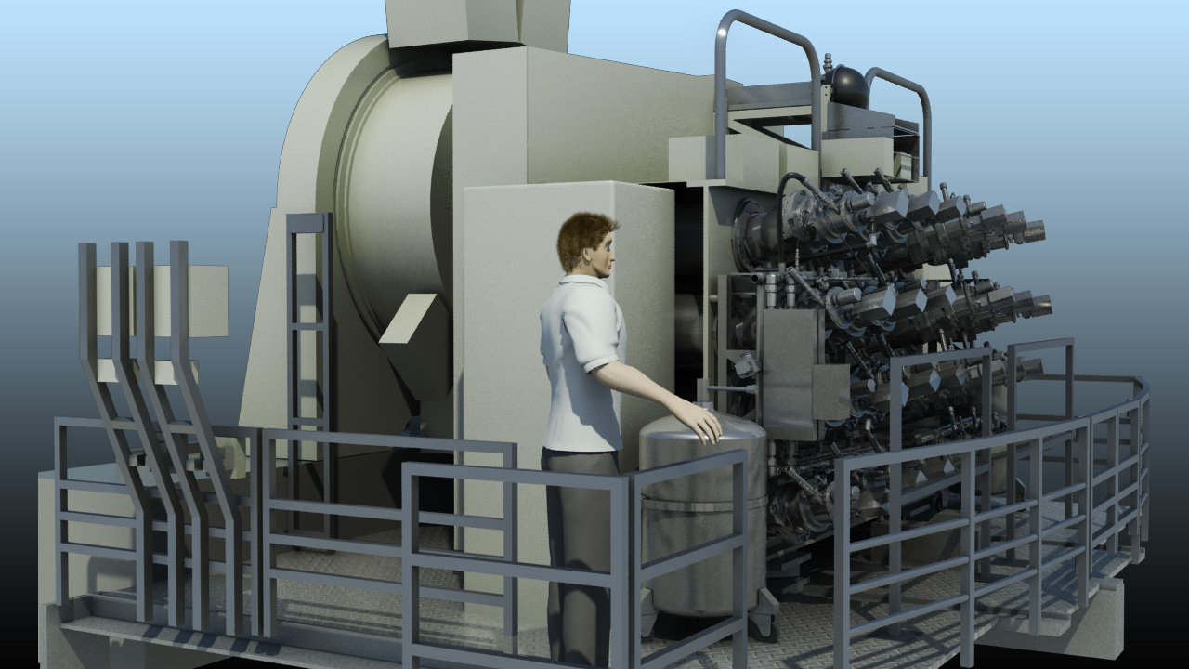
Side view

Slide 22
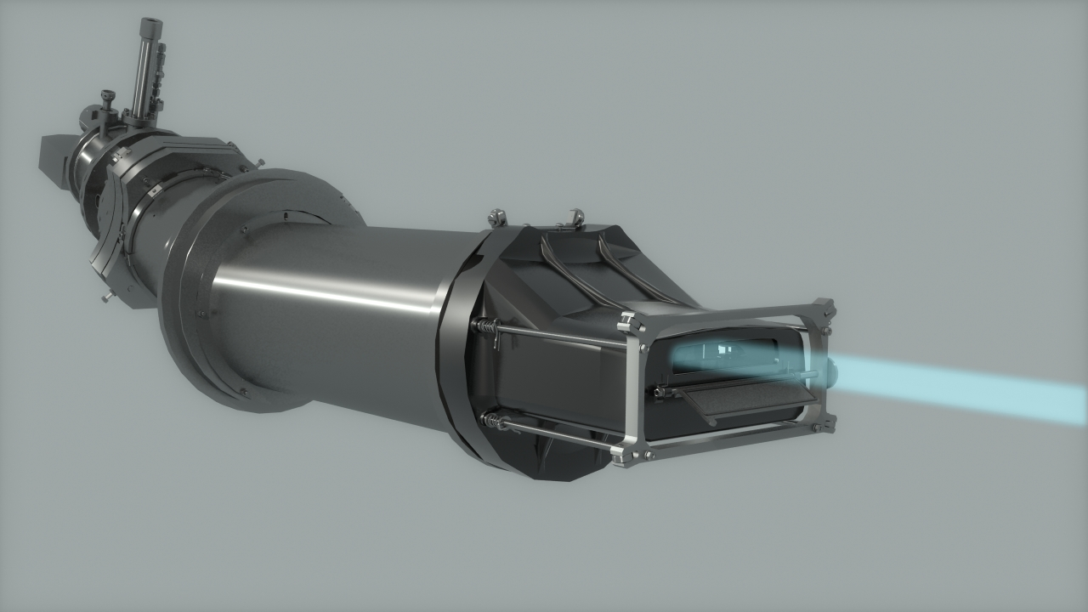
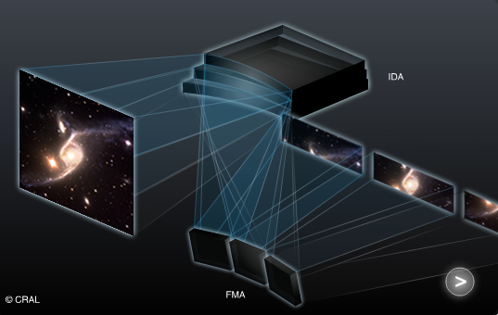
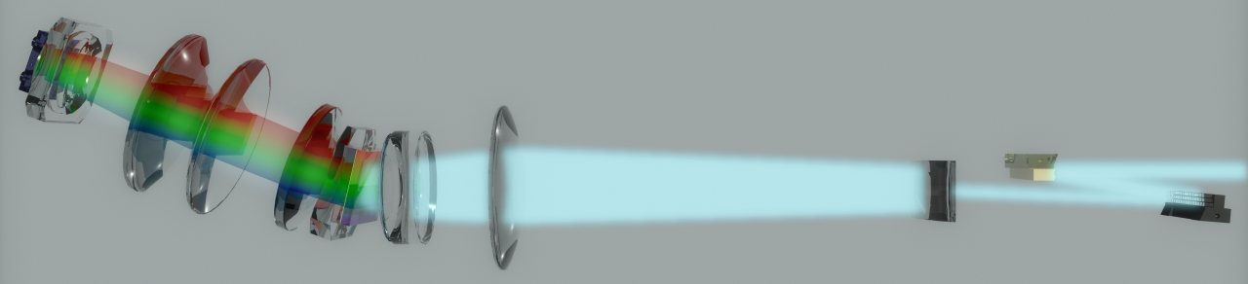
24 integral field units
CCD 4k²
VPHG
Image Slicer
Camera f/2
Collimator

Slide 23
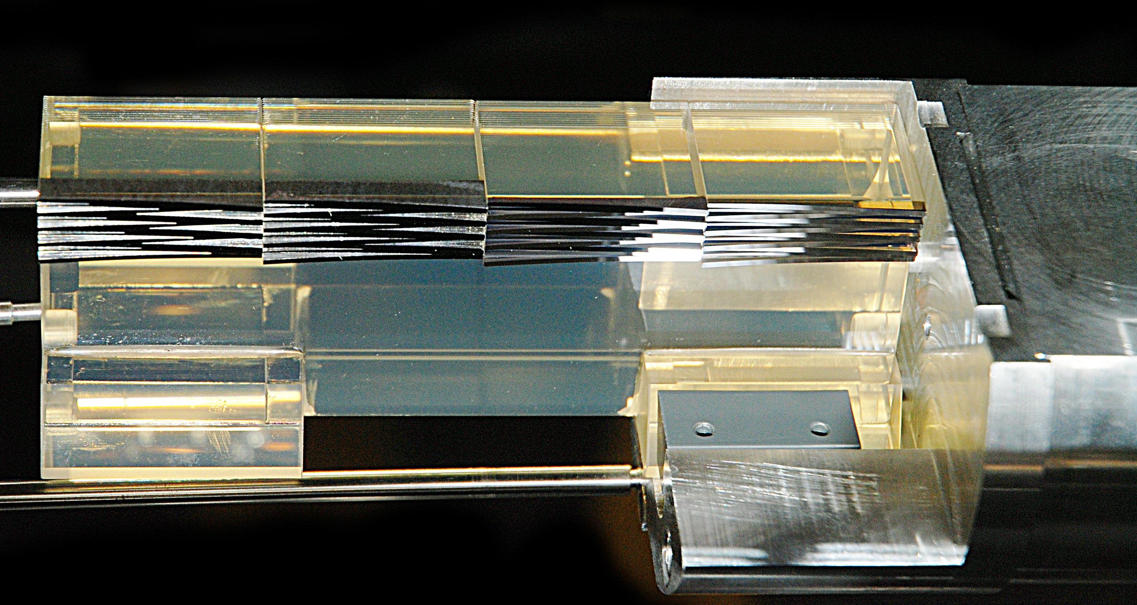
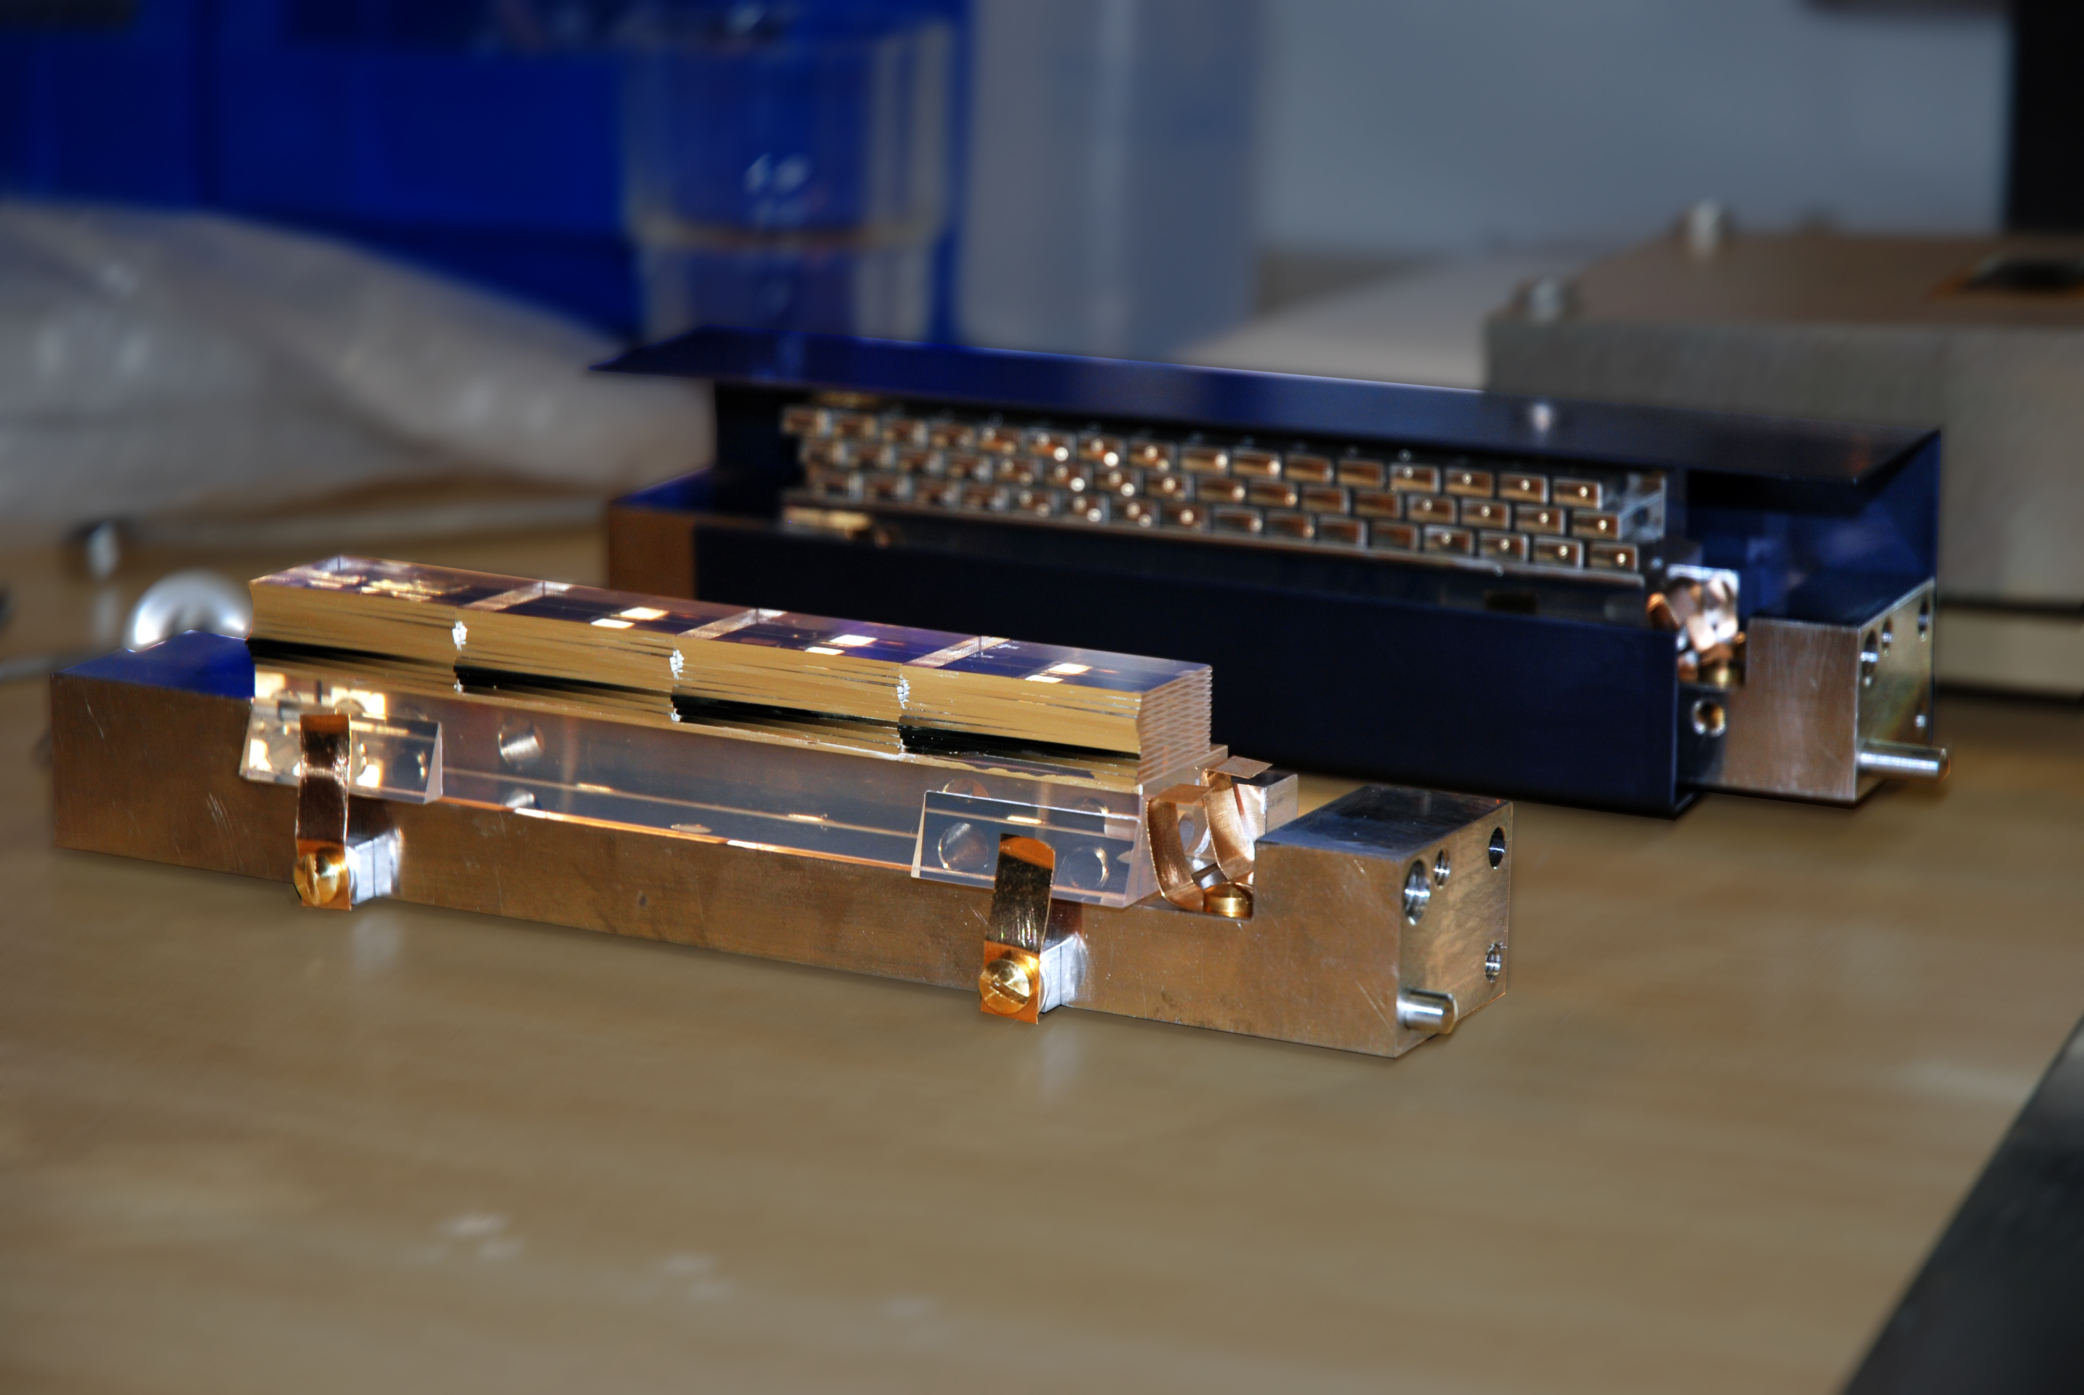
Image slicers
FMA: 4 stack of 12 off axis spherical mirrors 6x2 mm elliptical aperture
IDA: 4 stacks of 12 off-axis spherical mirrors, 33x0.9 mm rectangular aperture
Winlight Optics

Slide 24
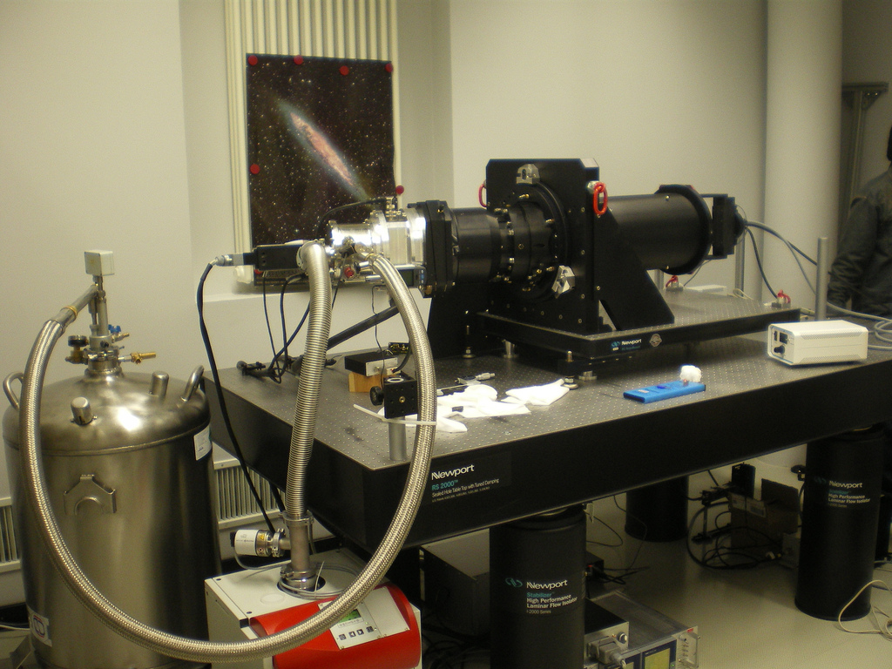
Spectrographs + detectors on test bench

Slide 25
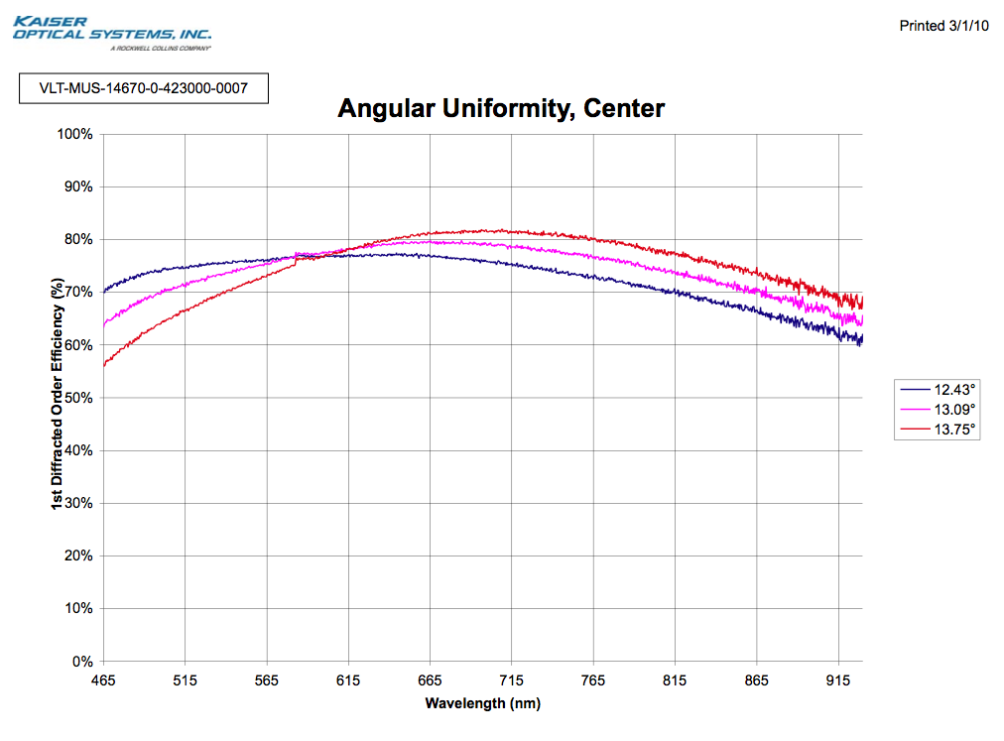
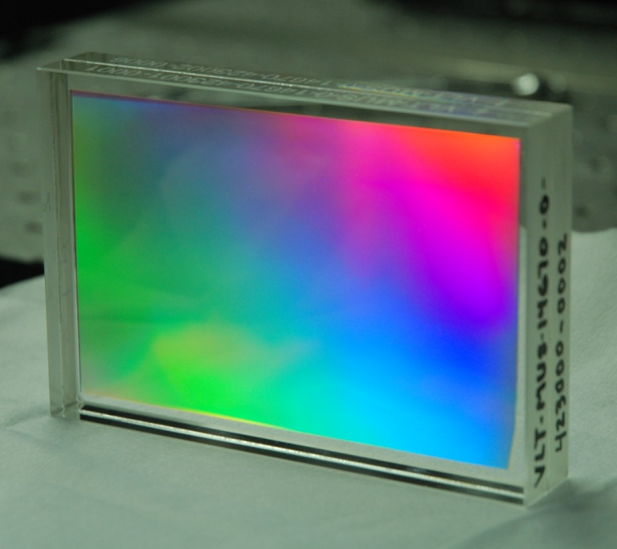
Volume-phased holographic gratings
Kaiser Optical System Inc

Slide 26
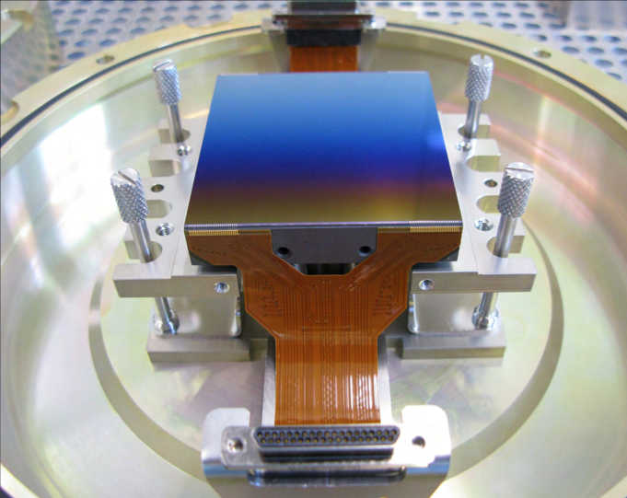
Detectors
Linearity
231-84 4kx4k
Readout Noise
e2v
24 CCDs: 4k × 4k
red-sensitive
graded AR coating

Slide 27
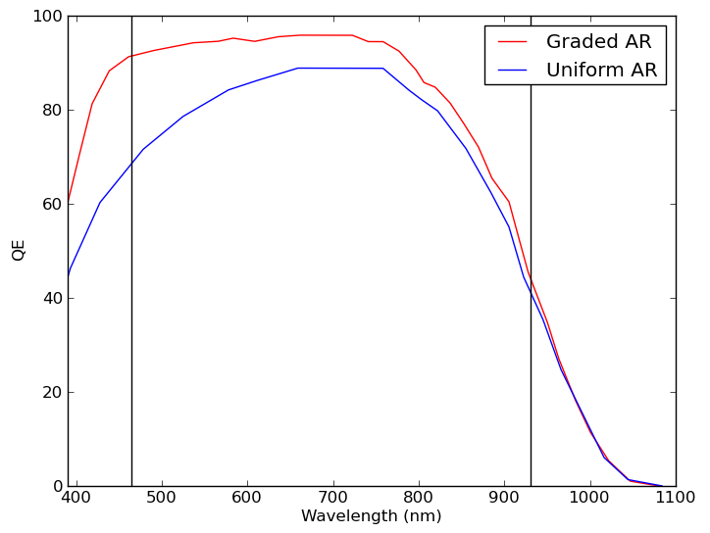
Benefit of graded AR coating
Fixed wavelength range → constant mapping from pixels to wavelengths
→ allow for optimised wavelenth-dependent coating

Slide 28
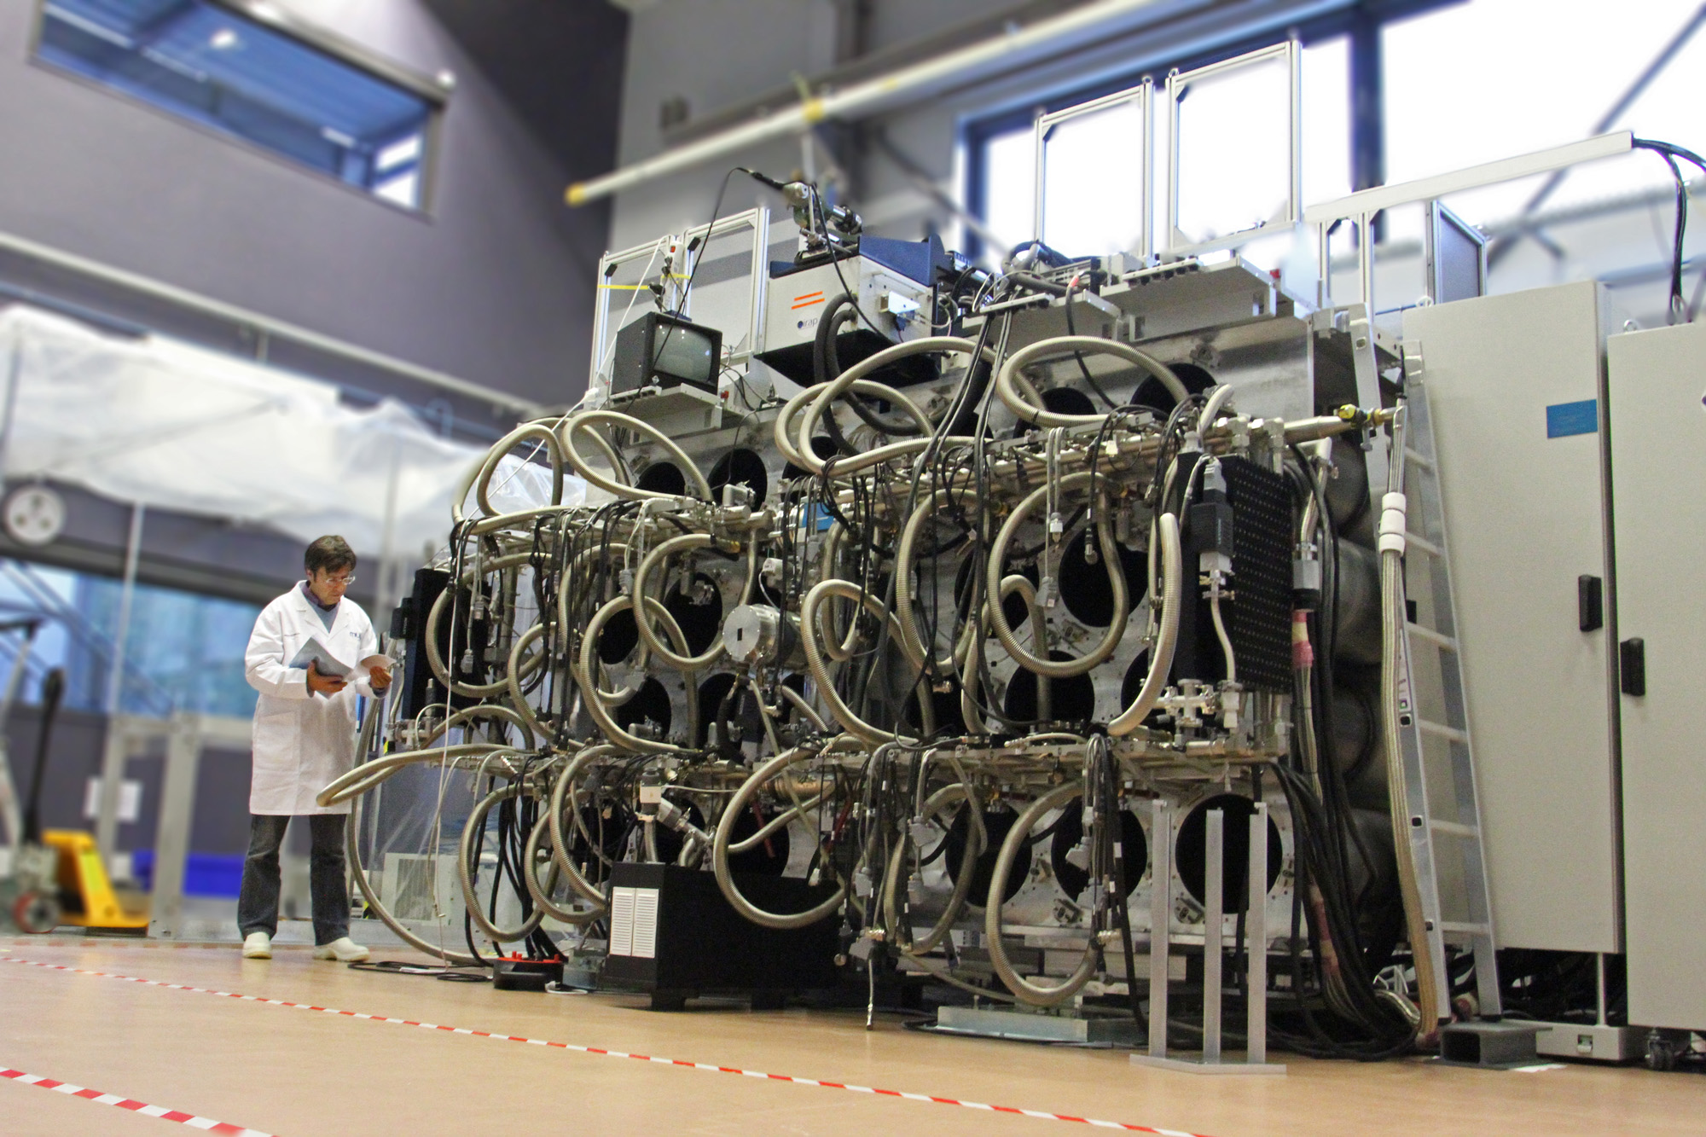
Cryogenic system with 1 IFU and 1 PI

Slide 29
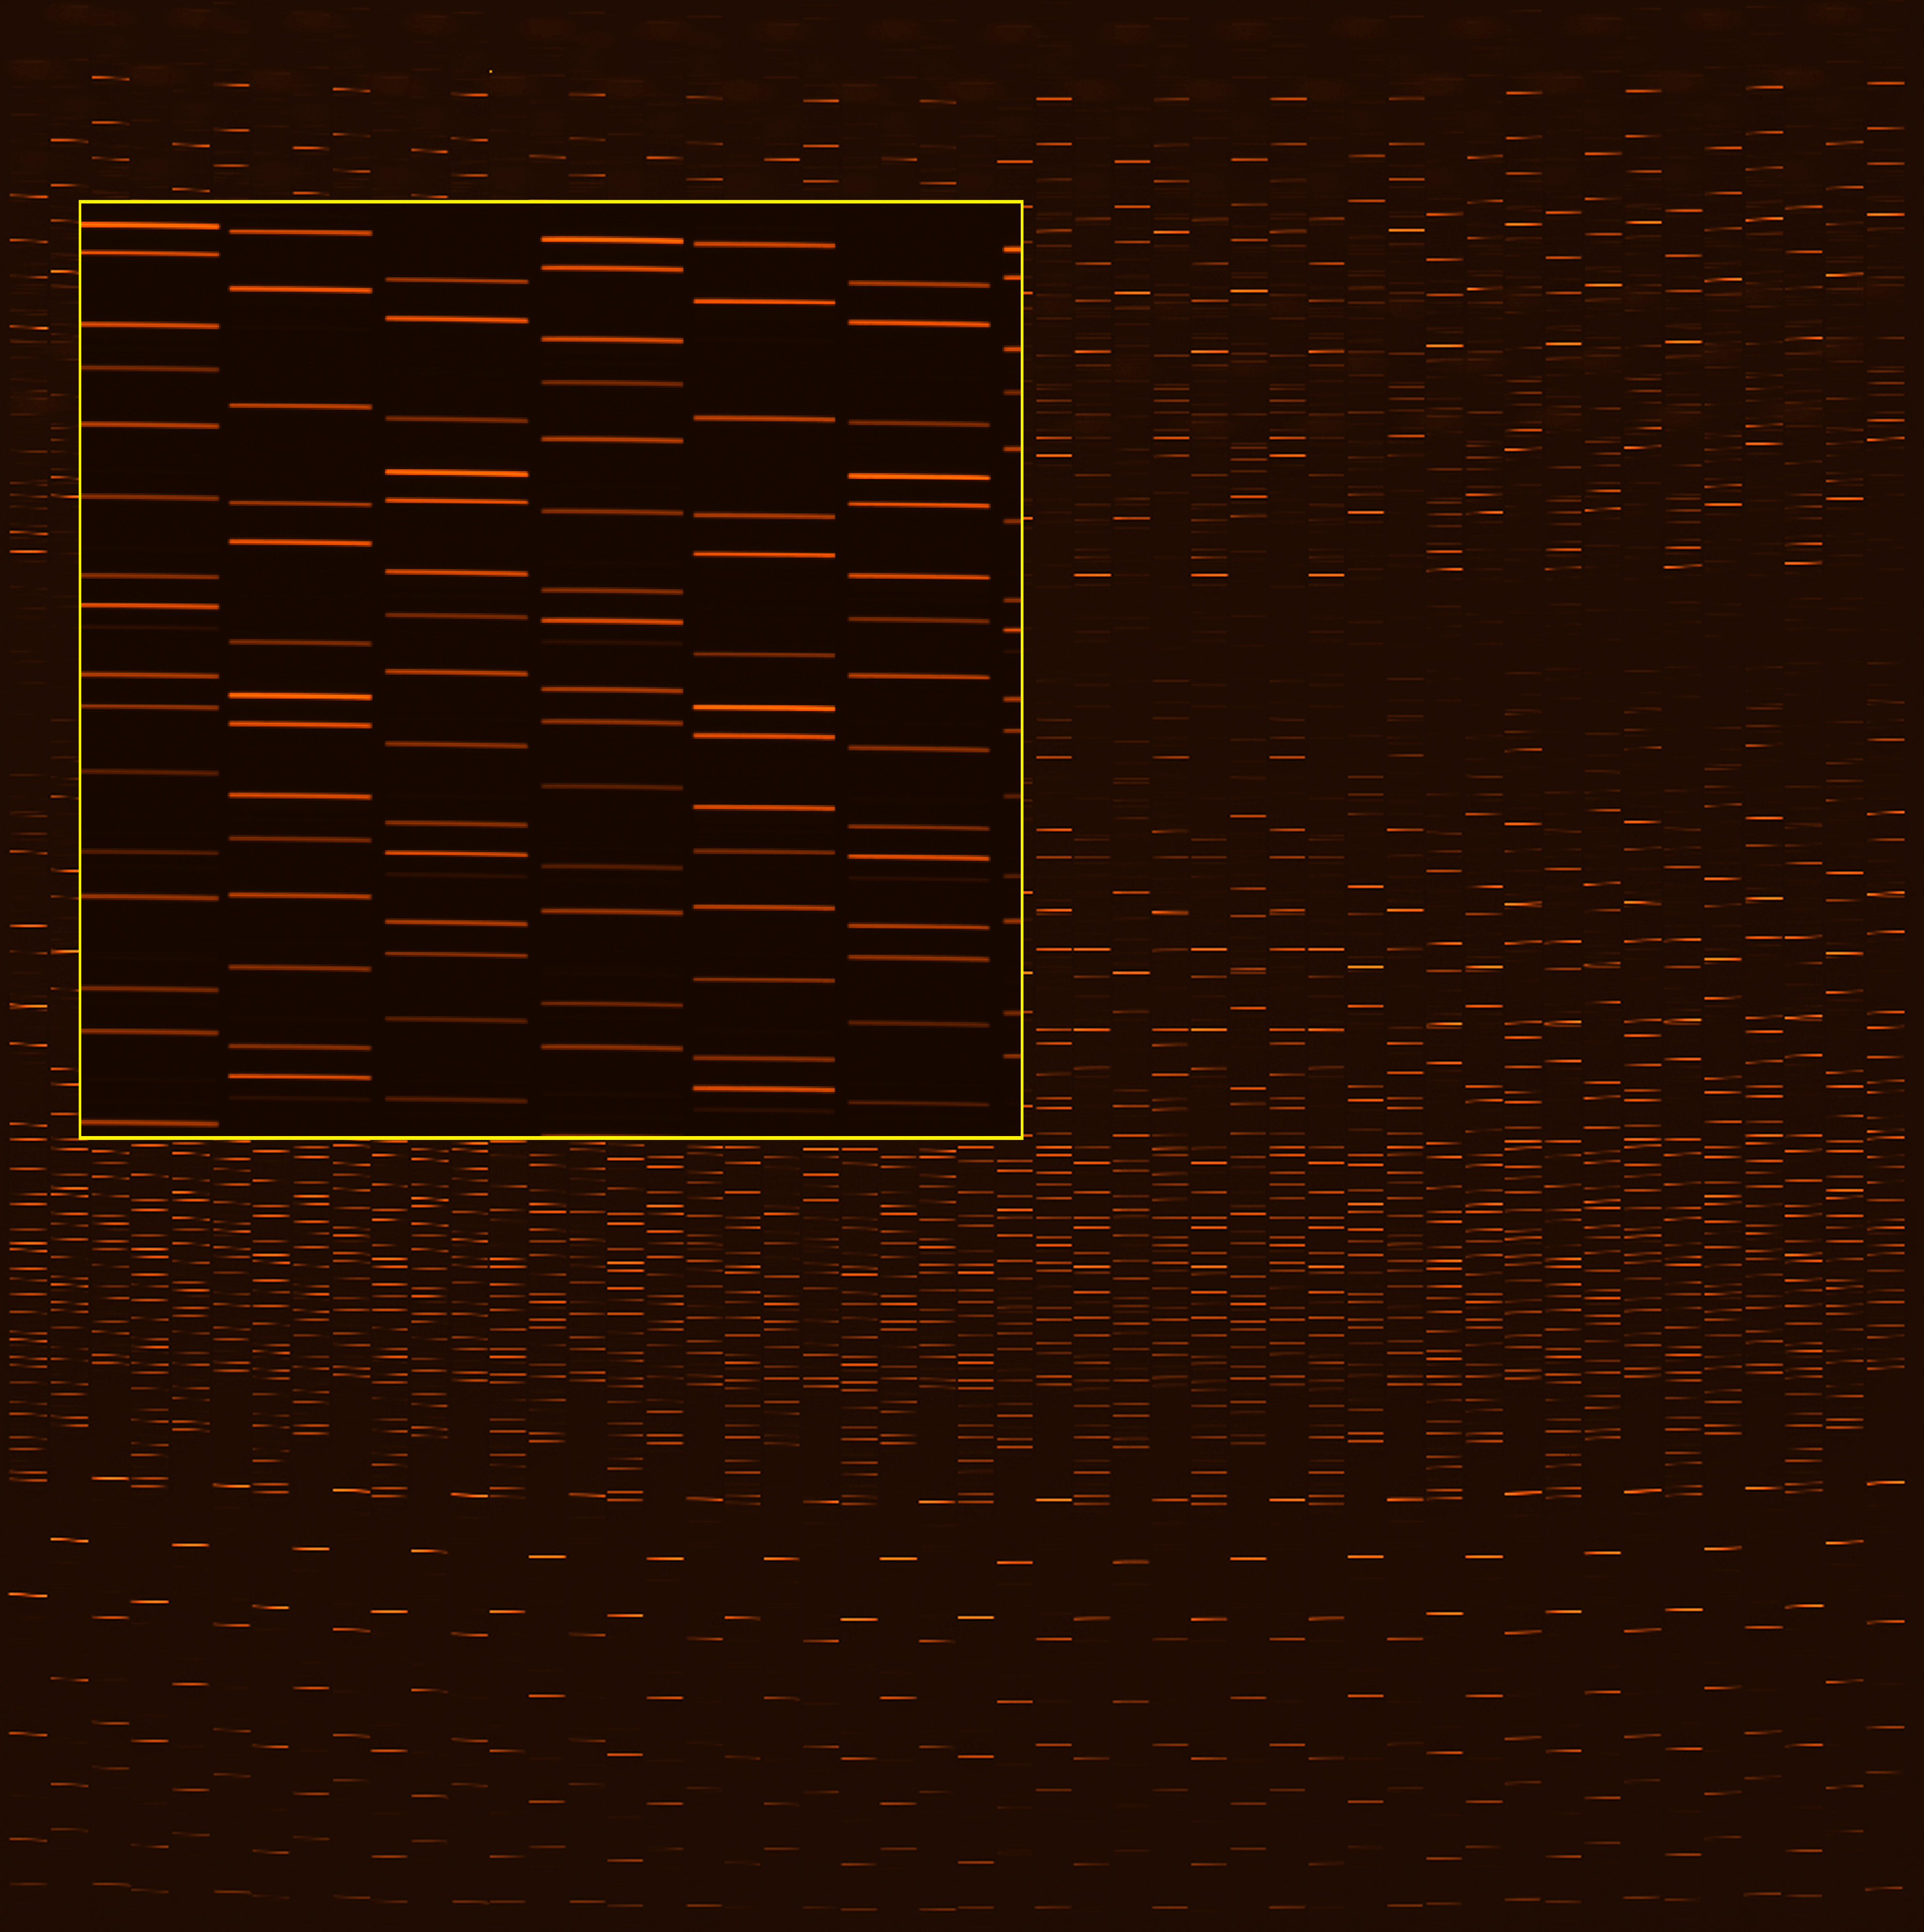
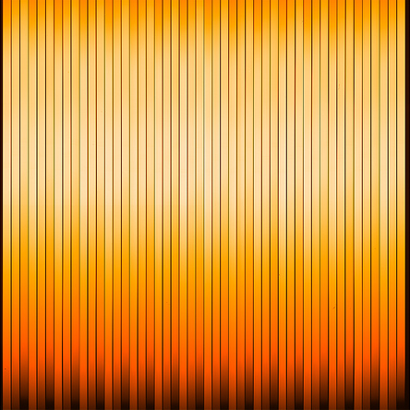
IFU #1: Technical first light
January 2010
Continuum
HgCd + Ne + Xe arc
3750 spectra – only 1/24 of full dataset!

Slide 30
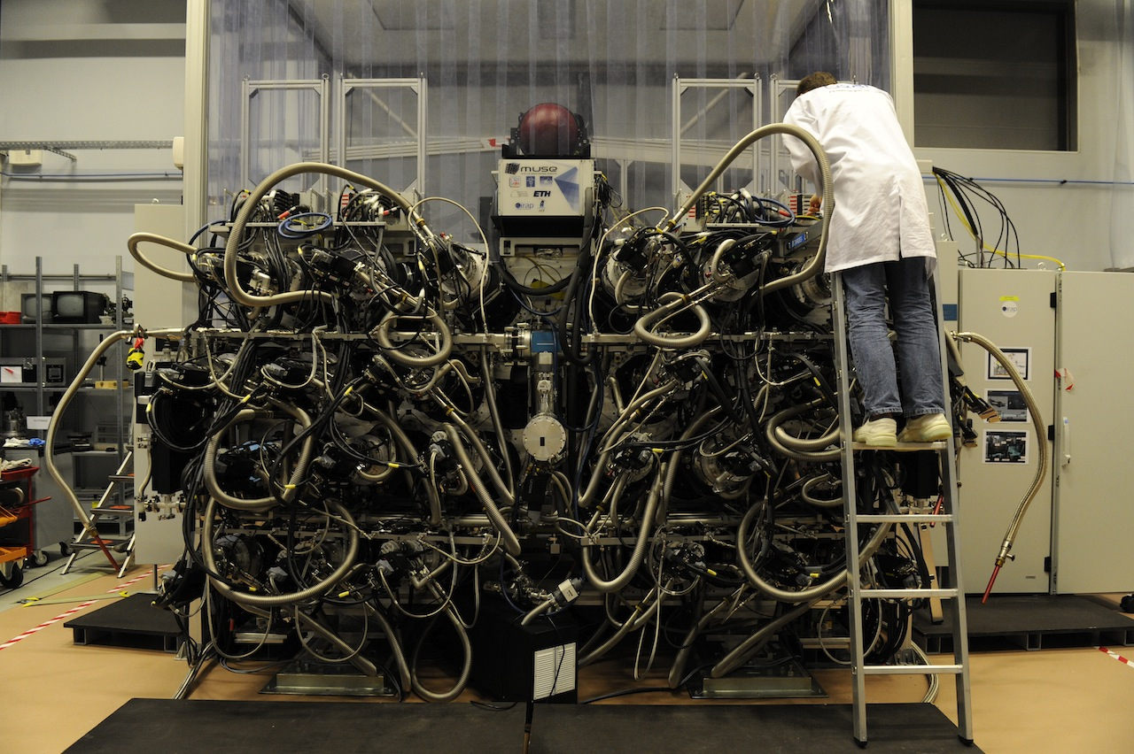
June 2013: MUSE is fully integrated!

Slide 31
Performance: Measured throughput

Slide 32
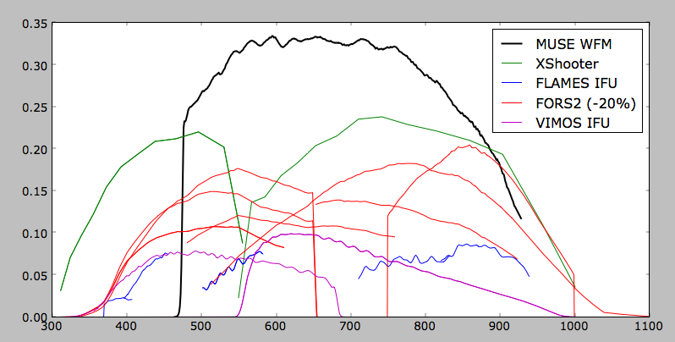
Average (MUSE + VLT) throughput in comparison
including telescope, w/o atmosphere

Slide 33
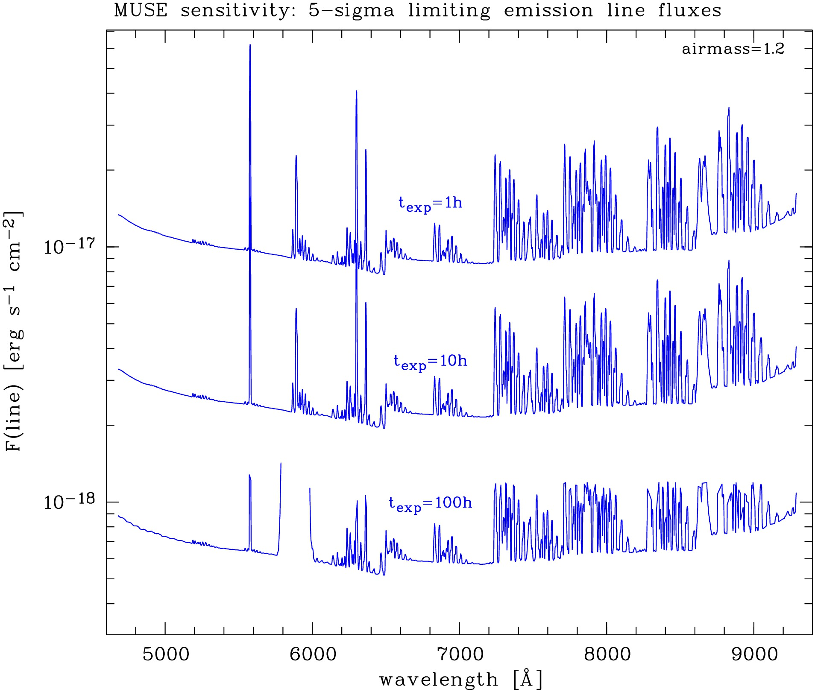
Expected performance: Point source sensitivity
approx. limit for
narrow-band LAE surveys
MUSE:
detection limits for
single line emitters
as fct of exposure time

Slide 34
Science goal revisited:
Progenitors of Milky Way-like galaxies
Growth history of `simulated MW´
Simulations suggest that
MW progenitors were
bright in the Ly-α line,
but most are too faint
for existing narrow-band surveys!
current limiting
sensitivity in Ly α
MUSE sensitivity
MUSE will be able to reveal
the typical MW progenitors
at 3 < z < 6.7
Simulation by Yajima et al 2012; cf. also Dayal & Libeskind 2012

Slide 35
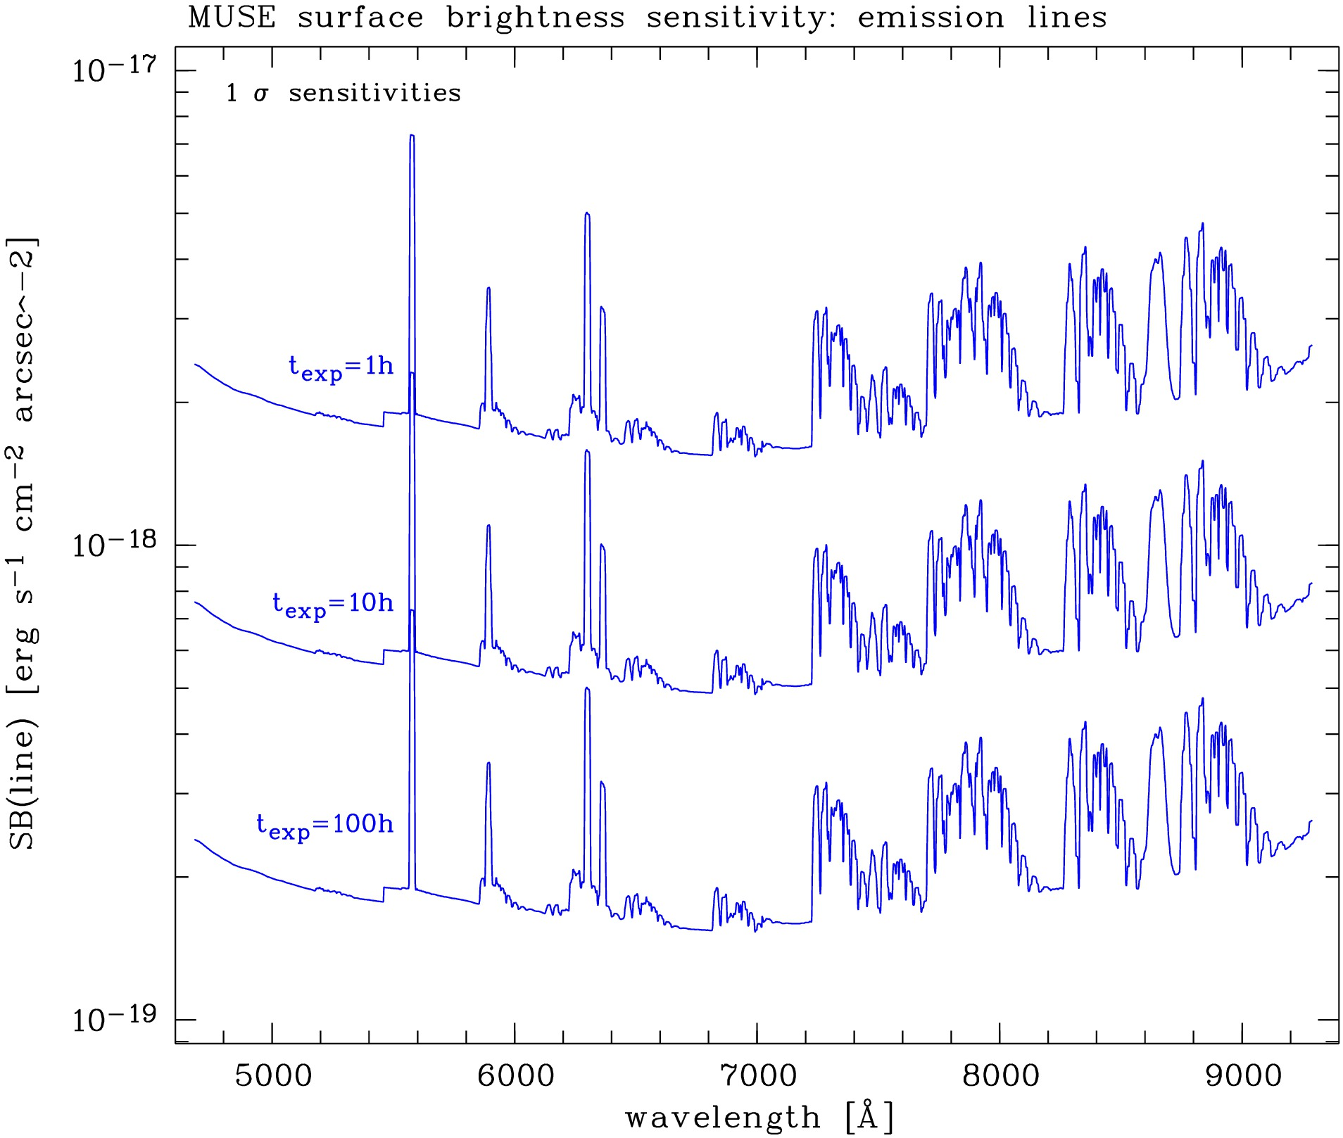
Expected performance: Surface Brightness Sensitivity
approx. limit for
deep narrow-band imaging
MUSE:
detection limits for
extended line emission
as fct of exposure time

Slide 36
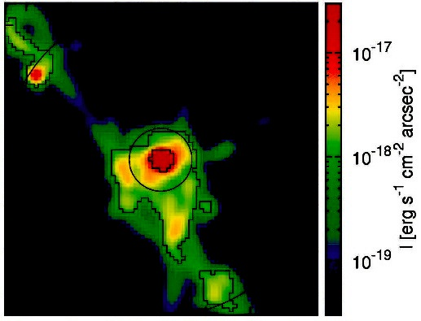
Science goal revisited:
How do galaxies get their baryons?
Simulations: High-z galaxies grow predominantly by smooth accretion of gas
through filamentary streams
Best chance for detection: Ly-α emission from densest filaments near galaxies
but predicted surface brightnesses are extremely low (and uncertain!)
SB limit: 10⁻¹⁸ erg s⁻¹ cm⁻² arcsec⁻²
MUSE will hopefully be able to map the gaseous `Cosmic Web‘ by its extended Ly-α emission.
SB limit: 10⁻¹⁹ erg s⁻¹ cm⁻² arcsec⁻²
SB limit: 10⁻¹⁸ erg s⁻¹ cm⁻² arcsec⁻²
Current limit
for NB imaging
MUSE limit
for t_{exp} = 100h
Simulation: Goerdt et al 2010

Slide 37
Adaptive Optics for MUSE
In 2015, VLT #4 will receive ``Adaptive Optics Facility‘‘
Link to MUSE via GALACSI module.
Wide Field Mode (WFM):
AO correction only for turbulent ground layer
→ "Seeing enhancement" over full 1' x 1' FoV:
Prediction: FWHM < 0.5 arcsec in 60% of nights.
Narrow Field Mode (NFM):
High-order AO for field of view of 7.5" x 7.5"
goal: up to 20% Strehl at 850 nm

Slide 38
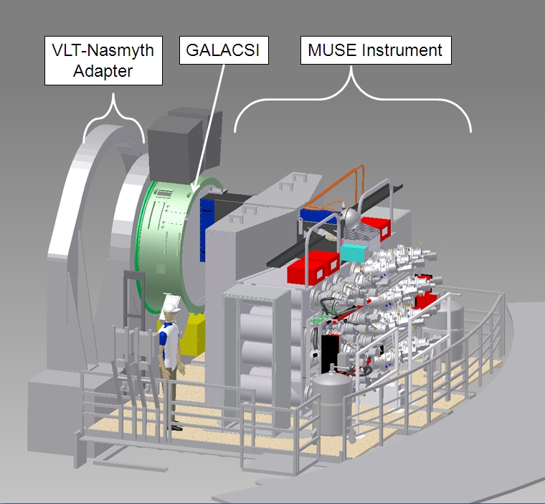
MUSE and GALACSI

Slide 39
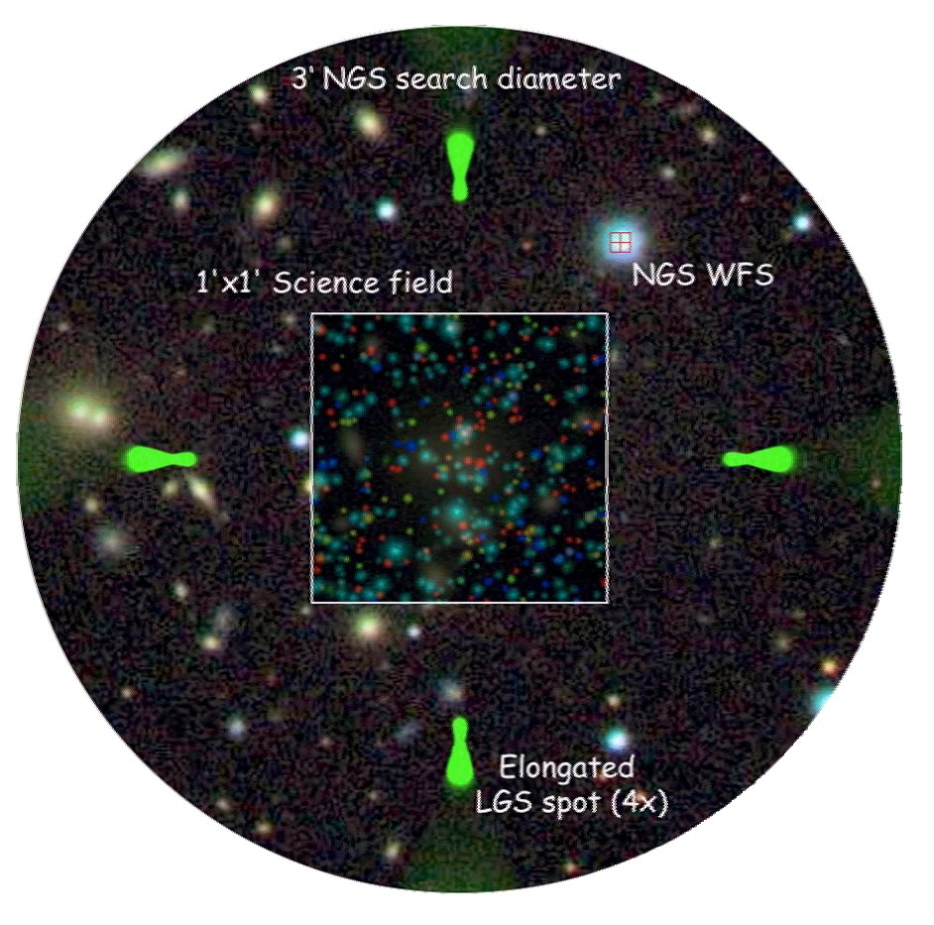
4 laser guide stars:

Slide 40
MUSE Data Handling
1 MUSE exposure: Data from 24 IFUs and 1152 slices
≈ 4 × 10⁸ pixels in data cube ≈ 2 GB
Already elementary data reduction is extremely complex
& resource-consuming.
  Science-grade Data Reduction Software is part of instrument deliverables
  & will be part of ESO standard pipeline.
Many challenges for higher level data analysis:
  Optimal combination of multiple exposures
  Source detection in 3D data cubes
  Extraction of spectra, especially in crowded fields

Slide 41
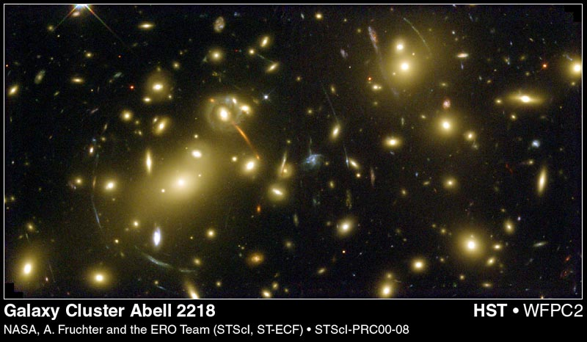

More Key Science Goals for MUSE:
Galaxy Clusters

Slide 42
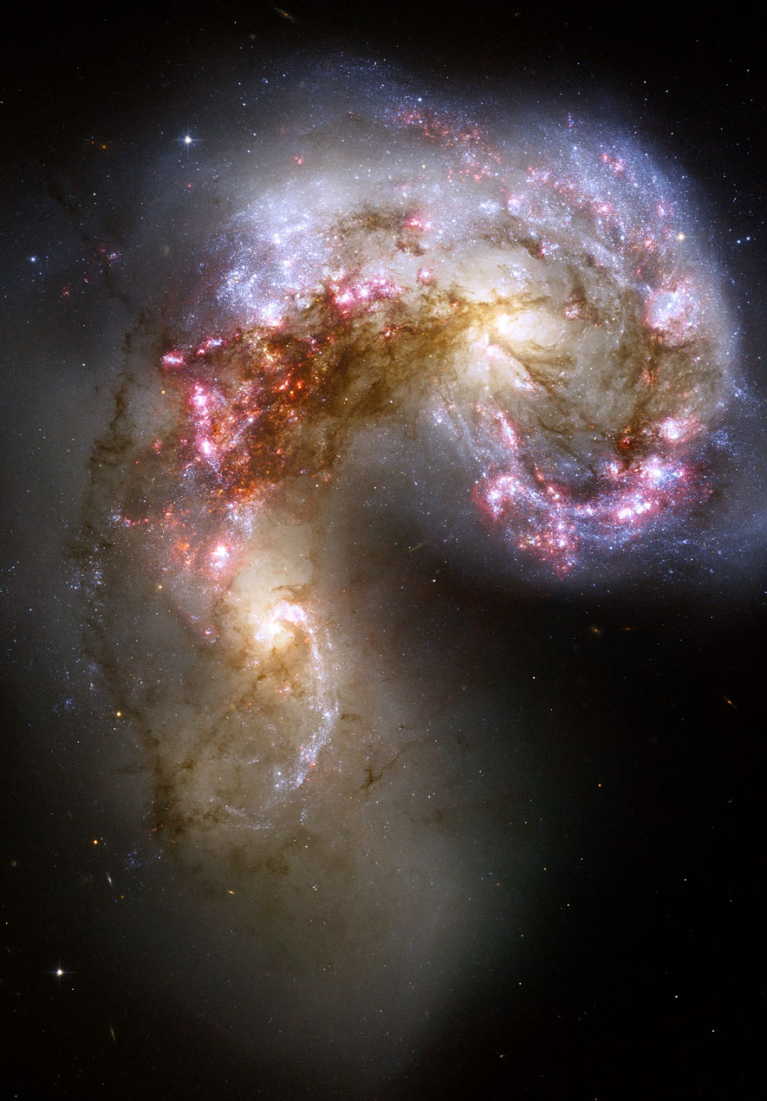
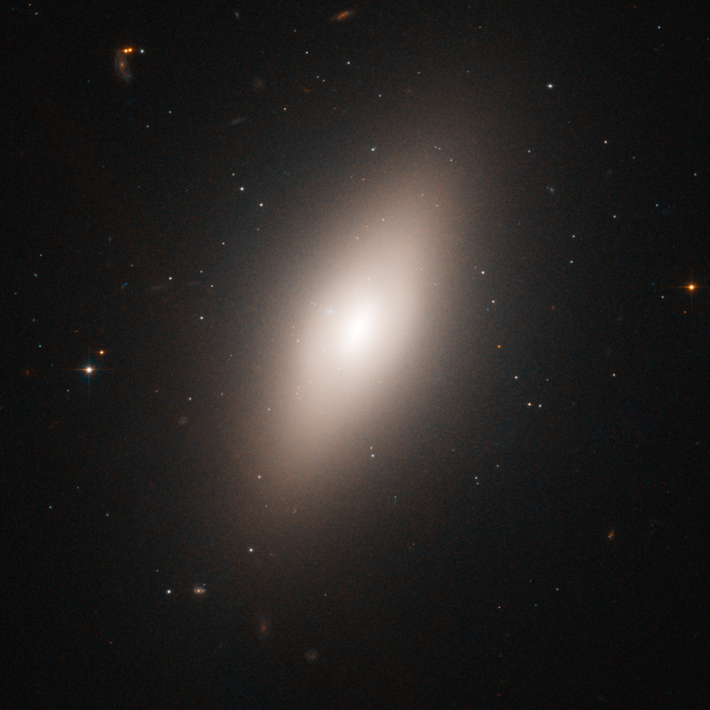
More Key Science Goals for MUSE:
Nearby Galaxies and Galaxy Nuclei

Slide 43
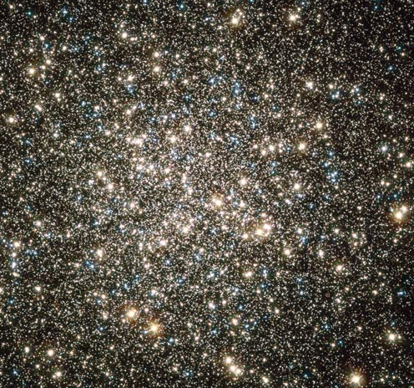
More Key Science Goals for MUSE:
Resolved Stellar Populations and Black Holes in Globular Clusters

Slide 44
MUSE properties in summary
Huge multiplex: 10⁸ spatial × spectral resolution elements
enabled through modular design
maximally stable for very long integrations
essentially no moving parts: fixed spectral format
Extremely high throughput
due to state-of-the-art coatings
AO supported: "seeing enhancement" over 1' x 1' field of view

Slide 45
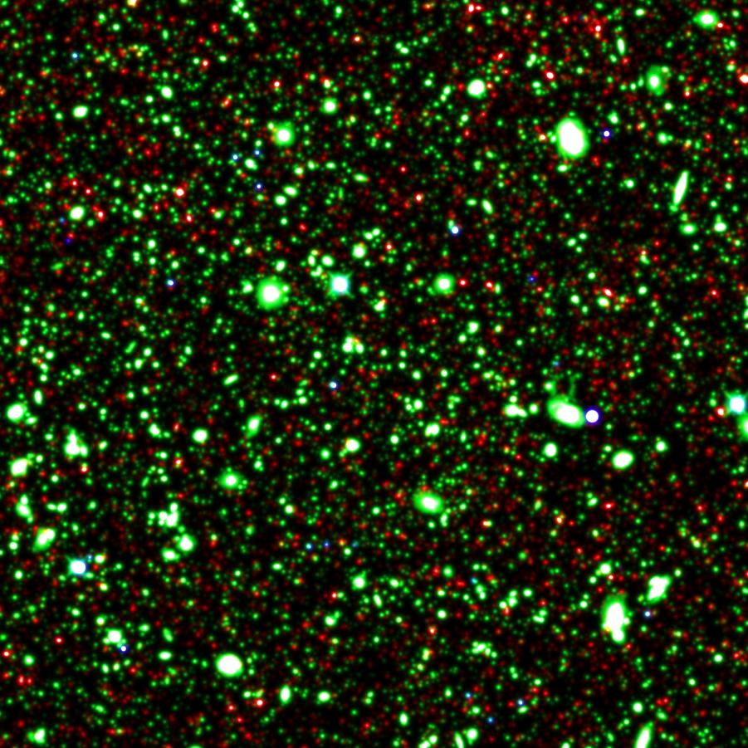
A simulated Hubble Ultra Deep Field `observed‘ with MUSE
Noise-free input to
3' x 3' data cube:
Red: z > 2.875
Ly α galaxies
(from cosmological hydro simulation)
Green: z < 2.875
HUDF galaxies + assumed velocity fields
Blue: HUDF stars
all: 35,018 objects

Slide 46
A simulated Hubble Ultra Deep Field `observed‘ with MUSE
white light images 1' x 1'
t_{exp} = 2^{h}, no AO,
poor seeing,
some moon.
t_{exp} = 10^{h}, no AO,
median seeing,
dark time.
t_{exp} = 80^{h} + AO,
good seeing,
dark time.

Slide 47
Detection of continuum counterparts:

Slide 48
MUSE science cases
Formation and evolution of galaxies at z > 3
Galaxy evolution at z < 1.5
High-resolution studies of nearby galaxies
Resolved stellar populations in the Milky Way and very nearby galaxies
Young Stellar Objects
Gas Nebulae
Solar System objects
...

