Slide 1
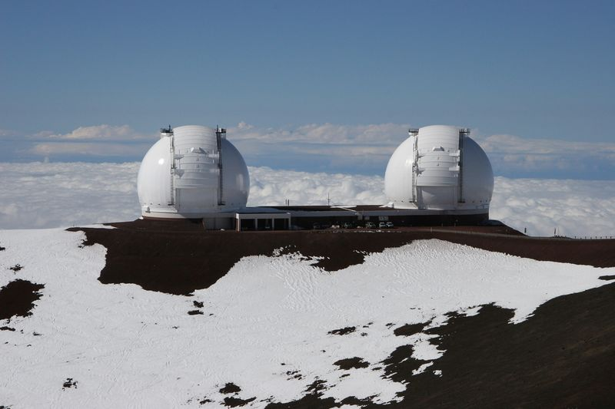
The Performance of MOSFIRE
Ian S. McLean
Dept. Physics & Astronomy
UCLA, Los Angeles, CA
Scientific Detector Workshop 2013, Florence

Slide 2
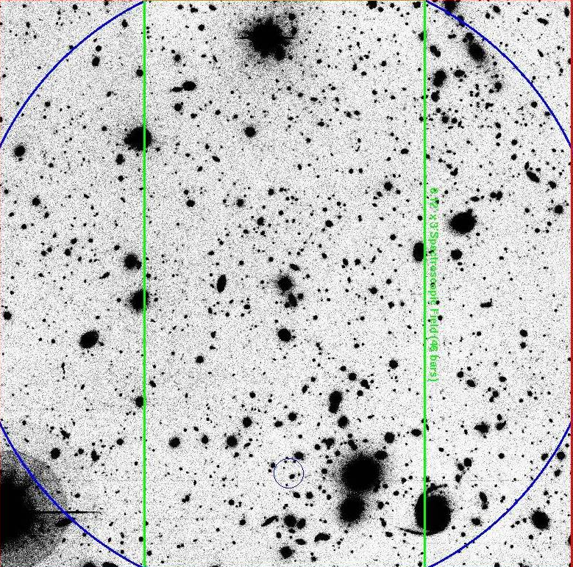
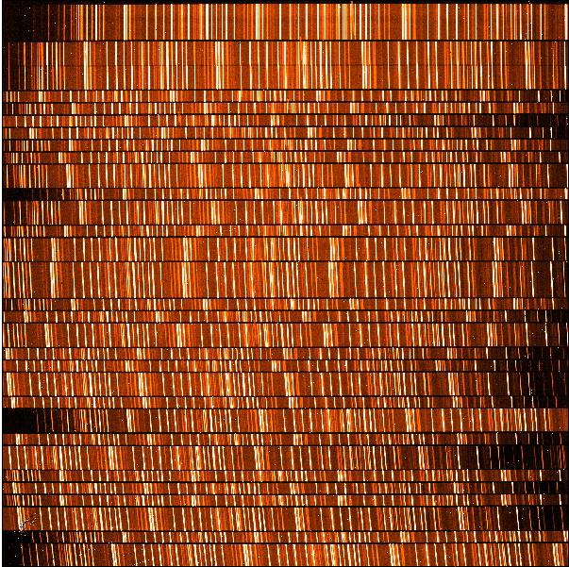
MOSFIRE is the newest instrument for the W. M. Keck Observatory
Takes an infrared picture …
Then, by switching a mirror to a diffraction grating, it records the spectrum of all targets at same time on the same detector.
Field of View 6′ x 6′
isolates individual targets …
Slit mask in central 6′ x 3′
The pattern of 46 short slits is reconfigurable in under 6 minutes

Slide 3
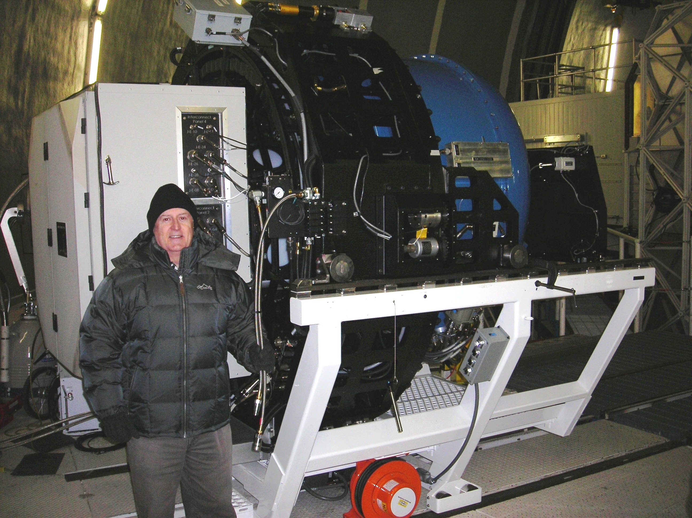
MOSFIRE ready for installation at the Keck Observatory
But the story does not begin here …
April 2012

Slide 4
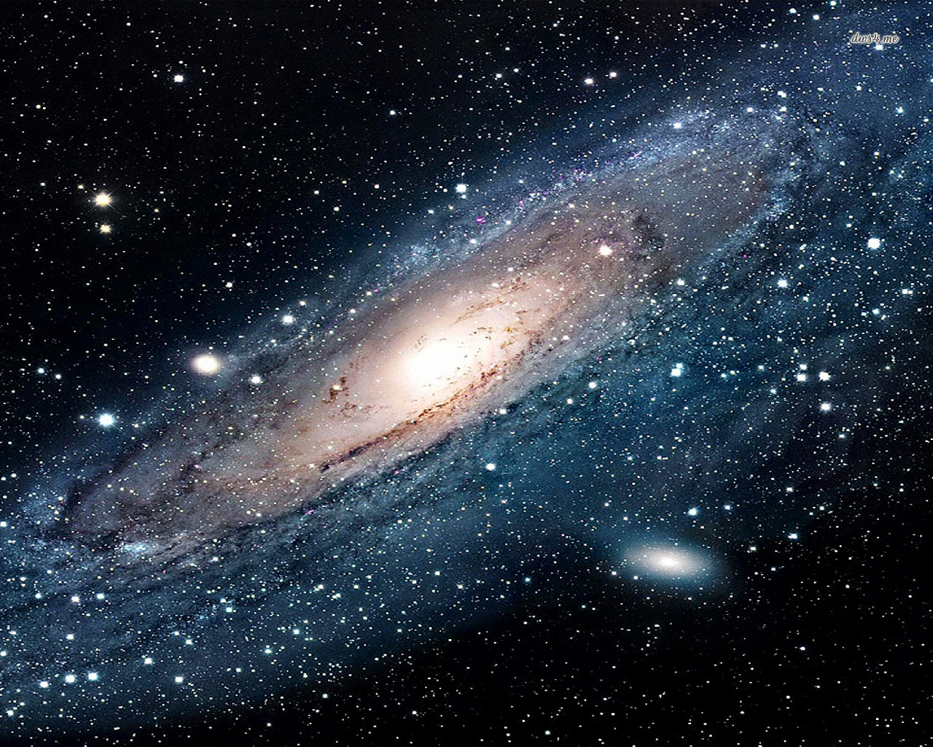
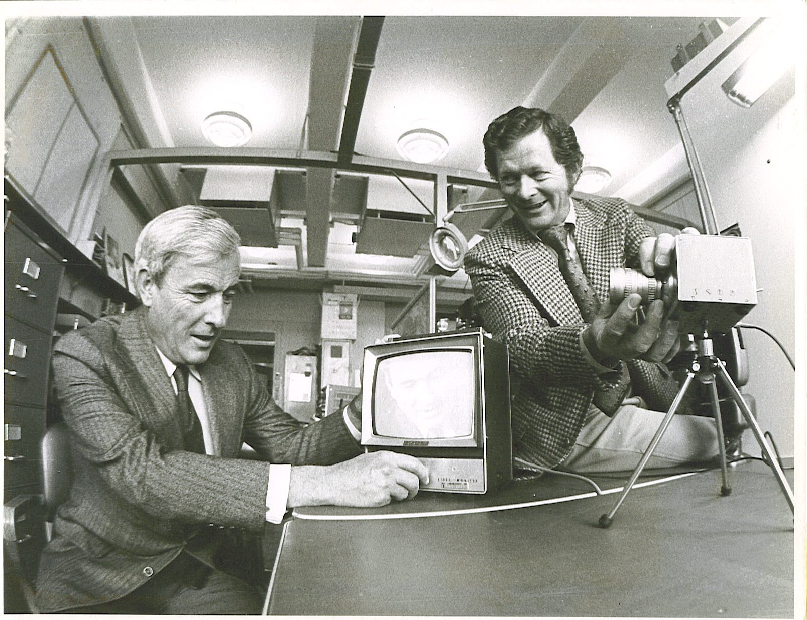
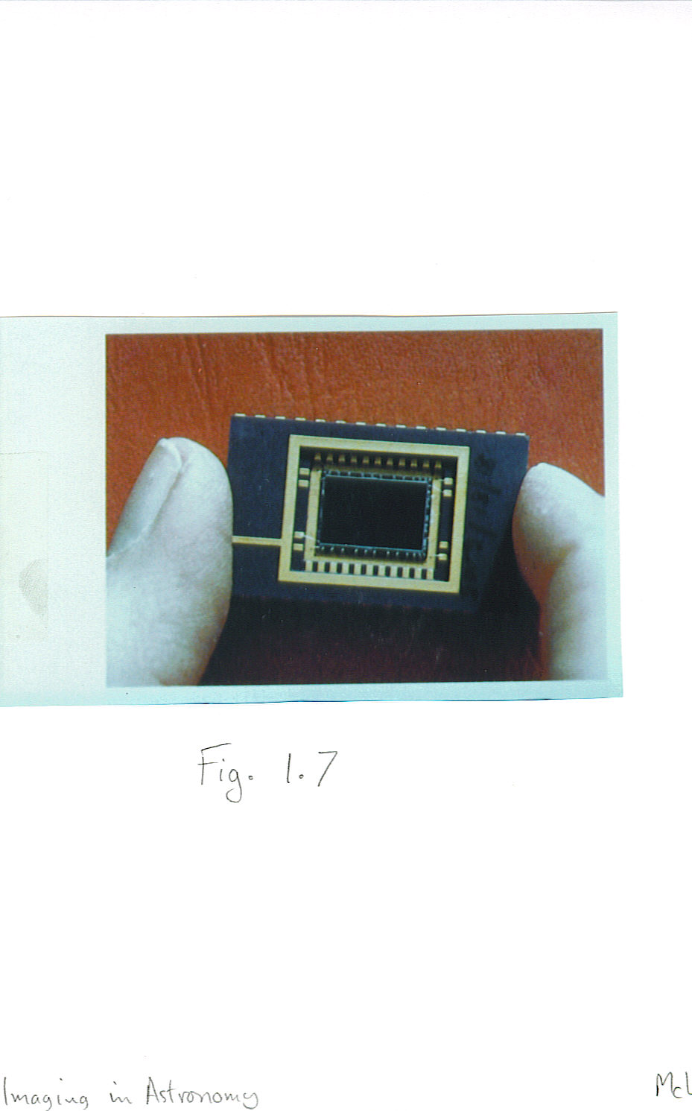
The advent of Digital Imaging
Visible light astronomy gets the Charge-Coupled Device
“PIXELS”
An early CCD
c. 1979
1970
Willard Boyle and George Smith – CCD inventors
CCDs change everything! What about IR?

Slide 5
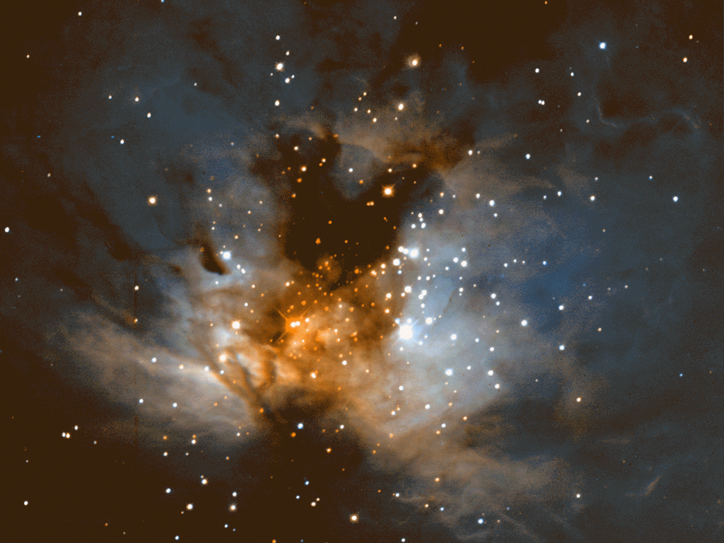
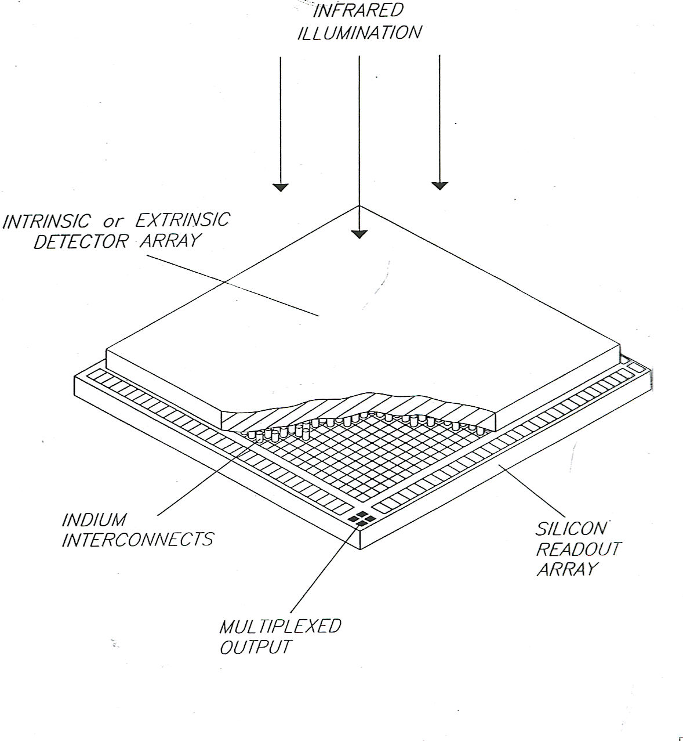
Infrared Array Detectors
Slower development than CCDs
Need lower band-gap semiconductors
Ge, InSb or HgCdTe – these materials are intrinsic semiconductors
Or extrinsic arrays of doped Si or Ge
HYBRID construction: Infrared material bonded by tiny indium bumps to a silicon readout circuit; harder to yield therefore more costly.

Slide 6
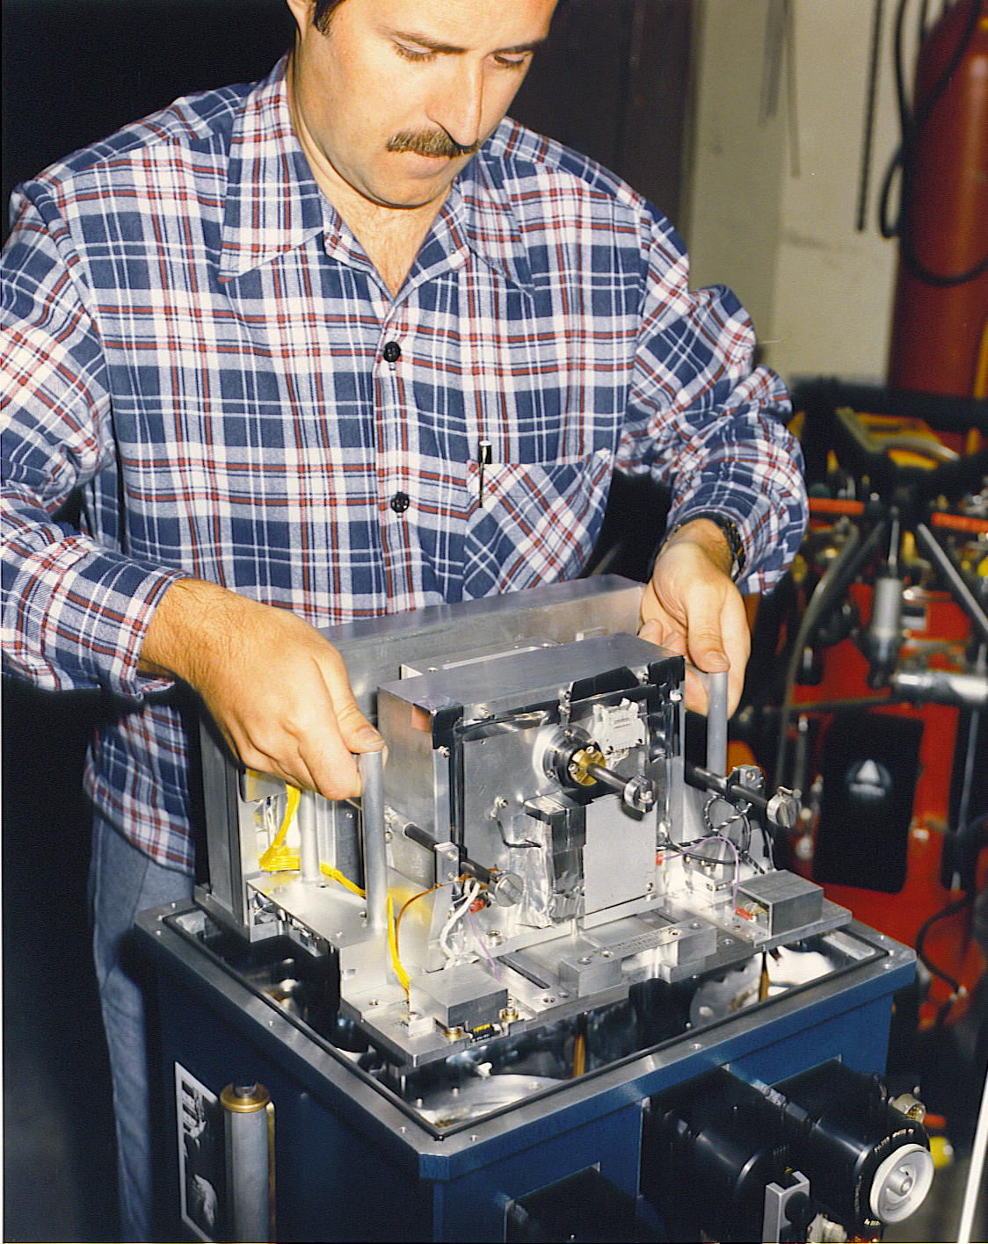
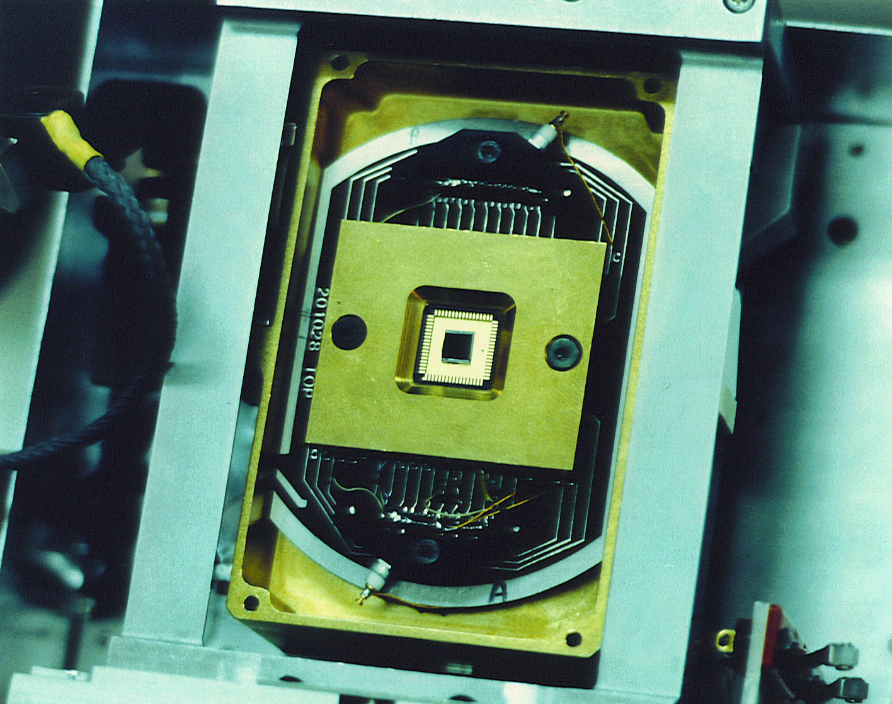
First good infrared arrays ~1984
That’s me with the first infrared camera for UKIRT in 1986.
58 x 62 = 3,596 pixels … very small
Today, IR arrays drive instrument designs. Consider Keck:

Slide 7
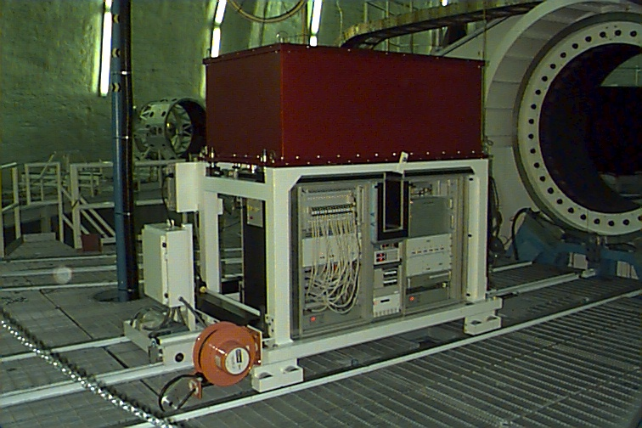
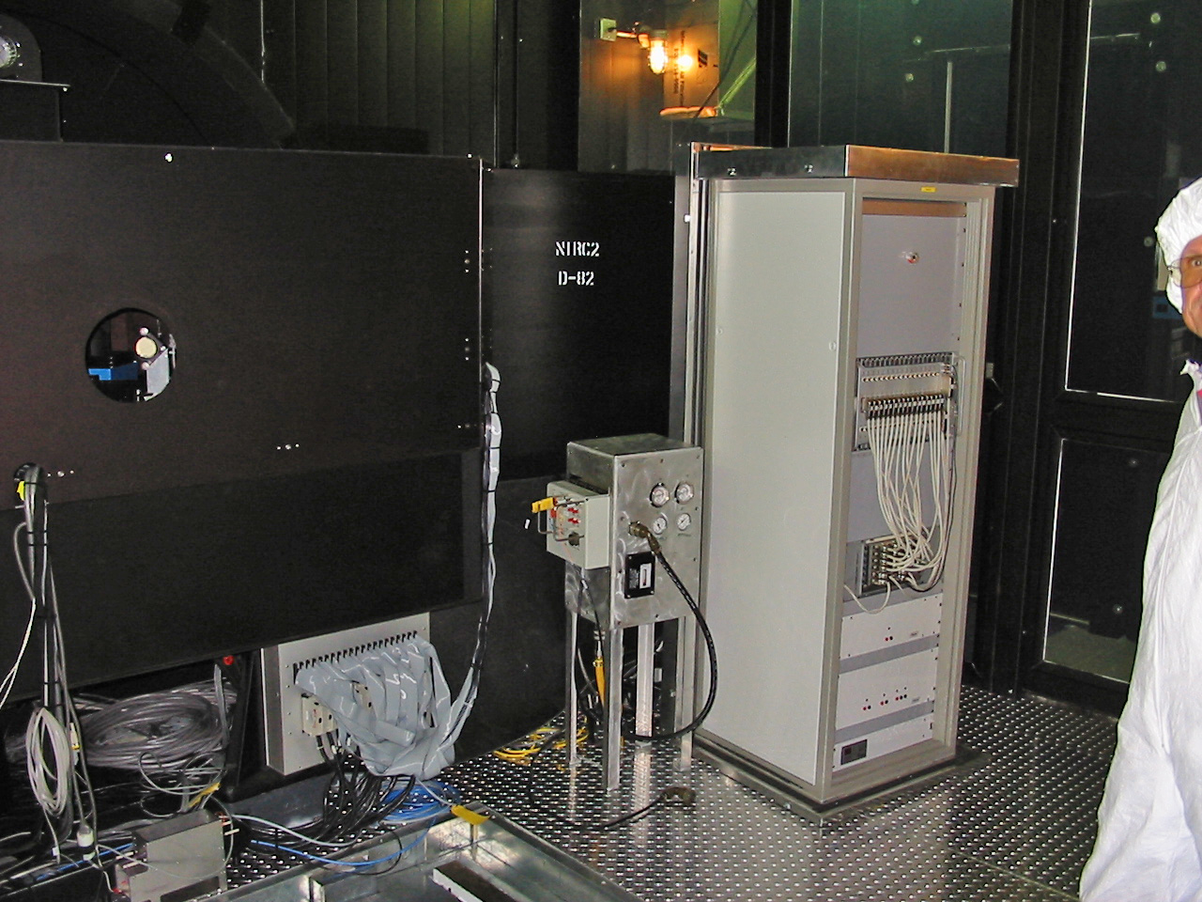
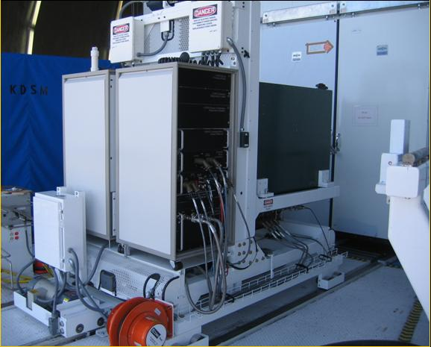
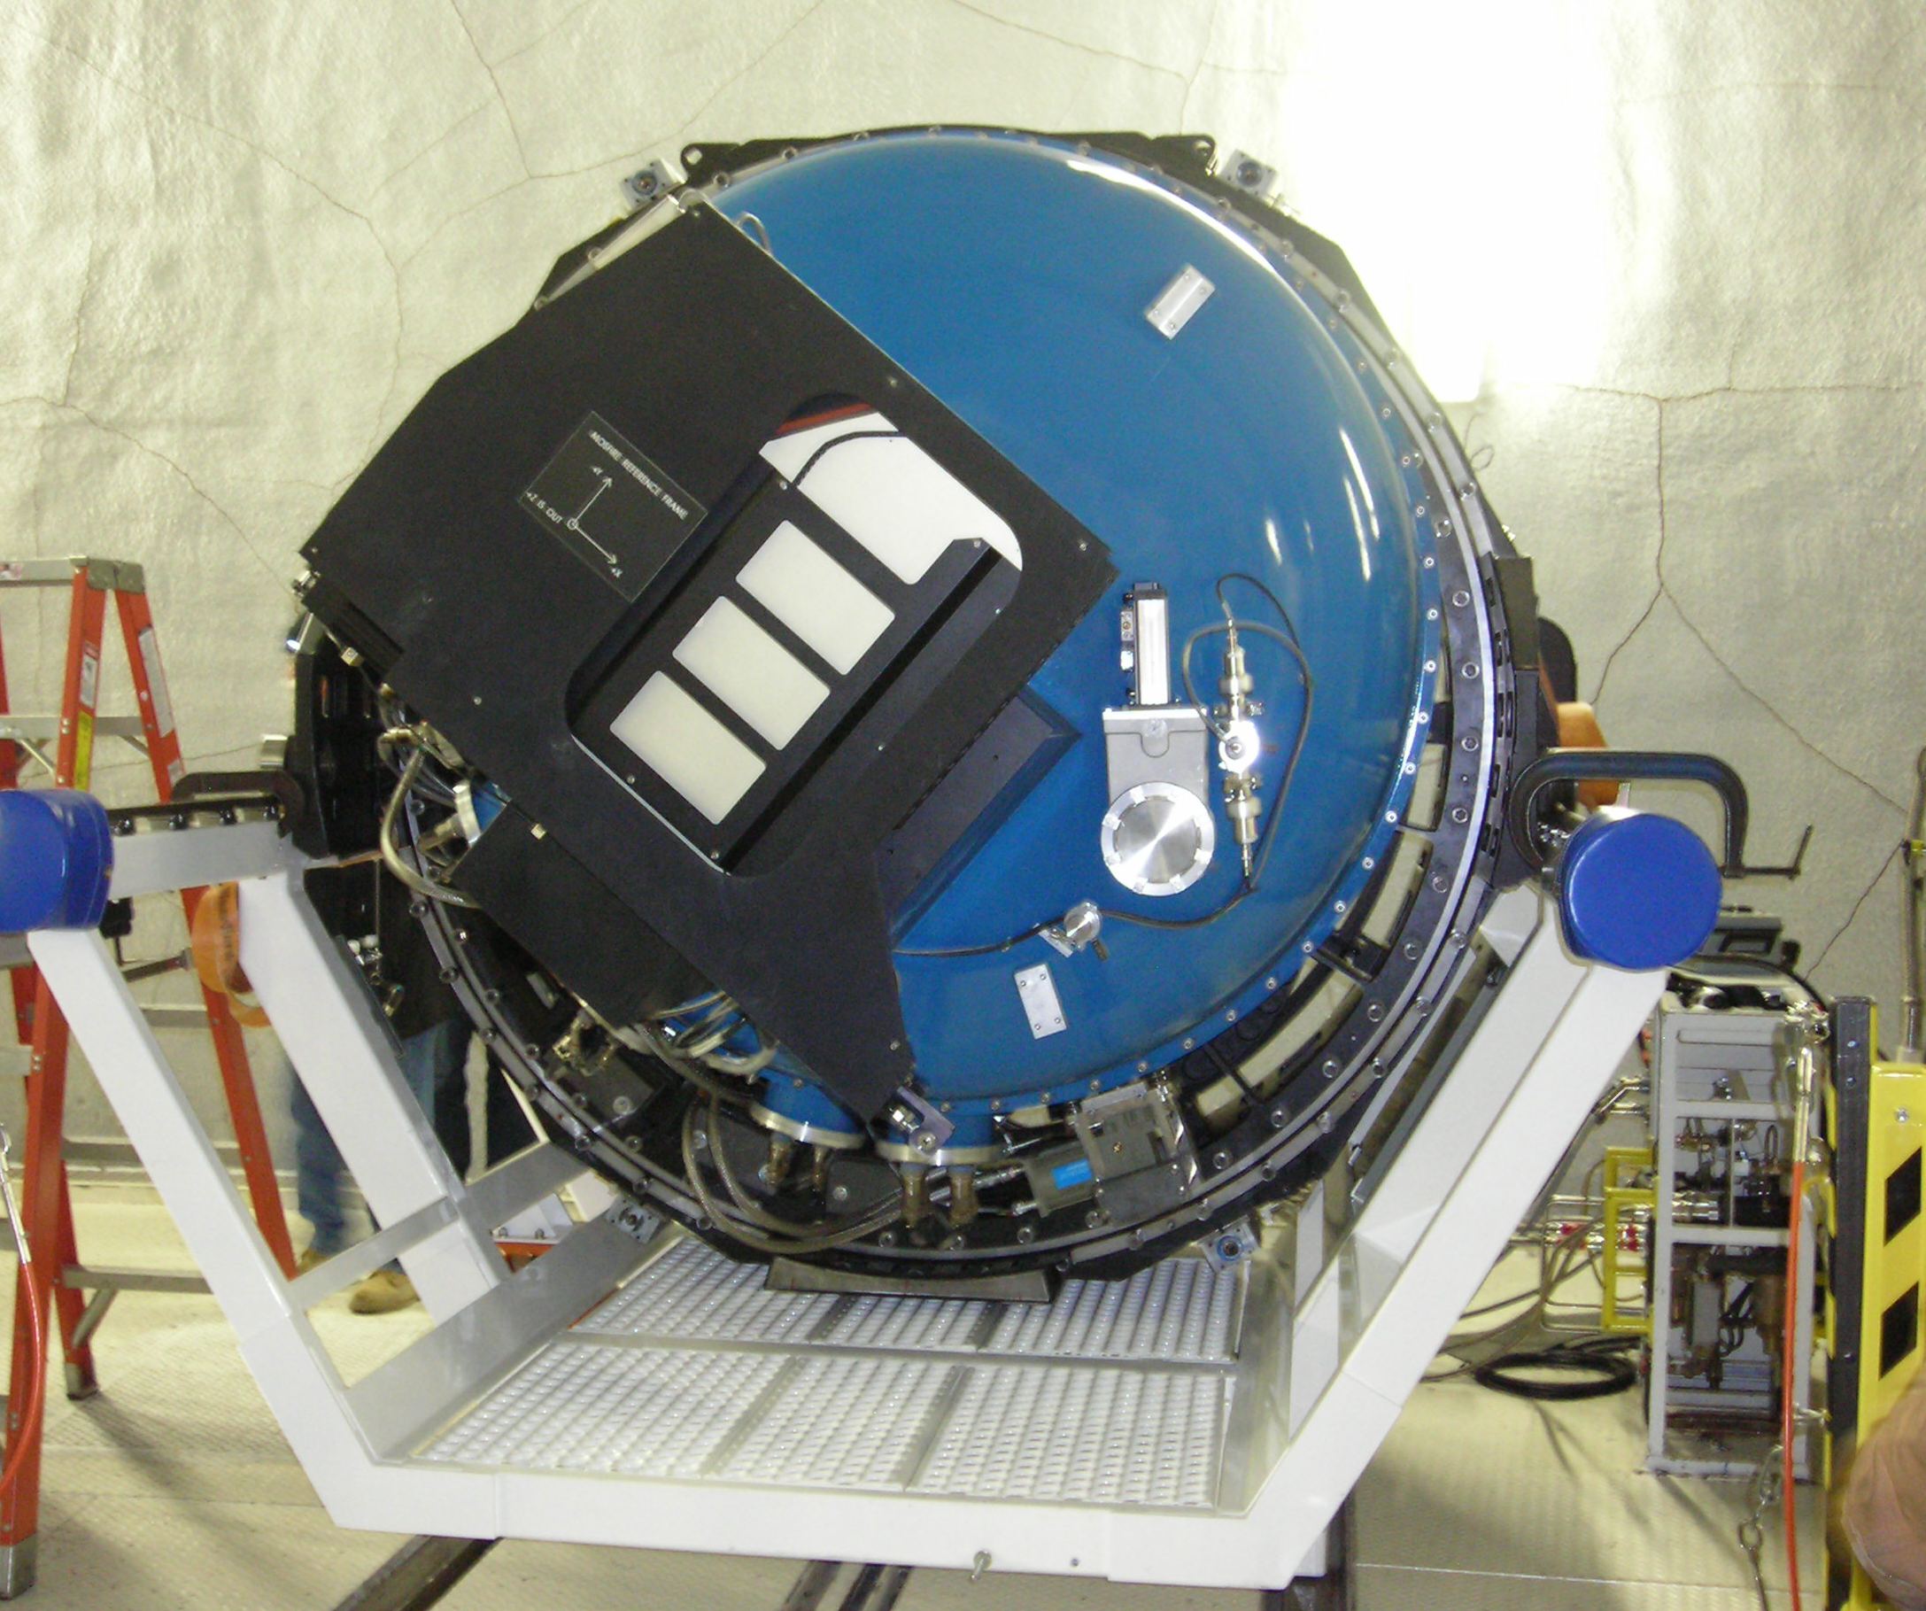
Keck’s Infrared Instruments
These instruments help drive the development of detector formats and performance
NIRSPEC
[1 megapixels; 1-5 microns]
NIRC2
KII
KII
Diffraction-limited imaging with AO
Single object echelle spectro-graph
1999
UCLA
2001
CIT + UCLA
[4 megapixels; 1-. 2.5 microns]
KI
KI
Diffraction-limited integral field spectroscopy
The newest instrument is
MOSFIRE
2005
UCLA
2012
UCLA + CIT
OSIRIS
Multi-object spectrograph and camera

Slide 8
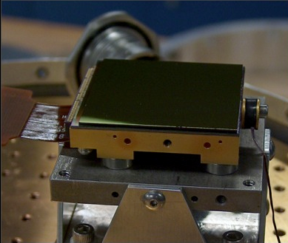
Imaging & spectroscopy on the same detector is a challenge
Key Requirements: 5e- rms noise; negligible dark current; QE~1; good uniformity, excellent flatness (fast beams) and no persistence.
H2-RG HgCdTe array; Teledyne (2.5μ cut-off)
With SIDECAR ASIC
100 kHz data rate
32 channel read out
V2.3 of HxRG; shortest exposure = 1.45s
Single, CDS, MCDS (Fowler), UTR
Reference pixel subtraction … later

Slide 9
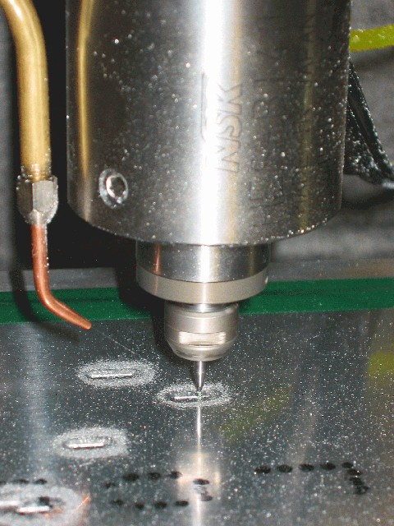
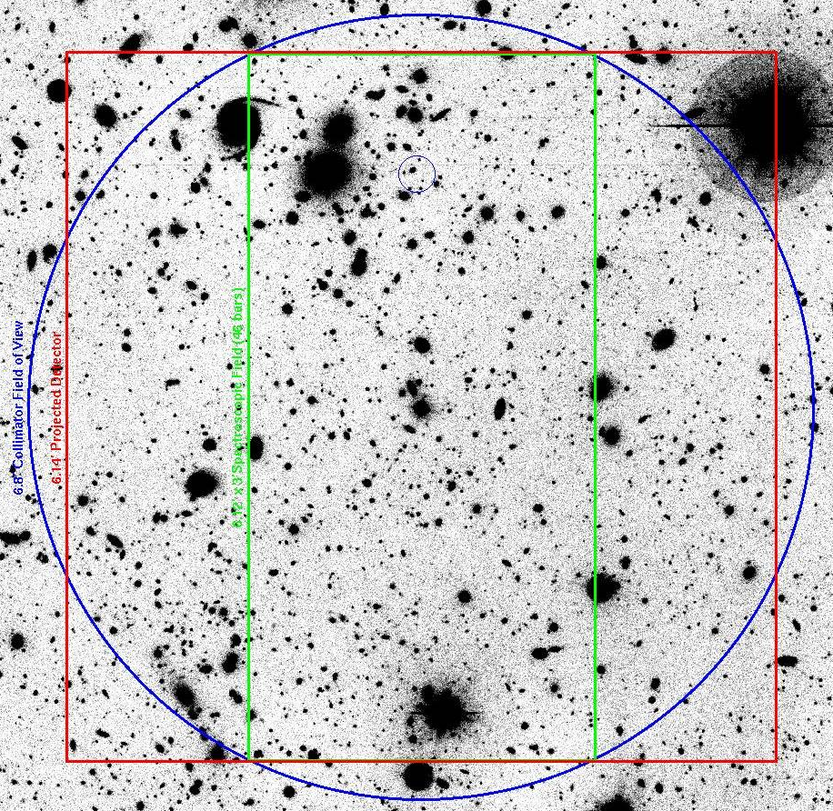
Requirements for MOSFIRE
Achieve a field of view of 6′ x 6′, like our optical spectrographs.
Highest spectral resolution possible on a state-of-the-art, 4 megapixel infrared detector. (R ~3,500 for 0.7″ slit; ~3 pixels).
At least 15-20 objects (slits) per field.
Excellent stability and repeatability.
Achieve best possible sensitivity for faint object spectroscopy – every photon counts!
Avoid the classic slit mask concept – slits milled in an aluminium plate ahead of time – and
Avoid thermal cycles of the instrument to install a batch of slit plates
But how do you do this?

Slide 10
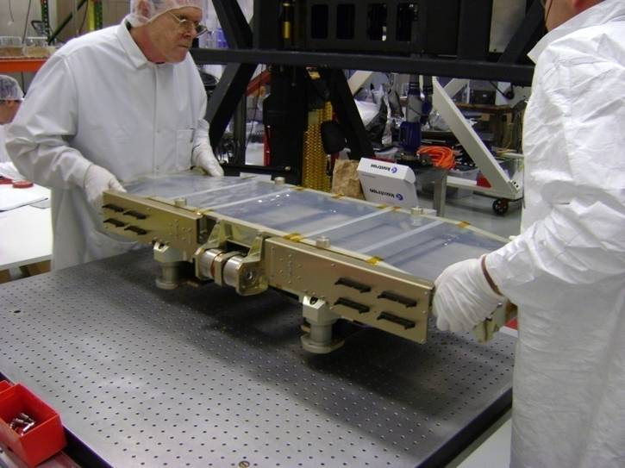
MOSFIRE’s Cryogenic Slit Mask Unit
The aperture is 267 x 267 mm.
THE MOSFIRE CSU
Pairs of opposing bars configured under computer control produce a slit mask without cryo-cycling.
Developed by the Swiss Center for Electronics and Micro-technology (CSEM)
10

Slide 11
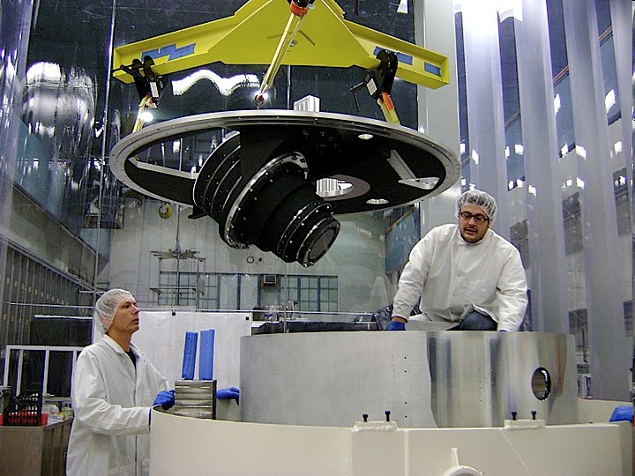
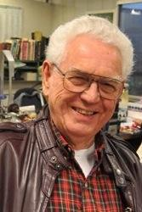
Internal Layout
Large vacuum-cryogenic instrument
~5 tons shipping wt.
Cassegrain/Keck 1
Double-window
Configurable slit mask
Large Field Lens
Flexure compensation
Double Filter Wheel
Rotating Pupil
Grating/Mirror Turret
7-element Camera
H2-RG (2K x 2K)
Offset guider
Optical design by Harland Epps, UC Santa Cruz
11

Slide 12
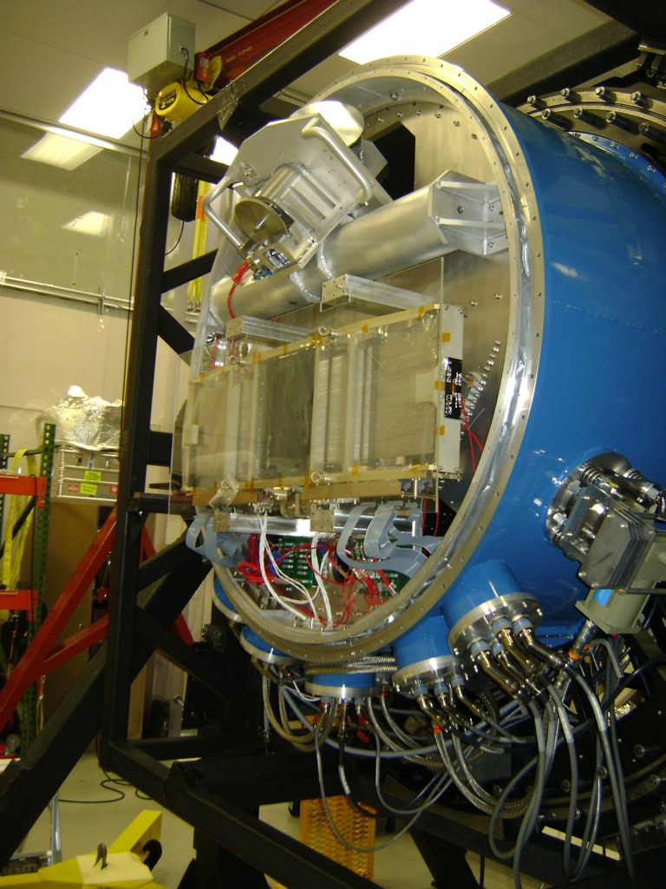
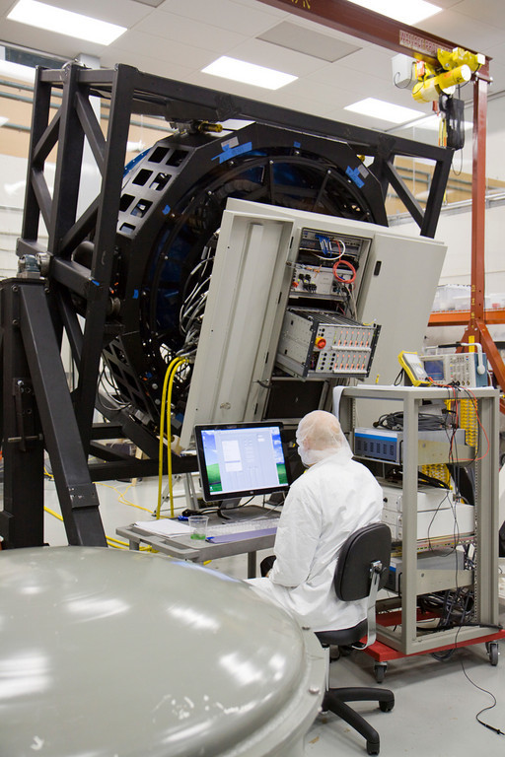
Intensive Lab Testing
1.5m
Front side of instrument open, showing slit mask unit in place.
Rear side, showing electronics cabinet (open) under test.

Slide 13
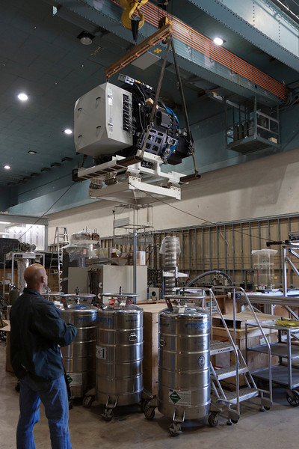
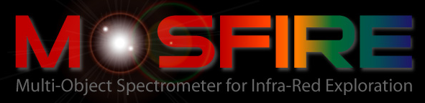
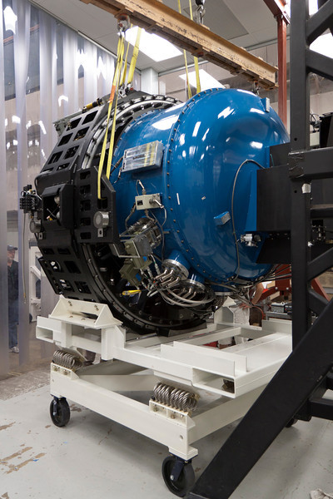
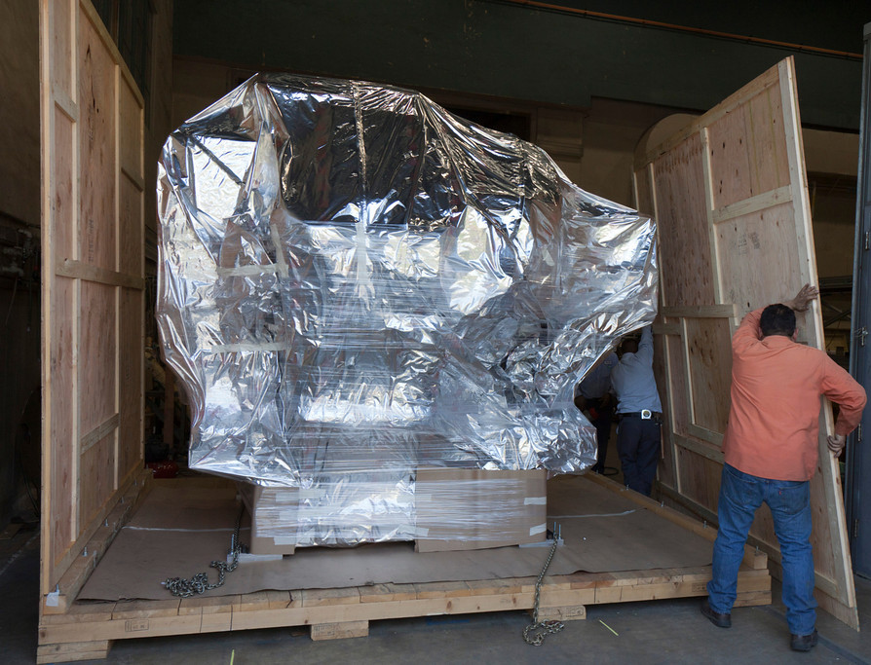
February 3, 2012 – Packing Day: MOSFIRE prepares for its journey to Hawaii

Slide 14
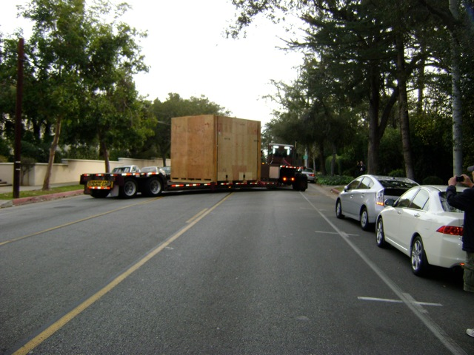
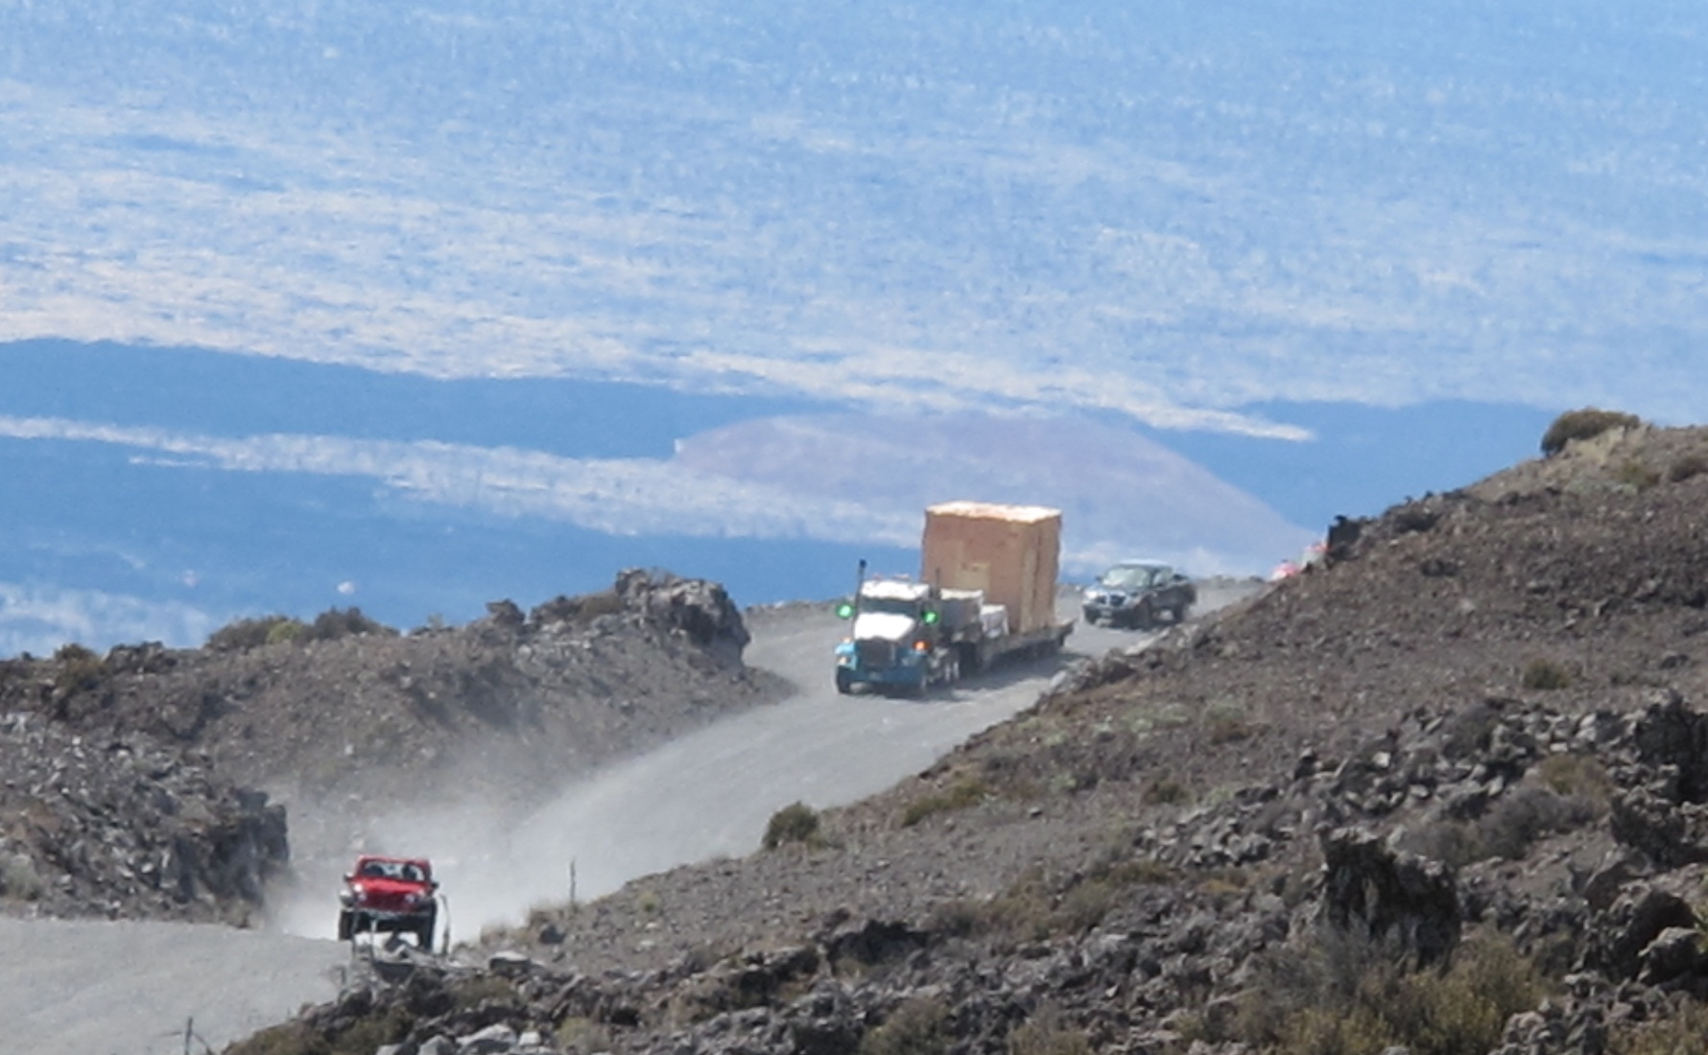
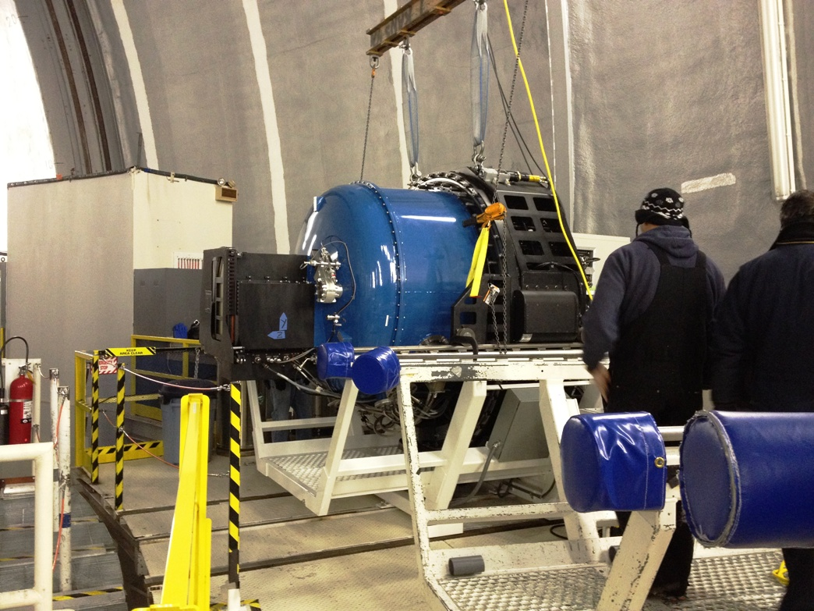
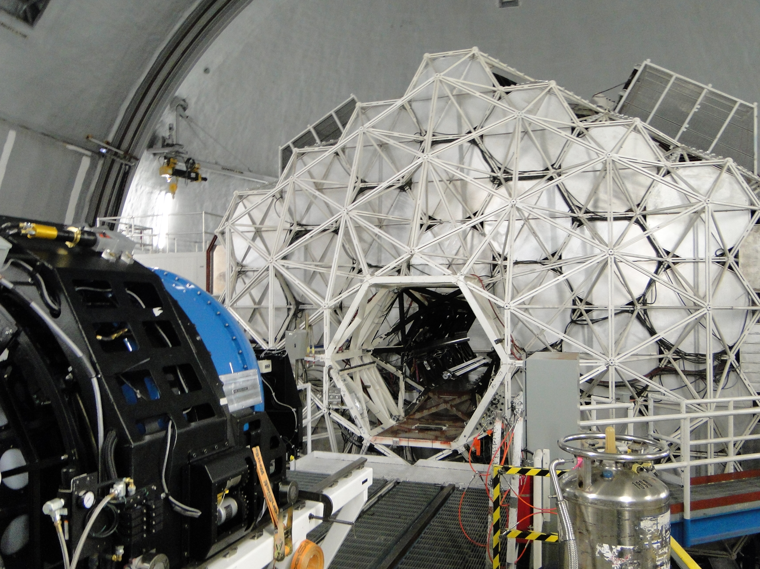
To Mauna Kea: February 6 –April 4
February 16 – arrival on Mauna Kea
9am Monday, February 6, 2012 – MOSFIRE departs for San Diego
April 4, 2012

Slide 15
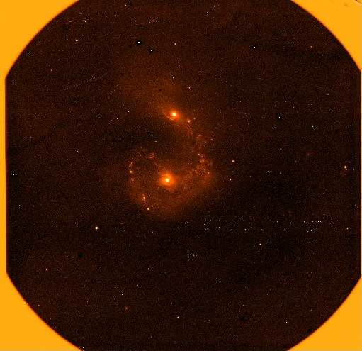
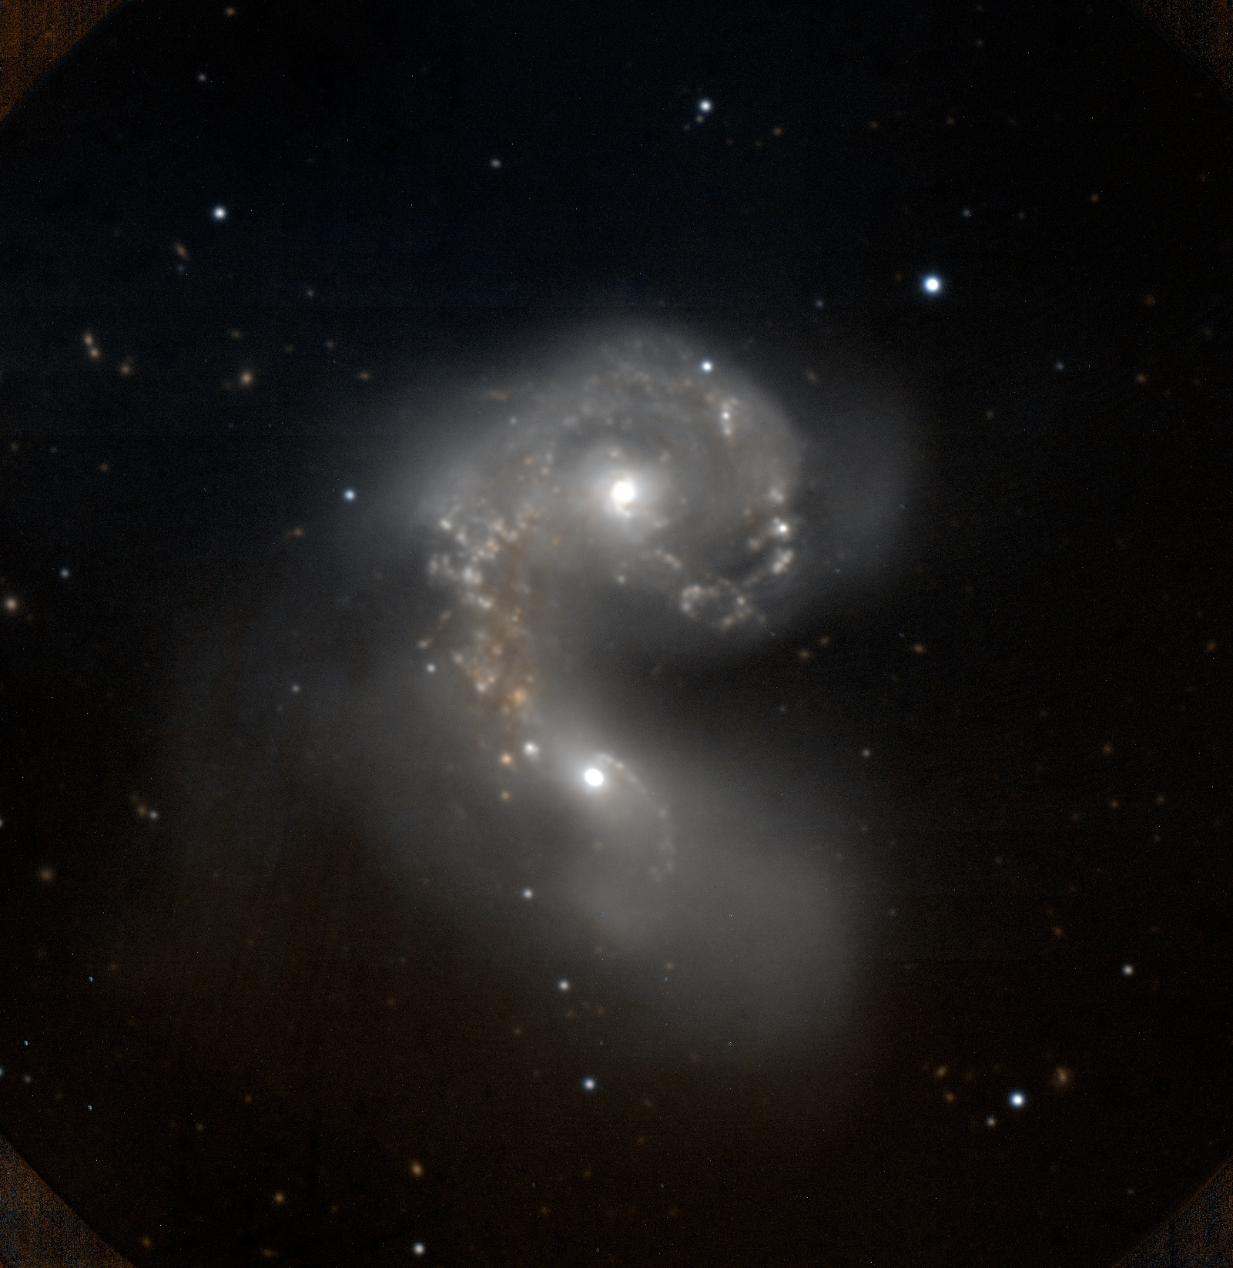
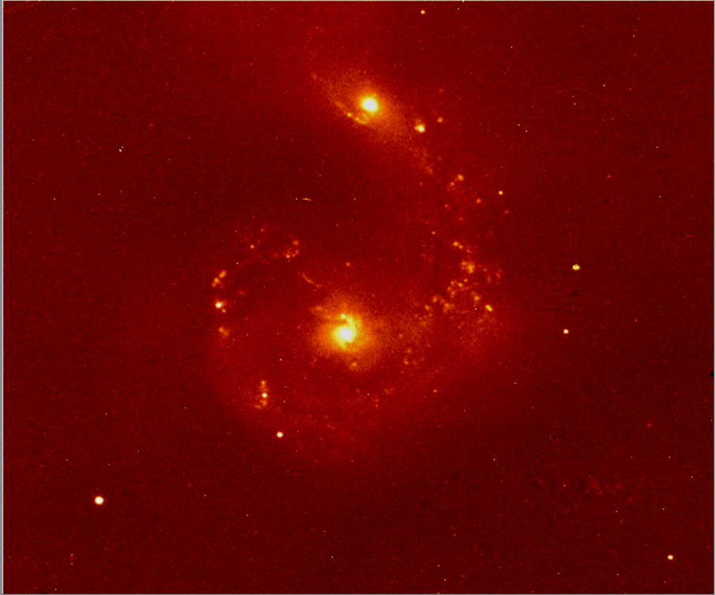
First Light through cirrus, but MOSFIRE works!
April 4, 2012
First Light: The Antennae
58s J-band; clouds!
Later run:
5-pt dither, J/K color composite
5-pt dither; J/K comp
zoomed
15

Slide 16
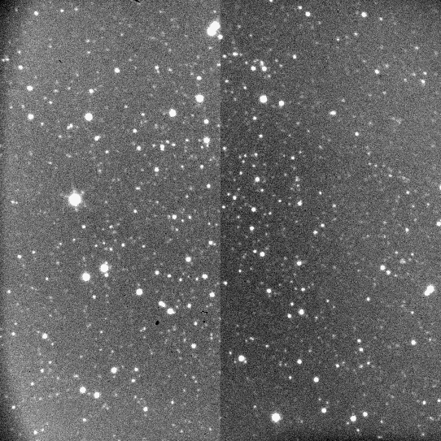
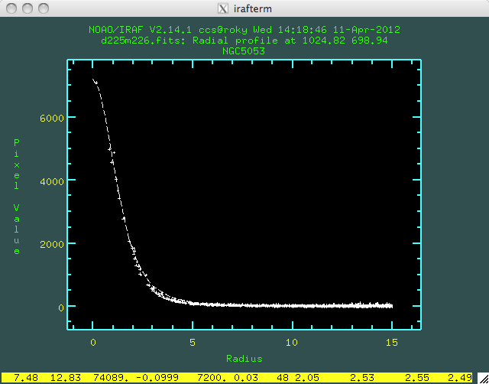
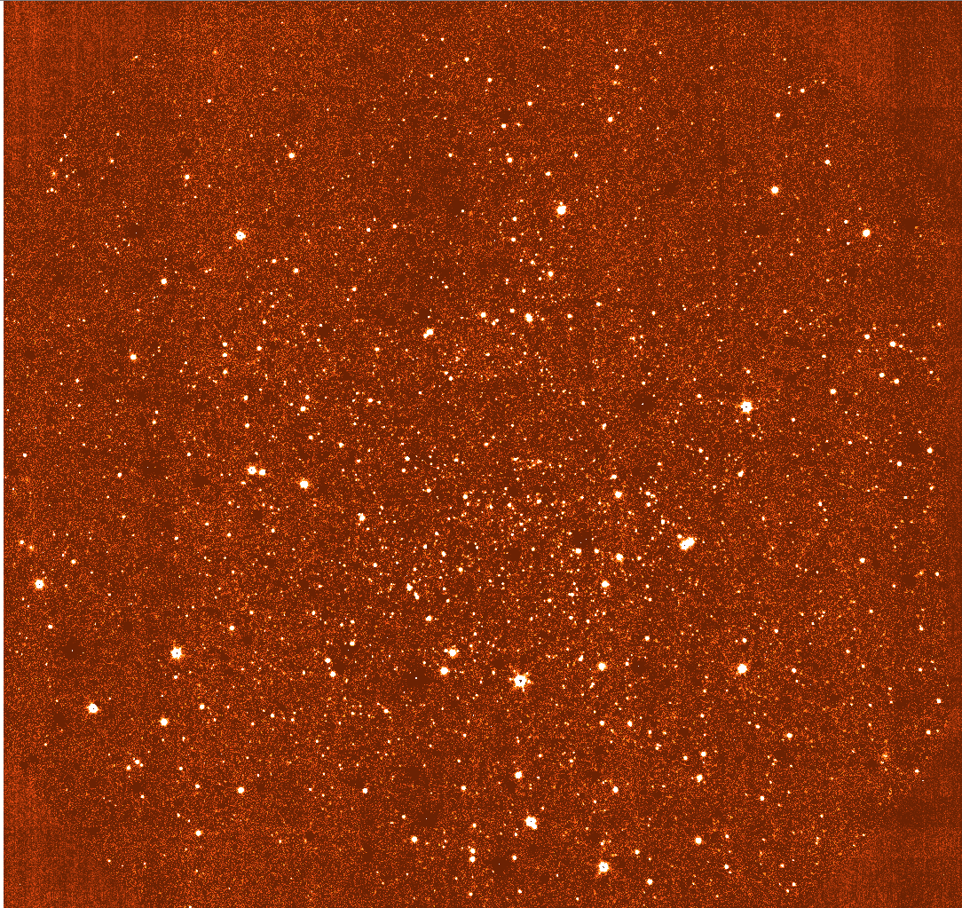
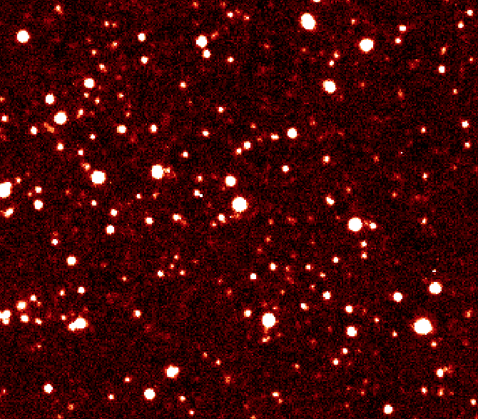
NGC5053 – star cluster at J
Image Quality and Astrometry Test, including guider; WCS.
Guider image
Images have
FWHM =2.5pix=0.45“
OUTSTANDING IMAGE QUALITY
Raw difference of two frames
16

Slide 17
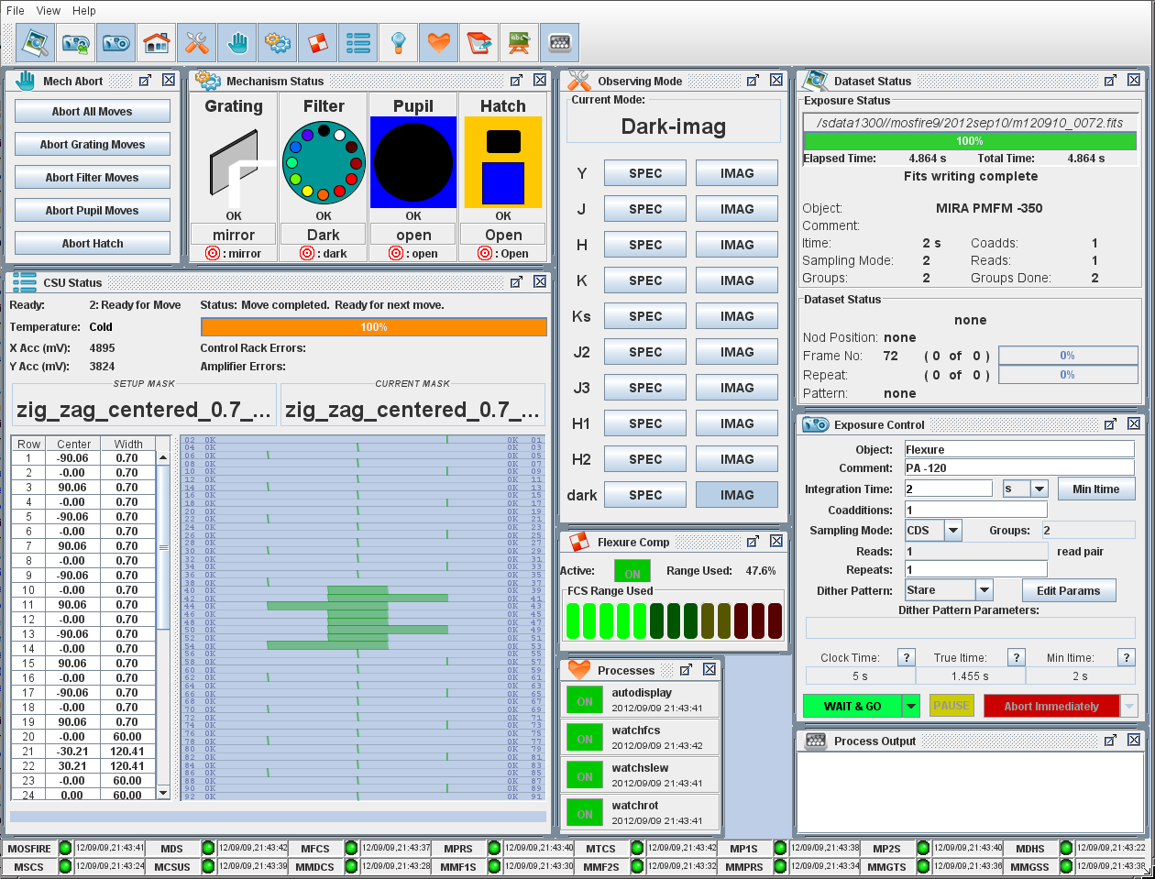
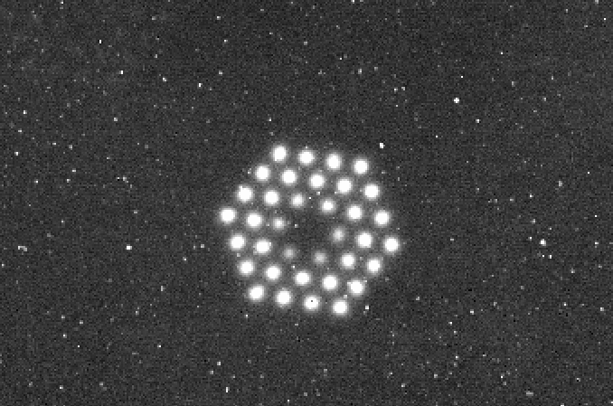
MOSFIRE Instrument Control
MOSFIRE Desktop
Buttons for
set up
Exposure Control
CSU status display
For MIRA, only the central bars open to provide an imaging box.

Slide 18
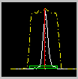
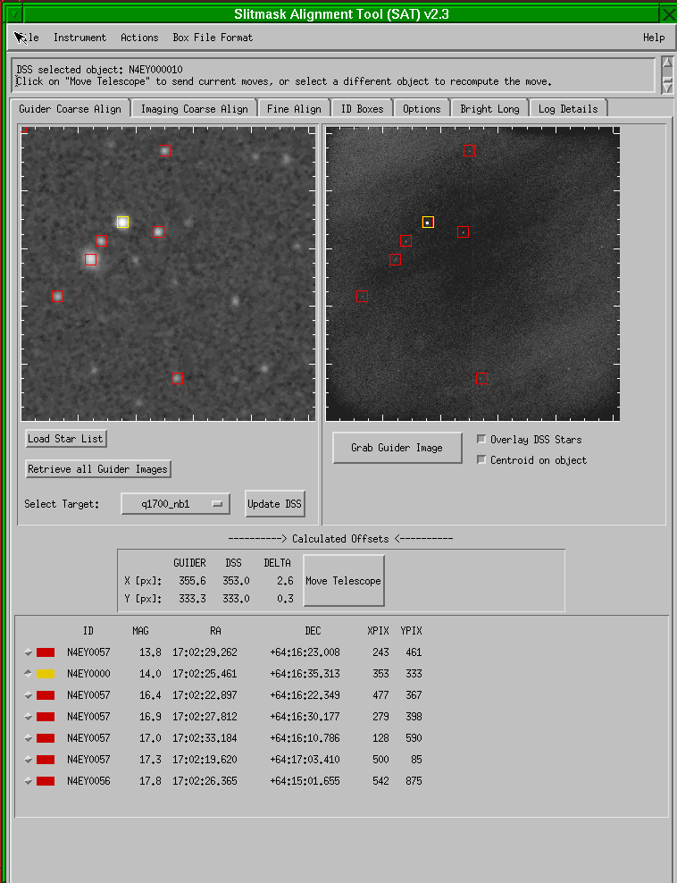
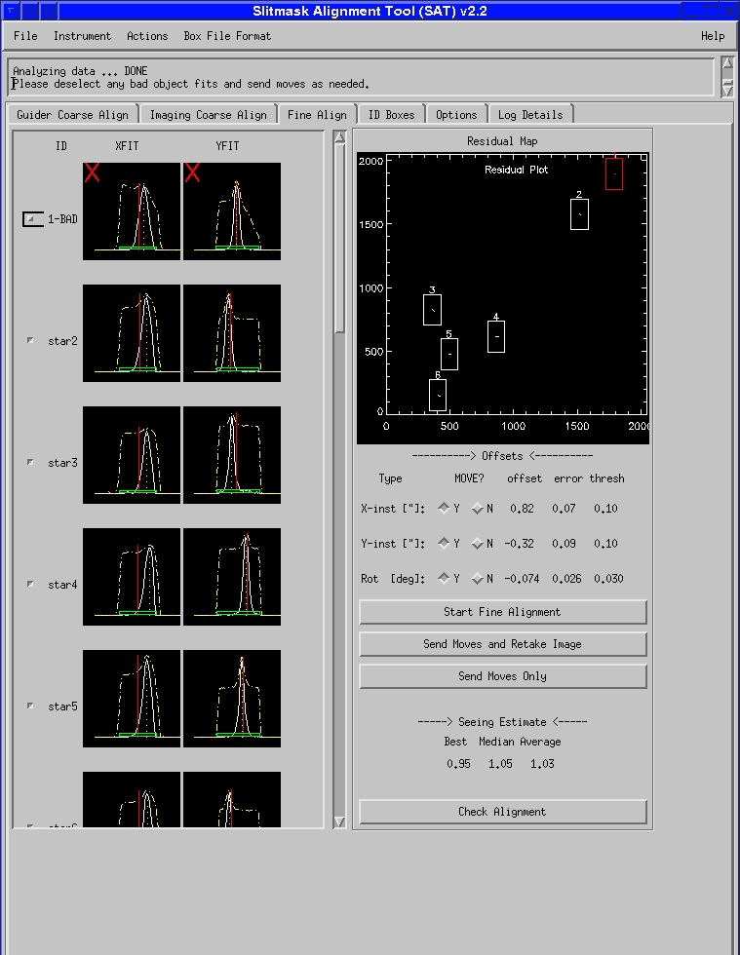
MOSFIRE Field Acquisition
“SAT”- M. Kassis, G. Wirth
Notes:
18
18

Slide 19
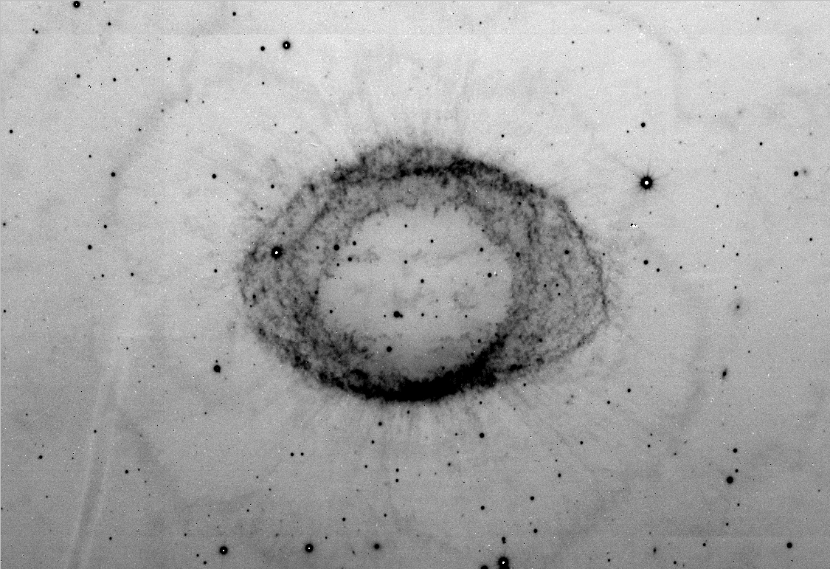
Highlights of Commissioning
The CSU works!
Slitmask alignment is efficient (Slitmask Alignment Tool).
Flexure compensation works well.
  We combined data from different months and used same calibrations!
Pupil tracking and alignment excellent.
No significant differential flexure between guider and MOSFIRE
  Guider is based on e2v CCD
Throughput - almost perfect agreement with predictions.
Infrared detector is excellent for this application
First science results are exceeding expectations.
19
19

Slide 20
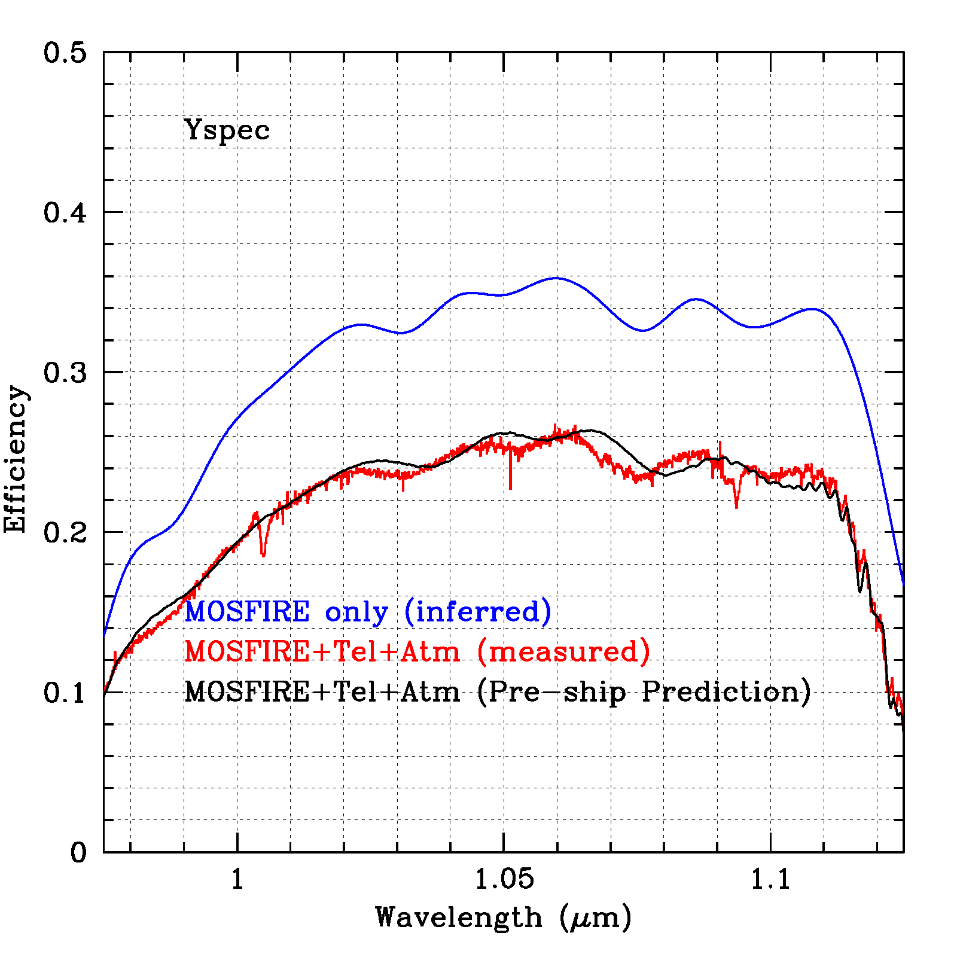
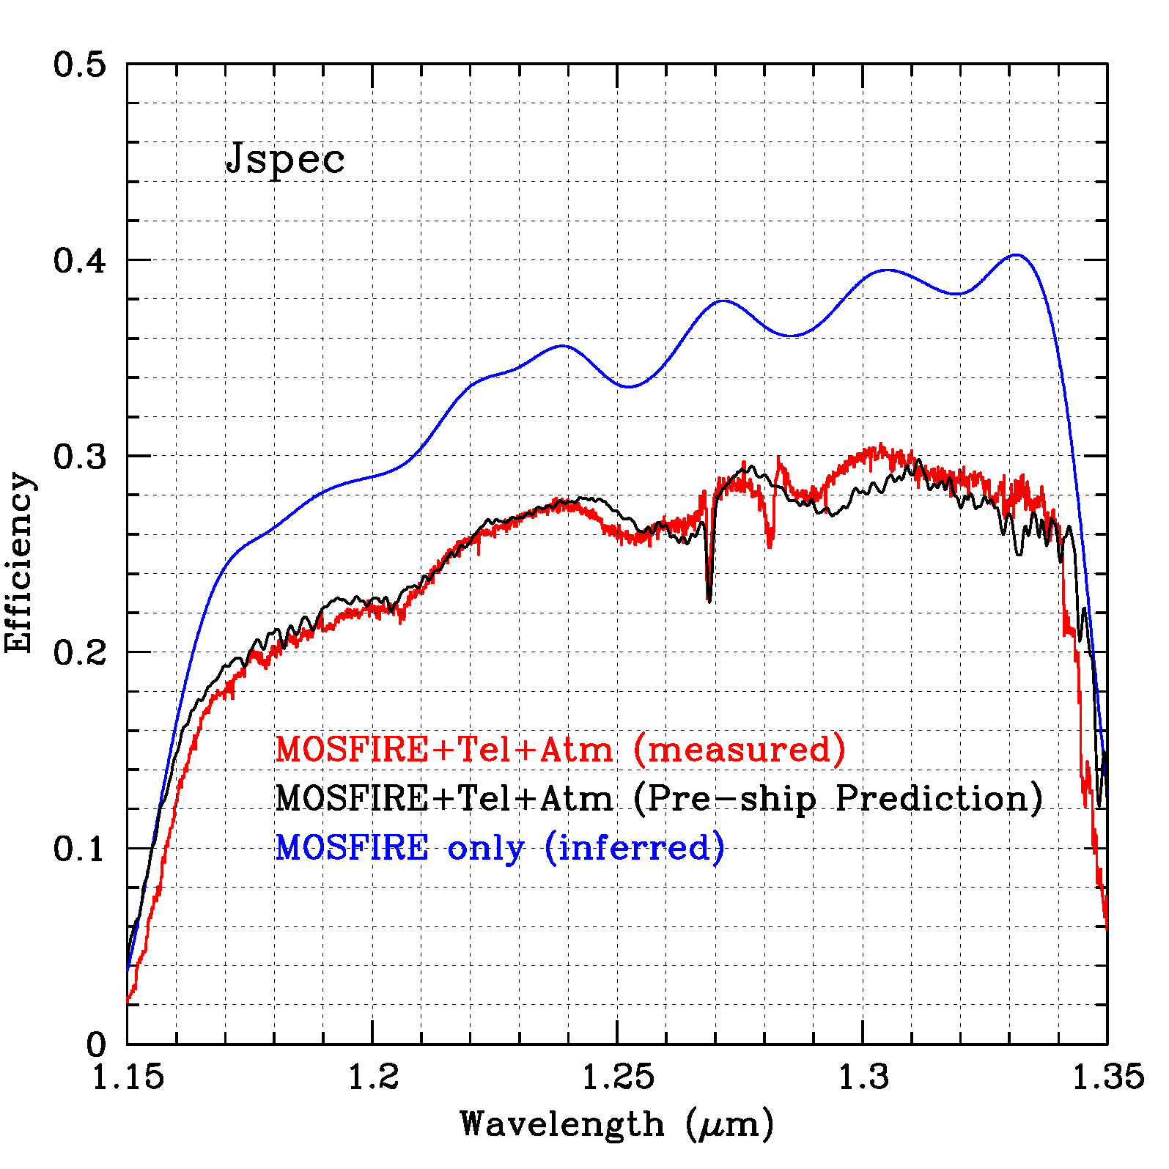
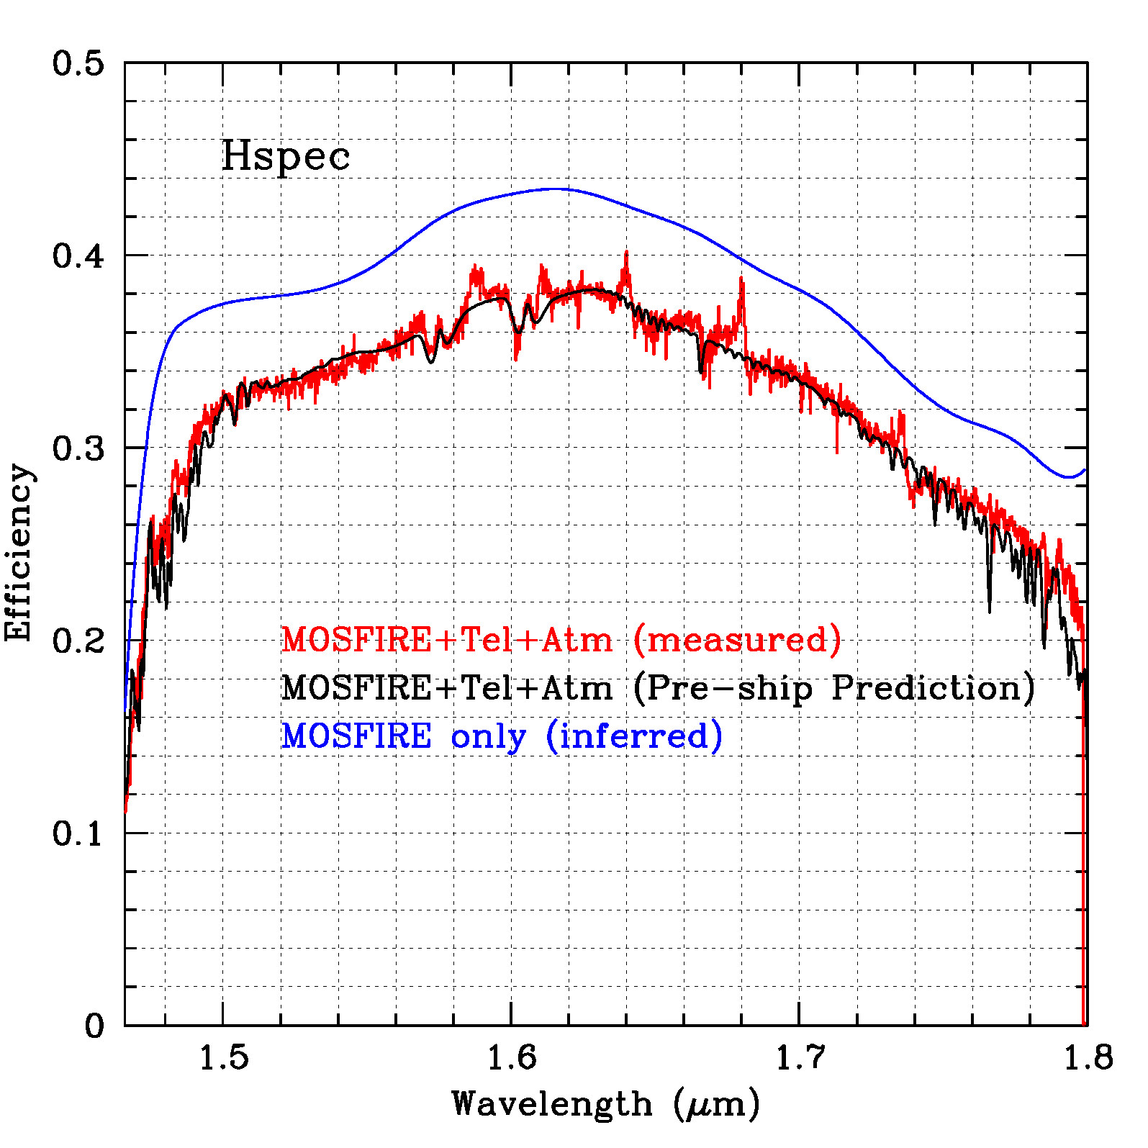
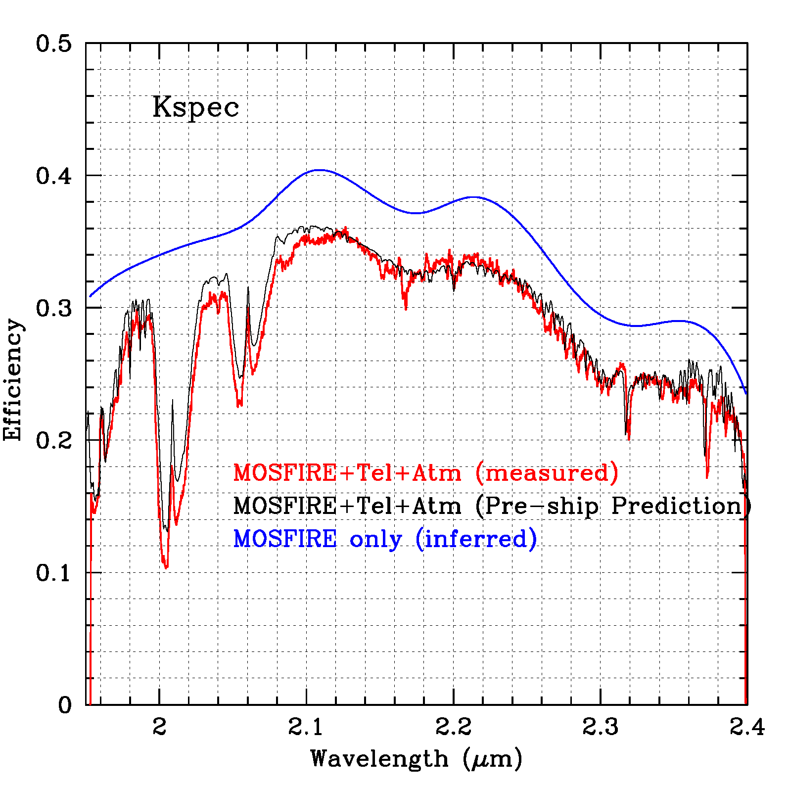
Predicted and Measured Throughput
Almost exactly as predicted!
Red= measured
Black=predicted
20

Slide 21
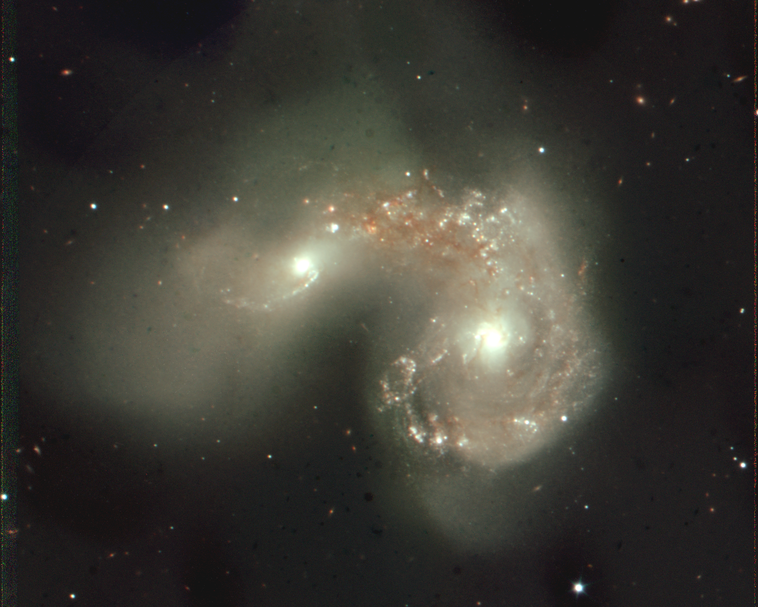
MOSFIRE – First Light
April 4, 2012
Color translation: 3 infrared wavelengths (Y,J, K) coded blue, green and red

Slide 22
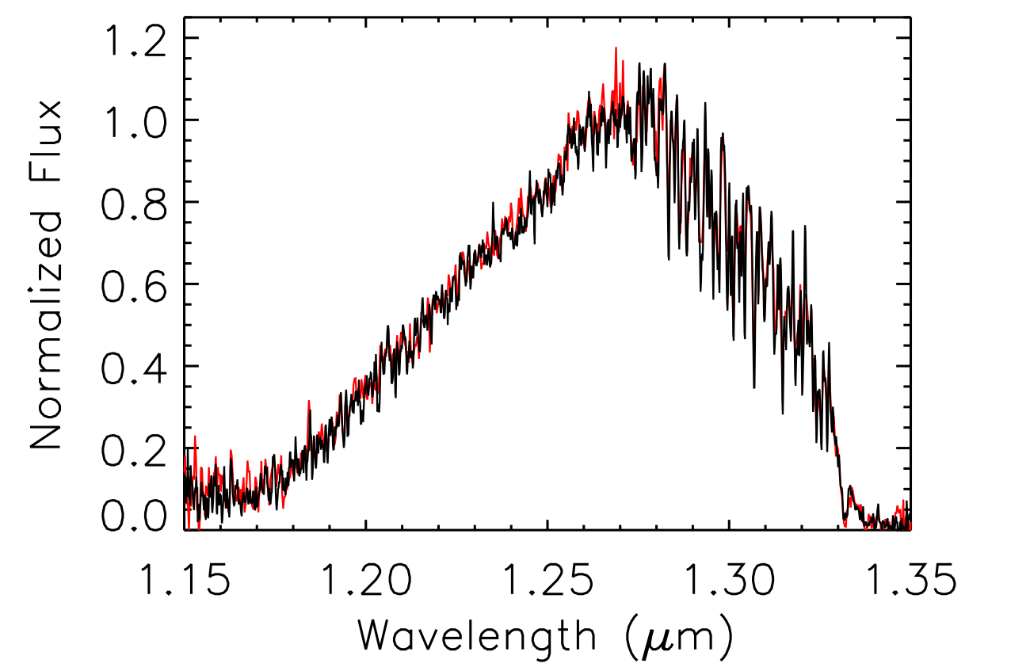
MOSFIRE vs NIRSPEC
T6.5 dwarf 2MASS1237+6526
J-band spectrum
R_{nspec} ~2000
R_{mos} ~3500
CH4 and H20 absorption
T_{eff} ~1100 K
NIRSPEC exposure = 900s
MOSFIRE exposure = 600s
Greg Mace
22

Slide 23


A typical application of MOSFIRE:
Spectra of faint/distant galaxies
MOSFIRE footprint on ~15′ by 15′ image of a field
Light blue square is CCD Guider Field of View; I-band 2.9′ square, centered 6.6′ off-axis
Green rectangle is selected 6.1′ x 4′ region for slit assignments
144 potential targets, 20 potential alignment stars
GUIDER FIELD
DETECTOR
Guider
COLLIMATOR
Software makes it easy to create masks and to align those masks at the telescope.
MOSFIRE window

Slide 24


MAGMA available for download from WMKO MOSFIRE web site.
Jason Weiss
24

Slide 25



VERY DEEP INFRARED IMAGES
J-band
1.25 μm
K-band
2.15 μm
z=3.356 means an age of ~2 billion yr or lookback time of 11.7Gyr
AGN
SENSITIVITY:
1 hour exposures in J and Ks
Seeing FWHM ~0.6″
Limiting mags (5σ, 2″ aperture):
JAB ~ 25.0 (Jvega~ 24.1);
KAB ~ 25.0 (Kvega ~ 23.2)
AGN

Slide 26





The MOSDEF survey (http://astro.berkeley.edu/~mariska/MOSDEF/Home.html)
Results below were provided by Alice Shapley (UCLA) and represent ~2 hours of exposure in each band.

Slide 27

1800 s Dark
MOSFIRE Detector
Teledyne Hawaii-2RG 2.5 micron cutoff
2048 x 2048
DQE: ~88% 0.95-2.45 microns
Dark current: <0.008 e-/s/pix
(> 75 times lower than NIRSPEC)
Read Noise: ~4.9 e- Fowler 16
~3.5 e- Fowler 32
Up the Ramp mode avail.
32 channels, read time 1.455 seconds
27

Slide 28

Persistence not quite perfect - yet
Signal that remains after illumination source has been removed
Average decay time: τ~660 s
Factor of 10 difference in amplitude in spatial direction
Time constant consistent despite illumination level

Slide 29

Where do we go from here?
Telescope
  30 meters instead of 10 m diameter
  9x collecting area and 3x better resolution
  UCLA is leading the construction of IRIS the first infrared instrument for TMT
Spectrograph
  Wavelength: 0.8-2.5 microns
  16 megapixels HgCdTe
  Spectral Resolution > 3500
Imager
  >15 arcsec field of view
  0.004 arcsec/pixel plate scale
  3x more detail

Slide 30
Got students or friends that want to know more?
Thank You
ISBN 978-3-540-76582-0
Notes:
Click to add notes

Slide 31


MOSFIRE would not be possible without the continuous development of detector technology. Let’s make sure it keeps going.
Thank You
MOSFIRE was developed by the consortium of the University of California, Los Angeles, California Institute of Technology, University of California, Santa Cruz and the W. M. Keck Observatory. Funding was provided by the Telescope System Instrumentation Program (TSIP) and by a donation from Gordon and Betty Moore.

