Slide 1
ALIENS
Donald Figer
Rochester Institute of Technology
Center for Detectors

Slide 2
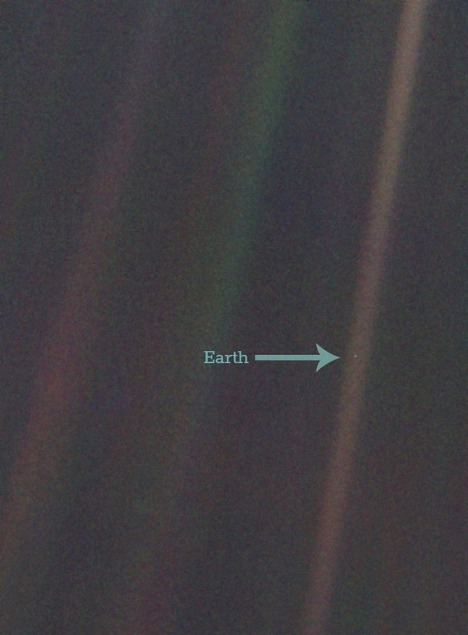


Slide 3
Are we alone?

Slide 4
400
billion stars in Milky Way
Most stars are surrounded by planets.

Slide 5
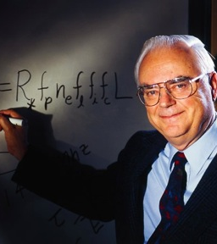
Frank Drake wanted to estimate how many alien civilizations are detectable in our Galaxy.

Slide 6
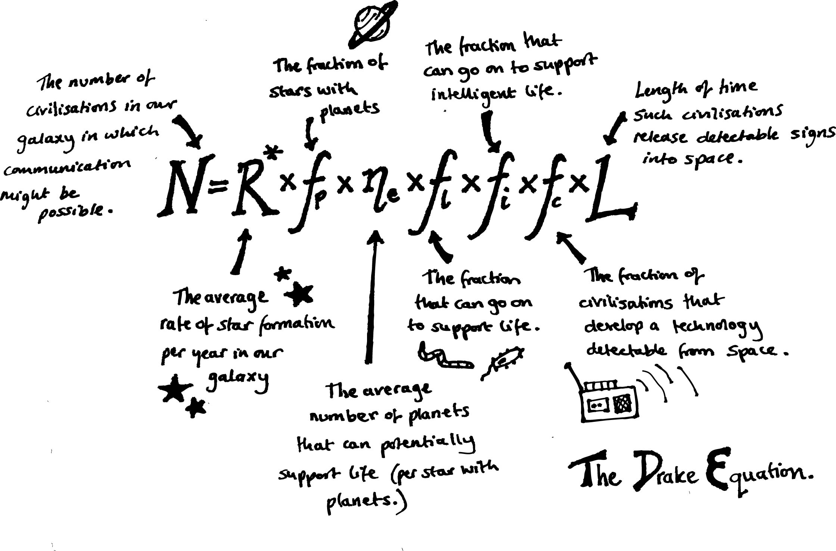

Slide 7
Calculate for yourself! http://www.pbs.org/lifebeyondearth/listening/drake.html http://www.astrodigital.org/astronomy/drake_equation.html

Slide 8
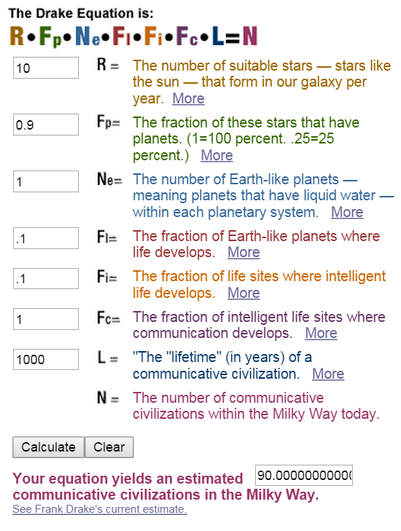
Here are my guesses.

Slide 9
Which planets have life?

Slide 10
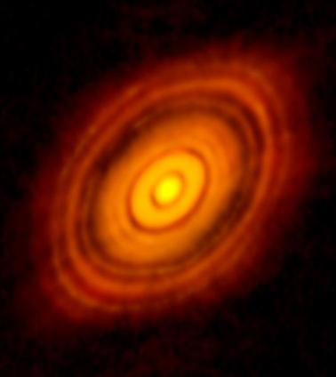
Planets form around stars from dust and rocks leftover from the star formation process.

Slide 11
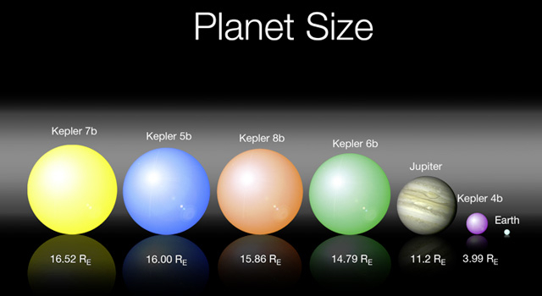

Slide 12
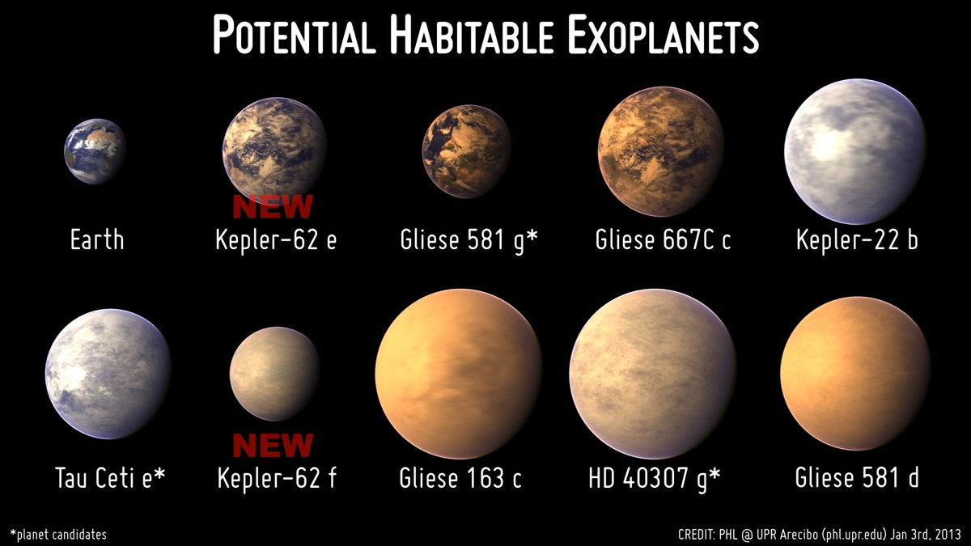

Slide 13
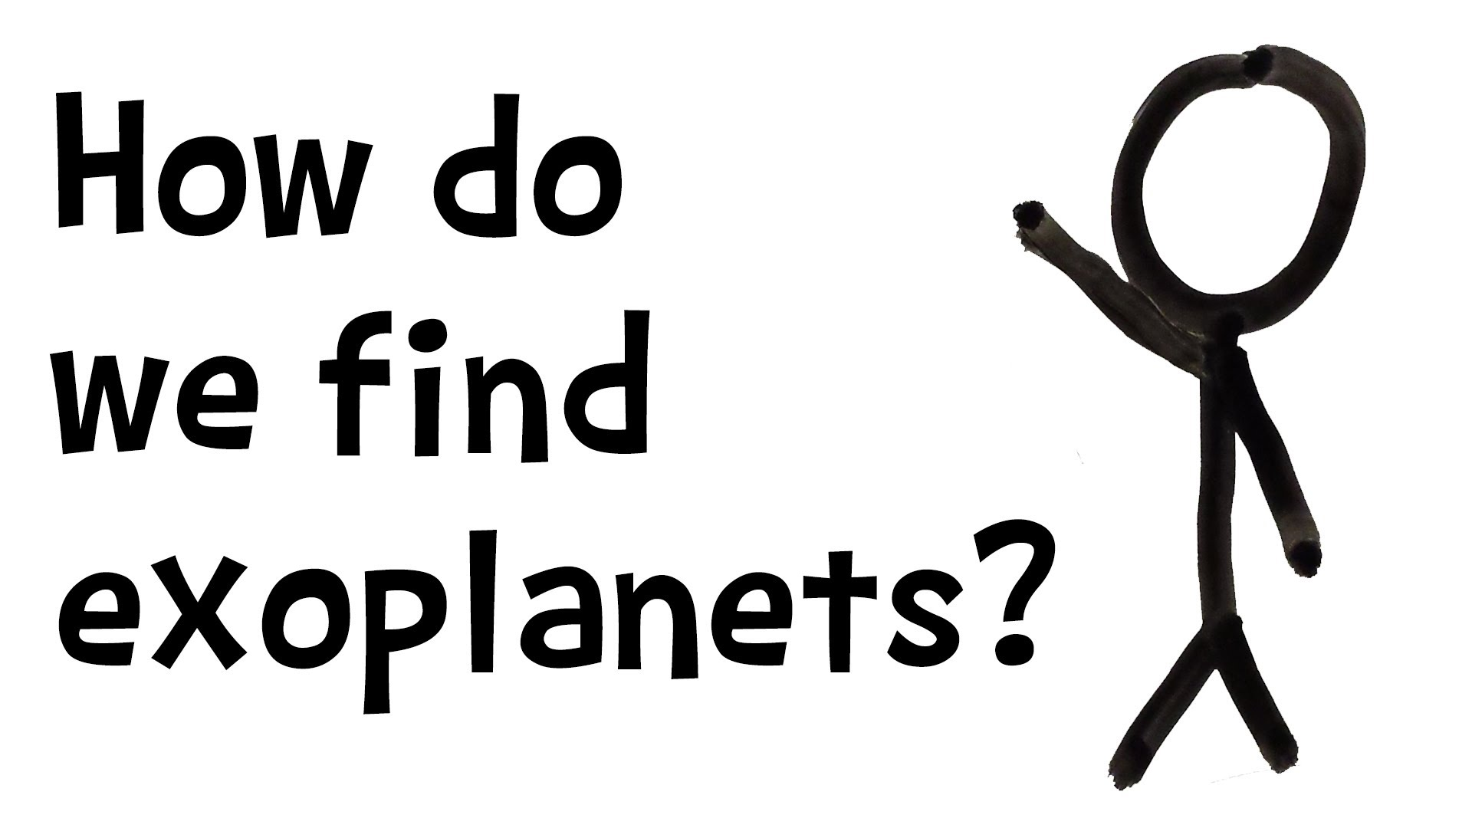

Slide 14
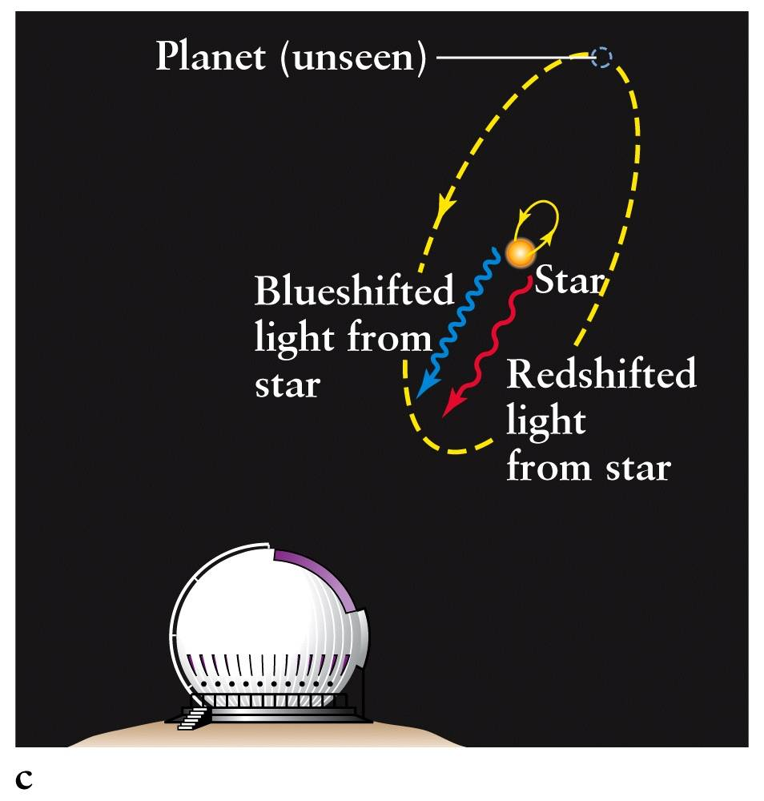

Slide 15
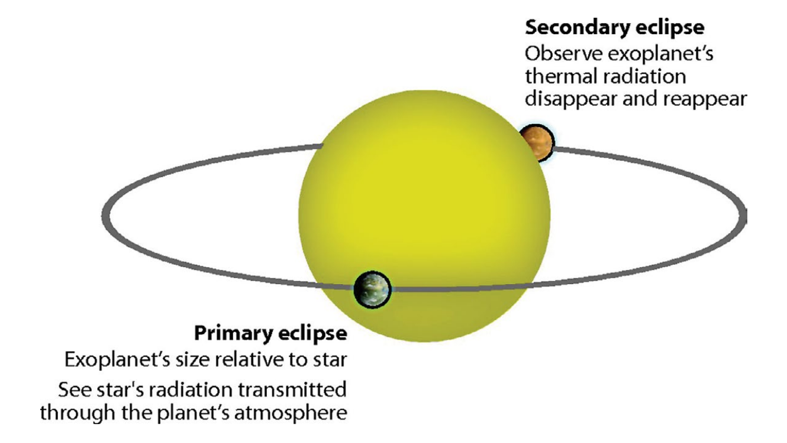

Slide 16
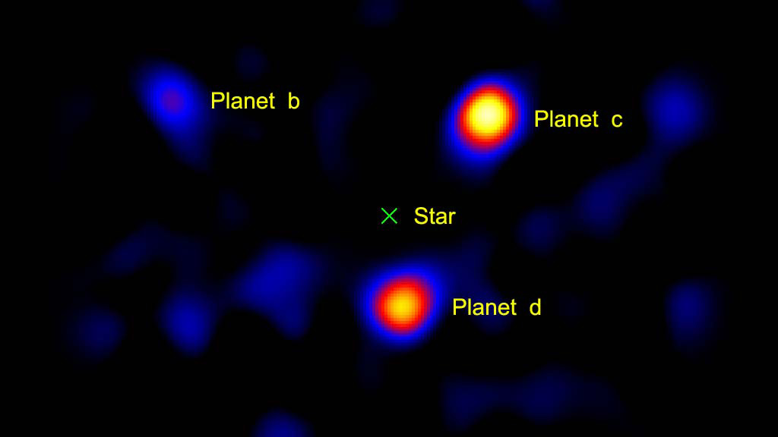

Slide 17
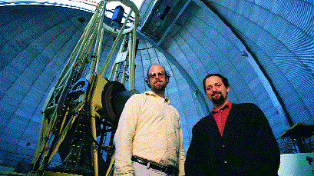
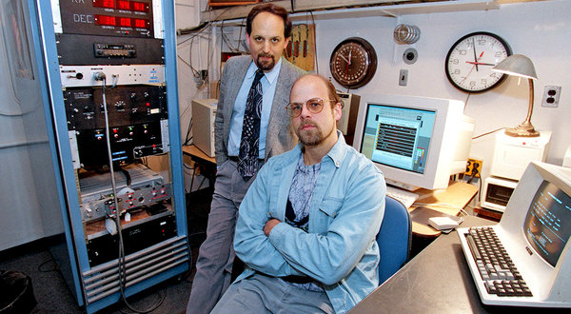
Geoff Marcy and Paul Butler pioneered the redshift technique.

Slide 18
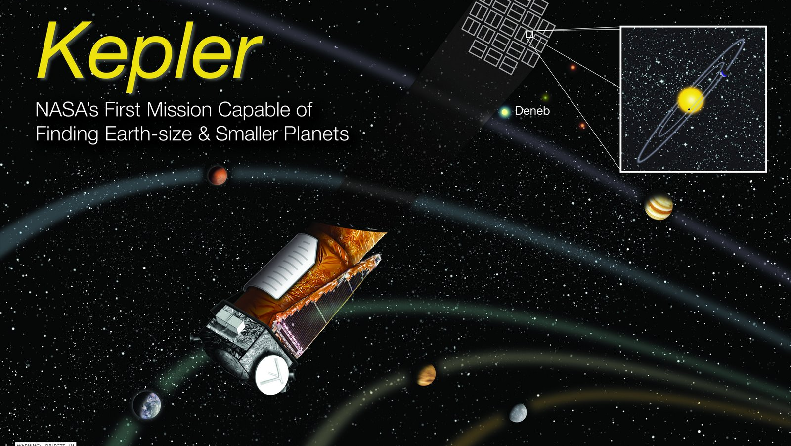

Slide 19
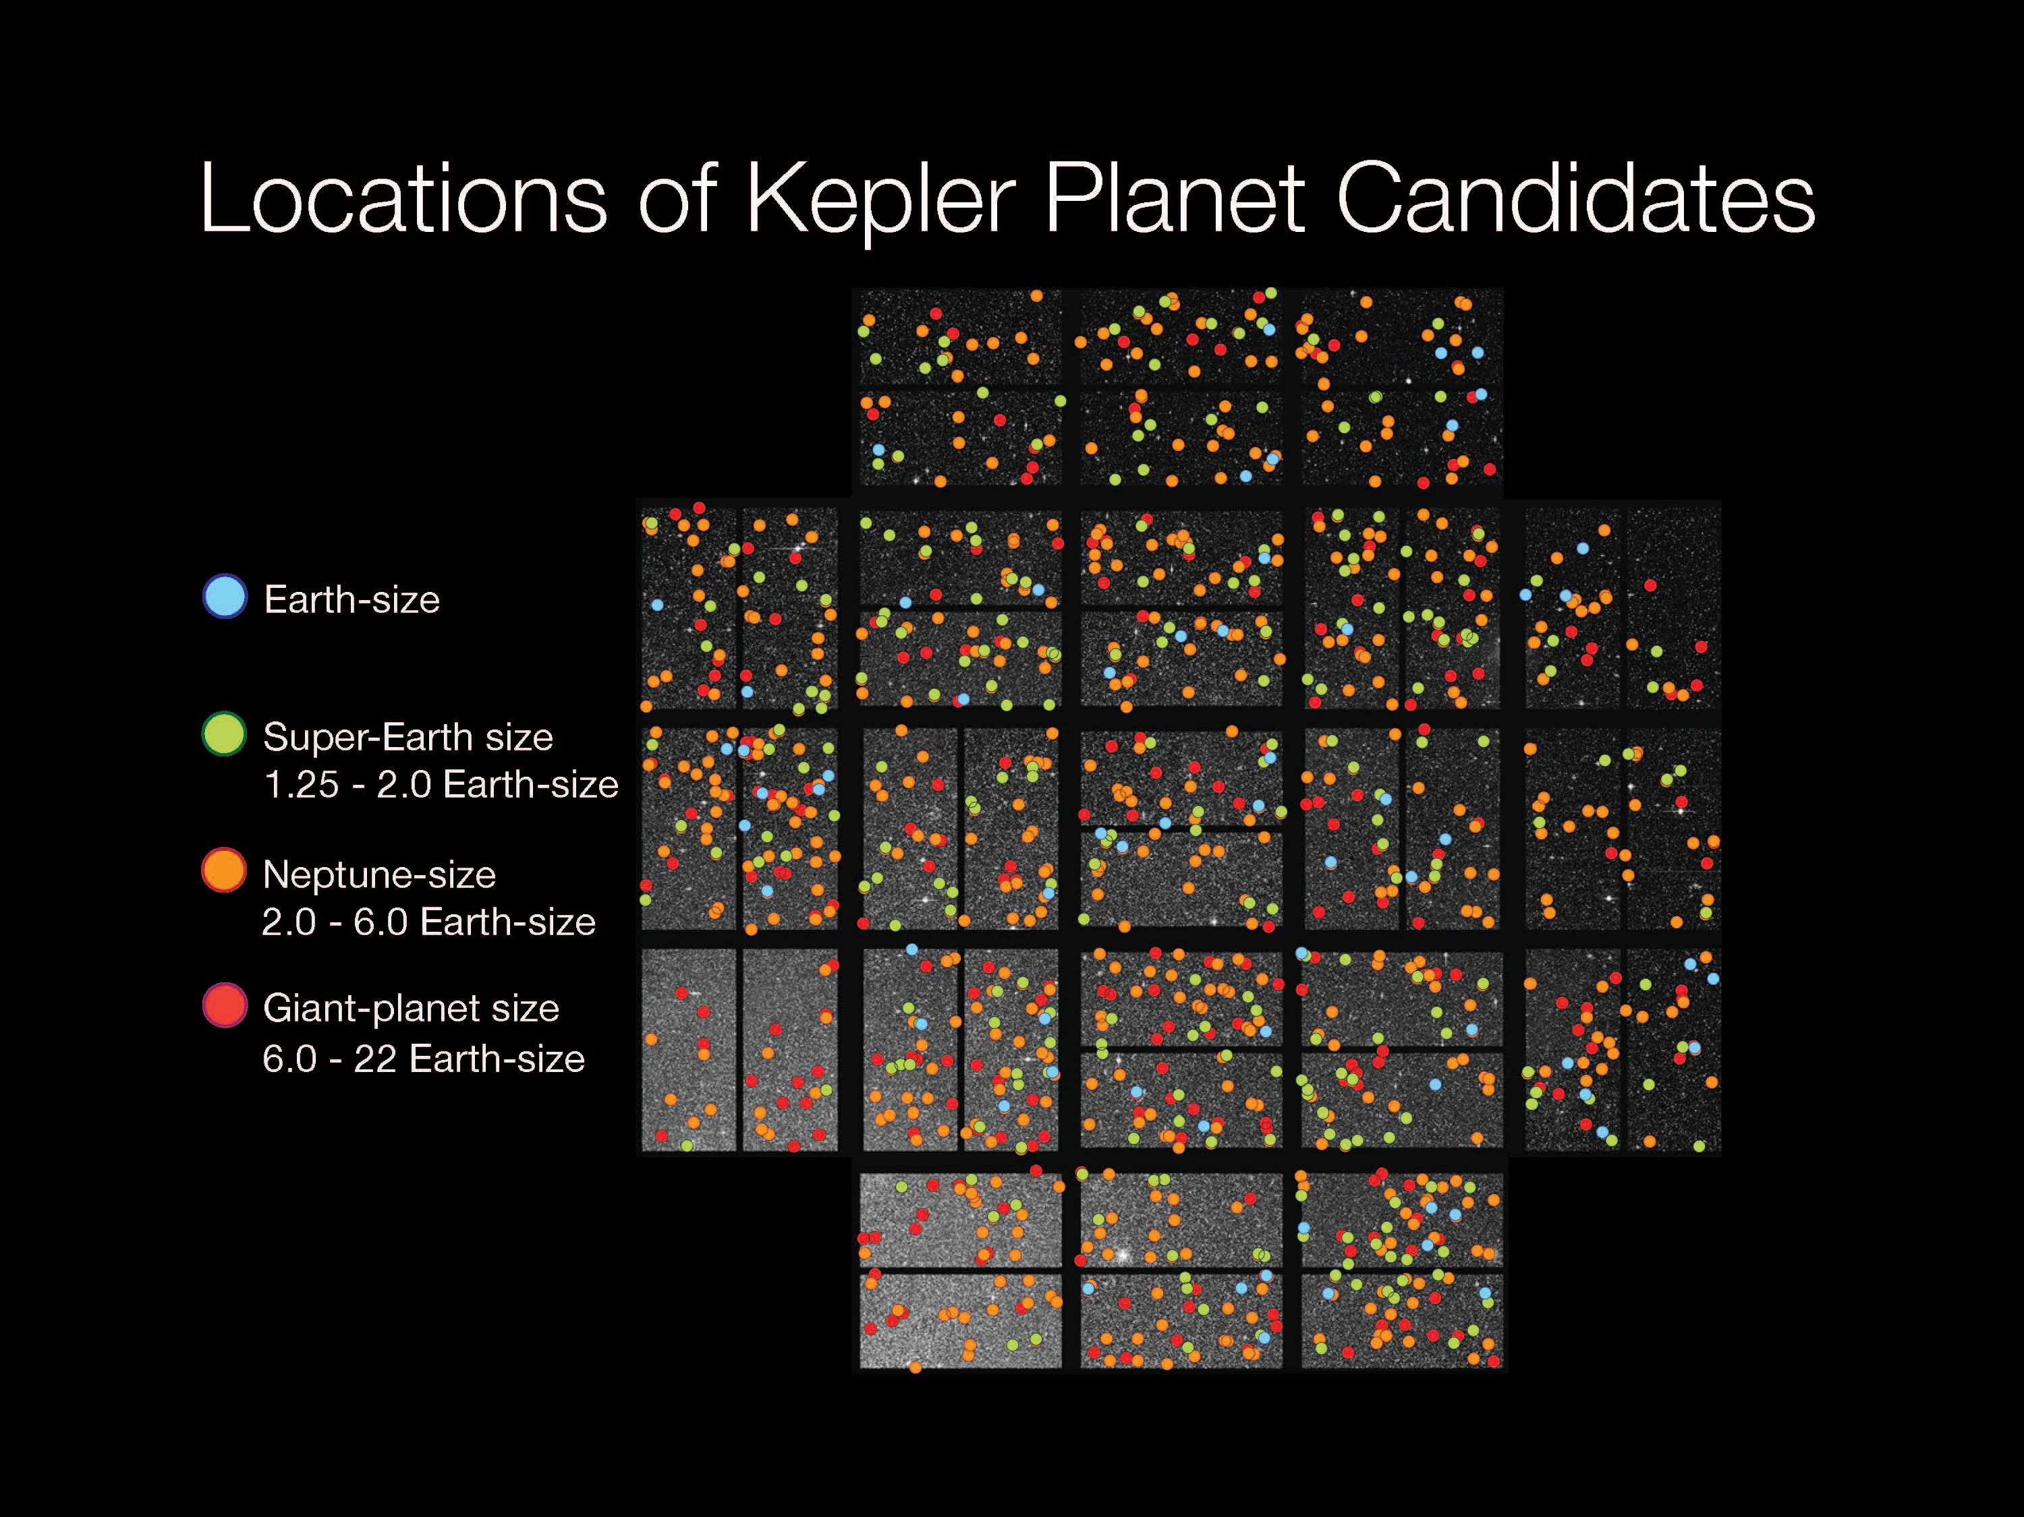

Slide 20
Can you recognize an alien?

Slide 21
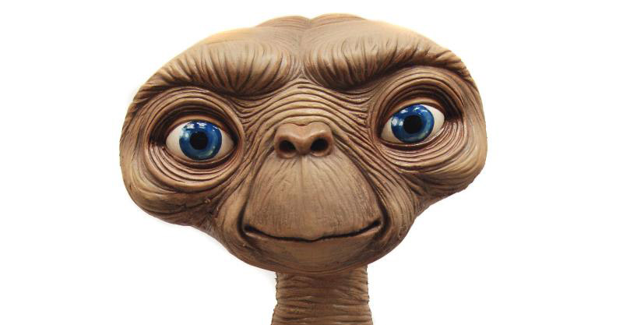


Slide 22
Have aliens been here?

Slide 23
Who among us would know?

Slide 24
Let’s ask an astronaut.
(cue Pettit video)

Slide 25
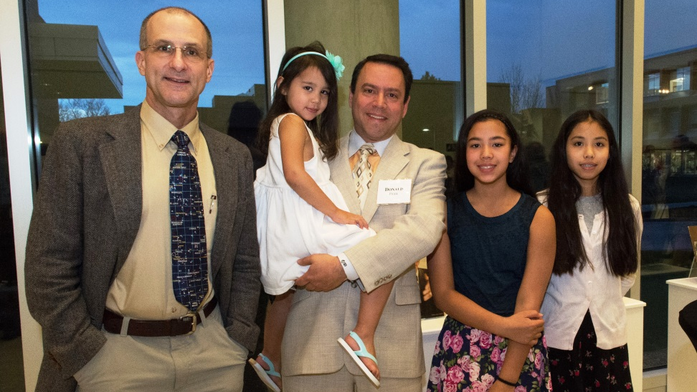
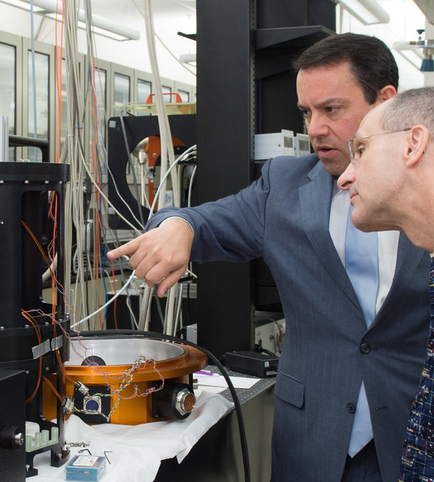
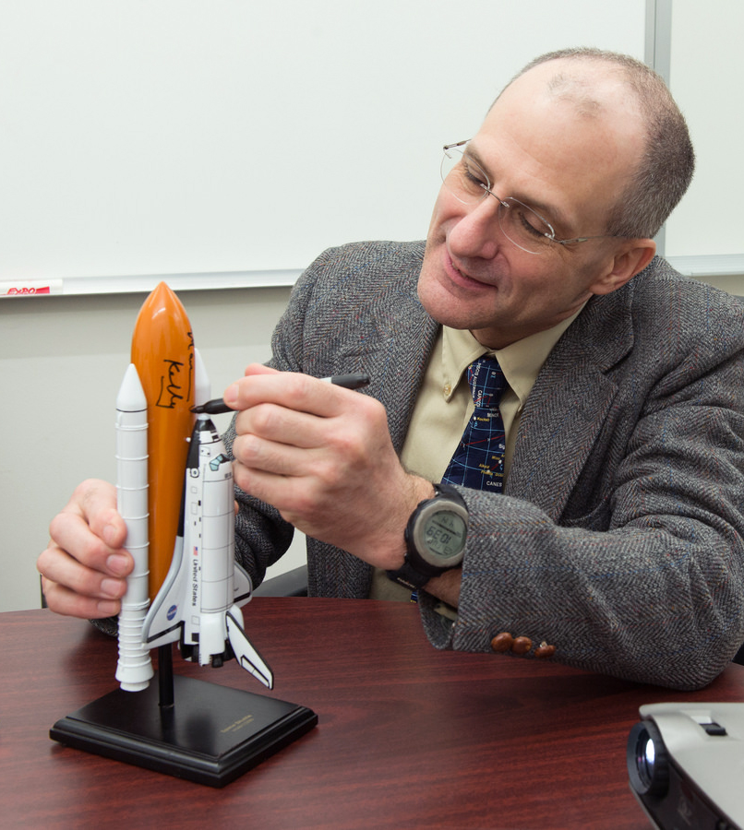
NASA Astronaut Donald Pettit toured the Center for Detectors and challenged students to solve a problem on International Space Station.
On right: Image series courtesy of RIT alumnus Peter A. Blacksberg ’75 of the Photography Department

Slide 26
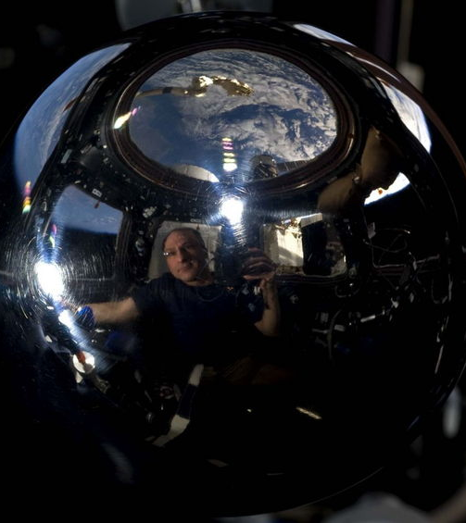
I get asked about NASA and “aliens” every so often. NASA has some credible evidence of alien life in the Mars meteorites found on Antarctica. The Martian Allan Hills meteorite from Antarctica shows evidence of fossil bacteria. There is still much scientific controversy about this but the best evidence to date is the presence of nano-particles of magnetite co-located with the so called fossil bacteria with the same structure as seen in magneto-taxic bacteria from Earth. It is difficult to show how these structures could be formed by non-biological processes. Anyway, this is still controversial and remains the most credible form of evidence I have seen for the presence of alien life forms.
Of course when I am asked this question, my answer is not very satisfying since most people are referring to some form of intelligent alien creature flying some sort of spacecraft. I have seen no credible evidence in or outside of NASA to support any such ideas.

Slide 27
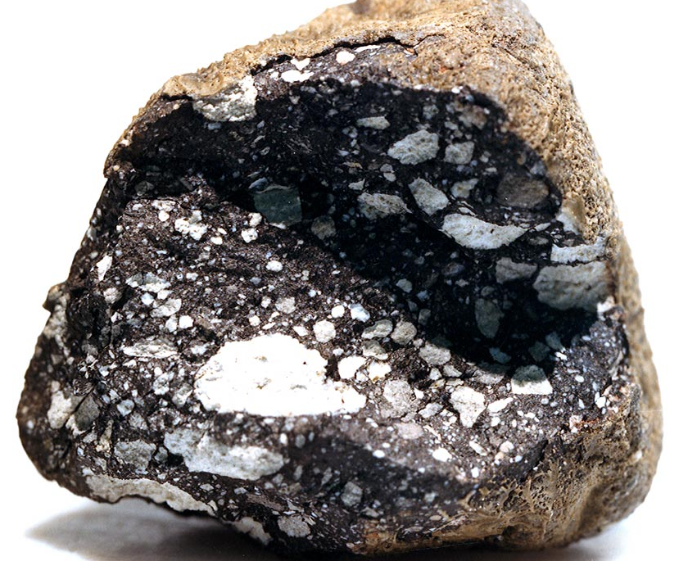
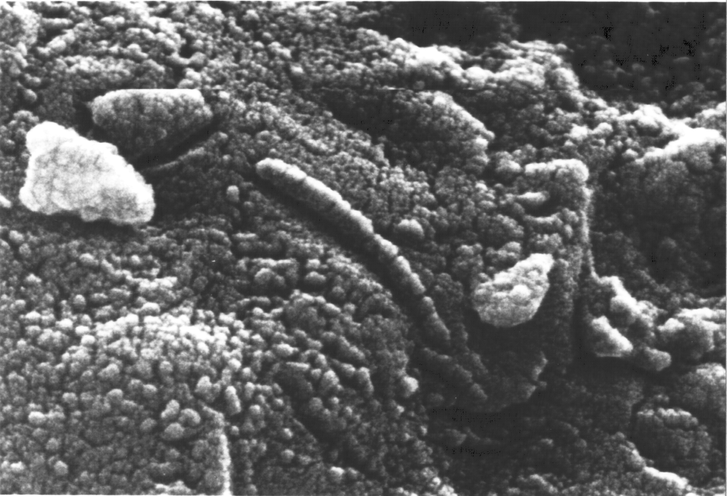
Allan Hills 84001 is a meteorite that was found in Allan Hills, Antarctica in 1984. It is thought to be from Mars.

Slide 28
Let’s ask another astronaut!

Slide 29
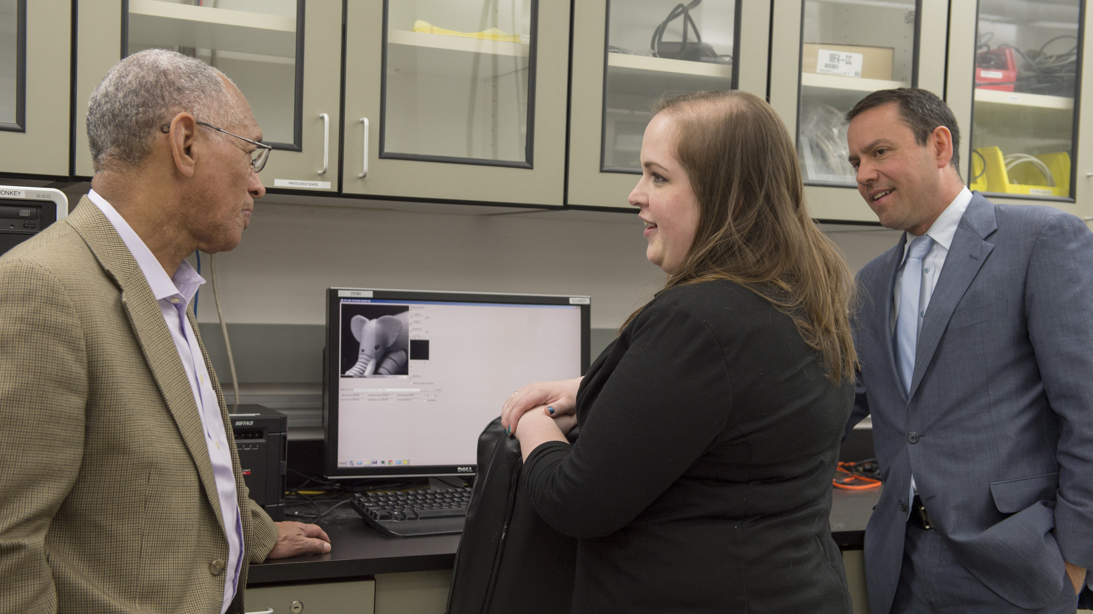
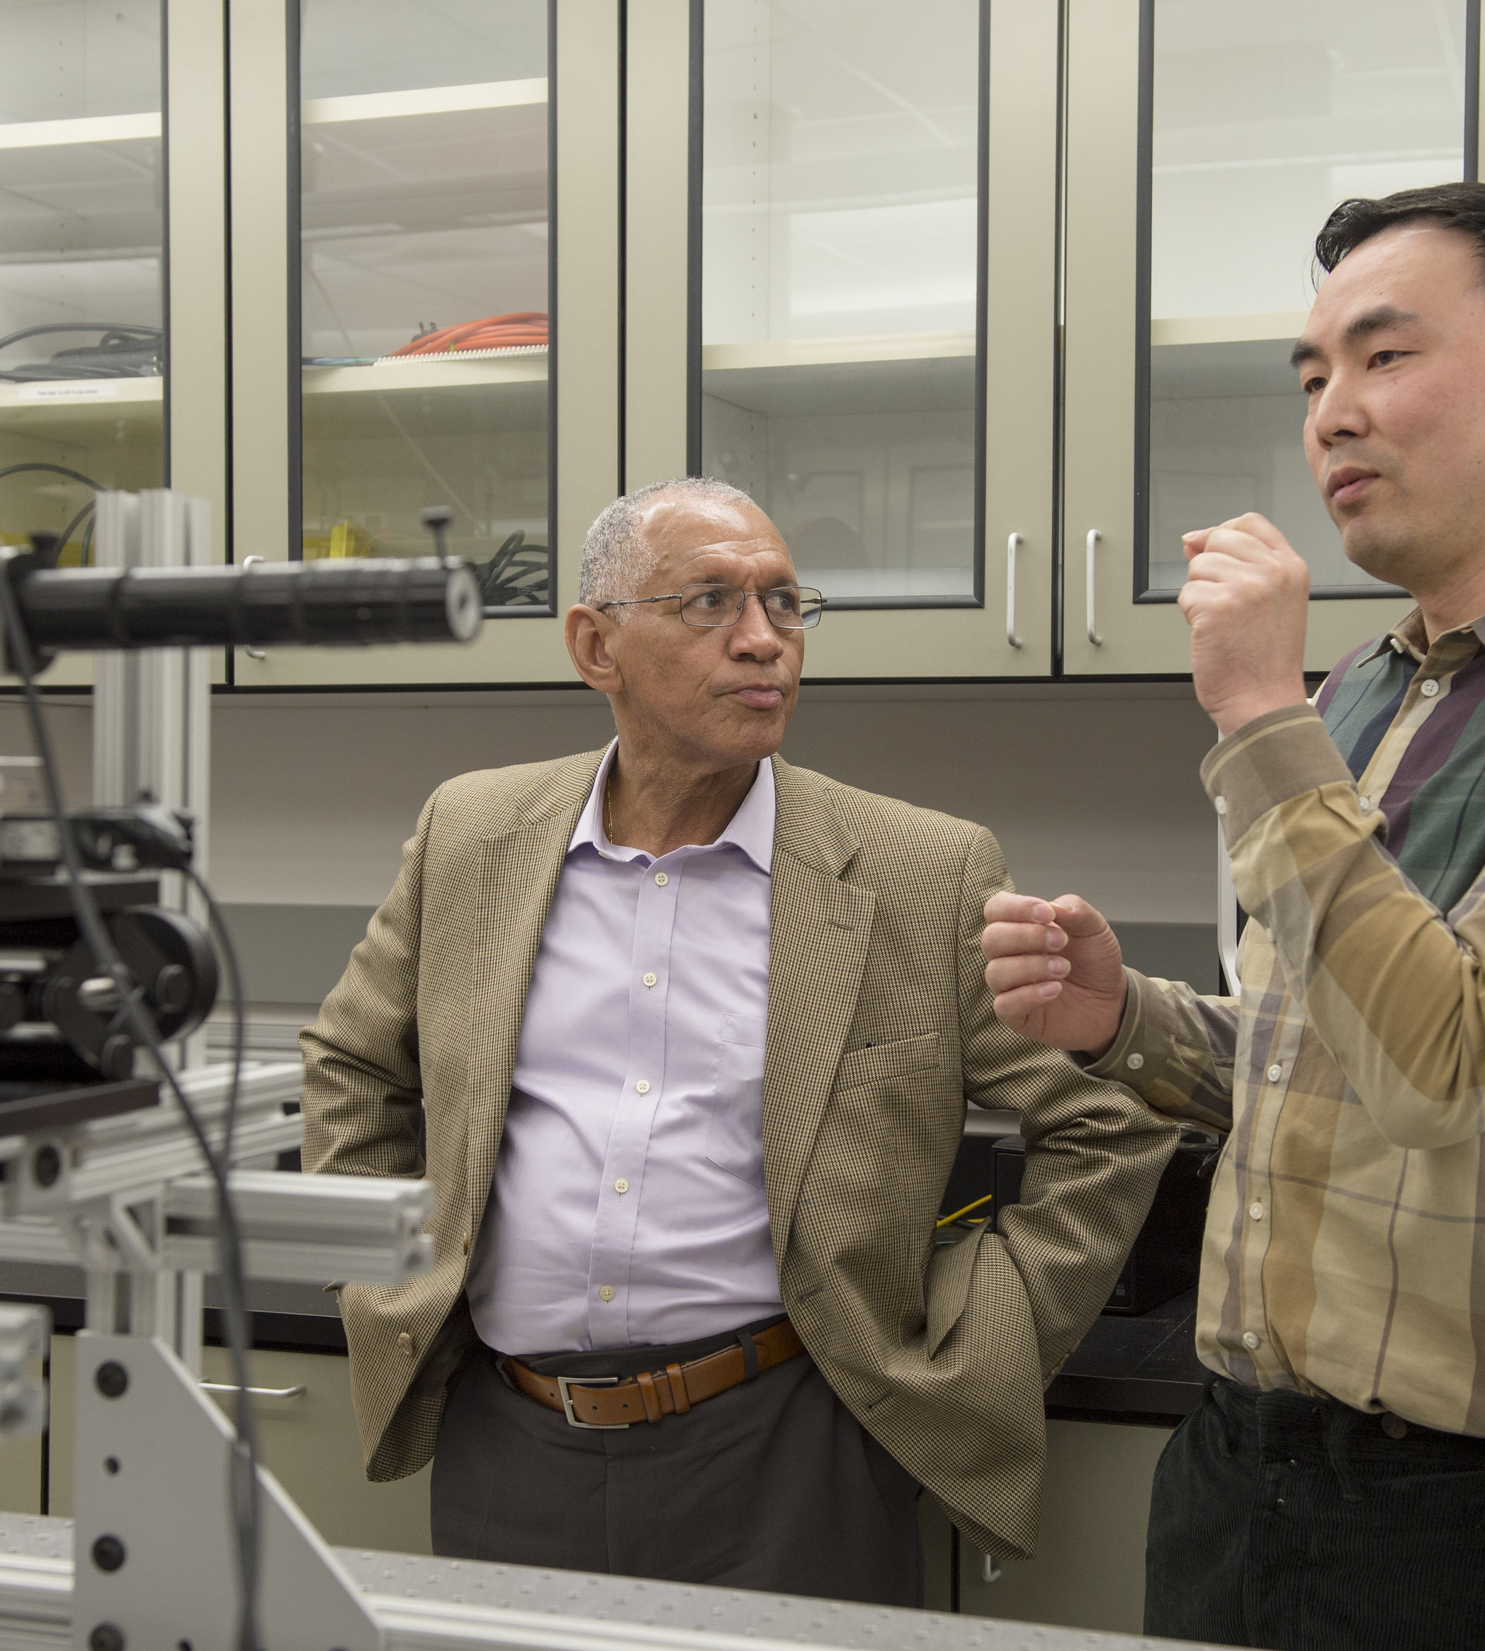
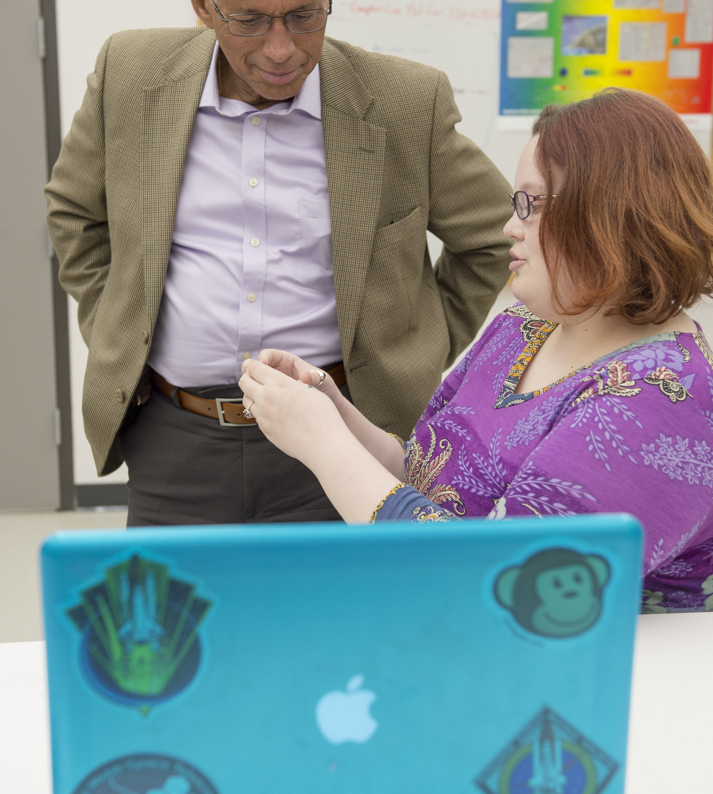
Charlie Bolden, Head of NASA, visited a few weeks ago.

Slide 30
I am searching for aliens.

Slide 31
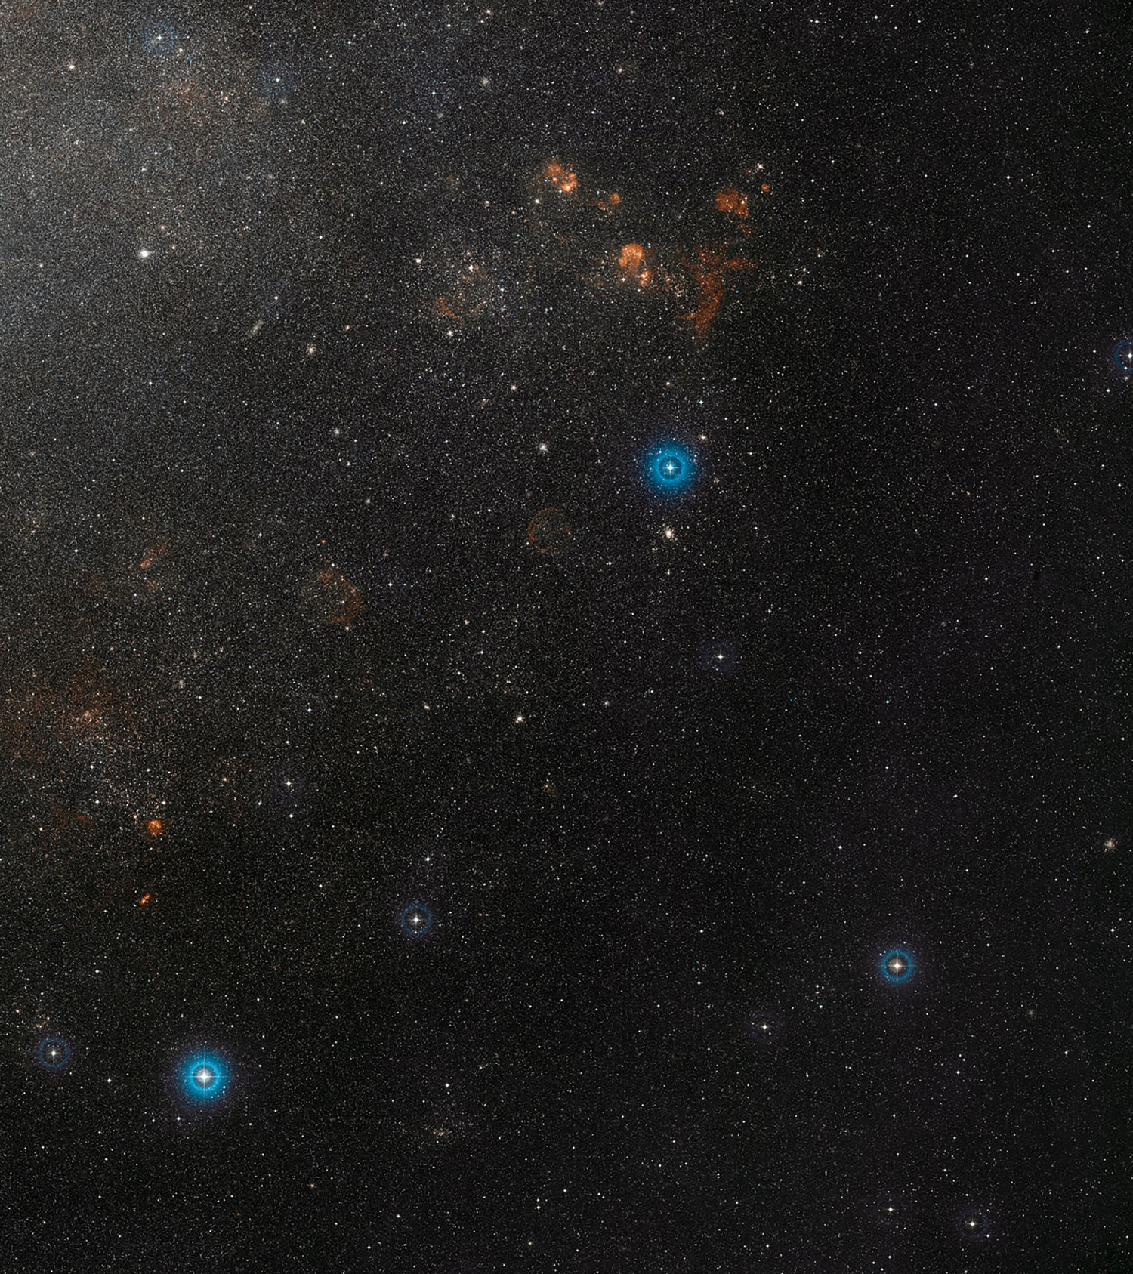
Childhood dreams turned into research that measured the distance to pulsating variable stars, and more.
On right: Wide field view of the Large Magellanic Cloud courtesy of ESO (European Southern Observatory)

Slide 32
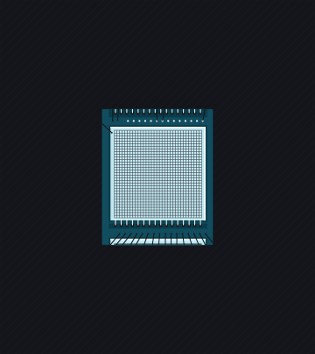
THE DETECTOR
is critical to discovery

Slide 33


Slide 34
In order to find aliens, we need your help.

Slide 35

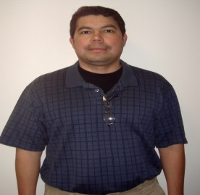
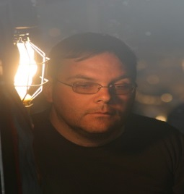




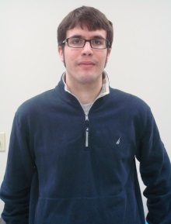




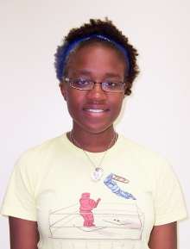





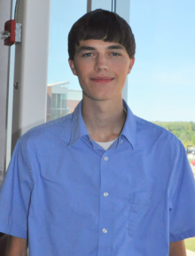



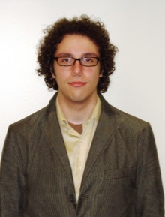








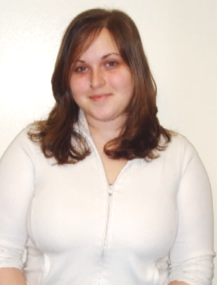

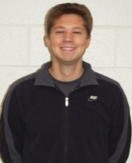








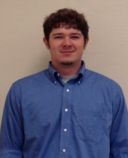












Student Research
Engineering
Imaging Science
Astronomy/Physics
Business
Imaging arts
Health Services

Slide 36
See more at:
Google Center for Detectors

Slide 37
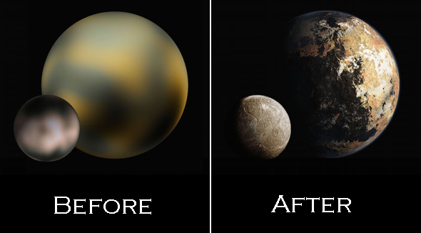
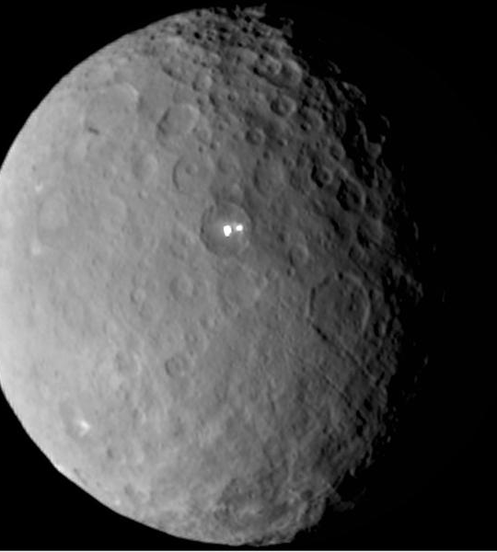
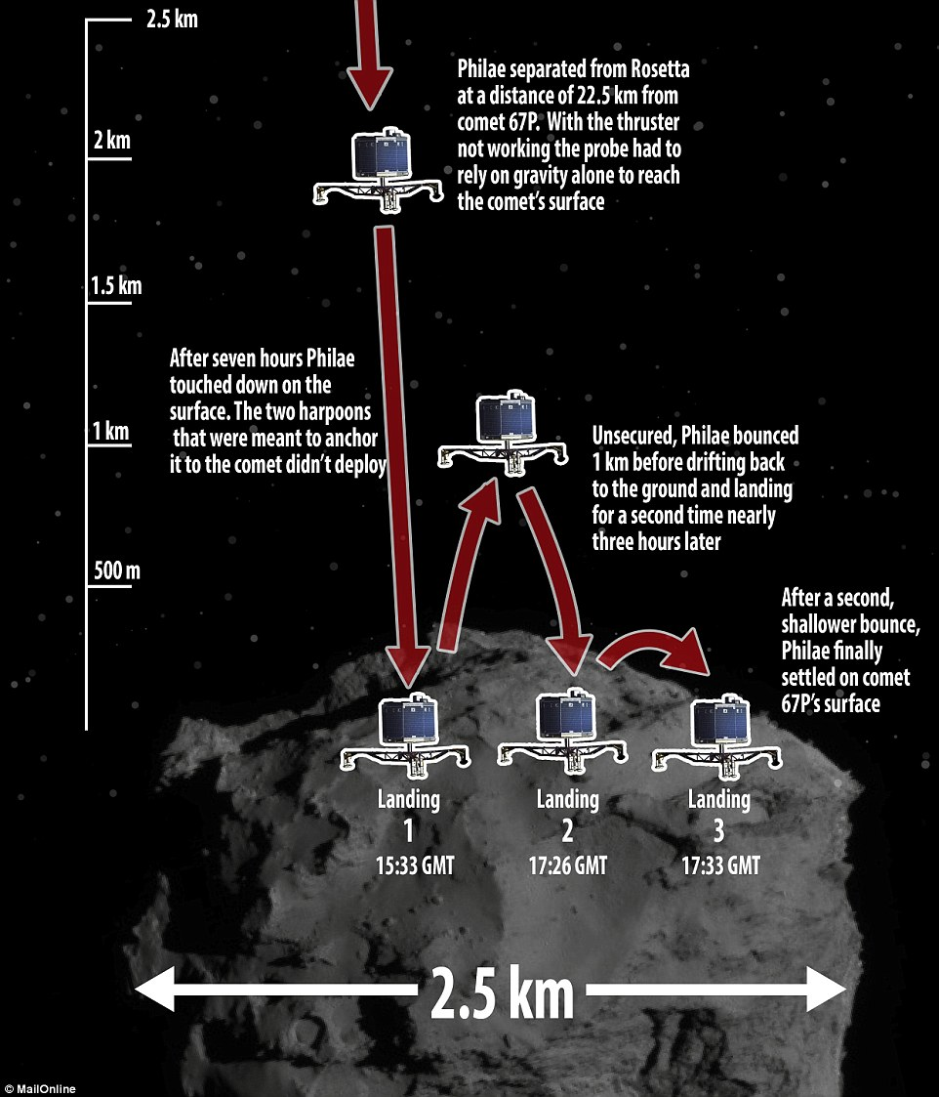
Aliens in Our Solar System?
Follow New Horizons when it reaches Pluto on July 14. Follow Dawn at Ceres to explore the “white spots.” Watch Philae come back “alive” on a comet.

Slide 38
Thank You
Donald Figer
Rochester Institute of Technology
Center for Detectors

Slide 39
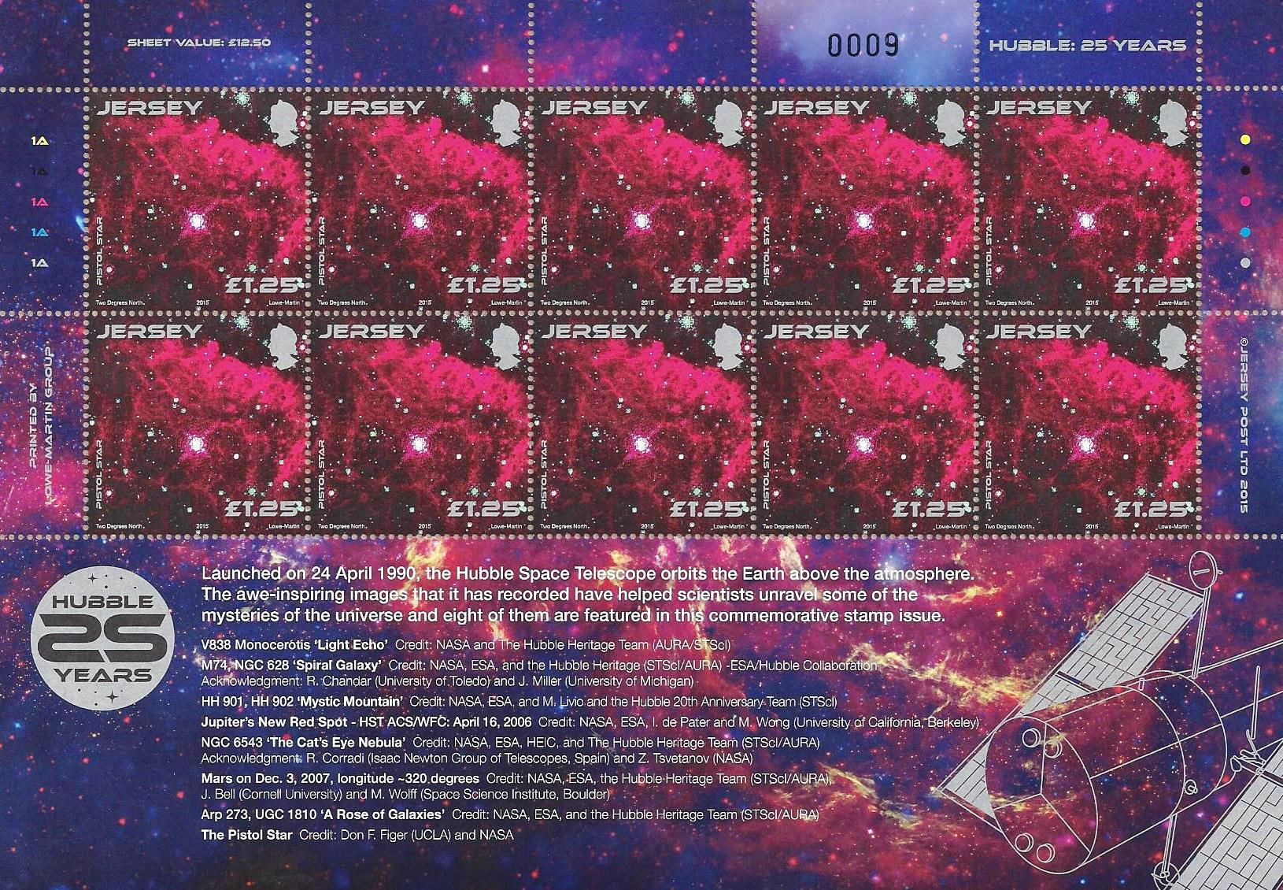
Questions?

Slide 40
Questions?

