Slide 1
Characterization of a Single Photon Sensing Detector for Astrophysics
Don F. Figer, Justin P. Gallagher
Center for Detectors
Rochester Institute of Technology, Rochester, NY
AAS 235 January 5, 2020

Slide 2
Outline
Science/Mission Background
Objectives and Goals
Technical Progress
Project Summary

Slide 3
Science/Mission Background
Next generation space telescopes require low-noise and large-format UV/Vis detectors.
Large formats are particularly relevant for wide-field applications, such as the High Definition Imager for LUVOIR.
Low noise is particularly relevant for low-light applications, such as exoplanet characterization.
This project is funded by NASA’s Strategic Astrophysics Technology program (COR).

Slide 4
Science/Mission Background

Slide 5
Objectives and Goals
The goals of the project are to:
characterize an existing low-noise CMOS detector in the lab, at a telescope, and after high energy irradiation simulating a space environment
propose design modifications to bring the performance of the technology closer to specifications for the intended applications
The work is significant because it would enable quantum-limited imaging in gigapixel formats for very low cost.
The primary innovation is the pixel design that demonstrates single-photon-sensing and photon-number-resolving performance.
With the success of this program, it will be possible to design and deploy gigapixel ultra-low-noise detectors for UV/Vis missions.
Potential applications include any that require low-light level performance (astro, planetary, Earth, helio, quantum, etc.).

Slide 6
Technical Targets
¹Data were taken from Ma et al. (2015), Fossum (2016), and Ma et al. (2017).

Slide 7
Technical Progress
RIT CfD received 20 prototype detectors packaged in a camera.
We established single-photon-sensing and photon-number-resolving performance.
A significant fraction of the acquisition and reduction software is complete.
We presented results at the Single Photon Workshop in October, 2019.

Slide 8
Technical Progress

Slide 9
Technical Progress

Slide 10
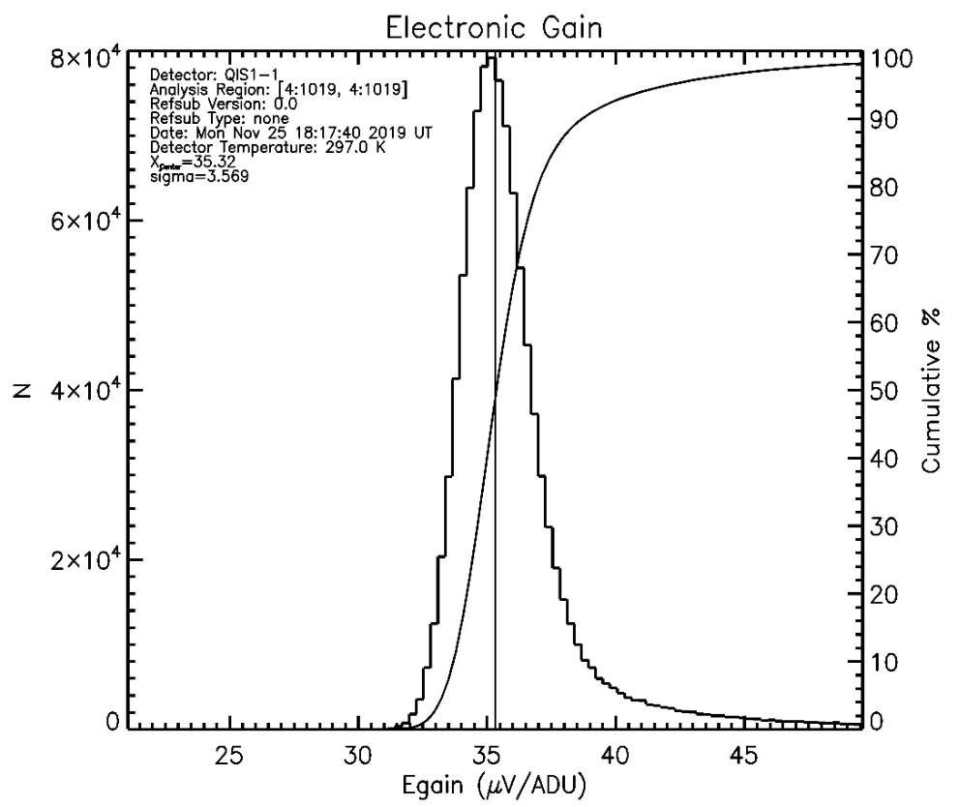
Technical Progress
(left) A histogram of (ADU/e‒) gain of the detector array. The mean gain is ~14.3 ADU/e‒. (right) A histogram of electronic gain (μV/ADU) electronic gain. The mean gain is ~35.3 μV/ADU. The mean output sensitivity is 500 μV/e‒.

Slide 11
Technical Progress
Large amplitude fringing is seen within the detector response (solid) and not in the Si diode response (dash). Thin film interference calculations suggest a thickness of 2.5 μm.

Slide 12
Technical Progress

Slide 13
Project Personnel
Don Figer (RIT PI)
Michael Zemcov (RIT Co-PI)
Eric Fossum (Dartmouth Co-PI)
Justin Gallagher (RIT Astrophysical Sciences and Technology MS)
Long Nguyen (RIT Electrical Engineering BS)
Michael Kha (RIT Software Engineering BS)

Slide 14
Project Personnel
Kaitlin Anagnost (Dartmouth Engineering Sciences PhD)
Margaret Cruz (RIT Mechanical Engineering MS)
Wei Deng (Dartmouth Engineering Sciences PhD)
Eric Stolt (Dartmouth Physics BS and Engineering Sciences BS)

Slide 15
Project Summary
acquired single photon sensing detectors
completed software driver code
completed IDL data acquisition software
wrote IDL data reduction/analysis software
demonstrated experiments to measure: dark current, read noise, quantum efficiency

Slide 16
Images

