Slide 1


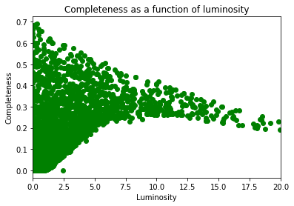
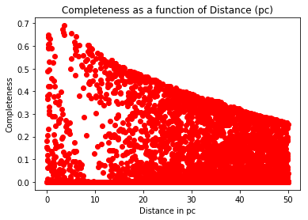
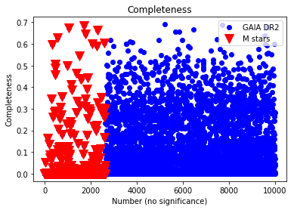
Simulating the Earth-like exoplanet yield of the NASA LUVOIR ‘A’ architecture direct-imaging mission
Dominic Oddo^{a,b},Donald Figer^{b} ªCase Western Reserve University, Department of Physics, ^{b}Rochester Institute of Technology, Center for Detectors
GOALS
METHODS
a
b
Estimate the Earth-like exoplanet yield of NASA LUVOIR ‘A’
Answer questions like “which stellar properties are best for directly imaging exoplanets?”
  We use a sample of GAIA DR2 stars and synthetic M class stars to generate a sample of 10⁵ synthetic planets per star and calculate planet-star separation and relative brightness, as well as S/N ratio.
  If planet is within coronagraph IWA and OWA, has a high enough S/N above threshold, and is bright enough to be detected above relative brightness threshold, it is “detected.”
  Detected planets are divided by total number of planets for each star to give completeness, then completeness of stars that are able to be observed within the given time are added to give total completeness, which is then multiplied by occurrence rate to give total number of planets detected.
BACKGROUND
One of the science objectives of NASA Large UltraViolet/ Optical/Infrared Surveyor (LUVOIR) is to detect and characterize exoplanets within 50 parsecs of the Sun using direct detection. To do so, it will have an advanced coronagraph for high contrast imaging. We use the proposed LUVOIR ‘A’ technical parameters to simulate the amount of Earth-like exoplanets the mission could find within a one-year observation period.
Figure 3: Completeness as a function of stellar luminosity and distance in parsecs, respectively
RESULTS/CONCLUSIONS
LUVOIR ‘A’ will detect approximately 54 Earth-like exoplanets. Out of the 3153 systems that are able to be studied within the observation period, one Earth-like exoplanet is detected for roughly 58 systems. Figure 3a shows a downward trend for completeness with respect to stellar luminosity. As shown in figure 3b, an upward trend for completeness is seen in closer stars. While it is possible to detect exoplanets around M class stars, it is more difficult to do so.
RESULTS
ACKNOWLEDGMENTS
This work was supported by The National Science Foundation (NSF) under the Research Experiences for Undergraduates (REU) program. This research has made use of the NASA Exoplanet Archive, which is operated by the California Institute of Technology, under contract with the National Aeronautics and Space Administration under the Exoplanet Exploration program.
Figure 1: Preliminary concept of LUVOIR ‘A’ architecture (credit: https://asd.gsfc.nasa.gov/luvoir/design/)
Figure 2: Scatter plot showing completeness for each star, separated by dataset

