Slide 1
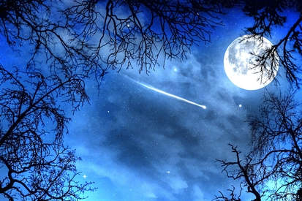
Starry Nights
Don Figer

Slide 3
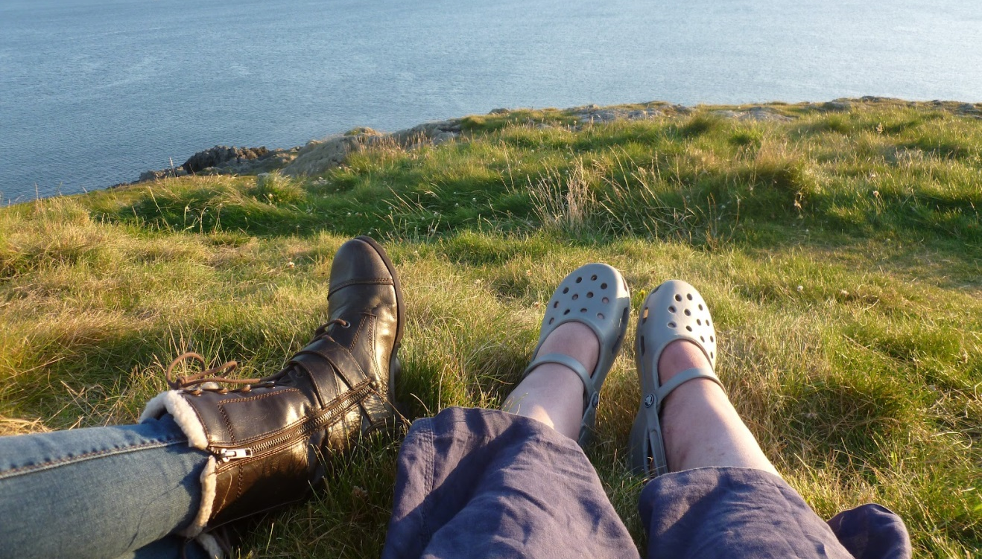
Lying on our backs,

Slide 4
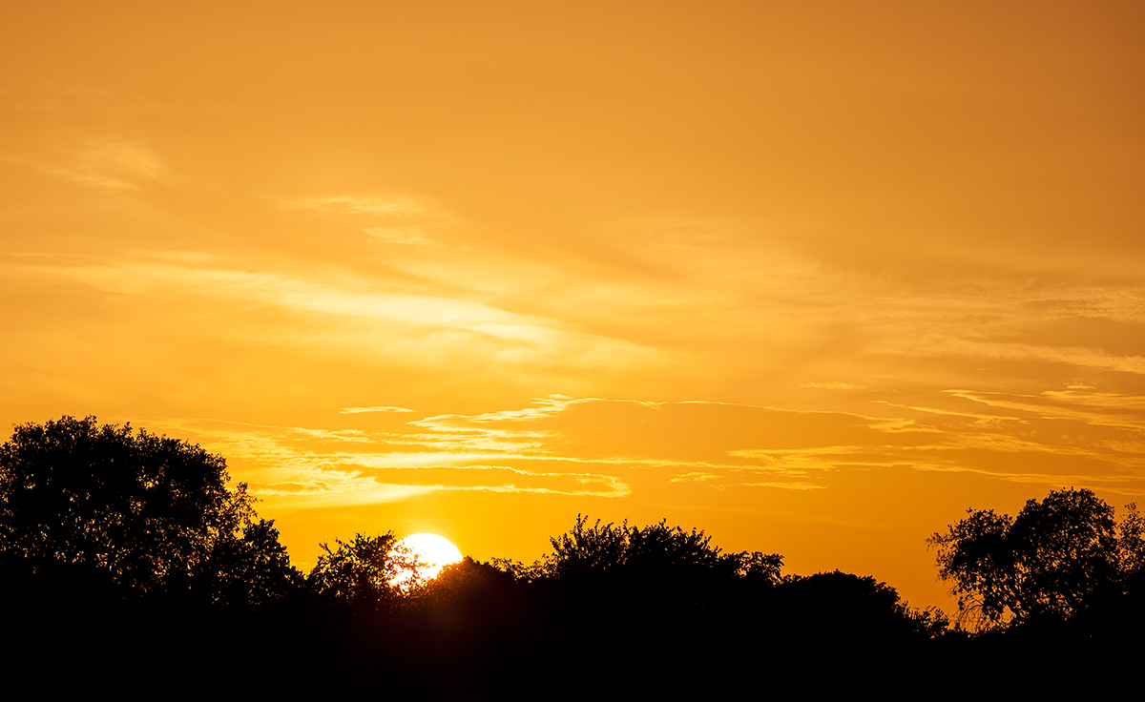
On a warm summer night,

Slide 5
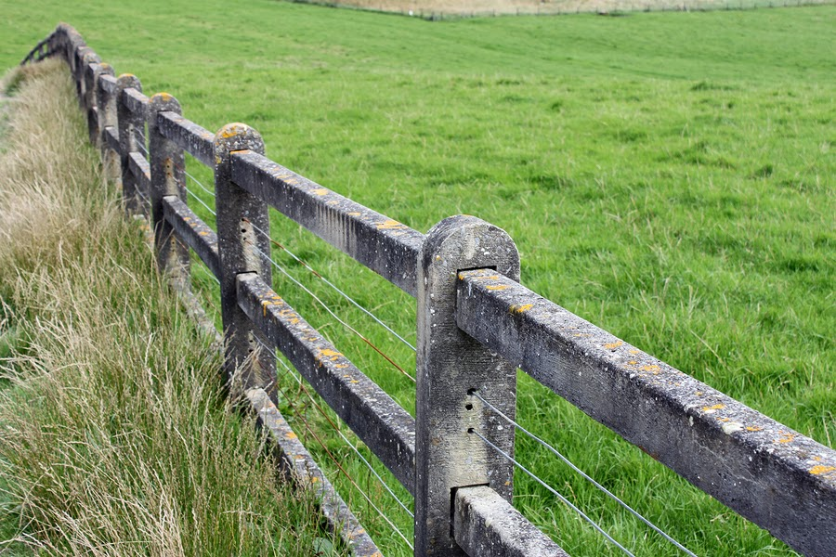
The grass as our blanket,

Slide 6
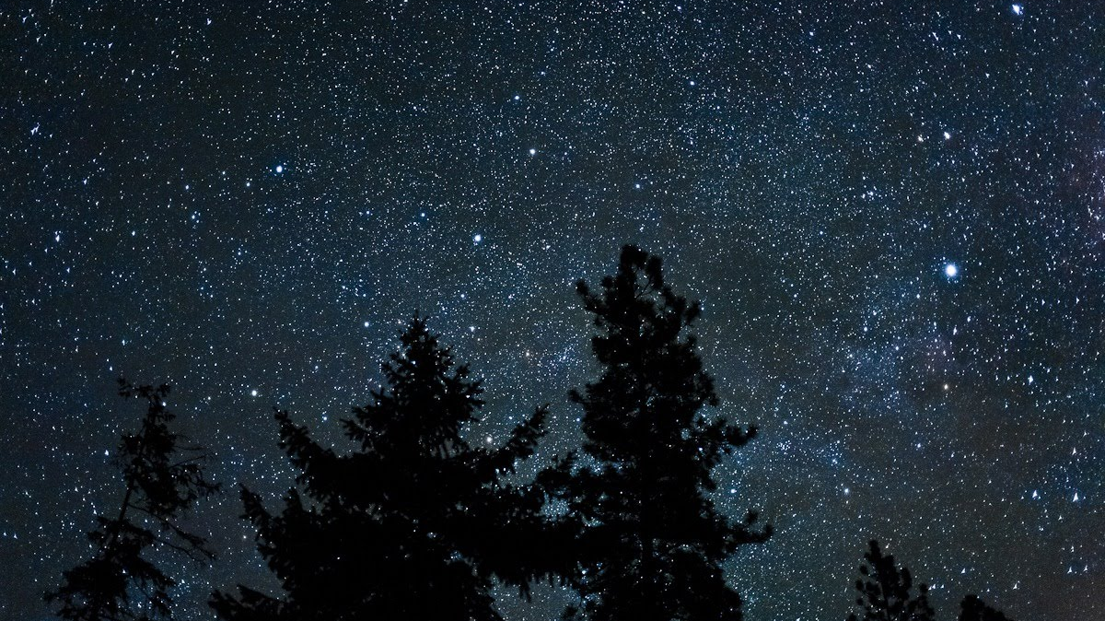
we take in the sight.

Slide 7
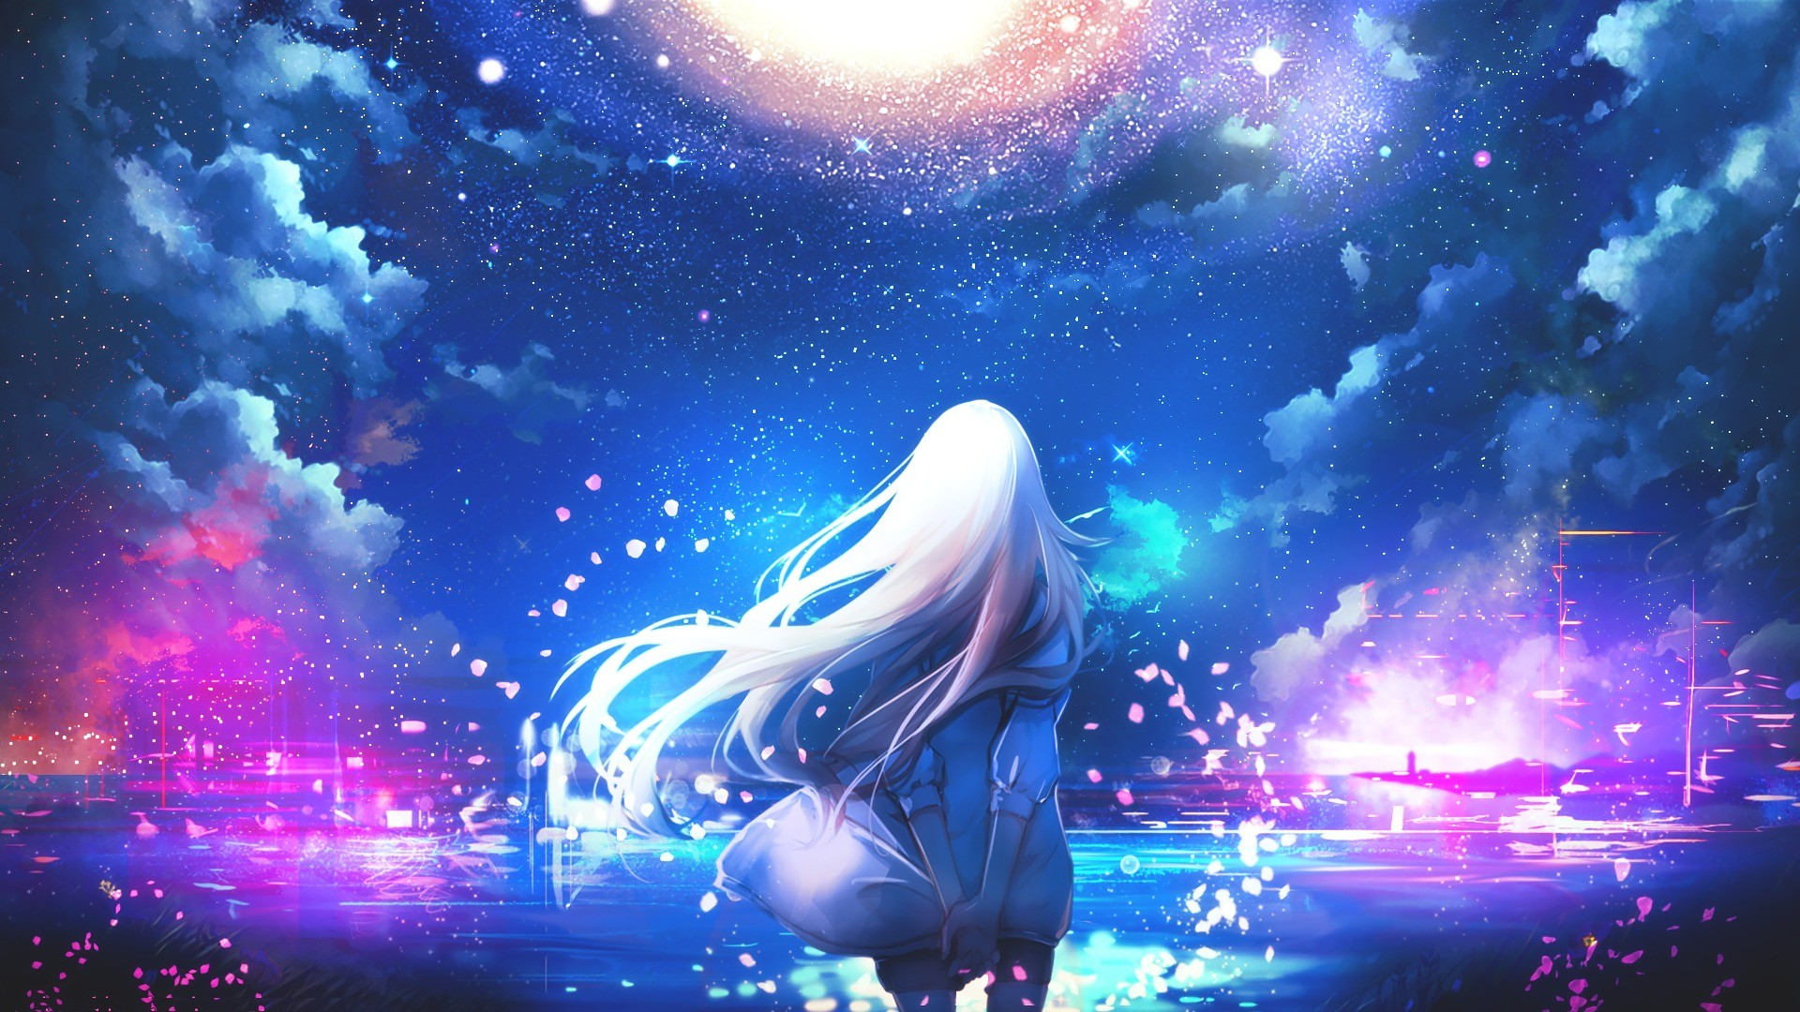
Stars are above us,

Slide 8
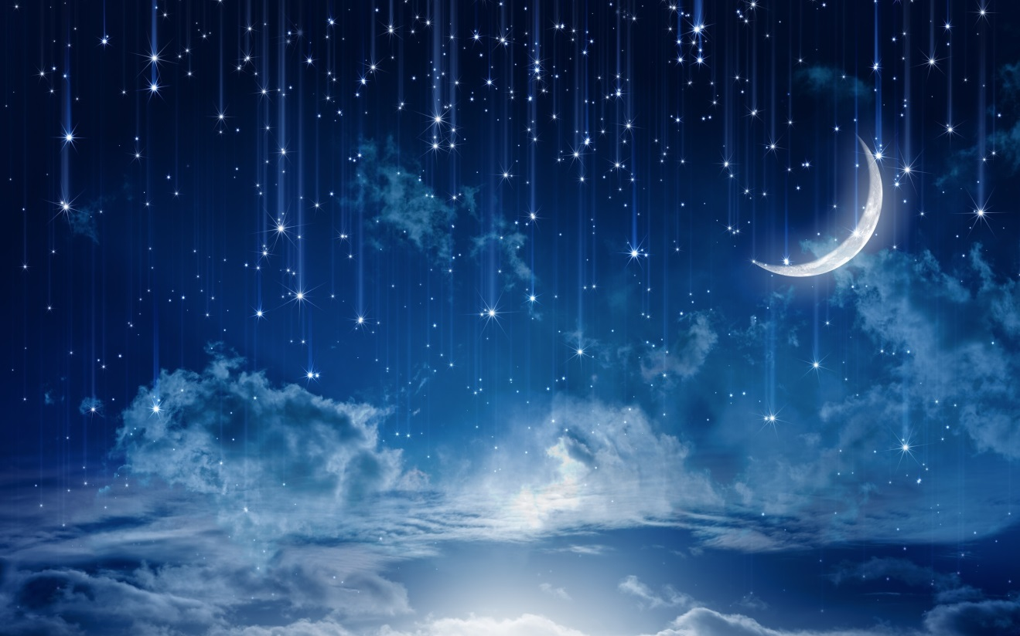
As far as we can see.

Slide 9
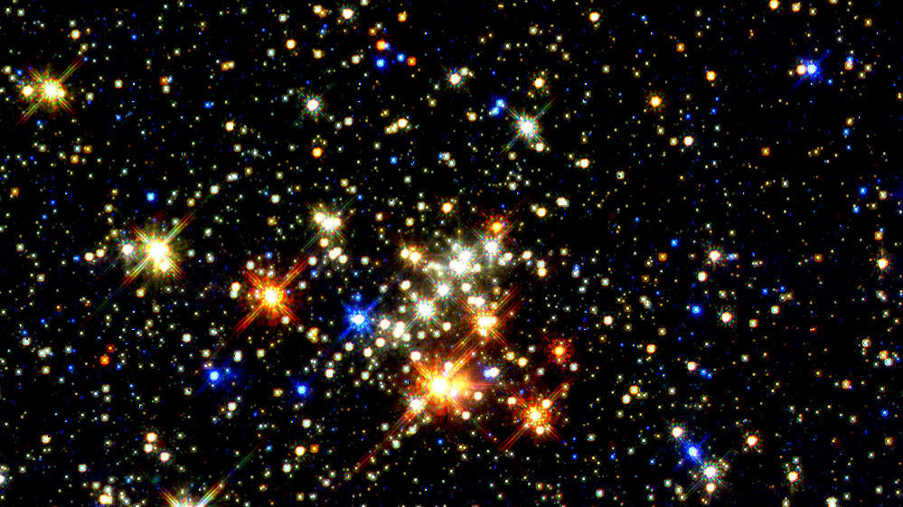
They are bright points of light.

Slide 10
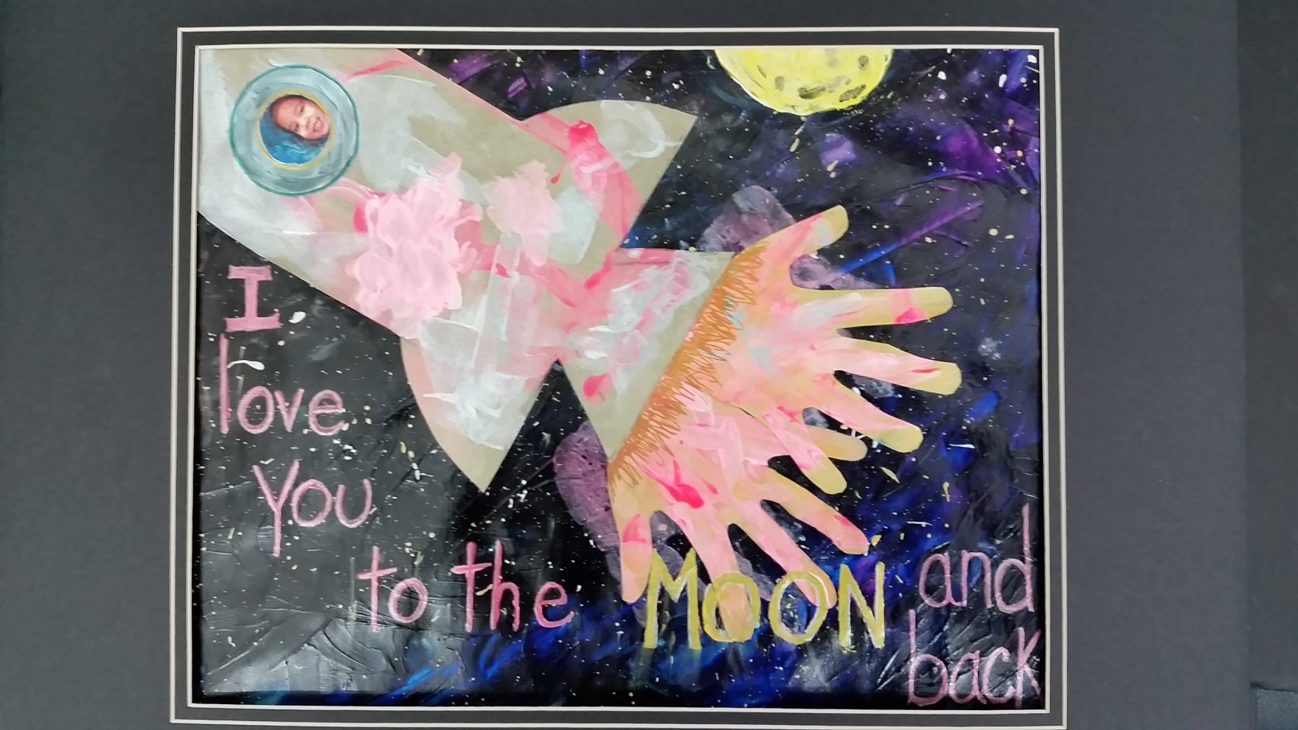
Where we wish we could be.

Slide 11
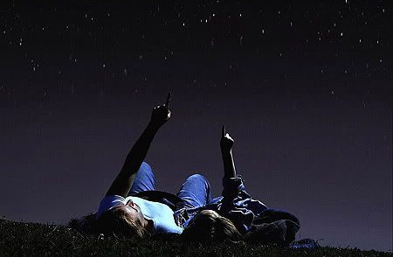
I point to a star,

Slide 12
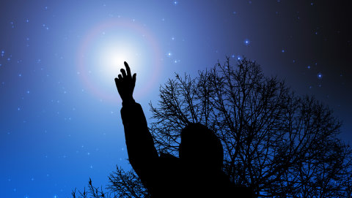
at the end of my finger.

Slide 13
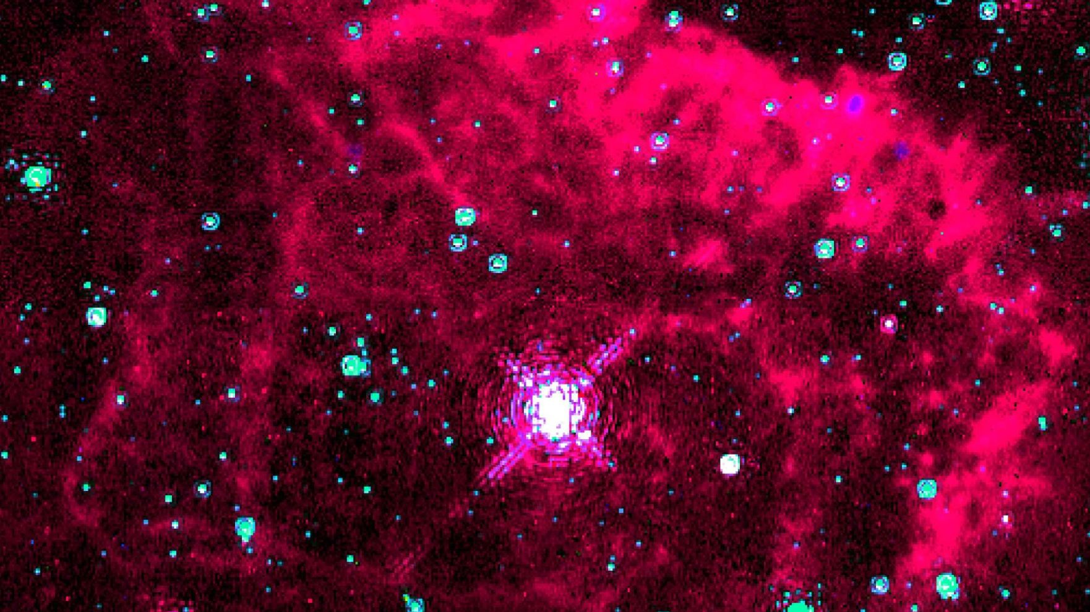
What is that one?

Slide 14

My question does linger.

Slide 15
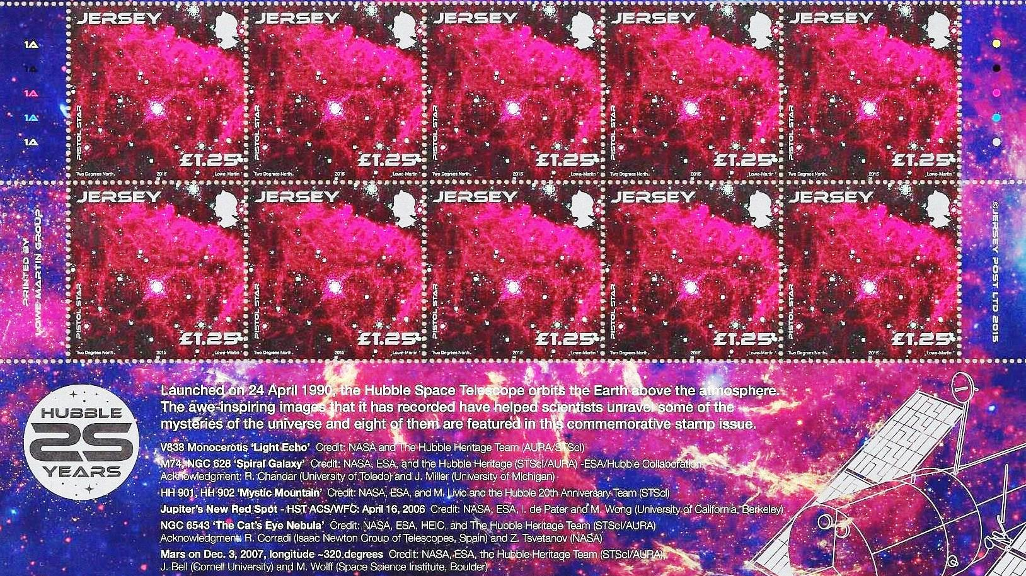
Daddy says, “That is the Pistol Star.”

Slide 16
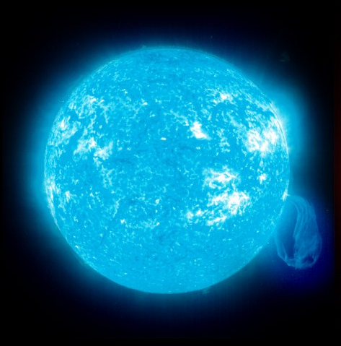
It’s bigger than our Sun.
Sun
Pistol Star

Slide 17
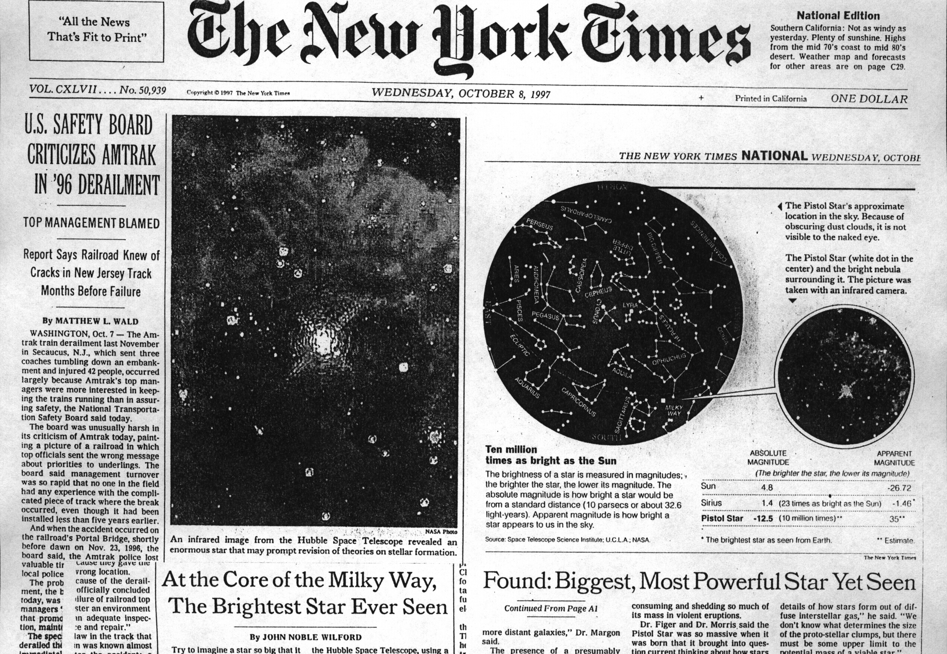
He tells me the story of it.

Slide 18

And now we’re having fun.

Slide 19
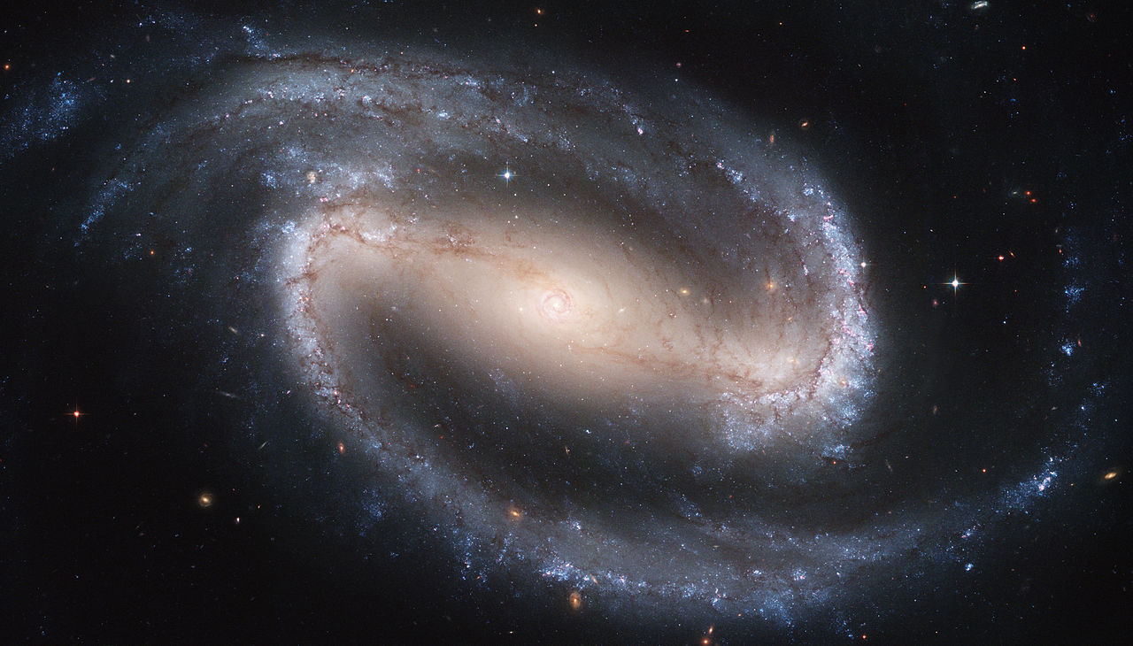
How far away is it?

Slide 20

I ask my Dad.

Slide 21
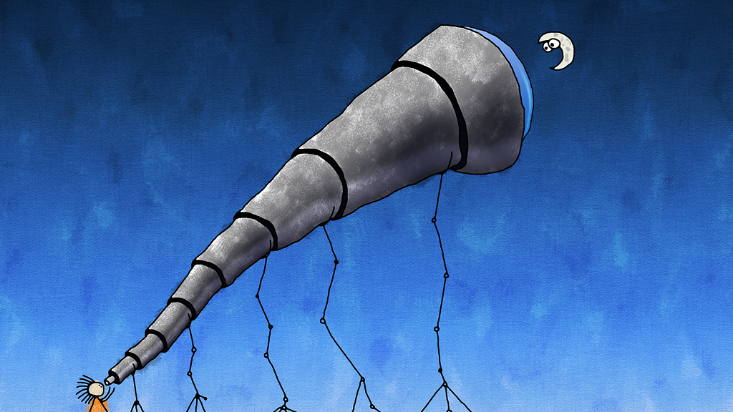
He says it is farther

Slide 22

than all the numbers we add.

Slide 23

What makes them so bright,

Slide 24
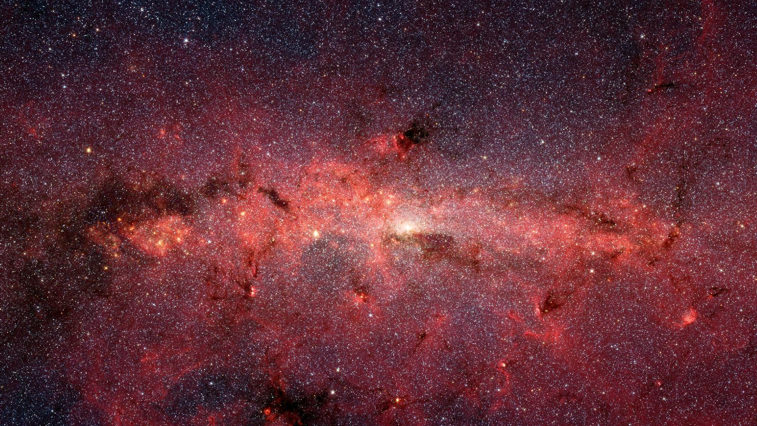
if they are so far away?

Slide 25
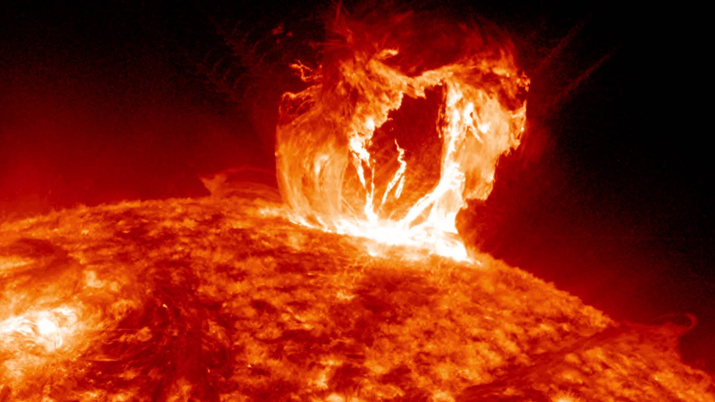
“Big explosions inside,

Slide 26
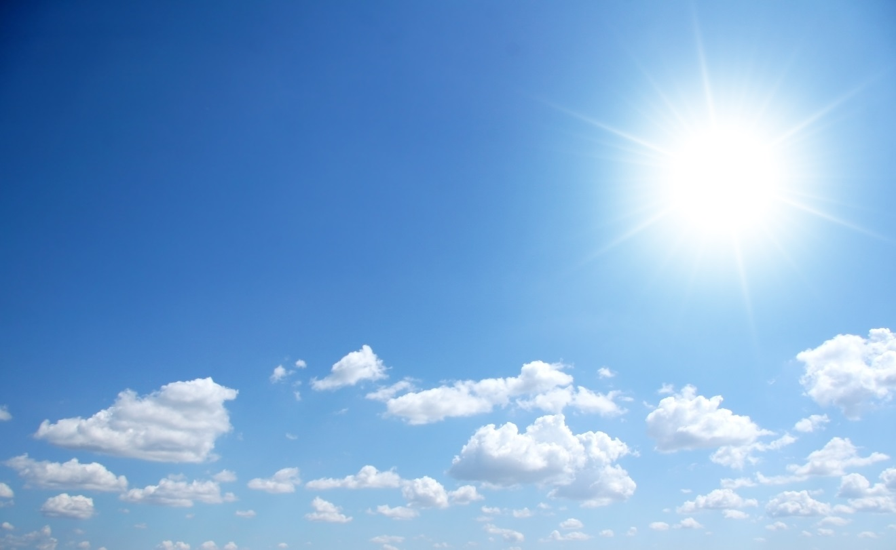
like in the Sun that lights our day.”

Slide 27
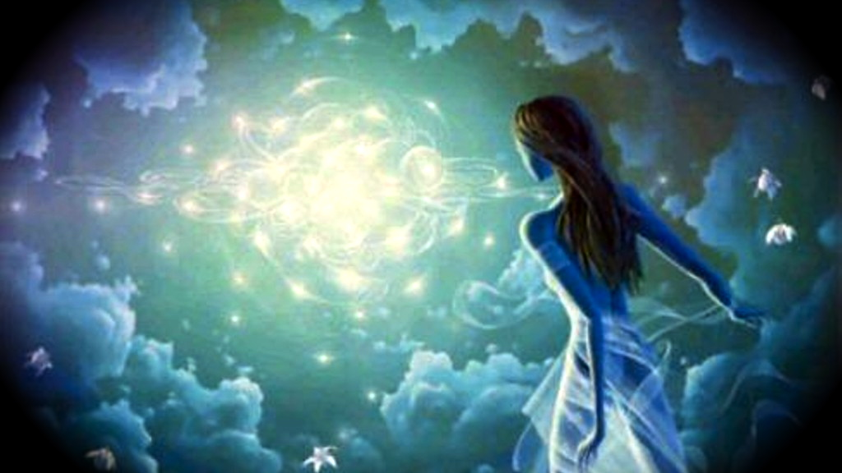
My body fills with wonder.

Slide 28

So much can I see.

Slide 29

I love my Daddy

Slide 30

and he loves me.

