Slide 1
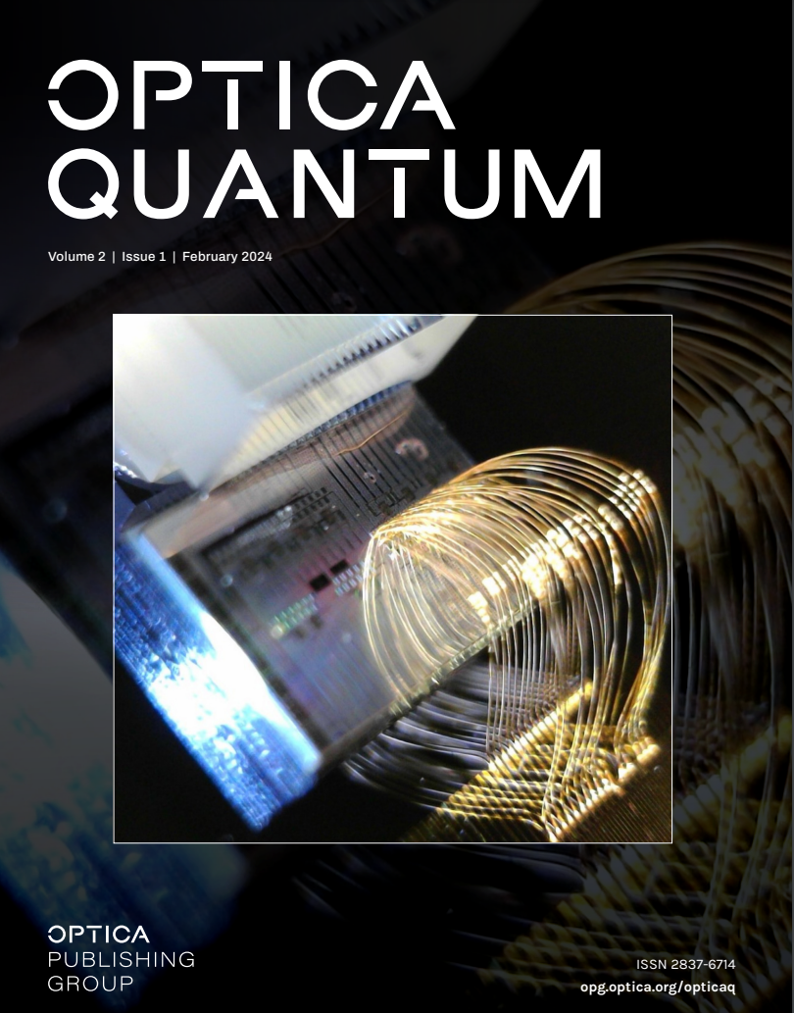
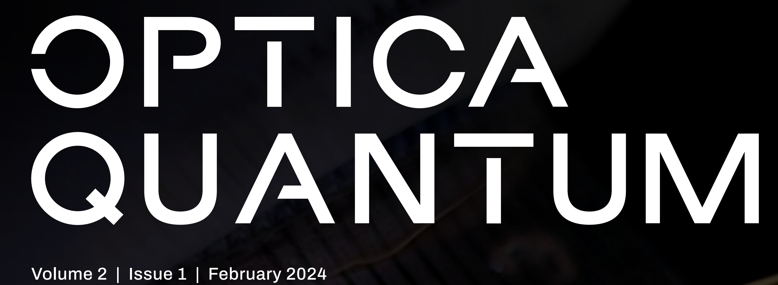

Foundry Fabricated Silicon Photonics
High-dimensional quantum entanglement on a chip
E. Manfreda-Schulz, J. Elliot, M. van Niekerk, D. Proctor, M. Ciminelli, T. Palone, C. Tison, M. Fanto, S. Preble, and G. Howland

