Slide 1

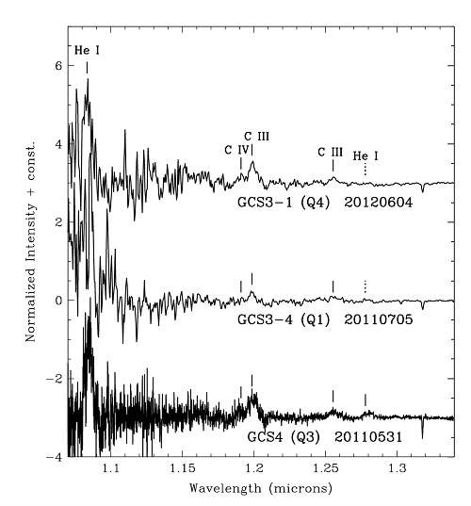

Most objects in the center of the Milky Way are so highly obscured from our view by intervening dust that, at wavelengths visible to the naked eye, only about one photon out of every trillion emitted by them toward the Earth actually reaches our planet. This makes it impossible to observe the copious visible light emitted by the Galactic center’s stars, hot gas, the accretion disk encircling the supermassive black hole, and many other objects. The amount of obscuration decreases rapidly with increasing wavelength and thus most of our information about the Galactic center’s resident objects and gas comes from infrared and radio observations.
For some Galactic center stars, those that are embedded in dust shells of their own making, the obscuration is even more extreme. Among these are five infrared-luminous objects known as the Infrared Quintuplet, located at the center of a cluster of hundreds of hot and massive stars, which has been given the name Quintuplet Cluster. The Quintuplet Cluster is only 30 parsecs (100 light years) distant from the central massive black hole at the very center of our galaxy.
The difficulty in observing these five stars is greater, not
J-band spectra of three of the five members of the Infrared Quintuplet showing emission lines of neutral helium and ionized carbon. The continuum radiation from the stars and their dust shells actually decrease rapidly from longer to shorter wavelengths and is barely detectable at the short wavelength edge of these spectra. In the figure the spectra have been “flattened” to more easily reveal the line emission. The increasing “noisiness” of the spectra toward their short wavelength edges demonstrates the increasing difficulty of detecting any light at all from these objects at those wavelengths.
only due to the additional obscuration by their dust shells, but also because the shells are warmed by their central stars and emit bright infrared continuum radiation, diluting any infrared light from the stars themselves. The combination of these effects has made it very challenging, if not impossible, at any infrared wavelength to detect light from the interiors of the shells leaking through the dust “cocoons” and surviving the journey through the interstellar dust to our telescopes, or so it was thought. Thus, little has been learned about natures of these objects since they were discovered over a quarter century ago. The only clues were high-resolution infrared images which showed that the dust emission from two of the five resembled pinwheels. Previously this phenomenon had only been seen outside of the Galactic center, in a few objects identified as Wolf-Rayet colliding wind binaries, which are double star systems comprised of extremely luminous hot stars with massive winds.
Several years ago, while using NIFS at Gemini North for an unrelated research program, Tom Geballe serendipitously discovered a very faint and broad emission line due to hot helium gas near 1.7 microns in the infrared spectrum of one of the Quintuplet stars. Prompted by this, a team consisting of him, Paco Najarro (Centro de Astrobiología, Spain), Don Figer (Rochester Institute of Technology), and Diego de la Fuente (Universidad Nacional Autónoma de México) successfully proposed to use NIFS and GNIRS to obtain sensitive spectra of all five members of the infrared Quintuplet, not only near 1.7 microns, but also down to wavelengths as short as 1.0 micron. Near the short end of that wavelength range, one photon in several thousand survives the journey first through the dust cocoon and then from the Galactic center to Earth. That fraction is much larger than the one in a trillion at visible wavelengths, but is still tiny. However, the contaminating emission from the warm dust shells is greatly reduced, increasing the contrast between any spectral features emitted from inside the dust shells and the continuum emission from the shells themselves. Thus, the team reasoned that with a large telescope, a sensitive spectrograph, and less dilution from the warm dust, they would be able to detect the faint light coming from within the cocoons.
The spectra, recently published in The Astrophysical Journal, reveal the presence of emission lines from four of the five members of the Quintuplet, and have allowed us to definitively identify the four as containing late-type, carbon-rich Wolf-Rayet stars, as was suspected based on the earlier imaging. These massive stars are only a few million years old, but have completely lost their outer hydrogen-rich layers and probably do not have much longer to exist before exploding violently as supernovae.

