Slide 1
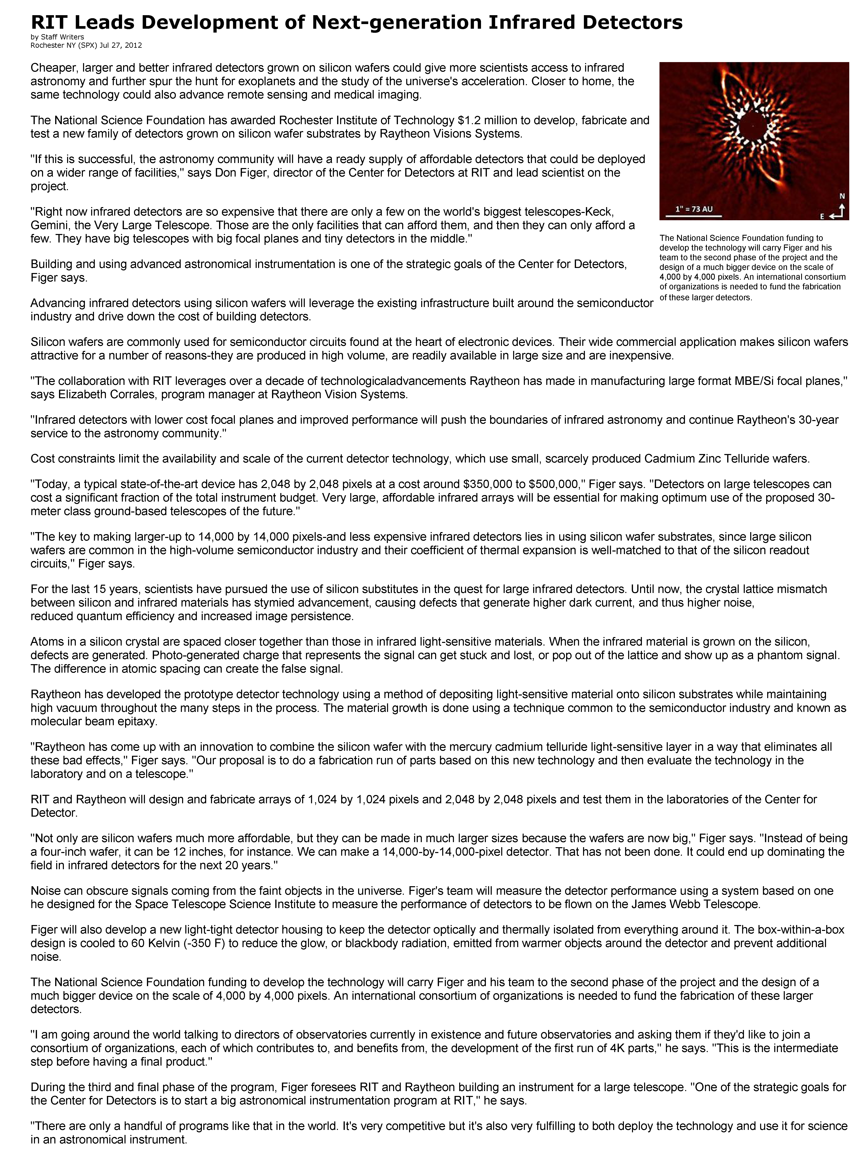

Slide 2
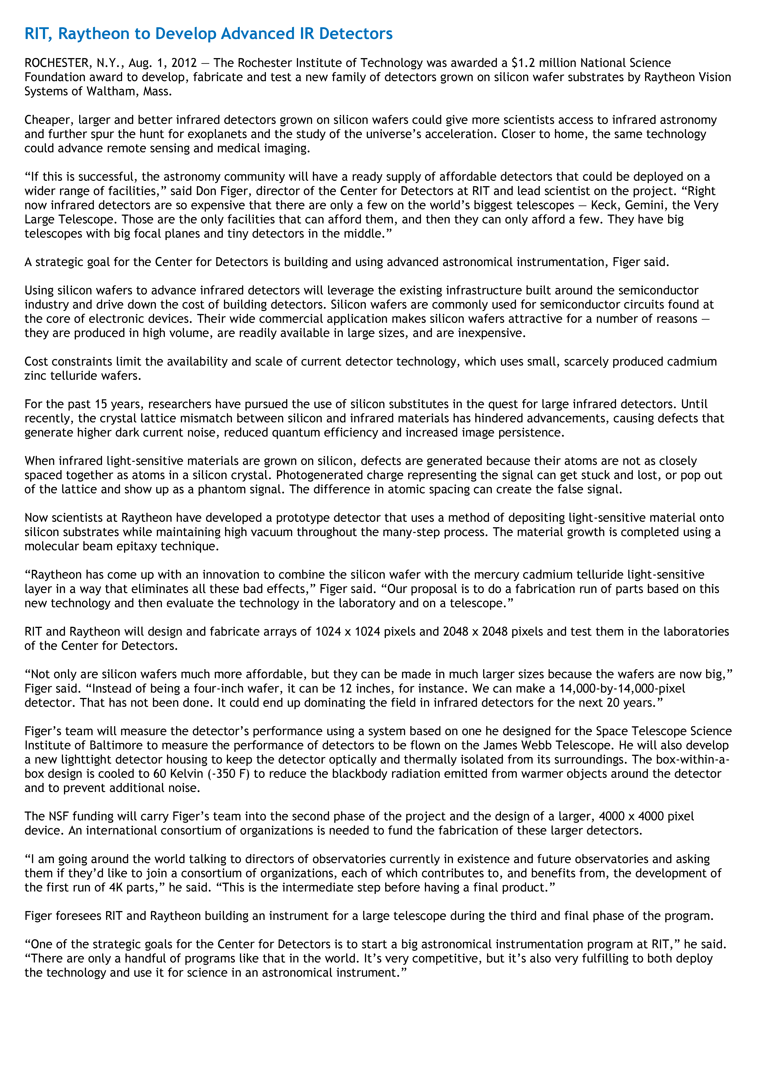

Slide 4
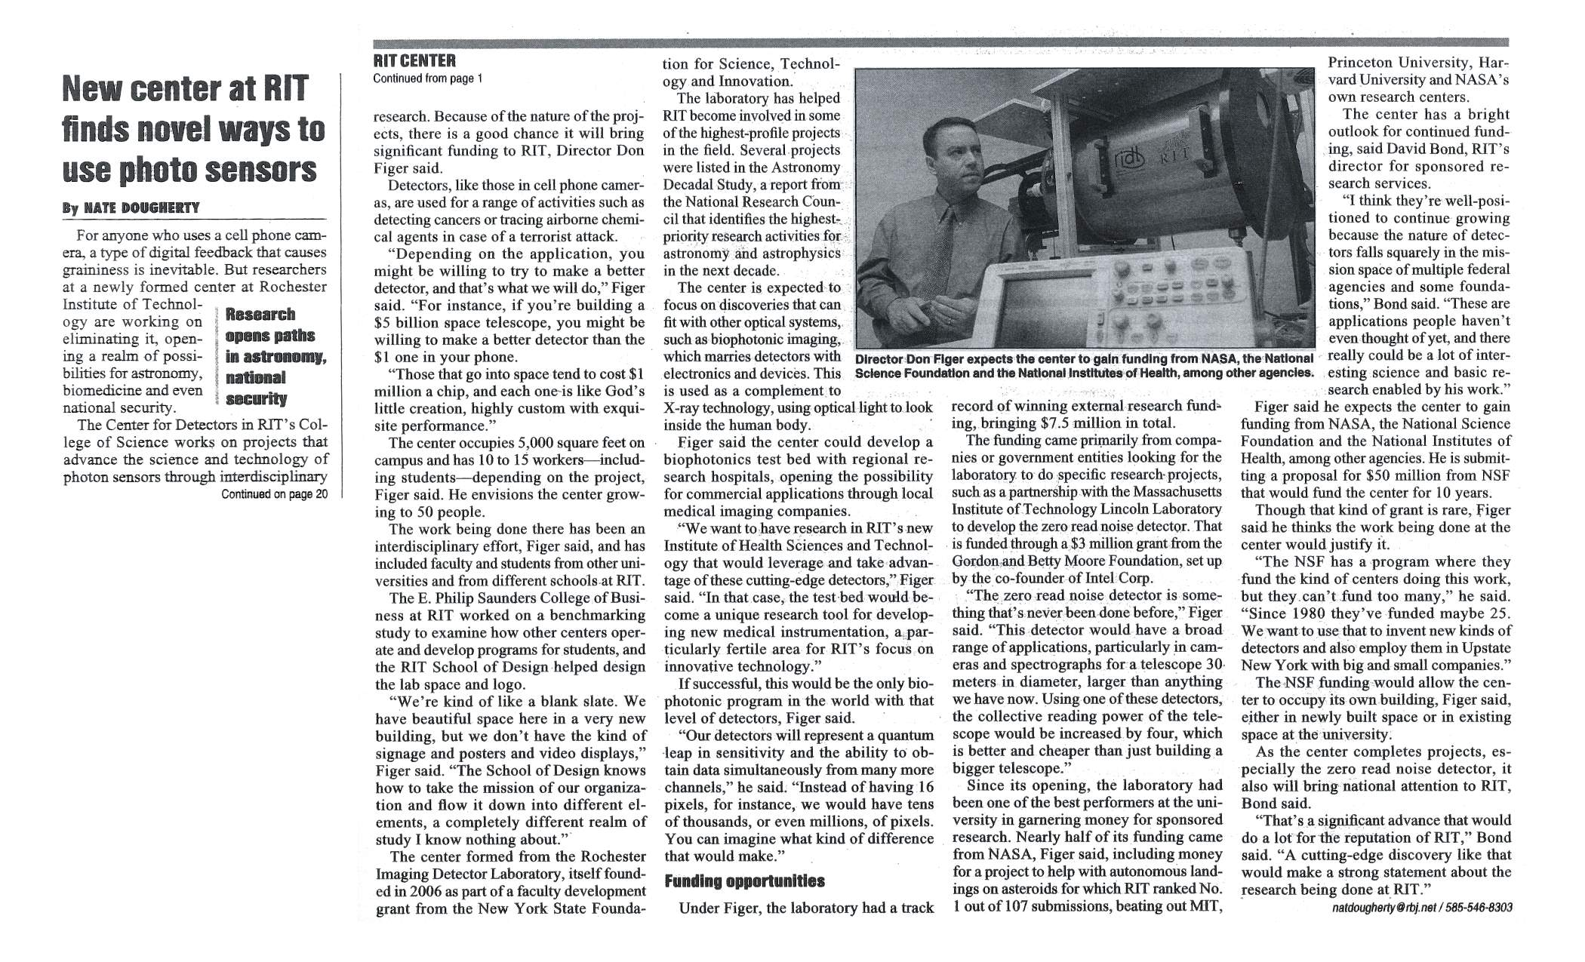

Slide 5
Specific R&D
FPI will focus on four specific areas for research and development.
Integrated Photonics
Stefan Preble, director of the RIT Integrated Photonics Group, is leading work that integrates photons onto microchips, which will address the key computing, energy, communication, and sensing challenges of the future. Through the FPI, Preble believes revolutionary advances in photon science and technology can be made.
“The goal is to be able to process every photon. Light is made up of photons and it’s very important you don’t lose any of those. You want to get all the information you can from these photons. That’s difficult to do at this point,” Preble said.
A key theme will be the exploitation of the quantum properties of photons and matter to eliminate tradeoffs in speed, efficiency, and noise. “By moving to a quantum-limited regime in the laser, the waveguide, the detector, essentially you’re able to have much higher performance than is possible in classical technology,” Preble said. “As a result that shift helps us to answer those big questions.”
Scaled Electronics
Bruce Smith, director of RIT’s microsystems engineering doctoral program, leads this area, which focuses on microelectronics, “making devices very small, well beyond the wavelength of light itself. We’re talking about building structures in electronic devices that approach the single nanometer scale.That requires huge challenges going beyond the traditional predictive scaling laws,” Smith said.
Having the Initiative build partnerships with businesses, consortia, and other academic institutions is key. “More than ever, there are challenges that require thinking about nano-scale devices and process technology in nonconventional ways. Collaborating with groups that are involved with the latest advances is extremely important as we move to new opportunities to communicate with, connect to, and control the world around us.” Smith said. “The current challenges aren’t anything that can be resolved with one single discipline; the goal is to create opportunities to work together.”
Photovoltaics
Seth Hubbard, director of RIT’s NanoPower Research Laboratories, has overall responsibility for the energy area of the FPI. The United States and other countries have identified sustaining the energy supply as a high priority, according to Hubbard. His research focuses on photovoltaics, specifically improving the efficiency at which photovoltaics converts sunlight into electricity.
Hubbard, Preble, and Figer already have been collaborating for a number of years, and plans call for a multidisciplinary team of scientists and engineers to develop breakthroughs to advance the state of the art in device efficiency.
While Hubbard has already developed collaborative relationships with a number of businesses over the years as a result of joint government funding, he believes the Future Photon Initiative will give the name recognition to be able to expand that.
Detectors
Two of the most exciting application areas for detectors are astrophysics and biophotonics, according to Figer, who oversees this area in his role as head of the Center for Detectors. The Center, which is one of the most well-funded astronomical detector programs in the world, is currently leading development programs for both single photon counting detectors and also large format infrared detectors. The FPI will leverage these developments for future astrophysics missions.
In the field of biophotonics, fast low- noise detectors are crucial for the develop- ment of next-generation biophotonic instruments. Ultimately, these instruments can help answer big questions such as how to extend the lives of breast cancer survivors and how to study brain hematomas in infants, Figer said. The Initiative plans to hire a principal investigator faculty member for this area.

Slide 6
AIM-ing up: Student-researchers help build the photonics ecosystem
Rochester is making an impact in photonics manufacturing, and RIT is playing a central role as a key partner in AIM Photonics, a national manufacturing initiative expected to stimulate economic development and global competitiveness.
Photonics is an intricate science about harnessing the power of light. RIT’s numerous experts are contributing to photonic device manufacturing, industry assessment to improve workforce training and education, and device packaging and assembly solutions—all critical areas necessary for the growing photonics ecosystem.
RIT students are a big part of that system, creating photonics devices and solutions in classes and through research projects that will also become foundational materials to help train others for an industry expected to transform manufacturing.
“Photonics is the future,” said Sanjna Lakshminarayanamurthy, a microelectronic engineering graduate student from India. “I do live in the present, but we need to have an eye for the future. I know I can contribute; I felt this work would bring out the best in me.”
Lakshminarayanamurthy was one of 20 students taking Photonic Integrated Circuits, an upper-level course, delivered by Stefan Preble, associate professor of microsystems engineering in RIT’s Kate Gleason College of Engineering, and several other faculty this past spring. Focused on learning the overall photonics manufacturing process, students designed a prototype photonics chip where laser light is precision-placed onto silicon.
“All the courses I took in microelectronics helped me in the clean room to work on this project. We tried different chemistries we had not used here before,” she said. “Silicon photonics is just growing, and it can be compatible with the existing integrated circuit process.”
Lakshminarayanamurthy helped define the preparation, etching steps and processing necessary to fabricate chips. Her project information will be integrated into the curriculum RIT is helping develop for AIM Academy, the educational arm of AIM Photonics. She will also use this knowledge in her new position as a process engineer at Global Foundries in Albany.
Once an optical fiber is aligned to a feature on silicon, the challenge becomes holding that fiber in place, protecting it during testing before packaging and assembly. Keyla Bastardo-Ramirez works closely with Martin Anslem, director of the Center for Electronics Manufacturing and Assembly, to produce solutions that ensure manufacturing processes are efficient, cost effective and sustainable. Her literature review on fiber attachment challenges, current solutions and those being developed is extensive. It also highlights the need to develop novel research programs that can eventually bridge the gap for adopting photonics integration technology in high volume production applications, she explained.
“When I started my master’s degree in manufacturing and mechanical system integration, I already had experience working in manufacturing firms, not in the electronics industry, but I was already fascinated with manufacturing processes of any kind,” said Bastardo-Ramirez, who is from Santo Domingo, Dominican Republic. “I would like to continue working on developing this technology in industry or in academia.”
Industry will need students like Bastardo-Ramirez, who will be entering the photonics workforce once she graduates in December. Other workforce needs—from entry-level positions to research and development—are being assessed through the Photonics and Optics Workforce Education Research (POWER) group, founded by Ben Zwickl and Kelly Martin, both assistant professors in RIT’s colleges of Science and Liberal Arts, respectively. POWER’s research is on skills needed for photonics and optics; the group explores how academia and industry define, perceive, influence and value STEM workforce development.
Alexandria Cervantes, an undergraduate on one of several projects within the research group, did in-depth interviews with managers and new hires from local companies as well as graduate research assistants at universities. Preliminary data revealed that supplementing current technical coursework with communications and interpersonal skills can benefit all students in STEM programs to better prepare them for success in their respective fields. Cervantes’ study was part of the Research Experiences for Undergraduates, where undergraduates from RIT and other national universities can apply for directed projects related to their degree programs and interests. Her work, titled, “Values and perception of communication in photonics and optics,” and featured at this summer’s Undergraduate Research Symposium, will become part of POWER’s contribution to AIM’s comprehensive workforce needs assessment studies.
Students are involved in many more projects related to photonics technology and education, and their work will reap dividends, not only for AIM Photonics, but for their own careers..

Slide 7
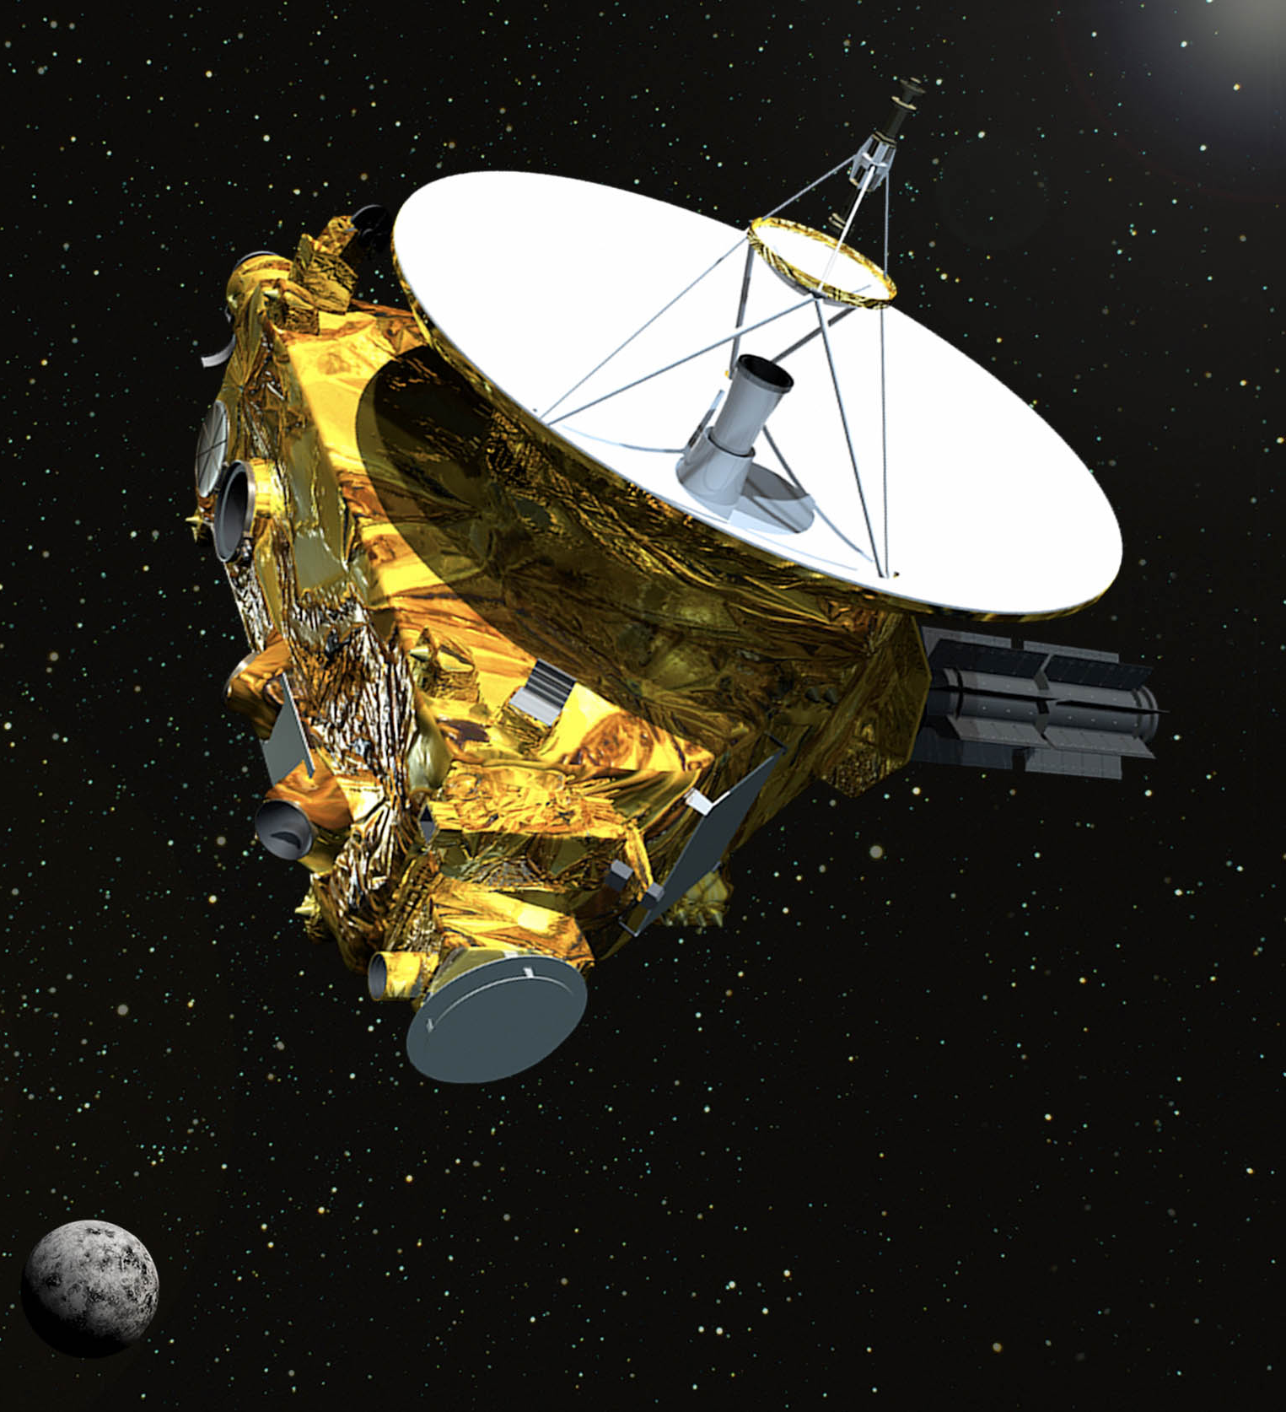
RIT scientist measures brightness of the universe with NASA’s New Horizons spacecraft Planetary mission offers up-close view of Cosmic Optical background.
April 11, 2017
by Susan Gawlowicz
Images taken by NASA’s New Horizons mission on its way to Pluto, and
now the Kuiper Belt, have given scientists an unexpected tool for
measuring the brightness of all the galaxies in the universe, said a
Rochester Institute of Technology researcher in a paper published this
week in Nature Communications.
In the study, “Measurement of the Cosmic Optical Background using the
Long Range Reconnaissance Imager on New Horizons,” lead author
Michael Zemcov used archival data from the instrument onboard New
Horizons—the Long Range Reconnaissance Imager, or LORRI—to measure
visible light from other galaxies. The light shining beyond the Milky Way is
known as the cosmic optical background. Zemcov’s findings give an
upper limit to the amount of light in the cosmic optical background.
“Determining how much light comes from all the galaxies beyond our own
Milky Way galaxy has been a stubborn challenge in observational
astrophysics,” said Zemcov, assistant professor in RIT’s School of
Physics and Astronomy and member of RIT’s Center for Detectors
and Future Photon Initiative. Light from the cosmic optical background can
reveal the number and location of stars, how galaxies work and give
insights into the peculiar nature of exotic physical processes, such as light
that may be produced when dark matter decays. Dark matter is the invisible
substance thought to comprise 85 percent of matter in the universe.
“This result shows some of the promise of doing astronomy from the outer solar system,” Zemcov said. “What we’re seeing is that the optical background is completely consistent with the light from galaxies and we don’t see a need for a lot of extra brightness; whereas previous measurements from near the Earth need a lot of extra brightness. The study is proof that this kind of measurement is possible from the outer solar system, and that LORRI is capable of doing it.” Spacecraft in the outer solar system give scientists virtual front-row seats for observing the cosmic optical background. The faint light from distant galaxies is hard to see from the inner solar system because it is polluted by the brightness of sunlight reflected off interplanetary dust in the inner solar system. Cosmic dust is sooty bits of rock and small debris that moved, over time, from the outer solar system toward the sun. Scientists launching experiments on sounding rockets and satellites must account for the dust that makes the Earth’s atmosphere many times brighter than the cosmic optical background.
NASA’s New Horizons mission has been funded through 2021, and Zemcov is hopeful for the chance to use Long Range Reconnaissance Imager to re-measure the brightness of the cosmic optical background. “NASA sends missions to the outer solar system once a decade or so,” Zemcov said. “What they send is typically going to planets and the instruments onboard are designed to look at them, not to do astrophysics. Measurements could be designed to optimize this technique while LORRI is still functioning.”Zemcov’s method harkens back to NASA’s first long distance missions Pioneer 10 and 11 in 1972 and 1974. Light detectors on the instruments measured the brightness of objects outside the Milky Way and made the first direct benchmark of the cosmic optical background. “With a carefully designed survey, we should be able to produce a definitive measurement of the diffuse light in the local universe and a tight constraint on the light from galaxies in the optical wavebands,” Zemcov said. Archived data from New Horizon’s Long Range Reconnaissance Imager show “the power of LORRI for precise low-foreground measurements of the cosmic optical background,” Zemcov wrote in the paper. Chi Nguyen, a Ph.D. student in RIT’s astrophysical sciences and technology program, mined data sets from New Horizons’ 2006 launch, Jupiter fly-by and cruise phase. She isolated four different spots on the sky between Jupiter and Uranus, captured in 2007, 2008 and 2010, that met their criteria: looking away from the solar system and looking out the galaxy. Poppy Immel, an undergraduate majoring in math and computer science, generated the data cuts and determined the photometric calibration of the instrument. Other co-authors include Asantha Cooray from University of California Irvine; Carey Lisee from Johns Hopkins University; and Andrew Poppe from UC Berkeley. Zemcov is affiliated with the Jet Propulsion Laboratory.
The New Horizons spacecraft flew by Pluto and is headed for the Kuiper Belt in the outer solar system. The space camera aboard New Horizons, in the artist’s illustration above, could be used to re-measure the brightness of the cosmic optical background, said RIT scientist Michael Zemcov.

Slide 8
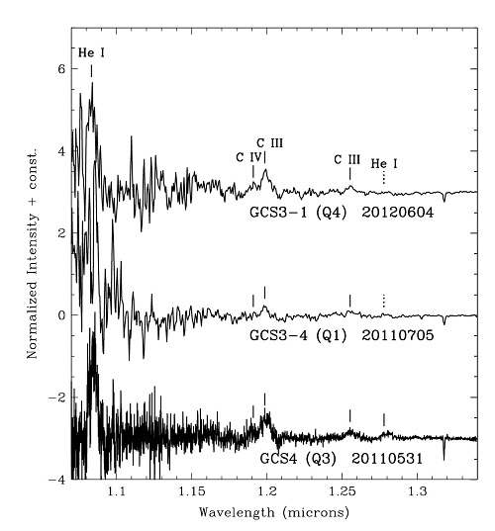
August 20, 2017
Most objects in the center of the Milky Way are so highly obscured from our view by intervening dust that, at wavelengths visible to the naked eye, only about one photon out of every trillion emitted by them toward the Earth actually reaches our planet. This makes it impossible to observe the copious visible light emitted by the Galactic center’s stars, hot gas, the accretion disk encircling the supermassive black hole, and many other objects. The amount of obscuration decreases rapidly with increasing wavelength and thus most of our information about the Galactic center’s resident objects and gas comes from infrared and radio observations.
For some Galactic center stars, those that are embedded in dust shells of their own making, the obscuration is even more extreme. Among these are five infrared-luminous objects known as the Infrared Quintuplet, located at the center of a cluster of hundreds of hot and massive stars, which has been given the name Quintuplet Cluster. The Quintuplet Cluster is only 30 parsecs (100 light years) distant from the central massive black hole at the very center of our galaxy.
J-band spectra of three of the five members of the Infrared Quintuplet showing emission lines of neutral helium and ionized carbon. The continuum radiation from the stars and their dust shells actually decrease rapidly from longer to shorter wavelengths and is barely detectable at the short wavelength edge of these spectra. In the figure the spectra have been “flattened” to more easily reveal the line emission. The increasing “noisiness” of the spectra toward their short wavelength edges demonstrates the increasing difficulty of detecting any light at all from these objects at those wavelengths.
The difficulty in observing these five stars is greater, not only due to the additional obscuration by their dust shells, but also because the shells are warmed by their central stars and emit bright infrared continuum radiation, diluting any infrared light from the stars themselves. The combination of these effects has made it very challenging, if not impossible, at any infrared wavelength to detect light from the interiors of the shells leaking through the dust “cocoons” and surviving the journey through the interstellar dust to our telescopes, or so it was thought. Thus, little has been learned about natures of these objects since they were discovered over a quarter century ago. The only clues were high-resolution infrared images which showed that the dust emission from two of the five resembled pinwheels. Previously this phenomenon had only been seen outside of the Galactic center, in a few objects identified as Wolf-Rayet colliding wind binaries, which are double star systems comprised of extremely luminous hot stars with massive winds.
Several years ago, while using NIFS at Gemini North for an unrelated research program, Tom Geballe serendipitously discovered a very faint and broad emission line due to hot helium gas near 1.7 microns in the infrared spectrum of one of the Quintuplet stars. Prompted by this, a team consisting of him, Paco Najarro (Centro de Astrobiología, Spain), Don Figer (Rochester Institute of Technology), and Diego de la Fuente (Universidad Nacional Autónoma de México) successfully proposed to use NIFS and GNIRS to obtain sensitive spectra of all five members of the infrared Quintuplet, not only near 1.7 microns, but also down to wavelengths as short as 1.0 micron. Near the short end of that wavelength range, one photon in several thousand survives the journey first through the dust cocoon and then from the Galactic center to Earth. That fraction is much larger than the one in a trillion at visible wavelengths, but is still tiny. However, the contaminating emission from the warm dust shells is greatly reduced, increasing the contrast between any spectral features emitted from inside the dust shells and the continuum emission from the shells themselves. Thus, the team reasoned that with a large telescope, a sensitive spectrograph, and less dilution from the warm dust, they would be able to detect the faint light coming from within the cocoons.
The spectra, recently published in The Astrophysical Journal, reveal the presence of emission lines from four of the five members of the Quintuplet, and have allowed us to definitively identify the four as containing late-type, carbon-rich Wolf-Rayet stars, as was suspected based on the earlier imaging. These massive stars are only a few million years old, but have completely lost their outer hydrogen-rich layers and probably do not have much longer to exist before exploding violently as supernovae.

Slide 9
RIT, FIT Camera Being Tested on ISS
ROCHESTER, N.Y. — Imaging technology advanced by researchers at the Rochester Institute of Technology (RIT) and the Florida Institute of Technology (FIT) is being tested on the International Space Station (ISS) and could someday be used on future space telescopes. A new twist on the charge injection device (CID) camera, originally developed in 1972 by General Electric Co., fine-tunes the array of pixels for improved exposure control in low-light conditions. The enhanced technology could give scientists a new method for imaging planets around other stars and improve the search for habitable Earth-like planets. Zoran Ninkov, professor at RIT's Chester F. Carlson Center for Imaging Science, and Daniel Batcheldor, head of physics and Space Sciences at FIT, designed the charge injection device camera to capture contrasts between light emitted by astronomical objects. "CID arrays offer considerable promise in many applications due to the focal plane architecture that allows random pixel access and nondestructive readout," Ninkov said. “In addition to improving presently available devices, the development of next-generation imaging arrays promise considerable flexibility in read-out and on-chip processing for the future." A SpaceX Falcon 9 rocket carried the charge injection device to the ISS in the cargo of supplies and science experiments in February. Astronauts have installed the camera on a platform outside the space station and will test the camera for six months. "We expect to start seeing results by the end of April," Batcheldor said. "A complex test pattern will be sent from a successfully operated camera through the ISS systems and down to the ground. A successful demonstration of CIDs on the International Space Station will put this technology at the NASA Technology Readiness Level 8, which means it's ready to fly as a primary instrument on a future space telescope."

Slide 10
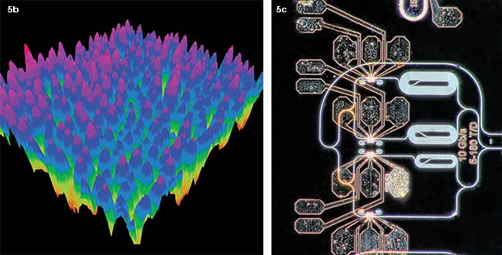
Data Centers and Telecommunications
Integration and packaging of optical components such as laser sources, multiplexers, detectors and modulators into a single chip are ushering in a new era of communications to 100 Gbps and beyond.
Today’s data centers deliver millions of services, processing terabytes of data per second around the world for billions of devices. Considering the volume, it’s amazing that we ever have a signal. As the need for connectivity increases, data centers are under constant pressure to add more and more massive racks of servers and fiber optic interconnects, which takes money and time, energy and real estate. The demand for large-scale cloud computing and ever-faster processing is growing so fast that network traffic in data centers is doubling every twelve months, according to Diane Bryant, vice president and general manager of data centers at Intel.¹ And copper wires struggle to transmit at data rates of 25 Gbps over a few meters, says Microsoft’s general manager of hardware engineering, Kushagra Vaid. “As data rates start getting to 100 Gbps — and this will happen in the future — we are going to hit a brick wall,” Vaid said.
Figure 5b. This false color 3D atomic force microscope image shows the height profile of the InAs QDs on Si (at left). Figure 5c. The Si PIC generates optical time-division multiplexing signals at 40 Gbps from 10 Gbps QD mode-locked lasers (right). The circuit splits the short pulses from the laser into four separate paths, each modulated by Si ring resonator electro-optic modulators, delayed and recombined at the higher data rate of 40 Gbps. Courtesy of K. Tian and Z. Wang, RIT and M. Fanto, RIT.
PICture this
One of the steepest challenges to widespread adoption of PICs (photonic integrated circuit) is incorporating lasers into the chip. More than one material may emerge as a winner for use in hybrid lasers on PICs. Silicon itself doesn’t lase, although adding a layer of a III-V material helps overcome that limitation; Intel added InP, for example. But III-V materials are inherently not compatible with conventional CMOS fabrication, leading to expensive work-arounds. Research is hot on the trail of graphene, a two-dimensional layered material that can emit, transmit and detect photons, but issues of CMOS scalability and performance are handicaps that will take time to overcome⁴.
One lasing material showing great promise is quantum dots (QDs) (Figure 5). Recently, researchers at Rochester Institute of Technology (RIT, Rochester, N.Y.) demonstrated that indium arsenide (InAs) QD laser heterostructures can successfully be grown and transferred to Si substrates via a low-temperature palladium (Pd)-mediated wafer bonding process (Figure 5a, 5b). Associate professor of microsystems engineering Stefan Preble and colleagues at RIT, in collaboration with professor Wei Guo at the University of Massachusetts, Lowell, further demonstrated mode-locking of these lasers, which would enable stable optical pulse trains of short pulses (<10 ps) at high repetition rates for optical time-division multiplexing (OTDM), among other uses (Figure 5c)⁵. The group is looking at schemes to combine wavelength division multiplexing (WDM) with OTDM to get to data rates beyond 400 Gbps. The biggest hurdle with QDs is efficiency, but their temperature stability is making them hot prospects for next-generation PICs.
“Quantum dots have recently been pulling ahead of quantum wells as a promising next-gen PIC solution,” said Preble. “The QD is less susceptible to defects that destroy performance over time. And several promising approaches for direct growth of QDs on Si chips are emerging. But the yield and long-term reliability of QDs on silicon remains to be proven.”
Other schemes beyond WDM and OTDM may someday be able to carry terabyte data rates on a single chip. Assistant professor of electrical engineering Liang Feng at the University at Buffalo, State University of New York, and colleagues recently demonstrated a tiny microring laser that emits photons in a radially polarized stream. The orbital angular momentum (OAM) of the photons creates a vortex shape that offers novel degrees of freedom and flexible control through on-demand topological charge and polarization states. The scheme may enable mode multiplexing over many orders (potentially an infinite number of orders) for tens of OAM channels^{6,7,8} (Figure 6). The OAM laser might offer entirely new ways of implementing high-speed, secure optical signals in both classical and quantum regimes.
“Fifty years ago you couldn’t have imagined what our everyday life would be like today,” said Feng. “The power in our laptops is as great as the supercomputers that helped put astronauts on the moon. We certainly have a very long way to go, but all over the world people are trying to increase the laser energy emission in photonic circuits. In the next 50 years, it’s exciting to imagine what we’ll accomplish.”

Slide 11
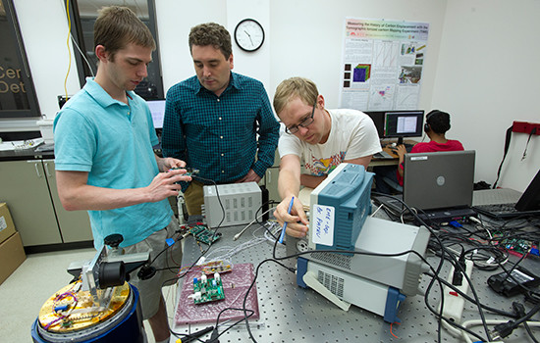
How does any ship, from watercraft to spacecraft, successfully navigate away from the sight of natural landmarks on the Earth’s surface? By using the stars. A team of engineering undergraduates at the Rochester Institute of Technology (RIT) are reaching for those stars with a new research project for NASA: designing a “compass” for rockets using a new type of detector technology. What these engineers are working to design, build and eventually deploy is a star-tracking system for rocket navigation. Intended to fly on a NASA technology demonstration mission later in the year, the system combines telescope and camera components that will orient rocket payloads based on images of the visible star field.
Star-Tracking Navigation Systems with New Cryogenic Materials
Star-tracking systems have been used for satellite, rocket and other spacecraft navigation for quite some time.
What sets this project apart is revealed in its name: the Cryogenic Star Tracking Attitude Regulation System (CSTARS). The RIT students are experimenting with detectors made of metal-oxide semiconductors (CMOS), which show promise to operate well even at temperatures as cold as that of liquid nitrogen, minus 320 degrees Fahrenheit.
Being able to operate at super-low temperatures is important for space systems, as the cryogenic temperatures reduce dark current in the sensors and increase instrument sensitivity. The traditional technology used in astronomical imagine systems is often similar to that found in consumer electronics – charge-coupled detectors (CCDs) – which become inoperable at very cold temperatures.
The prototype from RIT is a move toward developing fully cryogenic detectors that could improve the sensitivity of NASA’s future deep-space cameras. The star tracker will fly as part of a technology demonstration payload on a suborbital sounding rocket launching from NASA’s Wallops Flight Facility in December of this year.
“The aim is to control this sensor and make it work at cold temperatures,” said Kevin Kruse, a fifth-year electrical engineering student and the team leader. “Then we’ll launch it into space to take pictures. A future mission would involve us guiding the rocket using the images we take.”
Engineering Undergrads Build Their Skills with NASA Projects
The project at RIT is funded with a $200,000 grant from NASA’s Undergraduate Student Instrument Project (USIP) Flight Research Opportunity program, which provides research grants specifically to undergraduate-led teams. The program is geared to supporting the development of professional engineering skills in undergraduate engineering students. It also gives these students the valuable experience that comes from creating experiments directly relevant to NASA missions.
The students on the team hail from a range of engineering disciplines. Members include electrical, mechanical and computer engineering undergraduates. They are also working with team members from other departments at RIT, including physics, computational mathematics and business.
This type of interdisciplinary team environment enhances the experience and skills these students learn by creating an experience the same as how teams in future professional projects will operate. Between the high-level technical skills students develop through these kinds of programs, as well as the leadership and teamwork skills that come from collaborative projects, these engineers will have great experiences to bring with them into graduate school or their future career.

Slide 12
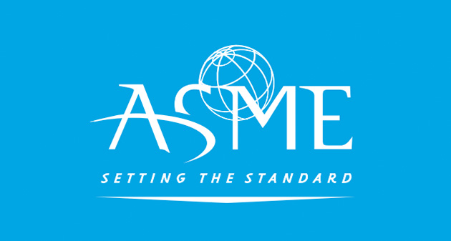
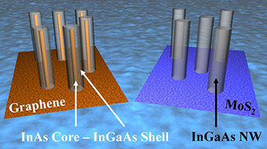
Solar Power for Everyone
Researchers at the Rochester Institute of Technology (RIT) are taking an unconventional approach to improving efficiency and lowering the cost of solar cell technology in the ongoing quest for feasible ways to reduce the reliance on a complex electrical infrastructure.Parsian Mohseni, assistant professor in RIT's Kate Gleason College of Engineering, is co-principal investigator, leading a team conducting research using nanowire to capture more of the sun’s energy instead of traditional film. He said that if trends go as expected, anyone with solar cells may be able to use them in their home while sending excess energy back to the grid. Consumers can also use the devices on-the-go, by taking them out of a backpack or attaching them to the roof of a car. “The idea is they can produce their own power wherever they are, whether at home or on the go,” Mohseni said.
Today’s solar panels convert the sun's rays into electricity by exciting electrons in silicon cells using the photons of light from the sun. Silicon has remained the current conductive material of choice in most electronic devices because of its low cost, simple processing, and useful temperature range. But with the demand for more storage, better conductivity, lower prices, and higher power for new technologies such as photonics and higher speed transistors, researchers are looking to supplement silicon with other materials that can meet those needs.
Mohseni’s team is building on work previously done that uses a combination of different types of materials, from Group Three and Five on the periodic table, and a different process for better conductive capabilities. But those materials are so expensive that they are used only in special applications, such as space technologies, and not for solar panels and other consumer products. Researchers began considering using these materials, a combination of metallic and non-metallic elements, around 1990. “It was a really novel approach then,” Mohseni says. After some work, they realized they could get superior performance compared to any other existing solar cell technologies, but it remained too costly for everyday use. Mohseni’s team began exploring ways to cut costs. One way is through the use of nanowires. The ultra-thin, grass-like vertical structures, they found, could be used as a replacement for the thin films made from silicon. The nanowires reduce the amount of material used in the devices and decreases costs by nearly 90 percent. When using film, Mohseni explained, the material has to be thick to capture more light, because when the light isn’t absorbed, it will bounce or reflect off of the film. Nanowires act differently. If light bounces off one wire in an array, it can be captured by a nearby wire and re-absorbed.
“This effect of multiple scattering interactions increases the light-trapping
capabilities of the nanowire array. Even though we are using 90 percent less material, we can absorb light better than a thin-film structure," he added. “It’s a luxury that using nanowires provides for us.”Mohseni was recently awarded about $300,000 for an Early Concepts Grant for Exploratory Research (EAGER) from the National Science Foundation. The award is designed to support exploratory early-stage work on untested but potentially transformative research ideas or approaches
The grant gives the team two years to advance the field. “During the two-year window, our goals are to realize high-quality nanowire growth on silicon. Our goals then continue on to characterize these materials to take advantage of them for solar cell applications,” he says. “We want to characterize their structure, their optical properties, and their electrical properties, and learn how their composition or their spacing or their size modifies these properties. That’s the materials exploration side of it.” On the engineering side, the team will study “how to take advantage of these properties we’ve uncovered and make better solar cells. Then the last part is to fabricate solar cells that allow us to realize high efficiencies, all at a significantly lower cost than conventional technologies require,” he noted. Mohseni hesitates to talk about a specific timetable because of so many factors beyond his control. “It’s not a simple question to answer,” he says. But he hopes it will be within the next decade that, “We are going to be independent of fossil fuels.”

Slide 13
RIT engineering faculty Jing Zhang awarded NSF grant for high-tech nanofabrication equipment
Plasma reactive ion etching system to be integrated into RIT’s clean room and used for photonics and nanoelectronic device research and development
Jing Zhang, engineering faculty member at Rochester Institute of Technology, received a $305,000 grant from the National Science Foundation to acquire a new etching system for photonic, electronic and bio-device fabrication. The system strengthens RIT’s fabrication capability in its Semiconductor & Microsystems Fabrication Laboratory to support new and existing multidisciplinary research in science and engineering, to enable educational curriculum development, and be used for workforce development and training activities led by RIT’s engineering college.
The ICP-RIE system—an inductively coupled plasma reactive ion etching system—is equipment used to create specific structural patterns, or to expose different conductive layers, on the integrated circuits found in electronic devices, said Zhang.
Jing Zhang, engineering faculty member at Rochester Institute of Technology, received a $305,000 grant from the National Science Foundation to acquire a new etching system for photonic, electronic and bio-device fabrication. The system strengthens RIT’s fabrication capability in its Semiconductor & Microsystems Fabrication Laboratory to support new and existing multidisciplinary research in science and engineering, to enable educational curriculum development, and be used for workforce development and training activities led by RIT’s engineering college.
The ICP-RIE system—an inductively coupled plasma reactive ion etching system—is equipment used to create specific structural patterns, or to expose different conductive layers, on the integrated circuits found in electronic devices, said Zhang.
“If we want to fabricate a wafer into a device, we needed to have this type of etcher,” said Zhang, the Kate Gleason Endowed Assistant Professor in the electrical and microelectronic engineering department in RIT’s Kate Gleason College of Engineering. “There is no equipment like this close by so there was a huge need, and it will help with collaborations we have with other university and corporate researchers.”
Traditional semiconductor research has focused on silicon-based materials. Zhang is working on compound semiconductors, and gallium nitride is an emerging material being applied. Gallium nitride-based semiconductors are being integrated into optoelectronics, such as LEDs, to power electronics for smart grid applications and power management for electric vehicles, solar applications to harvest solar energy and transfer it into electrical energy. New research in ultraviolet wavelength sensors is an emerging area, she explained.
“The instrument is essential to enable research and education on III-Nitride-based light emitting diodes and lasers, and other semiconductor devices. We are studying every aspect of this material, from understanding the physics to the realization of novel devices. This equipment will help with that process,” said Zhang, who has been at RIT since 2014 and is part of a growing and accomplished group of semiconductor materials and photonics device researchers at the university. She has expertise in the area of ultraviolet and visible light emitting diodes, also referred to as LEDs, and in developing semiconductors for optoelectronic and electronic devices.
Plasma reactive-ion etching systems incorporate several steps to the integrated circuit fabrication process. Reactive plasm, deposited onto the wafer, removes and refines excess material to “etch” or form patterns into the layers of the integrated circuit. These etched micro-nanostructures are the foundation for complex semiconductor devices. The ICP-RIE system provides dry etching capability for various material systems such as compound semiconductors, dielectric materials and metals with fast etching rate, well-controlled selectivity and uniformity.
With the emphasis on workforce development in the area of photonics, having the new equipment also provides a key educational opportunity for training. RIT’s microelectronic engineering department provides short courses in semiconductor fabrication for area high school and community college teachers and for regional company employees looking to advance knowledge in this area.
In the past year, RIT also acquired a metal organic vapor-phase epitaxy system, also referred to as an MOVPE, which grows III-V single crystal materials. The state-of-the-art tool gives researchers the ability to build high-performance optical and electronic devices and will be a key learning and training resource. This capability was once an outsourced to research laboratory partners such as NASA. Today, the in-house functionality provided by this equipment, combined with the ICP-RIE system, is available to RIT researchers as well as the regional Rochester photonics community, including partners in AIM Photonics, Zhang added.

