Slide 1


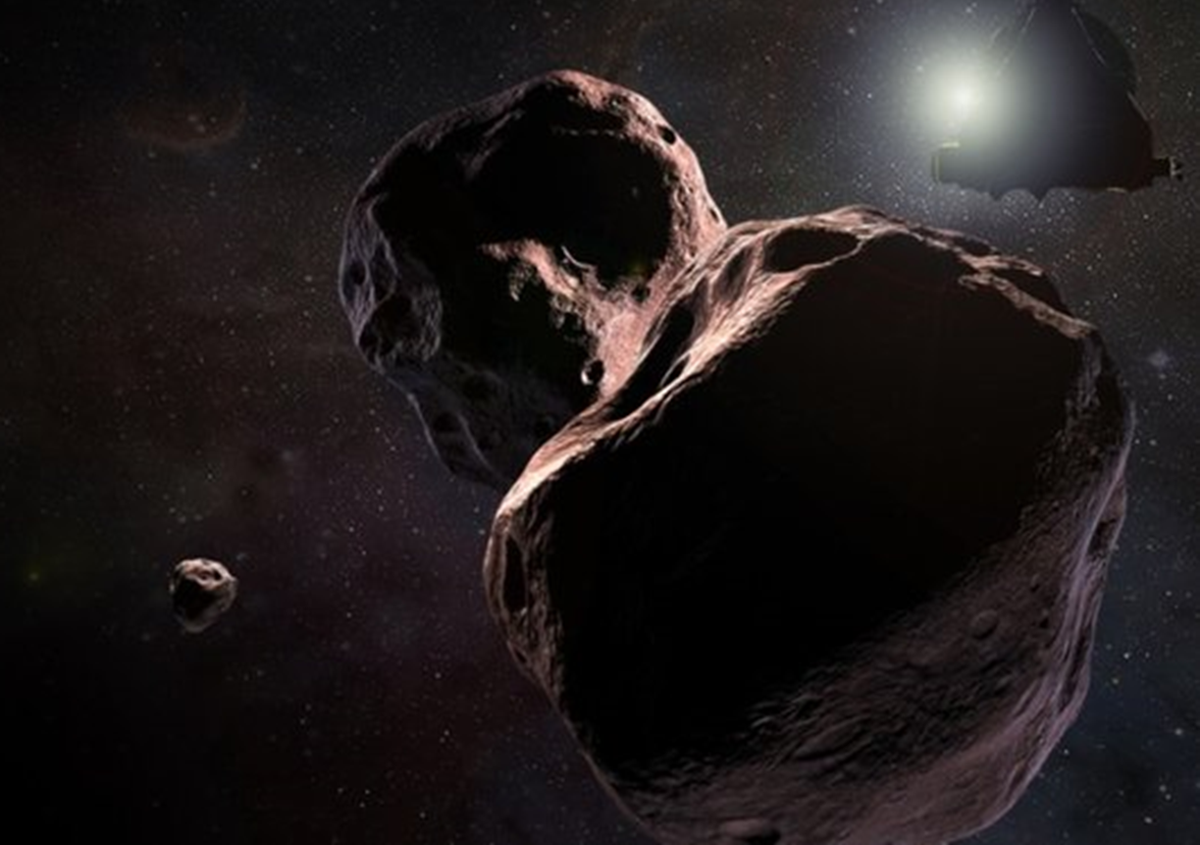
Newer Horizons:
Scientists Pitch Pluto Probe as a Unique Deep-Space Telescope
A maverick group of astronomers is proposing to radically reshape one of NASA’s most successful missions in the modern era, the New Horizons probe that flew by Pluto in 2015 and is now continuing its voyage into the depths of the outer solar system.
The group’s paper describing their proposal, submitted to the Publications of the Astronomical Society of the Pacific and available as a preprint, suggests that before its fuel is spent and some of the systems are shut down to conserve power, New Horizons should be repurposed as a space telescope that can take advantage of the near-lightless conditions in the outer solar system to study stars, galaxies and more.
According to the paper’s lead author Michael Zemcov, an astrophysicist at the Rochester Institute of Technology, the idea is largely meant to “catalyze the discussion.” At the very least, some members of the New Horizons team approached him to try to incorporate the idea into an upcoming mission review. (Only one of the paper’s co-authors is part of the New Horizons mission.) The plan calls for utilizing the Pluto probe’s eight-inch telescope, called the Long Range Reconnaissance Imager (LORRI), to peer at distant, dim objects beyond the solar system’s boundaries. LORRI, the group says, could be used to support NASA’s upcoming Transiting Exoplanet Survey Satellite (TESS), a planet-hunting space telescope launching in April.
Co-author Diana Dragomir, an MIT planetary scientist who works on TESS, says this mission will need all the backup help it can get. That is because it is set to find tens of thousands of candidate planets—many of which will require time-consuming independent confirmation using other telescopes.
Beyond boosting exoplanet research, New Horizons could also use its ultraviolet and infrared sensors to study the early universe. Whereas the cosmic microwave background, an information-packed afterglow of the big bang, is perhaps the most well-known, there are also ultraviolet and infrared backgrounds that come from stars and active galaxies lighting up cosmic dust in a faint, universe-spanning glow. This could provide insights into how the early universe came together. “The further you get out of the solar system, the more you can do these kind of observations,” says Michele Bannister, a planetary scientist at Queen's University Belfast who was not involved in the study. She points out one NASA spacecraft—Deep Impact, which studied Comet Tempel 1 in 2005—was later retooled into a new mission dubbed “EPOXI” in order to assist with exoplanet hunts.
Reality Check
So how realistic is the group’s proposal? “It’s really an issue of logistics and timing, and making sure the resources are available and we’re doing nothing to put the mission at risk,” Zemcov says. Convincing others there’s no risk involved may be a tall order, however.
New Horizon’s extended mission after Pluto involves flying by an ancient remnant from the solar system’s birth, a
An artist’s depiction of New Horizons’ planned late-2019 encounter with 2014 MU69, a small object well beyond the orbit of Pluto. A new proposal suggests that New Horizons could be repurposed to become a novel space telescope after this encounter. Credit: NASA, JHUAPL and SwRI
chunk of rock and ice known as 2014 MU69. After
that encounter, the craft will transmit its data to Earth—which, due to the immense distances, will take about two years to completely trickle back home.
After MU69 the craft will be low on propellant—less than a quarter of a tank. That could be enough to pursue a third flyby target during a second mission extension, as many senior New Horizons team members would prefer. But that encounter—plus keeping the spacecraft pointed at Earth for the subsequent data transmission—would probably use most if not all of the remaining fuel.
Those preexisting plans—plus the fundamental impracticalities of efficiently controlling and getting data from a telescope at the edge of the solar system—could crowd out Zemcov and company’s proposal. “These types of proposals are generated by the dozens, if not hundreds, so it’s not uncommon to see them come up and then go nowhere,” says Jason Callahan, a space policy advisor at The Planetary Society.
Another factor is funding. NASA’s spending is highly compartmentalized to protect its top-priority programs from cannibalizing one another—money for astrophysics, for example, is considered separately from funding for planetary science. But the system is flexible—some would say vulnerable—because Congress ultimately defines the details of the space agency’s budget.
There is some precedent for thinking outside of these budgetary boxes—EPOXI, for instance, although a planetary science mission like New Horizons, performed its astrophysics observations during an otherwise inactive cruise phase. Those observations were funded by NASA’s planetary science budget partly for that reason. And other missions have entirely switched budget lines, Callahan says, such as the Voyager 1 and 2 probes, which were moved from a planetary budget into a heliophysics one after their encounters with the outer planets were concluded. But “this is sort of a different animal altogether,” Callahan says. “This is a science team asking to use another science team’s mission at the end of its extended mission.”

