Slide 1

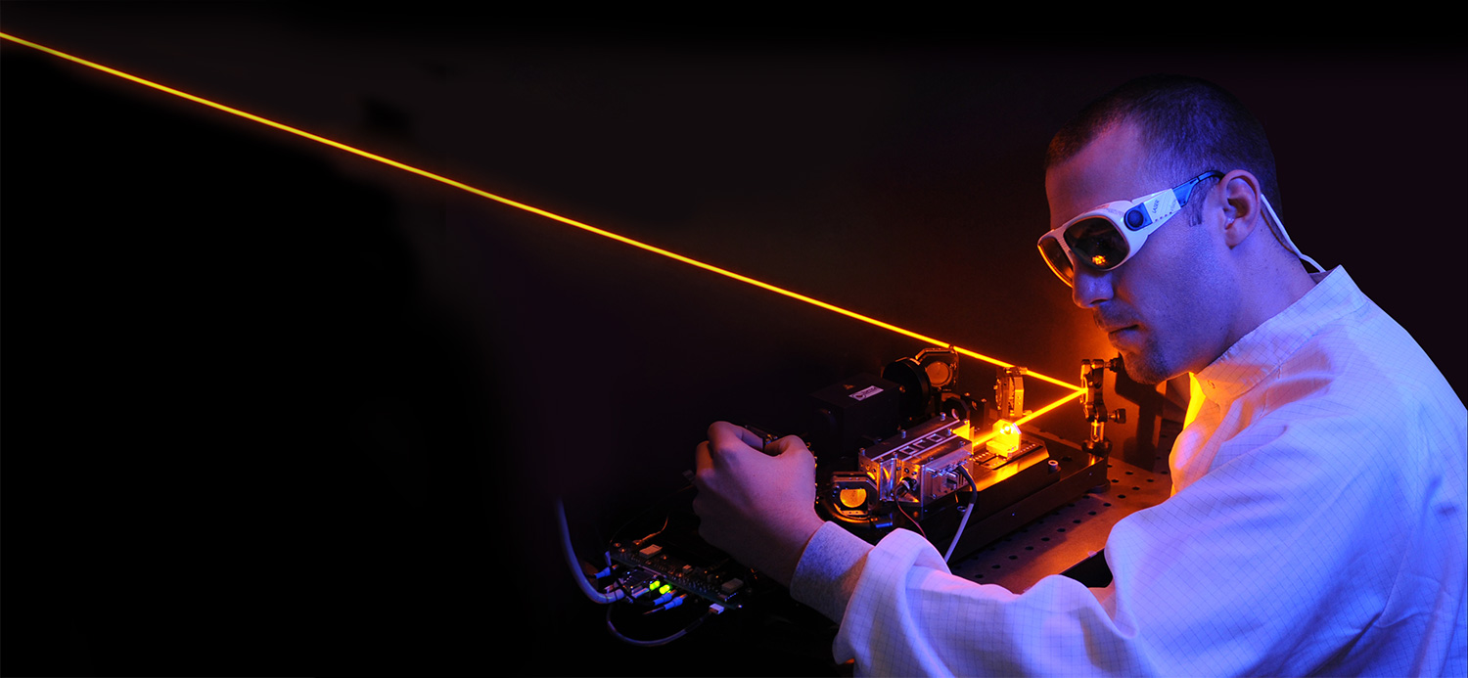

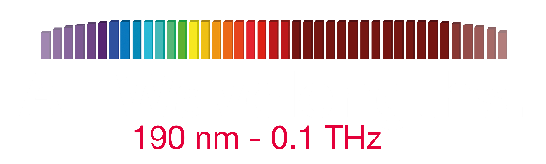

Slide 2
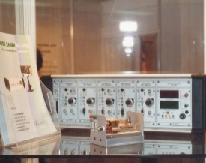
TOPTICA and Quantum
Founded in 1998 to serve quantum market
  Laser cooling and trapping
  Initial focus on near-Infrared (Rb, Cs)
Remains a core part of our business

Slide 3
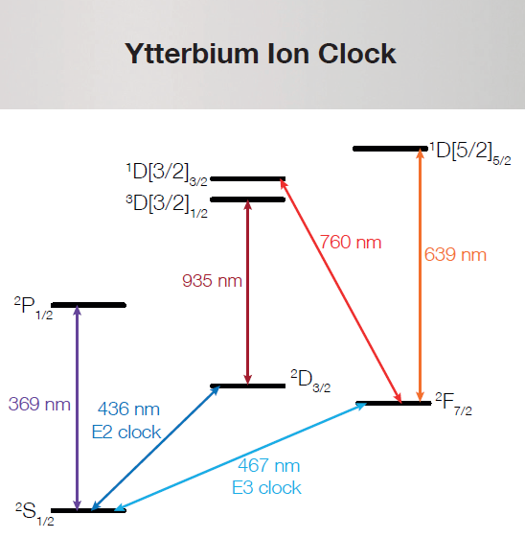
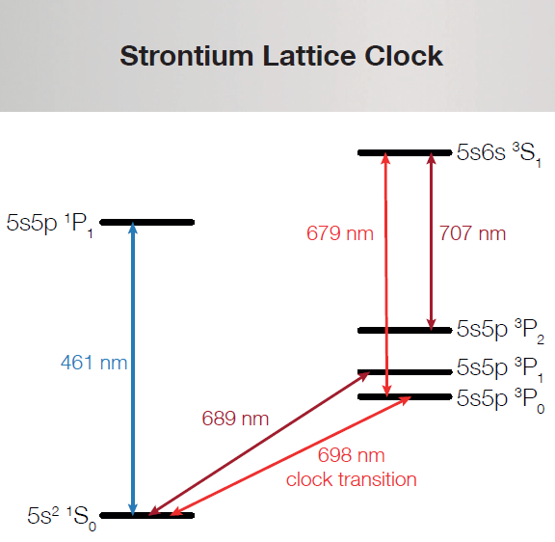
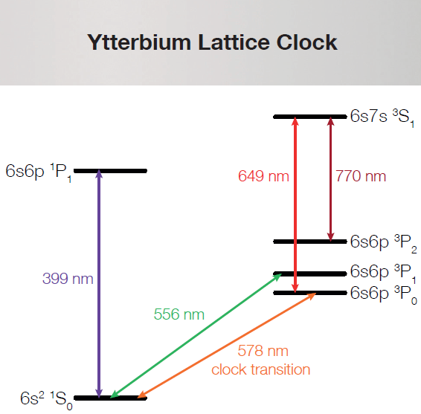
Quantum applications demand ALL Wavelengths!
Quantum applications
  Computation
  Communication
  Sensing
    Example: Optical Clocks

Slide 4
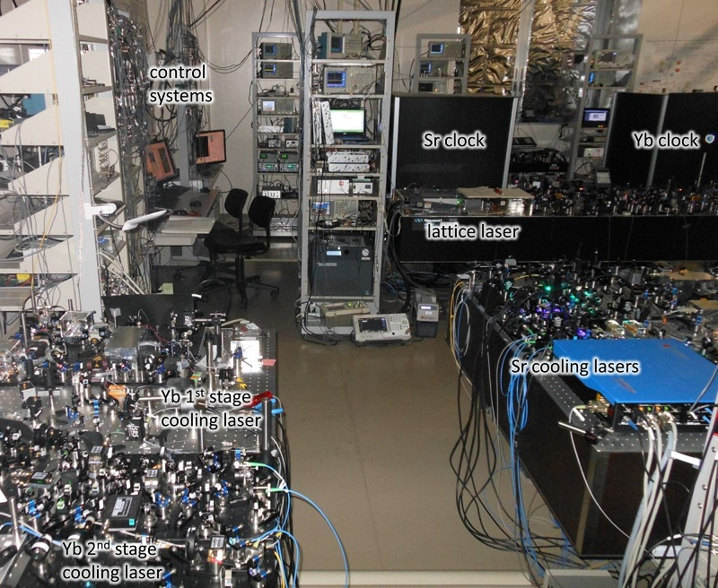
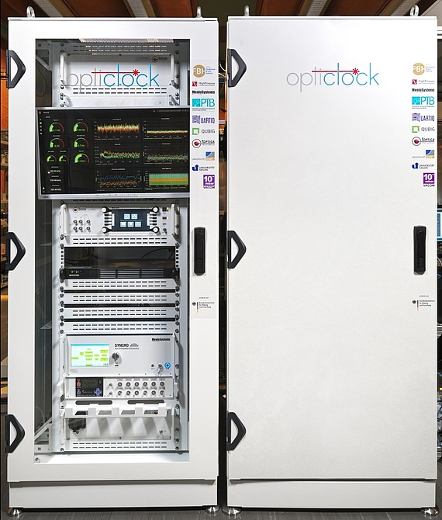
Move toward smaller size
Take this
Turn it into this
Flagship projects
  Opticlock
  IQClock
Credit: University of Tokyo

Slide 5
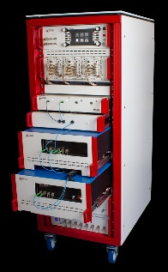
Laser Rack Systems
Generalized platform
Can incorporate any laser
Drivers, fiber coupling, locking electronics, etc. all integrated

Slide 6
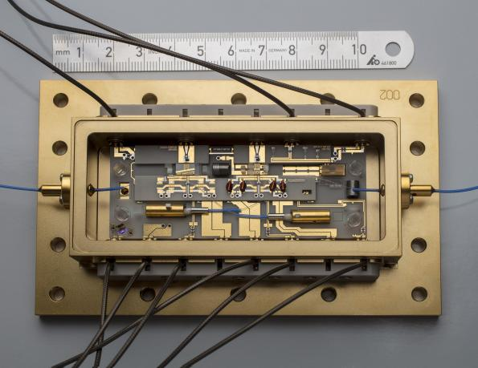
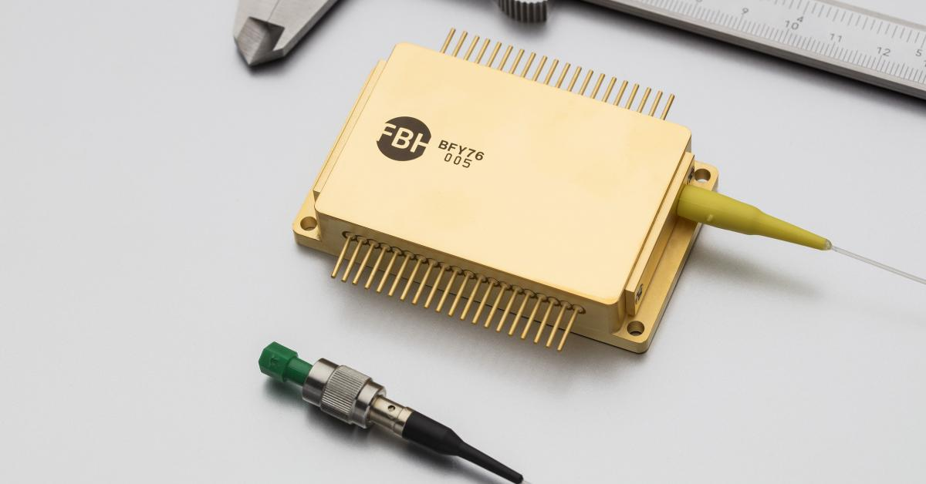
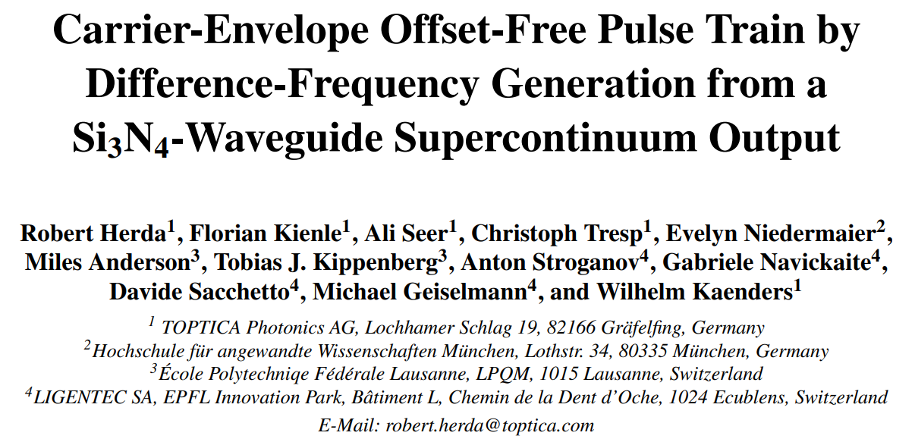
Next generation
Further shrink sources
Get integrated
HU Berlin and Ferdinand-Braun Institut

