Slide 1


Instrumentation for quantum science and education
www.qdusa.com

Slide 2
Product categories:
Magneto-optical cryogenic platform
Lithography
Single Photon Detection and Counting
Quantum Education
www.qdusa.com

Slide 3
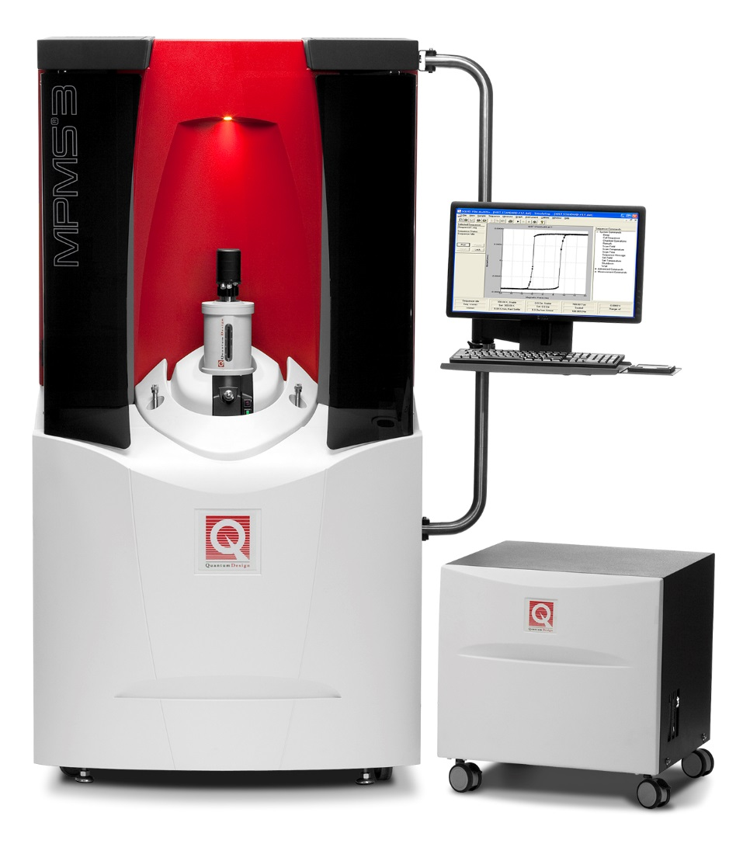
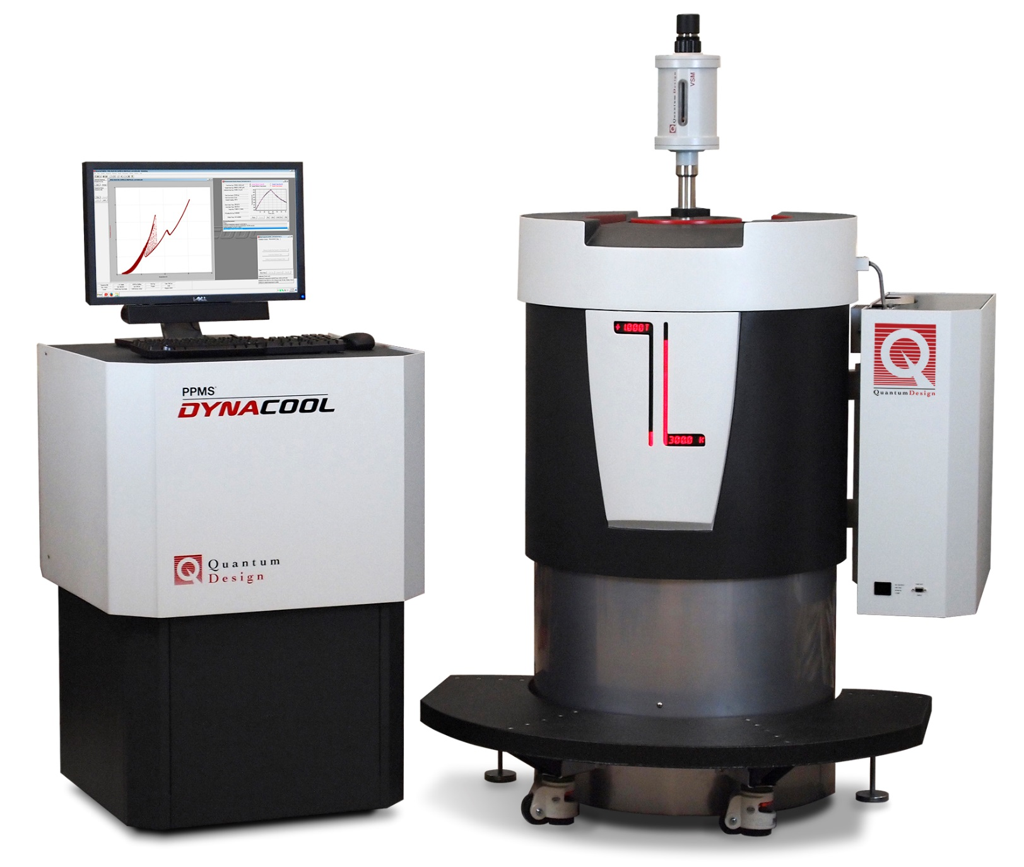
PPMS and MPMS – cryomagnetic characterization
(Manufactured by Quantum Design Inc)
Features
  Magnetic, electrical, thermal transport
  SQUID magnetometry
  Temperature range of 1.8 K – 400 K
  Continuous low temperature control
  No need for liquid cryogens
  7 T - 14 T magnets available
  Fully automated operation
  Over 2000 systems sold worldwide

Slide 4
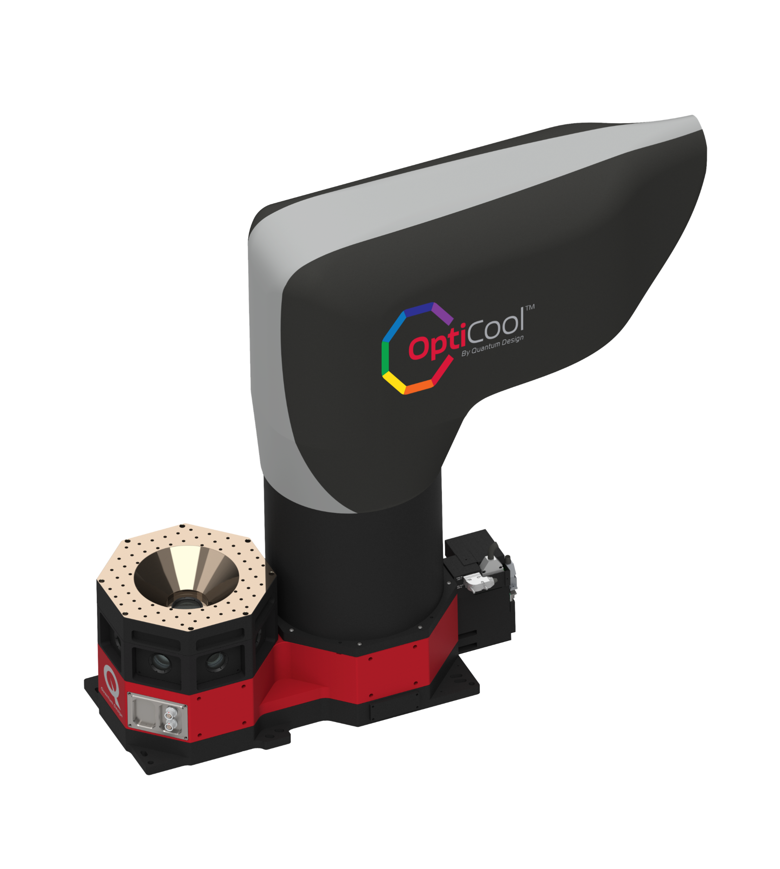
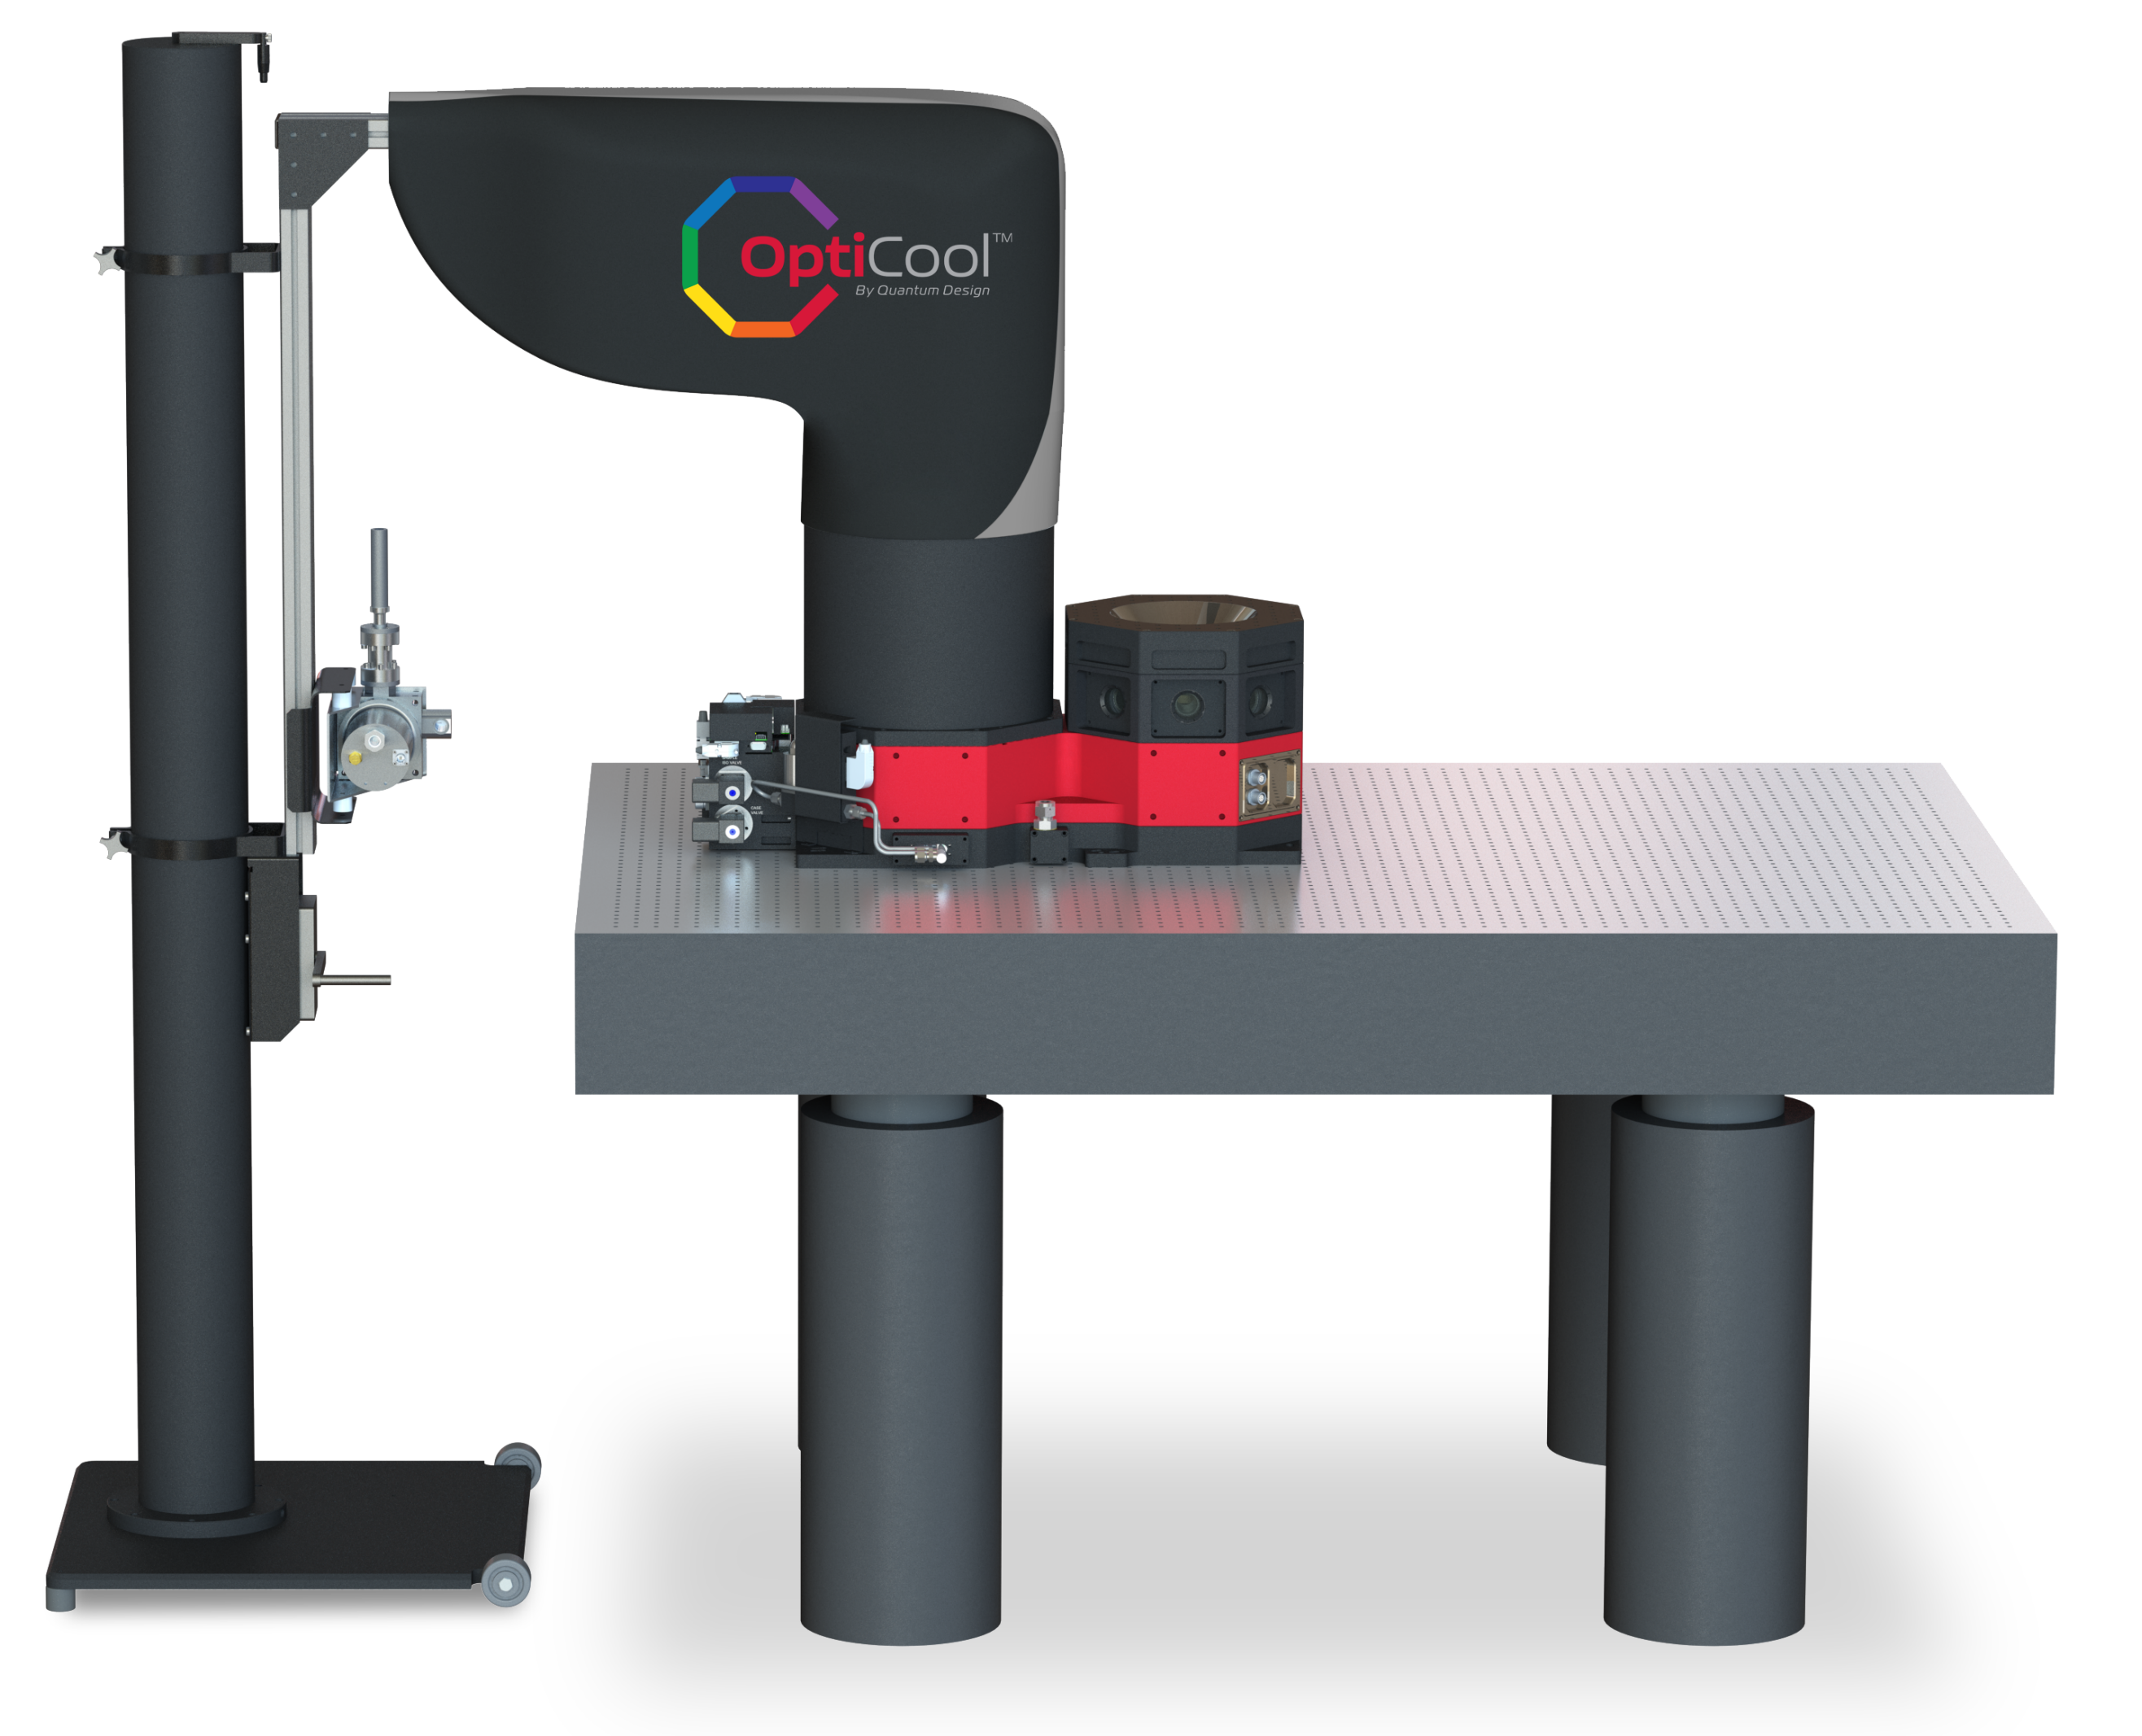
Magneto-optic cryostat
(Manufactured by Quantum Design Inc)
Features
  Open Optical Access: 8 Ports
    7 Side Ports (NA > 0.11)
    1 Top Port (NA > 0.7)
  Temperature range of 1.7 K – 350 K
  7 T Split-coil conical magnet
  Low Vibration: <10 nm peak-to-peak
  89 mm x 84 mm Sample volume
  Cryogen free
  Fully automated operation of
  temperature and magnetic field

Slide 5
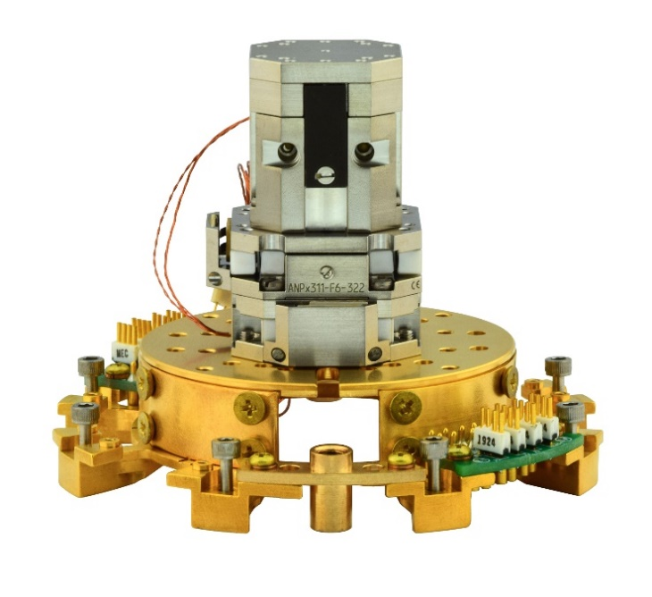
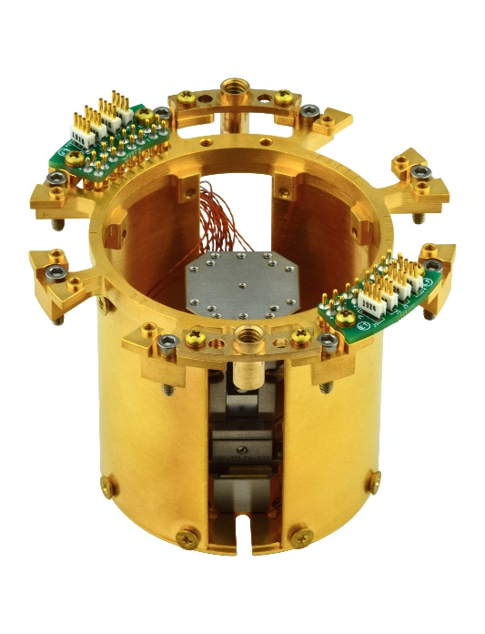
Optional Features
  Up to 80 user defined electrical interconnects including coax
  Flexible sample pod options for user defined experiments
  positioners
  objectives

Slide 6
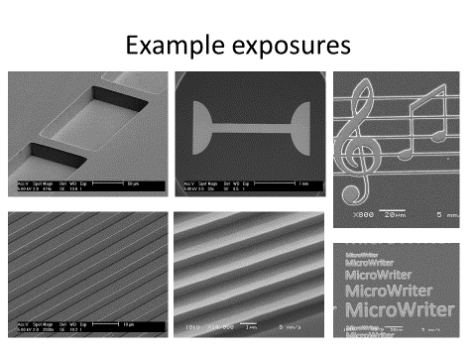
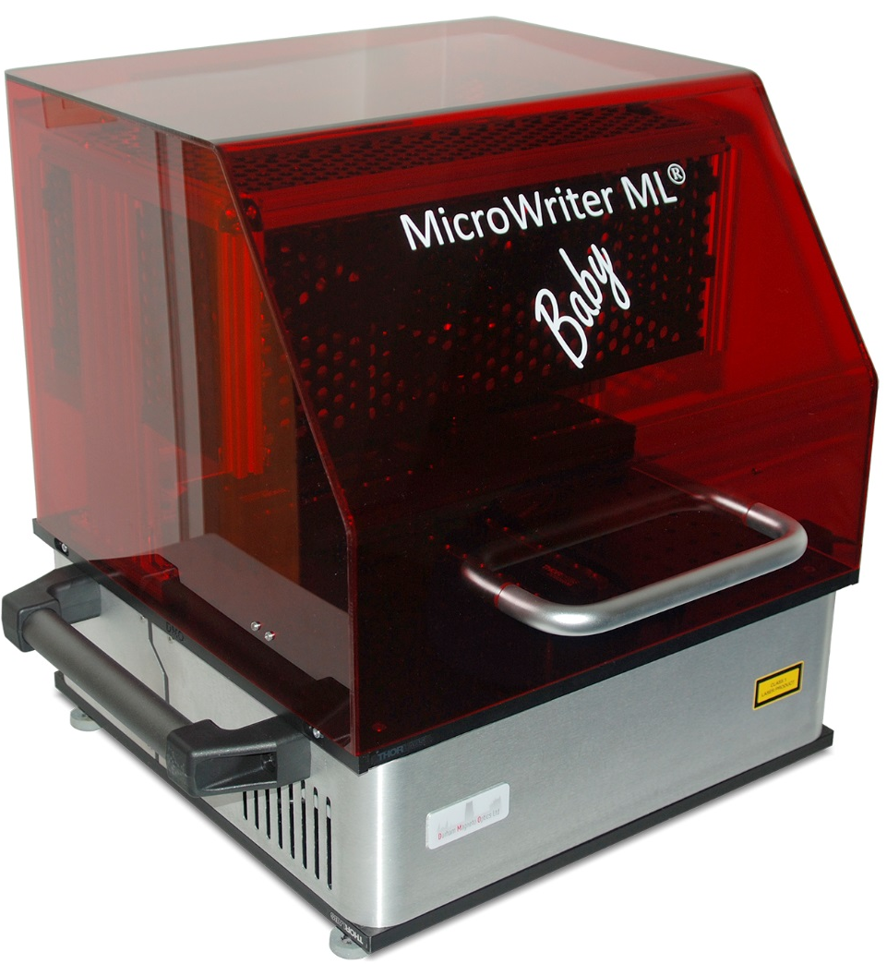

Lithography: Microwriter ML®3 direct write laser litho
(Manufactured by Durham Magneto Optics Ltd)
Features
Direct write laser lithography
Easy to use, Windows® based control software supplied
Supplied with pre-configured 64-bit Windows® laptop
for plug-and-play installation
Machine | Resolution
MicroWriter ML®3 Baby | 1 µm
MicroWriter ML®3 Baby Plus | 1 µm, 5 µm
MicroWriter ML®3 Mesa | 0.6 µm, 1 µm, 5 µm
MicroWriter ML®3 | 0.4 µm, 0.6 µm, 1 µm, 2 µm, 5 µm
Where more than 1 resolution exists on a machine, an automatic lens changer engages the required lens for each part of the designed pattern without manual intervention from the user.

Slide 7
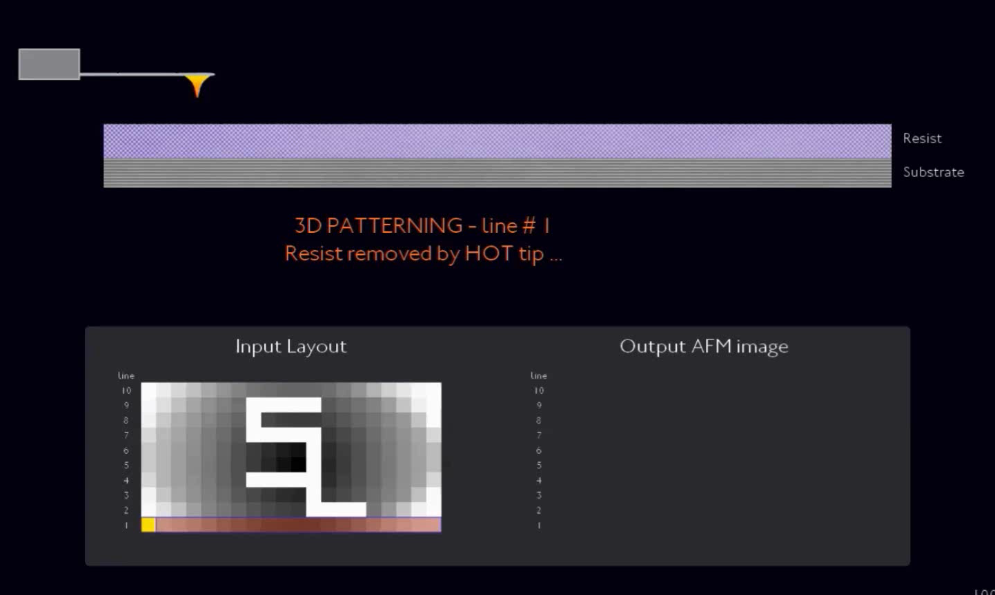
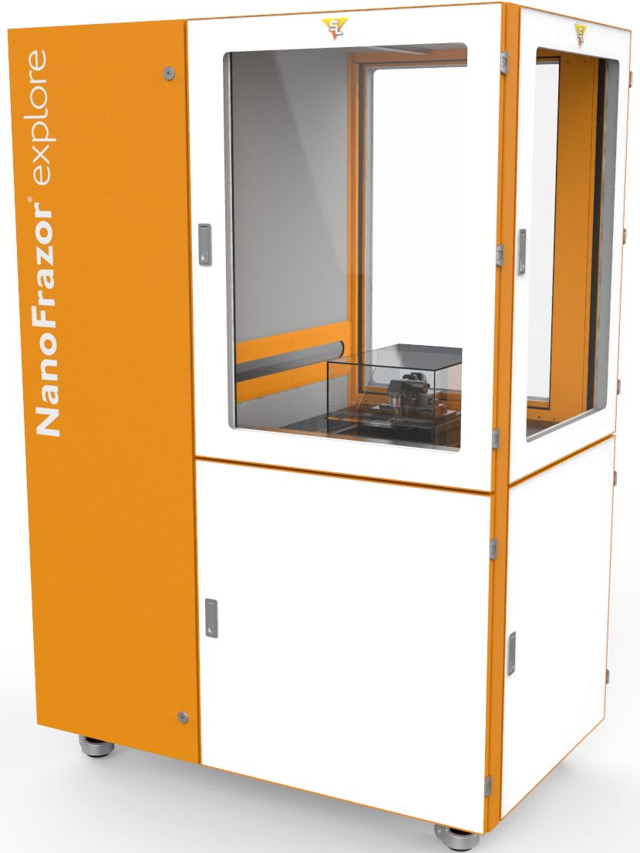
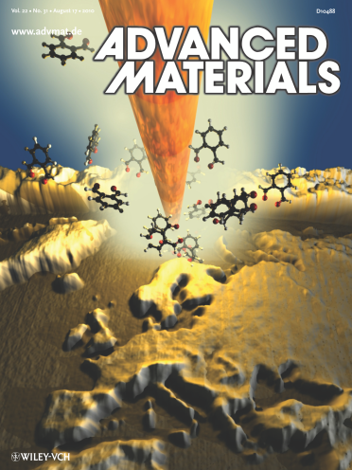
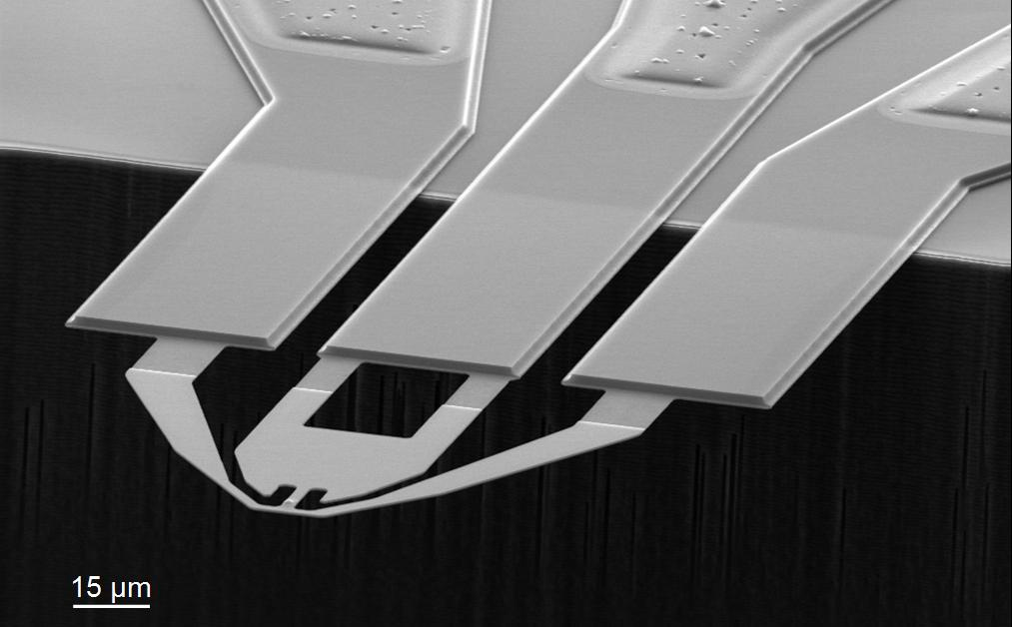

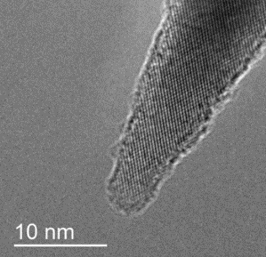
Nanolithograpy for quantum materials: NanoFrazor (Manufactured by Swiss Litho)
Features
3D patterning: write with unprecedented vertical accuracy, sub-10 nm lateral resolution
In-situ metrology
Extreme overlay accuracy for structures buried under the resist stacks
No damage to sensitive materials from charged beams
Low cost, throughput comparable to E-beam lithography
NanoFrazor cantilever (SEM image)

Slide 8
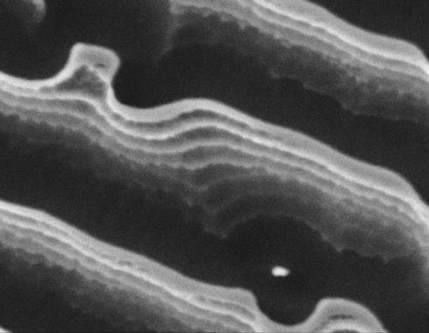
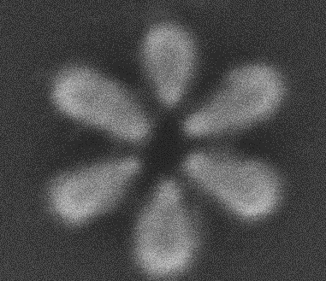
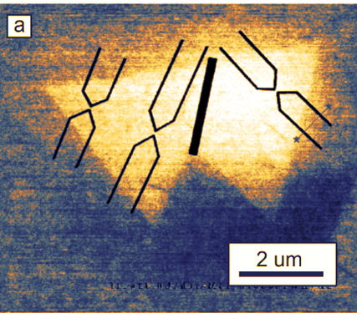
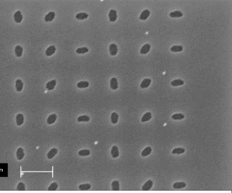
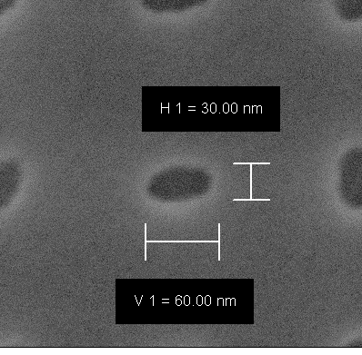
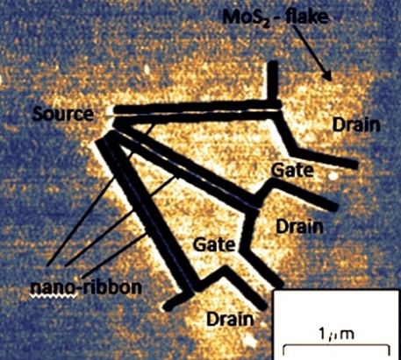
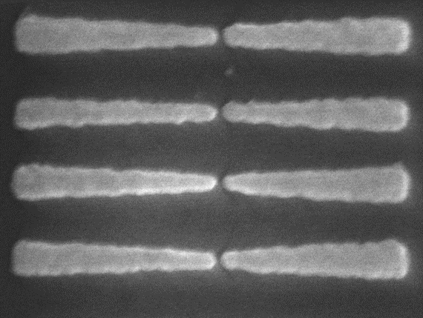
Nanolithograpy for quantum materials: NanoFrazor (Manufactured by Swiss Litho)
2D patterning: plasmonic structures
Damage free patterning in MoS2
3D patterning: 3D hologram in SI
Lift-off => Au plasmonic antennas
Single Point Contacts
50 nm
Reactive Ion Etching => quantum dots rotated ellipses
2 µm
Nanoribbon device
d1 = 30 nm
d2 = 60 nm
Bow tie antennas (30 nm AU)
1 µm
28 meV
100 nm
20 nm

Slide 9
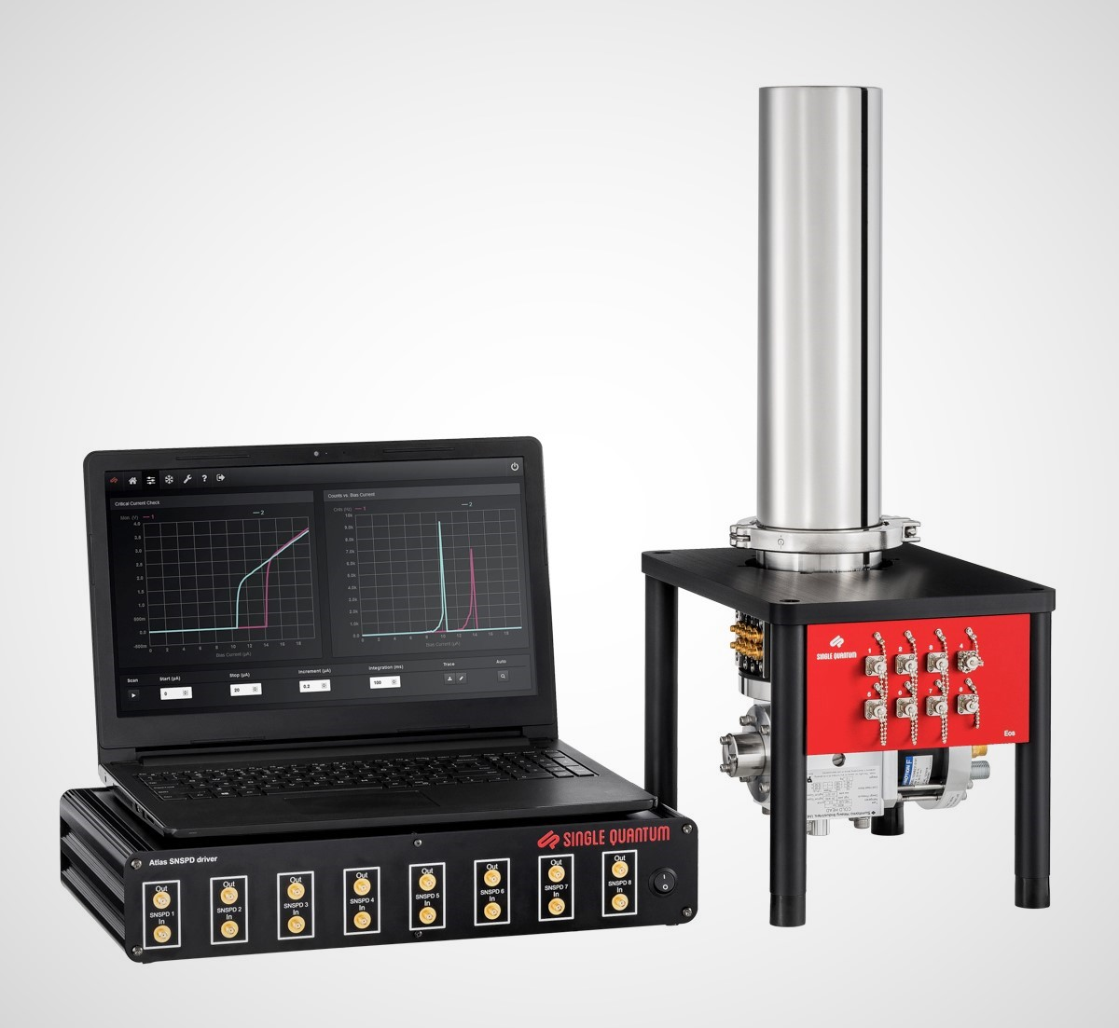
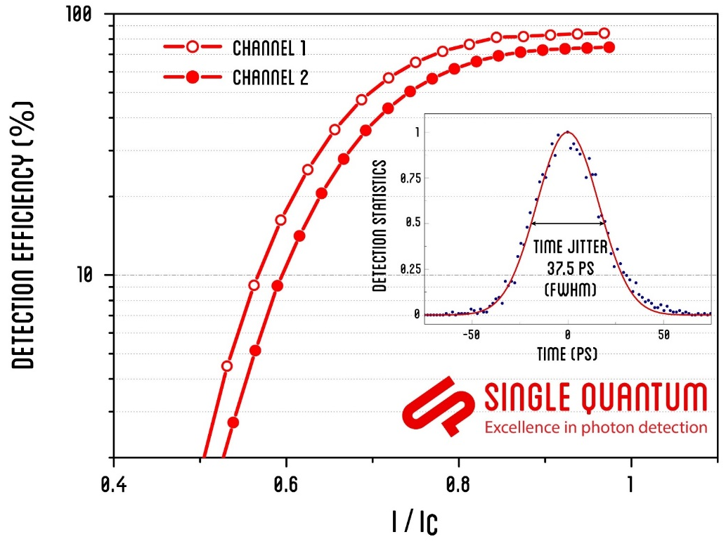

Superconducting Nanowire Single Photon Detectors
(Manufactured by Single Quantum)
Features
High detection efficiency in near infrared: ≥ 90%
Low timing jitter: ≤ 15 ps
High count rate: > 100 MHz
Robust fiber coupling
Low dark counts <10 Hz
Easy to use - plug & play
No helium consumption continuous operation >
10,000 Hours
Over 100 systems sold worldwide

Slide 10
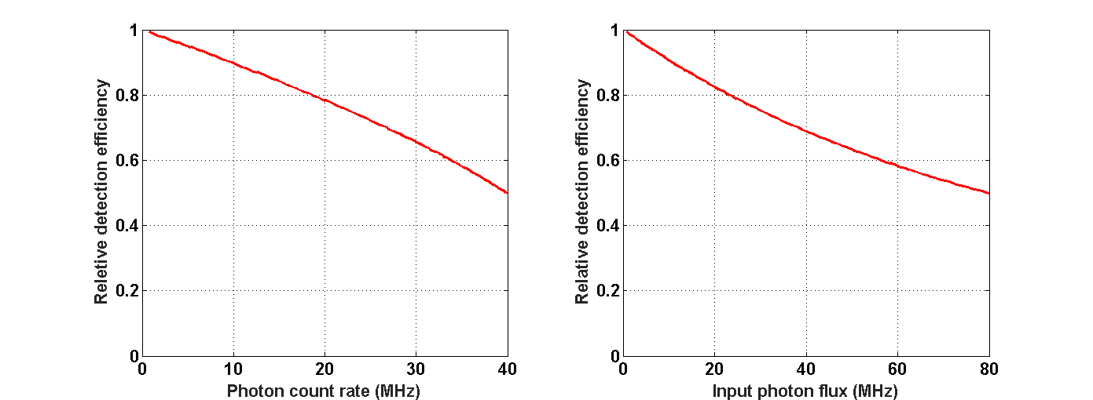
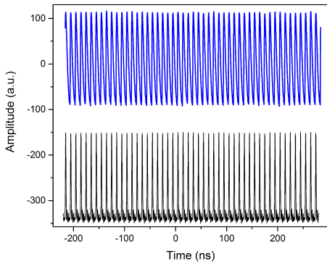
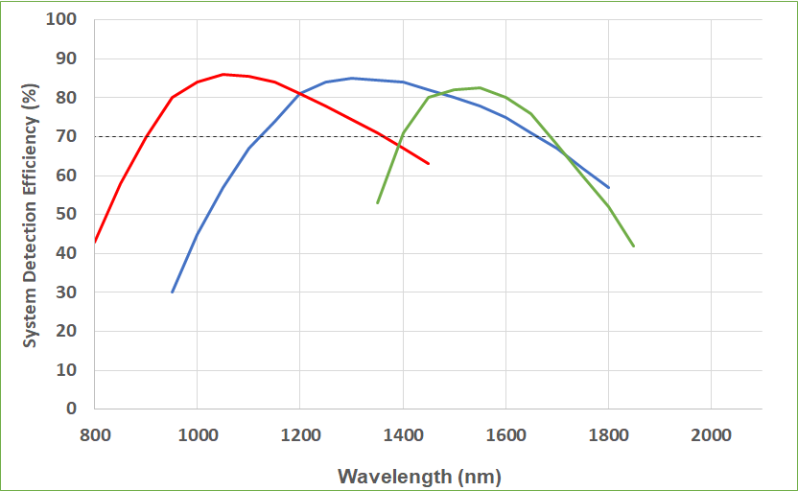
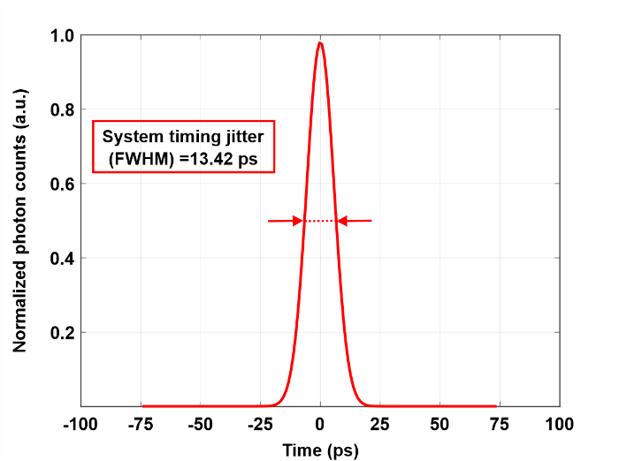
Superconducting Nanowire Single Photon Detectors
(Manufactured by Single Quantum)
Features
High efficiency (>90%)
Ultra low timing jitter (<15 ps)
High count rates (>100 MHz)
Broadband detection

Slide 11
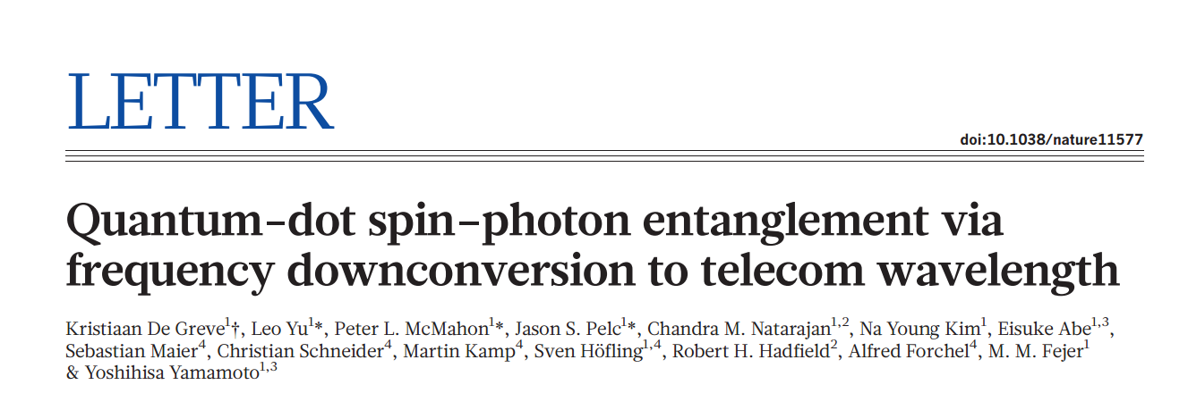

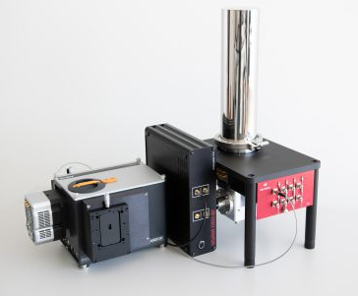
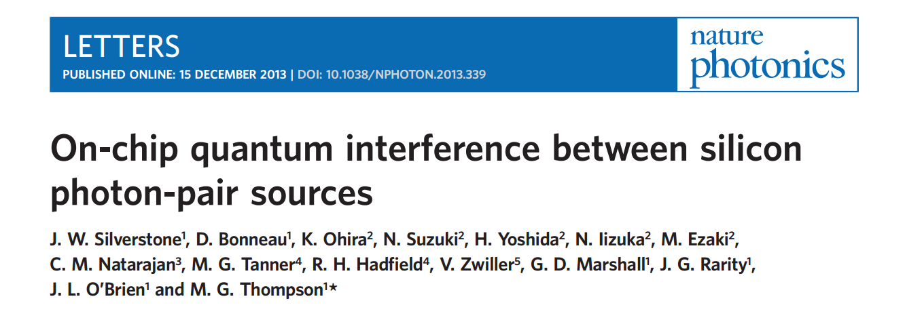
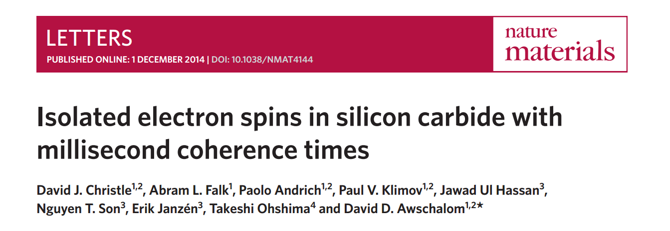
Superconducting Nanowire Single Photon Detectors
(Manufactured by Single Quantum)
SNSPD coupled spectrometer
Iris S19
Upcoming Features
Multimode coupling
Photon number resolution
Mid IR and visible

Slide 12
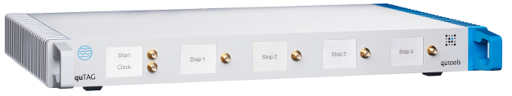

quTAG time-correlated single photon counter
(Manufactured by quTools)
Features
2.3 ps RMS timing jitter
100 M Events/s maximum rate
1 ps digital resolution
Up to 32 stop channels
Products
12

Slide 13
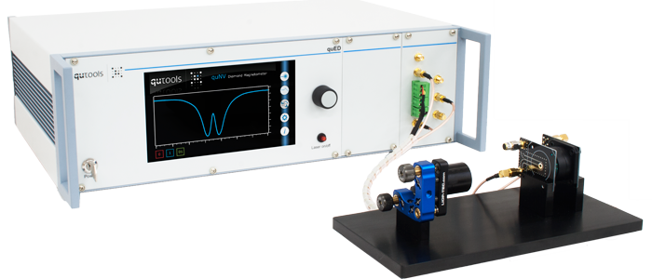
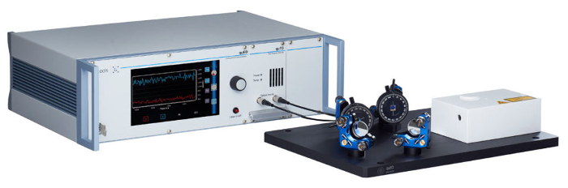
Quantum Education Tools- Science Kits
(Manufactured by quTools)
Photon Entanglement
Demonstrator- quED
Quantum Sensing
ODMR- quNV

Slide 14
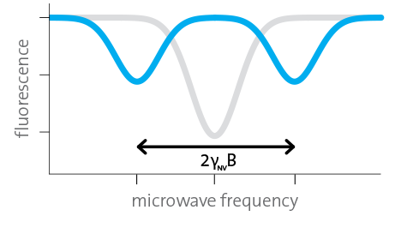
quNV – quantum sensing demonstrator
(Manufactured by quTools)
Excitation laser & photodiode
Microwave sweep generator
quNV-ODMR demonstrator
NV center fluorescence
Magnetic resonance
Spin relaxation time
Magnetic field sensing
14

Slide 15
quED entanglement demonstrator
(Manufactured by quTools)
Now offering a fully motorized version with the capacity for remote laboratory coursework
quEd-Entanglement demonstrator
Entangled photon source
APD single photon detectors
Counting electronics
GUI to control and measure

Slide 16
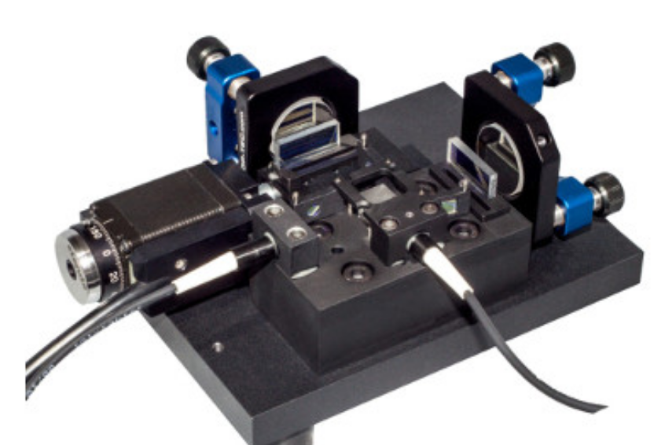
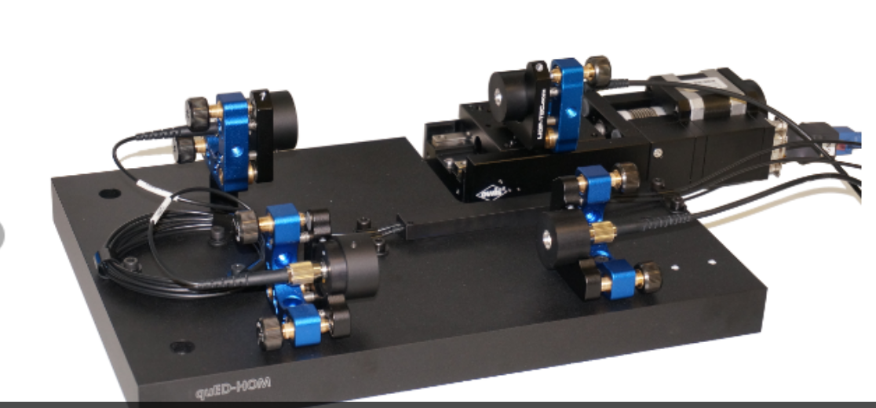
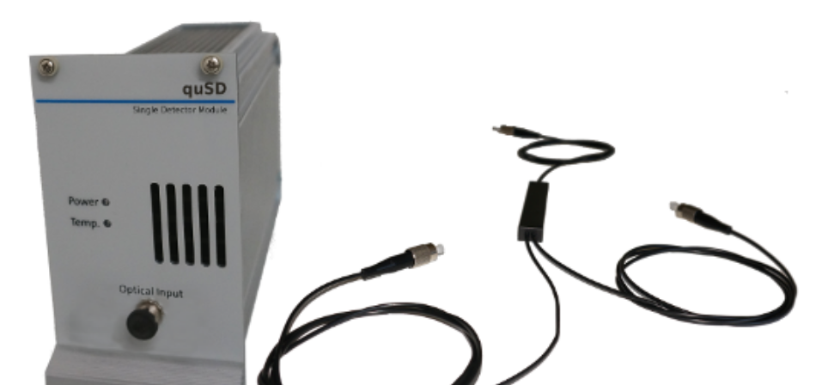
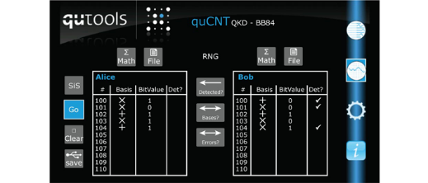
quED – Add-on Modules
(Manufactured by quTools)
quED-MI
quED-HBT
quED-HOM
quED-QKD
Wave Character of Photons
Particle Character of Photons: HBT
2-Photon Interference: Hong-Ou-Mandel
Secure Information Transfer with Alice, Bob and Eve

Slide 17
quED- initial list of sample experiments
(Manufactured by quTools)
Now offering a fully motorized version with the capacity for remote laboratory coursework
Single Photon Experiments without Interference
Particle Nature of Photons
Quantum Cryptography/QKD: BB84 Protocol
Tomographic Single Photon State Reconstruction
Quantum Zeno Effect
Quantum Random Number Generation
Single Photon Experiments with Interference
Wave Nature of Photons: Single Photon Michelson Interferometer
Quantum Eraser
Wave-Particle Dualism: Michelson + HBT
Double Michelson Interferometer
Visible (White) Light Interference (Observable by Eye)
Measurement of the Central Wavelength of Single Photons
Measurement of Coherence Length of Single Photons
Interaction-Free Measurement (Bomb Test)
Photon Pair Experiments with Polarisation Entanglement
Violation of Bell’s Inequality (CHSH)
“Non-Classical” Polarisation Correlations
Tomographic State Reconstruction of an Entangled Photon State
Quantum Cryptography/QKD: BBM Protocol
Quantum Cryptography: Ekert Protocol
Photon Pair Experiments without Polarisation Entanglement
Hong-Ou-Mandel 2-Photon Interference
Hong-Ou-Mandel Interference + Hanbury Brown & Twiss
Franson Interference

Slide 18
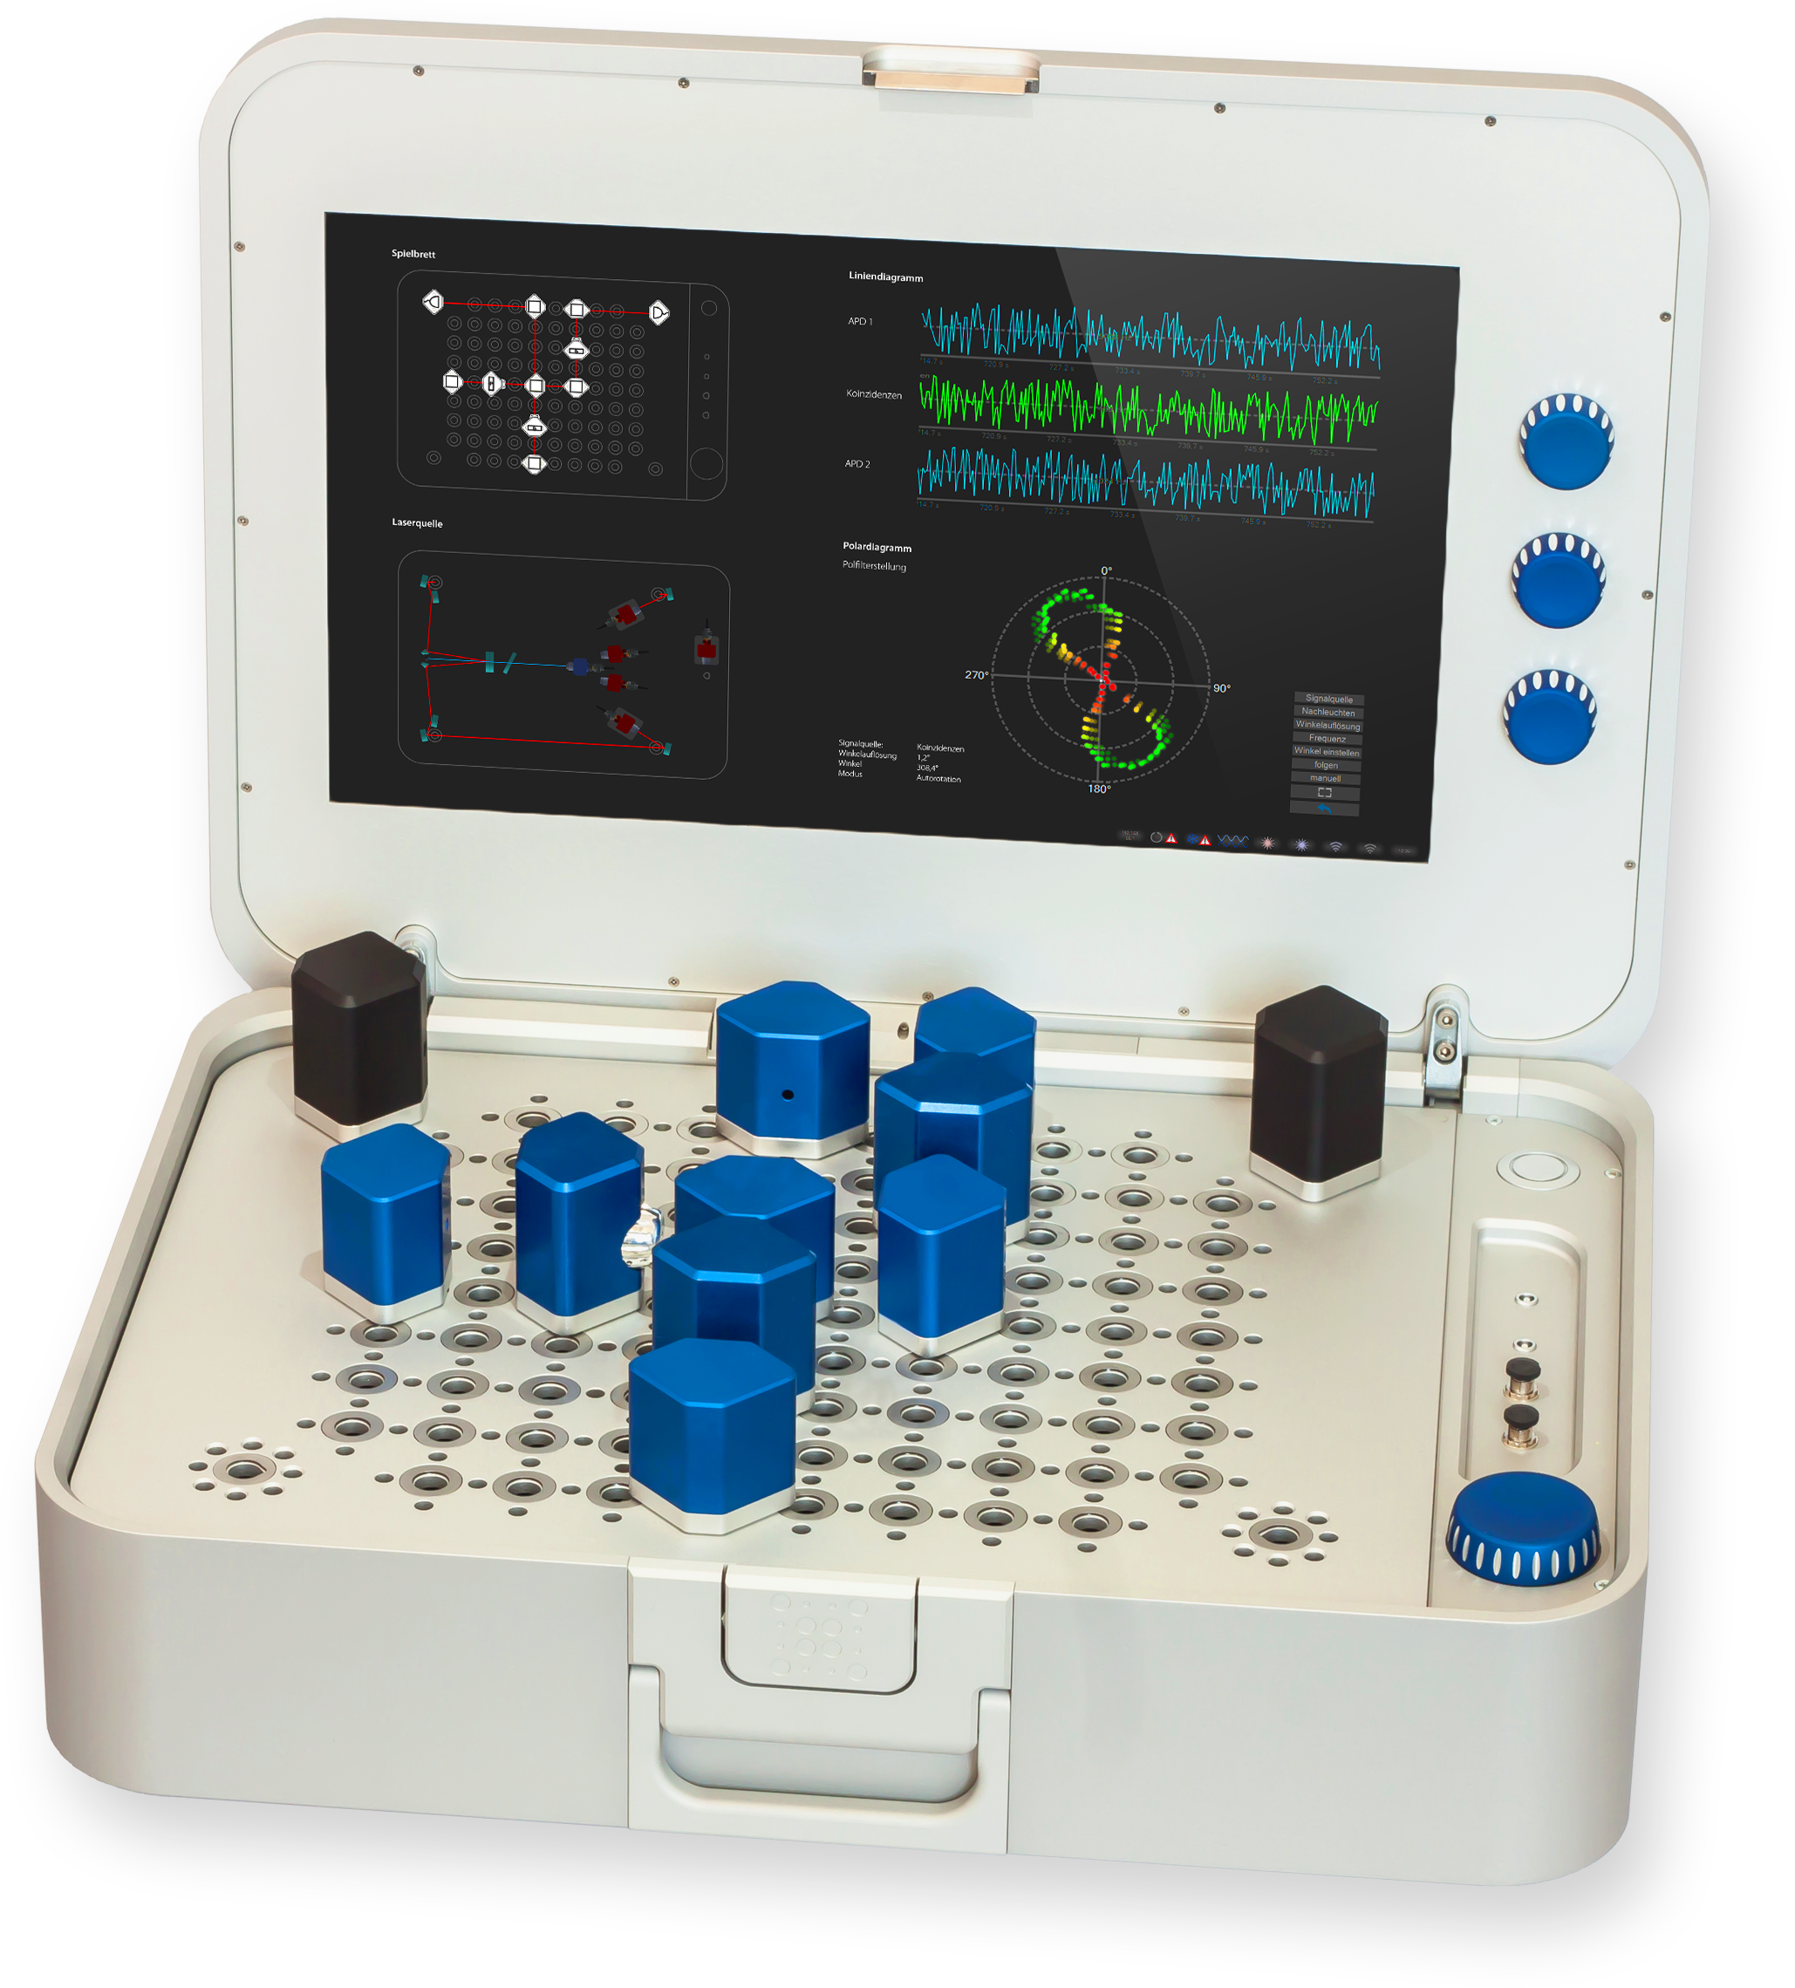
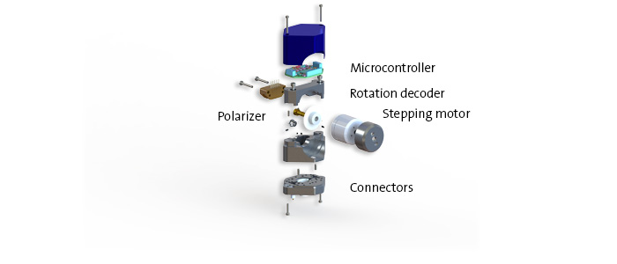
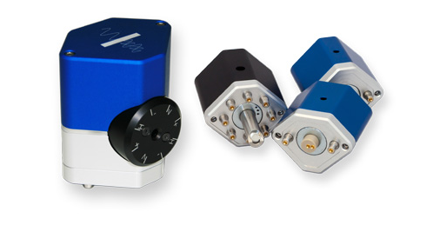
QuantenKoffer quantum science kit
(Manufactured by quTools)
Quantenkoffer
Source for single photons and entangled photon pairs
Single photon detectors
Picosecond time resolution
Variety of optical tokens
Intuitive operating concept
Robust and safe
More than 25 experiments

Slide 19
www.qdusa.com
Contact:
info@qdusa.com
https://www.rit.edu/fpi/pfq2

