Slide 1

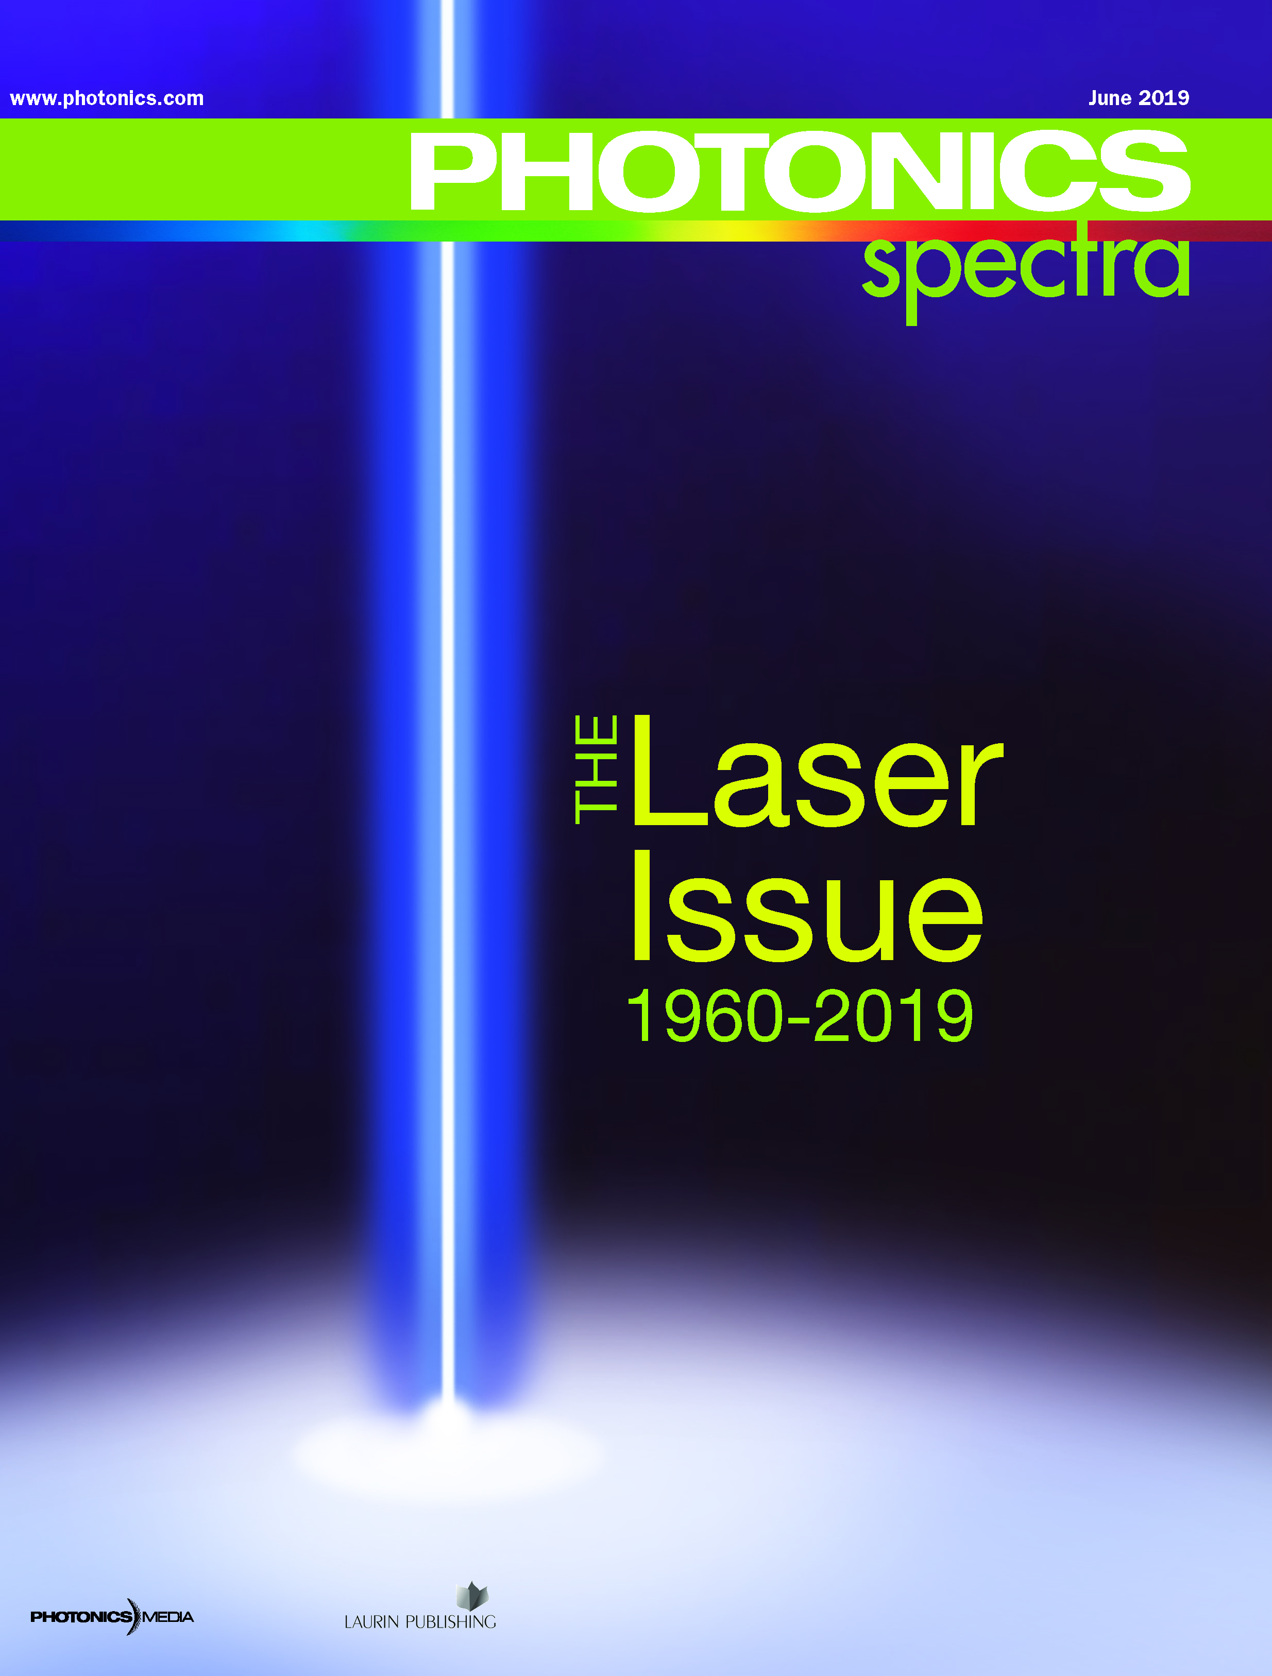


Photonics Media
About Us
Family-owned publisher based in Western Mass.
Flagship publication, Photonics Spectra, has 100,000 readers.
Complete coverage of lasers, optics, imaging, spectroscopy, fiber optics, test and measurement.
Coverage of emerging areas such as materials, plasmonics and quantum technology.
Editior-in-Chief Michael Wheeler/Senior Editor Dan McCarthy

Slide 2
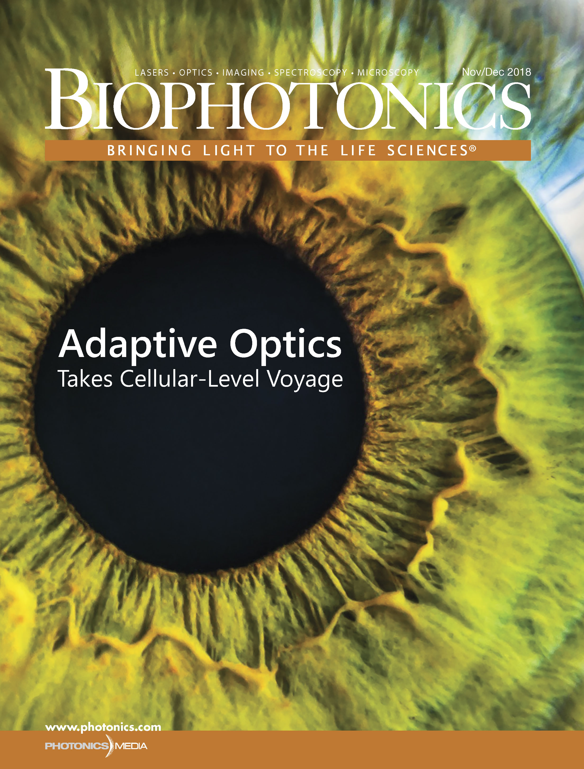

Photonics Media
About Us
Bi-monthly Biophotonics includes complete coverage of OCT, microscopy and spectroscopy.
Distinguished advisory board including Jurgen Popp and Aydon Ozcan.
Europhotonics chronicles developments in Europe
Senior Editor Doug Farmer oversees Biophotonics and Europhotonics.

Slide 3


Photonics Media
About Us
Vision Spectra launched in 2019.
Expansive coverage of machine vision.
“All Things Photonics” aired in January 2020.
Distinguished guests have included Jürgen Popp, Roberta Ramponi, Adam Wax, Nobel winner Donna Strickland and Ursula Keller.

Slide 4
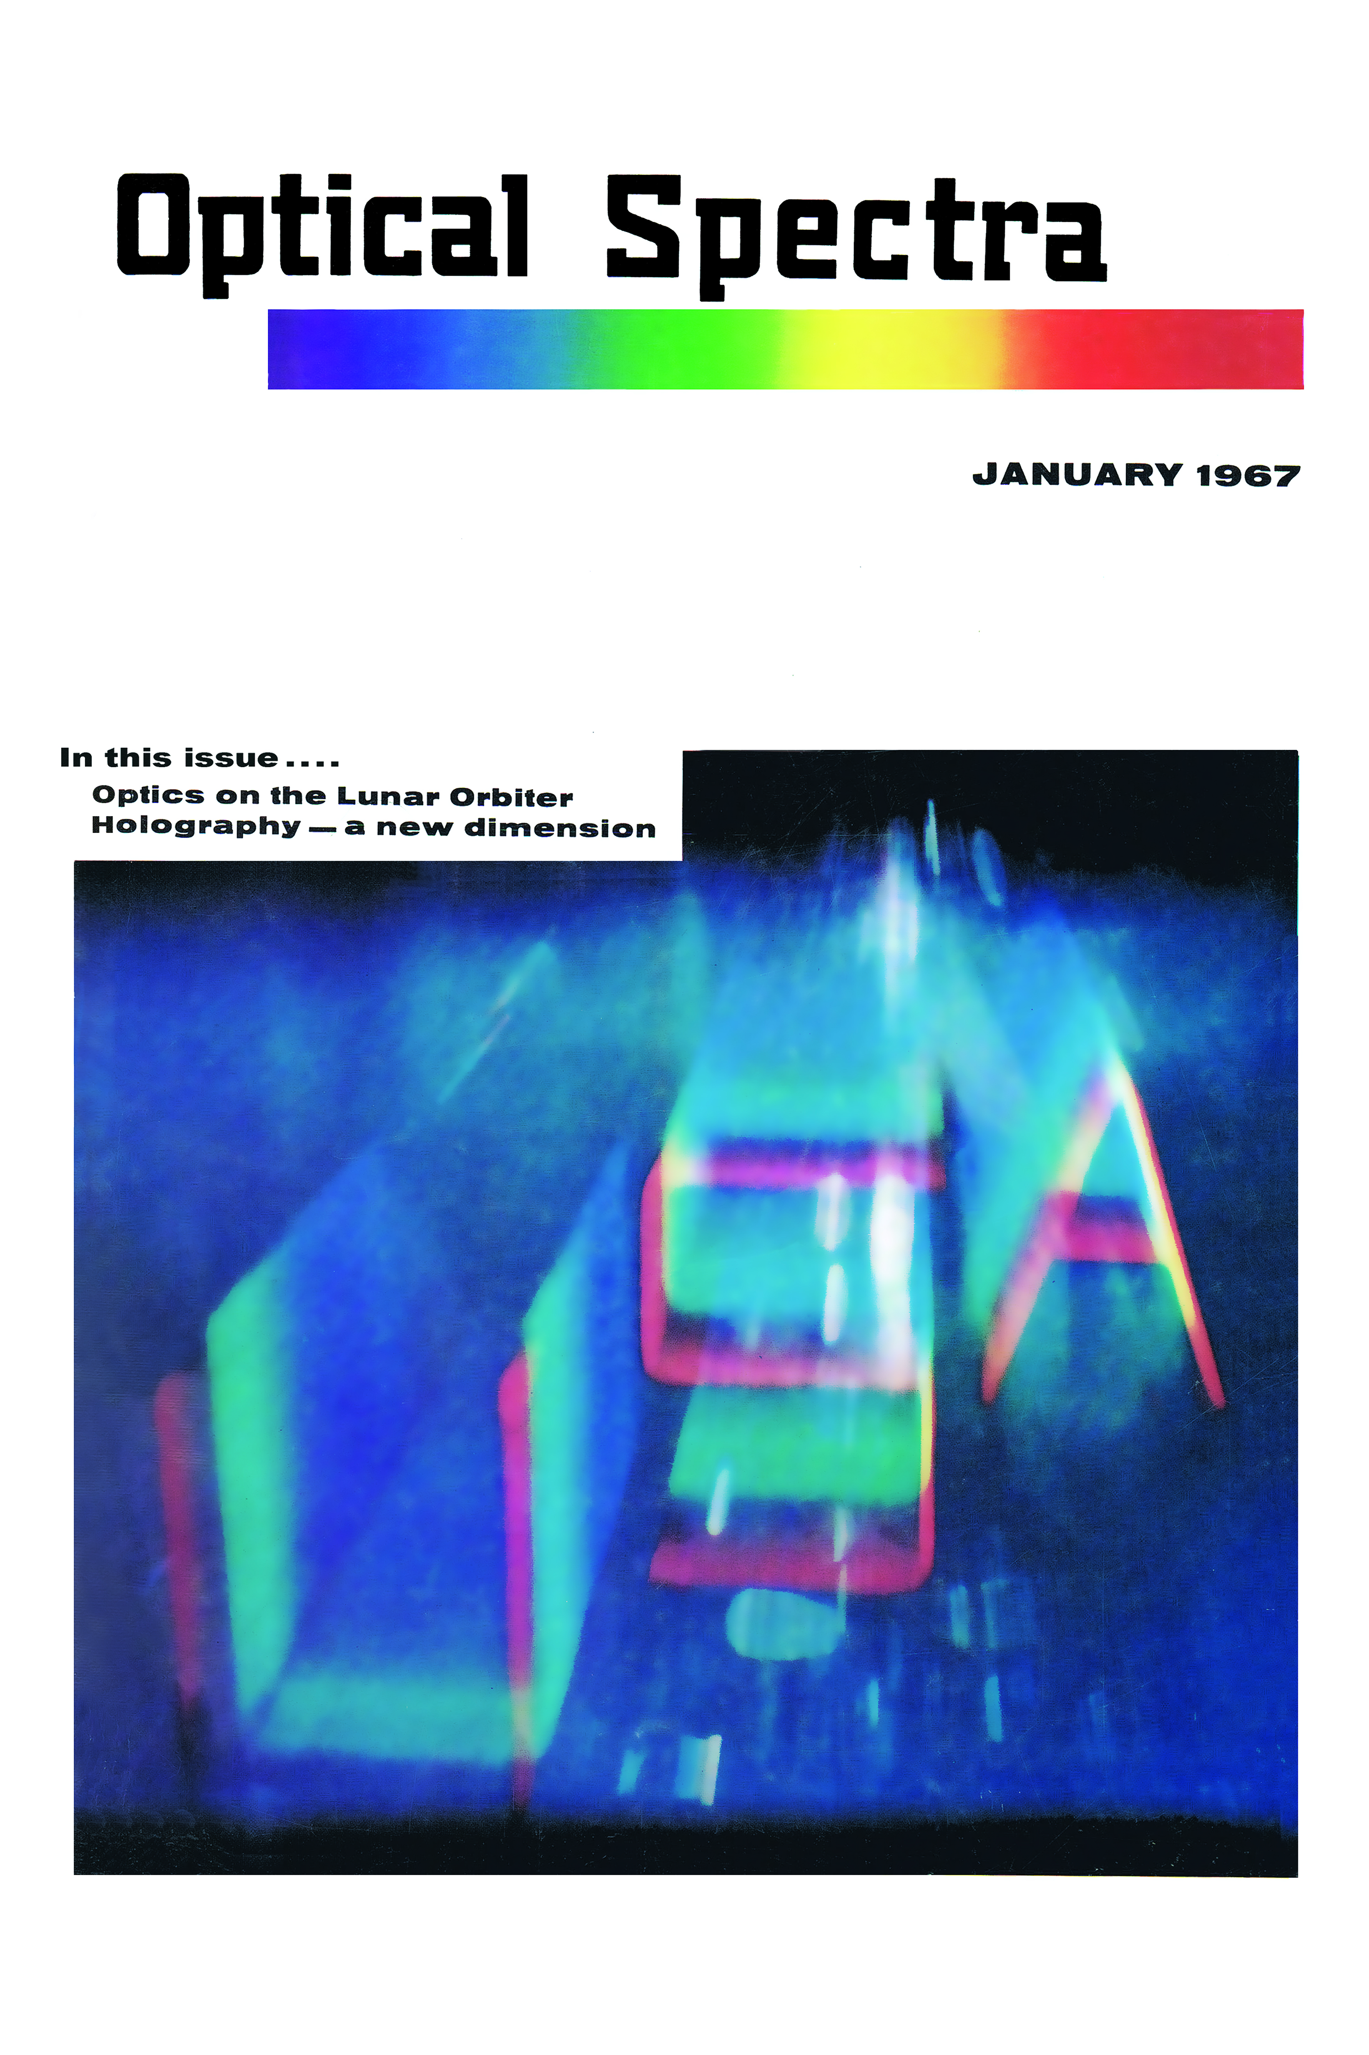
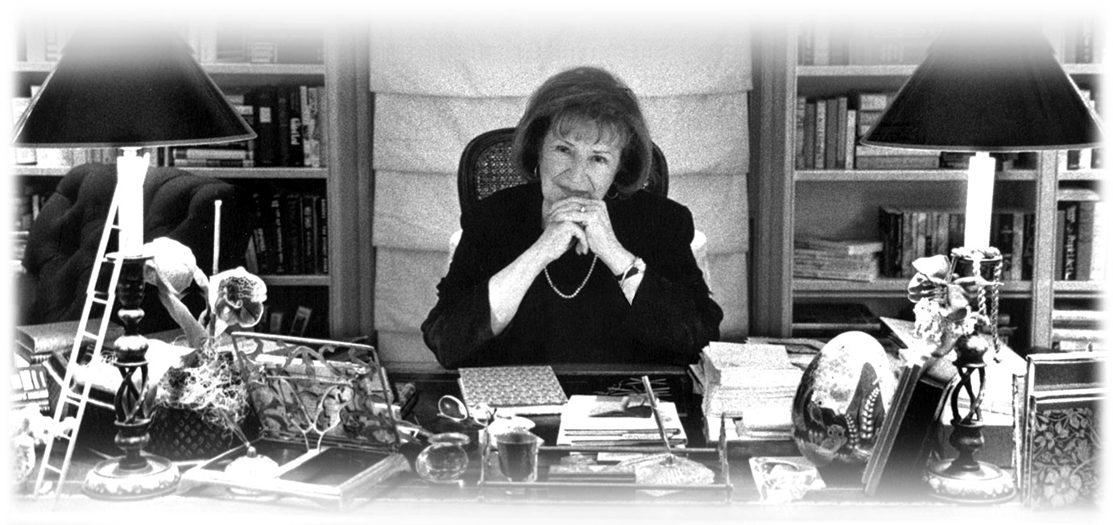
Photonics Media
History
First Issue Optical Spectra, 1967
Founder Teddi C. Laurin

Slide 5
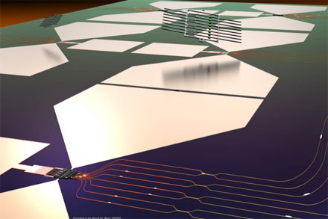
Photonics Media
Chronicling the Quantum Revolution
“Hybrid Process Integrates PIC with Artificial Atoms to Scale up Quantum Chip”
CAMBRIDGE, Mass., July 15, 2020 — MIT researchers have developed a way to manufacture and integrate artificial atoms with photonic circuitry to produce a quantum chip that could be used for large-scale quantum systems. Using a hybrid, modular approach, the researchers built what they believe to be the largest integrated artificial-atom photonics chip yet.

Slide 6
Photonics Media
Contact Information
Michael D. Wheeler
Michael.wheeler@photonics.com
Editor-in-Chief
PHOTONICS MEDIA
---------------------------
100 West Street
Pittsfield, MA 01202
413.499.0514 x 204
www.photonics.com

