Slide 1
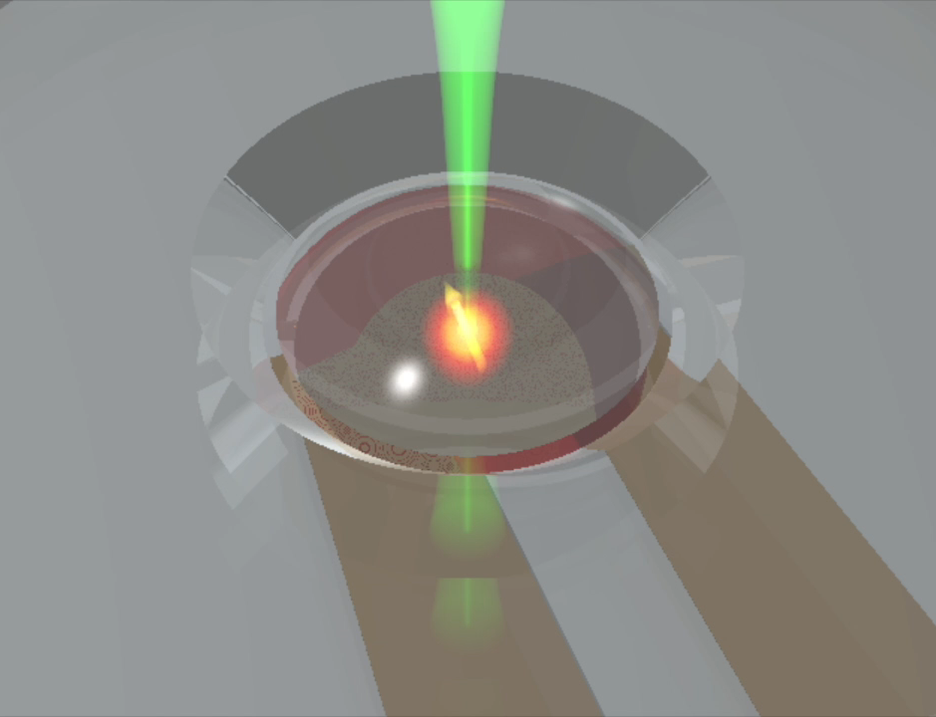
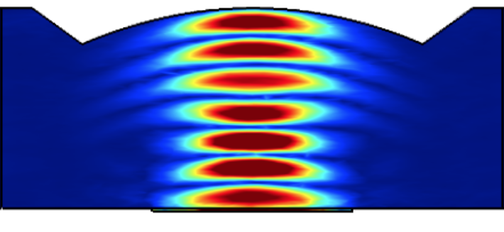


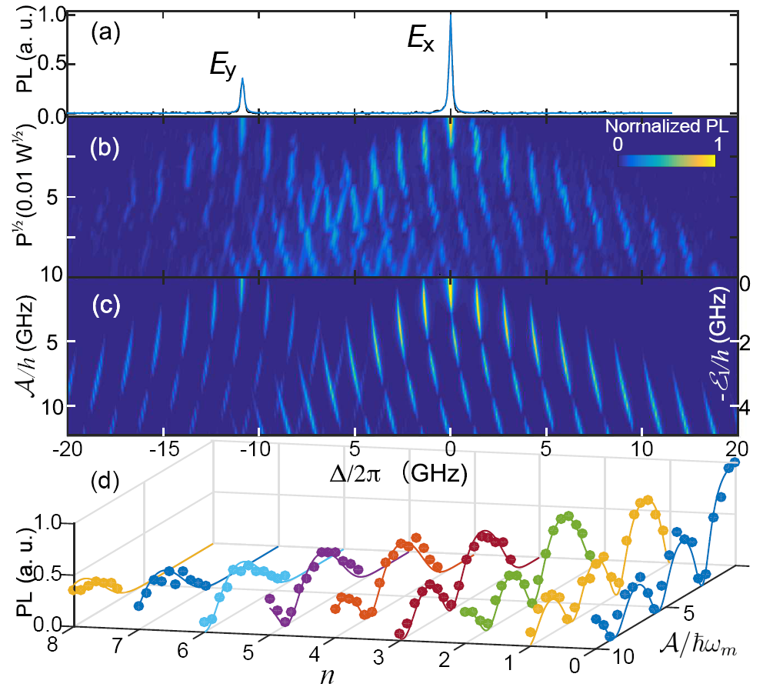



PfQ2 – Virtual
Spin and Orbital Resonance Driven by a Mechanical Resonator
Gregory D. Fuchs
School of Applied & Engineering Physics
Cornell University, Ithaca, NY USA
June 23, 2020

Slide 2
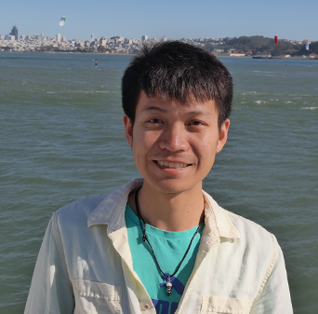
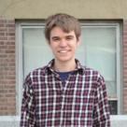
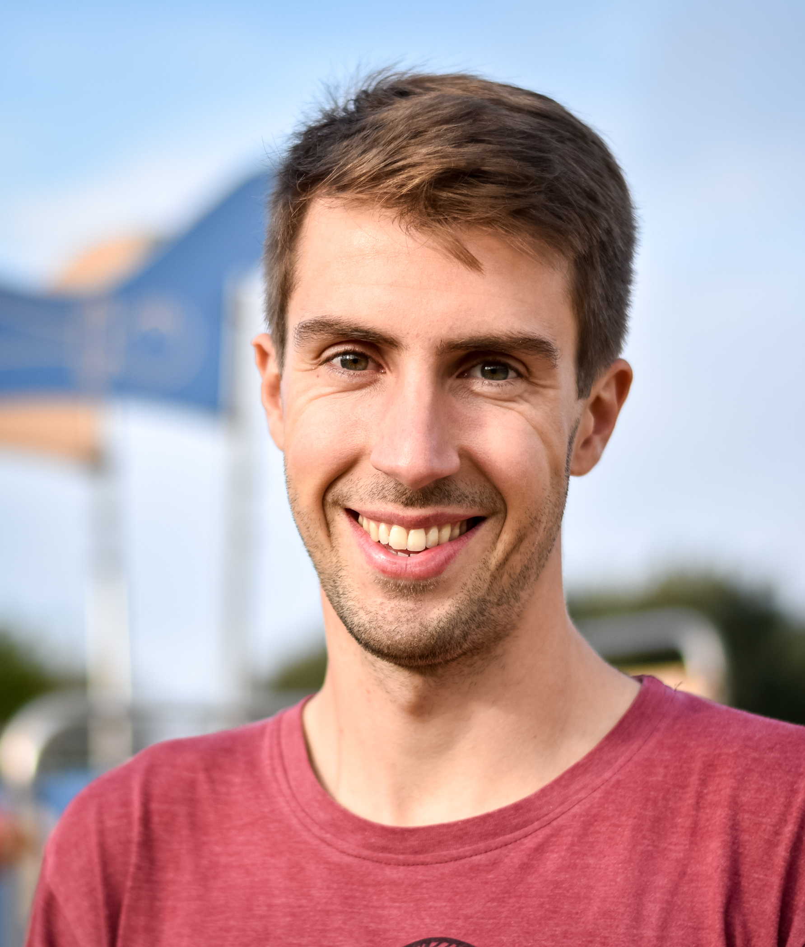
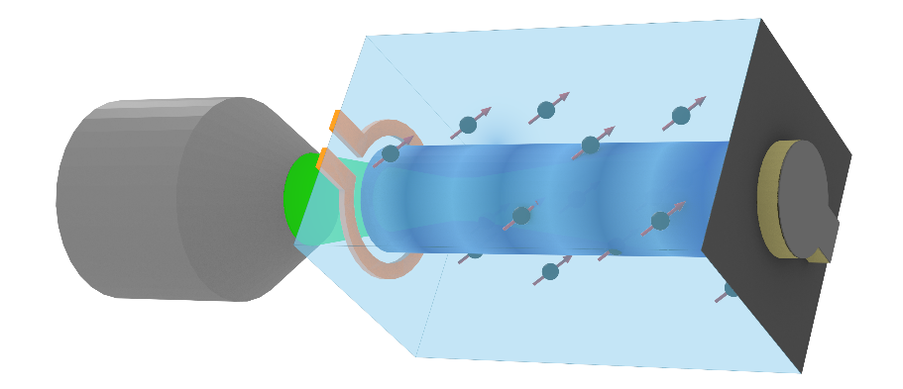
Cornell spin-mechanics: acknowledgements
Fuchs Group (Cornell)
Huiyao Chen*
Raphaël Daveau*
Evan MacQuarrie*
Sunil Bhave Group (Purdue ECE)
Noah Opondo
Alex Jiang
Huiyao
Evan
Raphaël
*group alumni

Slide 3
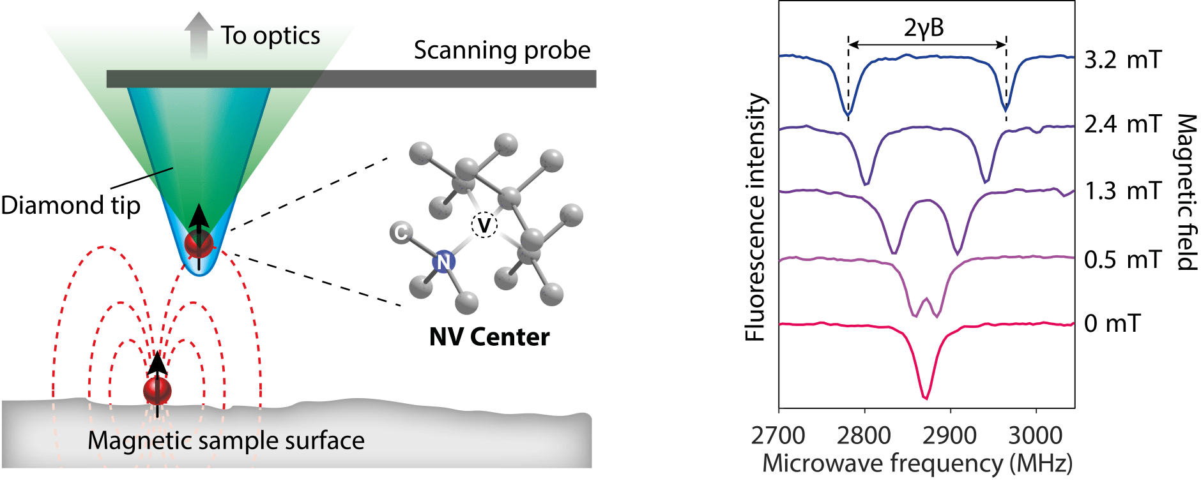
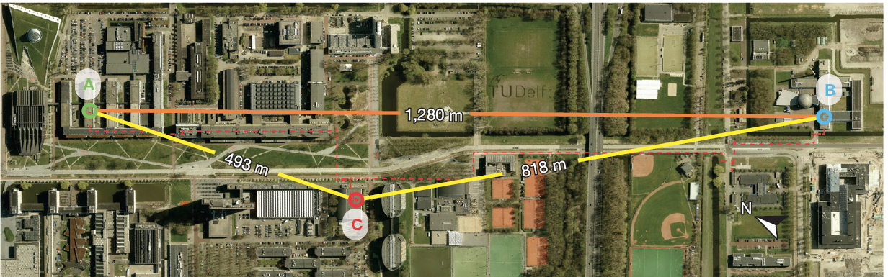
Applications of nitrogen-vacancy (NV) centers
Quantitative, atomic-scale probe at room or low temperature
  Magnetometry
  Thermometry
  Electrometry
Quantum information
  Multi-qubit quantum node
  Photonic quantum interface
  Hybrid quantum interface
Image: Qzabre.com
Entanglement between long-lived qubits
Hansen Group, Delft, 2015

Slide 4
Diamond NV centers: an experimentalist’s introduction
Nitrogen-vacancy (NV) center in diamond
S=1 spin defect in diamond
Model system for spins in the quantum limit
Experimentally simple:
  Solid state
  Address individually or in ensembles
  Optical spin initialization and read-out
  Room temperature quantum coherence
Photoluminescence image
Optical cycle: initialization and read-out
+1
Dark,
spin selective
relaxation
³E
-1
0
+1
read “dark”
-1
³A
read “bright”
0
Orbital
Spin
Review article: Dobrovitski, Fuchs, Falk, Santori, Awschalom, Ann. Rev. CMP (2013)

Slide 5
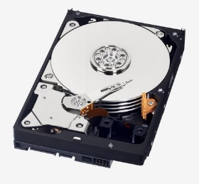
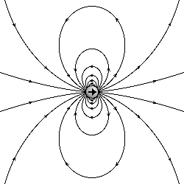
Hybrid quantum systems
Coupling different degrees of freedom
Color Center
Resonator,
Cavity
Different qubit
Long coherence lifetime
Sensing
Coherent coupling to photons
Driving
Quantum control
Logic
Connectedness
Scaling

Slide 6
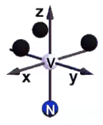
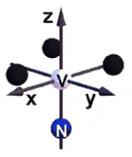
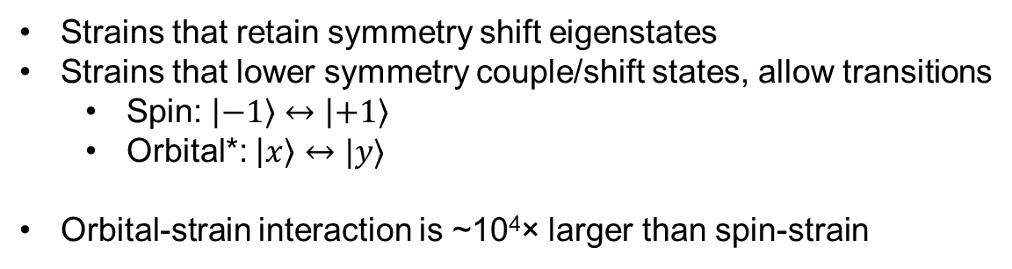
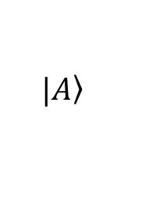
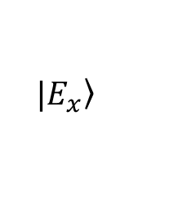
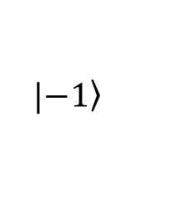
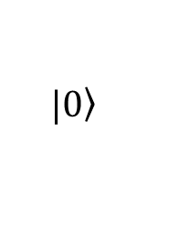
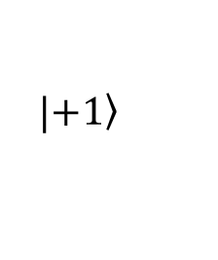
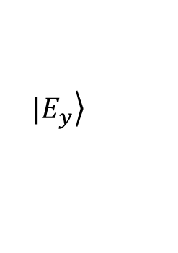
Coupling to resonators via strain
Both spin and optical transitions couple to strain
$$|\left.+1\right\rangle$$
$$|\left.−1\right\rangle$$
spin
$$|\left.0\right\rangle$$
Strains that retain symmetry shift eigenstates
Strains that lower symmetry couple/shift states, allow transitions
  Spin: $|−1〉↔|+1〉$
  Orbital*: $|x〉↔|y〉$
Orbital-strain interaction is ~10⁴× larger than spin-strain
$$|\left.E_{x}\right\rangle$$
$$|\left.E_{y}\right\rangle$$
orbital
*These animations are not fully correct for the case of orbital strains, the situation is a little complex, but this is true in spirit.
$$|\left.A\right\rangle$$

Slide 7
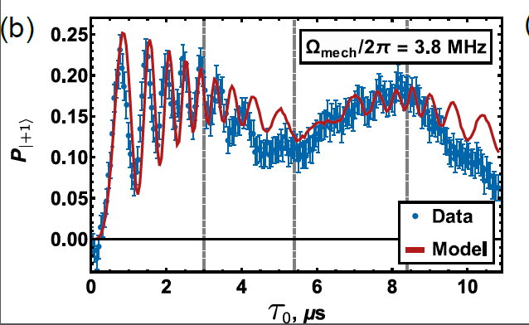
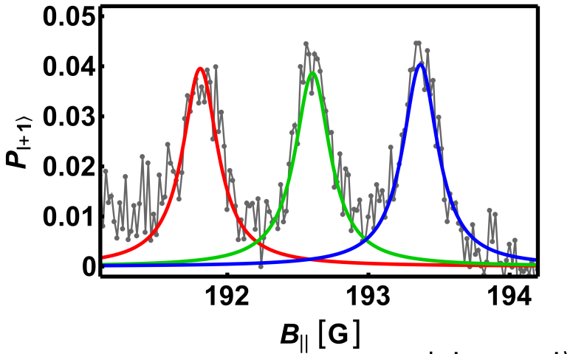
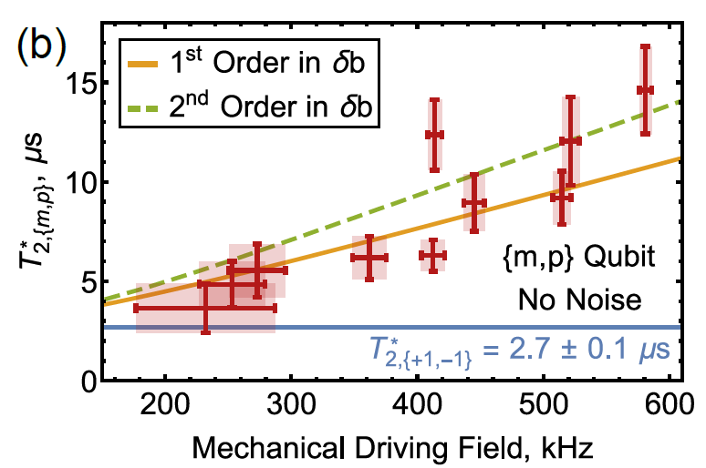
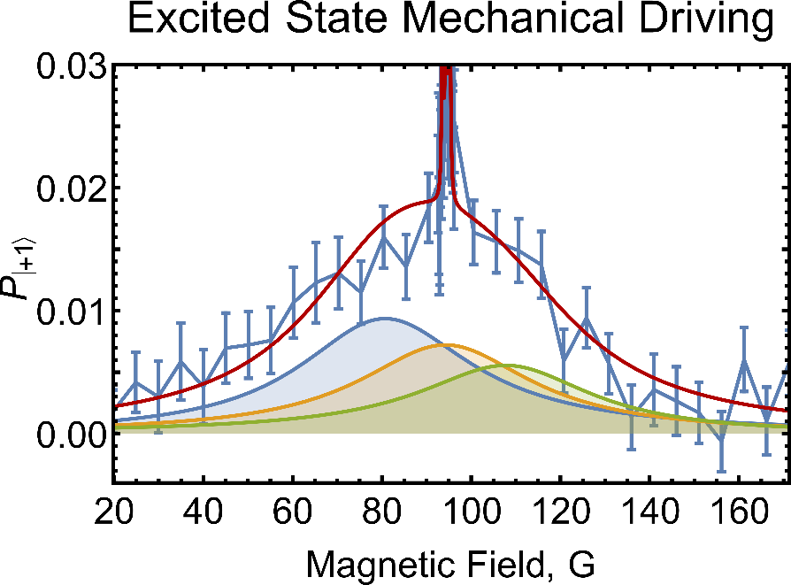
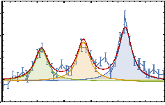
Past work: spin-mechanical coupling to spin
Spectroscopy
Decoherence protection
Coherent Control
m_{I}=+1 only
τ₀ (μs)
E. R. MacQuarrie, T. A. Gosavi, N. R. Jungwirth, S. A. Bhave, and G. D. Fuchs, PRL 111, 227602 (2013)
E. R. MacQuarrie, T. A. Gosavi, A. M. Moehle, N. R. Jungwirth, S. A. Bhave, and G. D. Fuchs, Optica 2, 233 (2015)
E. R. MacQuarrie, T. A. Gosavi, S. A. Bhave, and G. D. Fuchs, PRB 92, 224419 (2015)
Room-temperature excited-state spin strain interaction
See also work by Jayich (UCSB), Awschalom (UChicago), Wang (Oregon), Malentinsky (Basel), Loncar (Harvard), Wrachtrup (Stuttgardt), …
93
94
95
E. R. MacQuarrie, M. Otten, S. K. Gray, and G. D. Fuchs, Nat. Commun. 8, 14358 (2017)

Slide 8
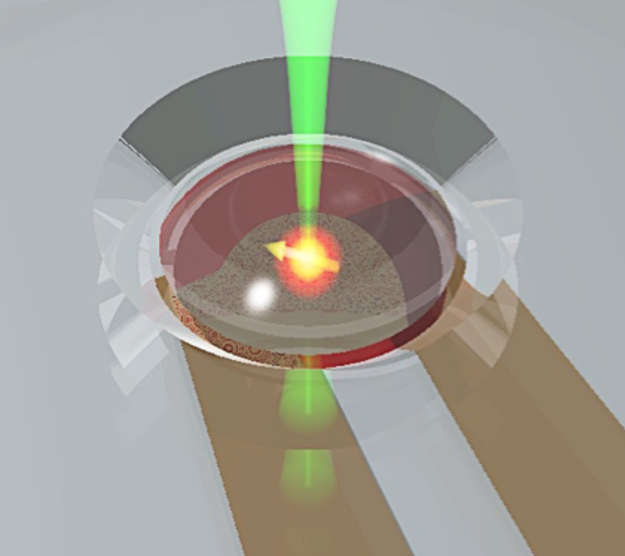
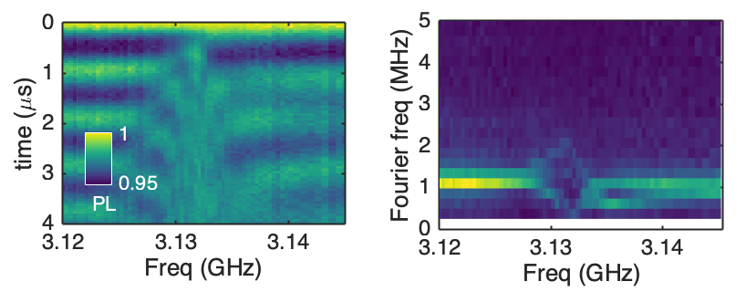
Outline
1. Engineering the optical transition using orbital-state resonance
2. Engineering stronger spin-phonon coupling by reducing resonator volume
3. Revisiting ground-state spin-strain: the single quantum transition

Slide 9















Engineering the optical transition with strain at low-T
For at T< 10 K, full orbital manifold is stable: ³E = (2 orbital) × (3 spin) = 6 levels
Consider only m_{s}=0 levels, and static terms for simplicity:
$$|E_{x}〉$$
$$|E_{x}′〉$$
$$|E_{x}〉, |E_{y}〉$$
$$|E_{x}〉, |E_{y}〉$$
$$|E_{y}〉$$
Optical transition
$$|E_{y}′〉$$
$$|A_{2},m_{s}=0〉$$
$$|A_{2},m_{s}=0〉$$
$$|A_{2},m_{s}=0〉$$
$$|A_{2},m_{s}=0〉$$
$$H=$$
$$H_{0}$$
$${+A}_{1}$$
$${+E}_{1}$$
$${+E}_{2}$$
Unperturbed
x and y shift together
x and y shift apart
x and y mix
Longitudinal Strain
Transverse Strain
Shear Strain
See e.g. Doherty et al., NJP 13, 025019 or Lee et al., PR Applied 6, 034005

Slide 10
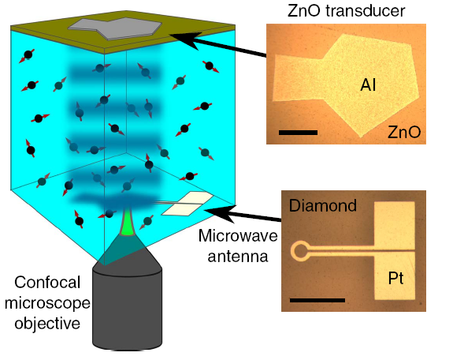
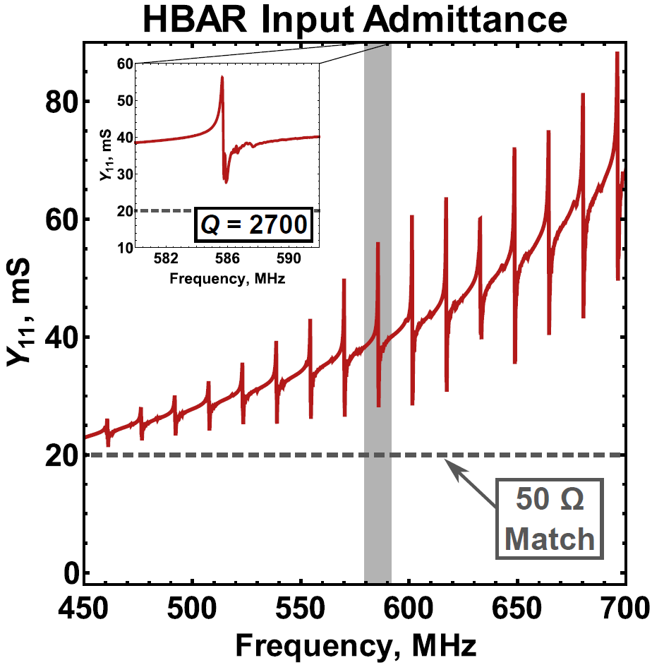
High-frequency diamond mechanical resonator
diamond
High-overtone bulk-mode acoustic resonator (HBAR)
  Fabery-Perot “type” phonon cavity: diamond surface as acoustic mirrors
  Driven by a piezoelectric transducer (either AlN or ZnO)
  Modes in the range 0.5 – 2 GHz
  Mechanical Q-factor ≈ 400 – 4000 typical
  Generates ≈ 10 - 100 MPa of stress along [001]

Slide 11
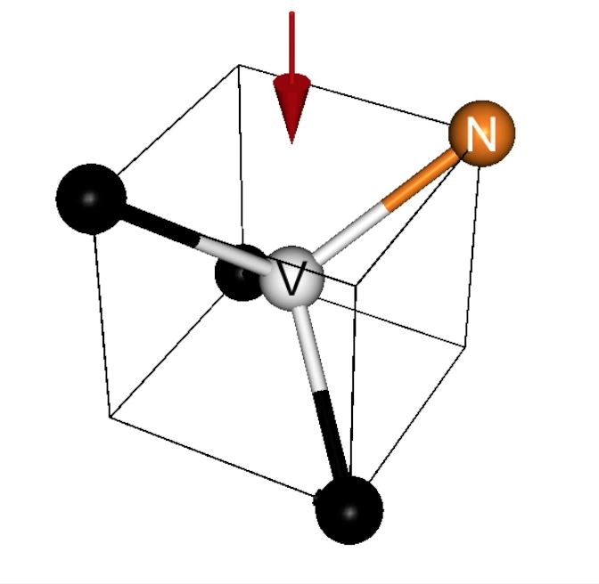




Dynamic Hamiltonian for NV excited orbital states
For our geometry in the sideband-resolved limit:
$$|E_{x}〉$$
$$|E_{y}〉$$
$$H= \left(\begin{matrix}𝒜\cos\left(ω_{m}t\right)+V_{E_{1}}+ℰ_{1}\cos\left(ω_{m}t\right) & V_{E_{2}} \\ V_{E_{2}} & 𝒜\cos\left(ω_{m}t\right)−V_{E_{1}}−ℰ_{1}\cos\left(ω_{m}t\right)\end{matrix}\right)$$
$$|E_{x}〉$$
$$|E_{y}〉$$
In a strongly-driven system, the eigenstates aren’t obvious!

Slide 12

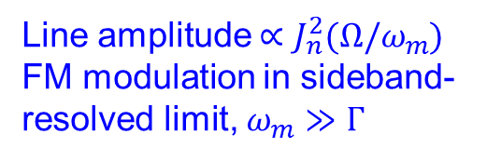



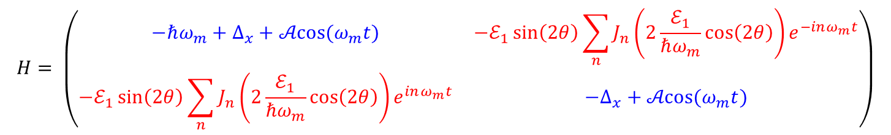

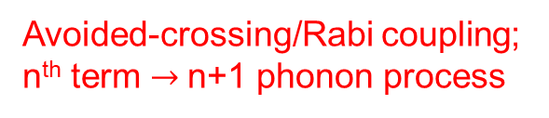
Driving the orbital states in the side-band resolved limit
$$H= \left(\begin{matrix}−ℏω_{m}+Δ_{x}+𝒜cos⁡(ω_{m}t) & −ℰ_{1}\sin\left(2θ\right)\sum_{n}{J_{n}\left(2\frac{ℰ_{1}}{ℏω_{m}}\cos\left(2θ\right)\right)e^{−inω_{m}t}} \\ −ℰ_{1}\sin\left(2θ\right)\sum_{n}{J_{n}\left(2\frac{ℰ_{1}}{ℏω_{m}}\cos\left(2θ\right)\right)e^{inω_{m}t}} & {−Δ}_{x}+𝒜cos⁡(ω_{m}t)\end{matrix}\right)$$
“frequency modulation”
“Orbital state mixing”
$${|E}_{x}〉$$
$$|E_{x}〉+|E_{y}〉$$
Energy
Fluorescence
$$|E_{x}〉−|E_{y}〉$$
$${|E}_{y}〉$$
Line amplitude $∝J_{n}^{2}(Ω/ω_{m}$)
FM modulation in sideband-resolved limit, $ω_{m}≫Γ$
Δ
Avoided-crossing/Rabi coupling;
n^{th} term$→$ n+1 phonon process
$$Δ_{x}$$
See Golter et al., PRL 2016
Displaced oscillator transformation see, e.g. Ashab et al. PRA 75, 032301 (2007)

Slide 13
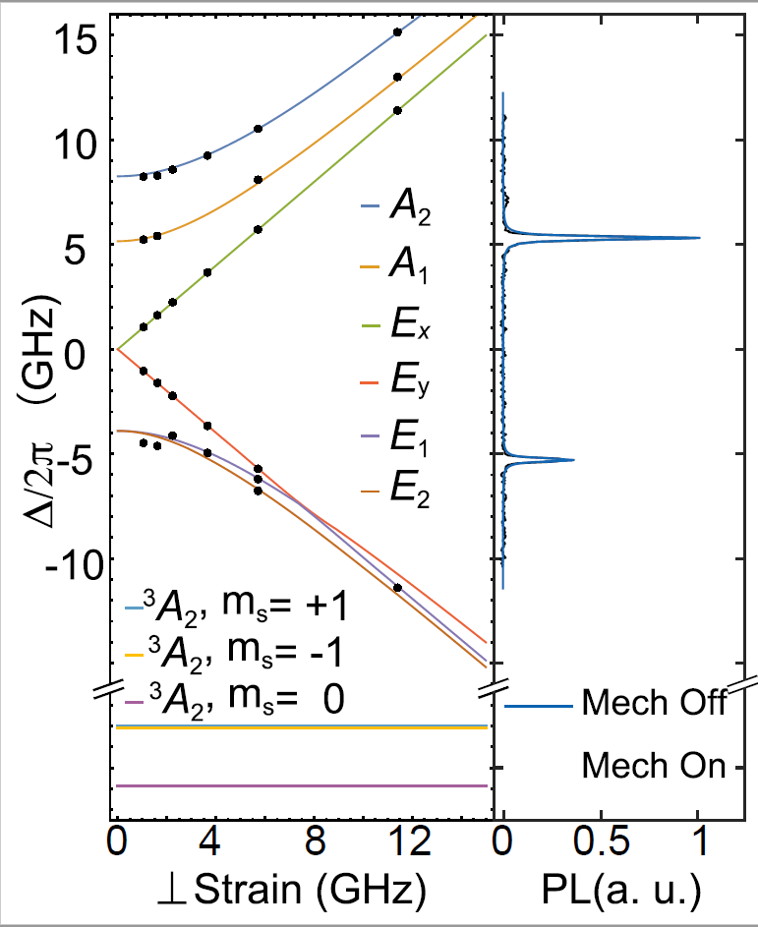
Photoluminescence excitation spectroscopy
E_{x}
E_{Y}
Scan the frequency of a tunable laser
Measure sideband fluorescence
A₂

Slide 14
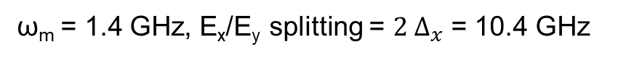
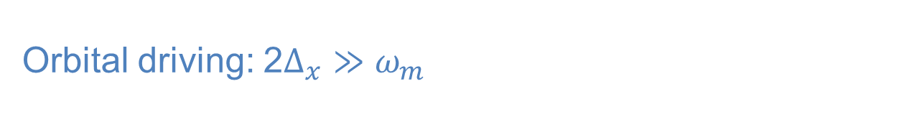
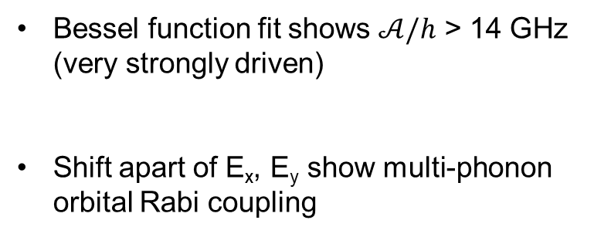
Orbital driving: 2$Δ_{x}≫ω_{m}$
ω_{m} = 1.4 GHz, E_{x}/E_{y} splitting = $2 Δ_{x}$ = 10.4 GHz
PLE
Photoluminescence Excitation Spectroscopy (PLE)
Bessel function fit shows $𝒜/h$ > 14 GHz
(very strongly driven)
Shift apart of E_{x}, E_{y} show multi-phonon orbital Rabi coupling
H. Y. Chen, E. R. MacQuarrie, G. D. Fuchs PRL 120, 167401 (2018)

Slide 15
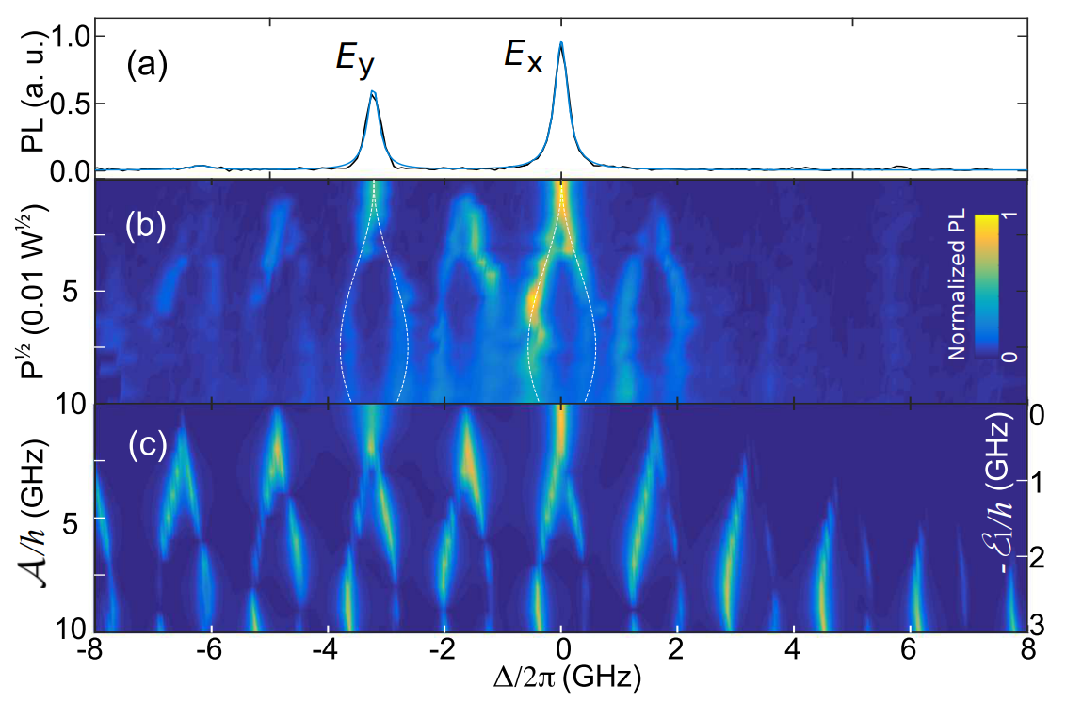
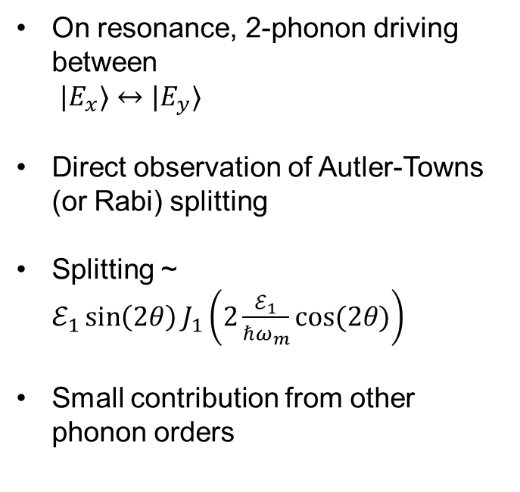


Orbital driving: 2$Δ_{x}={2ω}_{m}$
3.2 GHz
$$ω_{m}$$
$$ω_{m}$$
On resonance, 2-phonon driving between
$|E_{x}〉↔|E_{y}〉$
Direct observation of Autler-Towns (or Rabi) splitting
Splitting ~ $ℰ_{1}\sin\left(2θ\right)J_{1}\left(2\frac{ℰ_{1}}{ℏω_{m}}cos⁡(2θ)\right)$
Small contribution from other phonon orders
Data
Model
H. Y. Chen, E. R. MacQuarrie, G. D. Fuchs PRL 120, 167401 (2018)

Slide 16





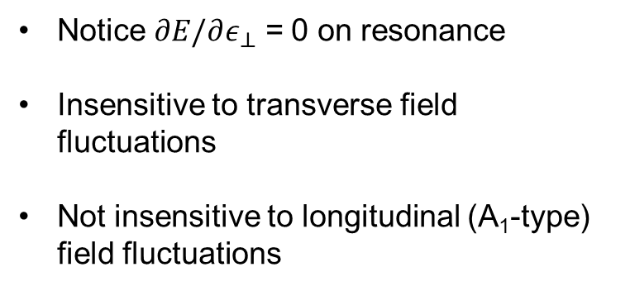
So what?
Direct quantum control within the orbital manifold
Orbital dynamical decoupling → toward improved coherent optical transitions for spin-photon interface (quantum network, quantum repeater)
$${|E}_{X}〉$$
$$|E_{X}〉+|E_{Y}〉$$
Notice $∂E/∂ε_{⊥}$ = 0 on resonance
Insensitive to transverse field fluctuations
Not insensitive to longitudinal (A₁-type) field fluctuations
Energy
$$|E_{X}〉−|E_{Y}〉$$
$${|E}_{Y}〉$$
Transverse E-field, $ε_{⊥}$

Slide 17
Outline
1. Engineering the optical transition using orbital-state resonance
2. Engineering stronger spin-phonon coupling by reducing resonator volume
3. Revisiting ground-state spin-strain: the single quantum transition

Slide 18
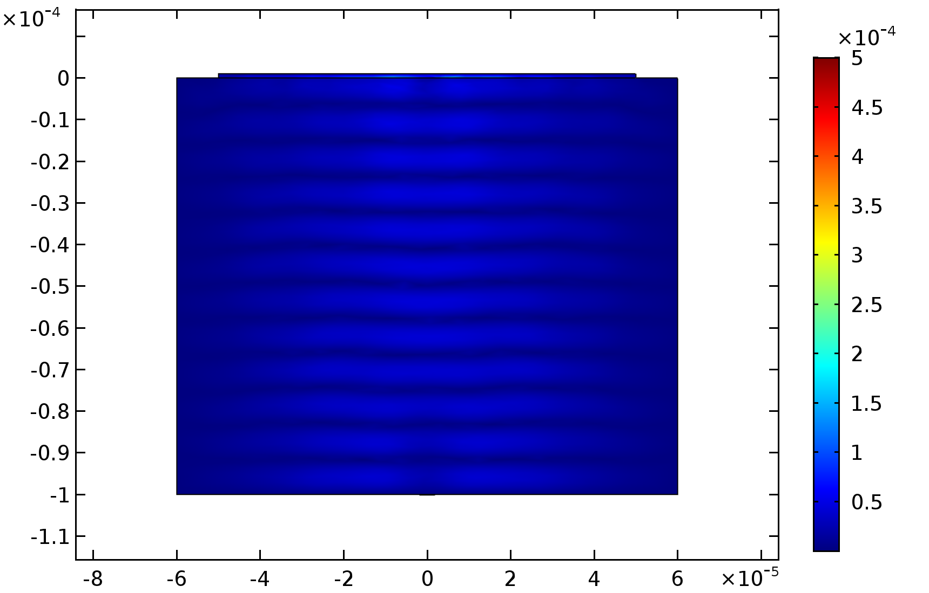
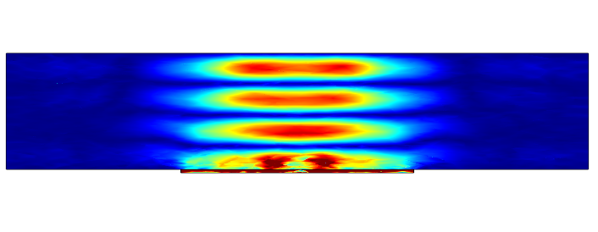
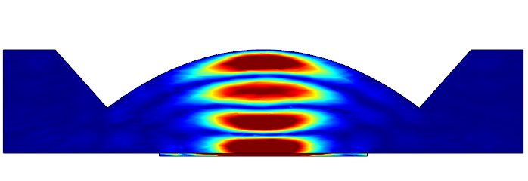
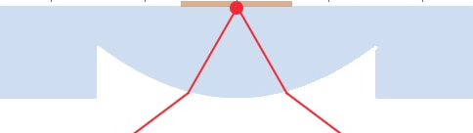
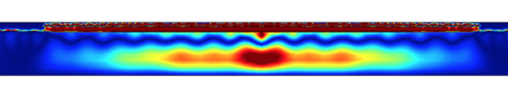
From HBAR to Semi-confocal HBAR (COMSOL simulation)
HBAR
2. Reduce λ
3. Reduce f(g)
strain
10 μm
10 μm
Semi-confocal HBAR
1. Reduce t
3x10⁴ times smaller volume
10 times more strain
H. Y. Chen, N. F. Opondo, B. Jiang, E. R. MacQuarrie, R. S. Daveau, S. A. Bhave, and G. D. Fuchs, Nano Letters 19, 7021-7027 (2019)
Notes:
To make the transition from HBAR to Semi-confocal HBAR.
Here is what we can do to achieve the small mode volume
1. Reduce the thickness of the resonator,
2. Increase the frequency of the resonator,
3. And finally add more confinement by creating a curved focusing boundary, that matches with the wave front of the acoustic beam.
The strain profiles are from the COMSOL simulation with the same voltage drive source, we can tell, not only the semi-confocal HBAR design can confine phonons in a small mode volume <10 um3,
The strain generated by the same drive is also bigger.
....as mentioned earlier, Optically, the curved surface also suppresses the light refraction, making it more efficient to collect fluorescence from the NV centers.

Slide 19
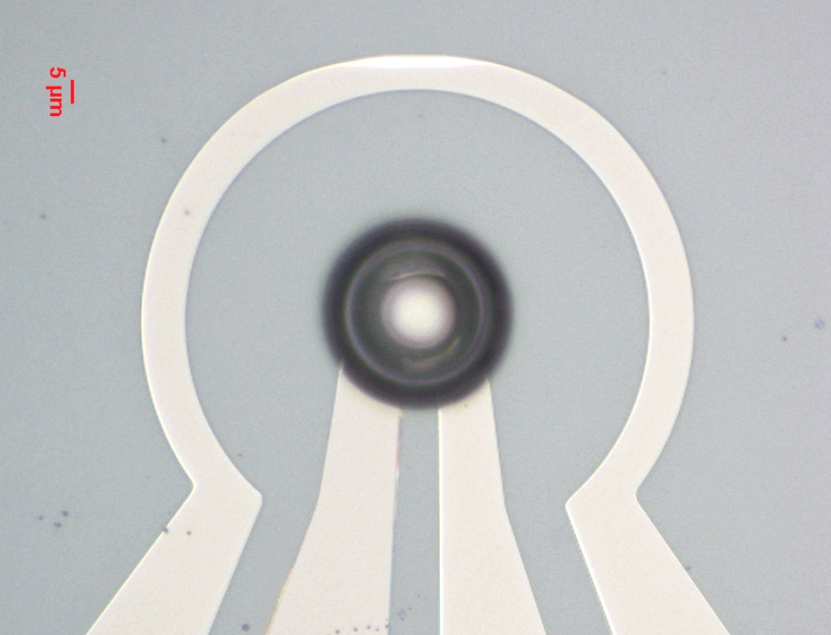
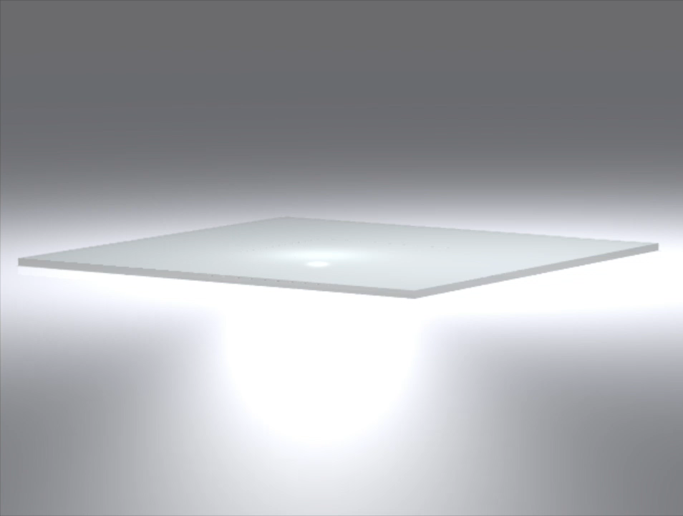

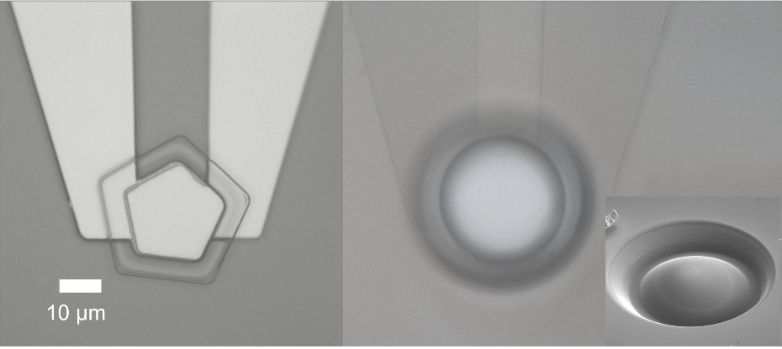
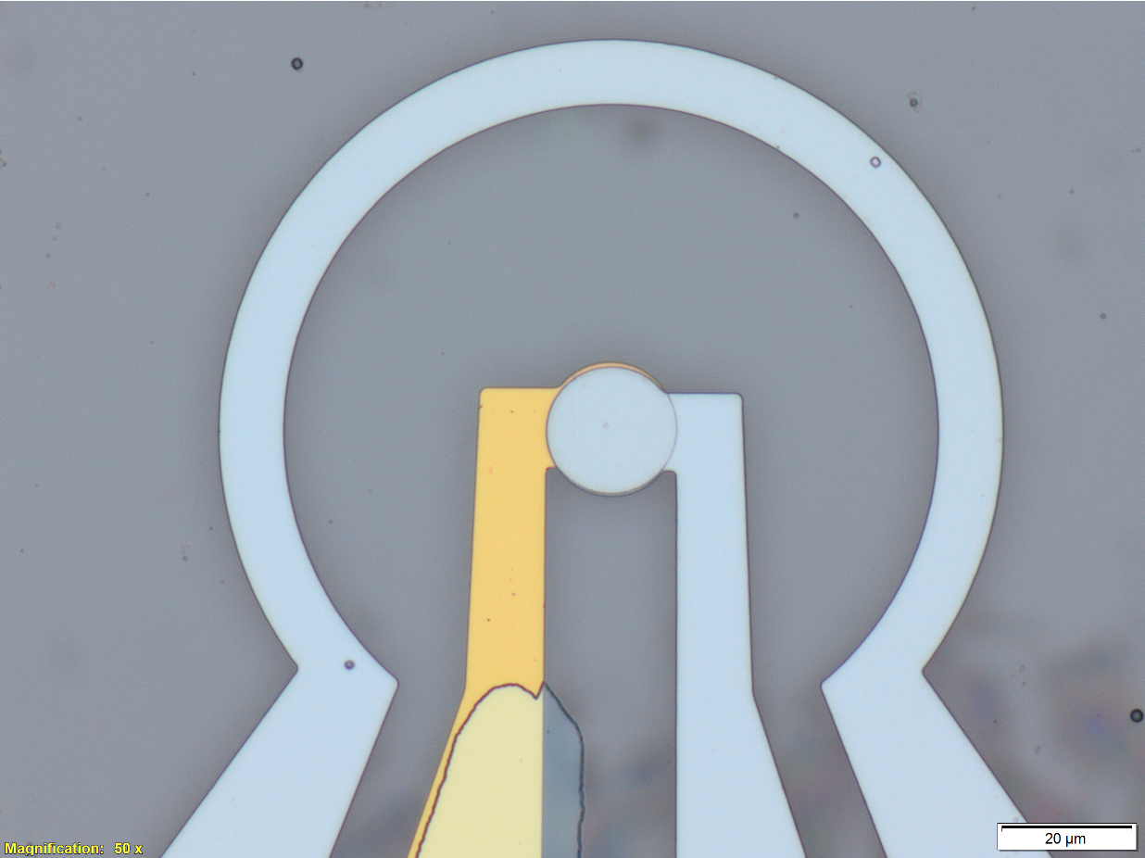
Device Fabrication
High rate DRIE etch 50 µm diamond (optical graded) down to 10 - 20 µm membrane. (~5 μm/hr)
10 μm
Milling a parabolic curved surface/lens using Focused Ion Beam (FIB);
Backside ZnO piezoelectric transducer fabrication.
10 μm
H. Y. Chen, N. F. Opondo, B. Jiang, E. R. MacQuarrie, R. S. Daveau, S. A. Bhave, and G. D. Fuchs, Nano Letters 19, 7021-7027 (2019)
Notes:
In terms of fabrication, let me present the process flow with a video.
we start from a DSP single crystal substrate,
the first step is to thin the substrate down to 10um using deep reactive ion etching method;
Then, we use focused ion beam to mill the lens structure on one side of the membrane;
In the end, we put down piezoelectric transducers and antenna on the other side of the membrane, aligned to the previously made lens.
A few images of the made devices are shown on the slides as well.

Slide 20
Spin Characterization
Polarizes nuclear spins
Acoustically-driven Rabi oscillations
Ramsey fringes in single and double quantum basis
~3.15 GHz
Spectroscopy
P₊₁
Double-quantum {+1,-1} basis is more sensitive for magnetometry
Direct quantum control can enable new magnetometry sequences
~100% polarization of ¹⁴N nuclear spins
H. Y. Chen, N. F. Opondo, B. Jiang, E. R. MacQuarrie, R. S. Daveau, S. A. Bhave, and G. D. Fuchs, Nano Letters 19, 7021-7027 (2019)
As power efficient as the magnetic antenna!

Slide 21
Outline
1. Engineering the optical transition using orbital-state resonance
2. Engineering stronger spin-phonon coupling by reducing resonator volume
3. Revisiting ground-state spin-strain: the single quantum transition

Slide 22

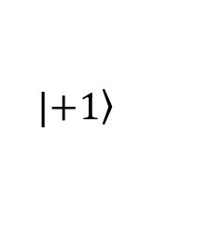













Spin resonance driven by an ac strain
$$|\left.+1\right\rangle$$
$$|\left.0\right\rangle$$
$$|\left.−1\right\rangle$$
  $a_{1}$= 4.86(2) MHz/GPa
$$H_{NV}=\left(\begin{matrix}D_{0}+a_{1}σ_{ZZ}+γ_{NV}B_{||} & \frac{γ_{NV}B_{⊥}}{\sqrt{2}}+\sqrt{2}b′σ_{zz} & 2bσ_{ZZ} \\ \frac{γ_{NV}B_{⊥}}{\sqrt{2}}+\sqrt{2}b′σ_{zz} & 0 & \frac{γ_{NV}B_{⊥}}{\sqrt{2}}−\sqrt{2}b′σ_{zz} \\ 2bσ_{ZZ} & \frac{γ_{NV}B_{⊥}}{\sqrt{2}}−\sqrt{2}b′σ_{zz} & D_{0}+a_{1}σ_{ZZ}+{γ_{NV}B}_{||}\end{matrix}\right)$$
$$|\left.+1\right\rangle$$
  $b$= 2.3(3) MHz/GPa
$$|\left.0\right\rangle$$
$b′$ = ???
(DFT predicts ~0.06b)
$$|\left.−1\right\rangle$$
P. Udvarhelyi, PR B (2018).
$$|\left.+1\right\rangle$$
Transverse B-field couples $|\left.0\right\rangle$ & $|\left.−1\right\rangle$ or $|\left.0\right\rangle$ & $|\left.+1\right\rangle$ (single quantum)
  → Conventional magnetic resonance spin control
  → $Δm_{s}=±1$ selection rule
Transverse strain couples $|0〉, |\left.−1\right\rangle$ & $|\left.+1\right\rangle$ (single or double)
  → NV spin controlled by lattice stress/strain
  → $Δm_{s}=±2, ±1$ selection rule
$$|\left.−1\right\rangle$$
$$|\left.0\right\rangle$$
Bennett et al. PRL 2013 [Theory @ Harvard]
MacQuarrie, … GDF, PRL (2013)
Udvarhelyi et al., PRB 2019 [Theory @Budapest]
Measuring $a_{1} \& b$ using cantilevers:
Ovartchaiyapong et al., Nat. Comm. (2014) [UCSB]
Teissier et al., PRL (2014) [Basel]

Slide 23







Decomposing the driving field vectors
Total driving field
$$|\left.+1\right\rangle$$
$$|\left.0\right\rangle$$
$$|\left.−1\right\rangle$$
$$H_{NV}=\left(\begin{matrix}D_{0}+a_{1}σ_{ZZ}+γ_{NV}B_{||} & \frac{γ_{NV}B_{⊥}}{\sqrt{2}}+\sqrt{2}b′σ_{zz} & 2bσ_{ZZ} \\ \frac{γ_{NV}B_{⊥}}{\sqrt{2}}+\sqrt{2}b′σ_{zz} & 0 & \frac{γ_{NV}B_{⊥}}{\sqrt{2}}−\sqrt{2}b′σ_{zz} \\ 2bσ_{ZZ} & \frac{γ_{NV}B_{⊥}}{\sqrt{2}}−\sqrt{2}b′σ_{zz} & D_{0}+a_{1}σ_{ZZ}+{γ_{NV}B}_{||}\end{matrix}\right)$$
$$|\left.+1\right\rangle$$
$$|\left.0\right\rangle$$
$$\vec{B}$$
$$\vec{σ}$$
$$φ$$
$$|\left.−1\right\rangle$$
The phase of $\vec{B}$ and $\vec{ε}$ depend on detuning from the mechanical resonance in a know-able way
The total SQ driving field is $Ω_{1}^{±}=\left|Ω_{B}\left(ω\right)e^{iφ}±Ω_{σ1}(ω)\right|$
  $Ω_{B}$ (on the transducer ) = $βΩ_{B}^{′}\left(ω\right)$ (at the leads )
  $Ω_{σ1}$ (SQ stress Rabi) = $αΩ_{σ_{2}}$ (DQ stress Rabi)
  All $Ω\left(ω\right)=Ω\left(ω\right)e^{iθ}$ depend on the resonator properties
Therefore $Ω_{1}^{±}(ω)=\left|βΩ′_{B}\left(ω\right)e^{iφ}±αΩ_{σ2}(ω)\right|$
  $β=1.3$ (by comparing Rabi at and at another frequency)
  $α=b^{′}/b\sqrt{2}$ = $Ω_{σ_{1}}/Ω_{σ_{2}}$ is the primary unknown

Slide 24















Rabi spectroscopy of the $\left|0\right\rangle ↔|\left.+1\right\rangle$transition
$$Ω′_{B}\left(f\right)$$
$$Ω_{σ2}(f)$$
$$Ω_{1}^{+}$$
f_{m}
f_{e}
f_{m}
PL
H. Y. Chen, S. A. Bhave, and G. D. Fuchs, Phys. Rev. Applied 13, 054068 (2020).
Notes:
We use Rabi spectroscopy to measure magnetic Rabi field at the marked blue cross location on the device.
We first focus on the mechanical mode at fr =3.132 GHz aiming at +1 SQ transition.
In the measurement, we use resonant microwave driving at a fixed power (10dbm), to record the NV spin Rabi oscillation at each frequencies
Using the sequence shown above.
The Fourier transform of the Rabi spectroscopy data (on the bottom) reports the Rabi field amplitude frequency dependence.
Here, we see two resonances that correspond to mechanical and electrical resonances of the device.
Similarly, we perform Rabi spectroscopy on |−1⟩ ↔ |+1⟩ DQ transition to measure acoustic Rabi field Ωσ2(f) at the marked orange cross location in the device.
Here ,we see a single Lorenzian peak showing the mechanical resonance behavior of the device.
Lastly, we we perform SQ Rabi spectroscopy at the same orange cross location. We see complex behavior in the total Rabi field.
because magnetic and acoustic fields jointly act on this transition, and the probed NV center ensemble includes NV centers coupled to both anti-node and node of the acoustic wave, which introduces spatial inhomogeneity in the acoustic field.

Slide 25







Rabi spectroscopy of the $\left|0\right\rangle ↔|\left.−1\right\rangle$transition
$$Ω′_{B}\left(f\right)$$
$$Ω_{σ2}(f)$$
$$Ω_{1}^{−}$$
PL
$$Ω_{1}^{±}(f)=\left|βΩ′_{B}\left(ω\right)e^{iφ}±αΩ_{σ2}(ω)\right|$$
where $Ω\left(ω\right)=$ $Ω\left(ω\right)e^{iθ\left(ω\right)}$
How to solve electromechanical phase $θ\left(ω\right)$ ?
H. Y. Chen, S. A. Bhave, and G. D. Fuchs, Phys. Rev. Applied 13, 054068 (2020).
Notes:
We also perform similar measurements on a different acoustic mode at 2.73 GHz to probe the |−1⟩ SQ transition. The results are shown here.
(click)
We now know the amplitude of the Rabi fields,
however, their electrical phase information, theta, is still unknown.
how do we solve this?
it turns out that Theta depends on resonator electromechanical characteristics, and can be inferred from an electrical model of the device.

Slide 26












Equivalent circuit model
Circuit model fit using modified Butterworth-Van Dyke model
$$Ω′_{B}\left(f\right)$$
$$θ′_{B}\left(f\right)$$
$$Ω′_{B}\left(f\right)$$
$$Ω_{σ2}(f)$$
$$Ω_{σ2}(f)$$
yields electromechanical phase $θ$ information
$$θ_{σ2}(f)$$
$$Ω_{1}^{±}=\left|βΩ′_{B}\left(ω\right)e^{iφ}±αΩ_{σ2}(ω)\right|$$
H. Y. Chen, S. A. Bhave, and G. D. Fuchs, Phys. Rev. Applied 13, 054068 (2020).
Notes:
The electromechanical response of a piezoelectric resonator like our device can be modeled using an electrical equivalent circuit known as the modified Butterworth–Van Dyke (mBVD) model shown above.
With magnetic and acoustic field measured experimentally, we can perform model fitting. using the equation given here. The results are shown on the right of the slide.
The fitted circuit model not only reproduces the measured Rabi field amplitude, but also contains the requisite phase information.
(beta, can be experimentally measured by driving the transducer off resonance, and turned out be be around 1.3 in our device.)
We are now ready to tackle alpha and phi.

Slide 27









Use quantum master equation to simulate an array of $φ, α$ ($\left|0\right\rangle ↔\left|+1\right\rangle$)
$$Ω_{1}^{±}(f,z)=\left|1.3Ω′_{B}\left(f\right)e^{iφ}±αΩ_{σ2}(f)cos(kz) \right|$$
Structural Similarity Index (SSIM)
…
…
…
…
…
…
…
…
…
…
…
…
…
…
…
…
…
…
…
…
Simulation
…
1.5
Data
Simulation
H. Y. Chen, S. A. Bhave, and G. D. Fuchs, Phys. Rev. Applied 13, 054068 (2020).
Notes:
To interpret the Rabi spectroscopy result, evaluate α and thus extract the spin stress susceptibility, b′, we implement a quantum master equation simulation for an ensemble of NV centers.
We did simulation for a range of {α,φ} values, and compare them to the experimental data by calculating their structural similarity index.
The heat map on the right shows the result.
Higher SSIM value indicates better match of simulation to experiments.
and We find the best match at circled region, where α is around 0.5, for the 3.13 GHz mode measurement
The corresponding simulated Rabi spectroscopy results are shown below, which agrees well with the experimental observation.

Slide 28






Use quantum master equation to simulate an array of $φ, α$ ($\left|0\right\rangle ↔\left|−1\right\rangle$)
$$Ω_{1}^{±}(f,z)=\left|1.3Ω′_{B}\left(f\right)e^{iφ}±αΩ_{σ2}(f)cos(kz) \right|$$
Structural Similarity Index (SSIM)
…
…
…
…
…
…
…
…
…
…
…
…
…
…
…
…
…
…
…
…
Simulation
…
1.5
Data
Simulation
H. Y. Chen, S. A. Bhave, and G. D. Fuchs, Phys. Rev. Applied 13, 054068 (2020).
Notes:
Similar simulation is done for the 2.7 GHz mode and the best match also occurs at , α = 0.5

Slide 29



Single quantum strain driving: summary of results
$b^{′}=\sqrt{2}\left(0.5±0.2\right)b$, an order-of-magnitude higher than predicted
This opens the door to all-acoustic quantum control over NV centers, NV centers, ensembles.
Interesting for NV-based sensors
  Higher sensitivity for DQ sensing
  Smaller footprint than a magnetic antenna
  Local selective spin control
  More scalable
  Uniform control of NV ensemble in growth layer
  Potentially lower power
$$|\left.+1\right\rangle$$
$$|\left.−1\right\rangle$$
$$|\left.0\right\rangle$$
H. Y. Chen, S. A. Bhave, and G. D. Fuchs, Phys. Rev. Applied 13, 054068 (2020).

Slide 30

Cornell spin-mechanics: acknowledgements
Fuchs Group
Evan MacQuarrie
Huiyao Chen
Raphael Daveau
Sunil Bhave Group
(Purdue)
Noah Opondo
Alex Jiang
Probing acoustically dressed optical transitions and multi-phonon orbital transitions
H. Y. Chen, E. R. MacQuarrie, and G. D. Fuchs PRL 120, 167401 (2018).
Engineering stronger electron-phonon interactions in high-efficiency diamond acoustic resonators
H. Y. Chen, N. F. Opondo, B. Jiang, E. R. MacQuarrie, R. S. Daveau, S. A. Bhave, and G. D. Fuchs, Nano Letters 19, 7021-7027 (2019)
Measuring the acoustically driven single quantum spin transition of NV centers
H. Y. Chen, S. A. Bhave, and G. D. Fuchs, Phys. Rev. Applied 13, 054068 (2020).

Slide 31
Orbital driving: 2$Δ_{x}≫ω_{m}$
ω_{m} = 1.4 GHz, E_{x}/E_{y} splitting = $2 Δ_{x}$ = 10.4 GHz
PLE
Photoluminescence Excitation Spectroscopy (PLE)
Bessel function fit shows $𝒜/h$ > 14 GHz
(very strongly driven)
Shift apart of E_{x}, E_{y} show multi-phonon orbital Rabi coupling
H. Y. Chen, E. R. MacQuarrie, G. D. Fuchs PRL 120, 167401 (2018)

Slide 32
Orbital driving: 2$Δ_{x}={2ω}_{m}$
3.2 GHz
$$ω_{m}$$
$$ω_{m}$$
On resonance, 2-phonon driving between
$|E_{x}〉↔|E_{y}〉$
Direct observation of Autler-Towns (or Rabi) splitting
Splitting ~ $ℰ_{1}\sin\left(2θ\right)J_{1}\left(2\frac{ℰ_{1}}{ℏω_{m}}cos⁡(2θ)\right)$
Small contribution from other phonon orders
Data
Model
H. Y. Chen, E. R. MacQuarrie, G. D. Fuchs PRL 120, 167401 (2018)

Slide 33

Mechanical resonance of the low temperature orbital states
At low temperature, the optical transition is coherent
  Basis for spin-photon entanglement
Orbital-strain coupling is ~10⁴ × (spin-strain coupling)
  Experimental demonstrations in Santa Barbara (Jayich), Oregon (Wang)
Idea: use coherent orbital resonance to engineer the optical transition

Slide 34


Dynamic Hamiltonian for NV excited orbital states
For our geometry in the sideband-resolved limit:
$$|E_{x}〉$$
$$|E_{y}〉$$
$$H= \left(\begin{matrix}𝒜\cos\left(ω_{m}t\right)+V_{E_{1}}+ℰ_{1}\cos\left(ω_{m}t\right) & V_{E_{2}} \\ V_{E_{2}} & 𝒜\cos\left(ω_{m}t\right)−V_{E_{1}}−ℰ_{1}\cos\left(ω_{m}t\right)\end{matrix}\right)$$
$$|E_{x}〉$$
$$|E_{y}〉$$
In a strongly-driven system, the eigenstates aren’t obvious!
Displaced oscillator basis $using U=exp⁡\left[i\left(\frac{ℰ_{1}}{ℏω_{m}}\right)\cos\left(2θ\right)\sin\left(ω_{m}t\right){\hat{σ}}_{z}\right]$:
$$H′= \left(\begin{matrix}−ℏω_{m}+Δ_{x}+𝒜cos⁡(ω_{m}t) & −ℰ_{1}\sin\left(2θ\right)\sum_{n}{J_{n}\left(2\frac{ℰ_{1}}{ℏω_{m}}\cos\left(2θ\right)\right)e^{−inω_{m}t}} \\ −ℰ_{1}\sin\left(2θ\right)\sum_{n}{J_{n}\left(2\frac{ℰ_{1}}{ℏω_{m}}\cos\left(2θ\right)\right)e^{inω_{m}t}} & {−Δ}_{x}+𝒜cos⁡(ω_{m}t)\end{matrix}\right)$$
where $2Δ_{x}=\sqrt{V_{E_{1}}^{2}+V_{E_{2}}^{2}}$ and $\tan\left(2θ\right)=V_{E_{2}}/V_{E_{1}}$
(Alternate description: Landau-Zener-Stückelberg transitions through strain-coupled states)
See e.g. Ashab et al. PRA 75, 032301 (2007)

Slide 35




Optical Characterization
Expect enhanced optical collection
PL confocal scan (Uniform Ensemble)
Z
PL (MHz)
Y
For our device, a factor of ~2.3
X
H. Y. Chen, N. F. Opondo, B. Jiang, E. R. MacQuarrie, R. S. Daveau, S. A. Bhave, and G. D. Fuchs, Nano Letters in press, (2019)

Slide 36
Diamond NV centers: an experimentalist’s introduction
Nitrogen-vacancy (NV) center in diamond
S=1 spin defect in diamond
Model system for spins in the quantum limit
Experimentally simple:
  Solid state
  Address individually or in ensembles
  Optical spin initialization and read-out
  Room temperature quantum coherence
Photoluminescence image
Optical cycle: initialization and read-out
+1
Dark,
spin selective
relaxation
³E
-1
0
+1
read “dark”
-1
³A
read “bright”
0
Orbital
Spin
Review article: Dobrovitski, Fuchs, Falk, Santori, Awschalom, Ann. Rev. CMP (2013)

Slide 37










Top electrode
Manson Model:
ZnO or AlN
Bottom electrode
Equivalent circuit model (mBVD):
HBAR: 10⁵ um²
scHBAR: 10² um²
Notes:
How do we generate GHz strain waves? we fabricated a diamond HBAR device.
For our experiment we fabricated a diamond high- overtone bulk-mode acoustic resonator (HBAR) device that consists of a zinc oxide piezoelectric transducer patterned on the surface of a type IIa diamond substrate, purchased from Element Six.
We designed the thickness of the piezoelectric layer to accommodate GHz frequency resonance modes.
The electrical response of the HBAR device is shown on the right, which features a range of GHz mechanical resonance modes.
the strain wave enters the diamond (click),
Upon resonant driving the transducer, a longitudinal strain wave enters the acoustic cavity formed by the parallel [100] diamond surfaces.
mechanically driving the NV centers in the bulk. NV centers located at an anti-node of the resulting standing wave experience the strongest strain modulation.
On the opposite diamond face, we also patterned a microwave antenna for conventional magnetic resonance manipulation of the NV center spin.

Slide 38
Orbital-strain driving and resonance
ω_{m} = 1.4 GHz, E_{x}/E_{y} splitting = 10.4 GHz
ω_{m} = 1.6 GHz, E_{x}/E_{y} splitting = 3.2 GHz
NV1
NV2
Data
Data
Model
Model
9 orders of coherent Raman sidebands
Direct Autler-Towns (or Rabi) splitting of orbital states
Nonlinear phonon orders
Manipulation of orbital manifold
H. Y. Chen, E. R. MacQuarrie, G. D. Fuchs PRL 120, 167401 (2018)

Slide 39


Resonator Characterization
Diamond
Silicon Carbide
Both fab on diamond and 4H-SiC substrate
A factor of 4x enhancement in Q brought by the lens confinement at RT.
SiC substrate, f*Q factor>10¹³ at 77 K.
Likely extrinsic differences – better quality polish, flatness, etc.
H. Y. Chen, N. F. Opondo, B. Jiang, E. R. MacQuarrie, R. S. Daveau, S. A. Bhave, and G. D. Fuchs, Nano Letters 19, 7021-7027 (2019)
Notes:
On the other hand, we care about the mechanical quality factor of these devices.
We did similar device fabrication on two types of substrate, diamond and Silicon carbide.
In SiC, for a planar structure, without the lens, the quality factor of these devices are around 500. After milling the lens using FIB, we achieved enhancement in the quality factor almost 4 times.
As we cool these devices down to nitrogen temperature, we realized f*Q product >10^13.
In diamond, the results are not as pleasing, limited by the substrate processing technique, we have quality factor ~200.

Slide 40



Comparison with fundamental limits
Not intrinsically limited
H. Y. Chen, N. F. Opondo, B. Jiang, E. R. MacQuarrie, R. S. Daveau, S. A. Bhave, and G. D. Fuchs, Nano Letters 19, 7021-7027 (2019)

