Slide 1
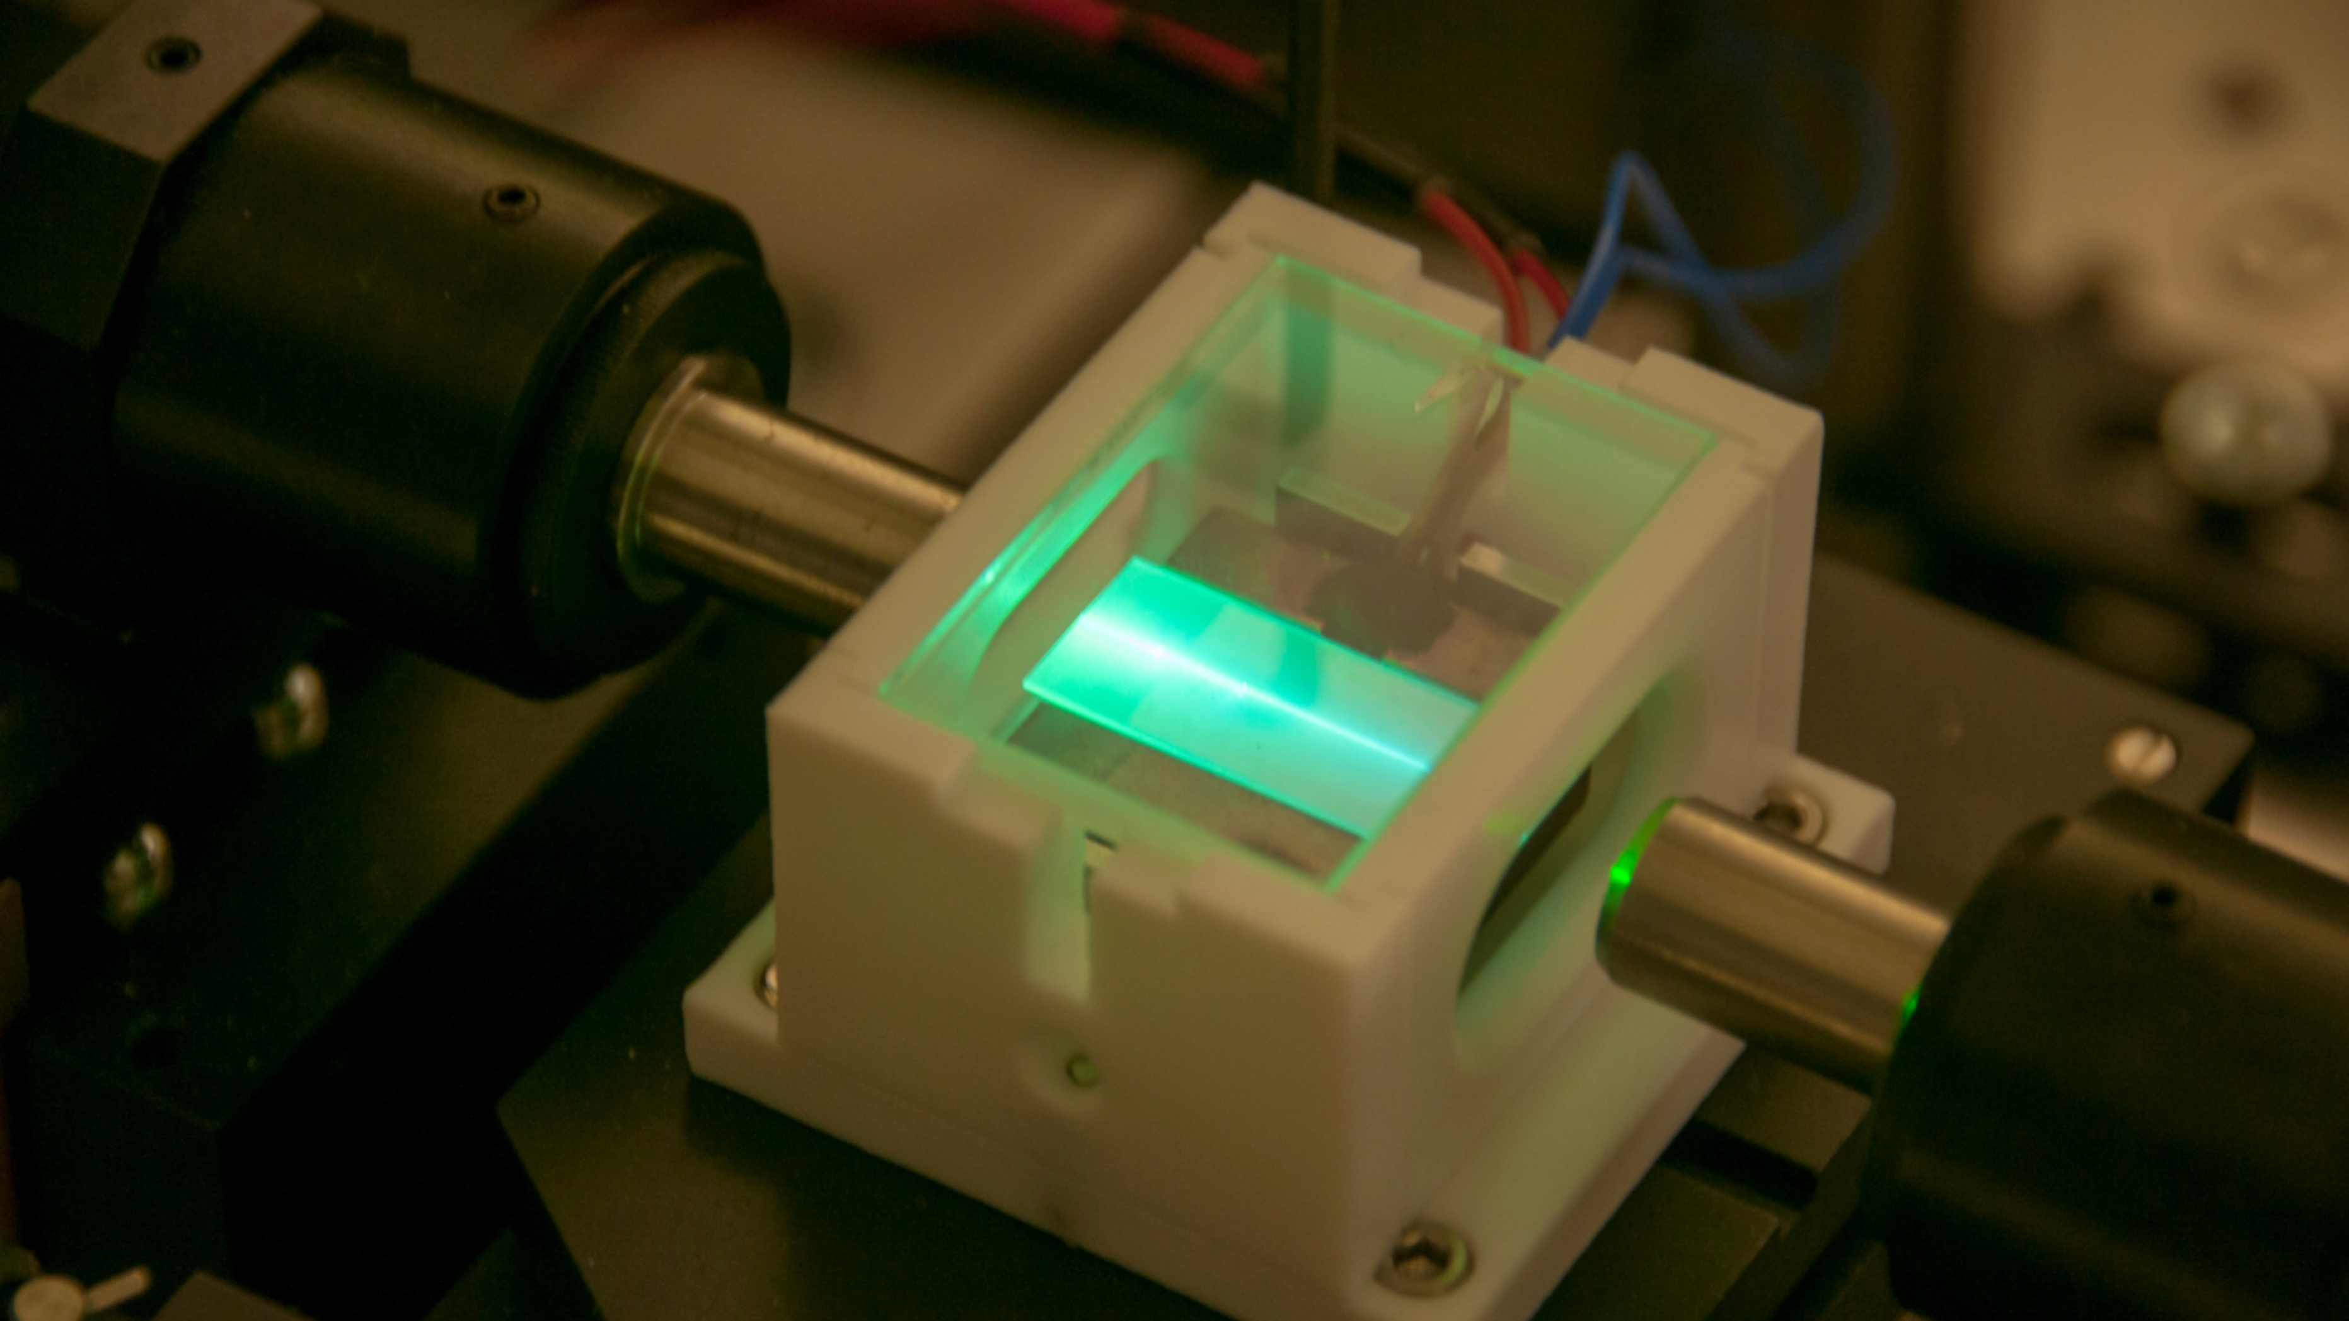

Nonlinear integrated
quantum optics
Christine Silberhorn
Integrated Quantum Optics
Paderborn University

Slide 2
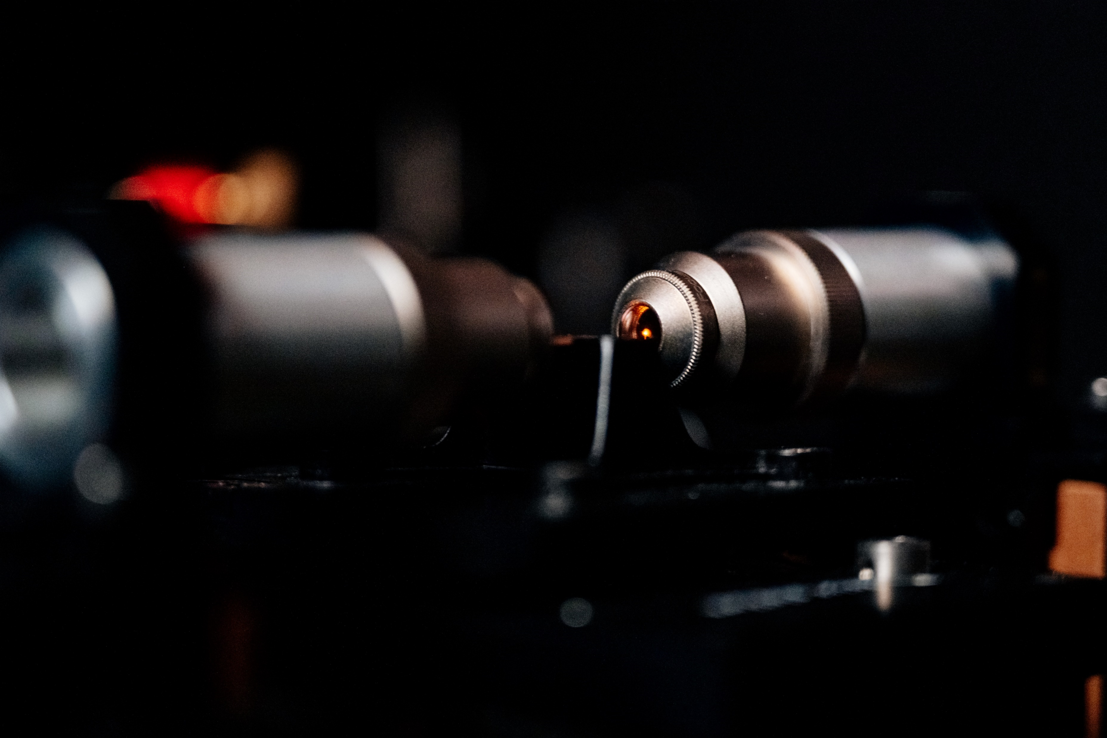

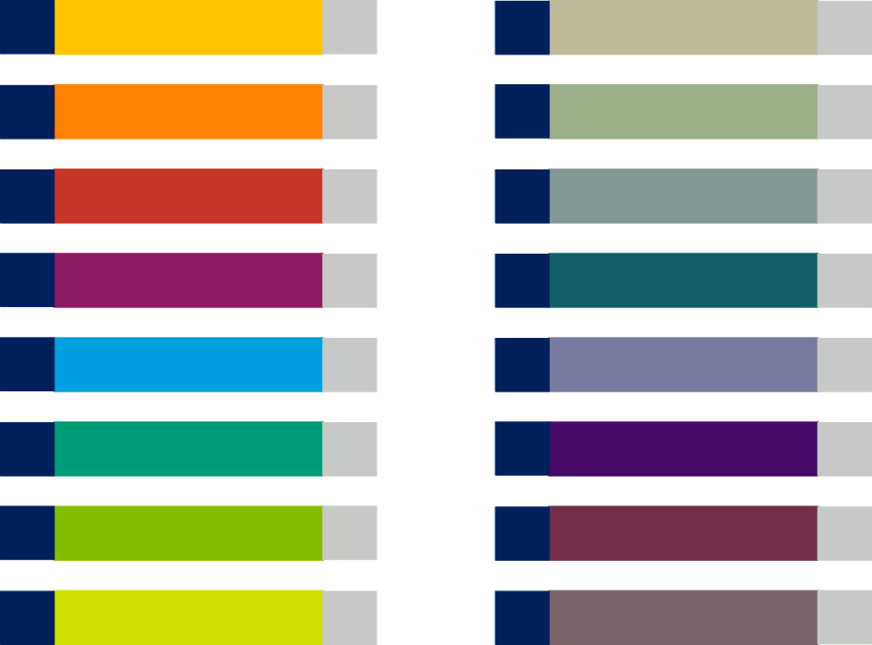
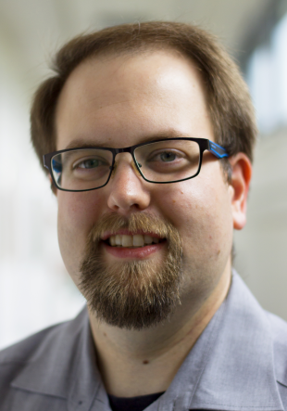

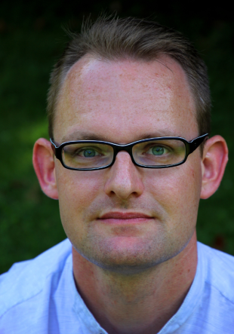


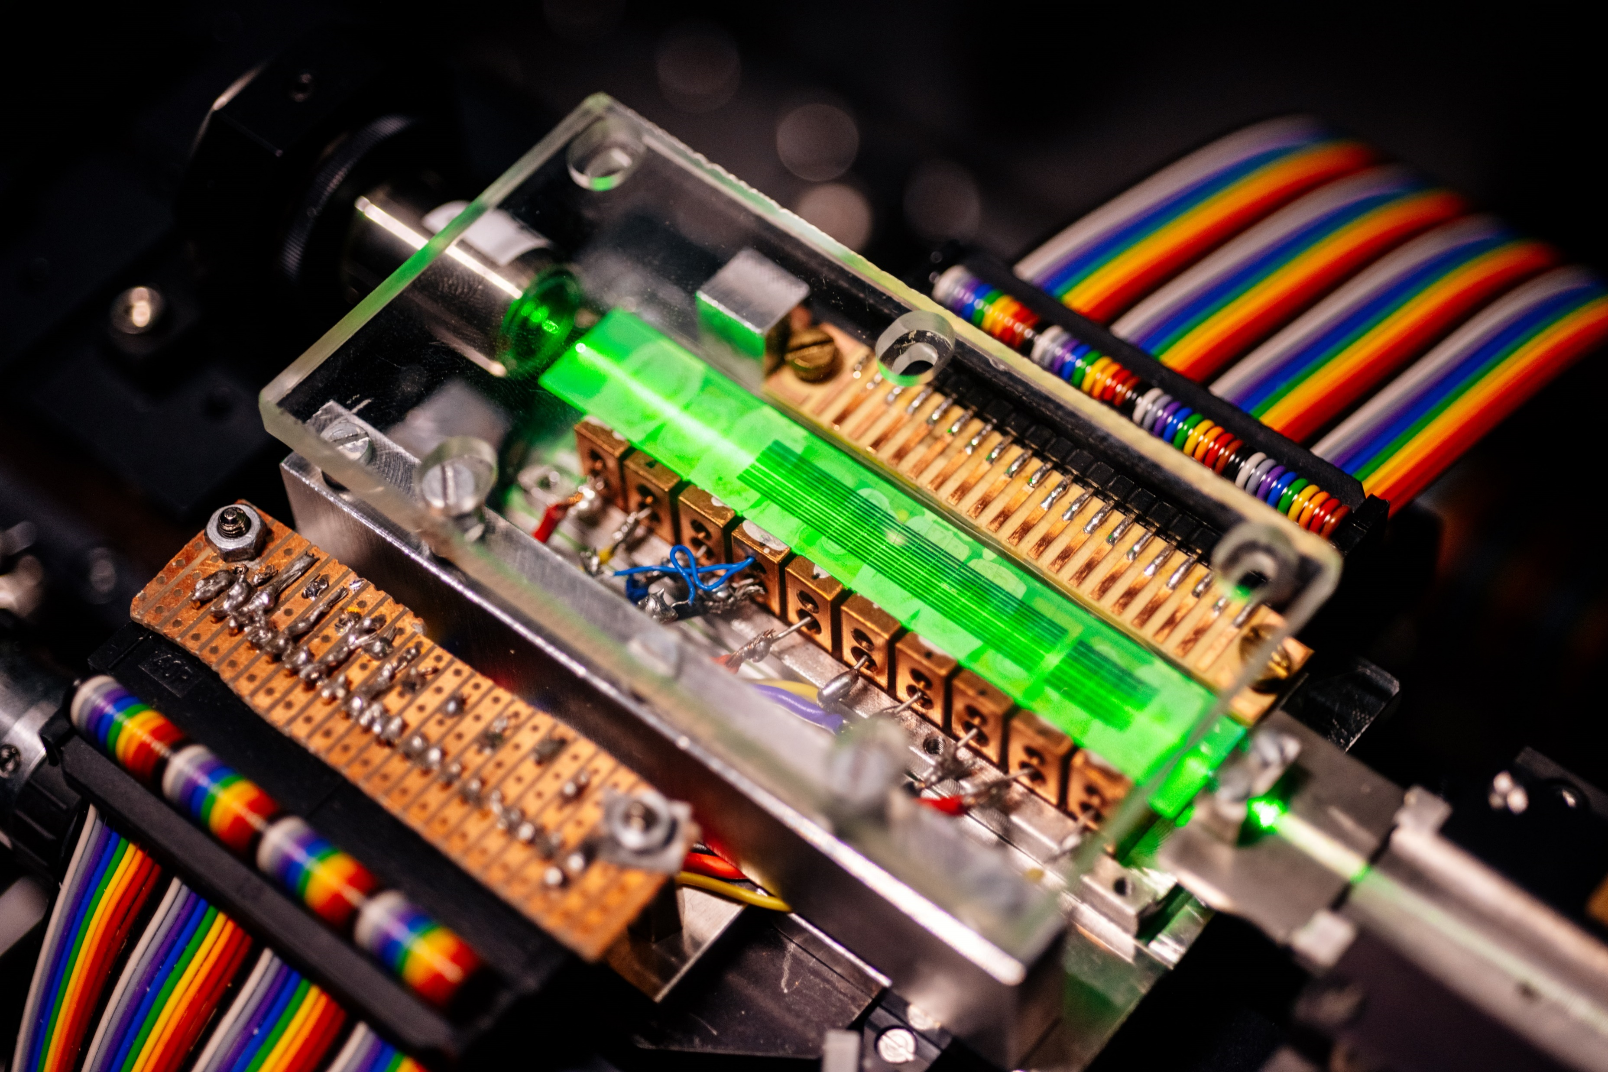
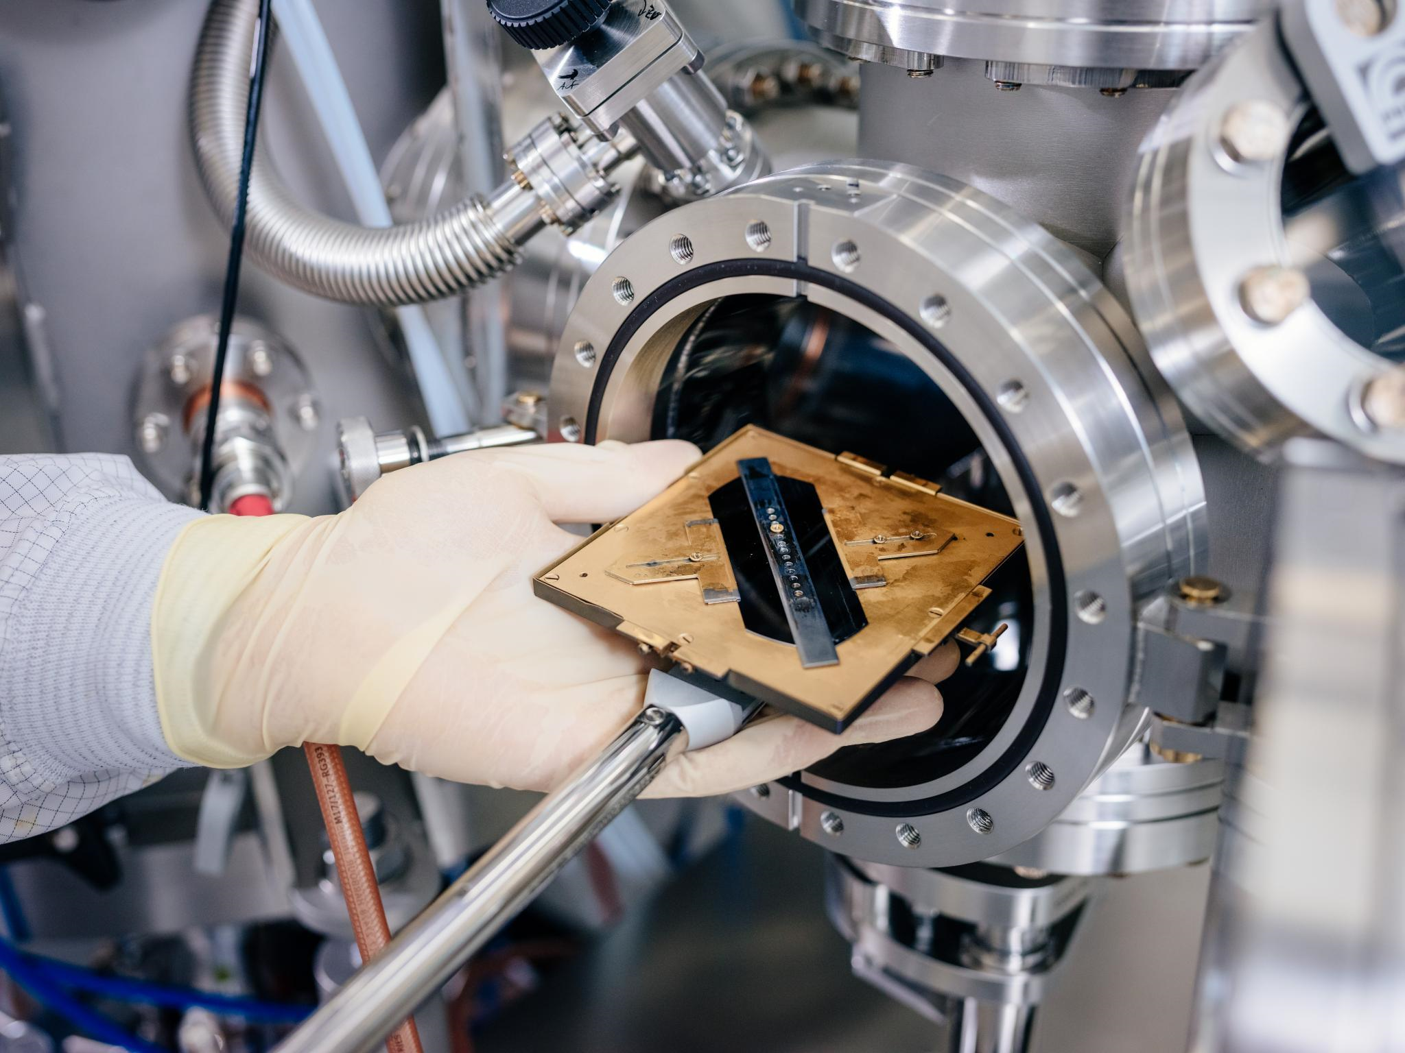
dielectric coatings
electrodes
characterization
multifunctional devices
time mlutiplexing
quantum pulse gate
topologies
waveguides
periodic poling
Bonding
source engineering
fiber coupling
temporal modes
packaging
EO modulators
metrology
KTiOPO₄
LNOI
LiNbO₃
modelling
optical circuits
Ultrafast pulses
Quantum walks
Technology
Devices
Networks
Christof
Eigner
Harald
Herrmann
Benjamin
Brecht
© Paderborn University, Besim Mazhiqi

Slide 3
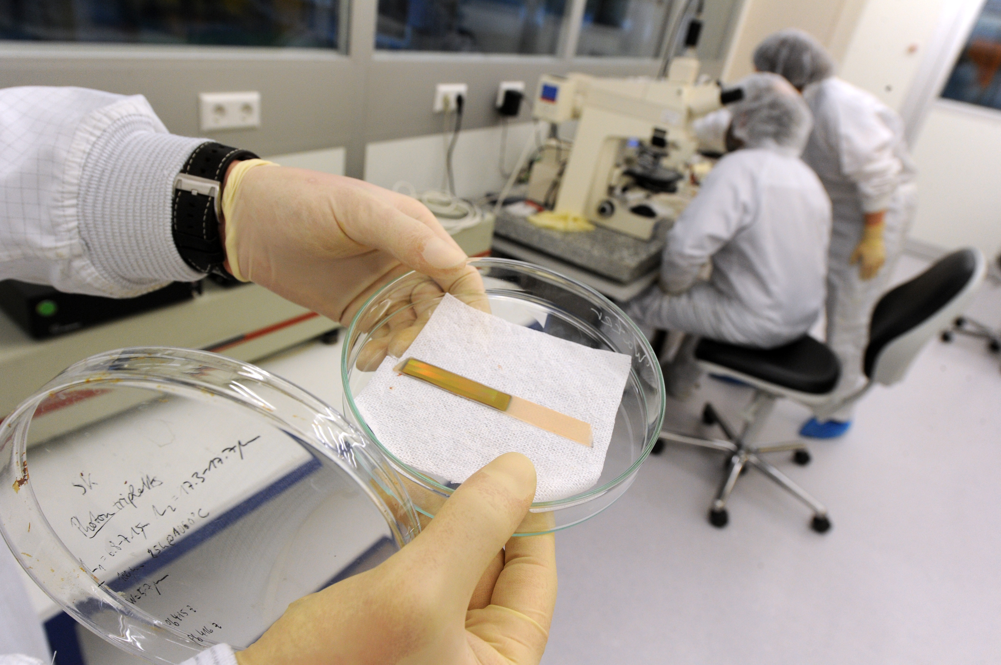
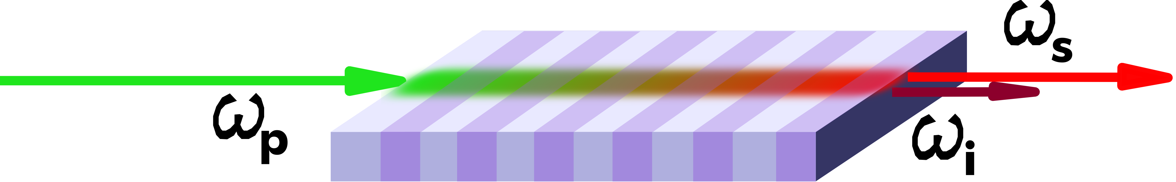
Outline
Integrated optics
Temporal modes
of pulsed light

Slide 4
Nonlinear integrated quantum optics

Slide 5
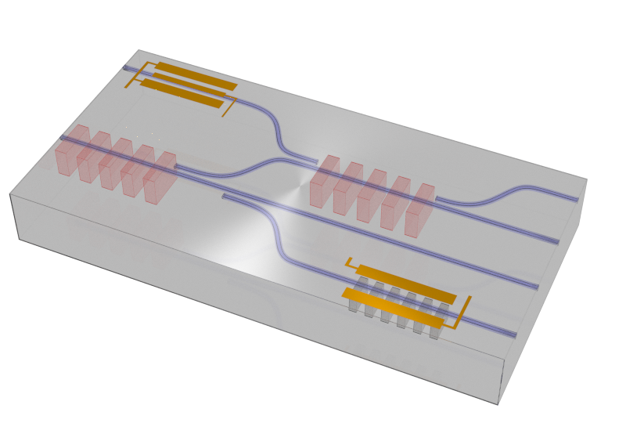
The LiNbO₃ platform
minimized decoherence
✓ low-loss waveguides
stability and scalability
✓ integrated devices
photon-pair generation
✓ χ⁽²⁾ nonlinearity
fast photon routing
✓ fast electro-optic switches
Phase-shifter
Single-photon
conversion
Photon-pair
generation
Detectors
Polarization
control
➔ Implementation of complex quantum circuits on PPLN platform

Slide 6
Parametric downconversion
PDC in PPLN waveguides
waveguide
Λ
pump
signal
idler
energy and momentum conservation (quasi-phase-matching):
strong confinement of optical waves to small cross sections over long interaction length ⇒ high efficiency
interaction lengths up to about 90 mm are possible

Slide 7
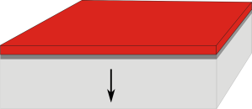

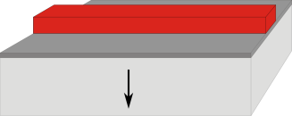

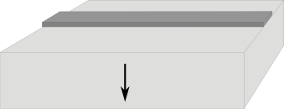
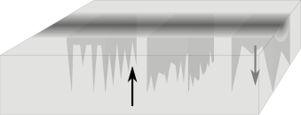
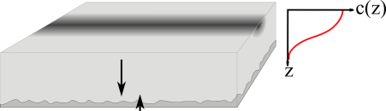
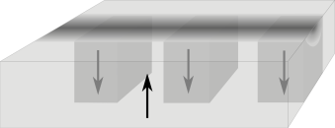
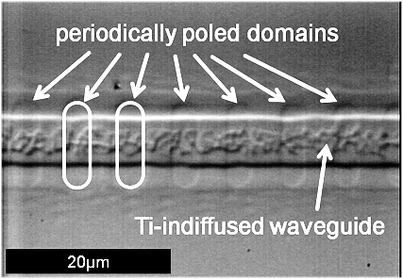
Technology
Titanium-indiffused
waveguide fabrication
Periodic domain inversion
Titanium deposition and
photoresist coating
Photoresist coating
Photolithographic
patterning
Photolithographic
patterning
Ti-etching and
photoresist removal
Domain growth under
pulsed HV application
Ti-indiffusion
Periodically inverted
domains
mode matching and confinement
✓ TE and TM guiding
✓ high nonlinear conversion efficiency
✓ high coupling efficiency to fibers
low-loss waveguides
✓ down to 0.03 dB/cm
quasi-phasematching
✓ tunable wavelengths
✓ long interaction length
✓ Type I and Type II processes
small poling periods
✓ down to < 2 µm

Slide 8
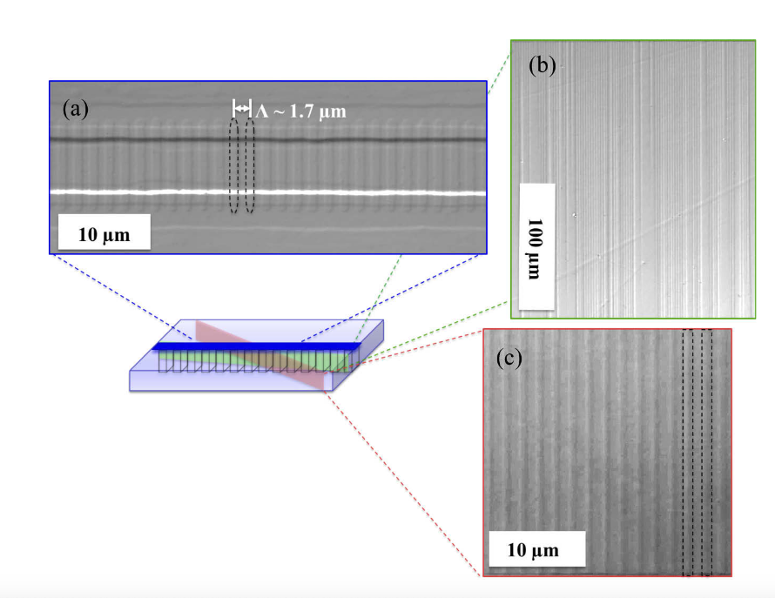
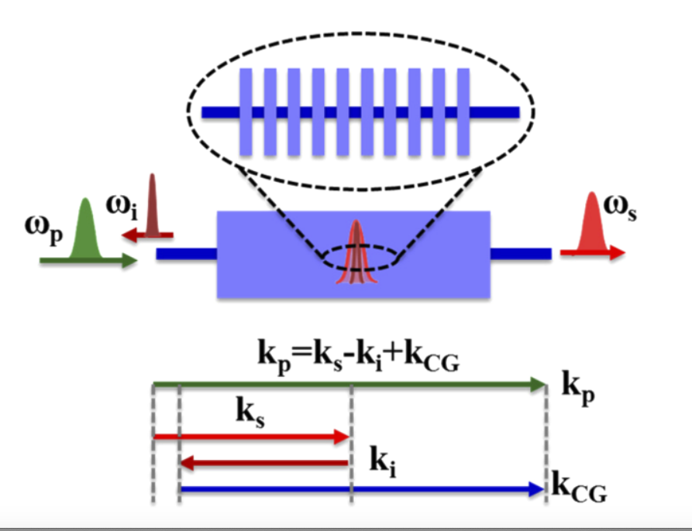
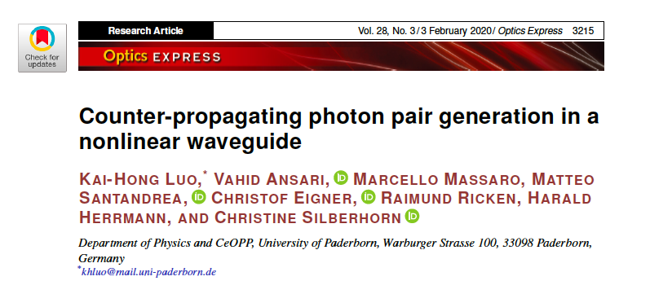
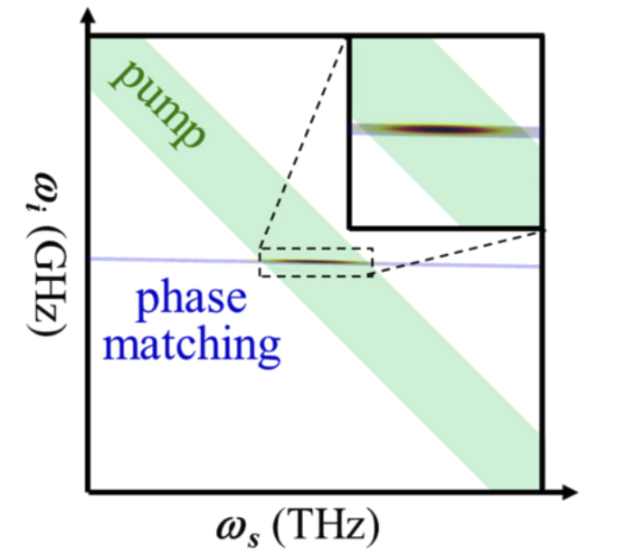

Slide 9

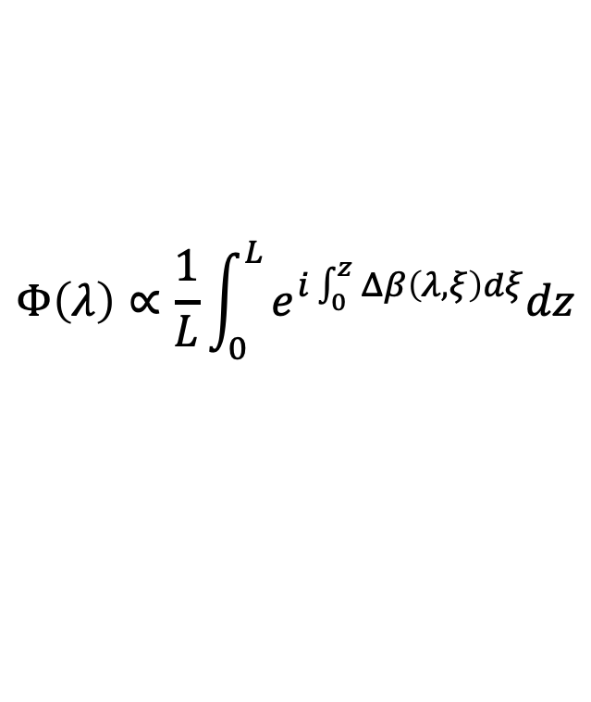
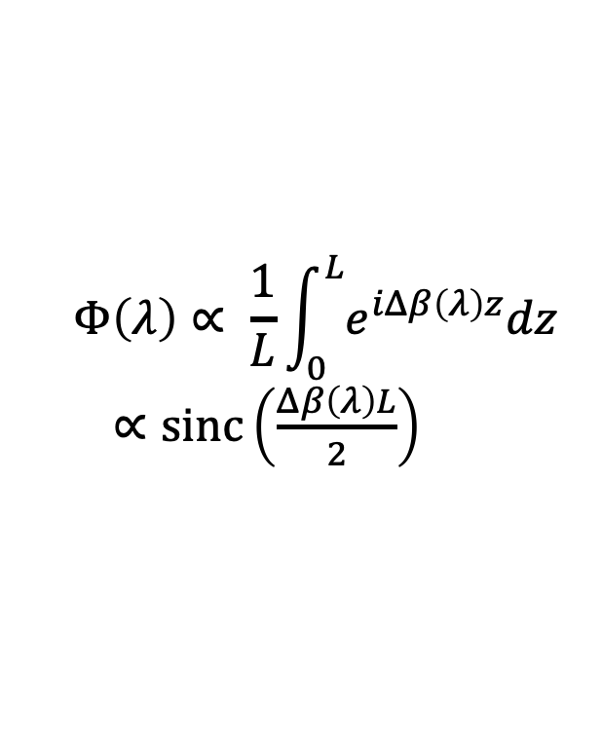

Fabrication errors
Homogeneous system
$$Φ\left(λ\right)∝ \frac{1}{L}\int_{0}^{L}{e^{iΔβ\left(λ\right)z}dz}$$
$∝\text{sinc}\left(\frac{Δβ\left(λ\right)L}{2}\right)$
$$L$$
Inhomogeneous system
$$Φ\left(λ\right)∝\frac{1}{L}\int_{0}^{L}{e^{i\int_{0}^{z}{Δβ\left(λ, ξ\right)dξ}}dz}$$
$$\text{sinc}\left(\frac{Δβ\left(λ\right)L}{2}\right)$$
Helmfrid & Arvidsson, JOSAB , 8 (4), 1991

Slide 10
Maximum squeezing
High dimensional information encoding
M. Santandrea et al., NJP 21, 033038 (2019)

Slide 11
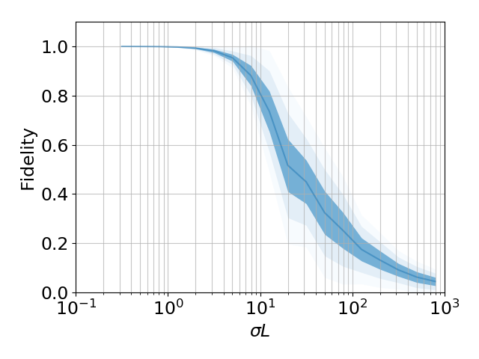
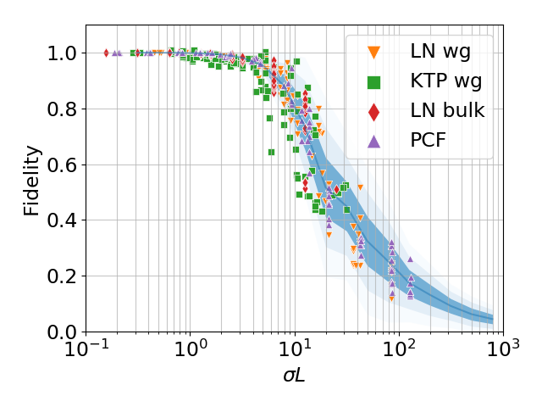
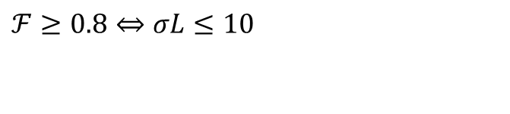
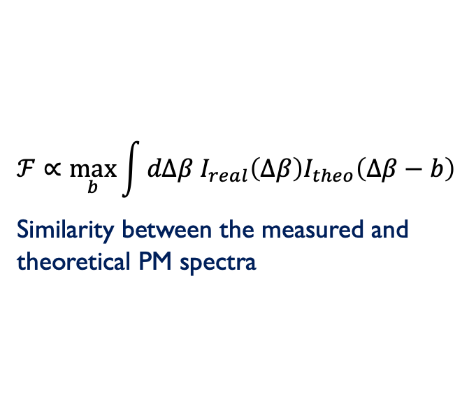
General model
Fidelity
$$ℱ∝\max_{b}{\int{dΔβ I_{real}\left(Δβ\right)I_{theo}\left(Δβ−b\right)}}$$
Similarity between the measured and theoretical PM spectra
Design rule
$$ℱ≥0.8⇔σL≤10$$
Can be used to:
  design new samples
  improve the technology
  estimate the PM quality
Santandrea et al., Opt. Lett., 44(21), 2019

Slide 12
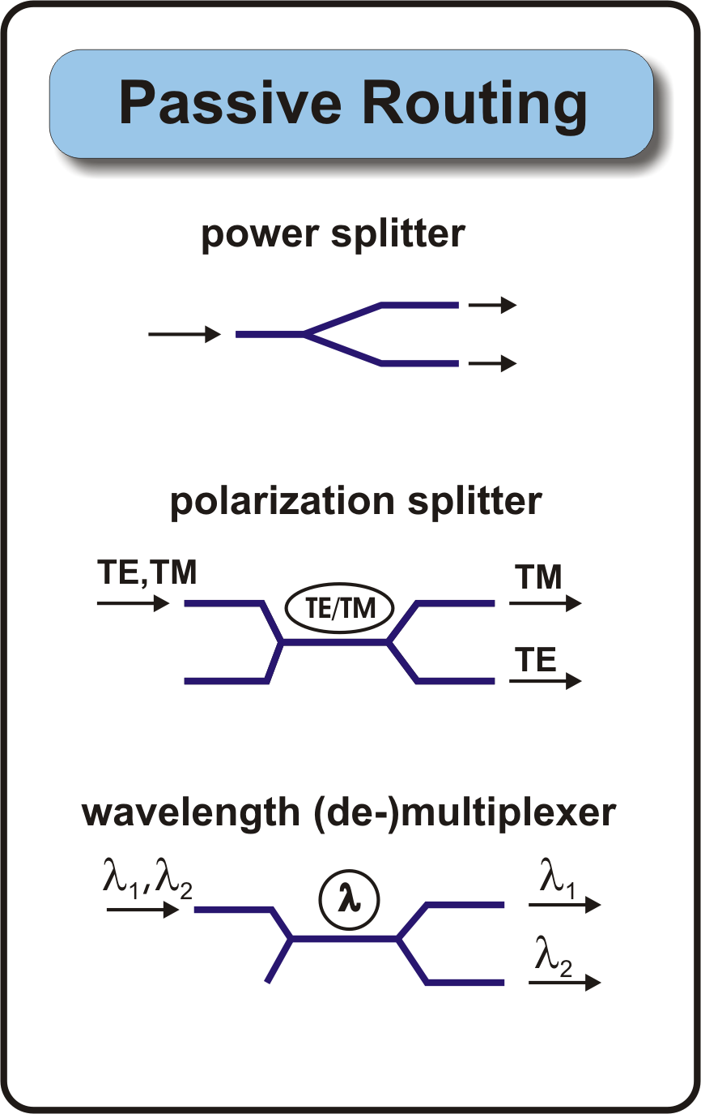
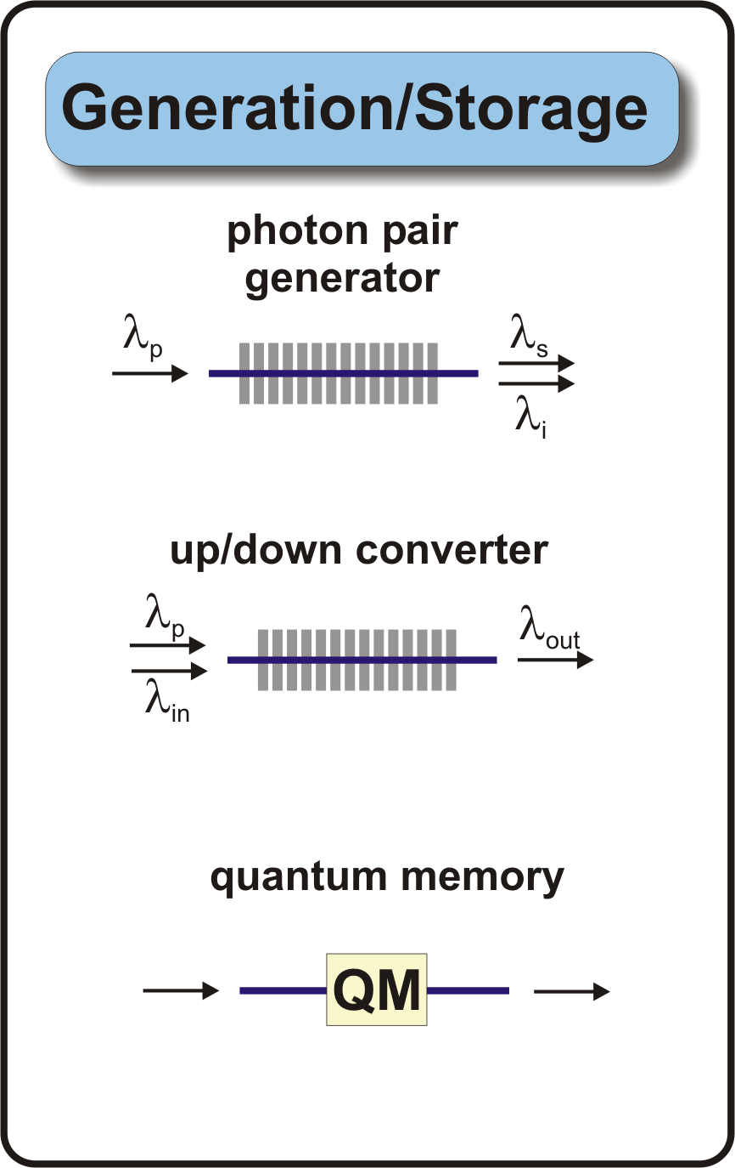
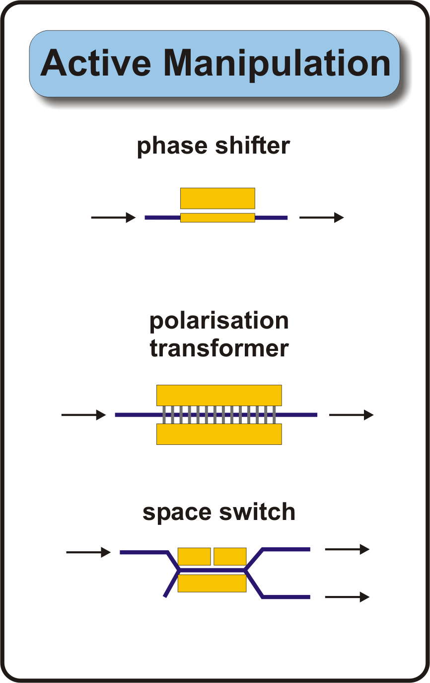
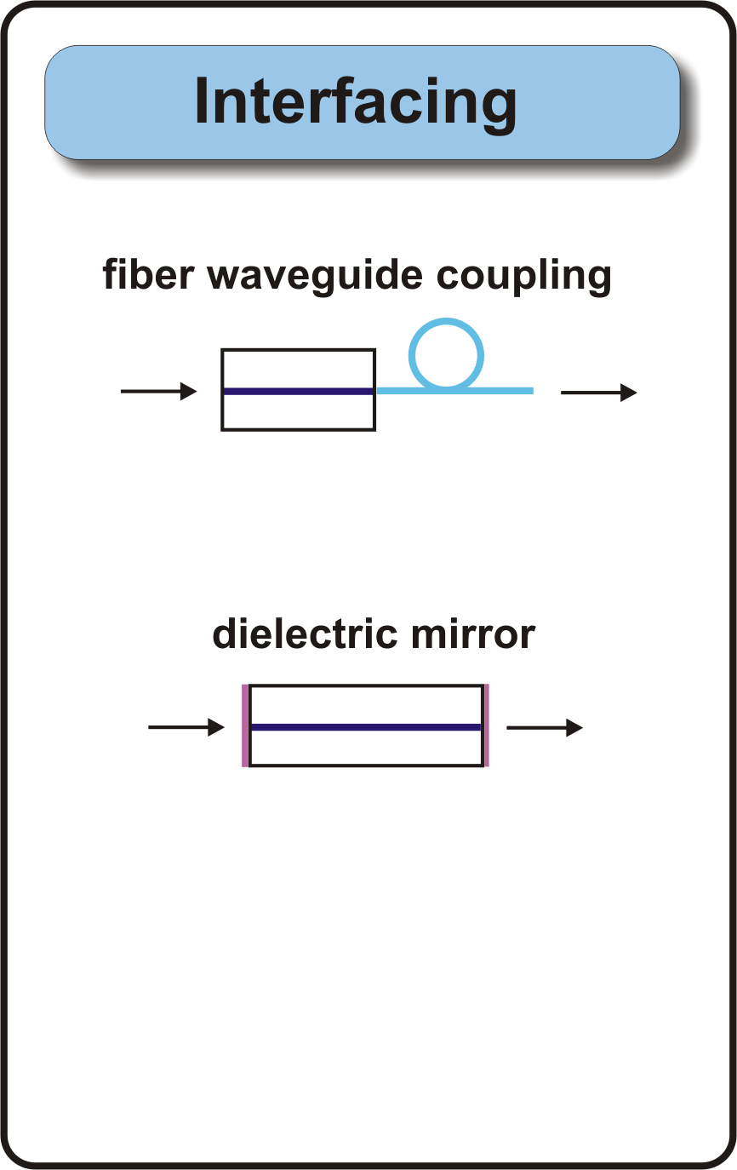
Toolbox for integrated quantum circuits.
Components have been developed for classical optical applications (telecom,sensing), but tailoring (i.e. redesign, optimization) for quantum applications is required
P. R. Sharapova et al. New J. Phys. 19 123009 (2017)

Slide 13
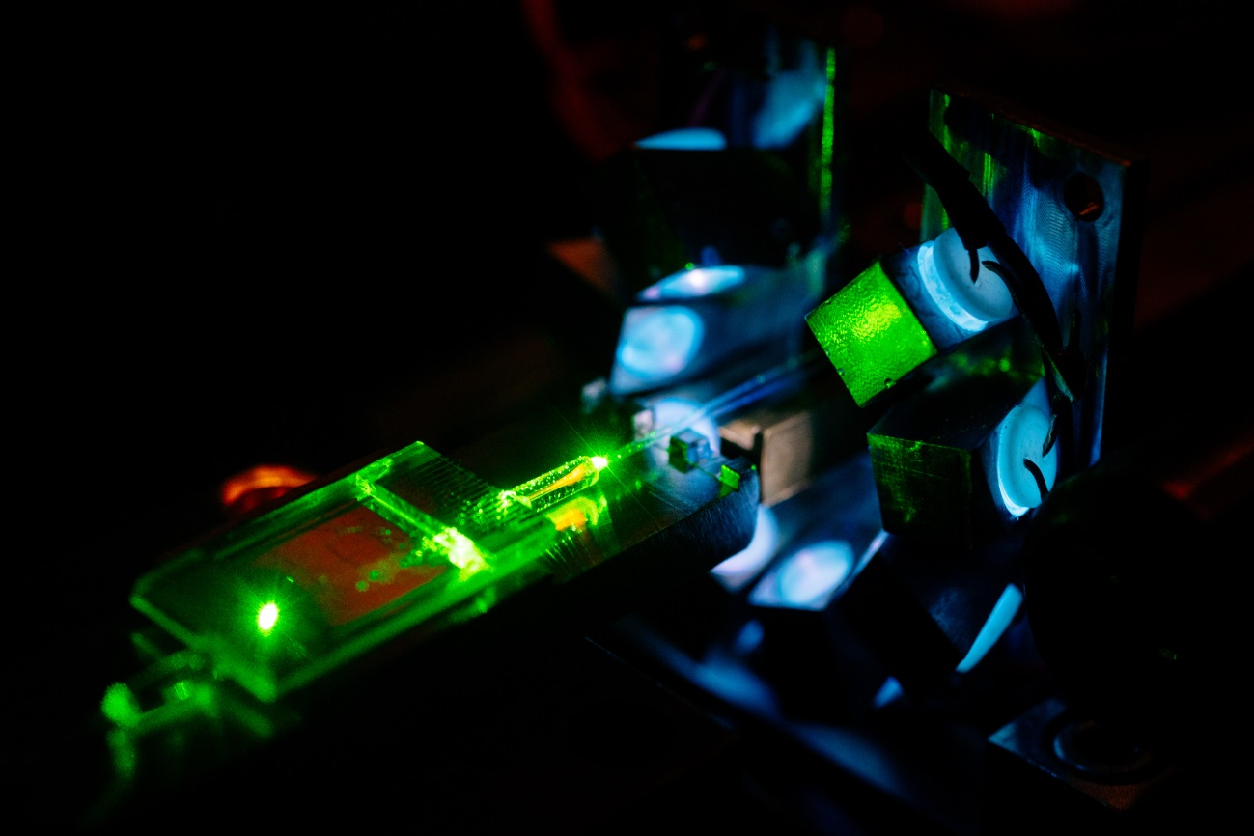
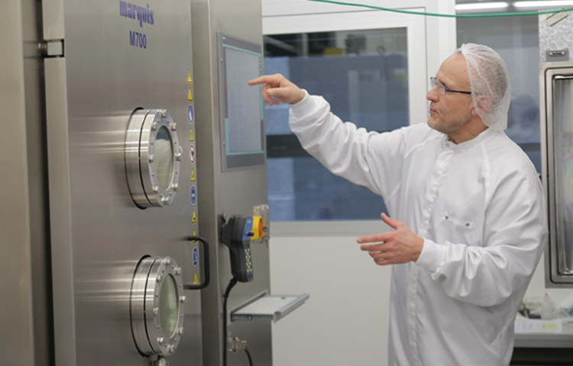
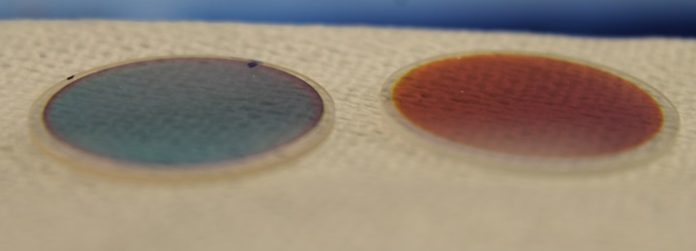
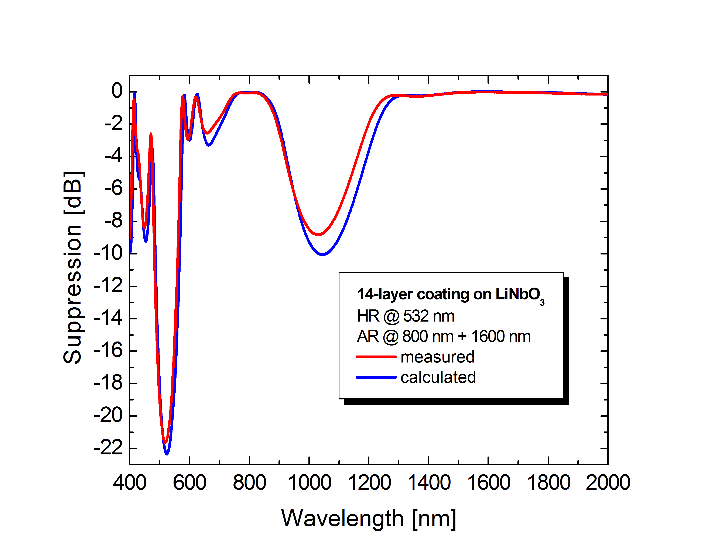
Dielectric coatings
Pigtailing
AR / HR coating performance
coupling efficiencies: > 85%

Slide 14
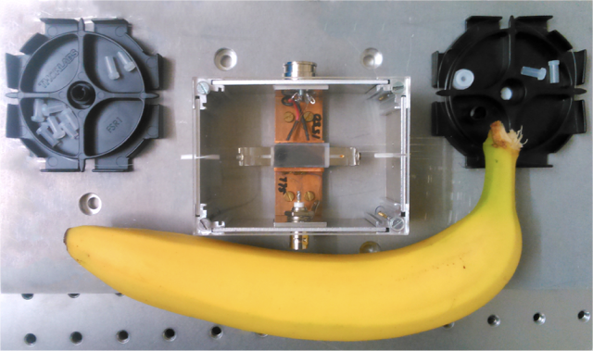
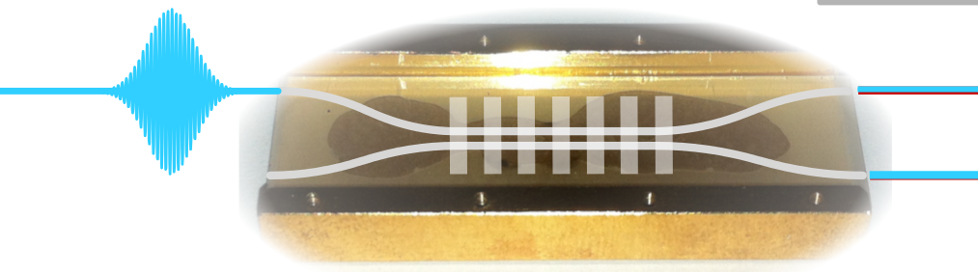
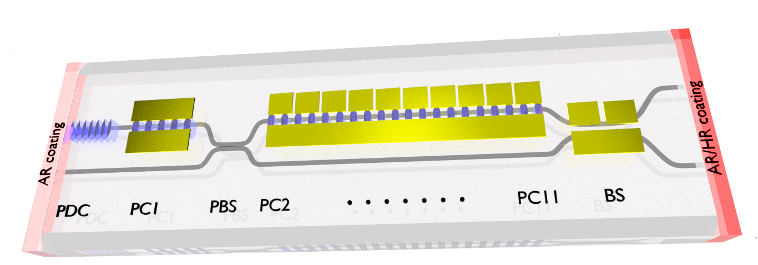
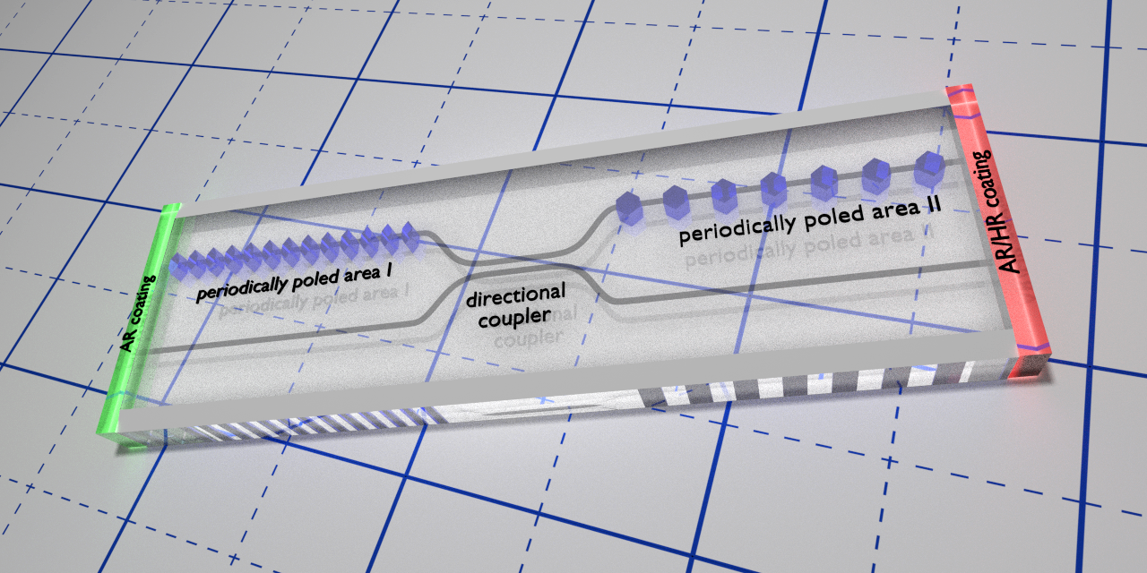
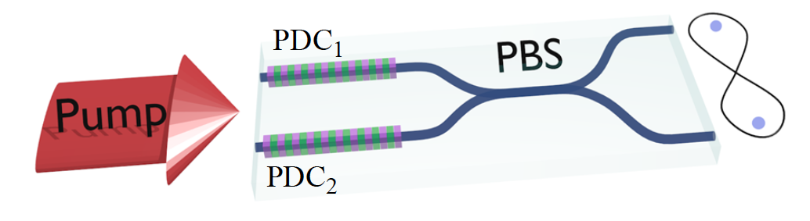
Examples of PPLN intgrated quantum devices
Plug & Play single photon source
Dual-path photon pair source
using a non-linear coupler
Fabrication and design of
non-linear quantum devices
Hong-Ou-Mandel interference
Generation of
polarization entanglement
Three-Photon States

Slide 15
Hong Ou Mandel interference on chip
Monolithic Integration of parametric down-conversion source and a two-photon interferometer with time-delay line
PDC, type II
Electro-optic control: polarization conversion,
fast optical delay
tunable beam splitter
K.- H. Luo et al., Science Advances (2019)

Slide 16
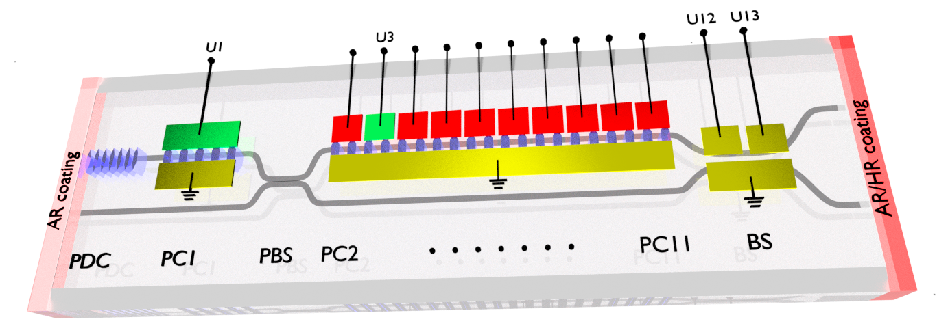

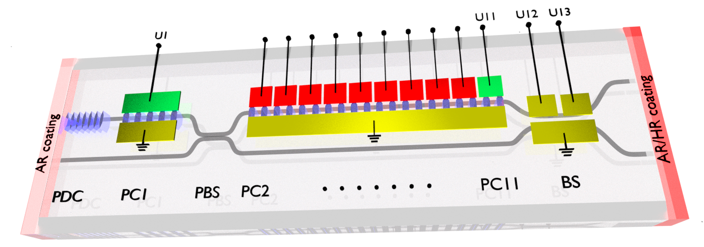
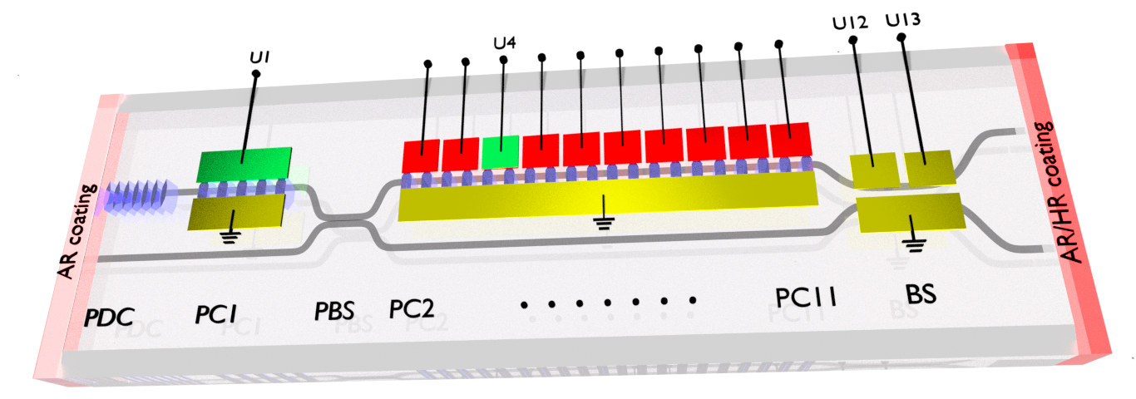
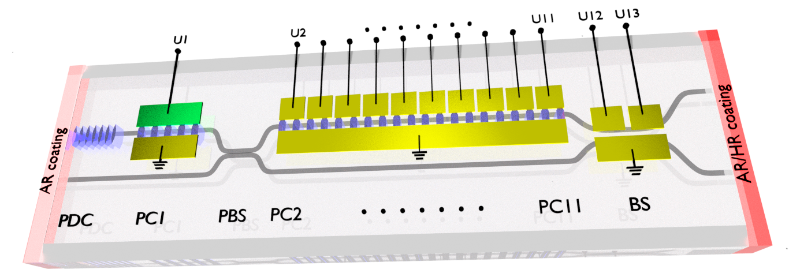


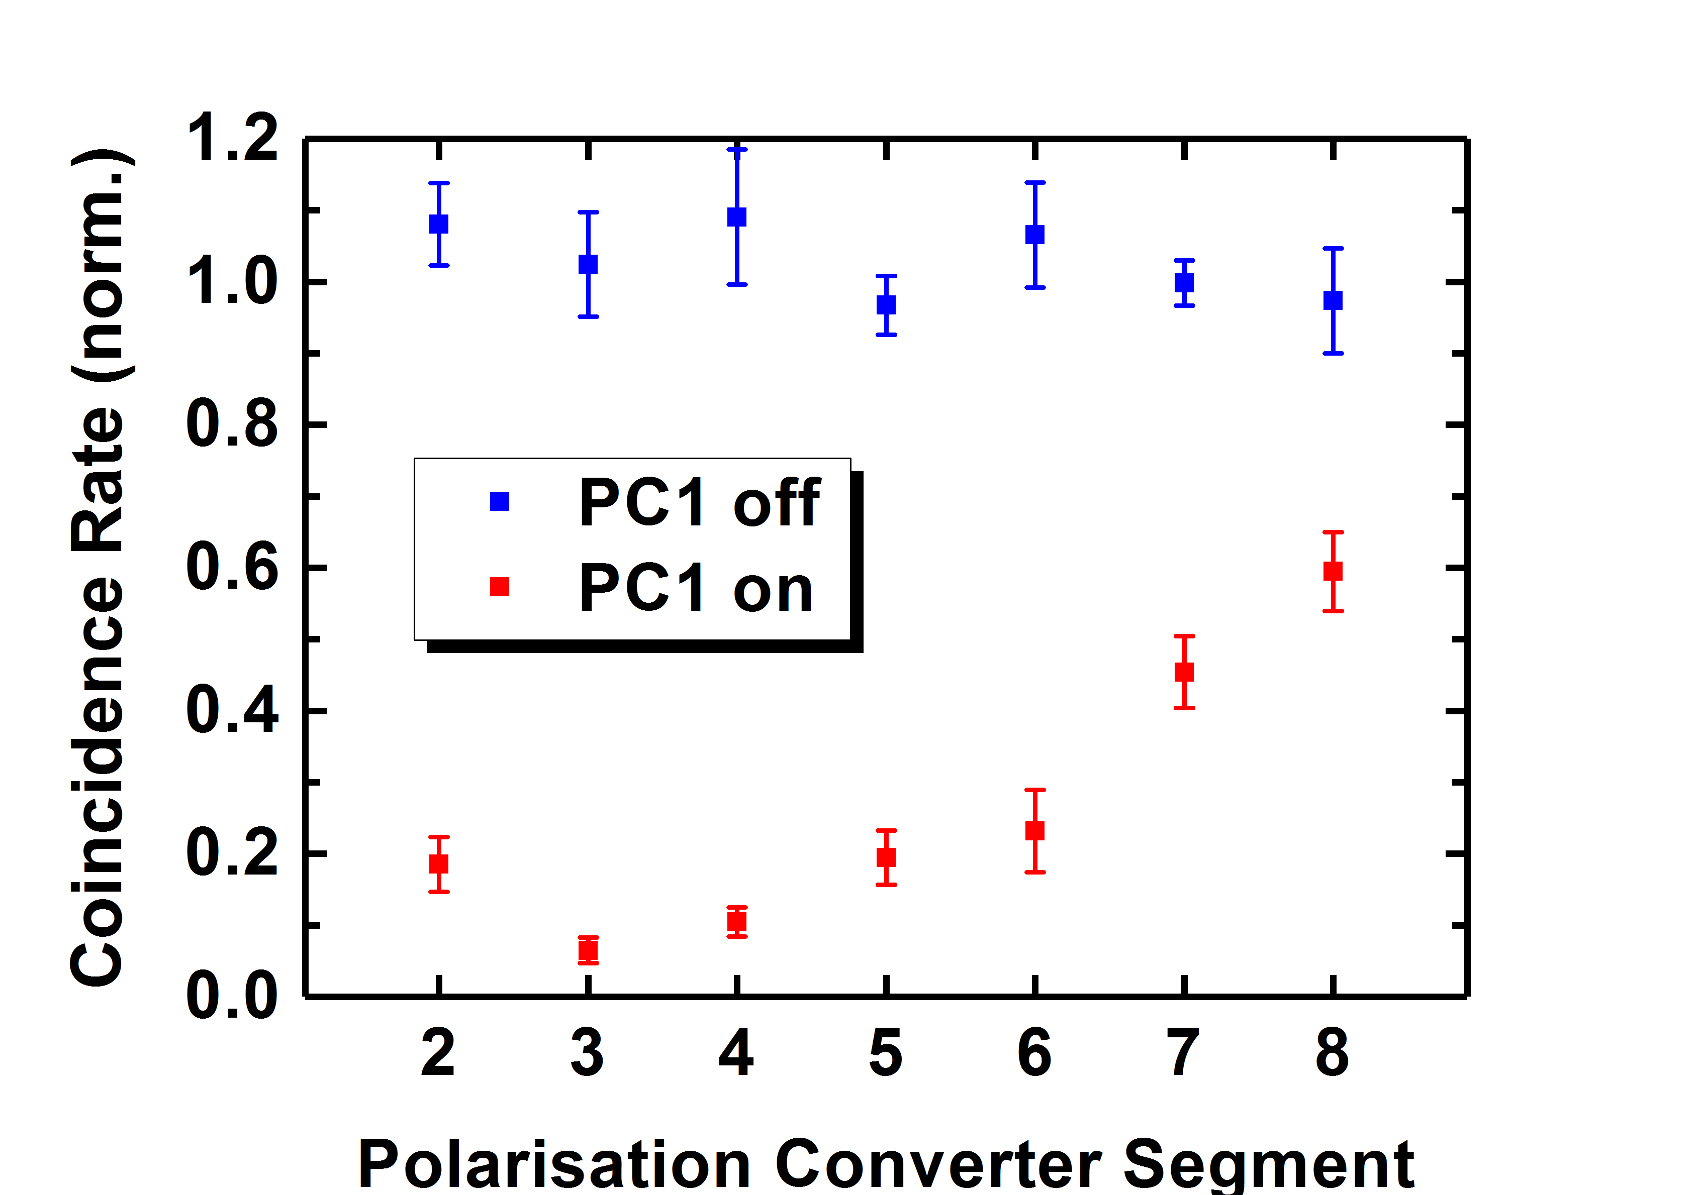
Birefringence of LiNbO_{3:}: H and V photons polarizations travel at different velocity
or
V
V
V
H
V
V
V
V
V
H
V
V
V
V
V
Δτ_{coinc}
0.5
0.4
PC1 off
Theory
Experiment
0.3
Coinc. Probability
PC1 on
0.2
0.1
0.0
2
3
4
5
6
7
8
9
10
11
PC segment

Slide 17

visibility: 93,5 ± 1,8%
time delay: ~ 12 ps
K.- H. Luo et al., Science Advances (2019)

Slide 18

Temporal modes of pulsed light

Slide 19
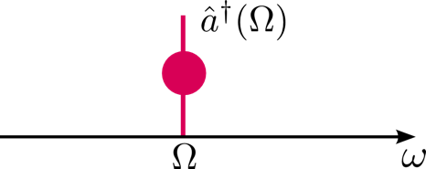
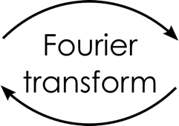
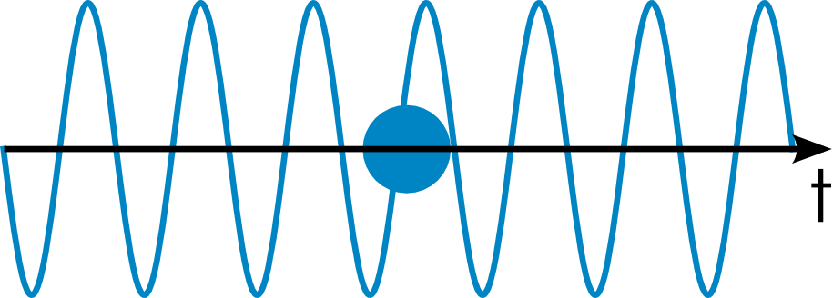
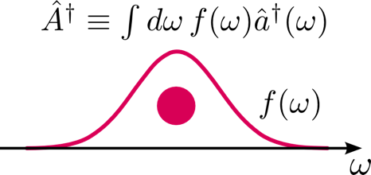

Temporal modes of pulsed photons
Monochromatic creation operator (bit rate = 0)
Temporal mode creation operator (bit rate = Fourier limit)
Δτ Δω ≥ C
Law, et al, Phys. Rev. Lett. 84, 5304 (2000)

Slide 20


Pulse shapes define field-orthogonal temporal modes
${\hat{A}}_{j}=∫dω f_{j}\left(ω\right)\hat{a}\left(ω\right)$
$$\left[{\hat{A}}_{i}, {\hat{A}}_{j}^{†}\right]=δ_{ij}$$
basis transformation to (broadband) pulsed temporal modes
Temporal modes
overlap
in frequency and time

Slide 21



Parametric downconversion in waveguides
Joint spectral
amplitude (JSA)
=
Schmidt decomposition
Pairs of pulsed
temporal modes
Law, Walmsley, Eberly, Phys. Rev. Lett. 84, 5304 (2000);

Slide 22

Spectral source engineering
Dispersion engineered parametric down-conversion
    Control of spectral correlations
Pairs of
temporal modes
Mosley, et al, Phys. Rev. Lett. 100, 133601 (2008);

Slide 23




Dispersion engineered parametric down-conversion
    Control of spectral correlations
Ideal PDC source for integrated network with multiple channels:
Pulsed light: synchronization
High purity
High brigthness
type-II PDC @ 1,5 µm
in KTP wave-guide
Eckstein, et al, Phys. Rev. Lett. 106, 013603 (2011);

Slide 24

Orchestring TMs
source engineering
J. Gil-Lopez et al. , in preparation

Slide 25

Manipulation of TMs
Temporal modes
overlap
in frequency and time
How can we address TMs?
► Quantum pulse gate

Slide 26



Manipulation of TMs
Temporal modes
overlap
in frequency and time
How can we address TMs?
► Quantum pulse gate
transfer functions: exp. & theory
dispersion engineered sum-frequency generation
Eckstein, et al., Opt. Exp. 19, 13370 (2011); Brecht, et al., New J. Phys. 13, 065029 (2011)

Slide 27

Quantum pulse gate in PPLN waveguide
In-house manufactured periodically poled LN waveguide:
Crystal length: 15…40 mm
SFG: 1536nm / 874nm to 557nm
Poling period 4.4 μm
Temperature stabalized at 190°C
Bandwidth compression
B. Brecht, et al., Phys. Rev. A. 030302(R)(2014);

Slide 28
Manipulating TMs with quantum pulse gate
Combination of PDC with QPG:
QPG
correlations
measurements
QPG

Slide 29




TM tomography of PDC
7-dimensional
tomographically complete set
 | Purity from g⁽²⁾ | Tomography
 | 0.929 ± 0.008 | 0.896 ± 0.008
 | 0.528 ± 0.010 | 0.523 ± 0.008
φ (ω)
Ansari, et al., PRL 120, 213601 (2018)

Slide 30

TM tomography of PDC
7-dimensional
tomographically complete set
 | Purity from g⁽²⁾ | Tomography
 | 0.929 ± 0.008 | 0.896 ± 0.008
 | 0.528 ± 0.010 | 0.523 ± 0.008
 | 0.327 ± 0.005 | 0.317 ± 0.005
spectral phase matters!
φ (ω)
φ (ω)
Ansari, et al., PRL 120, 213601 (2018)

Slide 31



TM tomography of designed multi-mode PDC
PDC pump
amp.
amp.
phase
phase
φ (ω)
Ansari, et al., PRL 120, 213601 (2018)

Slide 32









Quantum metrology with QPG
Estimating the separation $𝔰$ between two emitters
$$𝔰$$
$$𝔰$$
$$𝔰$$
frequency
frequency
frequency
Quantum (inspired) measurement:
$$\text{Var}\left(𝔰\right)≥\frac{1}{N∫dω\frac{1}{I\left(ν,𝔰\right)}{\left(\frac{∂I}{∂𝔰}\right)}^{2}}≥\frac{1}{4Nσ}$$
$${\left( \right)}^{2}$$
$$+$$
Quantum
Limit
$${\left( \right)}^{2}$$
$$−$$
Coherent amplitude detection
M. Tsang, R. Nair, X.-M. Lu, Phys. Rev. X 6, 031033 (2016)
Notes:
Nächste Folie: Time-frequency codings

Slide 33

Experimental setup
Notes:
Nächste Folie: Time-frequency codings

Slide 34








Single-parameter estimation with balanced sources
$λ_{p}=875\text{nm}$
$λ_{in}=1540\text{nm}$
$σ_{in}=182\left(2\right)\text{GHz}$
$τ_{in}=387\left(13\right)\text{fs}$
$L=17\text{mm}$
$T={200}^{\text{o}}\text{C}$
$σ_{φ}=28\text{GHz}$
Raw estimator limited by setup for low separations.
Measurements: first three HG modes; 20000 counts.
$$𝔰_{ν}$$
$$ν$$
J.M. Donohue et al, PRL 121, 090501 (2018),
in collaboration with: L. L. Sánchez-Soto, J.Rehacek, Z. Hradil,

Slide 35














Multi-parameter estimation
The problem
Two definitions
Two incoherent point sources with
unequal intensities ($𝔮$)
some separation ($𝔰$)
a centroid ($𝔰_{0})$
$$ρ_{θ}=𝔮ρ_{+}+\left(1−𝔮\right)ρ_{−}$$
$$θ={\left(𝔮, 𝔰, 𝔰_{0}\right)}^{t}$$
Quantum Fisher information matrix
$$Q_{αβ}\left(θ\right)=\frac{1}{2}\text{Tr}\left(ρ_{θ}\left\{L_{α}, L_{β}\right\}\right)$$
$$ρ_{+}$$
I
$$𝔮$$
$$2⋅\frac{∂ρ_{θ}}{∂θ_{α}}=L_{α}ρ_{θ}+ρ_{θ}L_{α}$$
$$ρ_{−}$$
$$1−𝔮$$
Variance of estimator
$$𝔰_{0}$$
space
time
frequency
…
$$\text{Var}\left({\hat{θ}}_{α}\right)≥{\left(Q^{−1}\right)}_{αα}(θ)$$
$$𝔰$$
The bound is attained by
eigenvectors of $L_{α}$
J. Rehacek et al, Phys. Rev. A 96, 062107 (2017)
Notes:
Nächste Folie: Time-frequency codings

Slide 36












Multi-parameter estimation
$λ_{p}=862\text{nm}$
$E_{p}=150\text{pJ}$
$λ_{in}=1540\text{nm}$
$σ_{in}=280\text{GHz}$
$τ_{in}=250\text{fs}$
$L=35\text{mm}$
$T={193}^{\text{o}}\text{C}$
$σ_{φ}=17\text{GHz}$
Vahid Ansari
$$𝔰_{}$$
$$𝔮$$
$$𝔰_{0}$$
$$ν$$
$$𝔰_{}$$
$$𝔮$$
$$t$$
$$𝔰_{0}$$
Submitted, in collaboration with: L. L. Sánchez-Soto, J.Rehacek, Z. Hradil,

Slide 37

Summary
Integrated nonlinear optics
Temporal modes of pulsed light

Slide 38






Thank you for your attention
Quantum Networks
Benjamin Brecht
Sonja Barkhofen
Jan Sperling
Michael Stefszky
Vahid Ansari
Evan Meyer-Scott
Syamsundar De
Thomas Nitsche
Melanie Engelkemeier
Jano Gil Lopez
Johannes Tiedau
Nidhin Prasannan
Lennart Lorz
Technology
Christof Eigner
Laura Padberg
Felix vom Bruch
Viktor Quiring
Raimund Ricken
Devices
Harald Herrmann
Kai-Hong Luo
Matteo Santandrea
Marcello Massaro
Sebastian Brauner
Patrick Max Bartkowiak
We have open positions
(and candy…)
Silberhorn group

Slide 39















Imbalanced sources w/ Gaussian point spread function, estimate $θ={\left(𝔮, 𝔰, 𝔰_{0}\right)}^{t}$
→ Superpositions of Hermite-Gauss modes are ideal measurements.
…
$$\left(0,\frac{1}{\sqrt{6}},\frac{1}{\sqrt{2}},−\frac{1}{\sqrt{3}}\right)$$
$$\left(0,\frac{1}{\sqrt{6}},−\frac{1}{\sqrt{2}},−\frac{1}{\sqrt{3}}\right)$$
$$\left(\frac{\sqrt{2}}{\sqrt{5}},\frac{\sqrt{2}}{\sqrt{5}},0, \frac{1}{\sqrt{5}}\right)$$
$$\left(−\frac{\sqrt{3}}{\sqrt{5}},\frac{2}{\sqrt{15}},0, \frac{\sqrt{2}}{\sqrt{15}}\right)$$
frequency
time
J. Rehacek et al, Phys. Rev. A 98, 012013 (2018)
Notes:
Nächste Folie: Time-frequency codings

Slide 40
Experimental setup
Notes:
Nächste Folie: Time-frequency codings

Slide 41







General model - I
$$Φ\left(λ\right)= \frac{1}{L}\int_{0}^{L}{e^{i\int_{0}^{z}{Δβ\left(λ, ξ\right)dξ}}dz}$$
$Δβ=β_{1}±β_{2}±β_{3}±β_{4}±$…
Decoupling approximation
wavelength-independent noise
$$Δβ\left(λ, z\right)≈{Δβ}_{0}\left(λ\right)+σ∙{δβ}_{0}\left(z\right)$$
$σ$: noise amplitude
$δβ(z)$: noise profile
$$Φ\left({∆β}_{0}L\right)= \int_{0}^{1}{e^{i{∆β}_{0}L∙x}∙e^{iσL\int_{0}^{z}{δβ\left(Lη\right)dη}}dx}$$
Noise-length product
Scaling law
All spectra are identical when plotted vs ${Δβ}_{0}L$
The effect of noise is identical for a given $σL$ and $δβ(z)$.
Santandrea et al., Opt. Lett., 44(21), 2019

Slide 42





Ugly spectra for everyone
PE-LN
L=4 cm
LNOI
L=1 cm
PE – LN waveguide
Chang et al., Opt. Lett., 39 (17), 2014
LNOI
Chen et al., OSA Continuum 1, 229-242, 2018
PCF
L=300 cm
PCF
L=15 cm
Rb:KTP wg
L=1.6 cm
PCF
Francis-Jones et al., Opt. Expr 24 (22), 2016
Rb:KTP waveguide
Ansari et al. , Opt. Expr 26 (3), 2018

Slide 43

Schmidt decompostion
generation of many TM pairs
Pairs of pulsed
temporal modes
Schmidt number = effective number of modes
= amount of spectral entanglement
Intrinsic high-dimensional structure
Law, Walmsley, Eberly, Phys. Rev. Lett. 84, 5304 (2000);

Slide 44
Spectral source engineering
Dispersion engineered parametric down-conversion
    Control of spectral correlations
Pairs of
temporal modes
Mosley, et al, Phys. Rev. Lett. 100, 133601 (2008);

Slide 45
Dispersion engineered parametric down-conversion
    Control of spectral correlations
Ideal PDC source for integrated network with multiple channels:
Pulsed light: synchronization
High purity
High brigthness
type-II PDC @ 1,5 µm
in KTP wave-guide
Eckstein, et al, Phys. Rev. Lett. 106, 013603 (2011);

Slide 46




High dimension quantum encodings
B. Brecht, D. V. Reddy, C. Silberhorn, M. G. Raymer, PRX 5 041017 (2015)
V. Ansari, J.M. Donohue, B. Brecht,
C. Silberhorn, Optica 5, 534 (2018)
Pulsed
Temporal Modes
Time
Bins
Frequency
Bins
Compatible with
waveguide devices
and fiber networks
High-dimensional
alphabet
Measurement?
Manipulation?

Slide 47
TM tomography of designed multi-mode PDC
PDC pump
amp.
amp.
phase
phase
φ (ω)
Ansari, et al., PRL 120, 213601 (2018)

